Slide 1
Independent events
Mathematics Advanced – Year 11
Probability and data

Slide 2
Learning intentions and success criteria
Learning intentions
To understand the difference between dependent and independent events.
To be able to prove that two events are independent.
Success criteria
I can define independent events and explain their characteristics.
I can show that two events are independent.
I can use algebraic reasoning to prove results and solve problems involving independent events.
Notes:
Notes for teachers:
Learning intentions and success criteria are best co-constructed with students. Adapt the learning intention as required and add matching success criteria.
For more information See ⁠AITSL or the NSW Department of Education explicit teaching strategies, ⁠Sharing learning intentions and ⁠Sharing success criteria
LISC is not necessarily presented at the beginning of the lesson. Teacher needs to consider most effectual time to introduce
LISC should be revisited during the lesson to support students' evaluation of their learning

Slide 3
Activating prior knowledge

Slide 4
Conditional probability (1)
The online dating dataset
21 short low-income earners
22 tall low-income earners
48 short high-income earners
101 tall high-income earners
T = the event of selecting a man that is taller than median height
H = the event of selecting a male who earns more than the median salary, that is, a high- income earner.

Slide 5
Conditional probability (2)
The online dating dataset
Samantha is only interested in dating a male who is taller than median height and a high-income earner.
She can either filter the male dating profiles by males taller than median height or high-income earners, not both.
Which filter will give her the best chance of finding someone who meets both of her requirements?

Slide 6
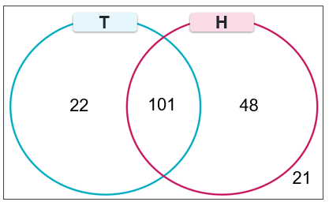
Conditional probability (3)
The online dating dataset
T = the event of selecting a man that is taller than median height
H = the event of selecting a male who earns more than the median salary, that is, a high-income earner.
 | Low-income earner | High-income earner | Total
Shorter than median height | 21 | 48 | 69
Taller than median height | 22 | 101 | 123
Total | 43 | 149 | 192

Slide 7

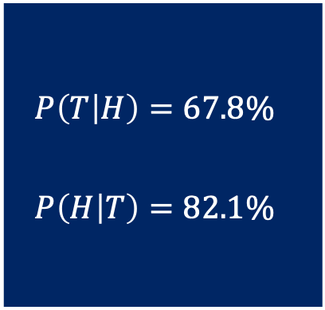
Conditional probability (4)
The online dating dataset
 | Low-income earner | High-income earner | Total
Shorter than median height | 21 | 48 | 69
Taller than median height | 22 | 101 | 123
Total | 43 | 149 | 192
$$P\left(T\right)=\frac{123}{192}$$
$$P\left(H\right)=\frac{149}{192}$$
$$P\left(T∩H\right)=\frac{101}{192}$$
$$P\left(T | H\right)=\frac{101}{149}$$
$$P\left(H | T\right)=\frac{101}{123}$$
$$P\left(T | H\right)=67.8\%$$
$$P\left(H | T\right)=82.1\%$$

Slide 8
Connecting learning

Slide 9
Dependent and independent events (1)
Two events are dependent if an event relies on another event to happen first. One event influences the probability of another event.
Two events are independent if the occurrence of one event does not affect the probability that the other event occurs.

Slide 10
Dependent and independent events (2)
Basketball scenario
Steph Curry has a free throw percentage of 92.9% in the 2024-2025 season.
John believes that Steph Curry has a higher chance of making a free-throw shot if they successfully made the previous shot.
Do you agree? Why or why not?

Slide 11
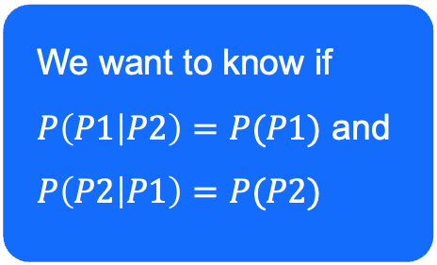
Dependent and independent events (3)
Steph Curry – 92.9% Free throw percentage (2024-2025 season)
Let $P1$ be the event of getting a point for the first free throw.
Let $P2$ be the event of getting a point for the second free throw.
Two events $A$ and $B$ are independent if $P\left(A | B\right)=P(A)$ and $P\left(B | A\right)=P(B)$
$$P2$$
𝑃2
$$\overline{P2}$$
(𝑃2) ̅
$$P2$$
𝑃2
$$\overline{P2}$$
(𝑃2) ̅
$$P1$$
𝑃1
$$\overline{P1}$$
(𝑃1) ̅
92.9%
92.9%
We want to know if
$P\left(P1 | P2\right)=P(P1)$ and $P\left(P2 | P1\right)=P(P2)$
7.1%
92.9%
7.1%
7.1%

Slide 12
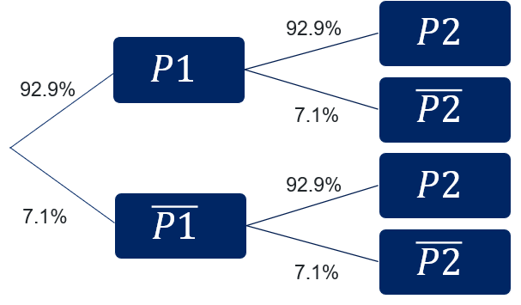
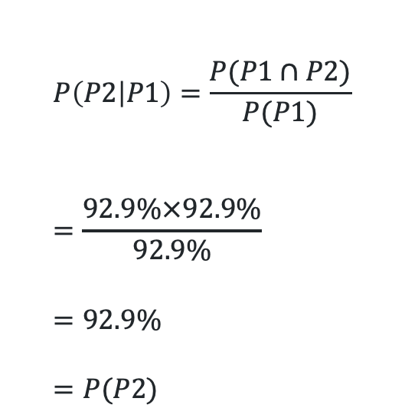
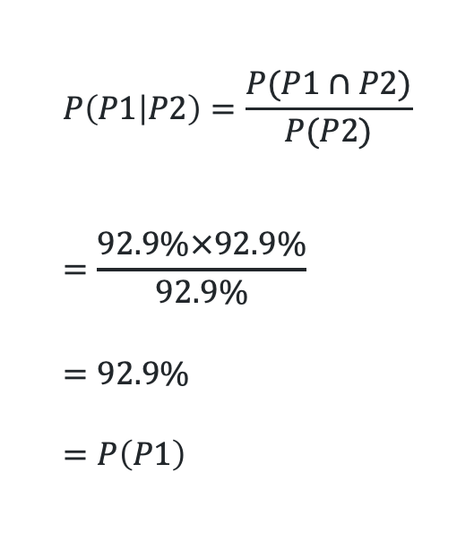
Dependent and independent events (4)
Steph Curry – 92.9% Free throw percentage (2024-2025 season)
We want to know if $P\left(P1 | P2\right)=P(P1)$ and $P\left(P2 | P1\right)=P(P2)$
$$P\left(P1 | P2\right)=\frac{P(P1∩P2)}{P(P2)} \\ =\frac{92.9\%×92.9\%}{92.9\%} \\ =92.9\% \\ =P\left(P1\right)$$
$$P\left(P2 | P1\right)=\frac{P(P1∩P2)}{P(P1)} \\ =\frac{92.9\%×92.9\%}{92.9\%} \\ =92.9\% \\ =P(P2)$$
Events are independent

Slide 13
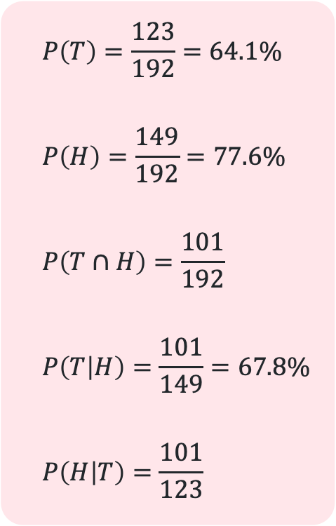
Dependent and independent events (5)
The online dating dataset
$$P\left(T\right)=\frac{123}{192}=64.1\%$$
$$P\left(H\right)=\frac{149}{192}=77.6\%$$
$$P\left(T∩H\right)=\frac{101}{192}$$
$$P\left(T | H\right)=\frac{101}{149}=67.8\%$$
$$P\left(H | T\right)=\frac{101}{123}$$
Two events $A$ and $B$ are independent if $P\left(A | B\right)=P(A)$ and $P\left(B | A\right)=P(B)$
 | Low-income earner | High-income earner | Total
Shorter than median height | 21 | 48 | 69
Taller than median height | 22 | 101 | 123
Total | 43 | 149 | 192

Slide 14
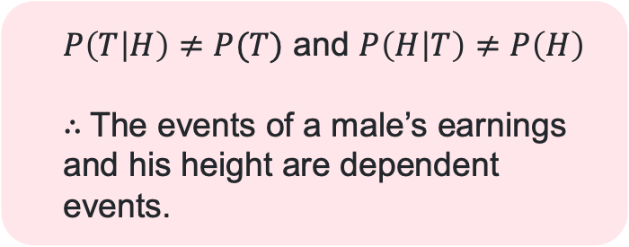
Dependent and independent events (6)
The online dating dataset
We want to know if $P\left(T | H\right)=P(T)$ and $P\left(H | T\right)=P(H)$
$$P\left(T\right)=\frac{123}{192}=64.1\%$$
$$P\left(H\right)=\frac{149}{192}=77.6\%$$
$$P\left(T∩H\right)=\frac{101}{192}$$
$$P\left(T | H\right)=\frac{101}{149}=67.8\%$$
$$P\left(H | T\right)=\frac{101}{123}$$
Why might the probability of selecting a tall person increase when we knew the person was a high-income earner?
$P\left(T | H\right)≠P(T)$ and $P\left(H | T\right)≠P\left(H\right)$
$∴$The events of a male’s earnings and his height are dependent events.
Why might the probability of selecting a high-income earner increase when we knew the person was tall?

Slide 15
Releasing responsibility

Slide 16

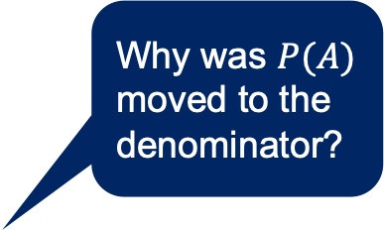

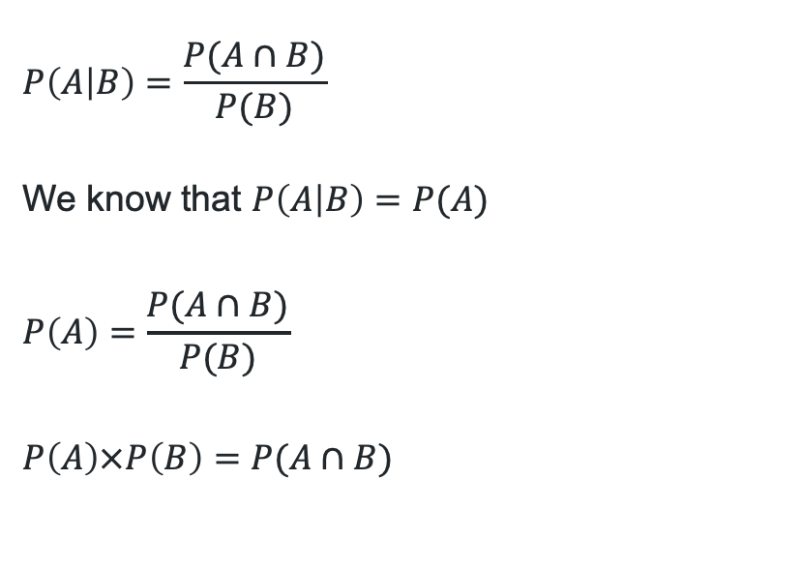
Independent events test (1)
Algebraic proof
It is given that two events, $A$ and $B$ are independent.
Show that if $P\left(A | B\right)=P\left(A\right)$ is true, then $P\left(B | A\right)=P(B)$ is also true.
Why was $P(A)$ moved to the denominator?
$$P\left(A | B\right)=\frac{P(A∩B)}{P(B)}$$
We know that $P\left(A | B\right)=P(A)$
$$P\left(A\right)=\frac{P(A∩B)}{P(B)}$$
$$P\left(A\right)×P\left(B\right)=P(A∩B)$$
$$P\left(B\right)=\frac{P(A∩B)}{P(A)}$$
$$P(B)=\frac{P(B∩A)}{P(A)}$$
$$P\left(B\right)=P(B|A)$$
$∴P\left(B | A\right)=P(B)$ is also true.
How do we know this?
What happened between these 2 lines of working?

Slide 17
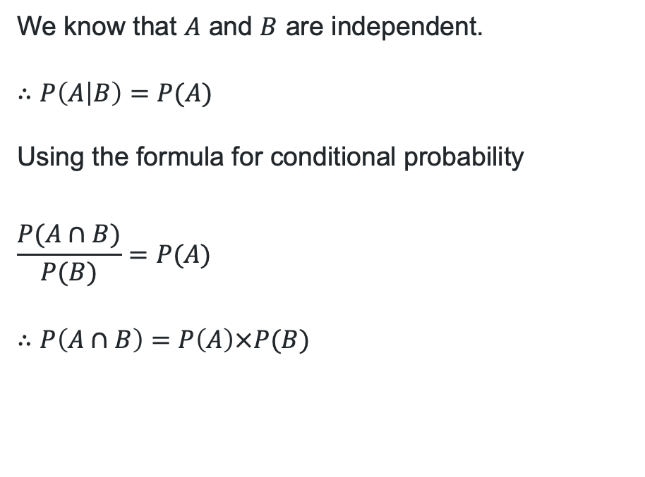
Independent events tests (2)
Algebraic proof
Prove that if two events, $A$ and $B$, are independent, then $P\left(A∩B\right)=P\left(A\right)×P(B)$
We know that $A$ and $B$ are independent.
$$∴P\left(A | B\right)=P(A)$$
Using the formula for conditional probability
$$\frac{P(A∩B)}{P(B)}=P(A)$$
$$∴P\left(A∩B\right)=P\left(A\right)×P(B)$$
How do we know this?
What has been proved in this final line?

Slide 18

Independent events tests (3)
Algebraic proof
Prove conversely that if $P\left(A∩B\right)=P\left(A\right)×P\left(B\right)$, then $A$ and $B$ are independent
Starting with the formula for $P(A|B)$
$$P\left(A | B\right)=\frac{P(A∩B)}{P(B)}$$
$$P\left(A | B\right)×P\left(B\right)=P(A∩B)$$
We know that $P\left(A∩B\right)=P\left(A\right)×P\left(B\right)$
$$P\left(A | B\right)×P\left(B\right)=P\left(A\right)×P\left(B\right)$$
$∴P\left(A | B\right)=P(A)$, proving that $A$ and $B$ are independent
How do we know this?
What happened between these last 2 lines of working?

Slide 19
Independent practice

Slide 20

Approaching questions

Slide 21
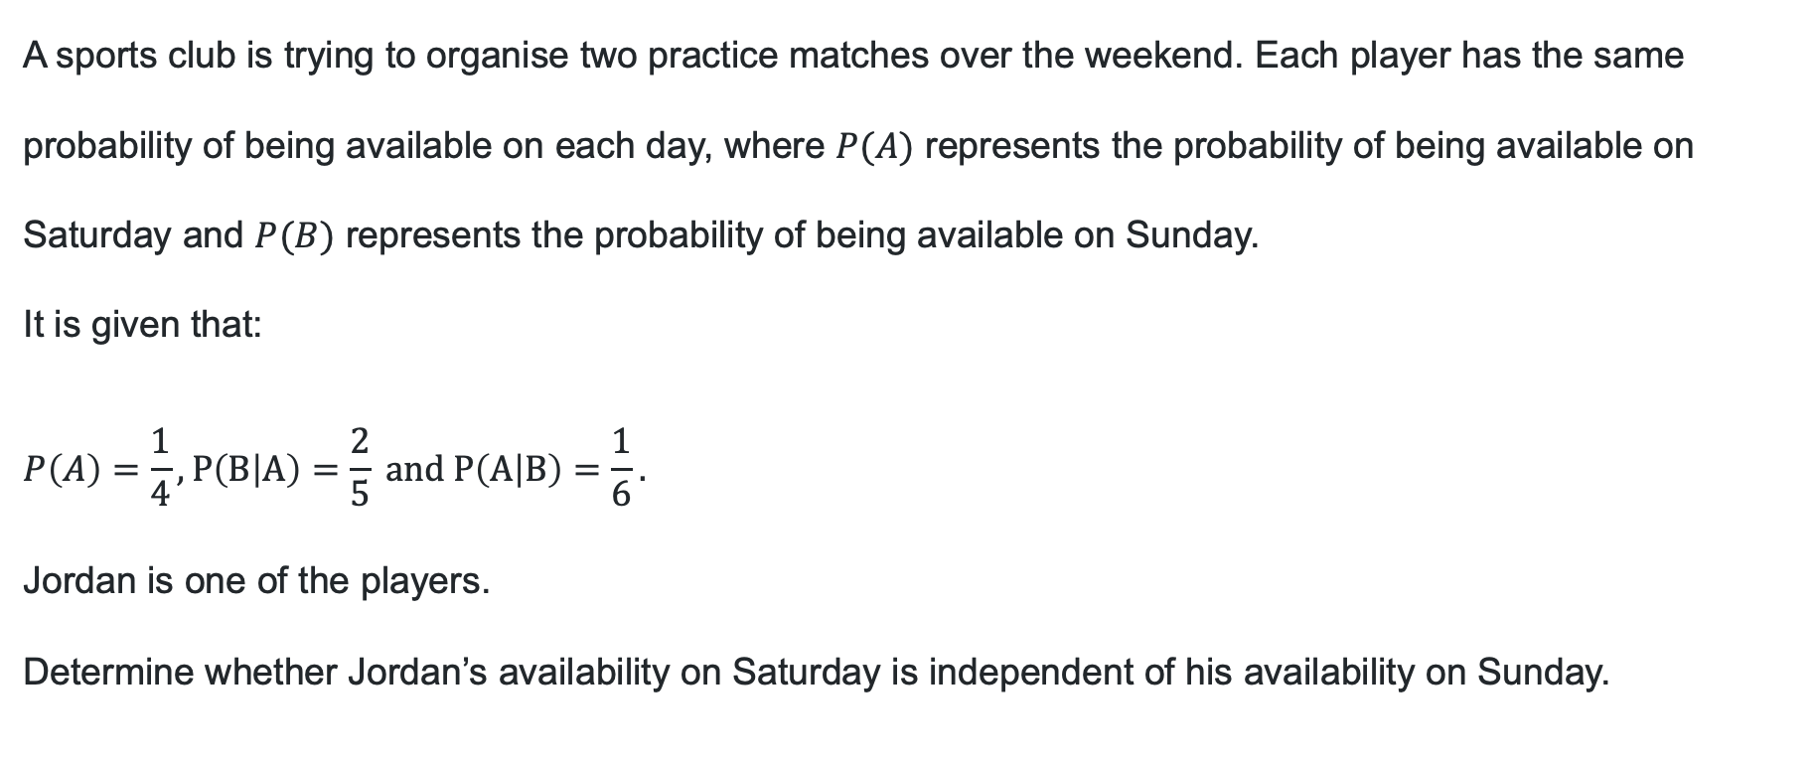
Problem
A sports club is trying to organise two practice matches over the weekend. Each player has the same probability of being available on each day, where $P(A)$ represents the probability of being available on Saturday and $P(B)$ represents the probability of being available on Sunday.
It is given that:
$$P\left(A\right)=\frac{1}{4}, P\left(B | A\right)=\frac{2}{5} \text{and} P\left(A | B\right)=\frac{1}{6}.$$
Jordan is one of the players.
Determine whether Jordan’s availability on Saturday is independent of his availability on Sunday.

Slide 22


Problem – solution (1)
For events to be independent, $P\left(A∩B\right)=P\left(A\right)×P\left(B\right).$
Step 1: Determining $P\left(A∩B\right)$
$$P\left(B | A\right)=\frac{P(B∩A)}{P(A)}$$
$$∴P\left(B∩A\right)=P\left(B | A\right)×P(A)$$
Substituting in known values,
$$P\left(B∩A\right)=\frac{2}{5}×\frac{1}{4}$$
$$∴P\left(A∩B\right)=\frac{1}{10}$$
$$P\left(A\right)=\frac{1}{4}, P\left(B | A\right)=\frac{2}{5} \text{and} P\left(A | B\right)=\frac{1}{6}.$$
conditional
probability
formula

Slide 23


Problem – solution (2)
For events to be independent, $P\left(A∩B\right)=P\left(A\right)×P\left(B\right).$
Step 2: Determining $P\left(B\right)$
  $$P\left(A|B\right)=\frac{P(A∩B)}{P(B)}$$
  $$∴P\left(B\right)=\frac{P(A∩B)}{P(A|B)}$$
  Substituting in known values,
  $$P\left(B\right)=\frac{1}{10}÷\frac{1}{6}$$
  $$∴P\left(B\right)=\frac{3}{5}$$
$$P\left(A\right)=\frac{1}{4}, P\left(B | A\right)=\frac{2}{5} \text{and} P\left(A | B\right)=\frac{1}{6},P\left(A∩B\right)=\frac{1}{10}$$
conditional
probability
formula

Slide 24

Problem – solution (3)
$P\left(A\right)=\frac{1}{4}, P\left(B | A\right)=\frac{2}{5} \text{and} P\left(A | B\right)=\frac{1}{6},P\left(A∩B\right)=\frac{1}{10}$, $P\left(B\right)=\frac{3}{5}$
Step 3: For events to be independent, $P\left(A∩B\right)=P\left(A\right)×P\left(B\right).$
$LHS=P(A∩B)$
$$=\frac{1}{10}$$
$$RHS=P\left(A\right)×P(B)$$
$$=\frac{1}{4}×\frac{3}{5}$$
$$=\frac{3}{20}$$
$≠LHS∴$ The Jordan’s availability on Saturday is not independent of his availability on Sunday.

Slide 25
References
This presentation contains NSW Curriculum and syllabus content. The NSW Curriculum is developed by the NSW Education Standards Authority. This content is prepared by NESA for and on behalf of the Crown in the right of the State of New South Wales. The material is protected by Crown copyright.
Please refer to the NESA Copyright Disclaimer for more information https://educationstandards.nsw.edu.au/wps/portal/nesa/mini-footer/copyright.
NESA holds the only official and up-to-date versions of the NSW Curriculum and syllabus documents. Please visit the NSW Education Standards Authority (NESA) website https://educationstandards.nsw.edu.au/wps/portal/nesa/home and the NSW Curriculum website https://curriculum.nsw.edu.au.
Mathematics Advanced 11–12 Syllabus © NSW Education Standards Authority (NESA) for and on behalf of the Crown in right of the State of New South Wales, 2024.

Slide 26
Copyright
© State of New South Wales (Department of Education), 2025
The copyright material published in this resource is subject to the Copyright Act 1968 (Cth) and is owned by the NSW Department of Education or, where indicated, by a party other than the NSW Department of Education (third-party material).
Copyright material available in this resource and owned by the NSW Department of Education is licensed under a Creative Commons Attribution 4.0 International (CC BY 4.0) license.
This license allows you to share and adapt the material for any purpose, even commercially.
Attribution should be given to © State of New South Wales (Department of Education), 2025.
Material in this resource not available under a Creative Commons license:
the NSW Department of Education logo, other logos and trademark-protected material
Material owned by a third party that has been reproduced with permission. You will need to obtain permission from the third party to reuse its material.
Links to third-party material and websites
Please note that the provided (reading/viewing material/list/links/texts) are a suggestion only and implies no endorsement, by the New South Wales Department of Education, of any author, publisher, or book title. School principals and teachers are best placed to assess the suitability of resources that would complement the curriculum and reflect the needs and interests of their students.
If you use the links provided in this document to access a third-party’s website, you acknowledge that the terms of use, including licence terms set out on the third-party’s website apply to the use which may be made of the materials on that third-party website or where permitted by the Copyright Act 1968 (Cth). The department accepts no responsibility for content on third-party websites.

