Slide 1
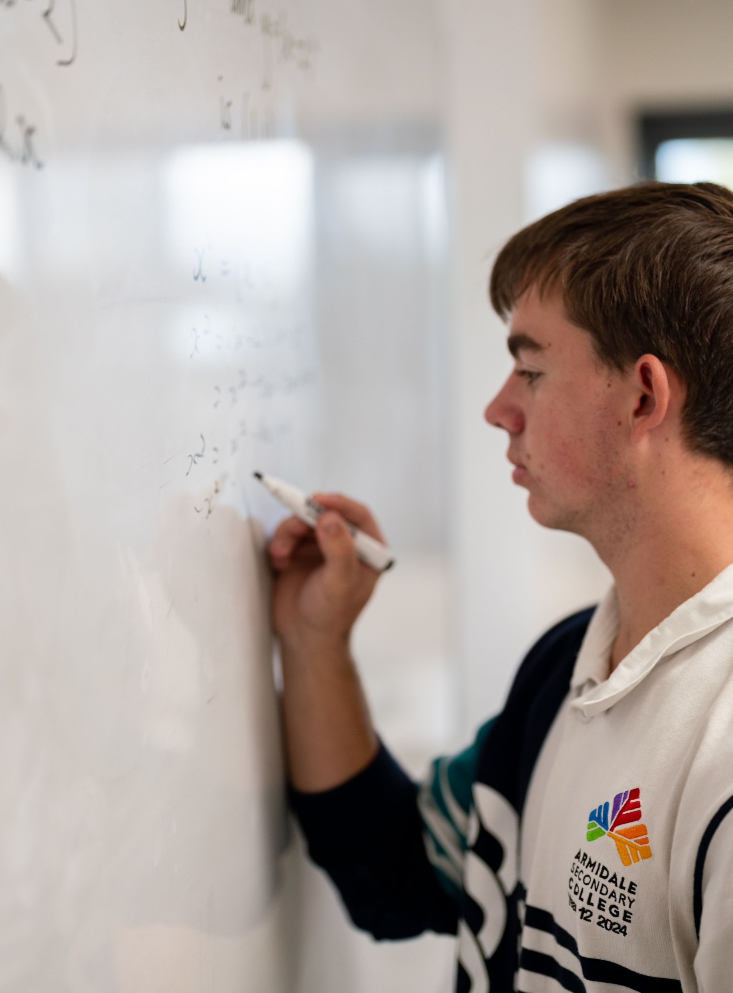
Differentiating natural logarithmic functions
Mathematics Advanced – Stage 6 (Year 12)
Further differentiation, modelling and graphing

Slide 2
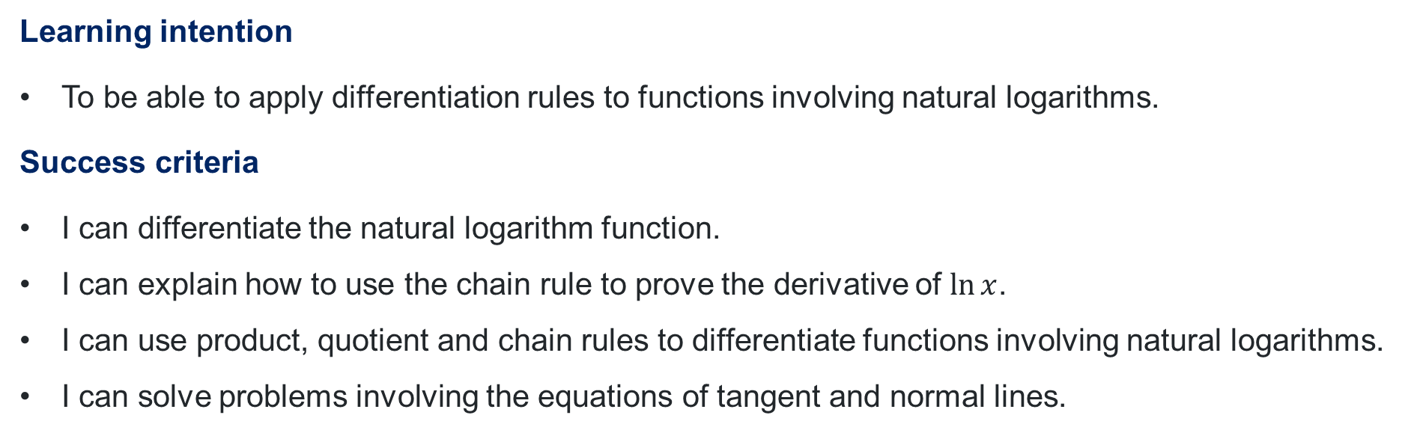
Learning intention and success criteria
Learning intention
To be able to apply differentiation rules to functions involving natural logarithms.
Success criteria
I can differentiate the natural logarithm function.
I can explain how to use the chain rule to prove the derivative of $\ln{x}$.
I can use product, quotient and chain rules to differentiate functions involving natural logarithms.
I can solve problems involving the equations of tangent and normal lines.

Slide 3
Activating prior knowledge

Slide 4
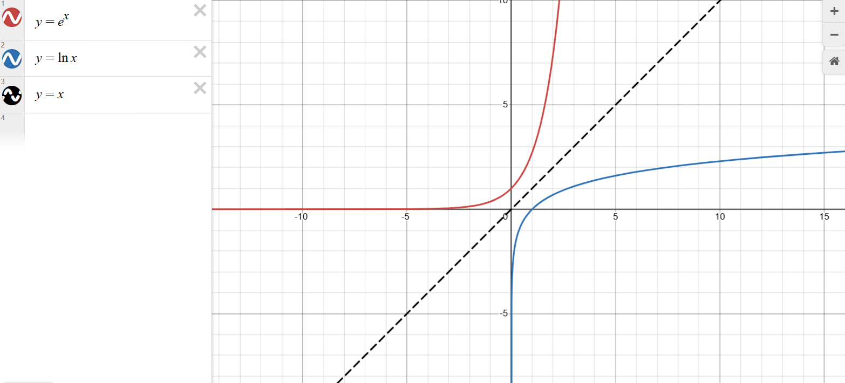
Logarithmic and exponential function

Slide 5
Connecting learning

Slide 6
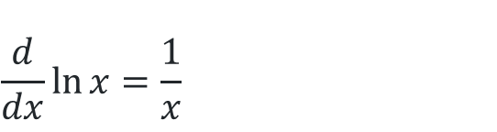
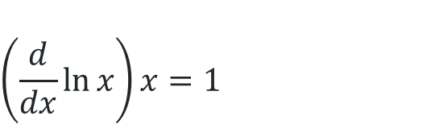
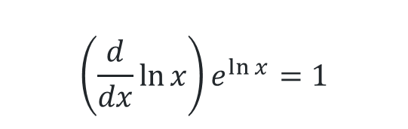
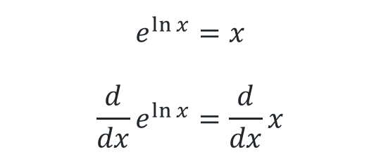
Prove $\frac{d}{dx}\left(\ln{x}\right)=\frac{1}{x}$ where $x>0$
What identity has been used here?
$$e^{\ln{x}}=x \\ \frac{d}{dx}e^{\ln{x}}=\frac{d}{dx}x$$
Why can we differentiate both sides?
$$\left(\frac{d}{dx}\ln{x}\right)e^{\ln{x}}=1$$
Where did this go?
What rule has been used to differentiate this?
$$\left(\frac{d}{dx}\ln{x}\right)x=1$$
$$\frac{d}{dx}\ln{x}=\frac{1}{x}$$

Slide 7

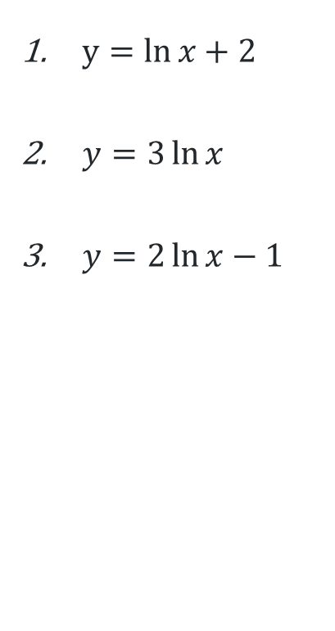
Differentiating $\ln{x}$
Use the rule $\frac{d}{dx}\left(\ln{x}\right)=\frac{1}{x}$ to differentiate the following
$y=ln{x+2}$
$y=3\ln{x}$
$y=2\ln{x−1}$
$\frac{dy}{dx}={\frac{1}{x}}$
$\frac{dy}{dx}=3\frac{d}{dx}(\ln{x)=\frac{3}{x}}$
$\frac{dy}{dx}=2\ln{x−1}$

Slide 8
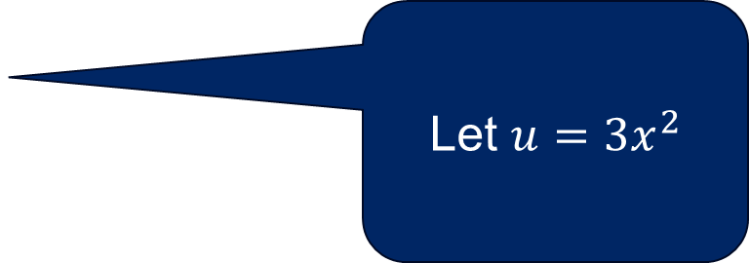
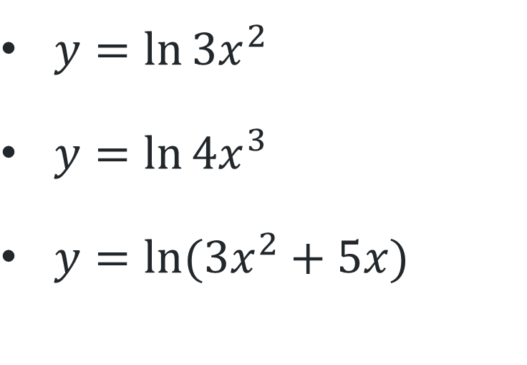
Differentiate the following
Chain rule: $\frac{dy}{dx}=\frac{dy}{du}×\frac{du}{dx}$
$y=\ln{3x^{2}}$
$y=\ln{4x^{3}}$
$y=\ln{(3x^{2}+5x)}$
Let $u=3x^{2}$

Slide 9

Solution – question 1
Chain rule: $\frac{dy}{dx}=\frac{dy}{du}×\frac{du}{dx}$
Where does this appear in the answer?
$$y=\ln{3x^{2}}$$
$u=$ $3x^{2}$ $\frac{du}{dx}=6x$
$y=\ln{u}$ $\frac{dy}{du}=\frac{1}{u}$
$$\frac{dy}{dx}=\frac{1}{u}×6x=\frac{6x}{3x^{2}}=\frac{2}{x}$$
Where does this appear in the answer?

Slide 10
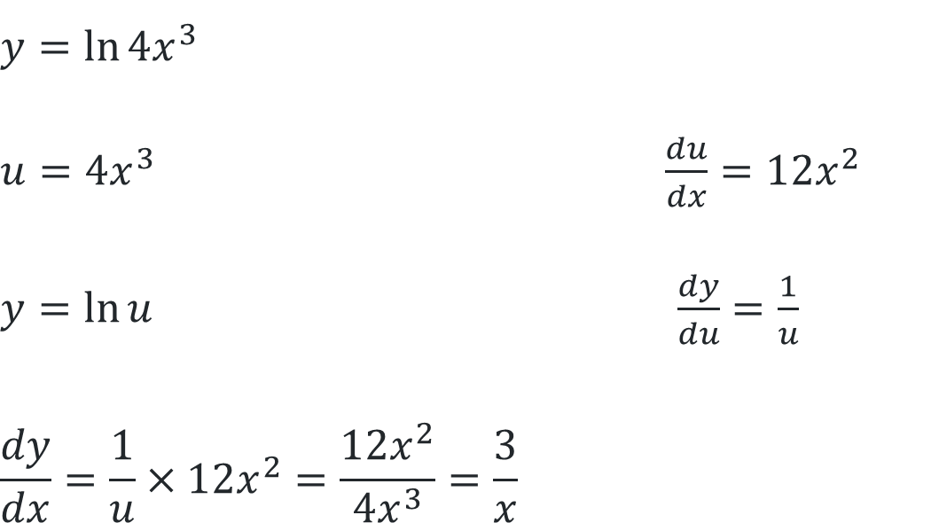
Solution – question 2
Chain rule: $\frac{dy}{dx}=\frac{dy}{du}×\frac{du}{dx}$
Where does this appear in the answer?
Where does this appear in the answer?
$$y=\ln{4x^{3}}$$
$u=$ $4x^{3}$ $\frac{du}{dx}=12x^{2}$
$y=\ln{u}$ $\frac{dy}{du}=\frac{1}{u}$
$$\frac{dy}{dx}=\frac{1}{u}×12x^{2}=\frac{12x^{2}}{4x^{3}}=\frac{3}{x}$$

Slide 11
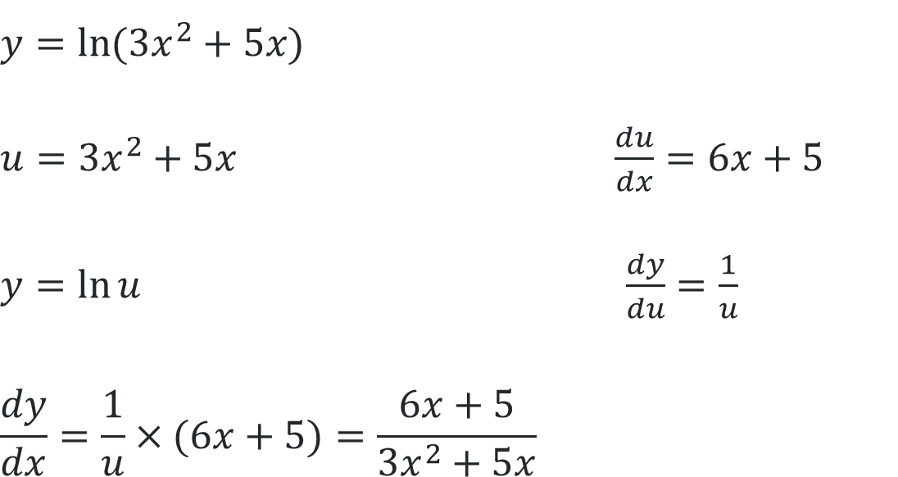
Solution – question 3
Chain rule: $\frac{dy}{dx}=\frac{dy}{du}×\frac{du}{dx}$
$$y=\ln{(3x^{2}+5x)}$$
$u=$ $3x^{2}+5x$ $\frac{du}{dx}=6x+5$
$y=\ln{u}$ $\frac{dy}{du}=\frac{1}{u}$
$$\frac{dy}{dx}=\frac{1}{u}×(6x+5)=\frac{6x+5}{3x^{2}+5x}$$
Where does this appear in the answer?
Where does this appear in the answer?

Slide 12
Releasing responsibility

Slide 13
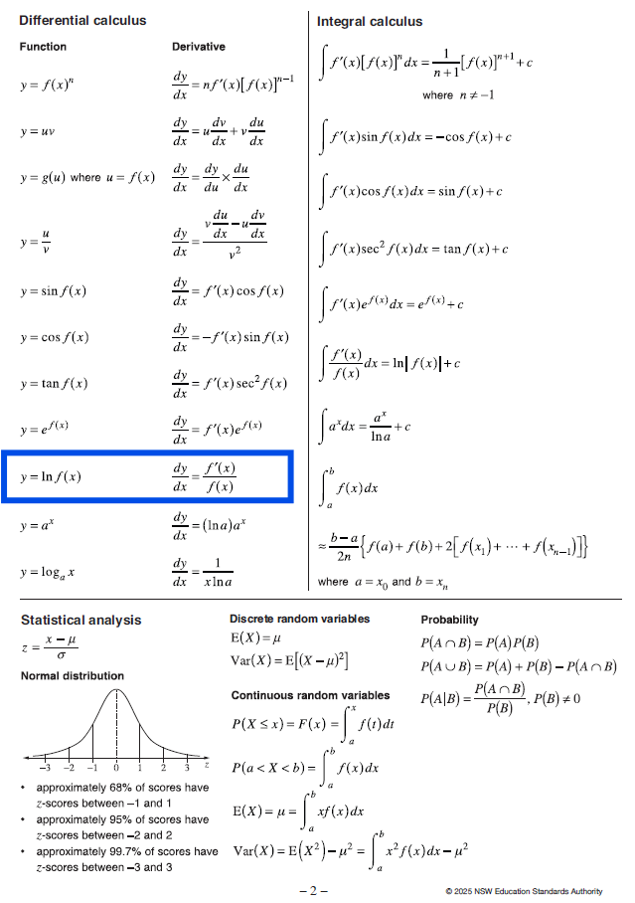
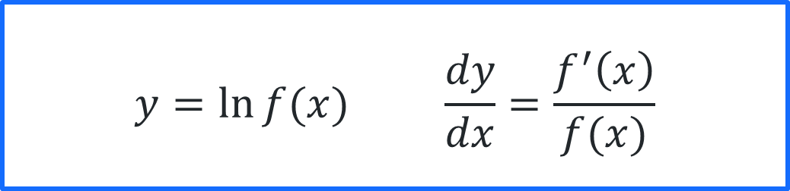
Reference sheet
$$y=\ln{f(x)} \frac{dy}{dx}=\frac{f^{′}\left(x\right)}{f(x)}$$

Slide 14
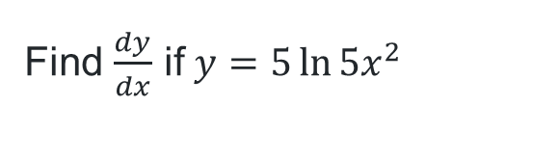
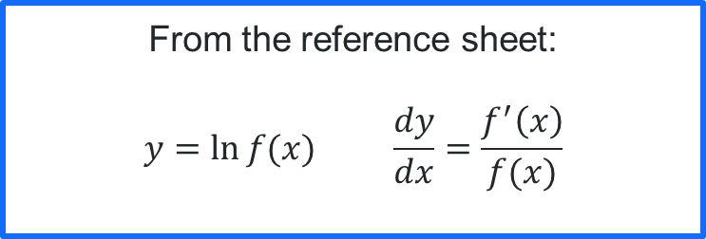
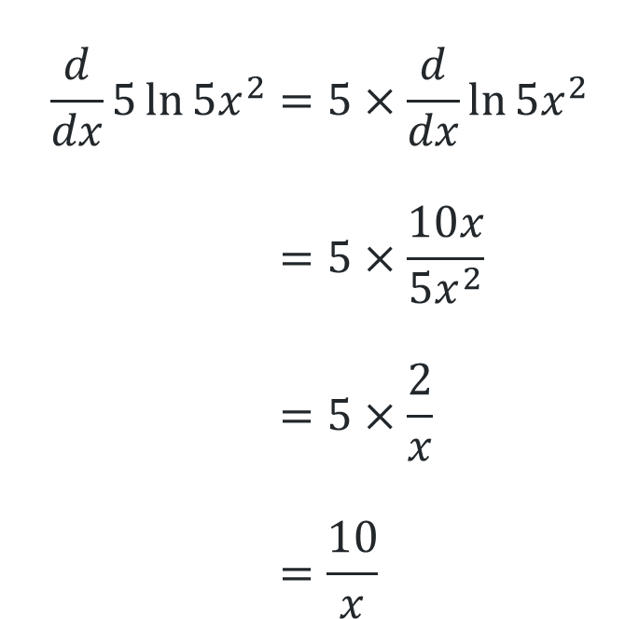
Finding the derivative (1)
Worked example 1
Find $\frac{dy}{dx}$ if $y=5\ln{5x^{2}}$
$$\frac{d}{dx}5\ln{5x^{2}}=5×\frac{d}{dx}\ln{5x^{2}} \\ =5×\frac{10x}{5x^{2}} \\ =5×\frac{2}{x} \\ =\frac{10}{x}$$
From the reference sheet:
$$y=\ln{f(x)} \frac{dy}{dx}=\frac{f^{′}\left(x\right)}{f(x)}$$
How could we use the chain rule to differentiate this instead?
Which differentiation rules are being used?

Slide 15
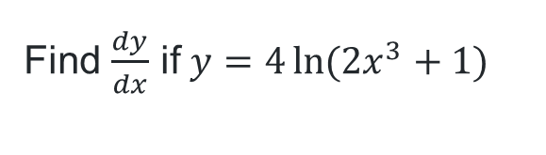

Finding the derivative (2)
Your turn – Question 1
Find $\frac{dy}{dx}$ if $y=4\ln{(2x^{3}+1)}$
$$\frac{d}{dx}4\ln{(2x^{3}+1)}=4×\frac{d}{dx}\ln{(2x^{3}+1)} \\ =4×\frac{6x^{2}}{2x^{3}+1} \\ =\frac{24x^{2}}{2x^{3}+1}$$
From the reference sheet:
$$y=\ln{f(x)} \frac{dy}{dx}=\frac{f^{′}\left(x\right)}{f(x)}$$

Slide 16
Independent practice

Slide 17

Approaching questions scaffold

Slide 18
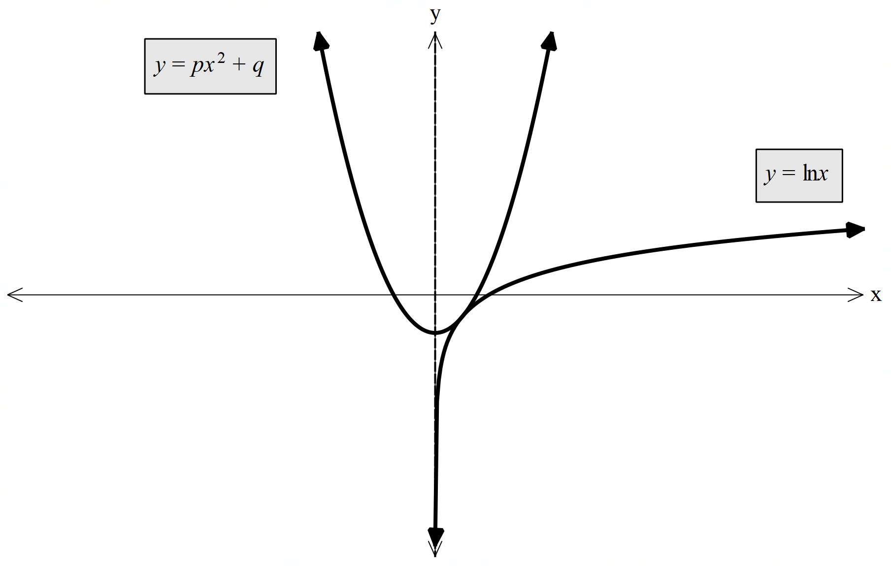
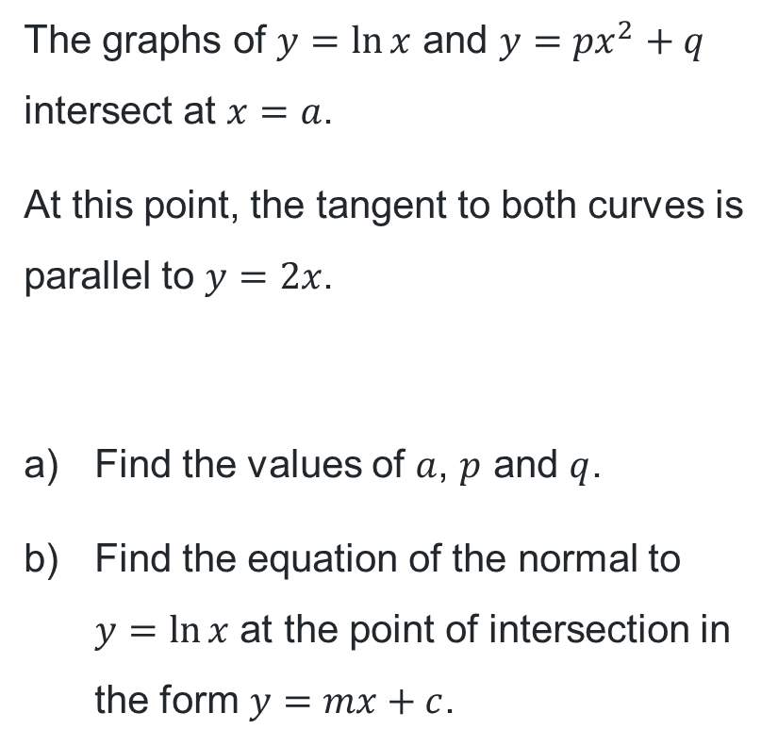
HSC-style question
The graphs of $y=\ln{x}$ and $y={px}^{2}+q$
intersect at $x=a$.
At this point, the tangent to both curves is parallel to $y=2x$.
Find the values of $a$, $p$ and $q$.
Find the equation of the normal to
$y=\ln{x}$ at the point of intersection in the form $y=mx+c$.

Slide 19
References
This presentation contains NSW Curriculum and syllabus content. The NSW Curriculum is developed by the NSW Education Standards Authority. This content is prepared by NESA for and on behalf of the Crown in the right of the State of New South Wales. The material is protected by Crown copyright.
Please refer to the NESA Copyright Disclaimer for more information https://www.nsw.gov.au/education-and-training/nesa/copyright.
NESA holds the only official and up-to-date versions of the NSW Curriculum and syllabus documents. Please visit NESA https://www.nsw.gov.au/education-and-training/nesa and NSW Curriculum https://curriculum.nsw.edu.au.
Mathematics Advanced 11-12 Syllabus © NSW Education Standards Authority (NESA) for and on behalf of the Crown in right of the State of New South Wales, 2024.

Slide 20
Copyright
© State of New South Wales (Department of Education), 2026
The copyright material published in this resource is subject to the Copyright Act 1968 (Cth) and is owned by the NSW Department of Education or, where indicated, by a party other than the NSW Department of Education (third-party material).
Copyright material available in this resource and owned by the NSW Department of Education is licensed under a Creative Commons Attribution 4.0 International (CC BY 4.0) license.
This license allows you to share and adapt the material for any purpose, even commercially.
Attribution should be given to © State of New South Wales (Department of Education), 2026.
Material in this resource not available under a Creative Commons license:
the NSW Department of Education logo, other logos and trademark-protected material
Material owned by a third party that has been reproduced with permission. You will need to obtain permission from the third party to reuse its material.
Links to third-party material and websites
Please note that the provided (reading/viewing material/list/links/texts) are a suggestion only and implies no endorsement, by the New South Wales Department of Education, of any author, publisher, or book title. School principals and teachers are best placed to assess the suitability of resources that would complement the curriculum and reflect the needs and interests of their students.
If you use the links provided in this document to access a third-party’s website, you acknowledge that the terms of use, including licence terms set out on the third-party’s website apply to the use which may be made of the materials on that third-party website or where permitted by the Copyright Act 1968 (Cth). The department accepts no responsibility for content on third-party websites.

