Slide 1
Conditional probability
Mathematics Advanced – Year 11
Probability and data
Term 1

Slide 2
Learning intentions and success criteria
Learning intentions
To understand and define conditional probability.
To be able to use Venn diagrams, two-way tables and tree diagrams to calculate conditional probabilities.
Success criteria
I can restrict the sample space in a Venn diagram, a two-way table and a tree diagram.
I can calculate conditional probabilities using provided data.
I can apply conditional probability to solve real-world problems.
Notes:
Notes for teachers:
Learning intentions and success criteria are best co-constructed with students. Adapt the learning intention as required and add matching success criteria.
For more information See ⁠AITSL or the NSW Department of Education explicit teaching strategies, ⁠Sharing learning intentions and ⁠Sharing success criteria
LISC is not necessarily presented at the beginning of the lesson. Teacher needs to consider most effectual time to introduce
LISC should be revisited during the lesson to support students' evaluation of their learning

Slide 3
Activating prior knowledge

Slide 4
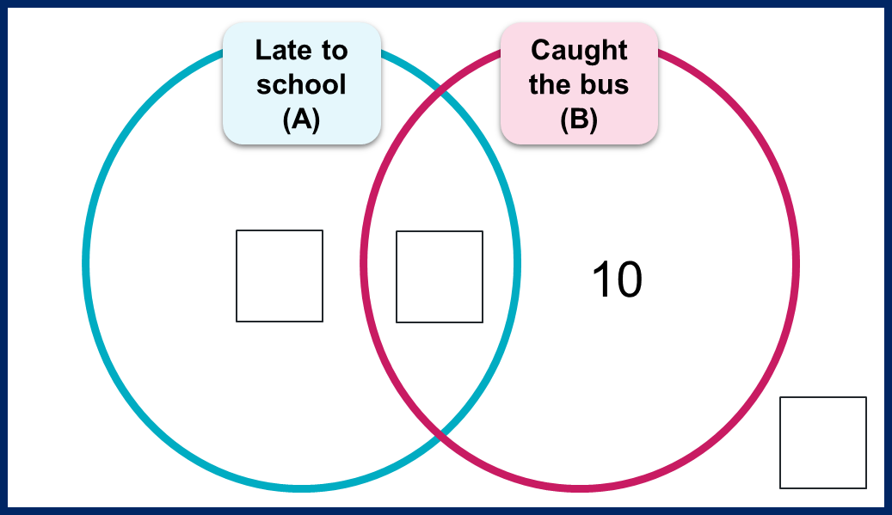
Getting to school (1)
Fill in the missing values
 | Late (A) | Not late (A’) | Totals:
Bus (B) |  |  | 14
Not bus (B’)
Totals: | 6 |  | 21

Slide 5
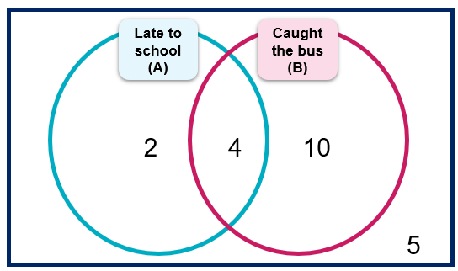
Getting to school (2)
Solution
 | Late (A) | Not late (A’) | Totals:
Bus (B) | 4 | 10 | 14
Not bus (B’) | 2 | 5
Totals: | 6 |  | 21

Slide 6
Connecting learning

Slide 7
Scenario (1)
Alex is concerned about having a specific allergy because a close relative has it.
Alex takes a test for the specific allergy.
The test comes back positive.
Is it certain that Alex has the allergy?

Slide 8
Allergy test
Possible outcomes
 | Has the allergy | Does not have the allergy
Positive test | True positive (TP) | False positive (FP)
Not positive (negative) test | False negative (FN) | True negative (TN)

Slide 9
Allergy test data
What do you notice and wonder?
 | Allergic (A) | Not allergic (A’) | Totals:
Positive test (B) | 18 | 50 | 68
Not positive test (B’) | 2 | 930 | 932
Totals: | 20 | 980 | 1000

Slide 10
Venn diagram
Alex’s allergy test data
Allergic (A)
Positive test (B)
2
18
50
930

Slide 11
Restricting the sample space and event space (1)
Two-way table
 | Allergic (A) | Not allergic (A’) | Totals:
Positive test (B) | 18 | 50 | 68
Not positive test (B’) | 2 | 930 | 932
Totals: | 20 | 980 | 1000

Slide 12
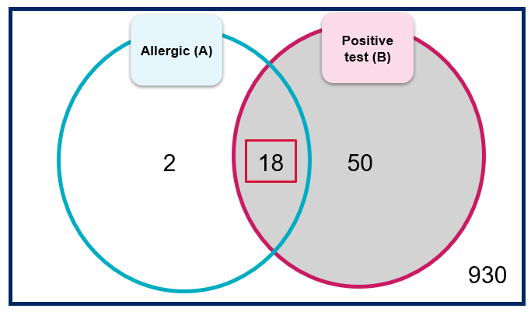
Restricting the sample space and event space (2)
Venn diagram

Slide 13
Releasing responsibility

Slide 14

Definition and notation (1)
Conditional probability
The probability that an event $A$ occurs, given that another event $B$ has already occurred.
Example: The probability that Alex has the allergy, given that the test result was positive.
$P\left(A | B\right)$
This is read as: The probability of $A$ given $B$.

Slide 15

Definition and notation (2)
Conditional probability
$P\left(A | B\right)=\frac{|A∩B|}{|B|}$
When all outcomes are equally likely, and provided $|B|≠0$
This is read as: The probability of $A$ given $B$ is the number of elements in the intersection of $A$ and $B$, divided by the number of elements in $B$.

Slide 16
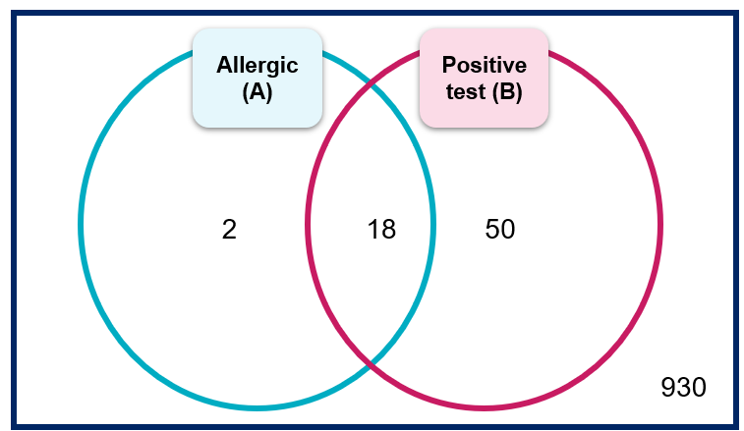

Calculating conditional probability (1)
Worked example 1
Calculate the probability that Alex has the allergy given that he tested positive.
Solution:
Event A – person has the allergy
Event B – person tests positive
$$P(A|B) = \frac{\left|A∩B\right|}{\left|B\right|}$$
$$P\left(A | B\right)=\frac{18}{68}≈0.26\text{47}$$
What does the formula represent in this situation?
Where did these values come from?
What is the answer as a percentage?

Slide 17
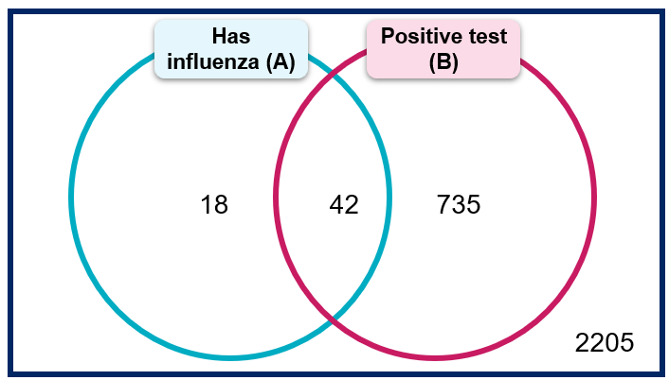

Calculating conditional probability (2)
Your turn – Question 1
Maria was tested for influenza.
Given that she tested positive, calculate the probability that Maria has influenza.
Solution:
Event A – person has influenza
Event B – person tests positive
$$P(A|B) = \frac{\left|A∩B\right|}{\left|B\right|}$$
$$P\left(A | B\right)=\frac{42}{777}≈0.05$$

Slide 18
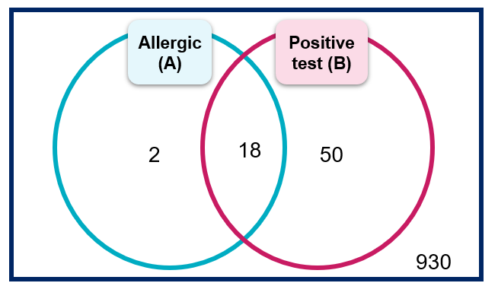
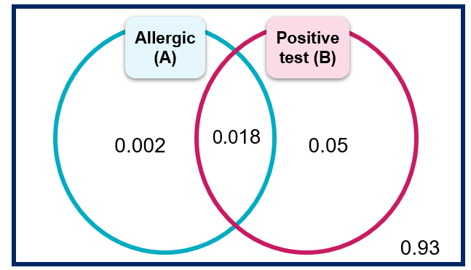
Definition and notation (3)
Conditional probability
What do you notice about the two Venn diagrams?
Is there a difference in the data being represented?

Slide 19
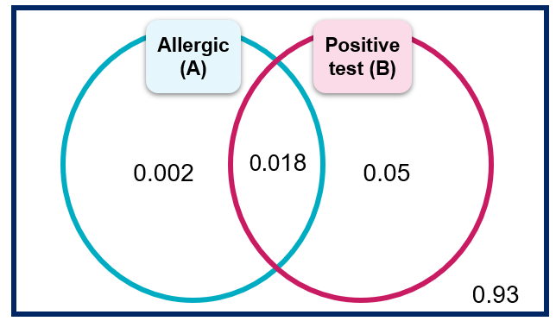
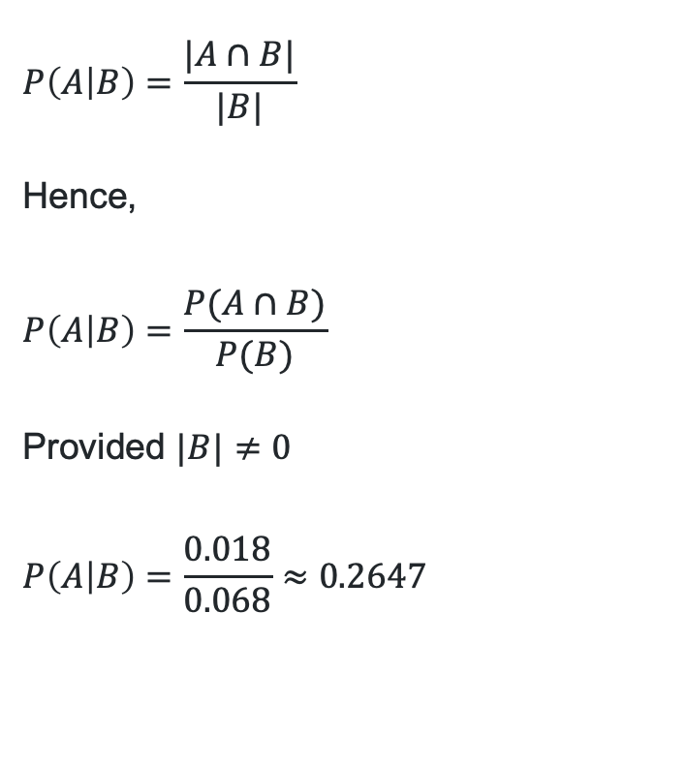
Definition and notation (4)
3. In what situations would each formula be used?
Conditional probability
$$P\left(A | B\right)=\frac{|A∩B|}{|B|}$$
Hence,
$$P\left(A | B\right)=\frac{P(A∩B)}{P(B)}$$
Provided $|B|≠0$
$$P\left(A | B\right)=\frac{0.018}{0.068}≈0.2647$$
1. How does this formula relate to the previous one?
2. Is this equal to the value calculated earlier?

Slide 20
Calculating conditional probability (3)
Worked example 2 – Question
A patient visits a doctor with a fever. The doctor knows from medical data that:
5% of people in the population have the flu.
80% of people who have the flu develop a fever.
10% of people who do not have the flu also develop a fever from other causes.
If a patient has a fever, what is the probability that they actually have the flu?

Slide 21
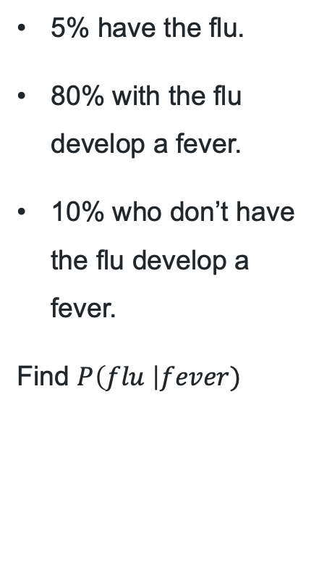
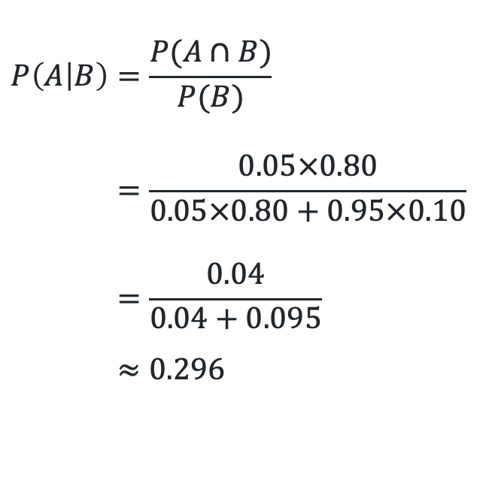
Calculating conditional probability (4)
What does A|B represent?
Worked example 2 – self-explanation prompts
Event B – having a fever
5% have the flu.
80% with the flu develop a fever.
10% who don’t have the flu develop a fever.
Find $P\left(flu \right|fever)$
Event A – having the flu
B
0.80
$$P\left(A | B\right)=\frac{P(A∩B)}{P(B)} \\ =\frac{0.05×0.80}{0.05×0.80+0.95×0.10} \\ =\frac{0.04}{0.04+0.095} \\ ≈0.296$$
A
0.05
B’
0.20
B
0.10
0.95
A’
B’
Where do the numbers come from?
0.90
Where do the calculations in the denominator come from?

Slide 22
Calculating conditional probability (5)
Your turn – Question 2
A doctor is trying to determine whether a patient with stomach pain has food poisoning.
Based on medical data:
4% of people in the population have food poisoning.
85% of people who have food poisoning experience stomach pain.
12% of people who do not have food poisoning also experience stomach pain from other causes.
If a person has stomach pain, what is the probability that they actually have food poisoning?

Slide 23
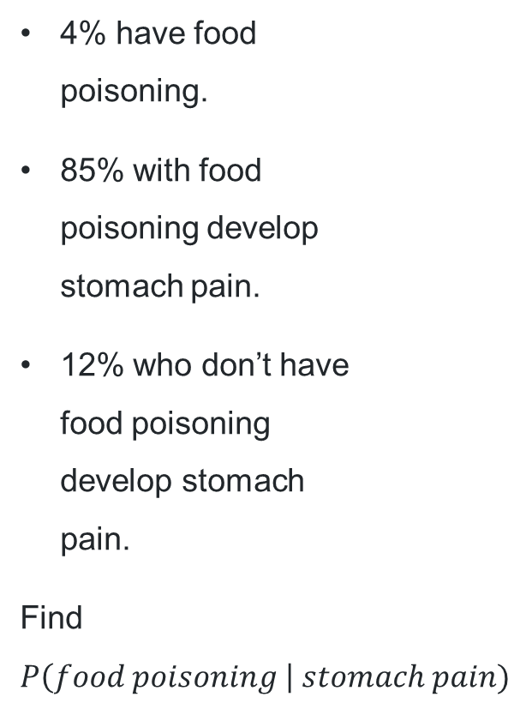
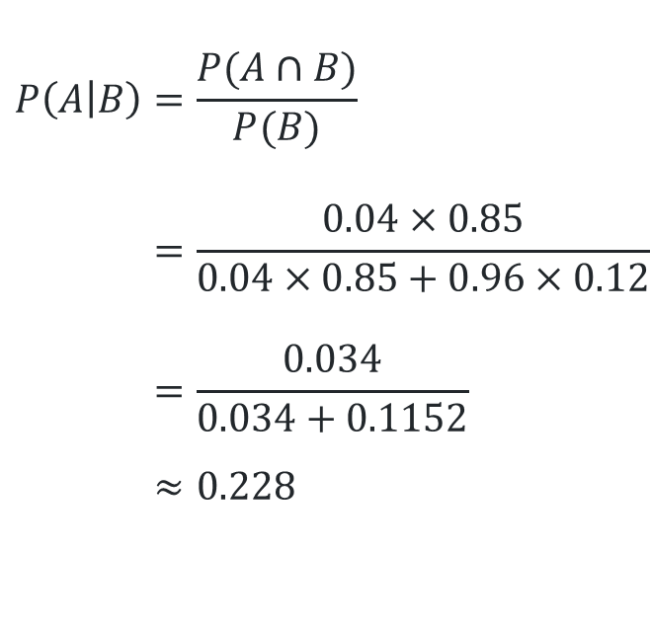
Calculating conditional probability (6)
Event B – stomach pain
Your turn – Question 2 Solution
4% have food poisoning.
85% with food poisoning develop stomach pain.
12% who don’t have food poisoning develop stomach pain.
Find $P\left(food poisoning \right| stomach pain)$
Event A – food poisoning
B
0.85
$$P\left(A | B\right)=\frac{P(A∩B)}{P(B)} \\ =\frac{0.04×0.85}{0.04×0.85+0.96×0.12} \\ =\frac{0.034}{0.034+0.1152} \\ ≈0.228$$
A
0.04
B’
0.15
B
0.12
0.96
A’
B’
0.88

Slide 24
Scenario (2)
We know that Alex’s relative has the allergy. If they are administered the same test as Alex, what is the probability that they test positive?
 | Allergic (A) | Not allergic (A’) | Totals:
Positive test (B) | 18 | 50 | 68
Not positive test (B’) | 2 | 930 | 932
Totals: | 20 | 980 | 1000

Slide 25
Independent practice

Slide 26
Diagnostic testing accuracy (1)
Many diagnostic tests do not test for the disease directly but for a chemical or biological product of the disease, hence they are not perfectly reliable.
We can describe a test’s accuracy by its sensitivity and specificity.
Sensitivity – probability that a test will be positive when administered to a person with the condition.
Specificity – probability that a test will be negative when administered to a person without the condition.

Slide 27
Diagnostic testing accuracy (2)
Sensitivity – probability that a test will be positive when administered to a person with the condition.
Specificity – probability that a test will be negative when administered to a person without the condition.
 | Allergic (A) | Not allergic (A’) | Totals:
Positive test (B) | 18 | 50 | 68
Not positive test (B’) | 2 | 930 | 932
Totals: | 20 | 980 | 1000

Slide 28
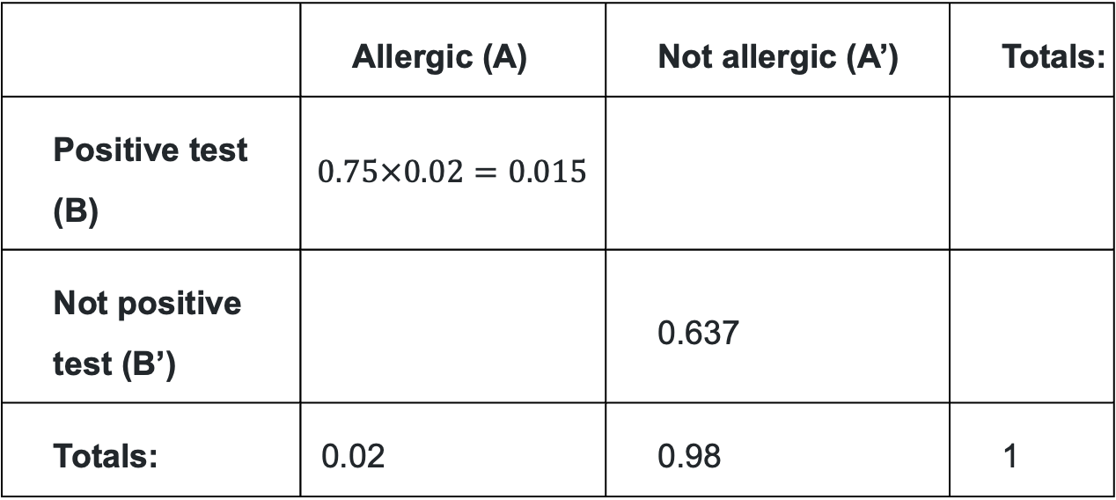
Using sensitivity and specificity (1)
Worked example and self-explanation prompts – two-way table
Consider a different allergy test with a sensitivity of 75% and a specificity of 65%. Assume 2% of the population have this allergy. Show this information in a two-way table and a probability tree diagram.
How has this been calculated?
 | Allergic (A) | Not allergic (A’) | Totals:
Positive test (B) | $$0.75×0.02=0.015$$
Not positive test (B’) |  | 0.637
Totals: | 0.02 | 0.98 | 1
What does 0.015 represent?
Why is the total here 1?
What does 0.02 represent?

Slide 29


Using sensitivity and specificity (2)
Worked example and self-explanation prompts – probability tree diagram
Consider a different allergy test with a sensitivity of 75% and a specificity of 65%. Assume 2% of the population have this allergy. Show this information in a two-way table and a probability tree diagram.
Event B – person tests positive
How would you find $P(A∩B)$?
Event A – person has allergy
What value should go here?
B
0.75
A
How would you find $P(B)$?
B’
B
A’
What does 0.65 represent here?
B’
0.65

Slide 30
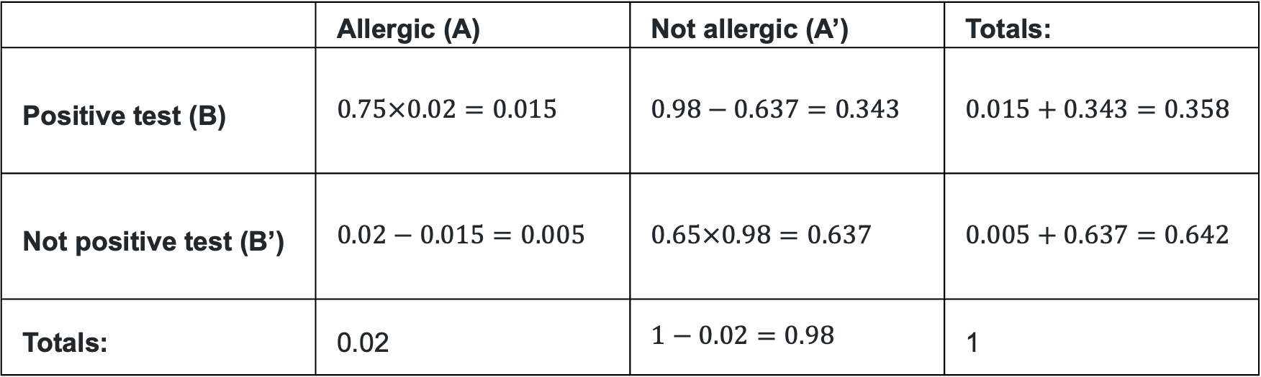
Using sensitivity and specificity (3)
Solution – two-way table
Consider a different allergy test with a sensitivity of 75% and a specificity of 65%. Assume 2% of the population have this allergy. Show this information in a two-way table and a probability tree diagram.
 | Allergic (A) | Not allergic (A’) | Totals:
Positive test (B) | $$0.75×0.02=0.015$$ | $$0.98−0.637=0.343$$ | $$0.015+0.343=0.358$$
Not positive test (B’) | $$0.02−0.015=0.005$$ | $$0.65×0.98=0.637$$ | $$0.005+0.637=0.642$$
Totals: | 0.02 | $$1−0.02=0.98$$ | 1

Slide 31
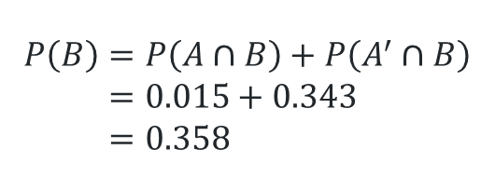




Using sensitivity and specificity (4)
Solution – probability tree diagram
Consider a different allergy test with a sensitivity of 75% and a specificity of 65%. Assume 2% of the population have this allergy. Show this information in a two-way table and a probability tree diagram.
Event B – person tests positive
$$P\left(A∩B\right)=0.2 ×0.75=0.015$$
Event A – person has allergy
B
0.75
A
$$P\left(A∩B′\right)=0.005$$
0.02
B’
0.25
$$P\left(B\right)=P\left(A∩B\right)+P\left(A^{′}∩B\right) \\ =0.015+0.343 \\ =0.358$$
B
$$P\left(A′∩B\right)=0.343$$
0.98
A’
0.35
B’
$$P\left(A′∩B′\right)=0.637$$
0.65

Slide 32
References
This presentation contains NSW Curriculum and syllabus content. The NSW Curriculum is developed by the NSW Education Standards Authority. This content is prepared by NESA for and on behalf of the Crown in the right of the State of New South Wales. The material is protected by Crown copyright.
Please refer to the NESA Copyright Disclaimer for more information https://educationstandards.nsw.edu.au/wps/portal/nesa/mini-footer/copyright.
NESA holds the only official and up-to-date versions of the NSW Curriculum and syllabus documents. Please visit the NSW Education Standards Authority (NESA) website https://educationstandards.nsw.edu.au/wps/portal/nesa/home and the NSW Curriculum website https://curriculum.nsw.edu.au.
Mathematics Advanced 11–12 Syllabus © NSW Education Standards Authority (NESA) for and on behalf of the Crown in right of the State of New South Wales, 2024.

Slide 33
Copyright
© State of New South Wales (Department of Education), 2025
The copyright material published in this resource is subject to the Copyright Act 1968 (Cth) and is owned by the NSW Department of Education or, where indicated, by a party other than the NSW Department of Education (third-party material).
Copyright material available in this resource and owned by the NSW Department of Education is licensed under a Creative Commons Attribution 4.0 International (CC BY 4.0) license.
This license allows you to share and adapt the material for any purpose, even commercially.
Attribution should be given to © State of New South Wales (Department of Education), 2025.
Material in this resource not available under a Creative Commons license:
the NSW Department of Education logo, other logos and trademark-protected material
Material owned by a third party that has been reproduced with permission. You will need to obtain permission from the third party to reuse its material.
Links to third-party material and websites
Please note that the provided (reading/viewing material/list/links/texts) are a suggestion only and implies no endorsement, by the New South Wales Department of Education, of any author, publisher, or book title. School principals and teachers are best placed to assess the suitability of resources that would complement the curriculum and reflect the needs and interests of their students.
If you use the links provided in this document to access a third-party’s website, you acknowledge that the terms of use, including licence terms set out on the third-party’s website apply to the use which may be made of the materials on that third-party website or where permitted by the Copyright Act 1968 (Cth). The department accepts no responsibility for content on third-party websites.

