Slide 1
Complements
Mathematics Advanced – Stage 6 Year 11
Probability and data
Term

Slide 2
Learning intentions and success criteria
Learning intentions
To understand how to calculate probabilities for events involving the phrase ‘at least’.
To be able to use the complement rule to solve probability problems
Success criteria
I can explain the relationship between an event and its complement.
I can construct a tree diagram.
I can perform probability calculations for problems involving the phrase ‘at least’.
I can apply the complement rule to simplify probability calculations.
Notes:
Notes for teachers:
Learning intentions and success criteria are best co-constructed with students. Adapt the learning intention as required and add matching success criteria.
For more information See ⁠AITSL or the NSW Department of Education explicit teaching strategies, ⁠Sharing learning intentions and ⁠Sharing success criteria
LISC is not necessarily presented at the beginning of the lesson. Teacher needs to consider most effectual time to introduce
LISC should be revisited during the lesson to support students' evaluation of their learning

Slide 3
Activating prior knowledge

Slide 4
Activating prior knowledge (1)
Scenario
Melissa and Nick are starting to plan their family and are hoping to have three children in the future.
They are curious about the possible gender combinations.
Melissa would like to have at least 1 girl and Nick is hoping for at least 2 boys.

Slide 5
Connecting learning

Slide 6
Connecting learning (1)
Scenario
At the Paris 2024 Olympics, the 6-day skateboarding event had to be postponed due to heavy rain, which made conditions unsafe for competitors.
Now, partway through the 2026 World Skate Games in Asunción, Paraguay, similar weather concerns are raising fears of another major disruption to the world of competitive skateboarding.
Day | 4 | 5 | 6
Chance of rain | 30% | 90% | 80%

Slide 7
Releasing responsibility

Slide 8
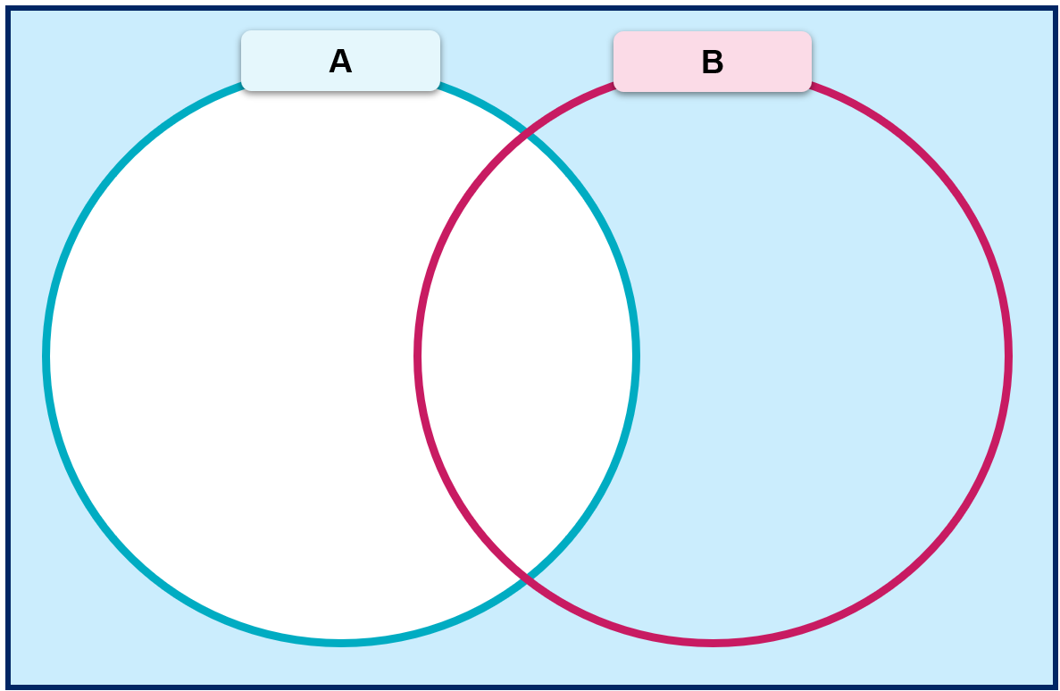


Definitions and notation
Complement
The notation $\overline{A}, A^{′}or A^{c}$ represents the complement of a set A with respect to some universal set, $U$. In probability, this notation can be used to describe the event ‘$A$ does not occur’.
$$\overline{A}$$

Slide 9
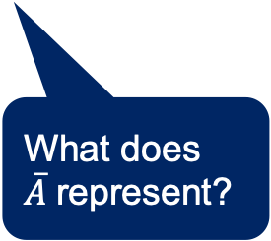
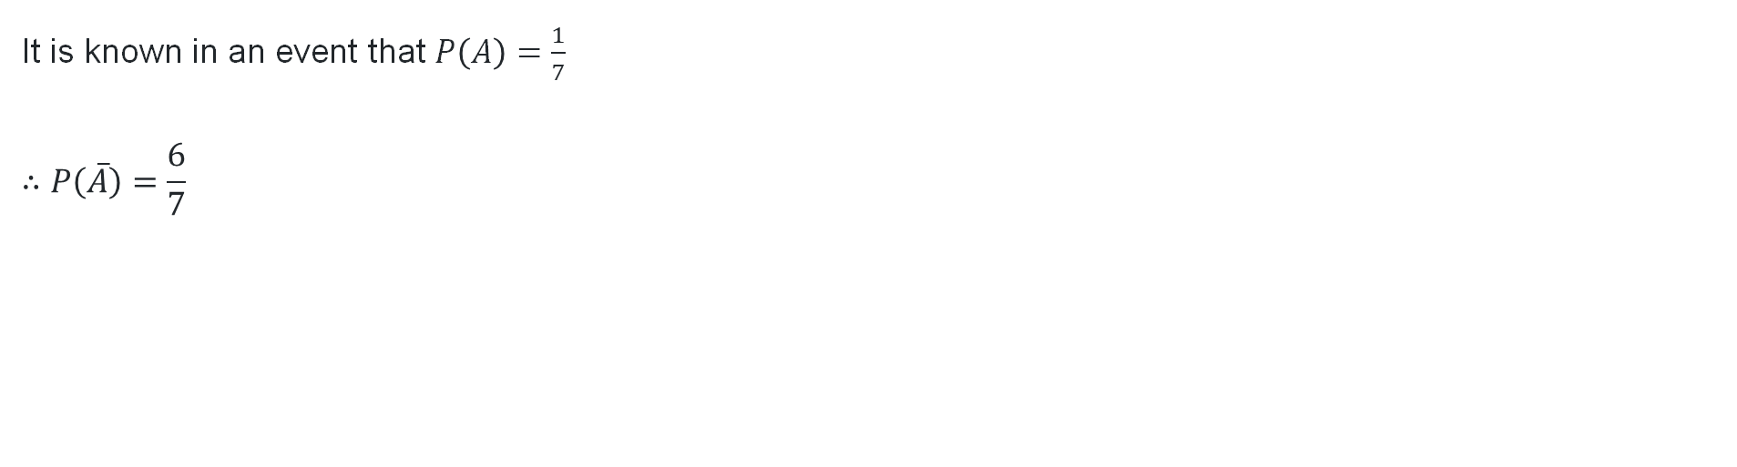

Definitions and rules
It is known in an event that $P\left(A\right)=\frac{1}{7}$
$$∴P\left(\overline{A}\right)=\frac{6}{7}$$
How do we know this?
What does $\overline{A}$represent?
$$P\left(\overline{A}\right)=1−P(A)$$

Slide 10

Complementary probabilities (1)
Worked example - question
Consider the universal set to be a standard deck of cards. Two sets $A$ and $B$ are given as:
$$A=\{a red card\}$$
$$B=\{\text{a} \text{face} \text{card}\}$$
Find the probability of selecting a card that is not a red card or a face card.

Slide 11
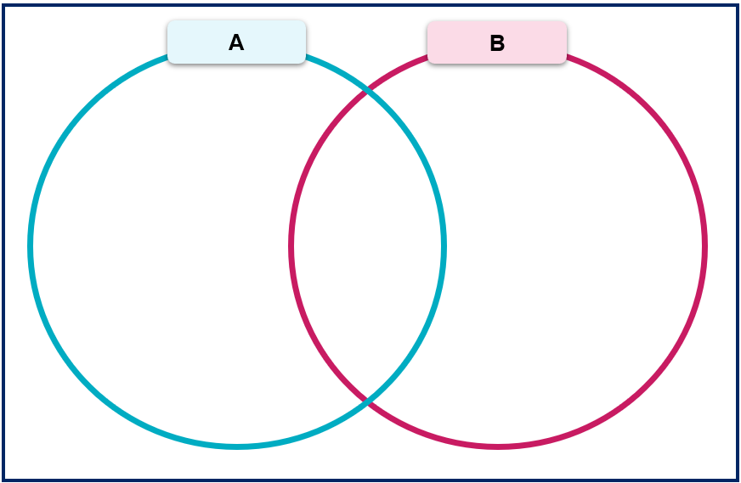

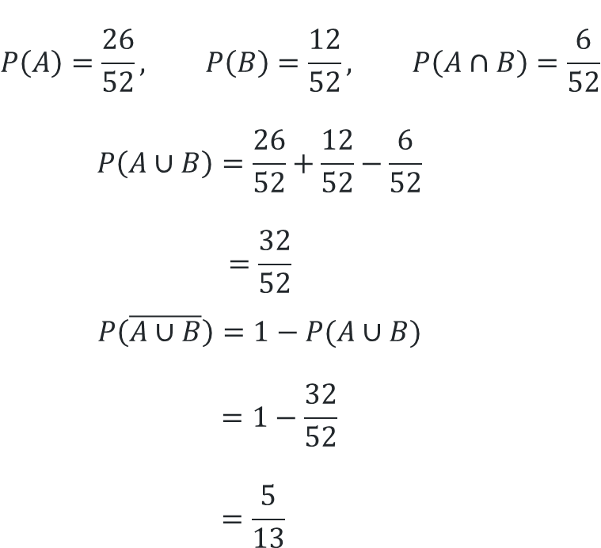



Complementary probabilities (2)
Worked example – self explanation prompts
Find the probability of selecting a card that is not a red card or a face card.
Where did this fraction come from?
$$P\left(A\right)=\frac{26}{52}, P\left(B\right)=\frac{12}{52}, P\left(A∩B\right)=\frac{6}{52}$$
$$P\left(A∪B\right)=\frac{26}{52}+\frac{12}{52}−\frac{6}{52}$$
$$=\frac{32}{52}$$
$$P\left(\overline{A∪B}\right)=1−P(A∪B)$$
$$=1−\frac{32}{52}$$
$$=\frac{5}{13}$$
Why is the denominator 52?
Why might we subtract the fraction from 1?
$$\frac{20}{52}$$
$$\frac{6}{52}$$
$$\frac{6}{52}$$
$$\frac{20}{52}$$

Slide 12

Complementary probabilities (3)
Your turn - question
Consider the universal set to be the students at Venn High School. Two events $S$ and $B$ are given as:
$$S=\left\{\text{number} \text{of} \text{students} \text{who} \text{play} \text{soccer}\right\}=40\%$$
$$B=\left\{\text{number} \text{of} \text{students} \text{who} \text{play} \text{basketball}\right\}=50\%$$
It is known that $22\%$ of students play both sports.
Find the probability of selecting a student that does not play either sport.

Slide 13
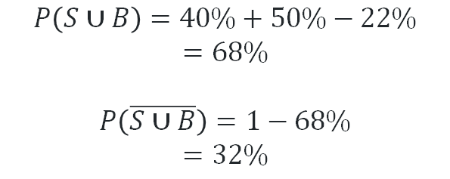




Complementary probabilities (4)
Your turn solution
Find the probability of selecting a student that does not play either sport.
$$P\left(S∪B\right)=40\%+50\%−22\%$$
$$=68\%$$
$$P\left(\overline{S∪B}\right)=1−68\%$$
$$=32\%$$
S
B
$$18\%$$
$$22\%$$
$$28\%$$
$$32\%$$

Slide 14
Independent practice

Slide 15

Approaching questions

Slide 16
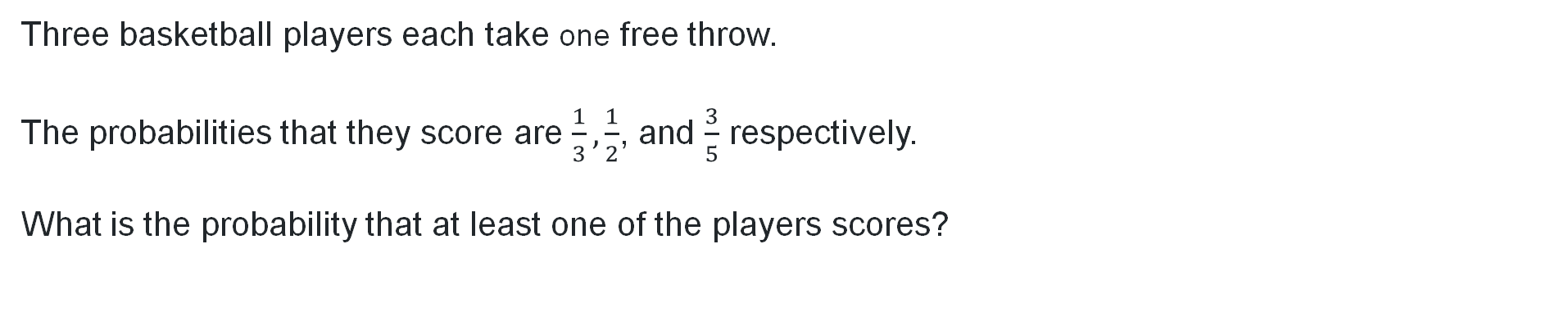
Problem 1 – question
Three basketball players each take one free throw.
The probabilities that they score are $\frac{1}{3},\frac{1}{2}$, and $\frac{3}{5}$ respectively.
What is the probability that at least one of the players scores?

Slide 17

Problem 1 – solution
$$P\left(at least one scores\right)=1−P(all miss)$$
$$P\left(all miss\right)=\frac{2}{3}×\frac{1}{2}×\frac{2}{5}$$
$$=\frac{2}{15}$$
$$∴P\left(at least one scores\right)=1−\frac{2}{15}$$
$$=\frac{13}{15}$$
Why do we want to find the probability of all 3 players missing their shots?
Why do we subtract this answer from 1?

Slide 18
Problem 2 – question
In a box of 100 tokens, there are 45 red tokens, 35 blue tokens, and 20 green tokens. Three tokens are drawn at random without replacement.
What is the probability that all three tokens drawn are not red?
What is the probability that at least one of the three tokens drawn is green?
What is the probability that at most two of the tokens drawn are blue?

Slide 19

Problem 2 – solution part a
In a box of 100 tokens, there are 45 red tokens, 35 blue tokens, and 20 green tokens. Three tokens are drawn at random without replacement.
What is the probability that all three tokens drawn are not red?
$$P\left(all 3 red\right)=\frac{45}{100}×\frac{44}{99}×\frac{43}{98}$$
$$≈0.0906$$
$$P\left(all 3 are not red\right)=1−0.0906$$
$$=0.9094$$

Slide 20

Problem 2 – solution part b
In a box of 100 tokens, there are 45 red tokens, 35 blue tokens, and 20 green tokens. Three tokens are drawn at random without replacement.
What is the probability that at least one of the three tokens drawn is green?
$$P\left(at least one green\right)=1−P(no green)$$
$$P\left(no green\right)=\frac{80}{100}×\frac{79}{99}×\frac{78}{98}$$
$$≈0.5056$$
$$P\left(at least one green\right)=1−0.5056$$
$$=0.4944$$

Slide 21

Problem 2 – solution part c
In a box of 100 tokens, there are 45 red tokens, 35 blue tokens, and 20 green tokens. Three tokens are drawn at random without replacement.
What is the probability that at most two of the tokens drawn are blue?
$$P\left(all 3 blue\right)=\frac{35}{100}×\frac{34}{99}×\frac{33}{98}$$
$$≈0.0413$$
$$P\left(at most 2 blue\right)=1−0.0413$$
$$=0.9587$$

Slide 22
References
This presentation contains NSW Curriculum and syllabus content. The NSW Curriculum is developed by the NSW Education Standards Authority. This content is prepared by NESA for and on behalf of the Crown in the right of the State of New South Wales. The material is protected by Crown copyright.
Please refer to the NESA Copyright Disclaimer for more information https://educationstandards.nsw.edu.au/wps/portal/nesa/mini-footer/copyright.
NESA holds the only official and up-to-date versions of the NSW Curriculum and syllabus documents. Please visit the NSW Education Standards Authority (NESA) website https://educationstandards.nsw.edu.au/wps/portal/nesa/home and the NSW Curriculum website https://curriculum.nsw.edu.au.
Mathematics Advanced 11–12 Syllabus © NSW Education Standards Authority (NESA) for and on behalf of the Crown in right of the State of New South Wales, 2024.

Slide 23
Copyright
© State of New South Wales (Department of Education), 2025
The copyright material published in this resource is subject to the Copyright Act 1968 (Cth) and is owned by the NSW Department of Education or, where indicated, by a party other than the NSW Department of Education (third-party material).
Copyright material available in this resource and owned by the NSW Department of Education is licensed under a Creative Commons Attribution 4.0 International (CC BY 4.0) license.
This license allows you to share and adapt the material for any purpose, even commercially.
Attribution should be given to © State of New South Wales (Department of Education), 2025.
Material in this resource not available under a Creative Commons license:
the NSW Department of Education logo, other logos and trademark-protected material
Material owned by a third party that has been reproduced with permission. You will need to obtain permission from the third party to reuse its material.
Links to third-party material and websites
Please note that the provided (reading/viewing material/list/links/texts) are a suggestion only and implies no endorsement, by the New South Wales Department of Education, of any author, publisher, or book title. School principals and teachers are best placed to assess the suitability of resources that would complement the curriculum and reflect the needs and interests of their students.
If you use the links provided in this document to access a third-party’s website, you acknowledge that the terms of use, including licence terms set out on the third-party’s website apply to the use which may be made of the materials on that third-party website or where permitted by the Copyright Act 1968 (Cth). The department accepts no responsibility for content on third-party websites.

