Slide 1
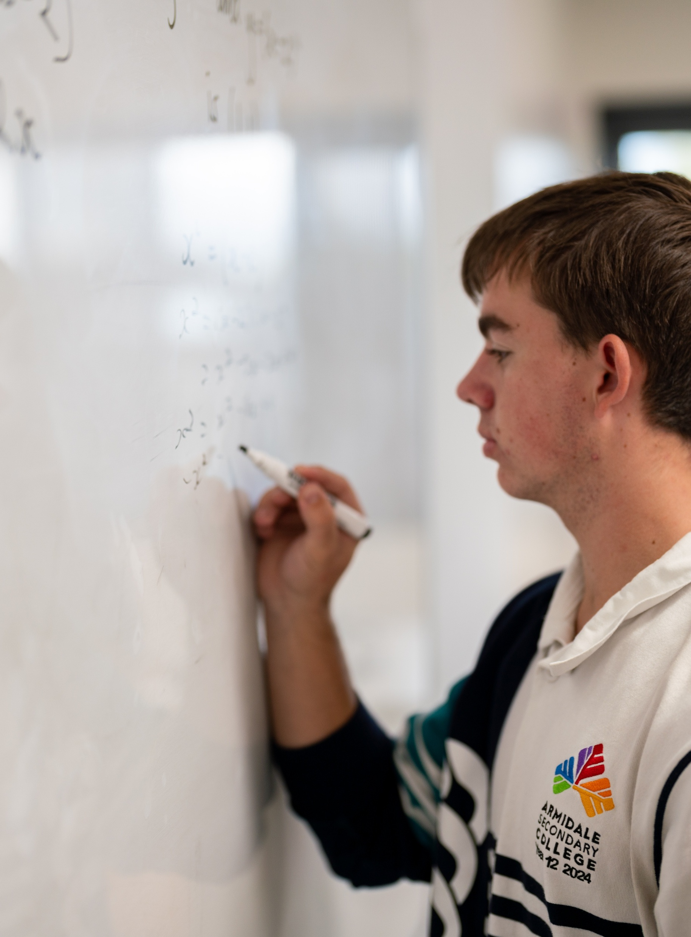

Differentiating exponential functions with base $e$
Mathematics Advanced – Stage 6 (Year 12)
Further differentiation, modelling and graphing

Slide 2
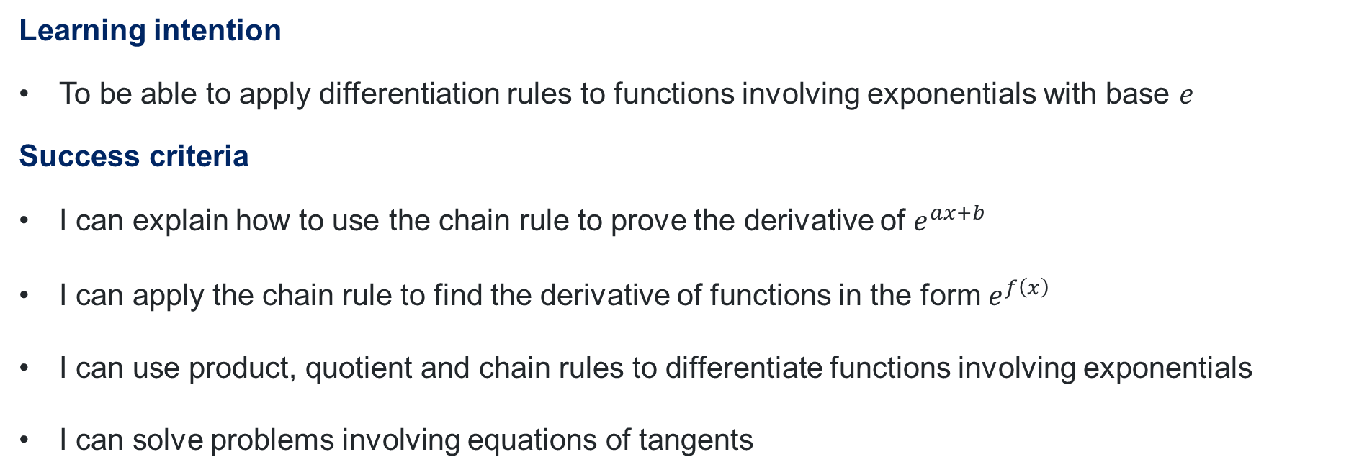
Learning intention and success criteria
Learning intention
To be able to apply differentiation rules to functions involving exponentials with base $e$
Success criteria
I can explain how to use the chain rule to prove the derivative of $e^{ax+b}$
I can apply the chain rule to find the derivative of functions in the form $e^{f\left(x\right)}$
I can use product, quotient and chain rules to differentiate functions involving exponentials
I can solve problems involving equations of tangents

Slide 3
Activating prior knowledge

Slide 4
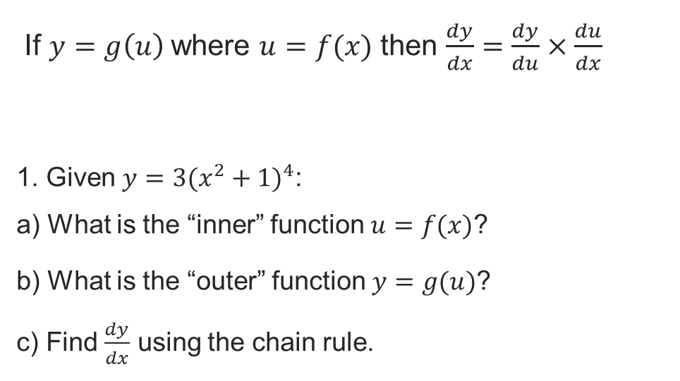
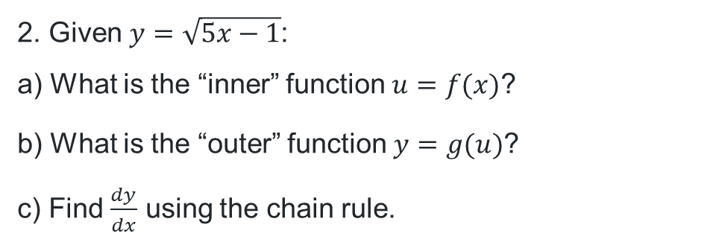


Chain rule for differentiation
If $y=g\left(u\right)$where $u=f(x)$ then $\frac{dy}{dx}=\frac{dy}{du}×\frac{du}{dx}$
  1. Given $y=3(x^{2}+1)^{4}$:
  a) What is the “inner” function $u=f(x)$?
  b) What is the “outer” function $y=g(u)$?
  c) Find $\frac{dy}{dx}$ using the chain rule.
  a) $u=x^{2}+1$
  b) $y=3u^{4}$
  c) $\frac{dy}{dx}=24x{\left(x^{2}+1\right)}^{3}$
  2. Given $y=\sqrt{5x−1}$:
  a) What is the “inner” function $u=f(x)$?
  b) What is the “outer” function $y=g(u)$?
  c) Find $\frac{dy}{dx}$ using the chain rule.
  a) $u=5x−1$
  b) $y=\sqrt{u}$
  c) $\frac{dy}{dx}=\frac{5}{2\sqrt{5x−1}}$

Slide 5
Connecting learning

Slide 6
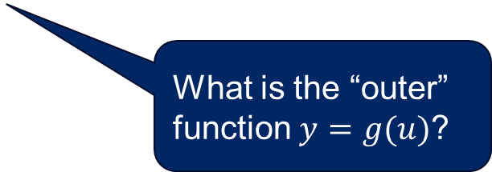
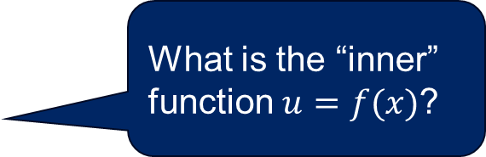

Chain rule (1)
  What is the “inner” function $u=f(x)$?
Differentiate $y=e^{3x}$ using the chain rule.
$$Let u=3x, \frac{du}{dx}=3 \\ y=e^{u}, \frac{dy}{du}=e^{u} \\ \frac{dy}{dx}=\frac{dy}{du}×\frac{du}{dx} \\ =e^{u}×3 \\ =3e^{u} \\ =3e^{3x}$$
  What is the “outer” function $y=g(u)$?

Slide 7

Chain rule (2)
Differentiate the following:
$y=e^{\left(\frac{1}{2}x\right)}$
$y=e^{−5x}$
$y=4e^{2x}$
$y=2e^{\left(\frac{1}{2}x\right)}$
$y=3e^{−5x}$
$y=e^{3x+2}$
$y=e^{\left(2−\frac{1}{2}x\right)}$

Slide 8
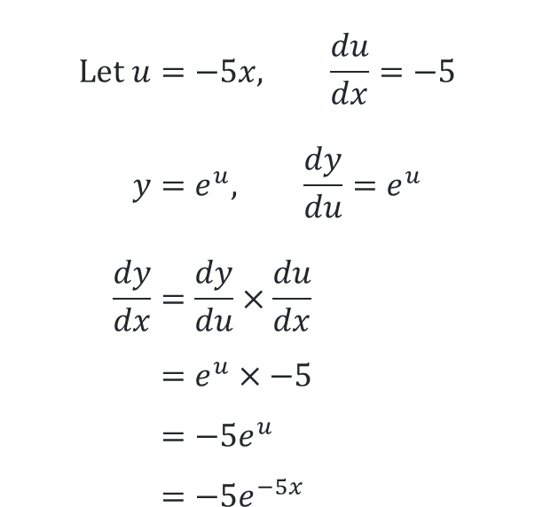
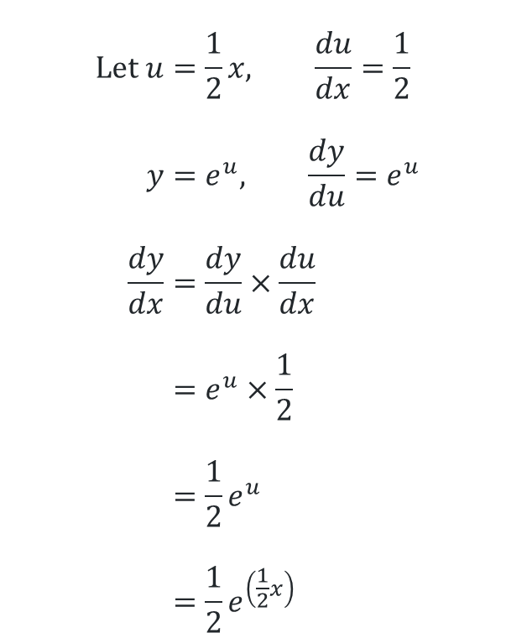
Chain rule – solutions (1)
Differentiate using the chain rule:
1. $y=e^{\left(\frac{1}{2}x\right)}$ 2. $y=e^{−5x}$
$$Let u=\frac{1}{2}x, \frac{du}{dx}=\frac{1}{2} \\ y=e^{u}, \frac{dy}{du}=e^{u} \\ \frac{dy}{dx}=\frac{dy}{du}×\frac{du}{dx} \\ =e^{u}×\frac{1}{2} \\ =\frac{1}{2}e^{u} \\ =\frac{1}{2}e^{\left(\frac{1}{2}x\right)}$$
$$Let u=−5x, \frac{du}{dx}=−5 \\ y=e^{u}, \frac{dy}{du}=e^{u} \\ \frac{dy}{dx}=\frac{dy}{du}×\frac{du}{dx} \\ =e^{u}×−5 \\ =−5e^{u} \\ =−5e^{−5x}$$

Slide 9
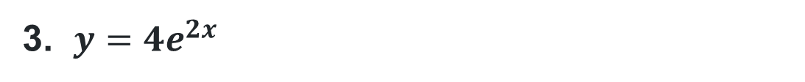

Chain rule – solutions (2)
3. $y=4e^{2x}$
$$Let u=2x, \frac{du}{dx}=2 \\ y=4e^{u}, \frac{dy}{du}=4×\frac{d}{du}e^{u}=4e^{u} \\ \frac{dy}{dx}=\frac{dy}{du}×\frac{du}{dx} \\ =4e^{u}×2 \\ =8e^{u} \\ =8e^{2x}$$

Slide 10
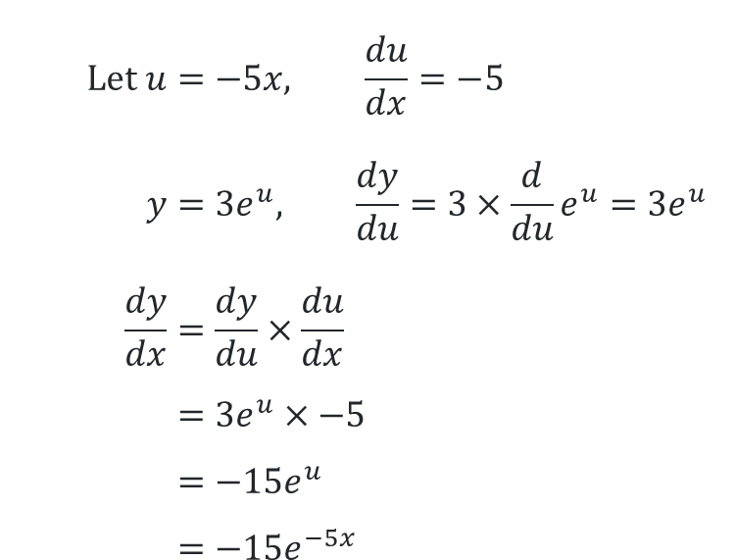
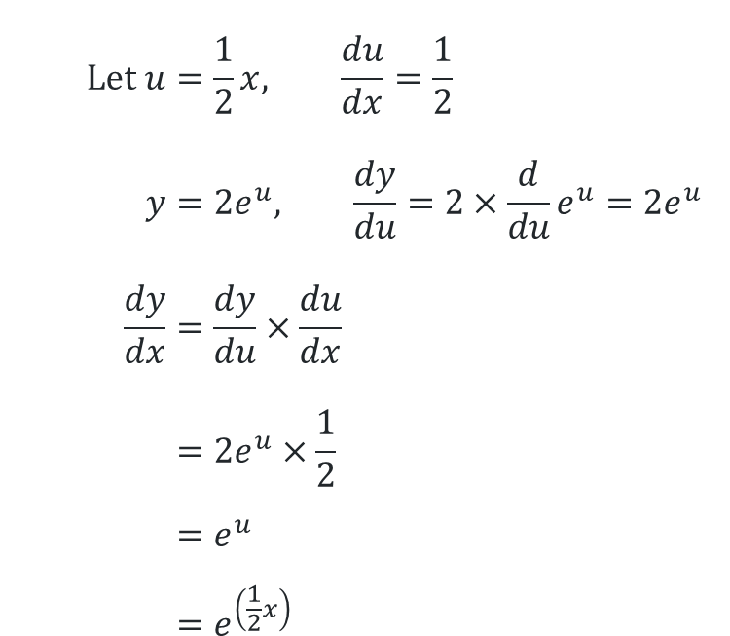
Chain rule – solutions (3)
Differentiate using the chain rule:
4. $y=2e^{\left(\frac{1}{2}x\right)}$ 5. $y=3e^{−5x}$
$$Let u=\frac{1}{2}x, \frac{du}{dx}=\frac{1}{2} \\ y=2e^{u}, \frac{dy}{du}=2×\frac{d}{du}e^{u}=2e^{u} \\ \frac{dy}{dx}=\frac{dy}{du}×\frac{du}{dx} \\ =2e^{u}×\frac{1}{2} \\ =e^{u} \\ =e^{\left(\frac{1}{2}x\right)}$$
$$Let u=−5x, \frac{du}{dx}=−5 \\ y=3e^{u}, \frac{dy}{du}=3×\frac{d}{du}e^{u}=3e^{u} \\ \frac{dy}{dx}=\frac{dy}{du}×\frac{du}{dx} \\ =3e^{u}×−5 \\ =−15e^{u} \\ =−15e^{−5x}$$

Slide 11

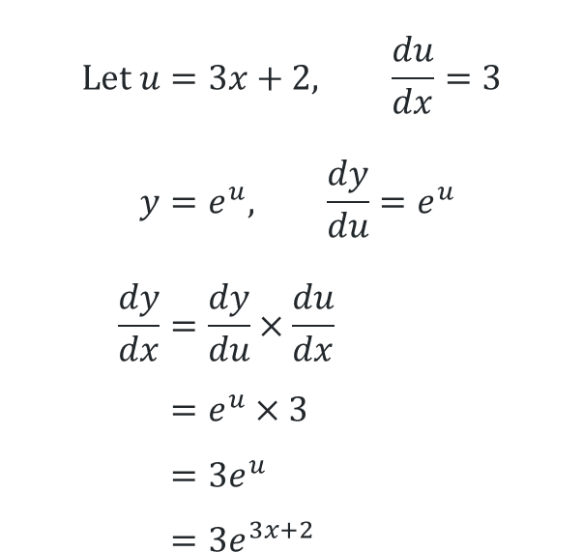
Chain rule – solutions (4)
Differentiate using the chain rule:
6. $y=e^{3x+2}$ 7. $y=e^{\left(2−\frac{1}{2}x\right)}$
$$Let u=3x+2, \frac{du}{dx}=3 \\ y=e^{u}, \frac{dy}{du}=e^{u} \\ \frac{dy}{dx}=\frac{dy}{du}×\frac{du}{dx} \\ =e^{u}×3 \\ =3e^{u} \\ =3e^{3x+2}$$
$$Let u=2−\frac{1}{2}x, \frac{du}{dx}=−\frac{1}{2} \\ y=e^{u}, \frac{dy}{du}=e^{u} \\ \frac{dy}{dx}=\frac{dy}{du}×\frac{du}{dx} \\ =e^{u}×−\frac{1}{2} \\ =−\frac{1}{2}e^{u} \\ =−\frac{1}{2}e^{\left(2−\frac{1}{2}x\right)}$$

Slide 12

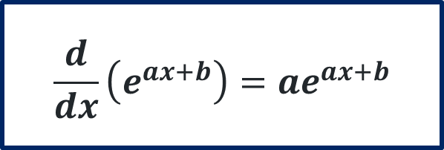
Finding $\frac{d}{dx}\left(e^{ax+b}\right)$ using the chain rule
$$Let u=ax+b, \frac{du}{dx}=a \\ y=e^{u}, \frac{dy}{du}=e^{u} \\ \frac{dy}{dx}=\frac{dy}{du}×\frac{du}{dx} \\ =e^{u}×a \\ =ae^{ax+b}$$
$$\frac{d}{dx}\left(e^{ax+b}\right)=ae^{ax+b}$$

Slide 13
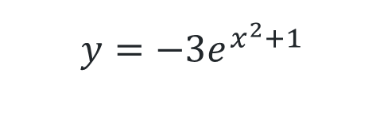
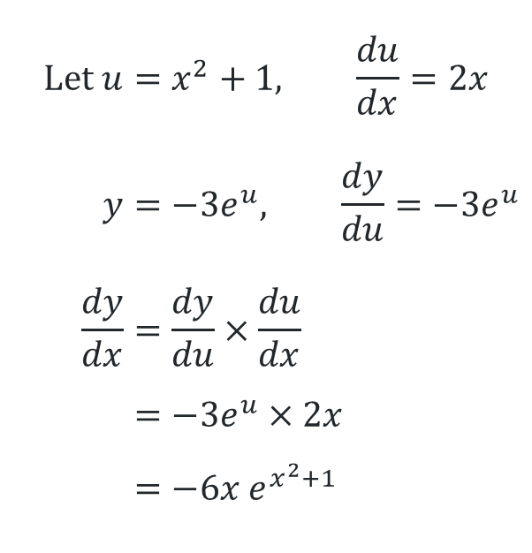
Exploring rules
$$y={−3e}^{x^{2}+1}$$
$$Let u=x^{2}+1, \frac{du}{dx}=2x \\ y=−3e^{u}, \frac{dy}{du}=−3e^{u} \\ \frac{dy}{dx}=\frac{dy}{du}×\frac{du}{dx} \\ =−3e^{u}×2x \\ =−6x e^{x^{2}+1}$$

Slide 14
Releasing responsibility

Slide 15
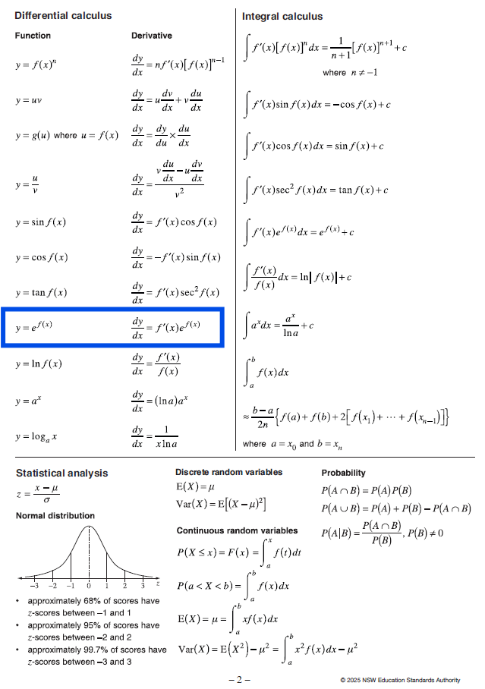
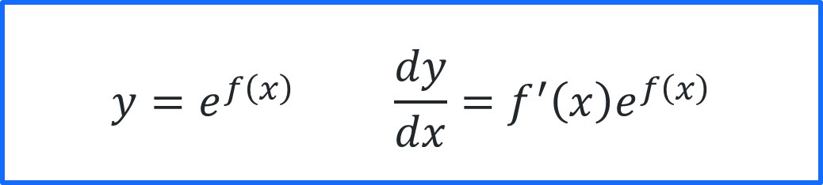
Reference sheet
$$y=e^{f\left(x\right)} \frac{dy}{dx}=f^{′}\left(x\right)e^{f\left(x\right)}$$

Slide 16
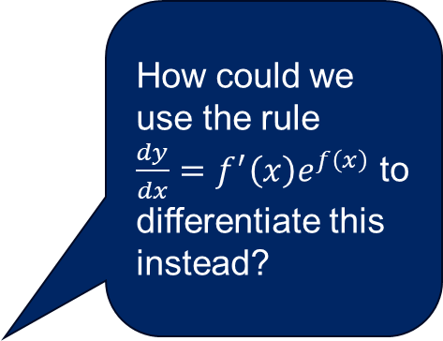
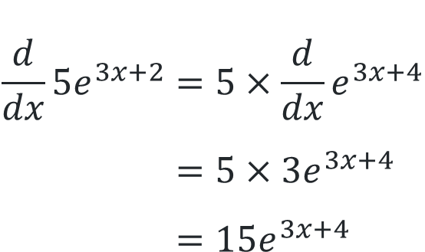
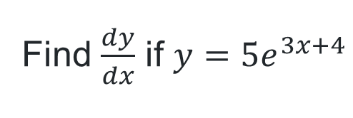
Differentiating using rules (1)
How could we use the rule
$\frac{dy}{dx}=f^{′}\left(x\right)e^{f\left(x\right)}$ to differentiate this instead?
Worked example
Find $\frac{dy}{dx}$ if $y={5e}^{3x+4}$
$$\frac{d}{dx}{5e}^{3x+2}=5×\frac{d}{dx}e^{3x+4} \\ =5×3e^{3x+4} \\ =15e^{3x+4}$$
How could we use the chain rule to differentiate this instead?
Which differentiation rules are being used?

Slide 17
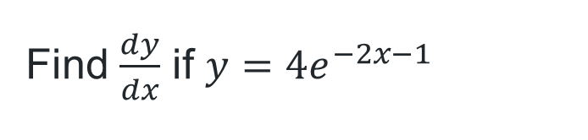

Differentiating using rules (2)
Your turn
Find $\frac{dy}{dx}$ if $y={4e}^{−2x−1}$
$$\frac{d}{dx}{4e}^{−2x−1}=4×\frac{d}{dx}e^{−2x−1} \\ =4×−2e^{−2x−1} \\ =−8e^{−2x−1}$$

Slide 18
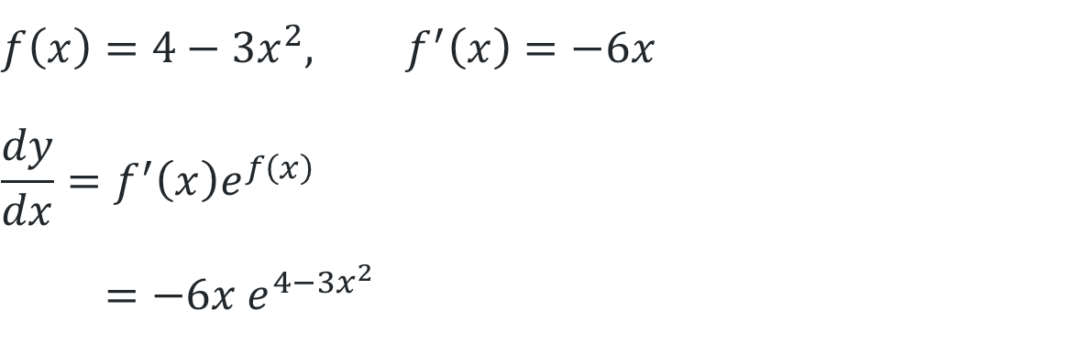

Differentiating using rules (3)
Worked example 2
Differentiate $y=e^{4−3x^{2}}$
$$f\left(x\right)=4−3x^{2}, f^{′}\left(x\right)=−6x \\ \frac{dy}{dx}=f^{′}\left(x\right)e^{f\left(x\right)} \\ =−6x e^{4−3x^{2}}$$

Slide 19
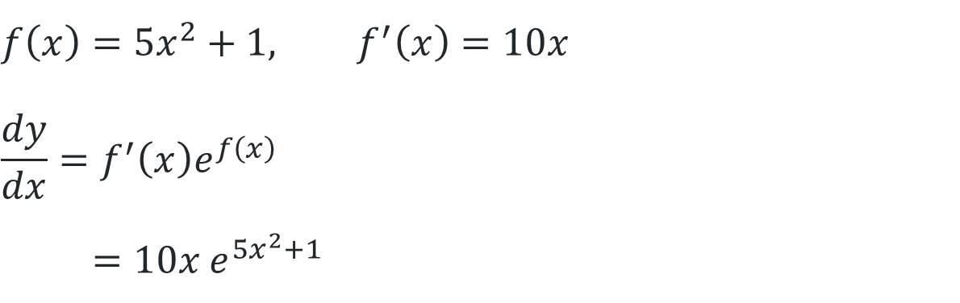

Differentiating using rules (4)
Your turn 2
Differentiate $y=e^{5x^{2}+1}$
$$f\left(x\right)=5x^{2}+1, f^{′}\left(x\right)=10x \\ \frac{dy}{dx}=f^{′}\left(x\right)e^{f\left(x\right)} \\ =10x e^{5x^{2}+1}$$

Slide 20
Independent practice

Slide 21

Approaching questions scaffold
…..

Slide 22
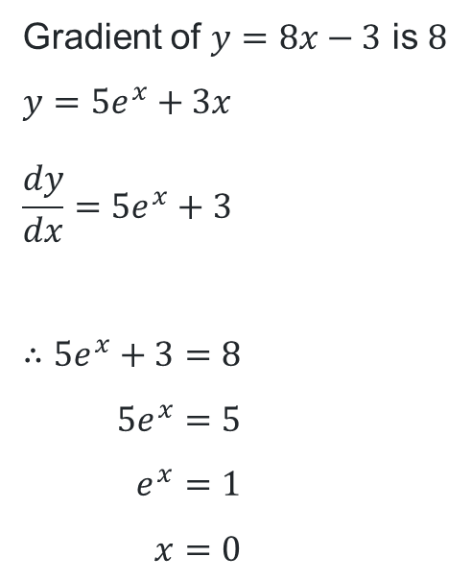
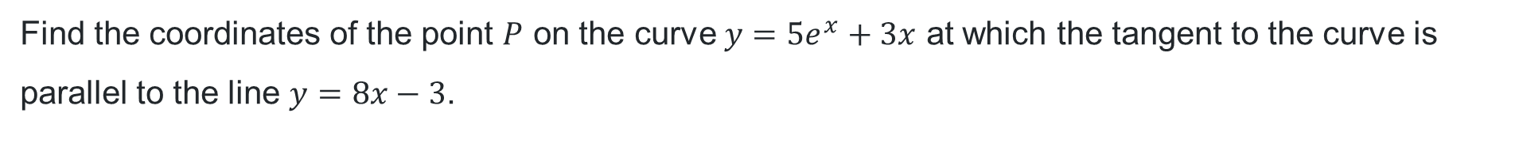
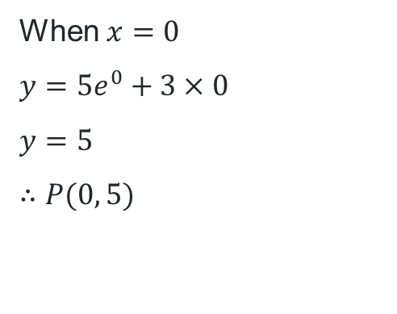
HSC-style question
Find the coordinates of the point $P$ on the curve $y=5e^{x}+3x$ at which the tangent to the curve is parallel to the line $y=8x−3$.
Can you spot any common errors that could happen?
How do we avoid them?
Gradient of $y=8x−3$ is $8$
$$y=5e^{x}+3x \\ \frac{dy}{dx}=5e^{x}+3$$
$$∴5e^{x}+3=8 \\ 5e^{x}=5 \\ e^{x}=1 \\ x=0$$
Which differentiation rules were used and why?
When $x=0$
$$y=5e^{0}+3×0$$
$y=5$
$$∴P(0, 5)$$

Slide 23
References
This presentation contains NSW Curriculum and syllabus content. The NSW Curriculum is developed by the NSW Education Standards Authority. This content is prepared by NESA for and on behalf of the Crown in the right of the State of New South Wales. The material is protected by Crown copyright.
Please refer to the NESA Copyright Disclaimer for more information https://www.nsw.gov.au/education-and-training/nesa/copyright.
NESA holds the only official and up-to-date versions of the NSW Curriculum and syllabus documents. Please visit NESA https://www.nsw.gov.au/education-and-training/nesa and NSW Curriculum https://curriculum.nsw.edu.au.
Mathematics Advanced 11-12 Syllabus © NSW Education Standards Authority (NESA) for and on behalf of the Crown in right of the State of New South Wales, 2024.

Slide 24
Copyright
© State of New South Wales (Department of Education), 2026
The copyright material published in this resource is subject to the Copyright Act 1968 (Cth) and is owned by the NSW Department of Education or, where indicated, by a party other than the NSW Department of Education (third-party material).
Copyright material available in this resource and owned by the NSW Department of Education is licensed under a Creative Commons Attribution 4.0 International (CC BY 4.0) license.
This license allows you to share and adapt the material for any purpose, even commercially.
Attribution should be given to © State of New South Wales (Department of Education), 2026.
Material in this resource not available under a Creative Commons license:
the NSW Department of Education logo, other logos and trademark-protected material
Material owned by a third party that has been reproduced with permission. You will need to obtain permission from the third party to reuse its material.
Links to third-party material and websites
Please note that the provided (reading/viewing material/list/links/texts) are a suggestion only and implies no endorsement, by the New South Wales Department of Education, of any author, publisher, or book title. School principals and teachers are best placed to assess the suitability of resources that would complement the curriculum and reflect the needs and interests of their students.
If you use the links provided in this document to access a third-party’s website, you acknowledge that the terms of use, including licence terms set out on the third-party’s website apply to the use which may be made of the materials on that third-party website or where permitted by the Copyright Act 1968 (Cth). The department accepts no responsibility for content on third-party websites.

