Slide 1
Tree diagrams and arrays
Mathematics Advanced – Year 11
Probability and data
Term 1

Slide 2
Learning intentions and success criteria
Learning Intentions
To understand how to construct tree diagrams and how they are used to calculate probabilities.
To know how to construct an array and use them to solve problems
Success Criteria
I can construct tree diagrams, including weighted probability trees, to represent possible outcomes.
I can interpret tree diagrams and arrays to determine probabilities of single and multiple events.
I can develop an array to solve probability problems.
I can justify my reasoning and apply my understanding of probability to real-world scenarios.
Notes:
Notes for teachers:
Learning intentions and success criteria are best co-constructed with students. Adapt the learning intention as required and add matching success criteria.
For more information See ⁠AITSL or the NSW Department of Education explicit teaching strategies, ⁠Sharing learning intentions and ⁠Sharing success criteria
LISC is not necessarily presented at the beginning of the lesson. Teacher needs to consider most effectual time to introduce
LISC should be revisited during the lesson to support students' evaluation of their learning

Slide 3
Activating prior knowledge

Slide 4
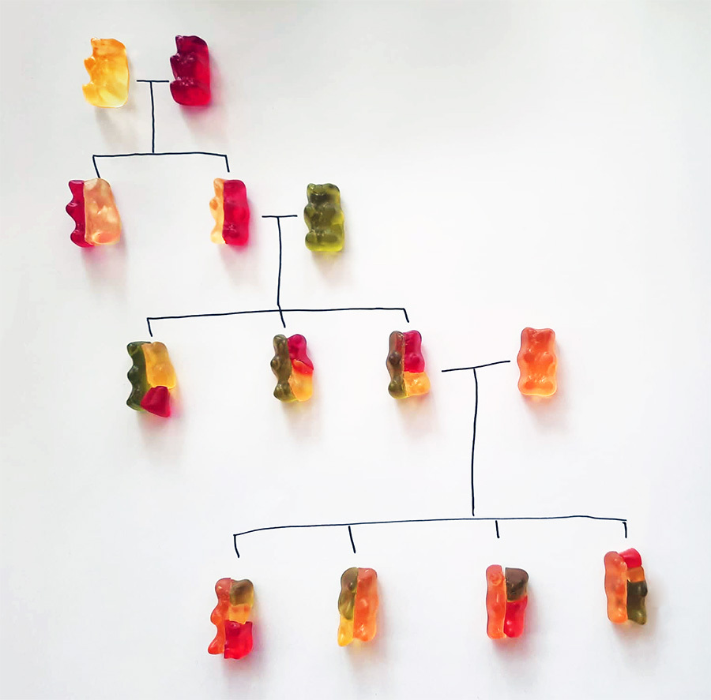
What do you notice and wonder?
Gummy Bear Genetic Table" from ScienceAlert. Image used under the Creative Commons License.

Slide 5
Simplified genetics model (1)
Worked example
Brown eyes (B) are dominant over blue eyes (b), which means that a person with one B and one b allele (genotype Bb) will have brown eyes, not blue.
If one parent has brown eyes with the genotype Bb and the other parent also has brown eyes with the genotype bB.
What is the probability that their child will have blue eyes?
Note: A person inherits one allele from each parent’s genotype (BB, Bb or bb)

Slide 6
Simplified genetics model (2)
Worked example
Parent 1 – Bb, Parent 2 – bB.
What is the probability that the child has blue eyes?
Parent 2
eye colour
Child’s eye colour
sample space
Child’s eye colour
Parent 1
eye colour
What are the two possible alleles that a mother can pass to her child?
Notes:
Note this slide contains animations

Slide 7
Simplified genetics model (3)
Worked example – self-explanation prompts
Parent 1 – Bb, Parent 2 – bB.
What is the probability that the child has blue eyes?
Parent 2
eye colour
Child’s eye colour
sample space
Child’s eye colour
Parent 1
eye colour
B
What are the two possible alleles that a Parent 2 can pass to her child?
b
Notes:
Note this slide contains animations

Slide 8
Simplified genetics model (4)
Worked example – self-explanation prompts
Parent 1 – Bb, Parent 2 – bB.
What is the probability that the child has blue eyes?
Parent 2
eye colour
Child’s eye colour
sample space
Parent 1
eye colour
B
BB
B
b
Bb
Does the order of inheritance matter? (Bb vs bB)? Why or why not?
B
bB
b
b
bb
Notes:
Note this slide contains animations

Slide 9
Simplified genetics model (5)
Worked example
Parent 1 – Bb, Parent 2 – bB.
What is the probability that the child has blue eyes?
Parent 2
eye colour
Child’s eye colour
sample space
Child’s eye colour
Parent 1
eye colour
B
Brown
BB
B
b
Bb
Brown
B
bB
Brown
b
b
bb
blue
Notes:
Note this slide contains animations

Slide 10
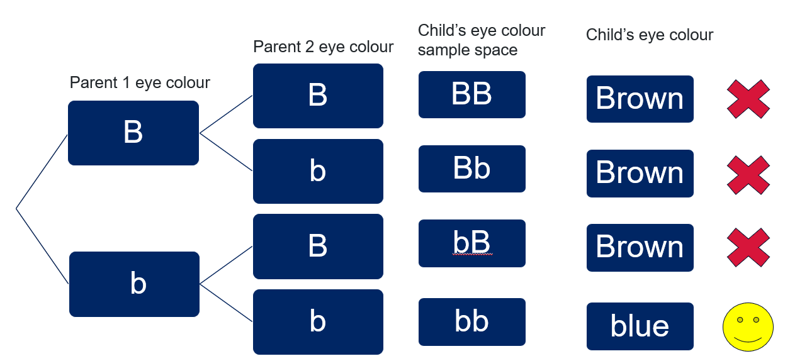
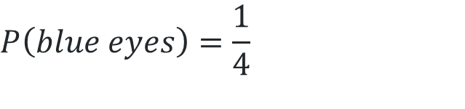
Simplified genetics model (6)
Worked example
If one parent has brown eyes with the genotype Bb and the other parent also has brown eyes with the genotype bB.
What is the probability that their child will have blue eyes?
(Brown = B and blue = b)
$$P\left(blue eyes\right)=\frac{1}{4}$$

Slide 11
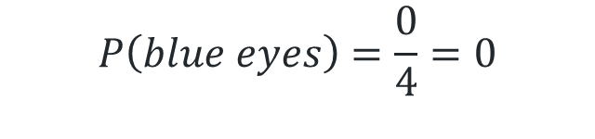
Simplified genetics model (7)
Your turn
If one parent has brown eyes with the allele BB and the other parent also has brown eyes with the allele bB, what is the probability their child will have blue eyes?
$$P\left(blue eyes\right)=\frac{0}{4}=0$$

Slide 12
Connecting learning

Slide 13


Tree diagram (1)
With replacement
Analyse the bag of tennis balls.
A ball is randomly drawn from the bag, its colour is recorded, and then it is replaced.
Another ball is then drawn.
Calculate:
$P\left(Both balls drawn are red\right)$
$P\left(blue then green\right)$
$P\left(blue and green\right)$
What do we know?
What we need to know?
Total number of tennis balls.
Tennis balls are being replaced.
The probability of drawing each colour on a single draw.
How to calculate with two events
Notes:
Use the arrows to navigate between related activities.
Hyperlink each arrow to compare between related slides.

Slide 14
Tree diagram (2)
With replacement
$P\left(Both balls drawn are red\right), P\left(blue then green\right)$,$P\left(blue and green\right)$
What are the outcomes of each event?
What will the sample space be?
Notes:
Use the arrows to navigate between related activities.
Hyperlink each arrow to compare between related slides.

Slide 15
Tree diagram (3)
With replacement
$P\left(Both balls drawn are red\right), P\left(blue then green\right)$,$P\left(blue and green\right)$
G
G
G
Do each of the outcomes in the sample space have equal probability? Why/why not?
R
G
R
B
G
B
G
G
R
G
R
R
R
R
B
R
B
B
How can we notate the different probabilities for each outcome?
G
B
G
R
B
R
B
B
B
Notes:
Use the arrows to navigate between related activities.
Hyperlink each arrow to compare between related slides.

Slide 16











Tree diagram (4)
With replacement
$P\left(Both balls drawn are red\right), P\left(blue then green\right)$,$P\left(blue and green\right)$
G
G
G
$$\frac{2}{10}$$
R
G
R
$$\frac{5}{10}$$
$$\frac{3}{10}$$
B
G
B
$$\frac{2}{10}$$
G
$$\frac{2}{10}$$
G
R
G
$$\frac{5}{10}$$
R
$$\frac{5}{10}$$
R
R
R
$$\frac{3}{10}$$
B
R
B
$$\frac{2}{10}$$
$$\frac{3}{10}$$
B
G
B
G
$$\frac{5}{10}$$
R
B
R
$$\frac{3}{10}$$
B
B
B
Notes:
Use the arrows to navigate between related activities.
Hyperlink each arrow to compare between related slides.

Slide 17










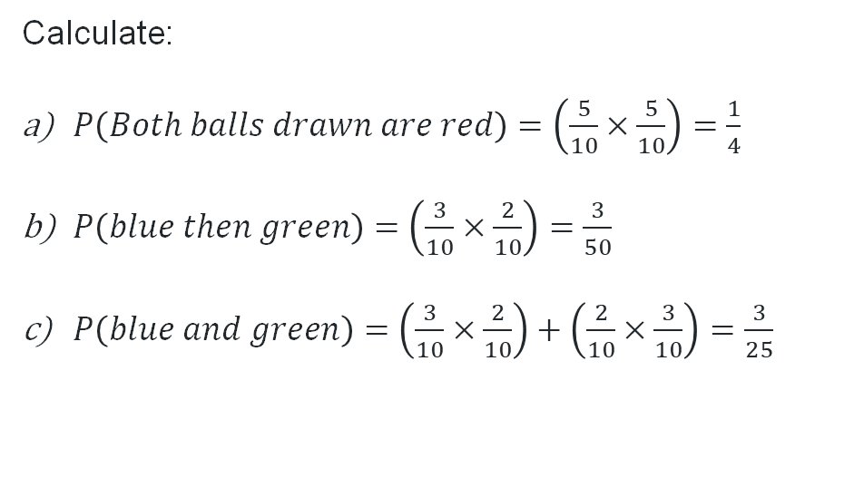
Tree diagram (5)
With replacement
Why have these fractions been multiplied?
G
G
G
$$\frac{2}{10}$$
R
G
R
$$\frac{5}{10}$$
Calculate:
$P\left(Both balls drawn are red\right)=\left(\frac{5}{10}×\frac{5}{10}\right)=\frac{1}{4}$
$P\left(blue then green\right)=\left(\frac{3}{10}×\frac{2}{10}\right)=\frac{3}{50}$
$P\left(blue and green\right)=\left(\frac{3}{10}×\frac{2}{10}\right)+\left(\frac{2}{10}×\frac{3}{10}\right)=\frac{3}{25}$
$$\frac{3}{10}$$
B
G
B
$$\frac{2}{10}$$
G
$$\frac{2}{10}$$
G
R
G
$$\frac{5}{10}$$
R
$$\frac{5}{10}$$
R
R
R
$$\frac{3}{10}$$
B
R
B
$$\frac{2}{10}$$
$$\frac{3}{10}$$
B
G
B
G
$$\frac{5}{10}$$
R
B
R
$$\frac{3}{10}$$
Why are these expressions added?
B
B
B
Notes:
Use the arrows to navigate between related activities.
Hyperlink each arrow to compare between related slides.

Slide 18
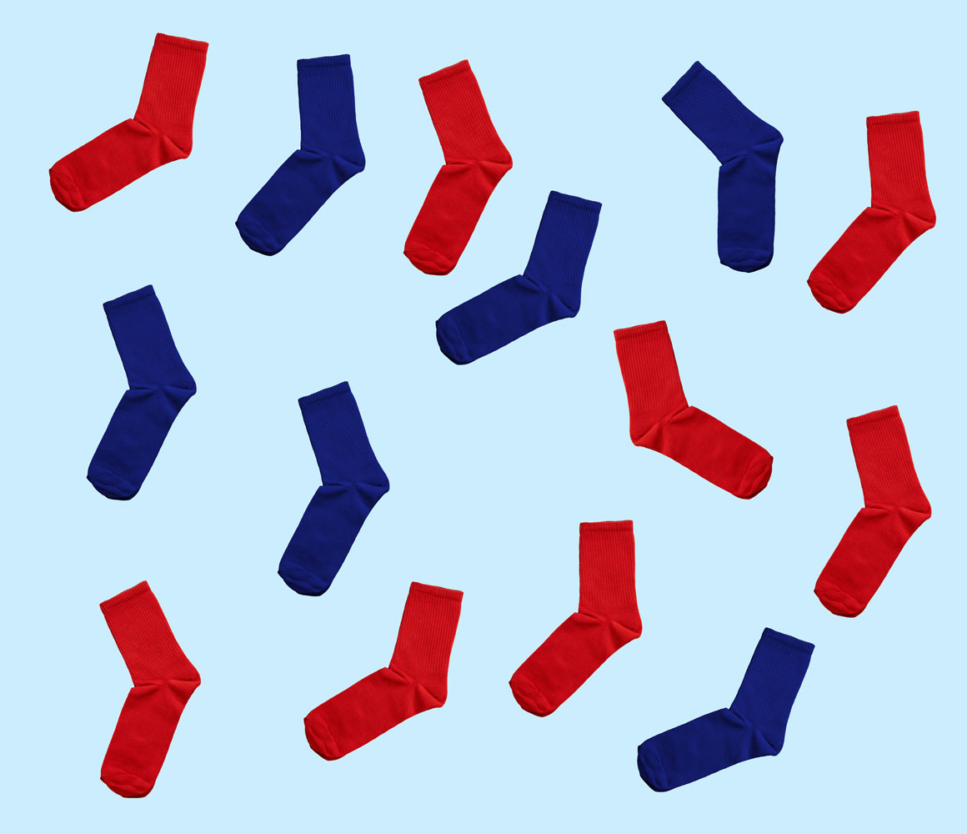
Tree diagram (6)
Without replacement
George owns two types of socks: red and blue.
In his drawer, there are 8 red socks and 6 blue socks, all unpaired.
If George randomly selects two socks, calculate the probability that he will select a perfect pair (two socks of the same colour).
Notes:
Use the arrows to navigate between related activities.
Hyperlink each arrow to compare between related slides.

Slide 19
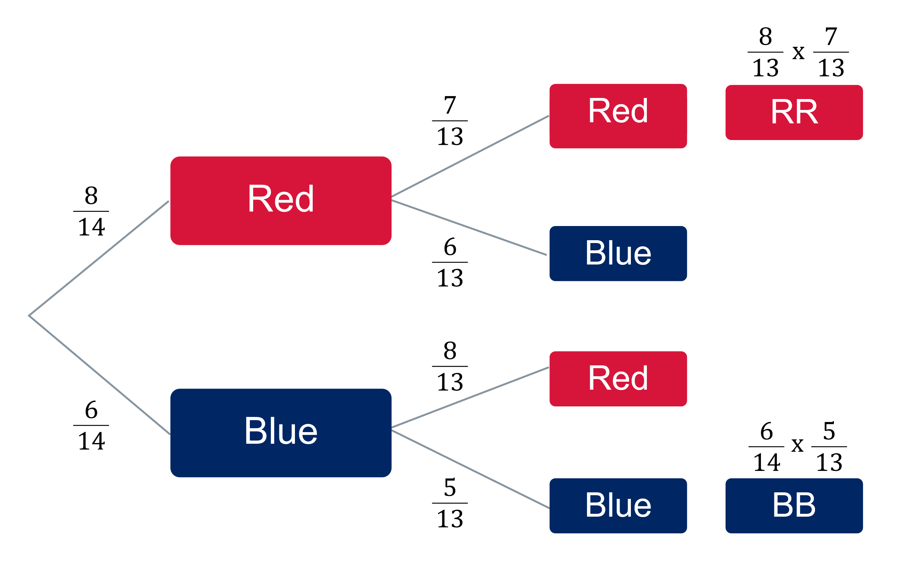
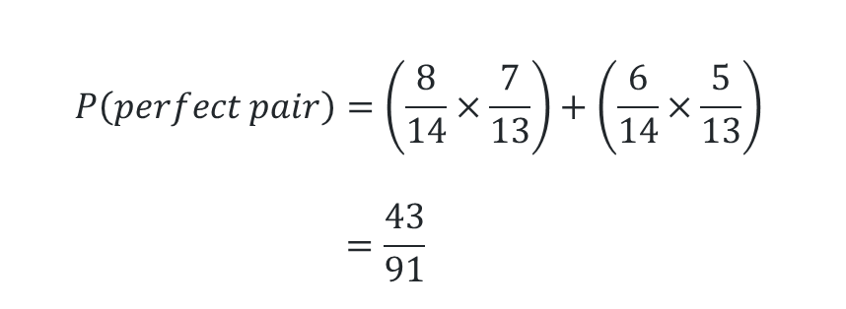
Tree diagram (7)
Without replacement
8 red, 6 blue socks, select two socks. What is the probability of selecting a perfect pair?
Why has the denominator changed?
$$P\left(perfect pair\right)=\left(\frac{8}{14}×\frac{7}{13}\right)+\left(\frac{6}{14}×\frac{5}{13}\right) \\ =\frac{43}{91}$$
Notes:
Use the arrows to navigate between related activities.
Hyperlink each arrow to compare between related slides.

Slide 20
Releasing responsibility

Slide 21
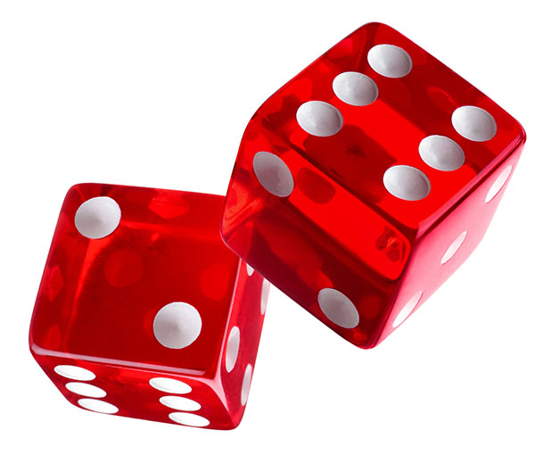
Dice Battle (1)
Rules of the game
Roll two dice and find the sum of the two results
Student A wins if the sum is 5, 6, 7, 8 or 9
Student B wins if the sum is 2, 3, 4, 10, 11 or 12
First to 5 wins
Notes:
Use the arrows to navigate between related activities.
Hyperlink each arrow to compare between related slides.

Slide 22
Dice Battle (2)
The array
Rules of the game
Roll two dice and find the sum of the two results
Student A wins if the sum is 5, 6, 7, 8 or 9
Student B wins if the sum is 2, 3, 4, 10, 11 or 12
First to 5 wins
+ | 1 | 2 | 3 | 4 | 5 | 6
1 | 2 | 3 | 4 | 5 | 6 | 7
2 | 3 | 4 | 5 | 6 | 7 | 8
3 | 4 | 5 | 6 | 7 | 8 | 9
4 | 5 | 6 | 7 | 8 | 9 | 10
5 | 6 | 7 | 8 | 9 | 10 | 11
6 | 7 | 8 | 9 | 10 | 11 | 12
Notes:
Use the arrows to navigate between related activities.
Hyperlink each arrow to compare between related slides.

Slide 23
Independent practice

Slide 24

Approaching questions
The approaching questions scaffold
Notes:
Use the arrows to navigate between related activities.
Hyperlink each arrow to compare between related slides.

Slide 25
Will the Dorking Wanders remain in the competition? (1)
In soccer, a team will receive 3 points for winning a match, 1 point for a draw and 0 points if they lose.
If a team ends the season ranked among the lowest three, they are moved down to a lower-level competition for the next season.
The Dorking Wanderers play 46 games in a season.
Currently, the Dorking Wanderers have won 12 games, drawn 8 and lost 24.
To not be ranked among the lowest three teams, they need to end the season with at least 48 points.
Using their current season win, lose and draw statistics, what is the probability that Dorking Wanderers will remain in the competition?
Notes:
Use the arrows to navigate between related activities.
Hyperlink each arrow to compare between related slides.

Slide 26
Will the Dorking Wanders remain in the competition? (2)
What do we know?
46 games a season
Win-Lose-Draw
What we need to know?
How to avoid relegation
Dorking’s current points
Points required
Number of remaining games
Probability of achieving the necessary points
Notes:
Use the arrows to navigate between related activities.
Hyperlink each arrow to compare between related slides.

Slide 27
Will the Dorking Wanders remain in the competition? (3)
W
What are the possible outcomes for the 45th match?
D
L

Slide 28
Will the Dorking Wanders remain in the competition? (4)
W
WW
W
D
WD
L
WL
W
DW
What are the possible outcomes for the final match?
D
D
DD
L
DL
W
LW
L
D
LD
L
LL

Slide 29
Will the Dorking Wanders remain in the competition? (5)
W
WW
9
W
D
WD
4
L
WL
4
W
DW
4
D
D
DD
2
List the sample space and the points earned
L
DL
1
W
LW
3
L
D
LD
1
L
LL
0

Slide 30
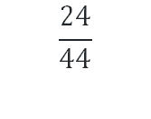
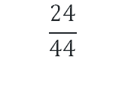

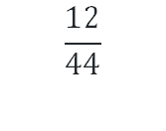
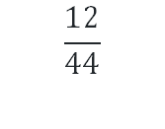
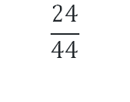
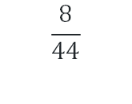

Will the Dorking Wanders remain in the competition? (6)
$$\frac{12}{44}$$
W
WW
9
W
$$\frac{8}{44}$$
D
WD
4
$$\frac{12}{44}$$
$$\frac{24}{44}$$
L
WL
4
$$\frac{12}{44}$$
W
DW
4
Are the outcomes an even chance?
$$\frac{8}{44}$$
D
$$\frac{8}{44}$$
D
DD
2
$$\frac{24}{44}$$
L
DL
1
$$\frac{24}{44}$$
$$\frac{12}{44}$$
W
LW
3
L
$$\frac{8}{44}$$
D
LD
1
$$\frac{24}{44}$$
L
LL
0

Slide 31
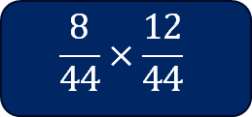
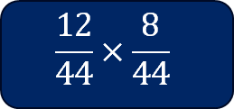
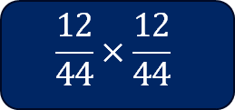
Will the Dorking Wanders remain in the competition? (7)
W
WW
9
$$\frac{12}{44}×\frac{12}{44}$$
$$\frac{12}{44}$$
W
$$\frac{8}{44}$$
D
WD
4
$$\frac{12}{44}×\frac{8}{44}$$
$$\frac{12}{44}$$
$$\frac{24}{44}$$
L
WL
$$\frac{8}{44}×\frac{12}{44}$$
$$\frac{12}{44}$$
W
DW
4
$$\frac{8}{44}$$
D
$$\frac{8}{44}$$
D
DD
$$\frac{24}{44}$$
L
DL
$$\frac{24}{44}$$
W
LW
Why have these fractions been multiplied?
$$\frac{12}{44}$$
L
$$\frac{8}{44}$$
D
LD
$$\frac{24}{44}$$
L
LL

Slide 32
Will the Dorking Wanders remain in the competition? (8)
W
WW
9
$$\frac{12}{44}×\frac{12}{44}$$
$$\frac{12}{44}$$
W
$$\frac{8}{44}$$
D
WD
4
$$\frac{12}{44}×\frac{8}{44}$$
$$\frac{12}{44}$$
$$\frac{24}{44}$$
L
WL
$$\frac{8}{44}×\frac{12}{44}$$
$$\frac{12}{44}$$
W
DW
4
$$\frac{8}{44}$$
D
$$\frac{8}{44}$$
D
DD
$$\frac{24}{44}$$
L
DL
$$\frac{24}{44}$$
$$\frac{12}{44}$$
W
LW
L
$$\frac{8}{44}$$
D
LD
$$\frac{24}{44}$$
L
LL

Slide 33
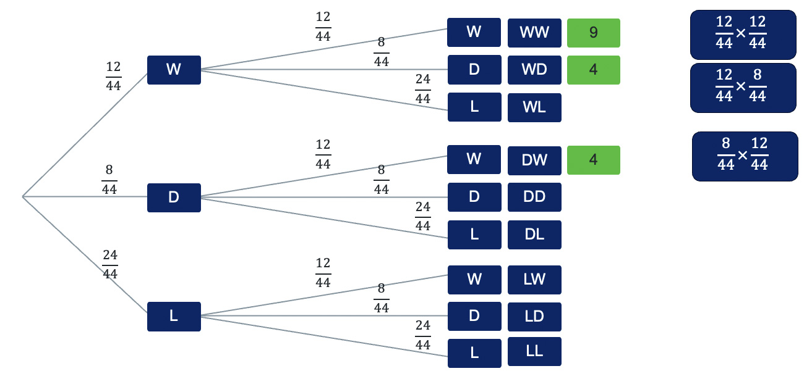
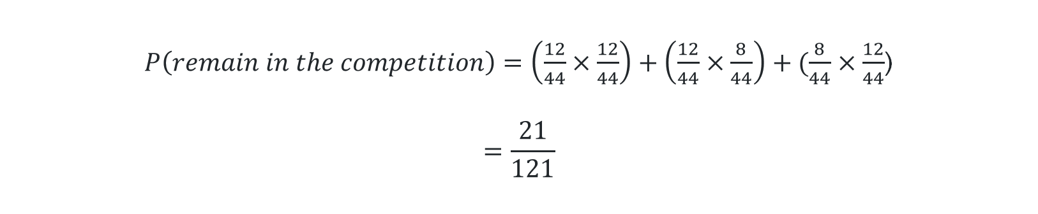
Will the Dorking Wanders remain in the competition? (9)
$P\left(remain in the competition\right)=\left(\frac{12}{44}×\frac{12}{44}\right)+\left(\frac{12}{44}×\frac{8}{44}\right)+(\frac{8}{44}×\frac{12}{44}$)
$$=\frac{21}{121}$$

Slide 34
References
This presentation contains NSW Curriculum and syllabus content. The NSW Curriculum is developed by the NSW Education Standards Authority. This content is prepared by NESA for and on behalf of the Crown in the right of the State of New South Wales. The material is protected by Crown copyright.
Please refer to the NESA Copyright Disclaimer for more information https://educationstandards.nsw.edu.au/wps/portal/nesa/mini-footer/copyright.
NESA holds the only official and up-to-date versions of the NSW Curriculum and syllabus documents. Please visit the NSW Education Standards Authority (NESA) website https://educationstandards.nsw.edu.au/wps/portal/nesa/home and the NSW Curriculum website https://curriculum.nsw.edu.au.
Mathematics Advanced 11–12 Syllabus © NSW Education Standards Authority (NESA) for and on behalf of the Crown in right of the State of New South Wales, 2024.

Slide 35
Copyright
© State of New South Wales (Department of Education), 2025
The copyright material published in this resource is subject to the Copyright Act 1968 (Cth) and is owned by the NSW Department of Education or, where indicated, by a party other than the NSW Department of Education (third-party material).
Copyright material available in this resource and owned by the NSW Department of Education is licensed under a Creative Commons Attribution 4.0 International (CC BY 4.0) license.
This license allows you to share and adapt the material for any purpose, even commercially.
Attribution should be given to © State of New South Wales (Department of Education), 2025.
Material in this resource not available under a Creative Commons license:
the NSW Department of Education logo, other logos and trademark-protected material
Material owned by a third party that has been reproduced with permission. You will need to obtain permission from the third party to reuse its material.
Links to third-party material and websites
Please note that the provided (reading/viewing material/list/links/texts) are a suggestion only and implies no endorsement, by the New South Wales Department of Education, of any author, publisher, or book title. School principals and teachers are best placed to assess the suitability of resources that would complement the curriculum and reflect the needs and interests of their students.
If you use the links provided in this document to access a third-party’s website, you acknowledge that the terms of use, including licence terms set out on the third-party’s website apply to the use which may be made of the materials on that third-party website or where permitted by the Copyright Act 1968 (Cth). The department accepts no responsibility for content on third-party websites.

