Slide 1
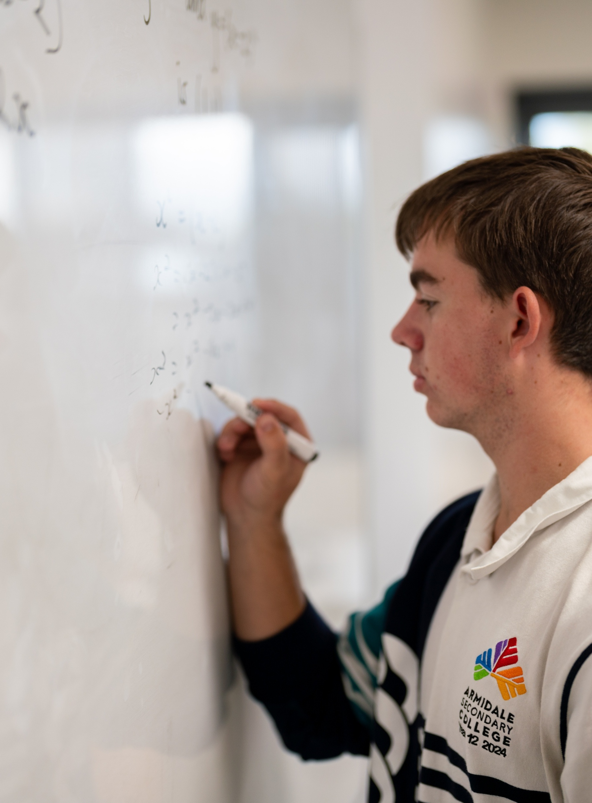
Logarithmic scales
Mathematics Advanced – Stage 6 (Year 12)
Further differentiation, modelling and graphing

Slide 2
Learning intentions and success criteria
Learning intentions
To be able to recognise when a logarithmic scale is useful to represent a variable.
To be able to apply and interpret logarithmic scales in a variety of contexts.
Success criteria
I can explain the differences between linear and logarithmic scales.
I can explain when and why a logarithmic scale is used.
I can find and plot values on a logarithmic scale.
I can interpret data shown on a logarithmic scale and draw meaningful conclusions.

Slide 3
Retreival practice

Slide 4


Retrieval questions
Complete the following questions
Calculate $\log_{10}{1000}.$
If $\log_{10}{x}=5$, what is the value of $x$?
Simplify $\log_{10}\left({10}^{2}×5\right)$
Evaluate $\log_{3}{20}$, correct to 2 decimal places.
$3$
$100 000$
$\log_{10}\left({10}^{2}\right)+\log_{10}5=2+\log_{10}{5}$
$2.73$

Slide 5
Activating prior knowledge

Slide 6
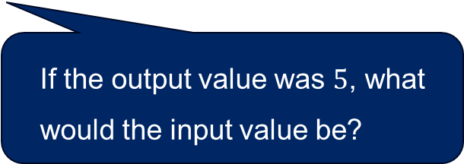
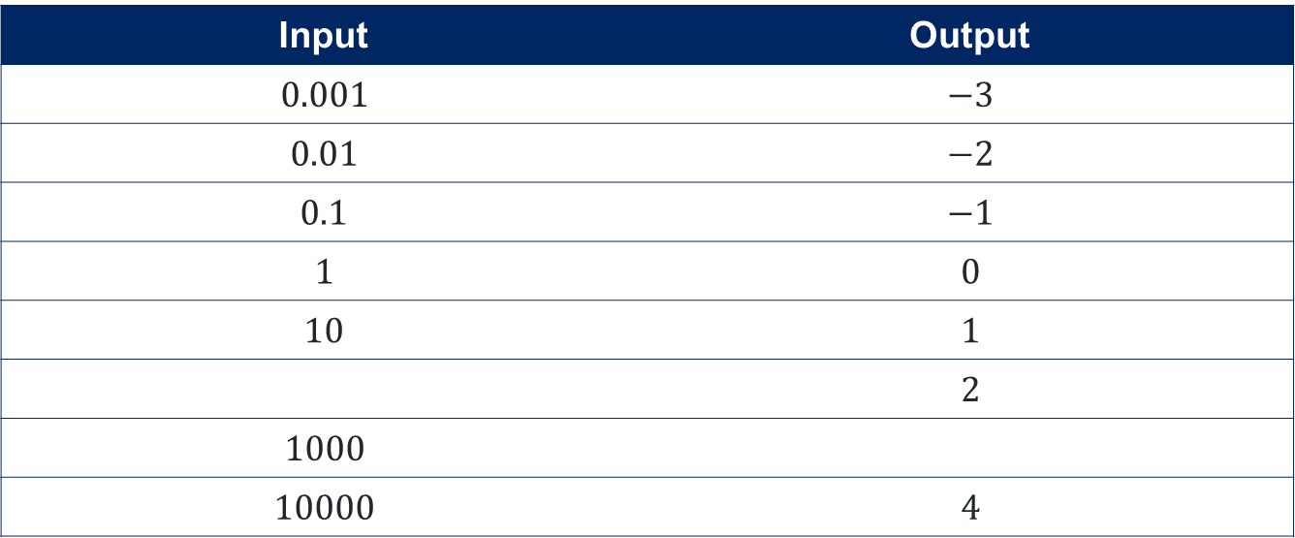


Table of values
Estimate what the output value could be if the input value was 50?
Use the pattern to complete the table of values
Input | Output
$$0.001$$ | $$−3$$
$$0.01$$ | $$−2$$
$$0.1$$ | $$−1$$
$$1$$ | $$0$$
$$10$$ | $$1$$
 | $$2$$
$$1000$$
$$10000$$ | $$4$$
$$100$$
$$3$$
If the output value was $5$, what would the input value be?

Slide 7
Connecting learning

Slide 8
Sources of sound
Rank from quietest to loudest
Rock concert
Total silence
Jet plane taking off
Breathing
Hair dryer
Normal conversation

Slide 9
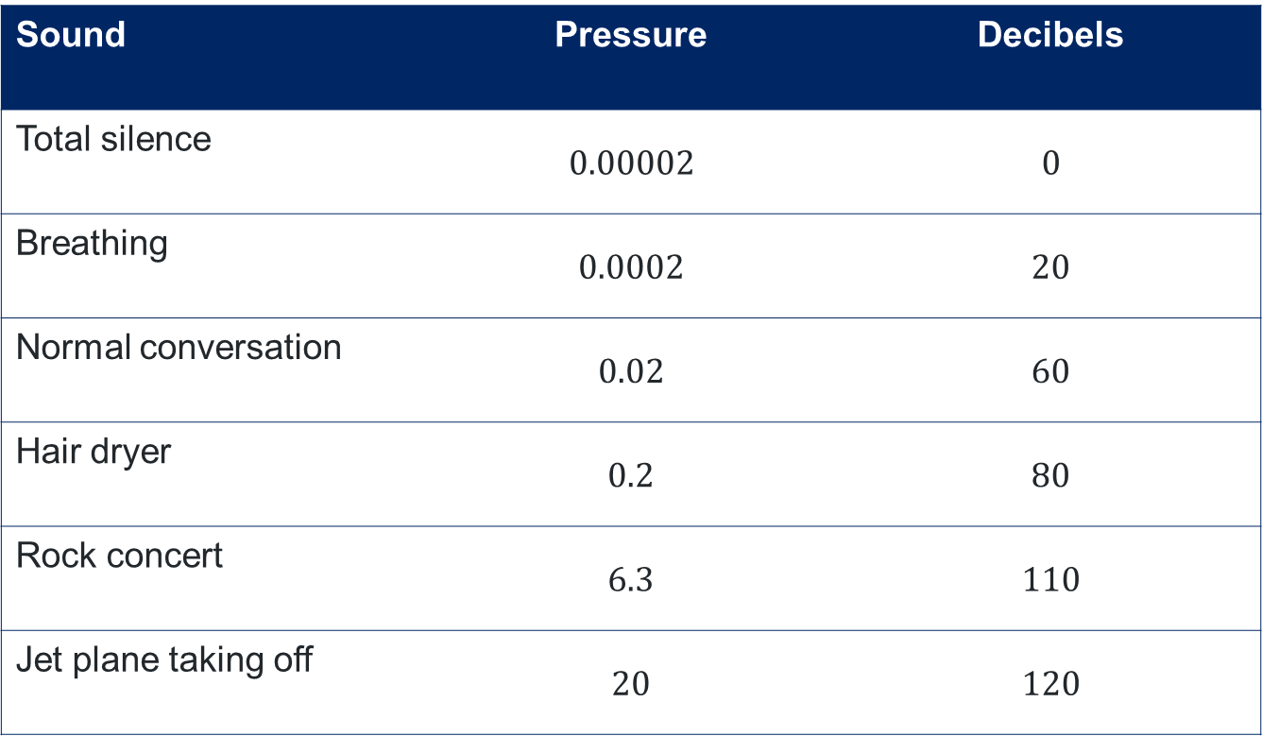
Sounds
Sound | Pressure | Decibels
Total silence | $$0.00002$$ | $$0$$
Breathing | $$0.0002$$ | $$20$$
Normal conversation | $$0.02$$ | $$60$$
Hair dryer | $$0.2$$ | $$80$$
Rock concert | $$6.3$$ | $$110$$
Jet plane taking off | $$20$$ | $$120$$

Slide 10
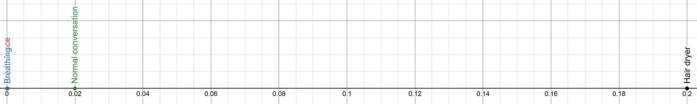
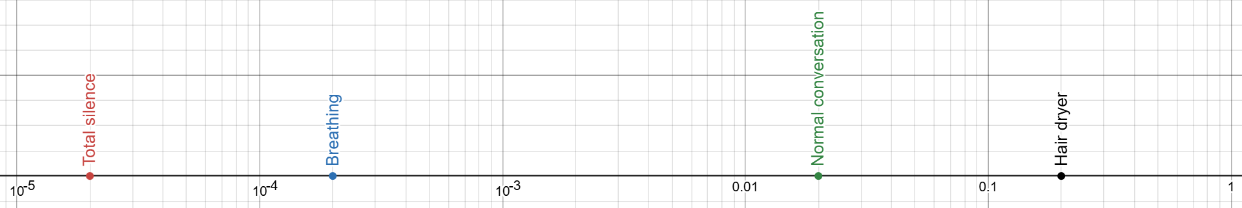
Pascal values on number lines

Slide 11
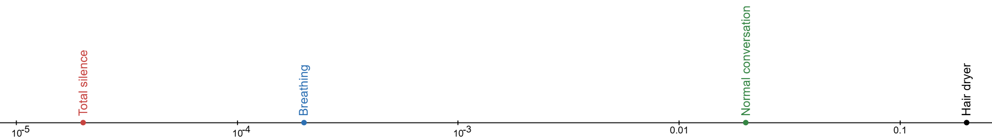
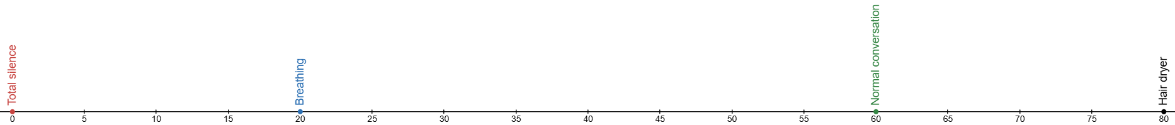
Sounds on number lines (1)
Pascals – logarithmic scale
Decibels

Slide 12
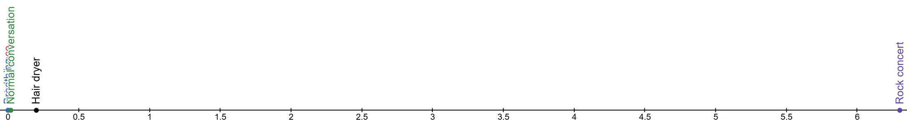
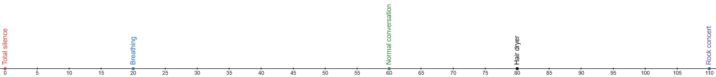
Sounds on number lines (2)
Adding rock concert
Pascals – linear scale
Decibels

Slide 13
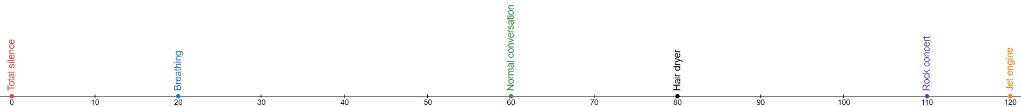



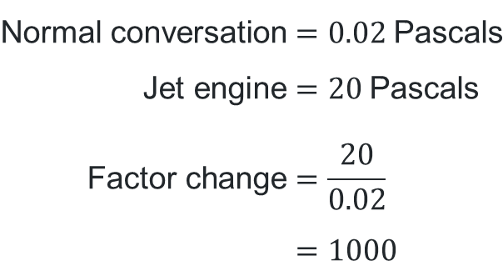
Normal conversation and jet plane
$$\text{Normal} \text{conversation}=0.02 \text{Pascals} \\ \text{Jet} \text{engine}=20 \text{Pascals} \\ \text{Factor} \text{change}=\frac{20}{0.02} \\ =1000$$
$$60 \text{dB}$$
$$×10$$ | $$×10$$ | $$×10$$
$$×10^{3}$$

Slide 14
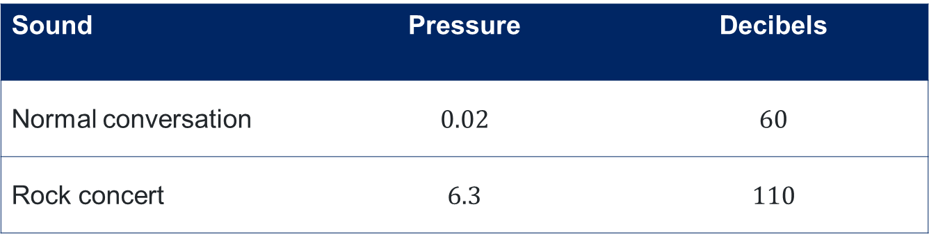
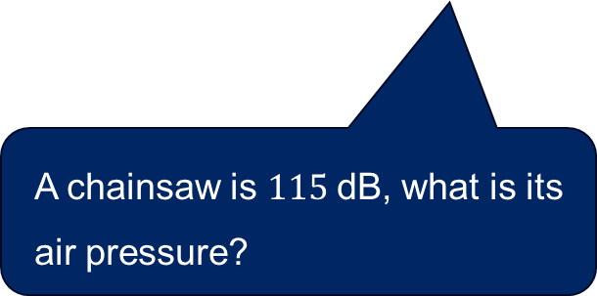
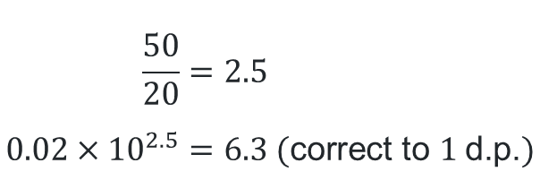

Normal conversation and rock concert
Sound | Pressure | Decibels
Normal conversation | $$0.02$$ | $$60$$
Rock concert | $$6.3$$ | $$110$$
$$50 \text{dB}$$
$$\frac{50}{20}=2.5 \\ 0.02×{10}^{2.5}=6.3 (\text{correct} \text{to} 1 \text{d}\text{.}\text{p}\text{.})$$
A chainsaw is $115 \text{dB}$, what is its air pressure?

Slide 15
Releasing responsibility

Slide 16
Logarithmic scale
A logarithmic scale is where successive endpoint values of intervals increase by a constant factor (multiplicatively). Contrast with linear scales in which the increase is a constant amount. (NESA 2024)
Some common uses are in decibels (dB) in acoustics, seismic scales for earthquakes, magnitudes of stars and the pH scale in chemistry.

Slide 17

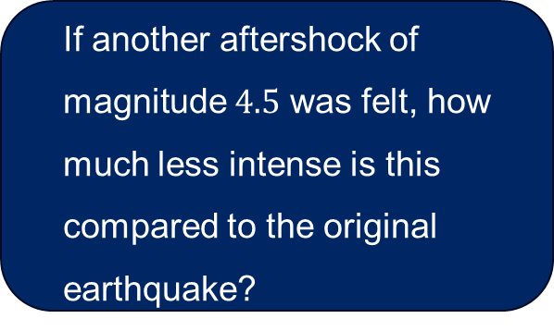
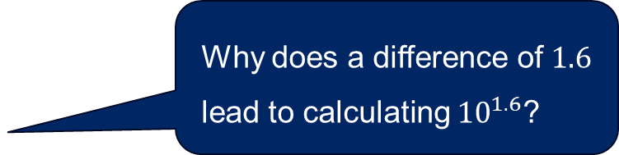
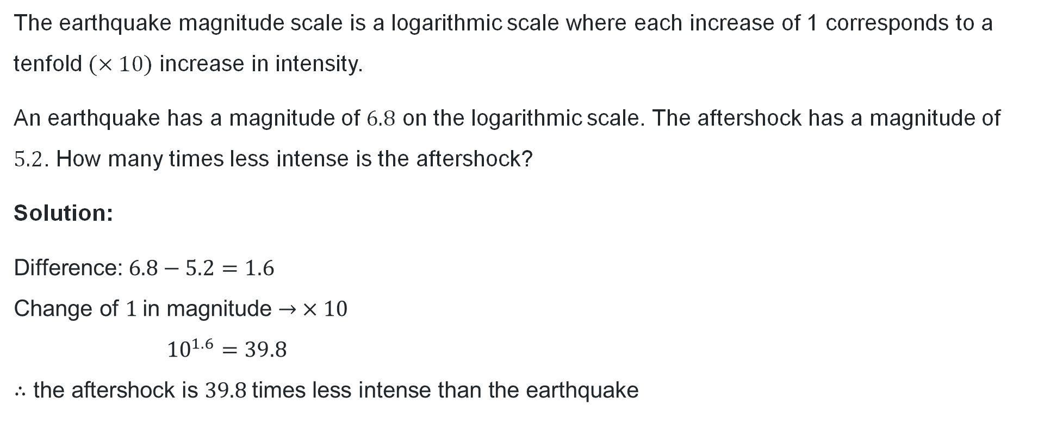
Worked example (1)
Question 1
The earthquake magnitude scale is a logarithmic scale where each increase of 1 corresponds to a tenfold $(×10)$ increase in intensity.
An earthquake has a magnitude of $6.8$ on the logarithmic scale. The aftershock has a magnitude of $5.2$. How many times less intense is the aftershock?
Solution:
$$\text{Difference}\text{:} 6.8−5.2=1.6 \\ \text{Change} \text{of} 1 \text{in} \text{magnitude}→ ×10 \\ {10}^{1.6}=39.8 \\ ∴\text{the} \text{aftershock} \text{is} 39.8 \text{times} \text{less} \text{intense} \text{than} \text{the} \text{earthquake}$$
If another aftershock of magnitude $4.5$ was felt, how much less intense is this compared to the original earthquake?
Why does a difference of $1.6$ lead to calculating ${10}^{1.6}$?
If the aftershock was $8.4$, would it change the result? Why/why not?

Slide 18
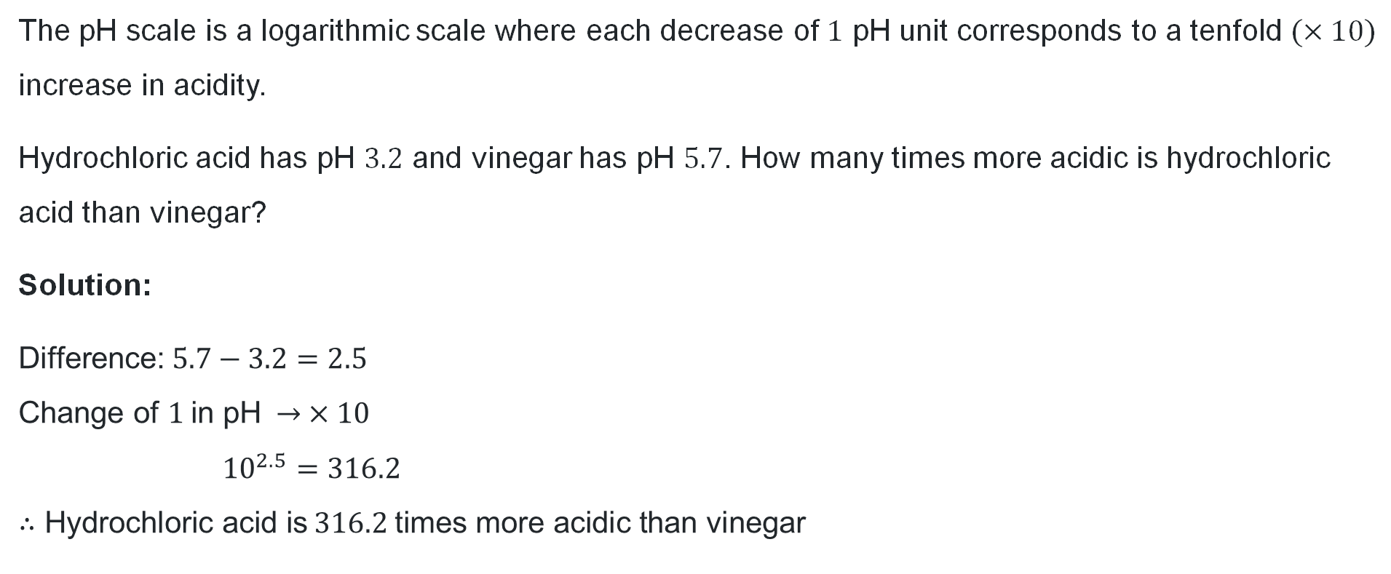
Your turn (1)
Question 2
The pH scale is a logarithmic scale where each decrease of $1$ pH unit corresponds to a tenfold $(×10)$ increase in acidity.
Hydrochloric acid has pH $3.2$ and vinegar has pH $5.7$. How many times more acidic is hydrochloric acid than vinegar?
Solution:
$$\text{Difference}\text{:} 5.7−3.2=2.5 \\ \text{Change} \text{of} 1 \text{in} \text{pH} → ×10 \\ {10}^{2.5}=316.2 \\ ∴\text{Hydrochloric} \text{acid} \text{is} 316.2 \text{times} \text{more} \text{acidic} \text{than} \text{vinegar}$$

Slide 19
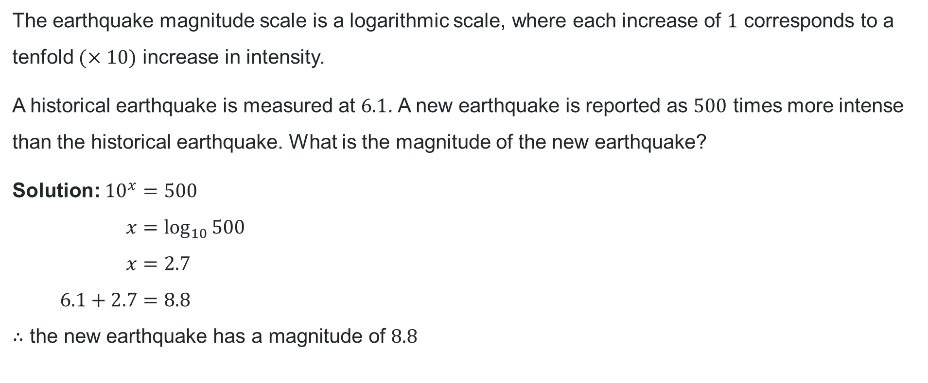
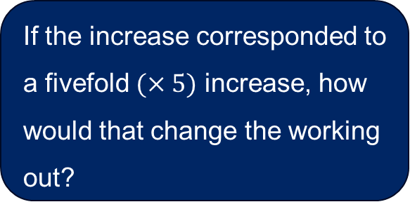
Worked example (2)
Question 3
The earthquake magnitude scale is a logarithmic scale, where each increase of $1$ corresponds to a tenfold $(×10)$ increase in intensity.
A historical earthquake is measured at $6.1$. A new earthquake is reported as $500$ times more intense than the historical earthquake. What is the magnitude of the new earthquake?
$$\text{Solution}\text{:} 10^{x}=500 \\ x=\log_{10}{500} \\ x=2.7 \\ 6.1+2.7=8.8 \\ ∴\text{the} \text{new} \text{earthquake} \text{has} \text{a} \text{magnitude} \text{of} 8.8$$
How does this relate to the logarithmic scale?
If the increase corresponded to a fivefold $(×5)$ increase, how would that change the working out?

Slide 20
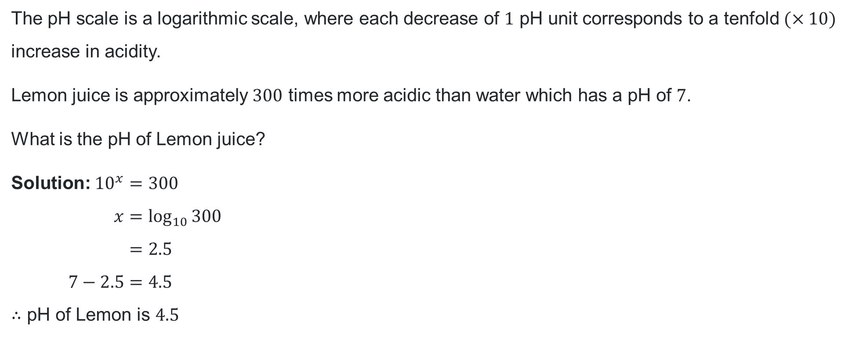
Your turn (2)
Question 4
The pH scale is a logarithmic scale, where each decrease of $1$ pH unit corresponds to a tenfold $(×10)$ increase in acidity.
Lemon juice is approximately $300$ times more acidic than water which has a pH of $7$.
What is the pH of Lemon juice?
$$\text{Solution}\text{:} {10}^{x}=300 \\ x=\log_{10}{300} \\ =2.5 \\ 7−2.5=4.5 \\ ∴\text{pH} \text{of} \text{Lemon} \text{is} 4.5$$

Slide 21
Independent practice

Slide 22
Brightness of stars
The apparent brightness of stars is measured on a logarithmic scale called magnitude. A decrease of 1 magnitude corresponds to 2.5 times the brightness with brighter stars having smaller magnitude values.
Sirius and Polaris are 2 stars visible from Earth.
Sirius has an absolute magnitude of 1.5 and Polaris has an absolute magnitude of 4.0.
How many times brighter is Sirius than Polaris? Give your answer correct to one decimal place.
Sirius is observed to be approximately 60 times brighter than another star. Determine the magnitude of this star, correct to one decimal place.

Slide 23
References
This presentation contains NSW Curriculum and syllabus content. The NSW Curriculum is developed by the NSW Education Standards Authority. This content is prepared by NESA for and on behalf of the Crown in the right of the State of New South Wales. The material is protected by Crown copyright.
Please refer to the NESA Copyright Disclaimer for more information https://www.nsw.gov.au/education-and-training/nesa/copyright.
NESA holds the only official and up-to-date versions of the NSW Curriculum and syllabus documents. Please visit NESA https://www.nsw.gov.au/education-and-training/nesa and NSW Curriculum https://curriculum.nsw.edu.au.
Mathematics Advanced 11-12 Syllabus © NSW Education Standards Authority (NESA) for and on behalf of the Crown in right of the State of New South Wales, 2024.

Slide 24
Copyright
© State of New South Wales (Department of Education), 2026
The copyright material published in this resource is subject to the Copyright Act 1968 (Cth) and is owned by the NSW Department of Education or, where indicated, by a party other than the NSW Department of Education (third-party material).
Copyright material available in this resource and owned by the NSW Department of Education is licensed under a Creative Commons Attribution 4.0 International (CC BY 4.0) license.
This license allows you to share and adapt the material for any purpose, even commercially.
Attribution should be given to © State of New South Wales (Department of Education), 2026.
Material in this resource not available under a Creative Commons license:
the NSW Department of Education logo, other logos and trademark-protected material
Material owned by a third party that has been reproduced with permission. You will need to obtain permission from the third party to reuse its material.
Links to third-party material and websites
Please note that the provided (reading/viewing material/list/links/texts) are a suggestion only and implies no endorsement, by the New South Wales Department of Education, of any author, publisher, or book title. School principals and teachers are best placed to assess the suitability of resources that would complement the curriculum and reflect the needs and interests of their students.
If you use the links provided in this document to access a third-party’s website, you acknowledge that the terms of use, including licence terms set out on the third-party’s website apply to the use which may be made of the materials on that third-party website or where permitted by the Copyright Act 1968 (Cth). The department accepts no responsibility for content on third-party websites.

