Slide 1
Intersections and unions
Mathematics Advanced – Year 11
Probability and data

Slide 2
Learning intentions and success criteria
Learning intentions
To know how to represent sets using Venn diagrams.
To understand how to interpret intersections, unions and disjoint sets
Success criteria
I can construct Venn diagrams.
I can interpret Venn diagrams and use them to make informed decisions.
I can use set notation to describe relationships between sets, including the notation for intersections, unions and disjoint sets.
I can apply my understanding of unions and intersections to solve problems.
Notes:
Notes for teachers:
Learning intentions and success criteria are best co-constructed with students. Adapt the learning intention as required and add matching success criteria.
For more information See ⁠AITSL or the NSW Department of Education explicit teaching strategies, ⁠Sharing learning intentions and ⁠Sharing success criteria
LISC is not necessarily presented at the beginning of the lesson. Teacher needs to consider most effectual time to introduce
LISC should be revisited during the lesson to support students' evaluation of their learning

Slide 3
Activating prior knowledge

Slide 4

Set notation review
Set notation
Consider the universal set, $U=\left\{1, 2, 3, 4, 5, 6, 7, 8, 9, 10\right\}.$
Let $A$ and $B$ be subsets of $U$.
List the elements of $A$ and the elements of$B$, if $A$ is defined as factors of 12 and $B$ is defined as factors 20.
Solution:
$A=\{1, 2, 3, 4, 6\}$
$$B=\{1, 2, 4, 5, 10\}$$

Slide 5
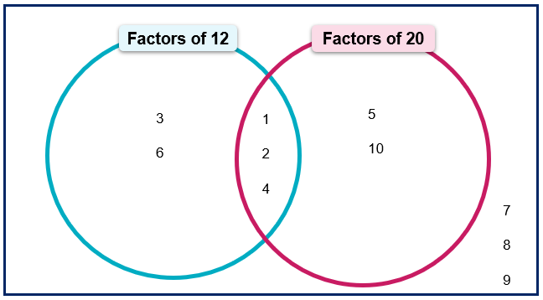
Venn diagram
Definition
A Venn diagram is a graphical representation containing several, typically, overlapping circles.
The example contains the numbers from 1 – 10, categorising them as factors of 12 and/or 20.

Slide 6
Releasing responsibility

Slide 7
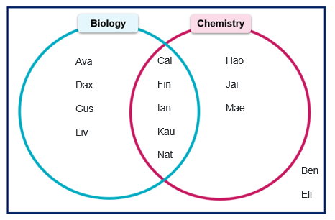
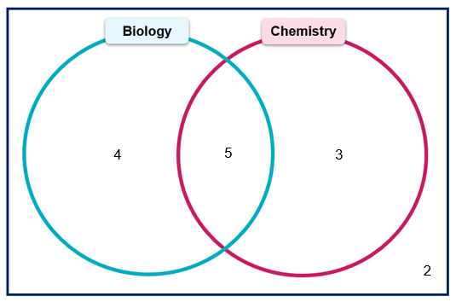

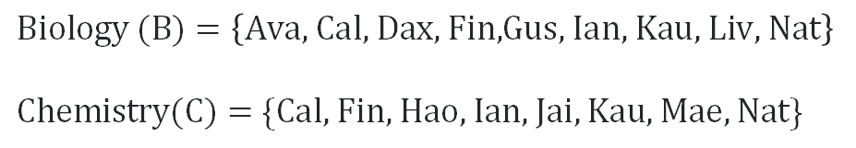
Definitions and notation (1)
          $$Biology (B)=\left\{\text{Ava}\text{, }\text{Cal}\text{, }\text{Dax}\text{, }\text{Fin}\text{,}\text{Gus}\text{, }\text{Ian}\text{, }\text{Kau}\text{, }\text{Liv}\text{, }\text{Nat}\right\}$$
          $\text{Chemistry}\text{(}\text{C}\text{)}=\{\text{Cal}\text{, }\text{Fin}\text{, }\text{Hao}\text{, }\text{Ian}\text{, }\text{Jai}\text{, }\text{Kau}\text{, }\text{Mae}\text{, }\text{Nat}\}$
          $$|B| = 9$$
          $$\left|C\right|=8$$
Where have these numbers come from?

Slide 8
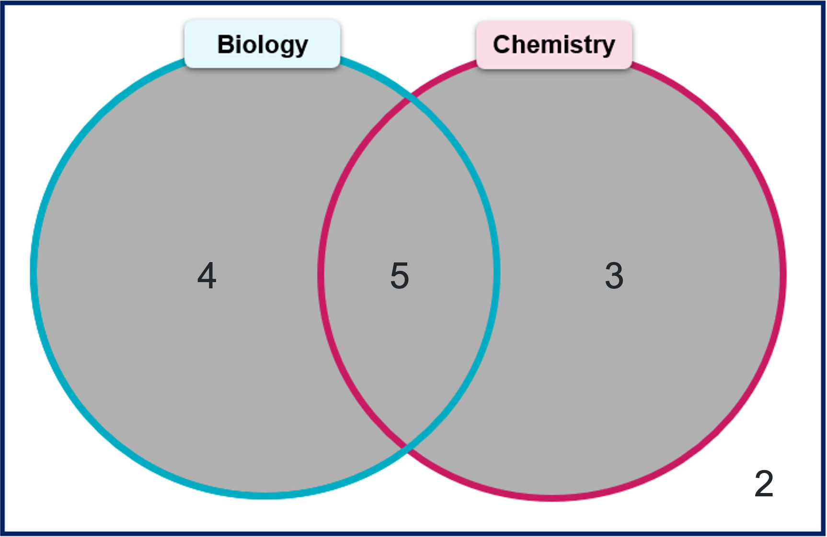
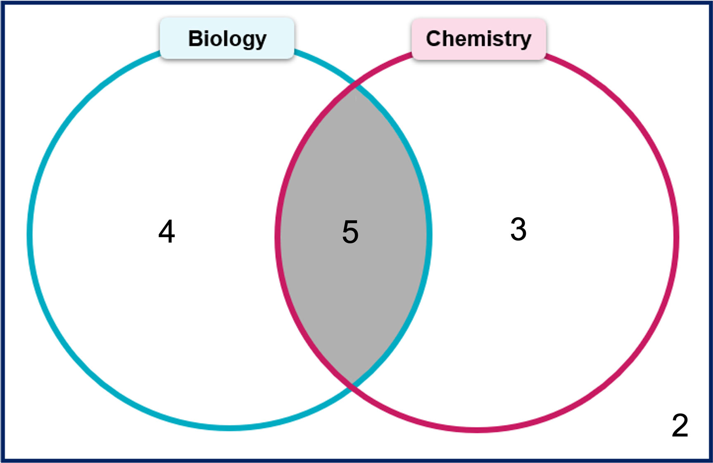




Definitions and notation (2)
What might intersection mean?
What might union mean?
Union
Intersection
Biology or Chemistry = $B∪C$
Biology and Chemistry = $B∩C$
What might $∪$ represent?
What might $∩$ represent?
$$\left|B∪C\right|=12$$
$$\left|B∩C\right|=5$$

Slide 9
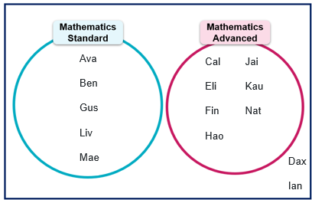
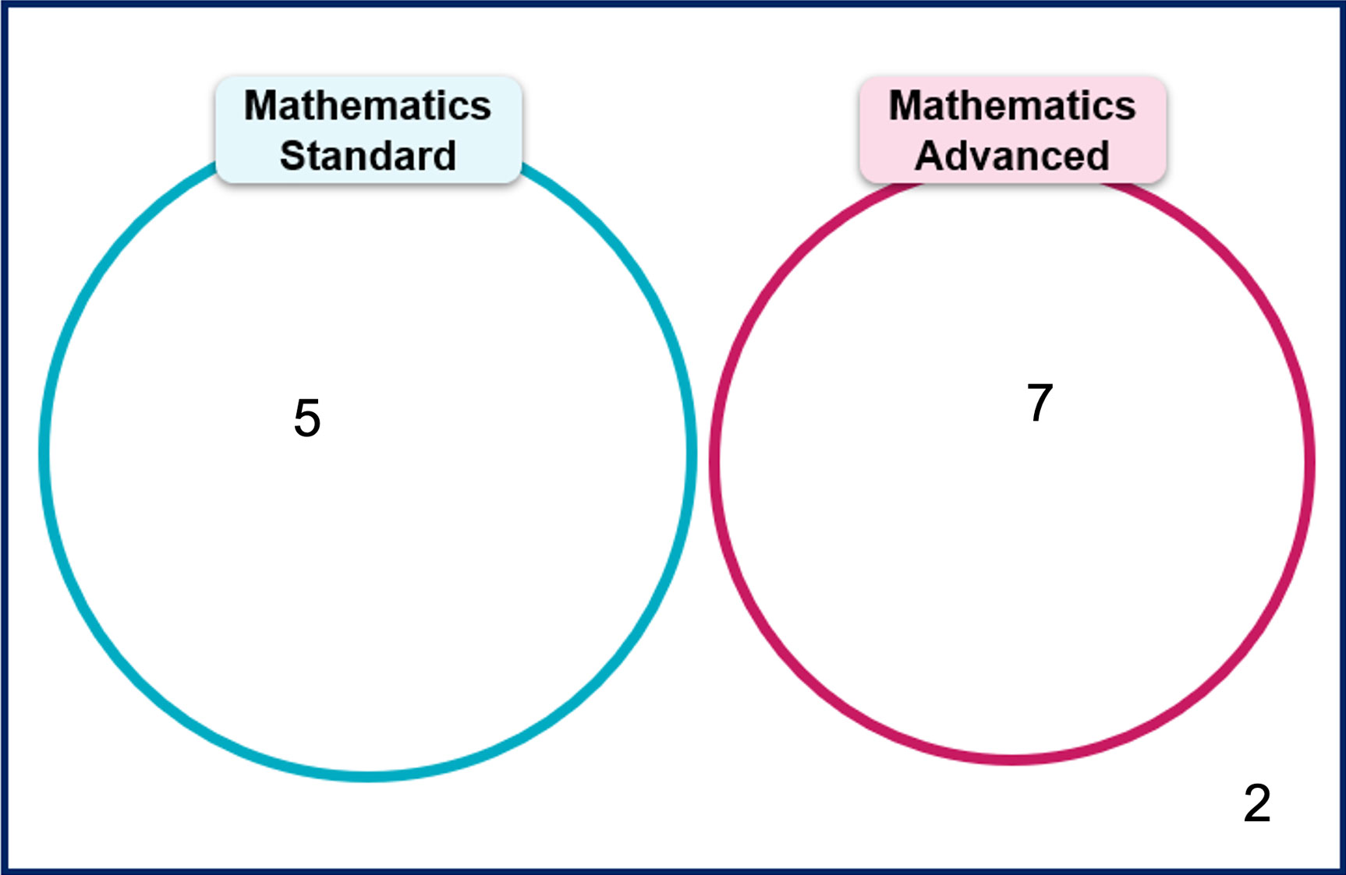
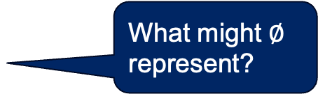
Definitions and notation (3)
Notice and wonder
An empty set is a set with no elements, denoted in set notation as $∅$.
Sets $A$ and $B$ are said to be disjoint if $A∩B=∅$, that is, they have no elements in common.
What do you notice about the Venn diagrams?
What might $∅$ represent?
$$S∩A=∅$$

Slide 10
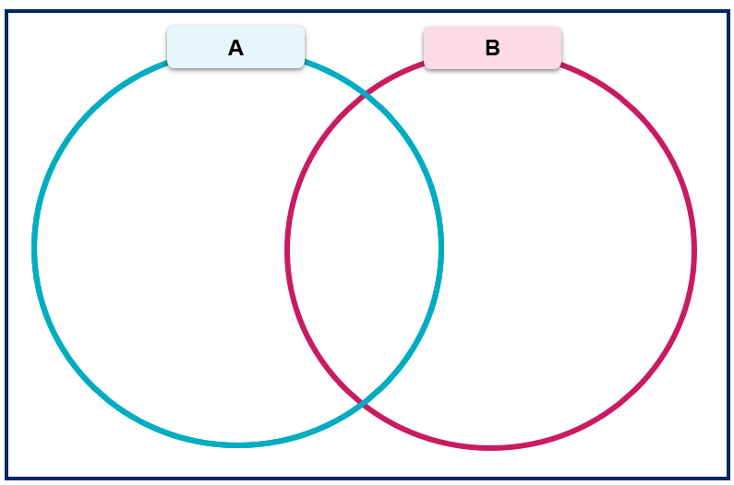

Intersection and unions (1)
Worked example 1
Consider the universal set, $U=\left\{1, 2, 3, 4, 5, 6, 7, 8, 9, 10\right\}.$Two sets $A$ and $B$ are given as
          $$A=\left\{1, 3, 5, 6, 8, 10\right\}$$
          $$B=\left\{2, 4, 6, 8, 10\right\}$$
        Find $A∪B$
          $$\{1, 2, 3, 4, 5, 6, 8, 10\}$$
        Find |$A∩B$|
        |$A∩B$| = 3
Why might 7
and 9 have been placed outside the circles?
Why might this have been drawn?
1
3
5
6
8
10
2
4
How was the answer of 3 found?
7
9

Slide 11

Intersection and unions (2)
Your turn – question 1
Consider the universal set, $U=\left\{1, 2, 3, 4, 5, 6, 7, 8, 9, 10\right\}.$Two sets $A$ and $B$ are given as
          $$A=\left\{2, 4, 6, 8, 10\right\}$$
          $$B=\left\{3, 6, 9\right\}$$
        Find $A∩B$
        $A∩B=\{6\}$
        Find $\left|A∪B\right|$
$\left|A∪B\right|=7$
2
4
8
10
3
9
6
1
5
7

Slide 12
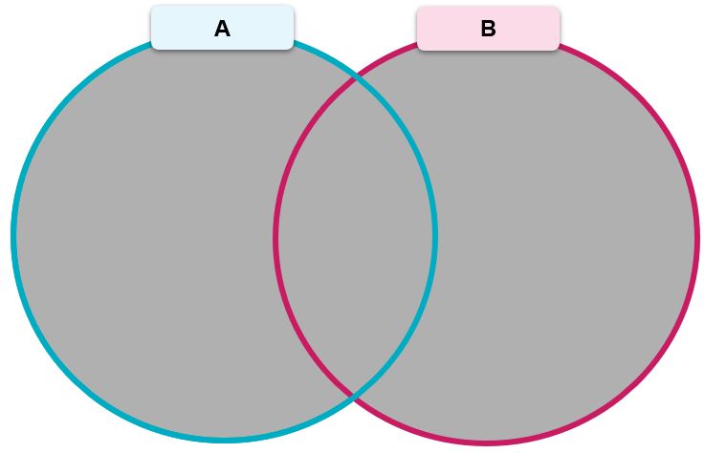
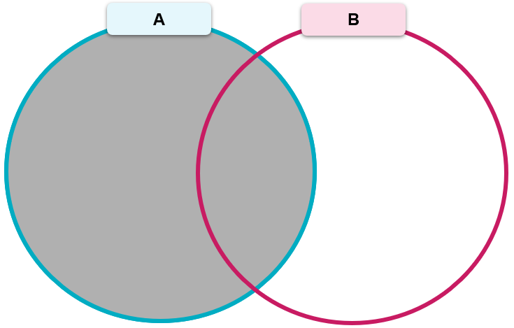
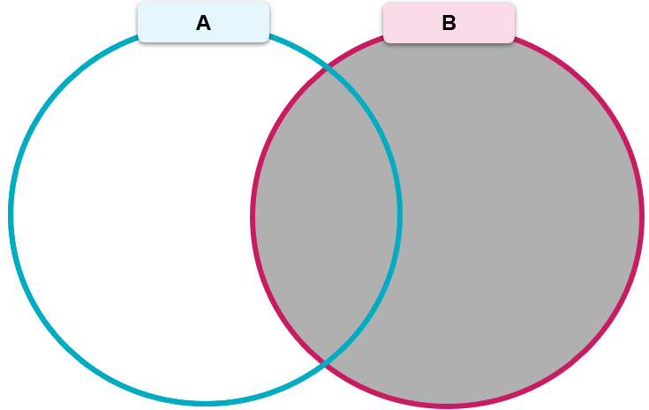
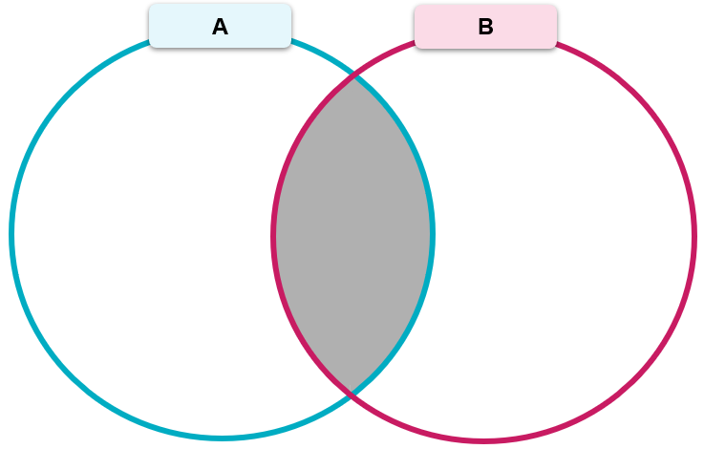




Definitions and notation (4)
Rule
$$\left|A∪B\right|=\left|A\right|+\left|B\right|−\left|A∩B\right|$$
$$=$$
$$+$$
$$−$$
$$P\left(A∪B\right)=P\left(A\right)+P\left(B\right)−P(A∩B)$$

Slide 13
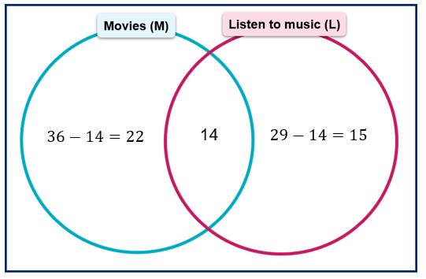
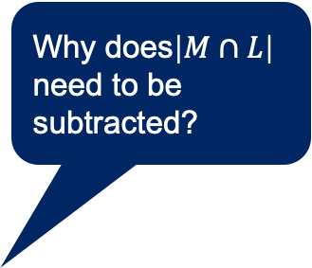

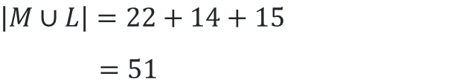
Intersection and unions (3)
Worked example 2
In a year group, 36 students watch movies in their free time $(M)$, 29 students enjoy listening to music in their free time $(L)$ and 14 do both. Find $\left|M∪L\right|$.
$$\left|M\right|=36$$
$$\left|L\right|=29$$
$$\left|M∩L\right|=14$$
$$\left|M∪L\right|=\left|M\right|+\left|L\right|−\left|M∩L\right|$$
$$=36+29−14$$
$$=51$$
Alternate method:
Why does$\left|M∩L\right|$ need to be subtracted?
Why was 14 subtracted from both 36 and 29?
Which method do you prefer?
$$\left|M∪L\right|=22+14+15$$
$$=51$$

Slide 14
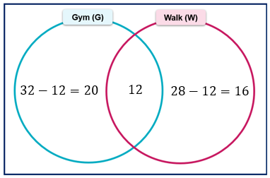

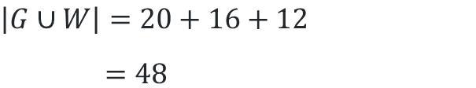
Intersection and unions (4)
Your turn 2
In a group of 50 students, 32 students go to the gym (G), 28 students go for a walk (W), and 12 students do both activities. Find $\left|G∪W\right|$, the total number of students who either go to the gym, go for a walk, or do both.
$$\left|G\right|=32$$
$$\left|W\right|=28$$
$\left|G∩W\right|=12$
$$\left|G∪W\right|=\left|G\right|+\left|W\right|−\left|G∩W\right|$$
$$=32+28−12$$
$$=48$$
Alternate method:
$$\left|G∪W\right|=20+16+12$$
$$=48$$

Slide 15
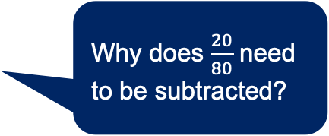

Intersection and unions (5)
Worked example 3
In a group of 80 students, 50 students play soccer (S), 45 students play volleyball (V), 20 students play both sports. What is the probability that a student chosen at random plays either soccer or volleyball?
$$P\left(S∪V\right)=P\left(S\right)+P\left(V\right)−P(S∩V) \\ =\frac{50}{80}+\frac{45}{80}−\frac{20}{80} \\ =\frac{15}{16}$$
Why does $\frac{20}{80}$ need to be subtracted?
Can you think of an alternate method that doesn’t require the formula?

Slide 16

Intersection and unions (6)
Your turn 3
In a group of 40 students, 25 students take Dance (D), 18 students take Drama (R) and 10 students take both Dance and Drama. What is the probability that a student chosen at random takes either Dance or Drama?
$$P\left(D∪R\right)=P\left(D\right)+P\left(R\right)−P(D∩R) \\ =\frac{25}{40}+\frac{18}{40}−\frac{10}{40} \\ =\frac{33}{40}$$

Slide 17
References
This presentation contains NSW Curriculum and syllabus content. The NSW Curriculum is developed by the NSW Education Standards Authority. This content is prepared by NESA for and on behalf of the Crown in the right of the State of New South Wales. The material is protected by Crown copyright.
Please refer to the NESA Copyright Disclaimer for more information https://educationstandards.nsw.edu.au/wps/portal/nesa/mini-footer/copyright.
NESA holds the only official and up-to-date versions of the NSW Curriculum and syllabus documents. Please visit the NSW Education Standards Authority (NESA) website https://educationstandards.nsw.edu.au/wps/portal/nesa/home and the NSW Curriculum website https://curriculum.nsw.edu.au.
Mathematics Advanced 11–12 Syllabus © NSW Education Standards Authority (NESA) for and on behalf of the Crown in right of the State of New South Wales, 2024.

Slide 18
Copyright
© State of New South Wales (Department of Education), 2025
The copyright material published in this resource is subject to the Copyright Act 1968 (Cth) and is owned by the NSW Department of Education or, where indicated, by a party other than the NSW Department of Education (third-party material).
Copyright material available in this resource and owned by the NSW Department of Education is licensed under a Creative Commons Attribution 4.0 International (CC BY 4.0) license.
This license allows you to share and adapt the material for any purpose, even commercially.
Attribution should be given to © State of New South Wales (Department of Education), 2025.
Material in this resource not available under a Creative Commons license:
the NSW Department of Education logo, other logos and trademark-protected material
Material owned by a third party that has been reproduced with permission. You will need to obtain permission from the third party to reuse its material.
Links to third-party material and websites
Please note that the provided (reading/viewing material/list/links/texts) are a suggestion only and implies no endorsement, by the New South Wales Department of Education, of any author, publisher, or book title. School principals and teachers are best placed to assess the suitability of resources that would complement the curriculum and reflect the needs and interests of their students.
If you use the links provided in this document to access a third-party’s website, you acknowledge that the terms of use, including licence terms set out on the third-party’s website apply to the use which may be made of the materials on that third-party website or where permitted by the Copyright Act 1968 (Cth). The department accepts no responsibility for content on third-party websites.

