Slide 1
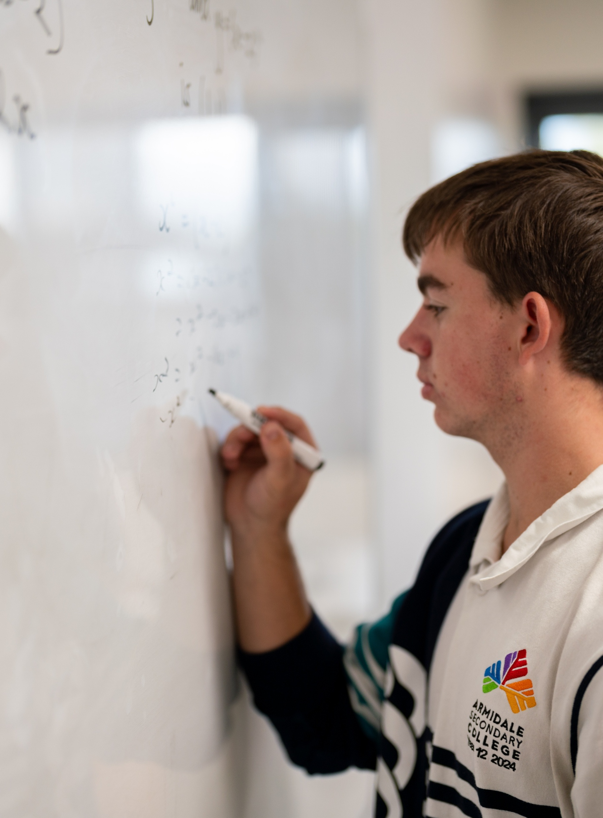
Trigonometric functions and modelling
Mathematics Advanced – Stage 6 (Year 12)
Further differentiation, modelling and graphing

Slide 2
Learning intentions and success criteria
Learning intentions
To be able to solve equations involving trigonometric function transformations.
To be able to model and solve problems involving periodic phenomena.
Success criteria
I can solve transformed trigonometric equations within specified domains.
I can model periodic phenomena using transformations of the trigonometric functions.
I can interpret solutions of transformed trigonometric functions in context.

Slide 3
Activating prior knowledge

Slide 4

Problem
The function $h$ is defined by
$$h=1.2+0.6\sin\left(\frac{π}{6}t\right),0≤t≤12$$
where $h$ and $t$ are real numbers.
What is the period of the function $h$?
What is the smallest value of $h$ and the value of $t$ at which this occurs.
Find all values of $t$ for which $h≥1.5$

Slide 5
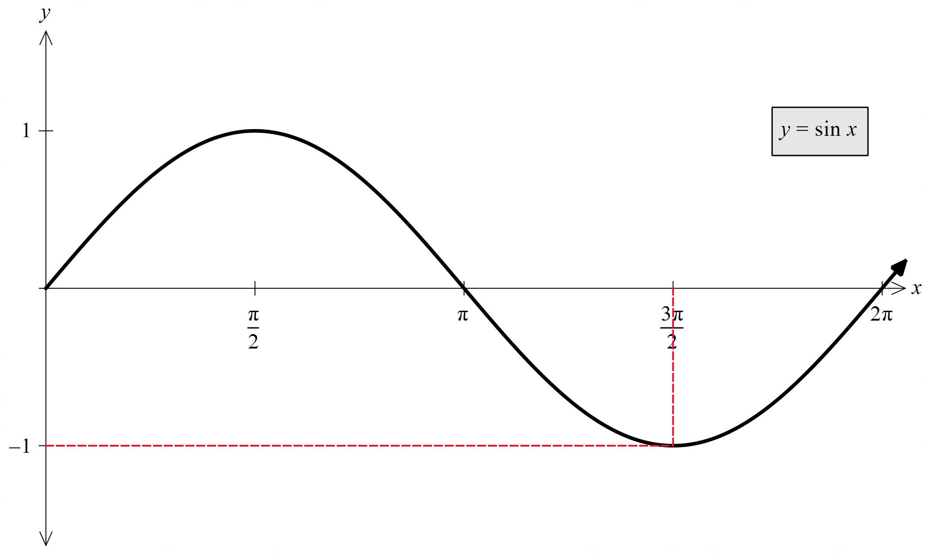
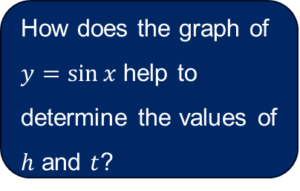
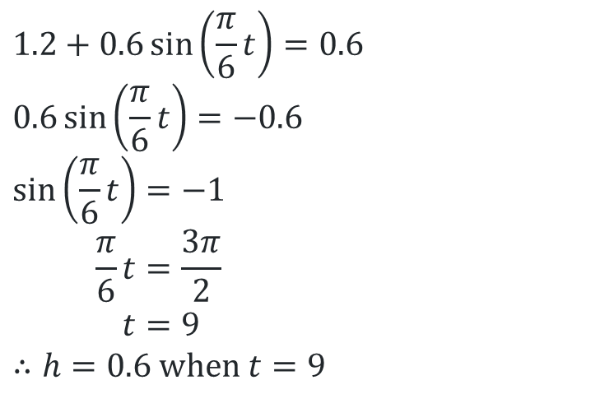

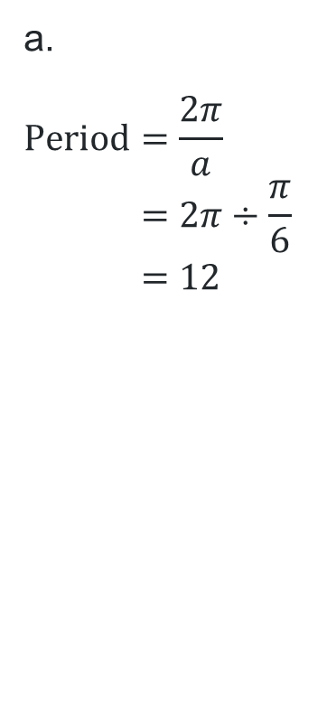
Solution a. and b.
Solving algebraically $h=1.2+0.6\sin\left(\frac{π}{6}t\right),0≤t≤12$
a.
$$\text{Period}=\frac{2π}{a} \\ =2π÷\frac{π}{6} \\ =12$$
b.
$$0.6\sin\left(\frac{π}{6}t\right) \text{has} \text{an} \text{amplitude} \text{of}\text{ 0.6.} \\ \text{Smallest} \text{value} \text{is} −0.6.$$
$$h=1.2−0.6 \\ =0.6$$
$$∴\text{Smallest} \text{value} \text{of} h \text{is} 0.6$$
$$1.2+0.6\sin\left(\frac{π}{6}t\right)=0.6$$
$$0.6\sin\left(\frac{π}{6}t\right)=−0.6$$
$$\sin\left(\frac{π}{6}t\right)=−1 \\ \frac{π}{6}t=\frac{3π}{2} \\ t=9$$
$$∴h=0.6 \text{when} t=9$$
How does the graph of $y=\sin{x}$ help to determine the values of $h$ and $t$?

Slide 6
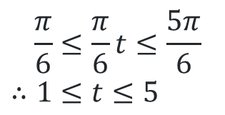


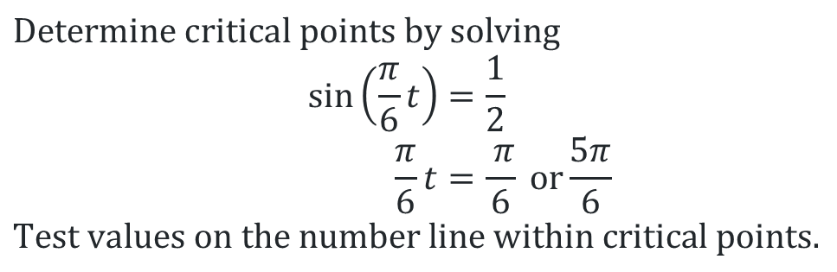
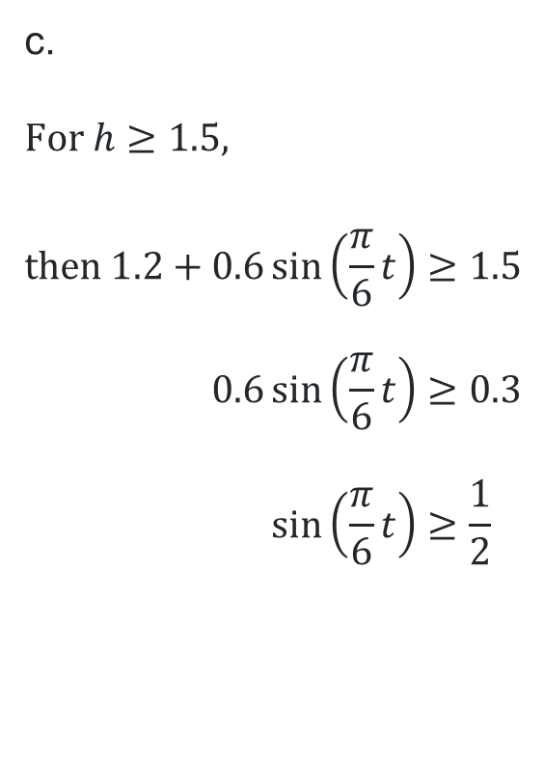
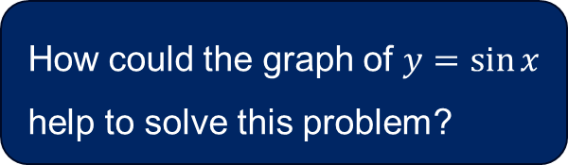
Solution c.
How could the graph of $y=\sin{x}$ help to solve this problem?
Solving algebraically $h=1.2+0.6\sin\left(\frac{π}{6}t\right),0≤t≤12$
$$\text{Determine} \text{critical} \text{points} \text{by} \text{solving}$$
$$\sin\left(\frac{π}{6}t\right)=\frac{1}{2} \\ \frac{π}{6}t=\frac{ π}{6} \text{or}\frac{5π}{6}$$
$$\text{Test} \text{values} \text{on} \text{the} \text{number} \text{line} \text{within} \text{critical} \text{points}\text{.}$$
c.
$$\text{For} h≥1.5,$$
$$\text{then} 1.2+0.6\sin\left(\frac{π}{6}t\right)≥1.5 \\ 0.6\sin\left(\frac{π}{6}t\right)≥0.3 \\ \sin\left(\frac{π}{6}t\right)≥\frac{1}{2}$$
✗
✓
✗
$$\frac{π}{6}$$
$$\frac{5π}{6}$$
$$\frac{π}{6}≤\frac{π}{6}t≤\frac{5π}{6} \\ ∴1≤t≤5$$

Slide 7
Connecting learning

Slide 8

Equation
Identify all the transformations
$$h=1.2+0.6\sin\left(\frac{π}{6}t\right), 0≤t≤12$$
What is the period of the function $h$?
What is the minimum value of $h$ and the value of $t$ at which this occurs.
Find all values of $t$ for which $h≥1.5$

Slide 9

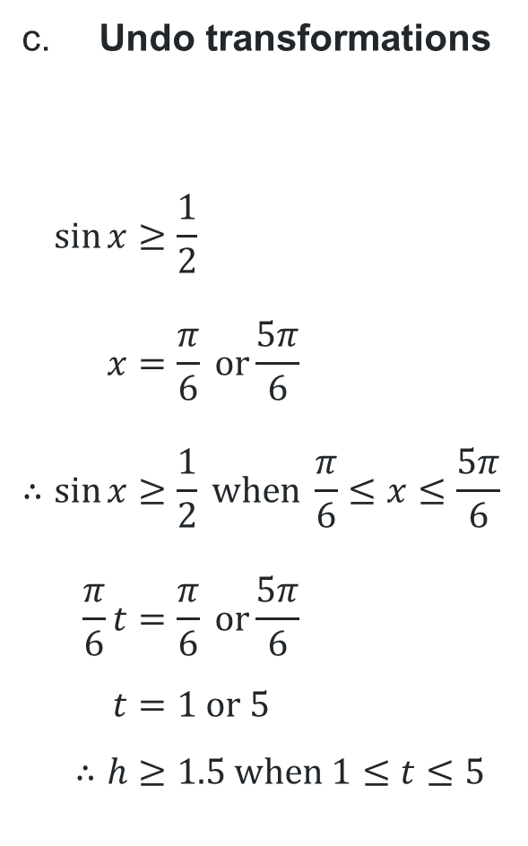

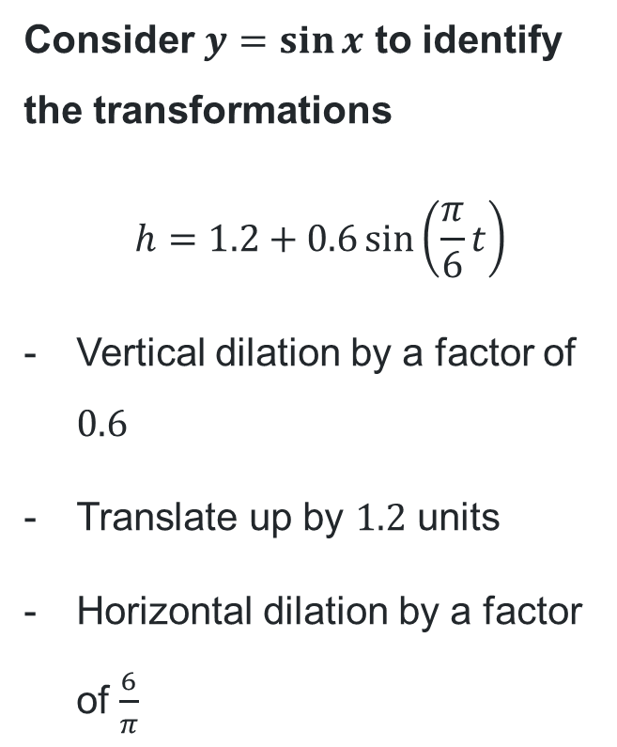









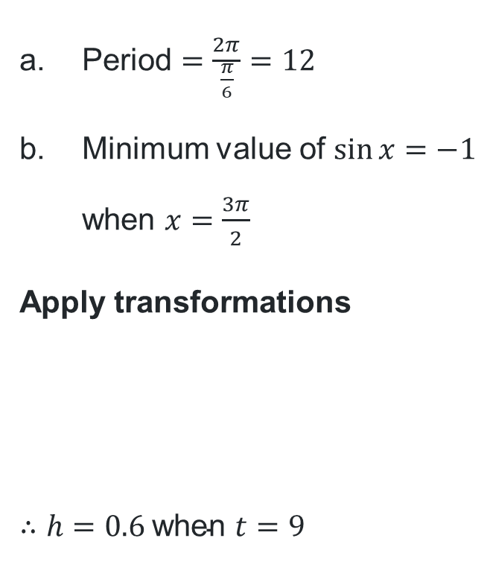


Solution (2)
Undo transformations
$$\sin{x}≥\frac{1}{2} \\ x=\frac{π}{6} or\frac{5π}{6} \\ ∴\sin{x}≥\frac{1}{2} \text{when} \frac{π}{6}≤x≤\frac{5π}{6} \\ \frac{π}{6}t=\frac{π}{6} or\frac{5π}{6} \\ t=1 \text{or} 5 \\ ∴h≥1.5 \text{when} 1≤t≤5$$
Solving using graph transformations
$$−1.2$$
$$÷0.6$$
$$\frac{1}{2}$$
$$h≥1.5$$
$$0.3$$
Consider $y=\sin{x}$ to identify the transformations
$$h=1.2+0.6\sin\left(\frac{π}{6}t\right)$$
Vertical dilation by a factor of $0.6$
Translate up by $1.2$ units
Horizontal dilation by a factor of $\frac{6}{π}$
$\text{Period}=\frac{2π}{\frac{π}{6}}=12$
Minimum value of $\sin{x=−1}$ when $x=\frac{3π}{2}$
Apply transformations
$$∴h=0.6 \text{when} t=9$$
$$h:−1$$
$$×0.6$$
$$−0.6$$
$$+1.2$$
$$0.6$$
$$×\frac{6}{π}$$
$$t:\frac{3π}{2}$$
$$9$$

Slide 10
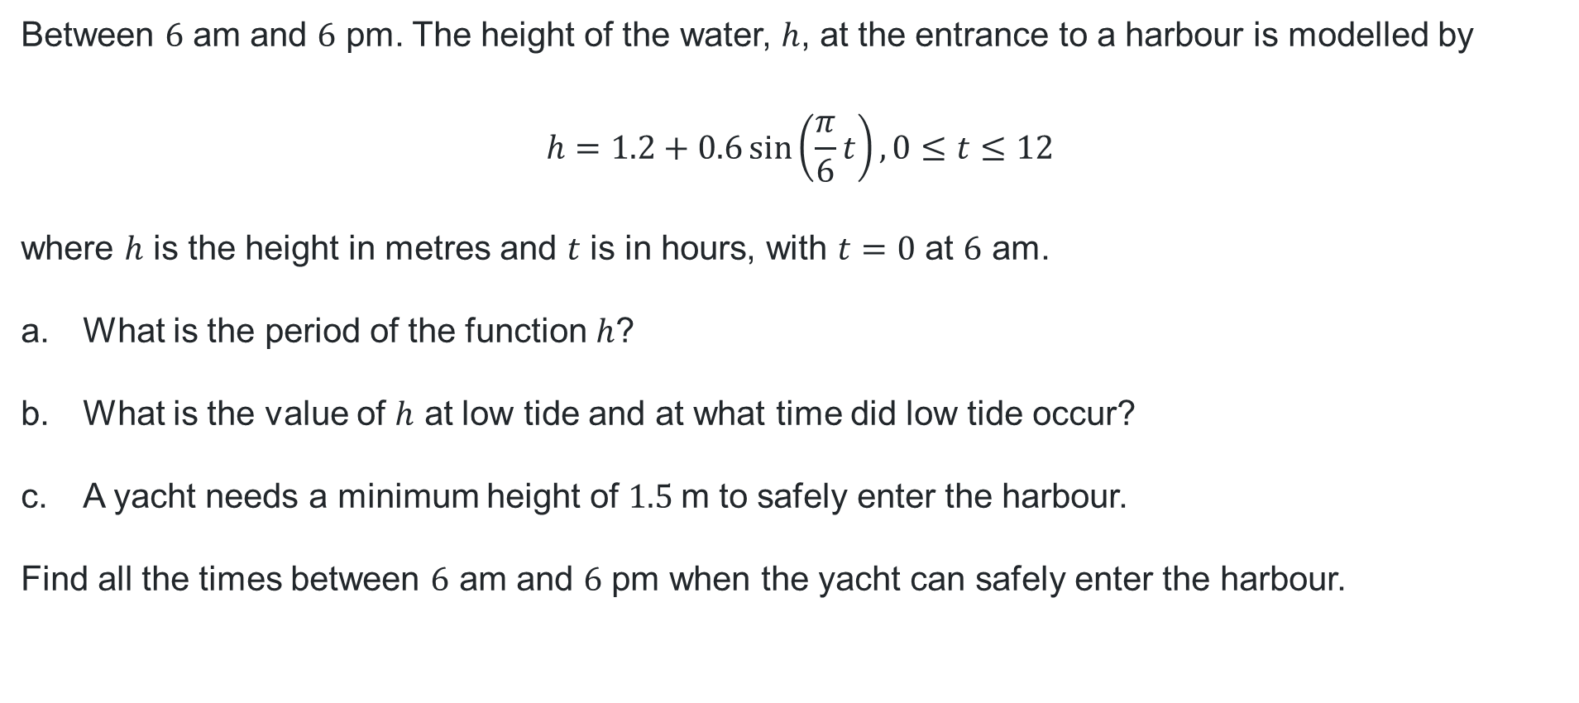
Contextual problem
Between $6$ am and $6$ pm. The height of the water, $h$, at the entrance to a harbour is modelled by
$$h=1.2+0.6\sin\left(\frac{π}{6}t\right), 0≤t≤12$$
where $h$ is the height in metres and $t$ is in hours, with $t=0$ at $6$ am.
What is the period of the function $h$?
What is the value of $h$ at low tide and at what time did low tide occur?
A yacht needs a minimum height of $1.5$m to safely enter the harbour.
Find all the times between $6$ am and $6$ pm when the yacht can safely enter the harbour.

Slide 11
Releasing responsibility

Slide 12
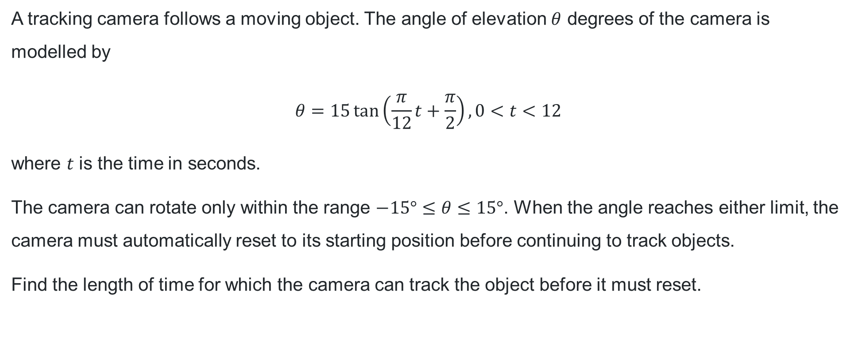
Question 1
Worked example
A tracking camera follows a moving object. The angle of elevation $θ$ degrees of the camera is modelled by
$$θ=15\tan\left(\frac{π}{12}t+\frac{π}{2}\right), 0<t<12$$
where $t$ is the time in seconds.
The camera can rotate only within the range $−15°≤θ≤15°$. When the angle reaches either limit, the camera must automatically reset to its starting position before continuing to track objects.
Find the length of time for which the camera can track the object before it must reset.

Slide 13
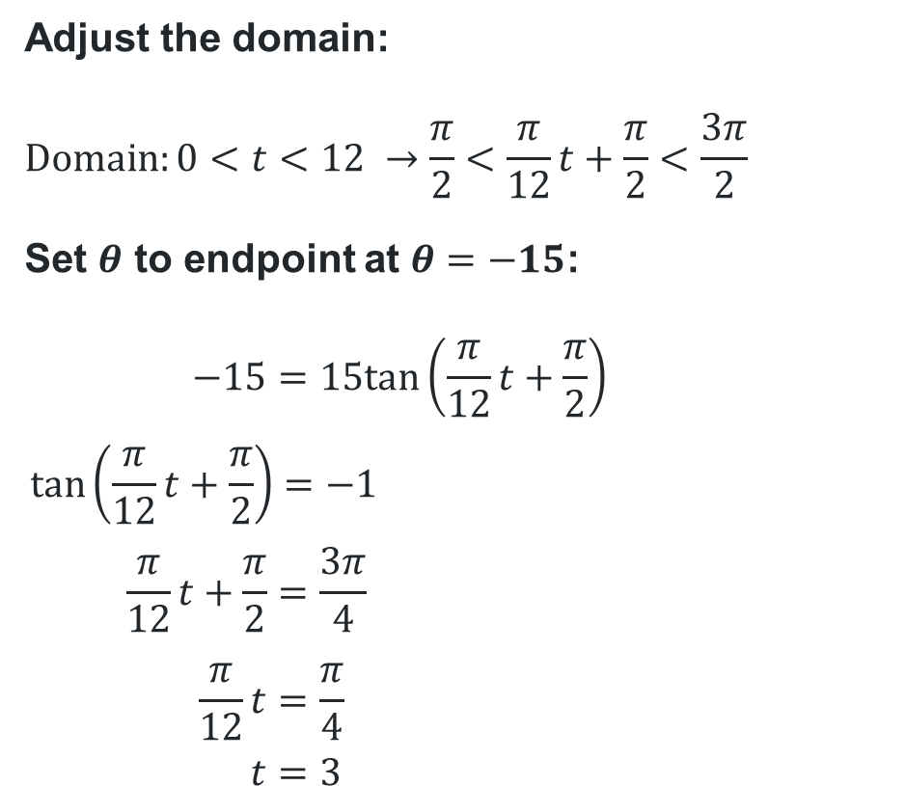
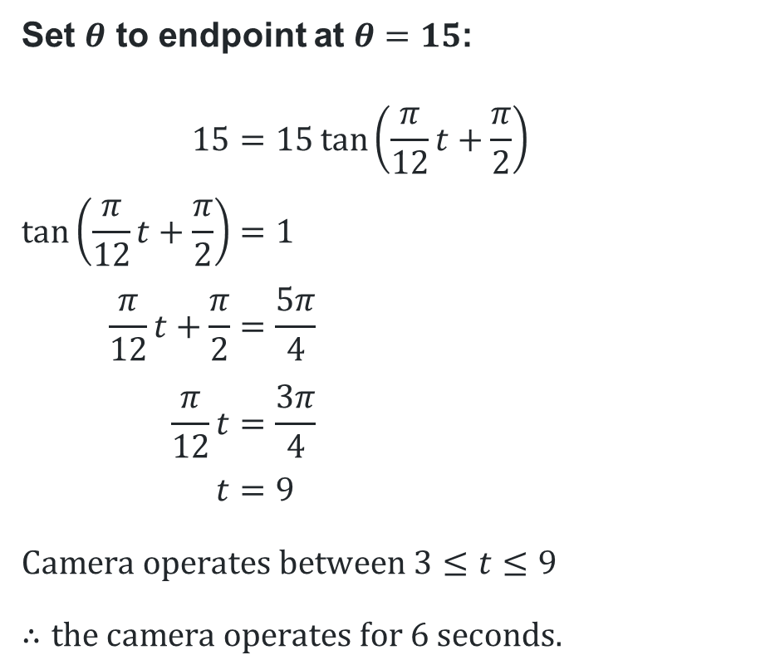

Method 1
Algebraic solution to $θ=15\tan\left(\frac{π}{12}t+\frac{π}{2}\right), 0<t<12$
Adjust the domain:
$$\text{Domain}:0<t<12 →\frac{π}{2}<\frac{π}{12}t+\frac{π}{2}<\frac{3π}{2}$$
Set $θ$ to endpoint at $θ=−15$:
$$−15=15tan\left(\frac{π}{12}t+\frac{π}{2}\right) \\ \tan\left(\frac{π}{12}t+\frac{π}{2}\right)=−1 \\ \frac{π}{12}t+\frac{π}{2}=\frac{3π}{4} \\ \frac{π}{12}t=\frac{π}{4} \\ t=3$$
Set $θ$ to endpoint at $θ=15$:
$$15=15\tan\left(\frac{π}{12}t+\frac{π}{2}\right) \\ \tan\left(\frac{π}{12}t+\frac{π}{2}\right)=1 \\ \frac{π}{12}t+\frac{π}{2}=\frac{5π}{4} \\ \frac{π}{12}t=\frac{3π}{4} \\ t=9$$
$$\text{Camera} \text{operates} \text{between} 3≤t≤9$$
$$∴\text{the} \text{camera} \text{operates} \text{for} 6 \text{seconds}\text{.}$$
Why is this value not $−\frac{π}{4}$?

Slide 14


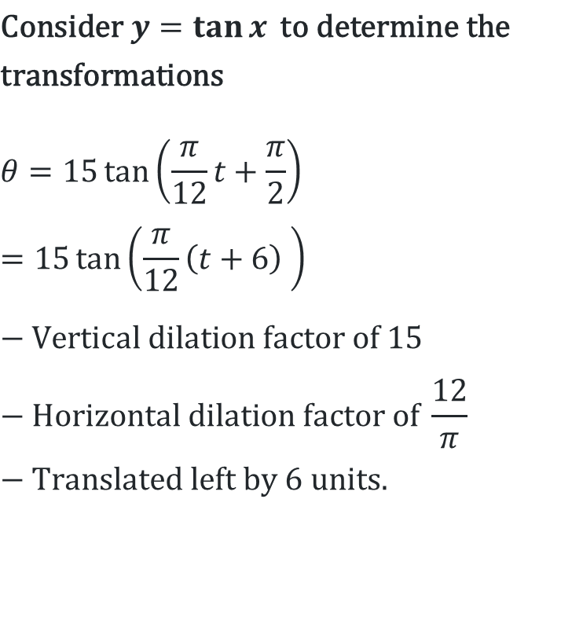





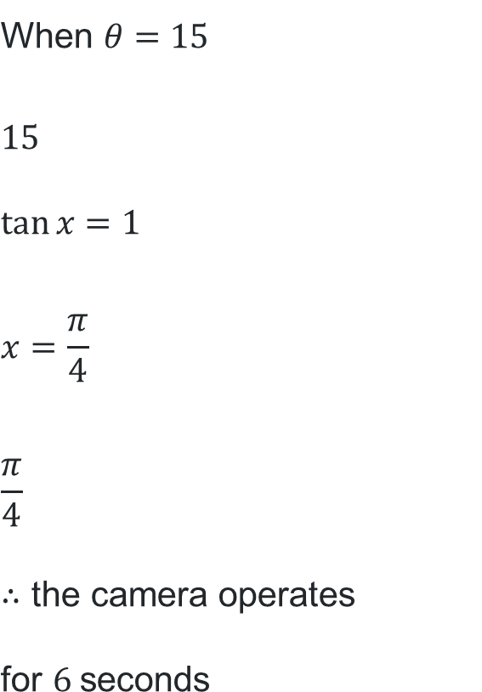






Method 2
Graph transformation solution to $θ=15\tan\left(\frac{π}{12}t+\frac{π}{2}\right), 0<t<12$
$$\text{C}\text{onsider} y=\tan{x} \text{to} \text{determine} \text{the} \\ \text{transformations}$$
$$θ=15\tan\left(\frac{π}{12}t+\frac{π}{2}\right) \\ =15\tan\left(\frac{π}{12}\left(t+6\right) \right)$$
$$\text{−} \text{Vertical} \text{dilation} \text{factor} \text{of} 15 \\ \text{− }\text{Horizontal} \text{dilation} \text{factor} \text{of} \frac{12}{π} \\ \text{− }\text{Translated} \text{left} \text{by} 6 \text{units}\text{.}$$
$$\text{When} θ=−15$$
$$−15 \\ \tan{x}=−1 \\ x=−\frac{π}{4} \\ −\frac{π}{4}$$
$$\text{When} θ=15$$
$$15 \\ \tan{x}=1 \\ x=\frac{π}{4} \\ \frac{π}{4} \\ ∴\text{the} \text{camera} \text{operates} \text{for} 6 \text{seconds}$$
$$÷15$$
$$÷15$$
$$−1$$
$$1$$
$$÷\frac{12}{π}$$
$$÷\frac{12}{π}$$
$$+6$$
$$+6$$
$$−3$$
$$3$$
$$3$$
$$9$$
Were vertical or horizontal transformations applied here?

Slide 15
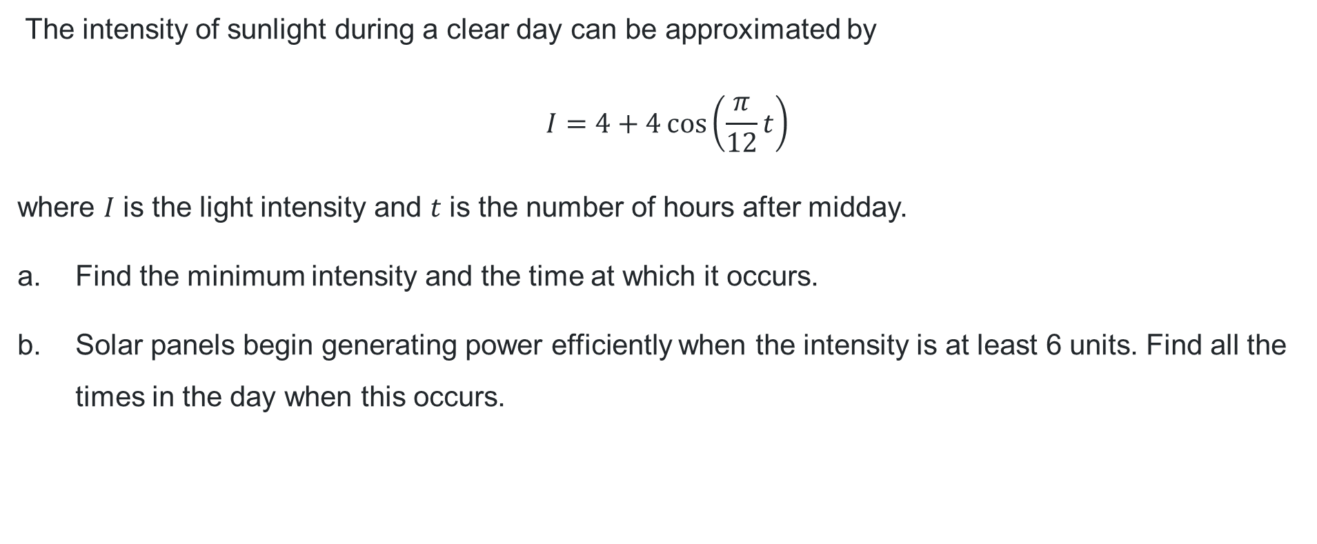
Question 2
Your turn
The intensity of sunlight during a clear day can be approximated by
$$I=4+4\cos\left(\frac{π}{12}t\right)$$
where $I$ is the light intensity and $t$ is the number of hours after midday.
Find the minimum intensity and the time at which it occurs.
Solar panels begin generating power efficiently when the intensity is at least 6 units. Find all the times in the day when this occurs.

Slide 16

Question 2 – part (a) solution
$$I=4+4\cos\left(\frac{π}{12}t\right) \\ \text{Period}=\frac{2π}{\frac{π}{12}}=24 \\ \text{Minimum} \text{of} \text{a} \text{cosine} \text{function} \text{occurs} \text{at} \text{the} \text{midpoint} \text{of} \text{the} \text{period}\text{, }t=12 \\ I=4+4\cos\left(\frac{π}{12}×12\right) \\ =4−4 \\ =0 \\ ∴\text{minimum} \text{intensity} \text{is} 0 \text{units} \text{at} \text{midnight}.$$

Slide 17
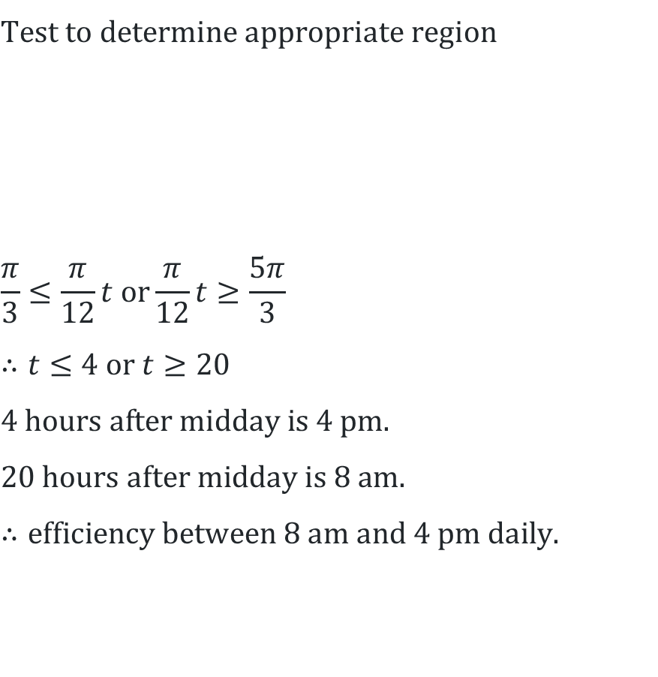
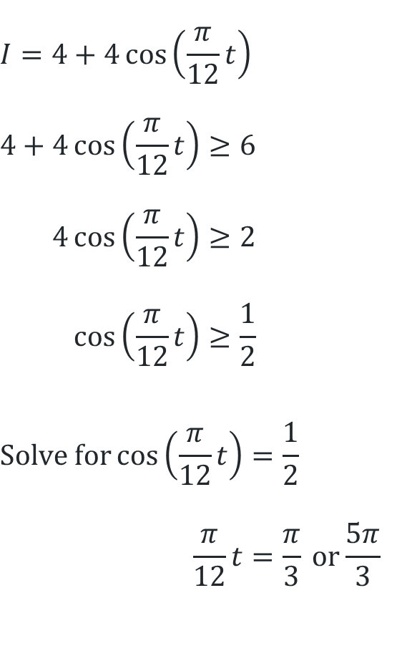


Question 2 – part b solution
$$I=4+4\cos\left(\frac{π}{12}t\right)$$
$$4+4\cos\left(\frac{π}{12}t\right)≥6 \\ 4\cos\left(\frac{π}{12}t\right)≥2 \\ \cos\left(\frac{π}{12}t\right)≥\frac{1}{2}$$
$$\text{Solve} \text{for}\cos\left(\frac{π}{12}t\right)=\frac{1}{2} \\ \frac{π}{12}t=\frac{π}{3} \text{or}\frac{5π}{3}$$
$$\text{Test} \text{to} \text{determine} \text{appropriate} \text{region}$$
$$\frac{π}{3}≤\frac{π}{12}t \text{or}\frac{π}{12}t≥\frac{5π}{3} \\ ∴t≤4 \text{or} t≥20 \\ 4 \text{hours} \text{after} \text{midday} \text{is} 4 \text{pm}. \\ 20 \text{hours} \text{after} \text{midday} \text{is} 8 \text{am}. \\ ∴\text{efficiency} \text{between} 8 \text{am} \text{and} 4 \text{pm} \text{daily}\text{.}$$
✓
✗
✓
$$\frac{π}{3}$$
$$\frac{5π}{3}$$

Slide 18
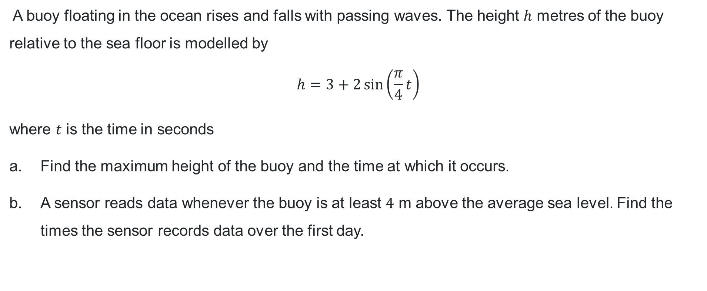
Question 3
Your turn
A buoy floating in the ocean rises and falls with passing waves. The height $h$ metres of the buoy relative to the sea floor is modelled by
$$h=3+2\sin\left(\frac{π}{4}t\right)$$
where $t$ is the time in seconds
Find the maximum height of the buoy and the time at which it occurs.
A sensor reads data whenever the buoy is at least $4$ m above the average sea level. Find the times the sensor records data over the first day.

Slide 19

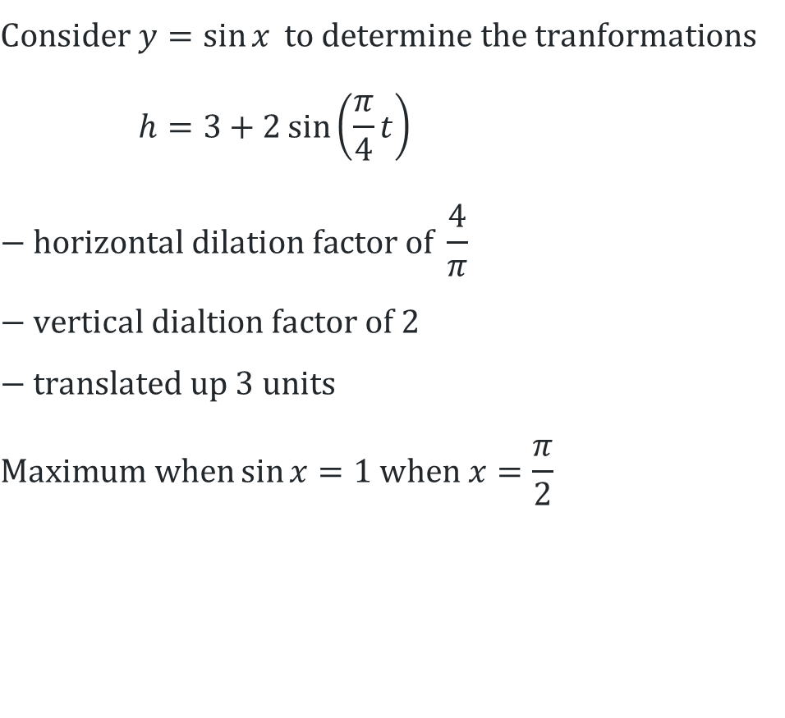



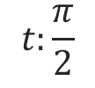




Question 3 – part (a) solution
$$\text{C}\text{onsider} y=\sin{x} \text{to} \text{determine} \text{the} \text{tranformations} \\ h=3+2\sin\left(\frac{π}{4}t\right) \\ \text{− }\text{horizontal} \text{dilation} \text{factor} \text{of} \frac{4}{π} \\ \text{− }\text{vertical} \text{dialtion} \text{factor} \text{of} 2 \\ \text{− }\text{translated} \text{up} 3 \text{units} \\ \text{Maximum} \text{when}\sin{x}=1 \text{when} x=\frac{π}{2}$$
$$h:1$$
$$×2$$
$$+3$$
$$2$$
$$5$$
$$×\frac{π}{4}$$
$$t:\frac{π}{2}$$
$$2$$
$$∴\text{maximum} \text{height} \text{is} 5 \text{m} \text{when} t=2$$

Slide 20
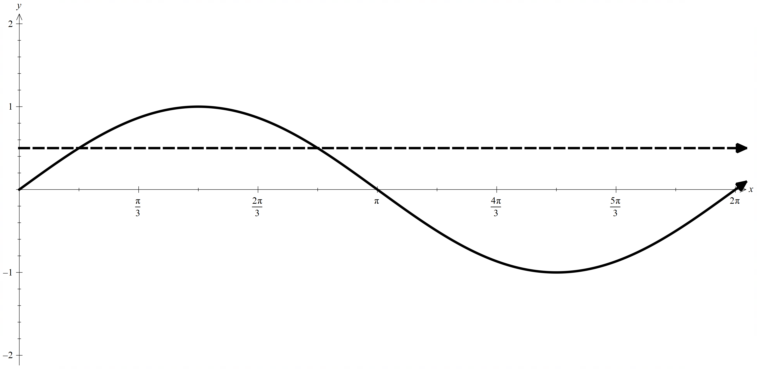
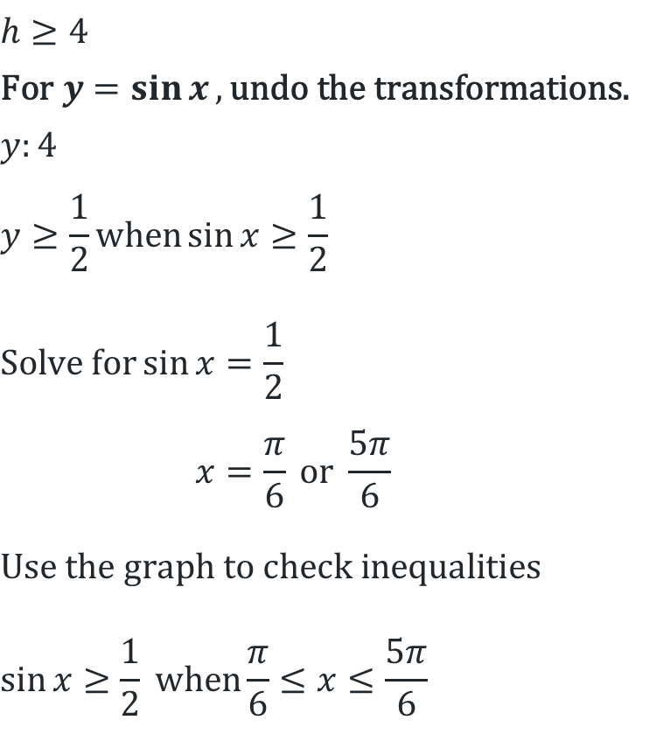




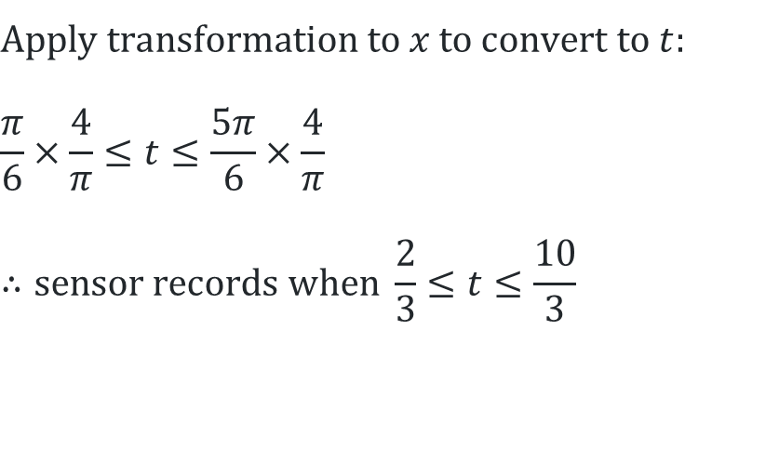
Question 3 – part (b) solution
$$h≥4 \\ \text{For} y=\sin{x}, \text{undo} \text{the} \text{transformations}\text{.} \\ y:4 \\ y≥\frac{1}{2}\text{when}\sin{x}≥\frac{1}{2}$$
$$\text{Solve} \text{for}\sin{x}=\frac{1}{2} \\ x=\frac{π}{6} \text{or} \frac{5π}{6}$$
$$\text{Use} \text{the} \text{graph} \text{to} \text{check} \text{inequalities}$$
$$\sin{x}≥\frac{1}{2} \text{when}\frac{π}{6}≤x≤\frac{5π}{6}$$
$$−3$$
$$÷2$$
$$\frac{1}{2}$$
$$1$$
$$\text{Apply} \text{transformation} \text{to} x \text{to} \text{convert} \text{to} t: \\ \frac{π}{6}×\frac{4}{π}≤t≤\frac{5π}{6}×\frac{4}{π} \\ ∴\text{sensor} \text{records} \text{when} \frac{2}{3}≤t≤\frac{10}{3}$$

Slide 21

Approaching questions scaffold
…..

Slide 22
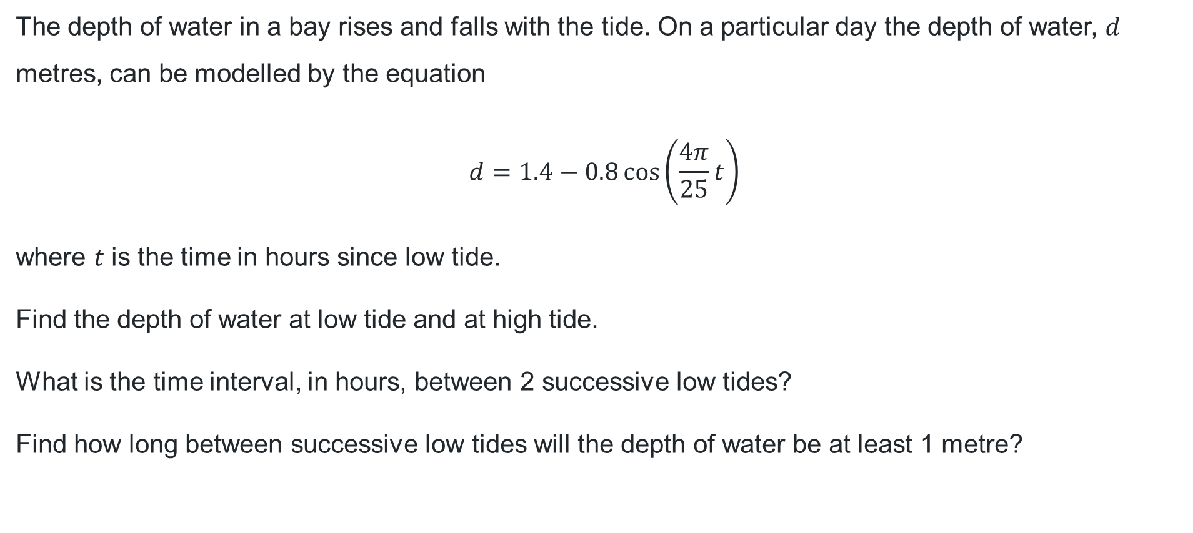
HSC style question
The depth of water in a bay rises and falls with the tide. On a particular day the depth of water, $d$ metres, can be modelled by the equation
$$d=1.4−0.8\cos\left(\frac{4π}{25}t\right)$$
where $t$ is the time in hours since low tide.
Find the depth of water at low tide and at high tide.
What is the time interval, in hours, between 2 successive low tides?
Find how long between successive low tides will the depth of water be at least 1 metre?

Slide 23
References
This presentation contains NSW Curriculum and syllabus content. The NSW Curriculum is developed by the NSW Education Standards Authority. This content is prepared by NESA for and on behalf of the Crown in the right of the State of New South Wales. The material is protected by Crown copyright.
Please refer to the NESA Copyright Disclaimer for more information https://www.nsw.gov.au/education-and-training/nesa/copyright.
NESA holds the only official and up-to-date versions of the NSW Curriculum and syllabus documents. Please visit NESA https://www.nsw.gov.au/education-and-training/nesa and NSW Curriculum https://curriculum.nsw.edu.au.
Mathematics Advanced 11-12 Syllabus © NSW Education Standards Authority (NESA) for and on behalf of the Crown in right of the State of New South Wales, 2024.

Slide 24
Copyright
© State of New South Wales (Department of Education), 2026
The copyright material published in this resource is subject to the Copyright Act 1968 (Cth) and is owned by the NSW Department of Education or, where indicated, by a party other than the NSW Department of Education (third-party material).
Copyright material available in this resource and owned by the NSW Department of Education is licensed under a Creative Commons Attribution 4.0 International (CC BY 4.0) license.
This license allows you to share and adapt the material for any purpose, even commercially.
Attribution should be given to © State of New South Wales (Department of Education), 2026.
Material in this resource not available under a Creative Commons license:
the NSW Department of Education logo, other logos and trademark-protected material
Material owned by a third party that has been reproduced with permission. You will need to obtain permission from the third party to reuse its material.
Links to third-party material and websites
Please note that the provided (reading/viewing material/list/links/texts) are a suggestion only and implies no endorsement, by the New South Wales Department of Education, of any author, publisher, or book title. School principals and teachers are best placed to assess the suitability of resources that would complement the curriculum and reflect the needs and interests of their students.
If you use the links provided in this document to access a third-party’s website, you acknowledge that the terms of use, including licence terms set out on the third-party’s website apply to the use which may be made of the materials on that third-party website or where permitted by the Copyright Act 1968 (Cth). The department accepts no responsibility for content on third-party websites.

