Slide 1
Sets, subsets and probability
Mathematics Advanced – Year 11
Probability and data
Term 1

Slide 2
Learning intentions and success criteria
Learning Intentions
To know how to represent sets and subsets.
To understand how to calculate simple probabilities.
Success Criteria
I can define a ‘set’ and ‘subset’ using relevant notation.
I can justify if a group of elements is a subset of a set.
I can use correct set notation to show how many elements are in a set.
I can define and compare simple probabilities.
Notes:
Notes for teachers:
Learning intentions and success criteria are best co-constructed with students. Adapt the learning intention as required and add matching success criteria.
For more information See ⁠AITSL or the NSW Department of Education explicit teaching strategies, ⁠Sharing learning intentions and ⁠Sharing success criteria
LISC is not necessarily presented at the beginning of the lesson. Teacher needs to consider most effectual time to introduce
LISC should be revisited during the lesson to support students' evaluation of their learning

Slide 3
Activating prior knowledge

Slide 4
Sample space
List the sample space for each experiment
Rolling a single die
{1, 2, 3, 4, 5, 6}
2. A single card is drawn from a standard deck of 52 cards. What is the sample space for the suits?
{hearts, diamonds, clubs, spades}
3. A family with two children
Notes:
{contains animations}

Slide 5
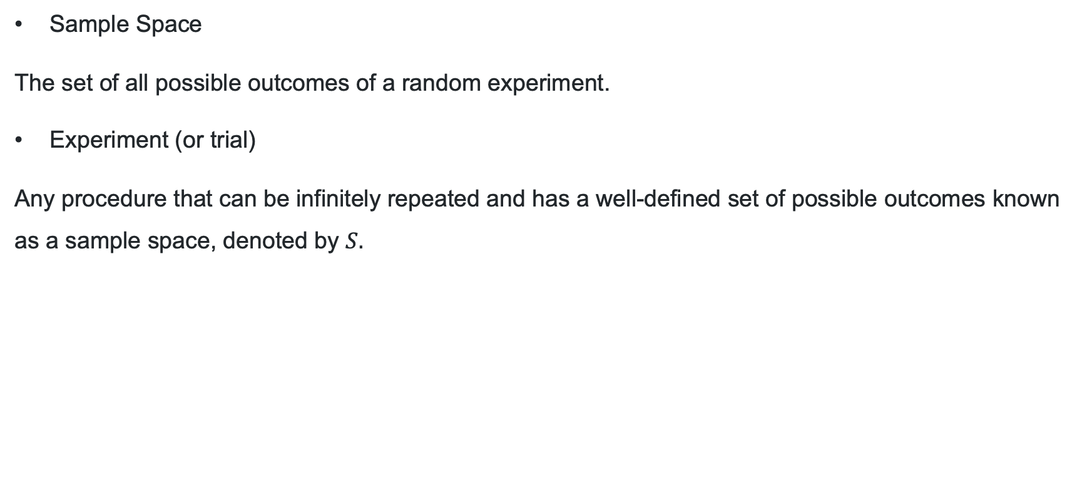
Definitions
Sample space and experiment
Sample Space
The set of all possible outcomes of a random experiment.
Experiment (or trial)
Any procedure that can be infinitely repeated and has a well-defined set of possible outcomes known as a sample space, denoted by $S.$

Slide 6
Connecting learning

Slide 7
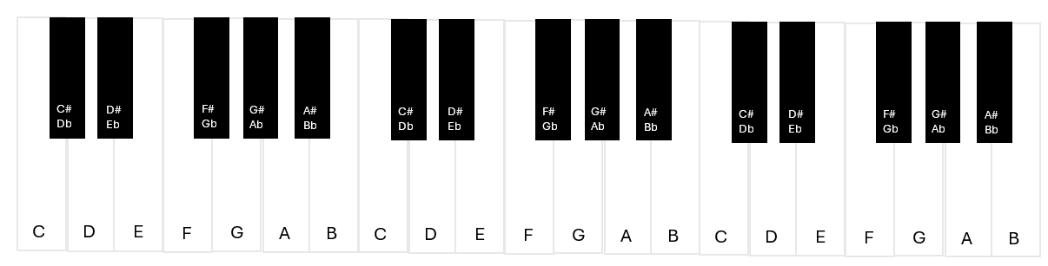
What do you notice and wonder?

Slide 8
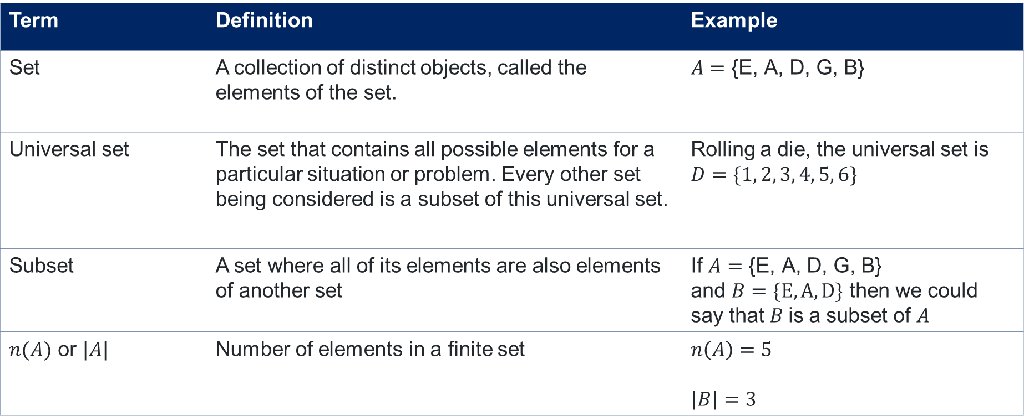
Sets and subsets
Definitions and examples
Term | Definition | Example
Set | A collection of distinct objects, called the elements of the set. | $$A=\text{\{}\text{E}\text{, }\text{A}\text{, }\text{D}\text{, }\text{G}\text{, }\text{B}\text{\}}$$
Universal set | The set that contains all possible elements for a particular situation or problem. Every other set being considered is a subset of this universal set. | Rolling a die, the universal set is $D=\{1, 2, 3, 4, 5, 6\}$
Subset | A set where all of its elements are also elements of another set | If $A=\text{\{}\text{E}\text{, }\text{A}\text{, }\text{D}\text{, }\text{G}\text{, }\text{B}\text{\}}$ and $B=\{E,A,D\}$ then we could say that $B$is a subset of $A$
$n(A)$ or $|A|$ | Number of elements in a finite set | $$n\left(A\right)=5$$ $\left|B\right|=3$

Slide 9
Releasing responsibility

Slide 10
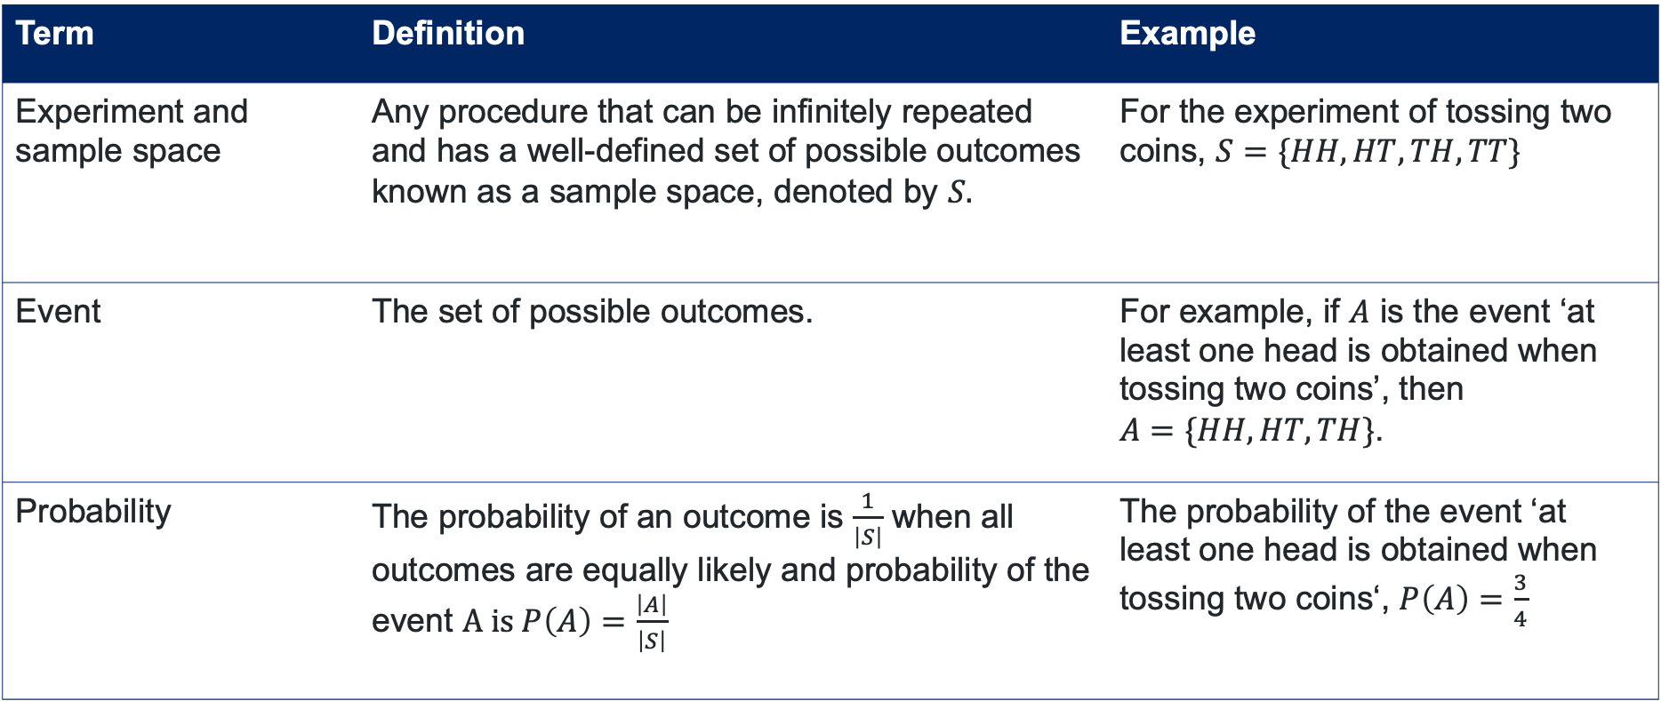
Sets, subsets and probability (1)
Definition
Term | Definition | Example
Experiment and sample space | Any procedure that can be infinitely repeated and has a well-defined set of possible outcomes known as a sample space, denoted by $S.$ | For the experiment of tossing two coins, $S=\{HH, HT, TH, TT\}$
Event | The set of possible outcomes. | For example, if $A$ is the event ‘at least one head is obtained when tossing two coins’, then $A=\{HH, HT, TH\}$.
Probability | The probability of an outcome is $\frac{1}{\left|S\right|}$ when all outcomes are equally likely and probability of the event $A is P\left(A\right)=\frac{\left|A\right|}{\left|S\right|}$ | The probability of the event ‘at least one head is obtained when tossing two coins‘, $P\left(A\right)=\frac{3}{4}$

Slide 11
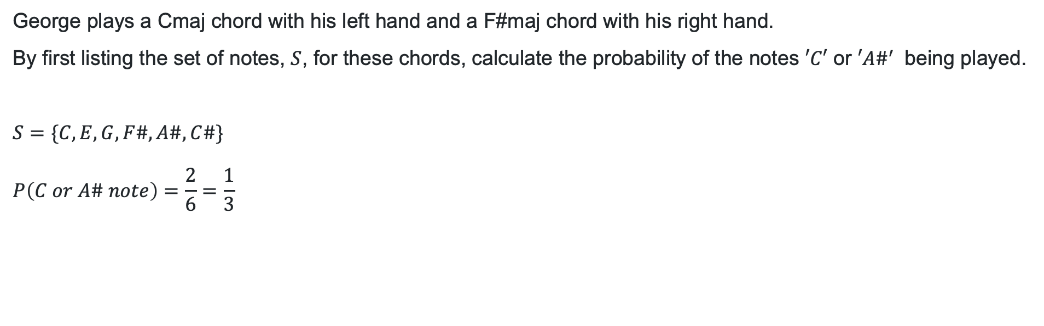
Sets, subsets and probability (2)
Worked example
George plays a Cmaj chord with his left hand and a F#maj chord with his right hand.
By first listing the set of notes, $S$, for these chords, calculate the probability of the notes $′C′$ or ${′A\#}^{′}$ being played.
$$S=\{C, E, G, F\#, A\#,C\#\}$$
$$P\left(C or A\# note\right)=\frac{2}{6}=\frac{1}{3}$$
What is a possible subset of this set?
How does the 6 relate to the listed set?

Slide 12

Sets, subsets and probability (3)
Your turn
George plays a Fmaj chord with his left hand and a Bmaj chord with his right hand.
What is the probability that he presses a black key?
$$S=\{F, A, C, B,D\#, F\#\}$$
$$P\left(‘D\#’ \text{or} ‘F\#’\right)=\frac{2}{6}=\frac{1}{3}$$

Slide 13
Independent practice

Slide 14
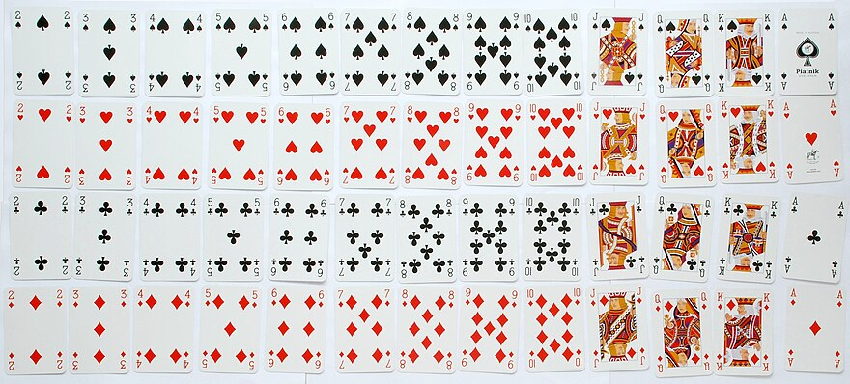
A deck of cards (1)
English pattern pack by Piatnik of Austria. The English pattern, also known as the Anglo-American or International pattern, is from Standard 52-card deck on Wikipedia. Image used under the Creative Commons License.

Slide 15
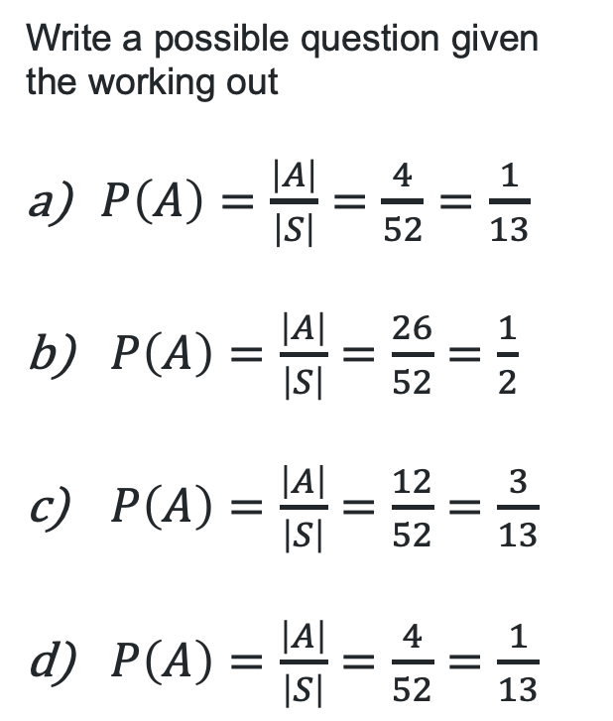
A deck of cards (2)
Write a possible question given the working out
$P\left(A\right)=\frac{\left|A\right|}{\left|S\right|}=\frac{4}{52}=\frac{1}{13}$
$P\left(A\right)=\frac{\left|A\right|}{\left|S\right|}=\frac{26}{52}=\frac{1}{2}$
$P\left(A\right)=\frac{\left|A\right|}{\left|S\right|}=\frac{12}{52}=\frac{3}{13}$
$P\left(A\right)=\frac{\left|A\right|}{\left|S\right|}=\frac{4}{52}=\frac{1}{13}$
English pattern pack by Piatnik of Austria. The English pattern, also known as the Anglo-American or International pattern, is from Standard 52-card deck on Wikipedia. Image used under the Creative Commons License.

Slide 16
References
This presentation contains NSW Curriculum and syllabus content. The NSW Curriculum is developed by the NSW Education Standards Authority. This content is prepared by NESA for and on behalf of the Crown in the right of the State of New South Wales. The material is protected by Crown copyright.
Please refer to the NESA Copyright Disclaimer for more information https://educationstandards.nsw.edu.au/wps/portal/nesa/mini-footer/copyright.
NESA holds the only official and up-to-date versions of the NSW Curriculum and syllabus documents. Please visit the NSW Education Standards Authority (NESA) website https://educationstandards.nsw.edu.au/wps/portal/nesa/home and the NSW Curriculum website https://curriculum.nsw.edu.au.
Mathematics Advanced 11–12 Syllabus © NSW Education Standards Authority (NESA) for and on behalf of the Crown in right of the State of New South Wales, 2024.

Slide 17
Copyright
© State of New South Wales (Department of Education), 2025
The copyright material published in this resource is subject to the Copyright Act 1968 (Cth) and is owned by the NSW Department of Education or, where indicated, by a party other than the NSW Department of Education (third-party material).
Copyright material available in this resource and owned by the NSW Department of Education is licensed under a Creative Commons Attribution 4.0 International (CC BY 4.0) license.
This license allows you to share and adapt the material for any purpose, even commercially.
Attribution should be given to © State of New South Wales (Department of Education), 2025.
Material in this resource not available under a Creative Commons license:
the NSW Department of Education logo, other logos and trademark-protected material
Material owned by a third party that has been reproduced with permission. You will need to obtain permission from the third party to reuse its material.
Links to third-party material and websites
Please note that the provided (reading/viewing material/list/links/texts) are a suggestion only and implies no endorsement, by the New South Wales Department of Education, of any author, publisher, or book title. School principals and teachers are best placed to assess the suitability of resources that would complement the curriculum and reflect the needs and interests of their students.
If you use the links provided in this document to access a third-party’s website, you acknowledge that the terms of use, including licence terms set out on the third-party’s website apply to the use which may be made of the materials on that third-party website or where permitted by the Copyright Act 1968 (Cth). The department accepts no responsibility for content on third-party websites.

