Slide 1
Identifying the mode and median
Mathematics Advanced – Year 11
Probability and data

Slide 2
Learning intention and success criteria
Learning intention
To understand how to identify and interpret the mode and median from frequency and cumulative frequency graphs and tables.
Success criteria
I can determine the mode and median of datasets from tables and graphs.
I can explain what the mode and median indicate in the context of the data.
I can compare findings from different datasets and hypothesise reasons for observed trends.
I can use mathematical language to communicate my findings and conclusions effectively.
Notes:
Notes for teachers:
Learning intentions and success criteria are best co-constructed with students. Adapt the learning intention as required and add matching success criteria.
For more information See ⁠AITSL or the NSW Department of Education explicit teaching strategies, ⁠Sharing learning intentions and ⁠Sharing success criteria
LISC is not necessarily presented at the beginning of the lesson. Teacher needs to consider most effectual time to introduce
LISC should be revisited during the lesson to support students' evaluation of their learning

Slide 3
Activating prior knowledge

Slide 4
Which one doesn't belong?
Dataset A: [10, 14, 16, 18, 20, 25, 28, 30, 32, 34]
Dataset B: [10, 14, 18, 20, 22, 22, 25, 28, 30, 34]
Dataset C: [8, 14, 18, 18, 22, 22, 25, 28, 30, 38]
Dataset D: [10, 18, 18, 22, 25, 28, 34]

Slide 5
Connecting learning

Slide 6
Context
In 2023, the US Open Tennis winners had the unique distinction of being both the:
Youngest since 1999 (Women's Open: Coco Gauff, 19 years)
Oldest on record (Men's Open: Novak Djokovic, 36 years)
So, what is the relationship between age and performance in professional tennis?
What is the magic age? Will it always be magic?
Link to video ‘Djokovic: 35 is the new 25 (0:30)’: https://bit.ly/Djokovic35new25

Slide 7
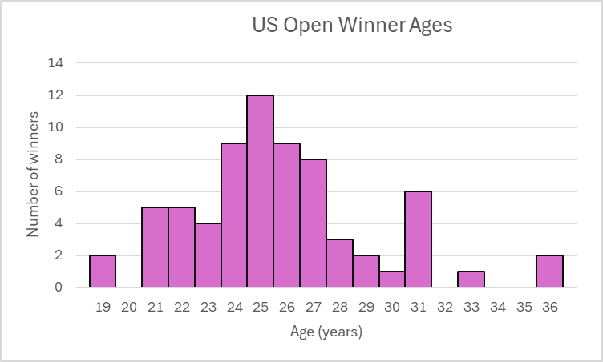
US Open
Age | Frequency
19 | 2
20 | 0
21 | 5
22 | 5
23 | 4
24 | 9
25 | 12
26 | 9
27 | 8
28 | 3
29 | 2
30 | 1
31 | 6
32 | 0
33 | 1
34 | 0
35 | 0
36 | 2
35 is the new 25

Slide 8
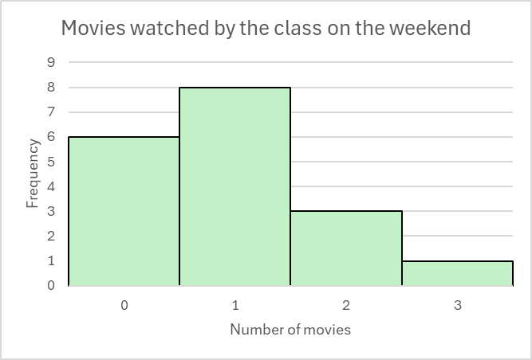
Mode (1)
How can we determine the mode from the histogram?
Definition and example
Mode: The most frequently occurring value in a set of data.
Number of movies | Frequency
0 | 6
1 | 8
2 | 3
3 | 1
Why is the mode 1 and not 8?

Slide 9
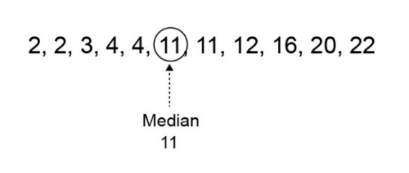
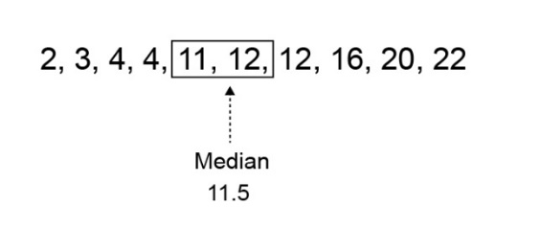
Median (1)
Definition and example
Median: The value in a set of ordered data that divides the data into 2 parts. It is frequently called the 'middle value'.
What is the same and what is different in these two examples?
How would you explain how to find the median?
Median by NESA in Data representations in 7 – 10

Slide 10
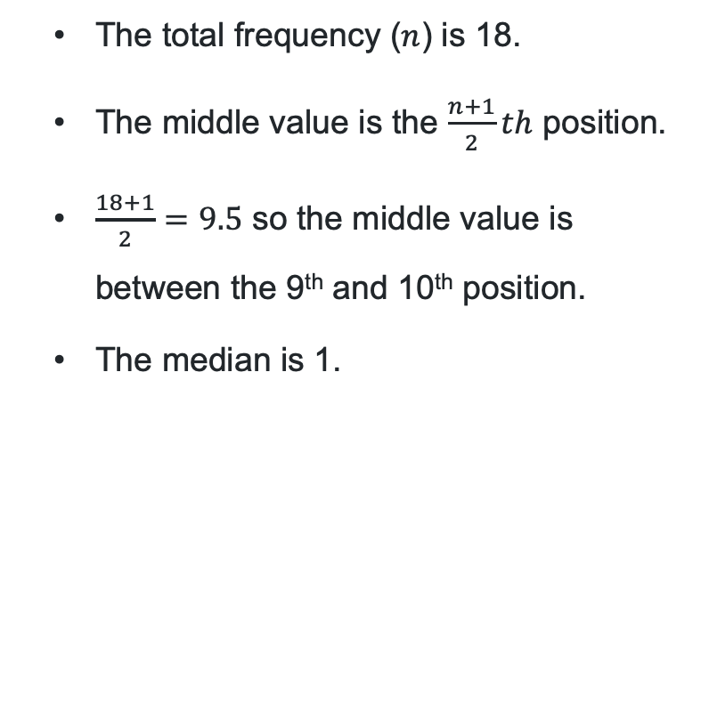
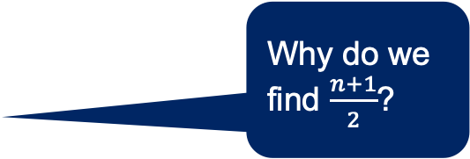
Median (2)
Definition and example
Why do we find $\frac{n+1}{2}$?
Number of movies | Frequency
0 | 6
1 | 8
2 | 3
3 | 1
Total: | 18
        The total frequency ($n$) is 18.
        The middle value is the $\frac{n+1}{2}th$ position.
        $\frac{18+1}{2}=9.5$ so the middle value is between the 9th and 10th position.
        The median is 1.
What are the 9th and 10th values for this data?
Why is the median 1?

Slide 11
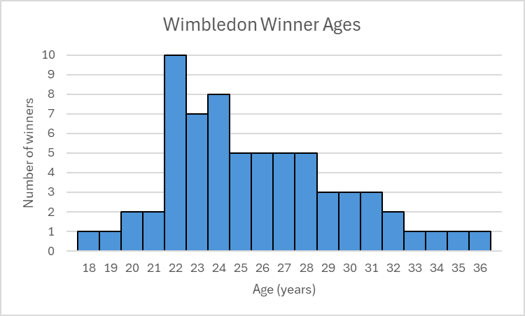
Wimbledon
Age | Frequency
18 | 1
19 | 1
20 | 2
21 | 2
22 | 10
23 | 7
24 | 8
25 | 5
26 | 5
27 | 5
28 | 5
29 | 3
30 | 3
31 | 3
32 | 2
33 | 1
34 | 1
35 | 1
36 | 1
Frequency table and histogram

Slide 12
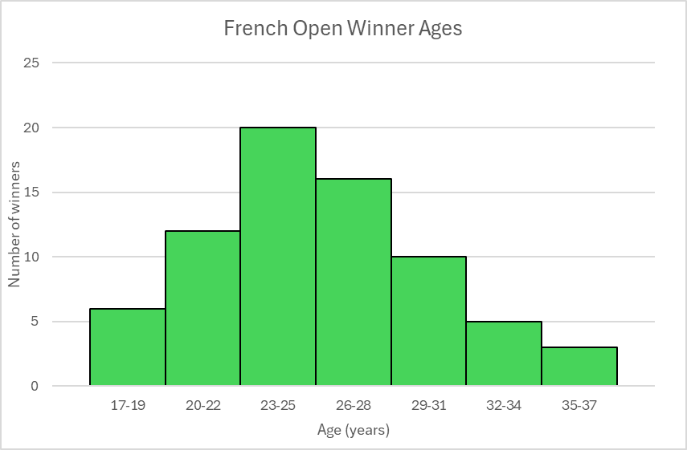
French Open
Frequency table and histogram, grouped data
Age | Frequency
17-19 | 6
20-22 | 12
23-25 | 20
26-28 | 16
29-31 | 10
32-34 | 5
35-37 | 3

Slide 13
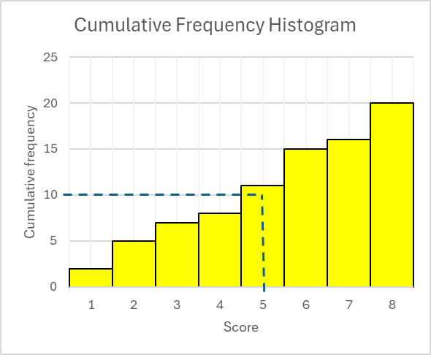
Median (4)
Why is there a line from 10 on the y-axis?
Cumulative frequency example
When might we use a cumulative frequency graph to find the median?
What is the total number of scores?
What does it mean when this line intersects with the column for a score of 5?

Slide 14
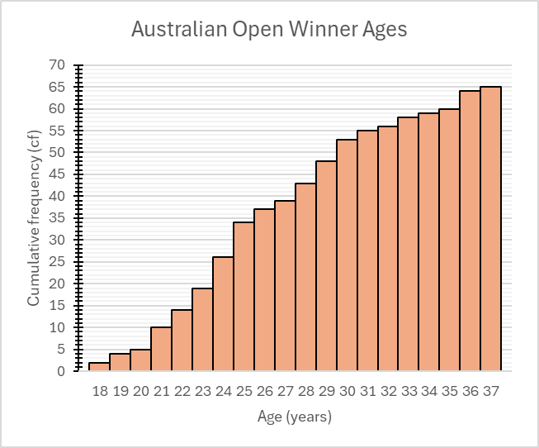
Australian Open
Age | Frequency | Cf
18 | 2 | 2
19 | 2 | 4
20 | 1 | 5
21 | 5 | 10
22 | 4 | 14
23 | 5 | 19
24 | 7 | 26
25 | 8 | 34
26 | 3 | 37
27 | 2 | 39
28 | 4 | 43
29 | 5 | 48
30 | 5 | 53
31 | 2 | 55
32 | 1 | 56
33 | 2 | 58
34 | 1 | 59
35 | 1 | 60
36 | 4 | 64
37 | 1 | 65
Cumulative frequency histogram

Slide 15
Independent practice

Slide 16
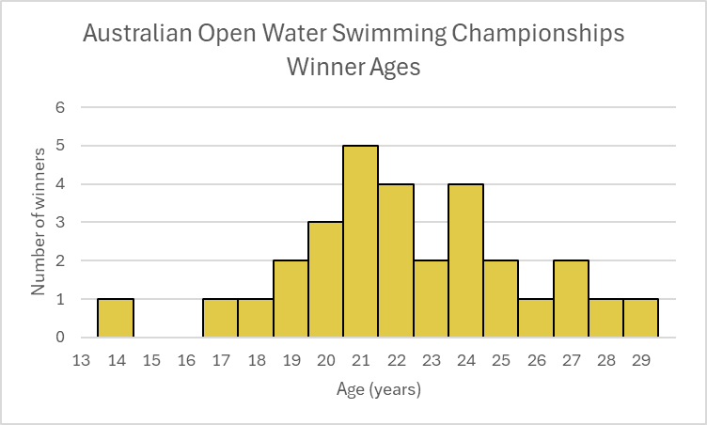
Australian Open Water Swimming Championships (1)
Frequency histogram
Age | Frequency
14 | 1
15 | 0
16 | 0
17 | 1
18 | 1
19 | 2
20 | 3
21 | 5
22 | 4
23 | 2
24 | 4
25 | 2
26 | 1
27 | 2
28 | 1
29 | 1

Slide 17
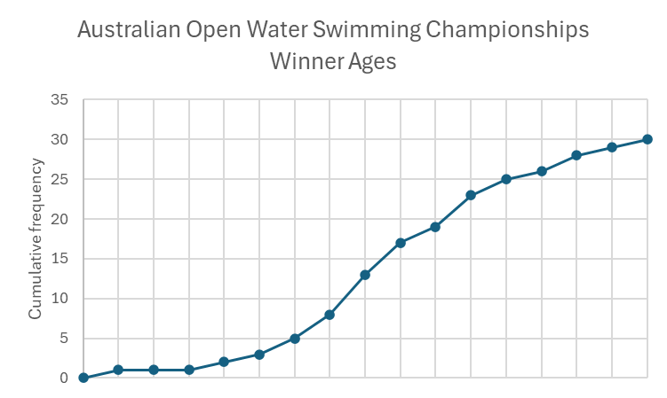

Australian Open Water Swimming Championships (2)
Cumulative frequency polygon
Age | Cumulative frequency
14 | 1
15 | 1
16 | 1
17 | 2
18 | 3
19 | 5
20 | 8
21 | 13
22 | 17
23 | 19
24 | 23
25 | 25
26 | 26
27 | 28
28 | 29
29 | 30

Slide 18
References
This presentation contains NSW Curriculum and syllabus content. The NSW Curriculum is developed by the NSW Education Standards Authority. This content is prepared by NESA for and on behalf of the Crown in the right of the State of New South Wales. The material is protected by Crown copyright.
Please refer to the NESA Copyright Disclaimer for more information https://educationstandards.nsw.edu.au/wps/portal/nesa/mini-footer/copyright.
NESA holds the only official and up-to-date versions of the NSW Curriculum and syllabus documents. Please visit the NSW Education Standards Authority (NESA) website https://educationstandards.nsw.edu.au/wps/portal/nesa/home and the NSW Curriculum website https://curriculum.nsw.edu.au.
Mathematics Advanced 11–12 Syllabus © NSW Education Standards Authority (NESA) for and on behalf of the Crown in right of the State of New South Wales, 2024.

Slide 19
Copyright
© State of New South Wales (Department of Education), 2025
The copyright material published in this resource is subject to the Copyright Act 1968 (Cth) and is owned by the NSW Department of Education or, where indicated, by a party other than the NSW Department of Education (third-party material).
Copyright material available in this resource and owned by the NSW Department of Education is licensed under a Creative Commons Attribution 4.0 International (CC BY 4.0) license.
This license allows you to share and adapt the material for any purpose, even commercially.
Attribution should be given to © State of New South Wales (Department of Education), 2025.
Material in this resource not available under a Creative Commons license:
the NSW Department of Education logo, other logos and trademark-protected material
Material owned by a third party that has been reproduced with permission. You will need to obtain permission from the third party to reuse its material.
Links to third-party material and websites
Please note that the provided (reading/viewing material/list/links/texts) are a suggestion only and implies no endorsement, by the New South Wales Department of Education, of any author, publisher, or book title. School principals and teachers are best placed to assess the suitability of resources that would complement the curriculum and reflect the needs and interests of their students.
If you use the links provided in this document to access a third-party’s website, you acknowledge that the terms of use, including licence terms set out on the third-party’s website apply to the use which may be made of the materials on that third-party website or where permitted by the Copyright Act 1968 (Cth). The department accepts no responsibility for content on third-party websites.

