Slide 1
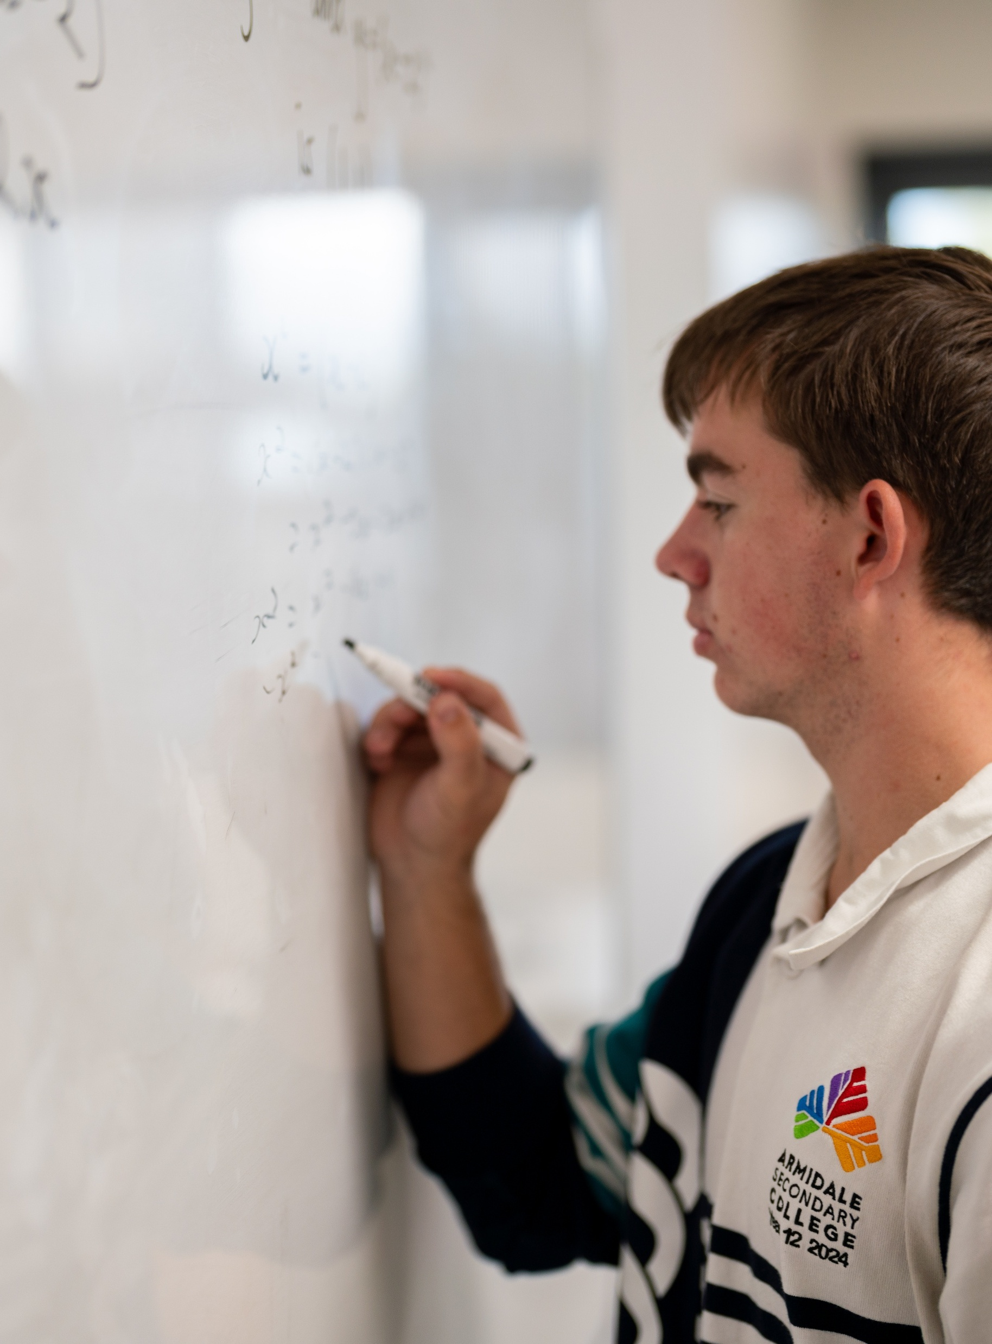
Dilations of trigonometric functions
Mathematics Advanced – Stage 6 (Year 12)
Further differentiation, modelling and graphing

Slide 2
Learning intentions and success criteria
Learning intentions
To be able to apply transformation principles to graph transformed trigonometric functions.
To be able to develop and use transformed trigonometric models to represent real world situations.
Success criteria
I can describe the effect of vertical dilation on amplitude.
I can describe the effect of horizontal dilation on period.
I can apply multiple transformations in the correct order to graph a variety of trigonometric functions.
I can construct a transformed trigonometric function to model a given situation and interpret its meaning in context.

Slide 3
Activating prior knowledge

Slide 4
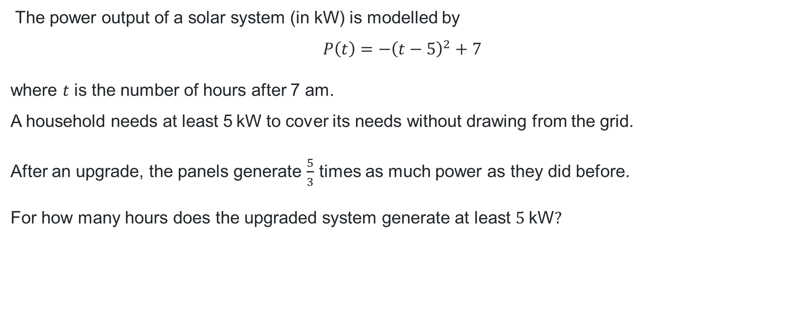
Scenario (1)
The power output of a solar system (in $\text{kW}$) is modelled by
$$P\left(t\right)=−{\left(t−5\right)}^{2}+7$$
where $t$ is the number of hours after 7 am.
A household needs at least 5$\text{kW}$ to cover its needs without drawing from the grid.
After an upgrade, the panels generate $\frac{5}{3}$ times as much power as they did before.
For how many hours does the upgraded system generate at least $5 \text{kW}?$

Slide 5
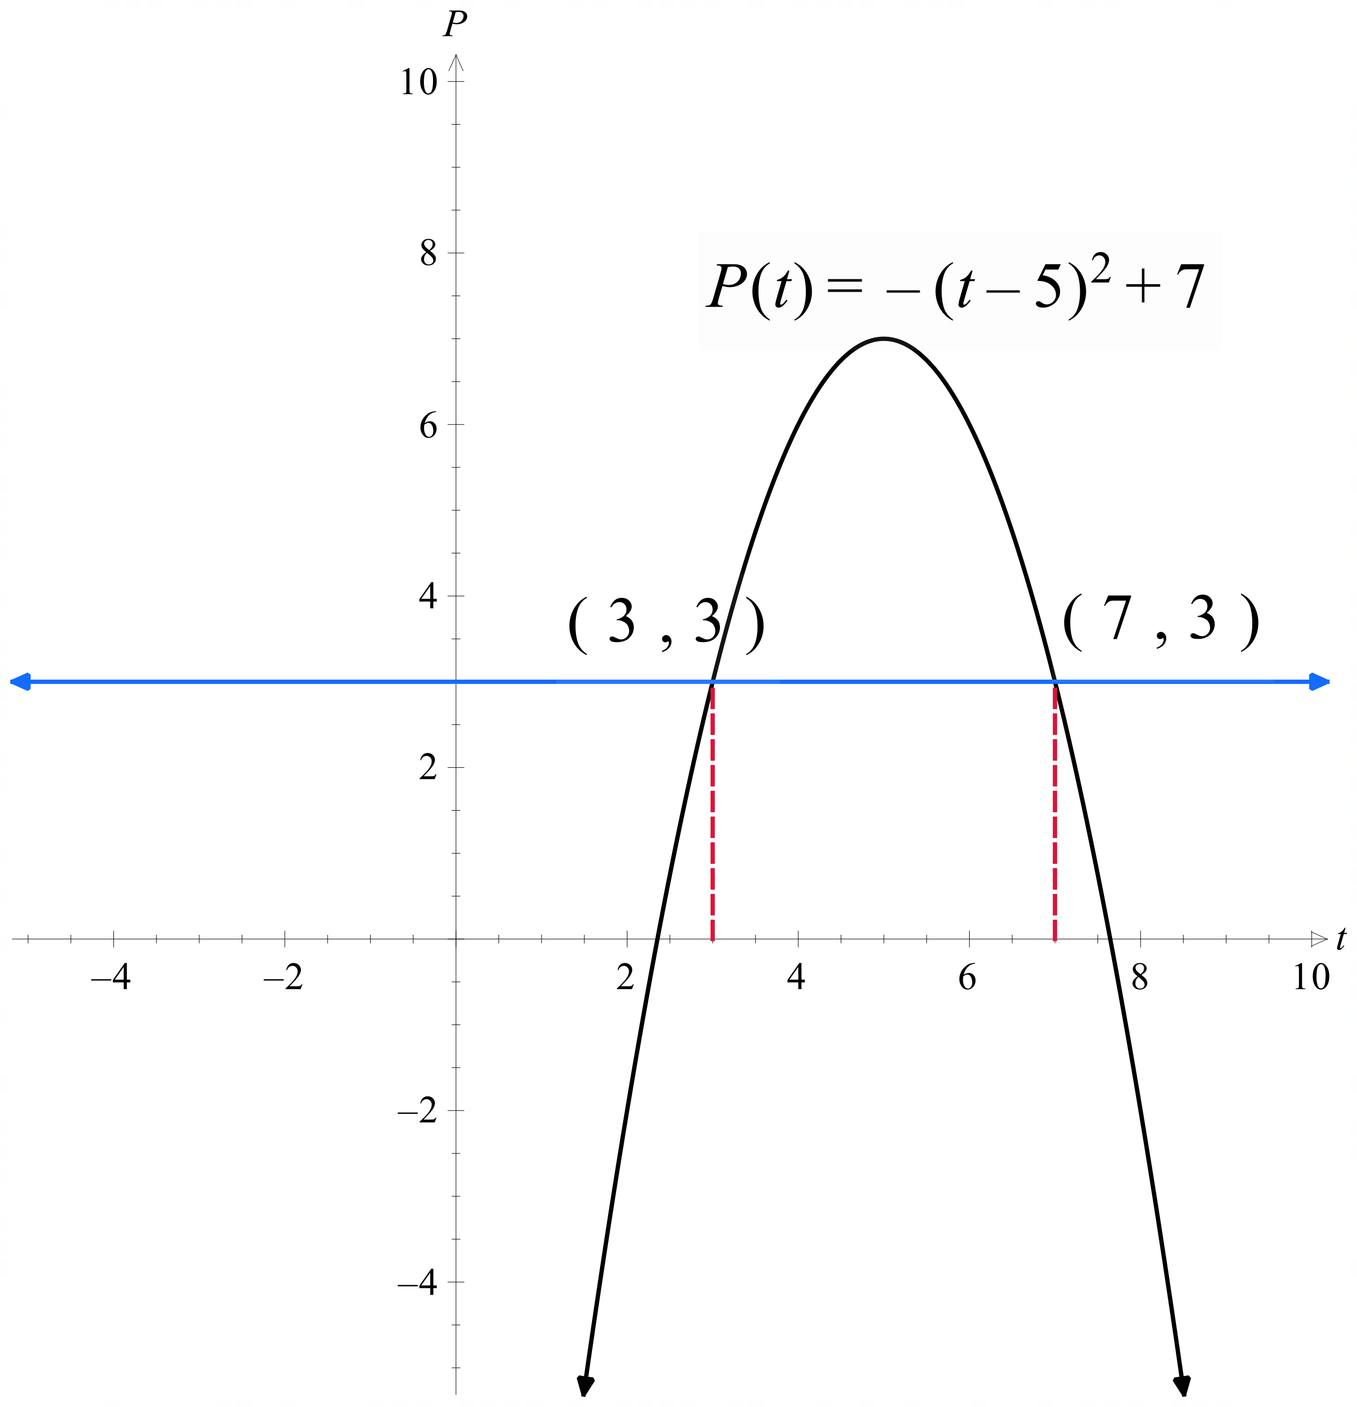
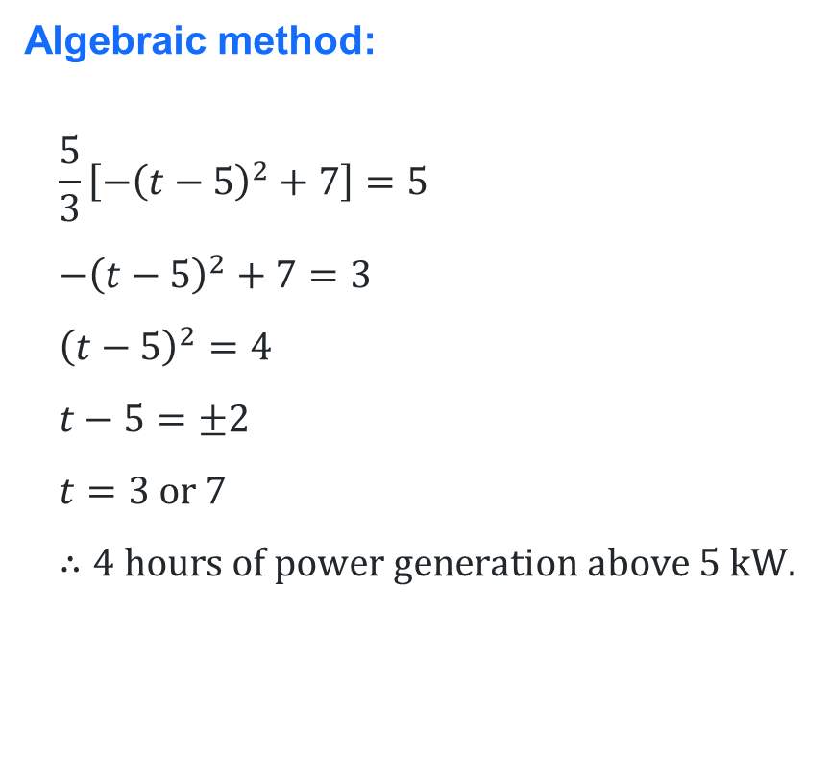
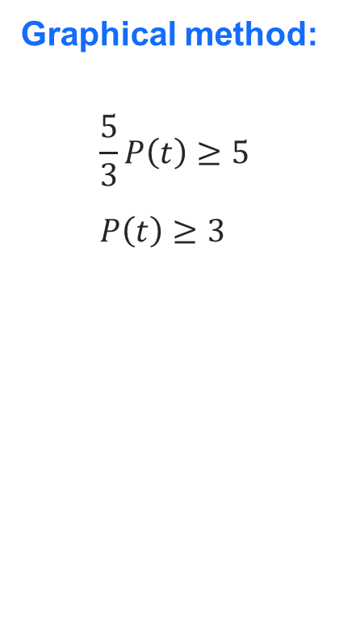
Solution
Graphical method:
$$\frac{5}{3}P\left(t\right)≥5 \\ P\left(t\right)≥3$$
Comparison
Algebraic method:
$$\frac{5}{3}\left[−{\left(t−5\right)}^{2}+7\right]=5 \\ {−\left(t−5\right)}^{2}+7=3 \\ {\left(t−5\right)}^{2}=4 \\ t−5=±2 \\ t=3 \text{or} 7 \\ ∴4 \text{hours} \text{of} \text{power} \text{generation} \text{above} 5 \text{kW}\text{.}$$

Slide 6
Connecting learning

Slide 7

Check for understanding (1)
Question 1
For $y=4\sin{x}$, what is the amplitude?
$4$
$−4$
$1$
$2π$

Slide 8

Check for understanding (2)
Question 2
For $y=−3\cos{x}$, what is the amplitude?
$−3$
$3$
$1$
$π$

Slide 9

Check for understanding (3)
Question 3
For $y=2\sin{x}+5$, what is the amplitude?
$2$
$5$
$7$
$3$

Slide 10
Releasing responsibility

Slide 11

Connecting dilations with period and amplitude
A vertical dilation affects the amplitude of sine and cosine functions and changes the ‘steepness’ of the tangent function.
A horizontal dilation changes the period of all trigonometric functions. For sine and cosine functions, the period is calculated as $\frac{2π}{a}$ and for the tangent function, the period is calculated as $\frac{π}{a}$.

Slide 12
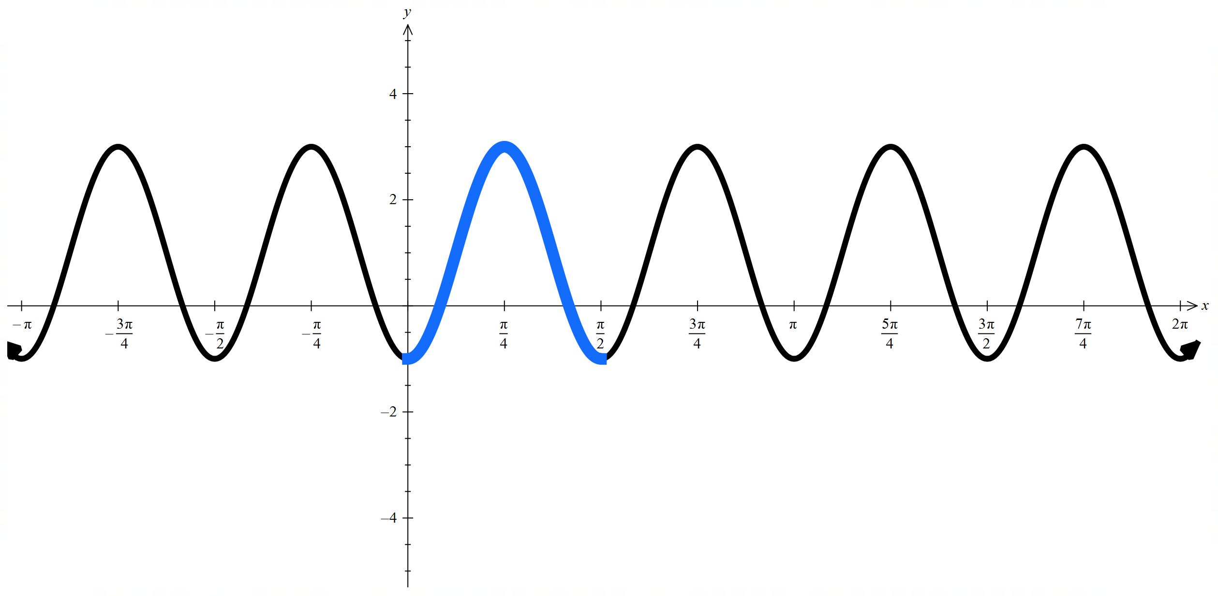

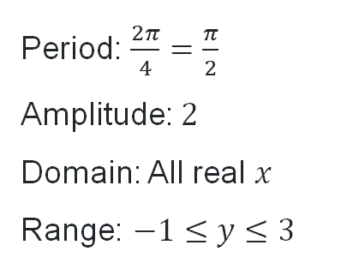
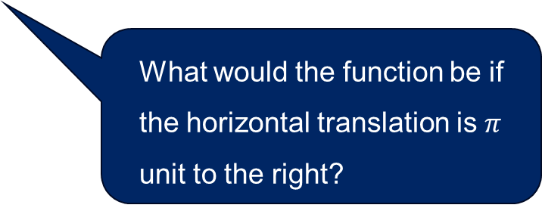
Question 1
If the graph were translated up before being vertically dilated, which features of the graph would remain the same and which would change?
Worked example 1
Sketch the graph of $y=2\cos\left(4x−π\right)+1$, stating the period, amplitude, domain and range.
Solution:
Rearrange to the form $y=kf\left(a\left(x+b\right)\right)+c$.
$$y=2\cos\left(4\left(x−\frac{π}{4}\right)\right)+1$$
Horizontally dilate by a factor of $\frac{1}{4}$
Translate to the right by $\frac{π}{4}$
Vertically dilate by a factor of $2$
Translate up by $1$
Period: $\frac{2π}{4}=\frac{π}{2}$
Amplitude: $2$
Domain: All real $x$
Range: $−1≤y≤3$
What would the function be if the horizontal translation is $π$ unit to the right?

Slide 13
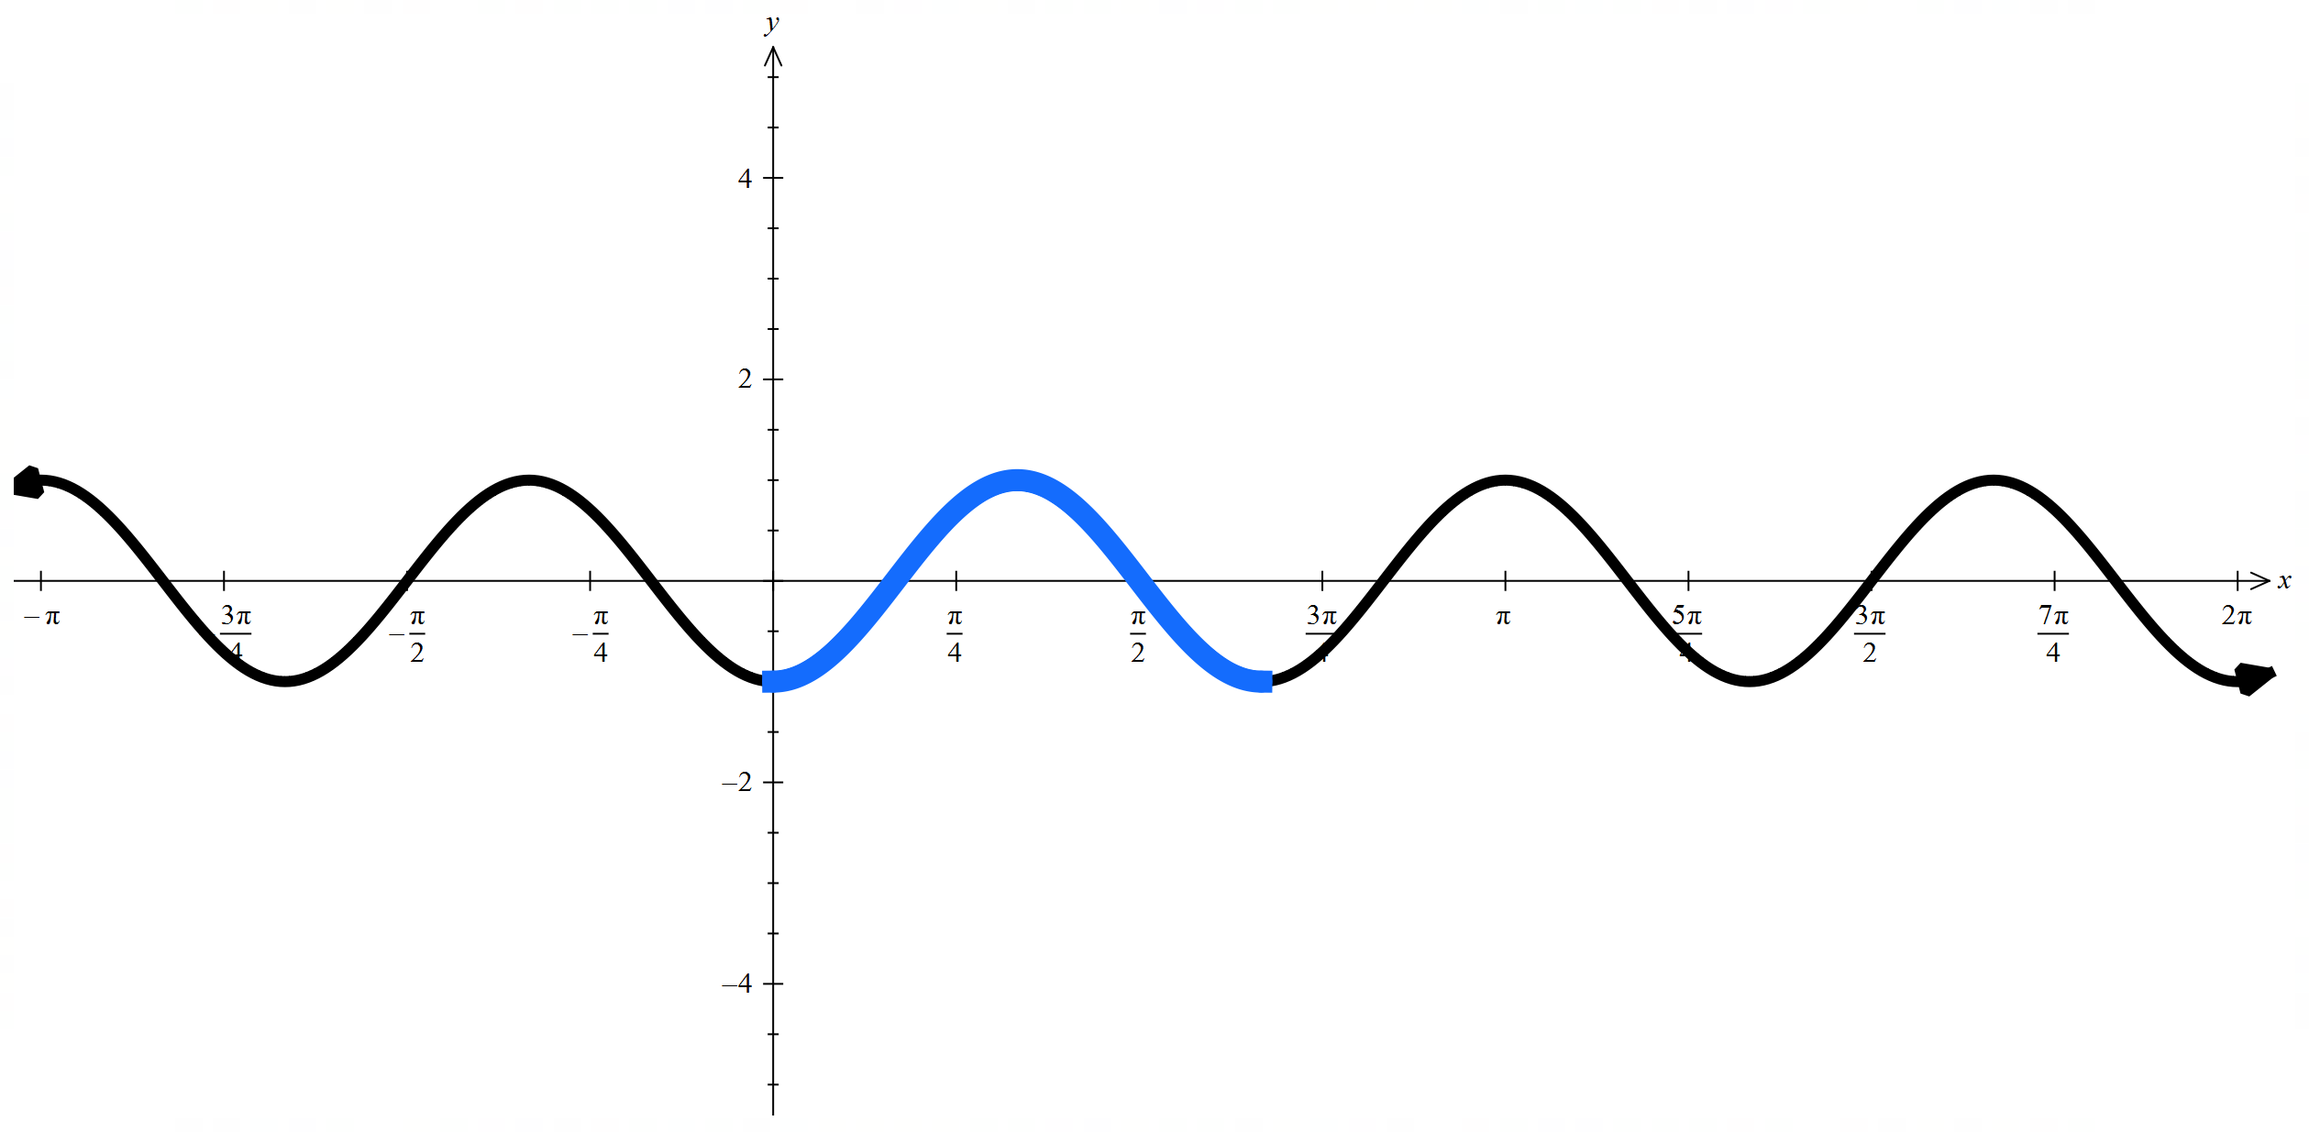


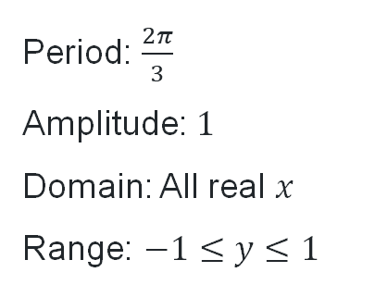
Question 2
Your turn
Sketch the graph of $y=\sin\left(3x−\frac{π}{2}\right)$, stating the period, amplitude, domain and range.
Solution:
Rearrange to the form $y=kf\left(a\left(x+b\right)\right)+c$.
$$y=\sin\left(3\left(x−\frac{π}{6}\right)\right)$$
Horizontally dilate by a factor of $\frac{1}{3}$
Translate to the right by $\frac{π}{6}$
Period: $\frac{2π}{3}$
Amplitude: $1$
Domain: All real $x$
Range: $−1≤y≤1$

Slide 14
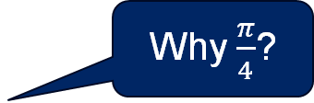
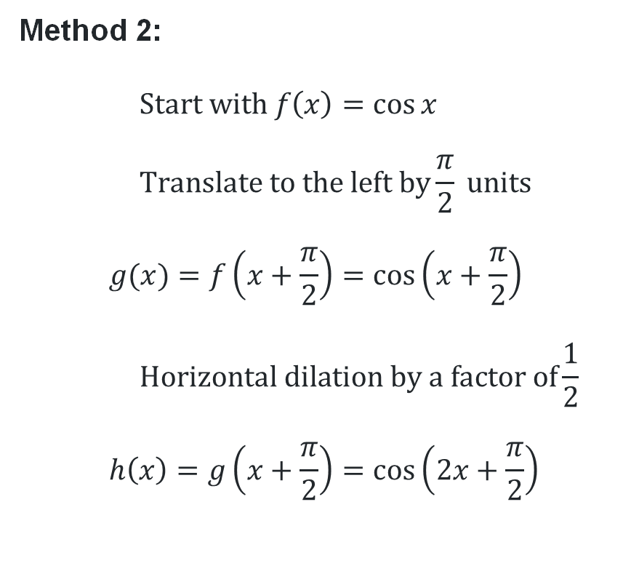
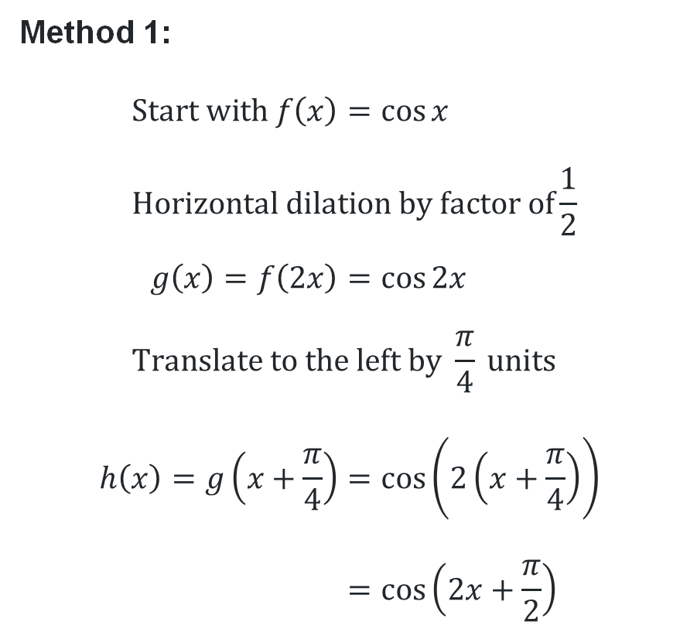
Worked example comparison
Sketch the graph of $y=\cos\left(2x+\frac{π}{2}\right)$
Method 1:
$$\text{Start} \text{with} f\left(x\right)=\cos{x} \\ \text{Horizontal} \text{dilation} \text{by} \text{factor} \text{of}\frac{1}{2} \\ g\left(x\right)=f\left(2x\right)=\cos{2x} \\ \text{Translate} \text{to} \text{the} \text{left} \text{by} \frac{π}{4} \text{units} \\ h\left(x\right)=g\left(x+\frac{π}{4}\right)=\cos\left(2\left(x+\frac{π}{4}\right)\right) \\ =\cos\left(2x+\frac{π}{2}\right)$$
Method 2:
$$\text{Start} \text{with} f\left(x\right)=\cos{x} \\ \text{Translate} \text{to} \text{the} \text{left} \text{by}\frac{π}{2} \text{units} \\ g(x)=f\left(x+\frac{π}{2}\right)=\cos\left(x+\frac{π}{2}\right) \\ \text{Horizontal} \text{dilation} \text{by} \text{a} \text{factor} \text{of}\frac{1}{2} \\ h\left(x\right)=g\left(x+\frac{π}{2}\right)=\cos\left(2x+\frac{π}{2}\right)$$
Why $\frac{π}{4}$?

Slide 15
Independent practice

Slide 16

Approaching questions scaffold

Slide 17
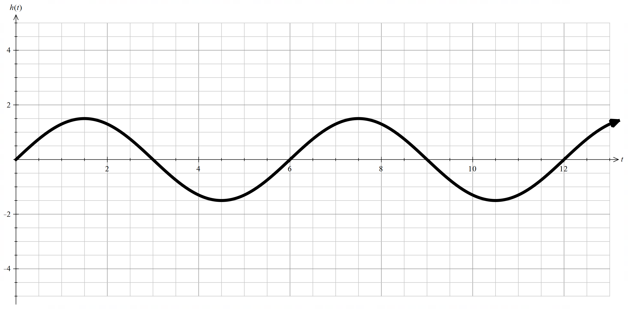
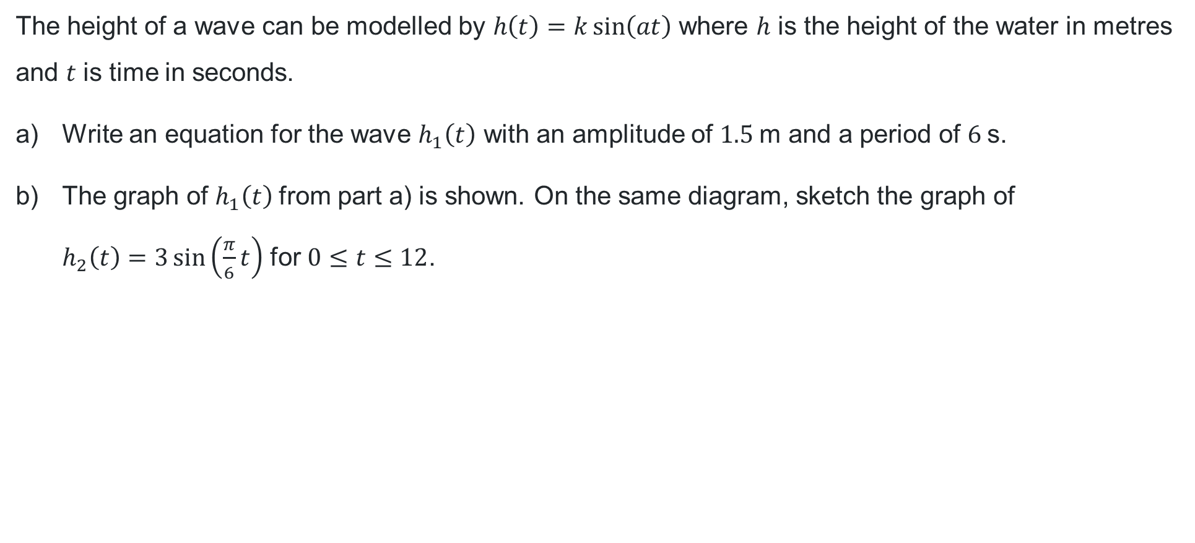
HSC-style question (1)
The height of a wave can be modelled by $h\left(t\right)=k\sin\left(at\right)$ where $h$ is the height of the water in metres and $t$ is time in seconds.
Write an equation for the wave $h_{1}\left(t\right)$ with an amplitude of $1.5 \text{m}$ and a period of $6 \text{s}$.
The graph of $h_{1}\left(t\right)$from part a) is shown. On the same diagram, sketch the graph of
$h_{2}\left(t\right)=3\sin\left(\frac{π}{6}t\right)$ for $0≤t≤12$.

Slide 18
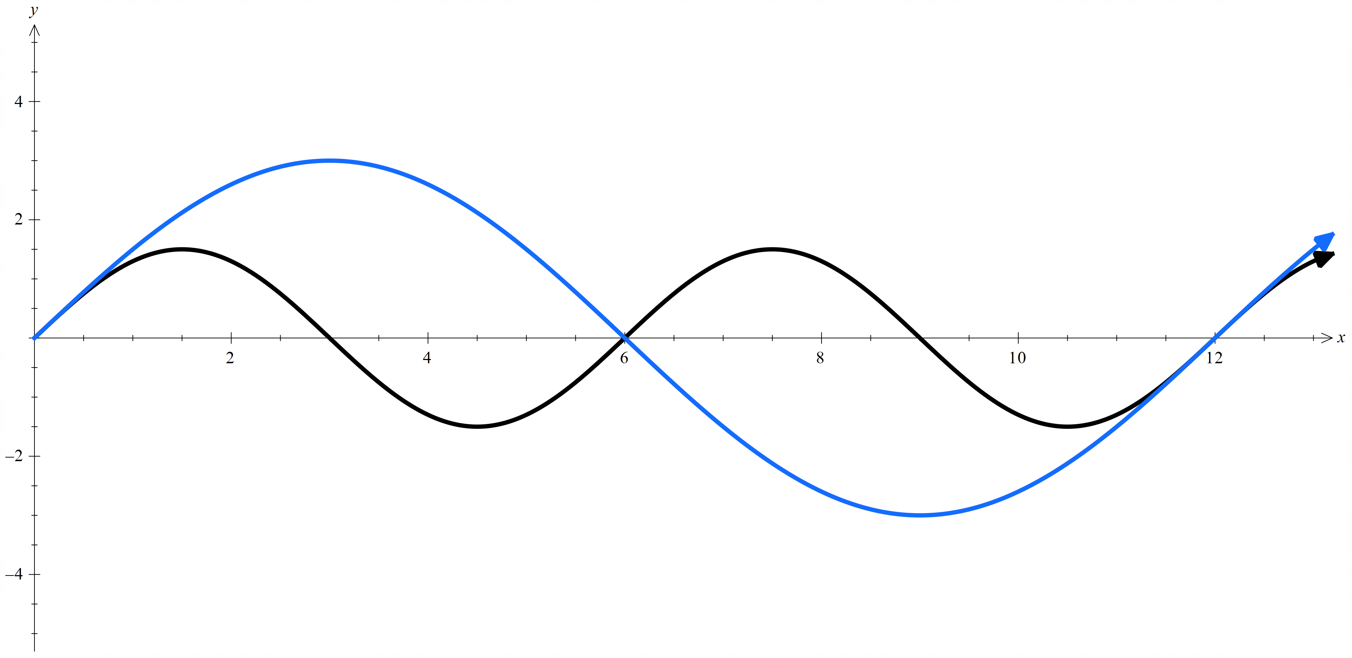
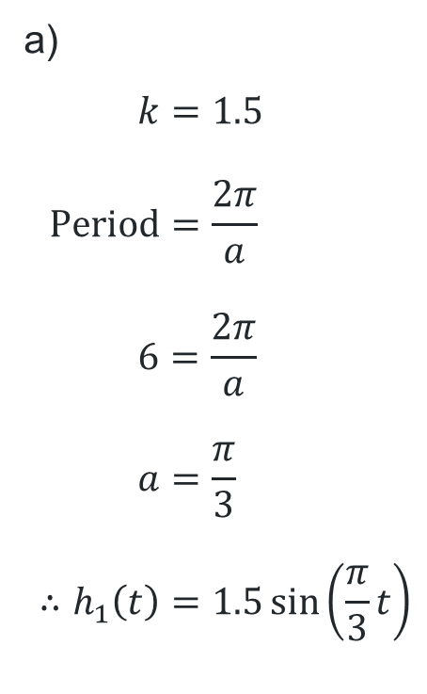
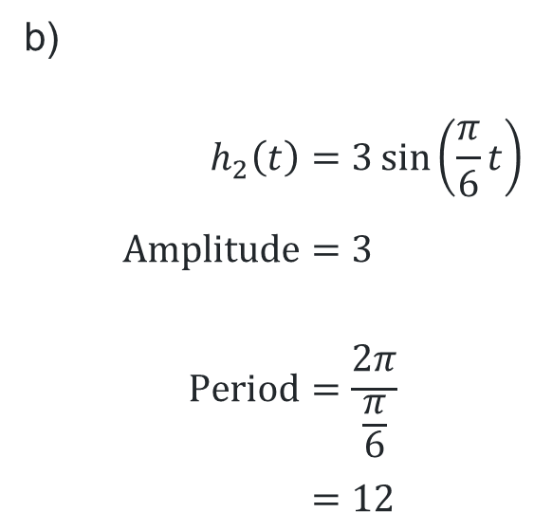
HSC-style question (2)
Solutions
a)
$$k=1.5 \\ \text{Period}=\frac{2π}{a} \\ 6=\frac{2π}{a} \\ a=\frac{π}{3} \\ ∴h_{1}\left(t\right)=1.5\sin\left(\frac{π}{3}t\right)$$
b)
$$h_{2}\left(t\right)=3\sin\left(\frac{π}{6}t\right) \\ \text{Amplitude}=3 \\ \text{Period}=\frac{2π}{\frac{π}{6}} \\ =12$$

Slide 19
References
This presentation contains NSW Curriculum and syllabus content. The NSW Curriculum is developed by the NSW Education Standards Authority. This content is prepared by NESA for and on behalf of the Crown in the right of the State of New South Wales. The material is protected by Crown copyright.
Please refer to the NESA Copyright Disclaimer for more information https://www.nsw.gov.au/education-and-training/nesa/copyright.
NESA holds the only official and up-to-date versions of the NSW Curriculum and syllabus documents. Please visit NESA https://www.nsw.gov.au/education-and-training/nesa and NSW Curriculum https://curriculum.nsw.edu.au.
Mathematics Advanced 11-12 Syllabus © NSW Education Standards Authority (NESA) for and on behalf of the Crown in right of the State of New South Wales, 2024.

Slide 20
Copyright
© State of New South Wales (Department of Education), 2026
The copyright material published in this resource is subject to the Copyright Act 1968 (Cth) and is owned by the NSW Department of Education or, where indicated, by a party other than the NSW Department of Education (third-party material).
Copyright material available in this resource and owned by the NSW Department of Education is licensed under a Creative Commons Attribution 4.0 International (CC BY 4.0) license.
This license allows you to share and adapt the material for any purpose, even commercially.
Attribution should be given to © State of New South Wales (Department of Education), 2026.
Material in this resource not available under a Creative Commons license:
the NSW Department of Education logo, other logos and trademark-protected material
Material owned by a third party that has been reproduced with permission. You will need to obtain permission from the third party to reuse its material.
Links to third-party material and websites
Please note that the provided (reading/viewing material/list/links/texts) are a suggestion only and implies no endorsement, by the New South Wales Department of Education, of any author, publisher, or book title. School principals and teachers are best placed to assess the suitability of resources that would complement the curriculum and reflect the needs and interests of their students.
If you use the links provided in this document to access a third-party’s website, you acknowledge that the terms of use, including licence terms set out on the third-party’s website apply to the use which may be made of the materials on that third-party website or where permitted by the Copyright Act 1968 (Cth). The department accepts no responsibility for content on third-party websites.

