Slide 1
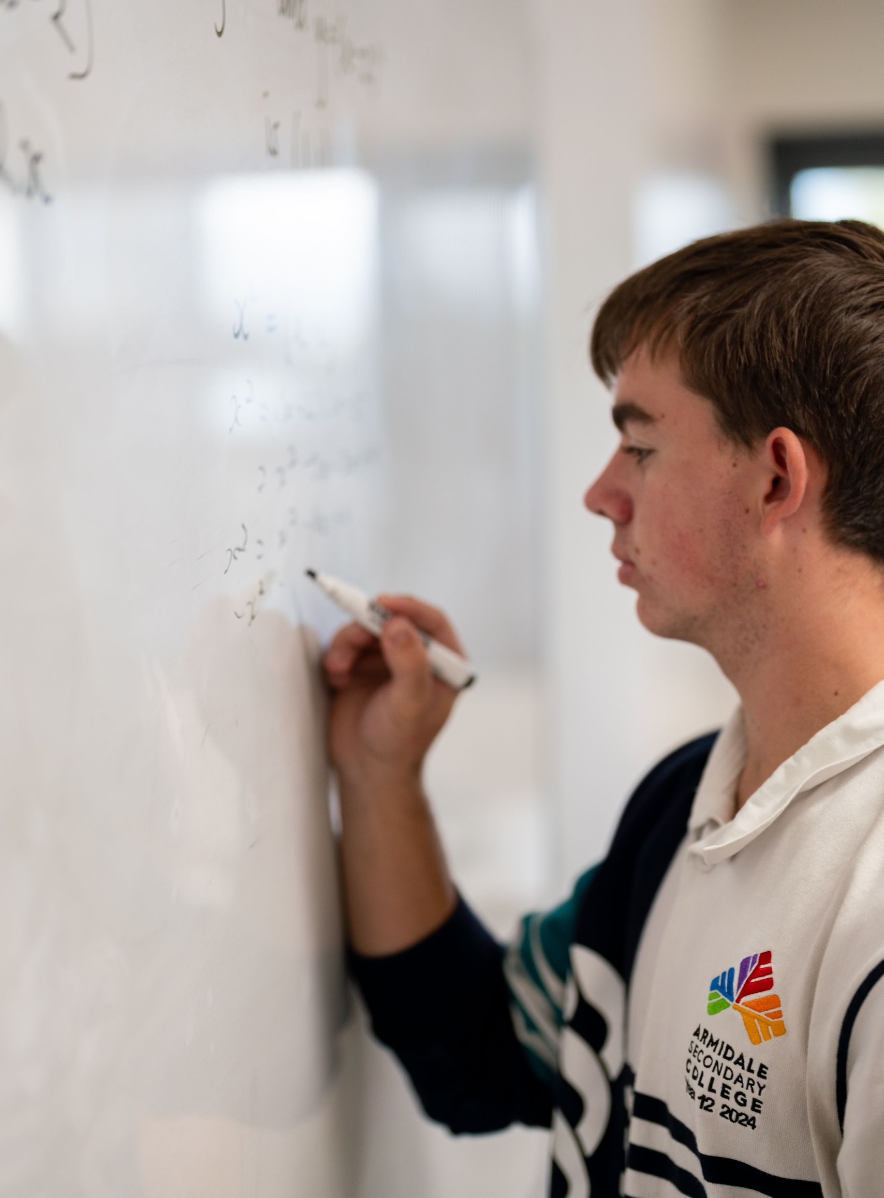
Reflections and translations of trigonometric functions
Mathematics Advanced – Stage 6 (Year 12)
Further differentiation, modelling and graphing

Slide 2
Learning intentions and success criteria
Learning intentions
To be able to identify and describe reflections and translations of trigonometric functions.
To be able to apply reflections and translations to graph transformations on sine, cosine and tangent functions.
To be able to develop and use transformed trigonometric models to represent real world situations.
Success criteria
I can describe the transformations applied to trigonometric functions.
I can find and state the domain and range of a transformed trigonometric function.
I can explain how reflections and translations affect graph properties of trigonometric functions.
I can construct a transformed trigonometric function to model a given situation and interpret its meaning in context.

Slide 3
Activating prior knowledge

Slide 4

Scenario (1)
When a student shoots a basketball, the height of the ball (in metres) after $t$ seconds is modelled by:
$$h\left(t\right)=−{\left(t−2\right)}^{2}+6$$
When is the ball $5$ metres high?

Slide 5
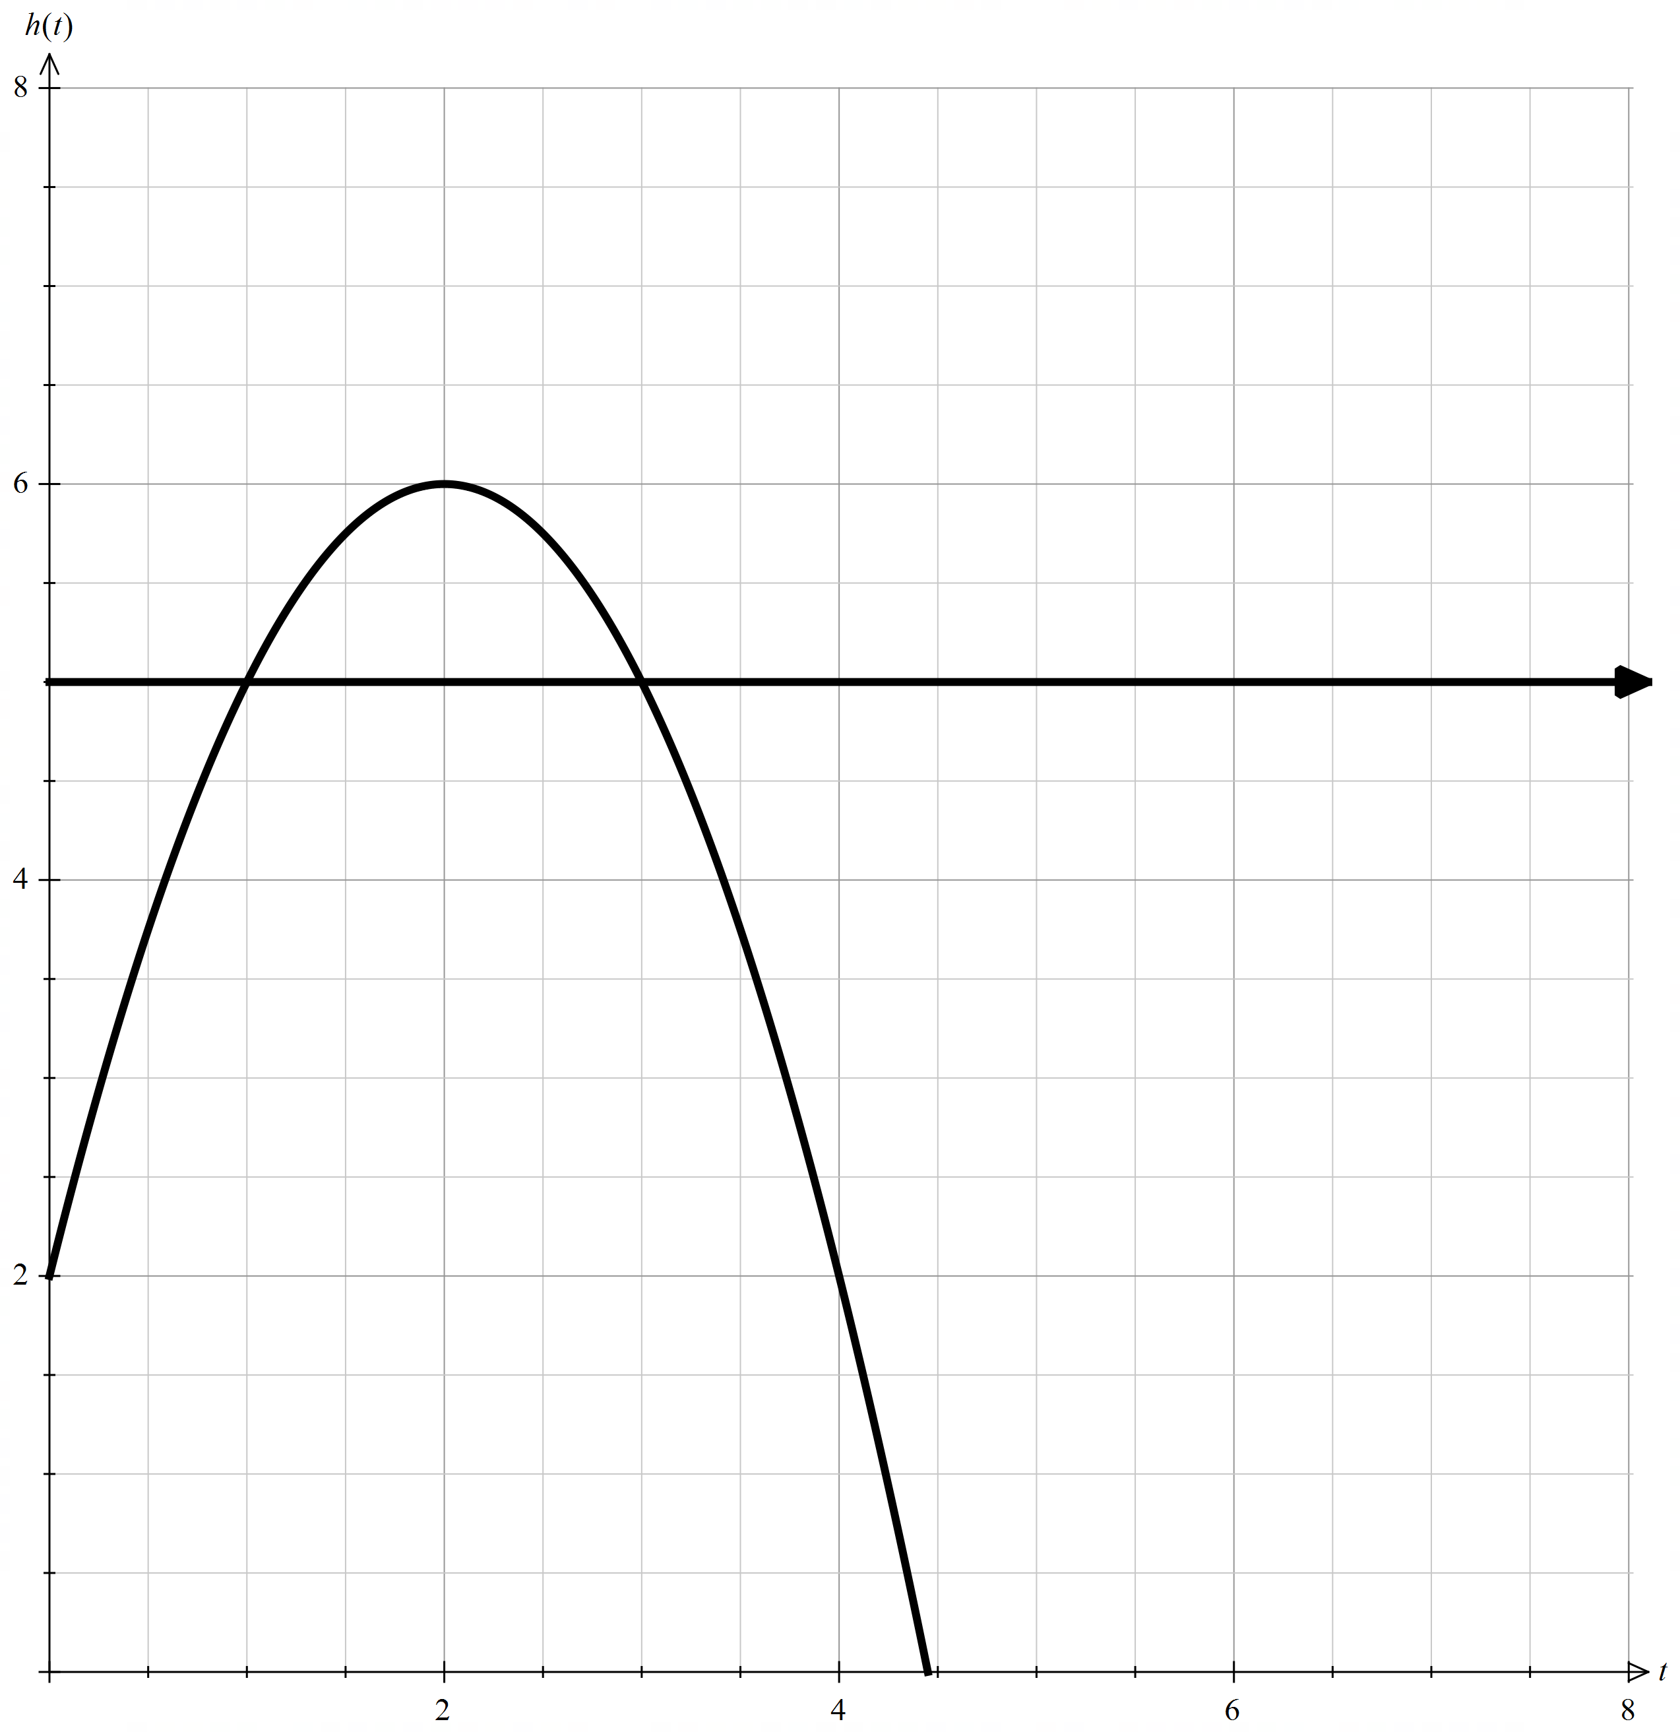
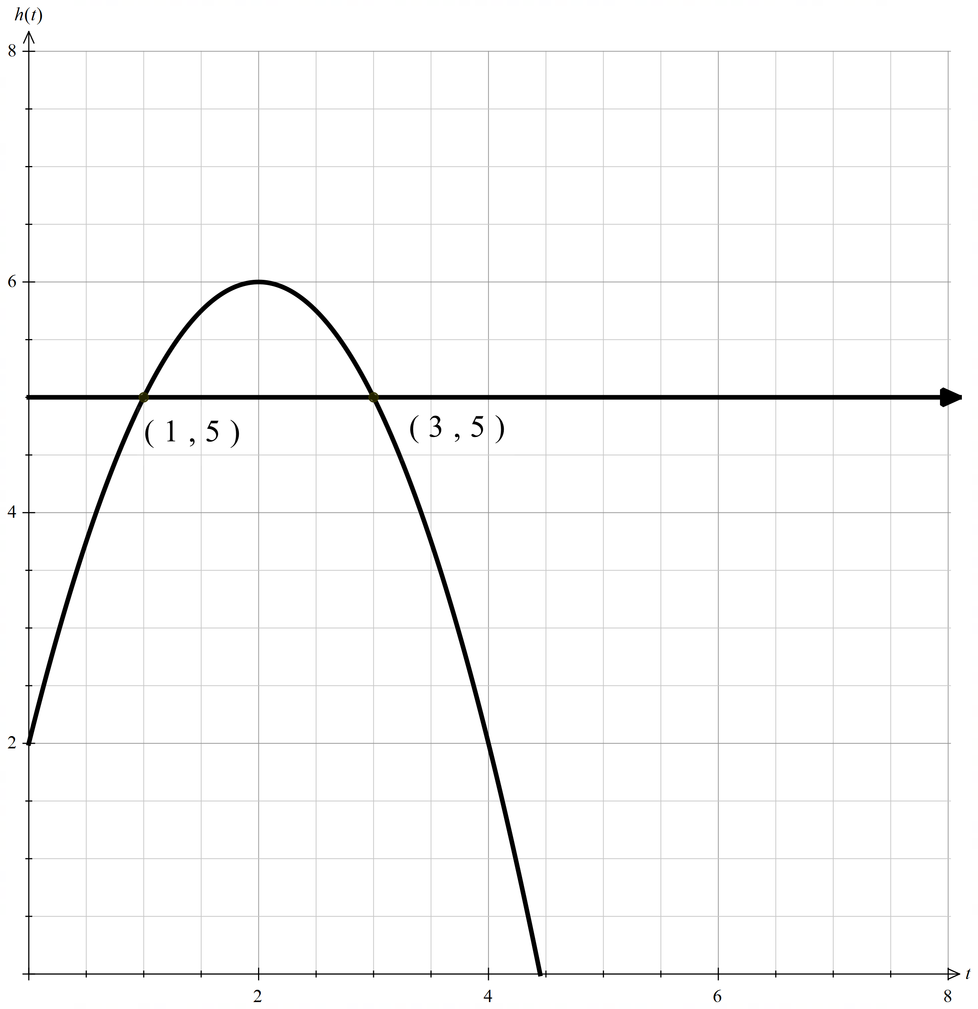

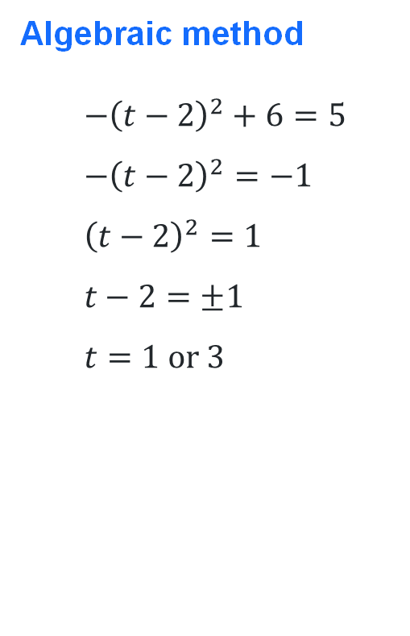
Solution (1)
Algebraic method
$$−{\left(t−2\right)}^{2}+6=5 \\ −{\left(t−2\right)}^{2}=−1 \\ {\left(t−2\right)}^{2}=1 \\ t−2=±1 \\ t=1 \text{or} 3$$
Graphical method
$$∴t=1 \text{or} 3$$
2 points of intersection

Slide 6

Scenario (2)
When a student shoots a basketball, the height of the ball (in metres) after $t$ seconds is modelled by:
$$h\left(t\right)=−{\left(t−2\right)}^{2}+6$$
Another student releases a basketball $3$ seconds later. When will their ball be $5$ metres high?

Slide 7
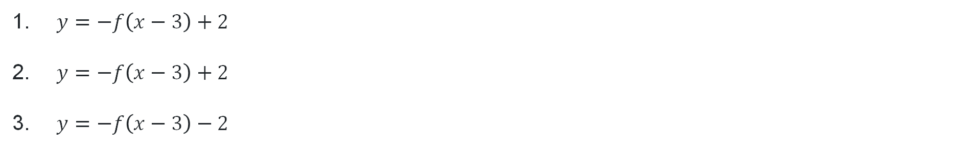
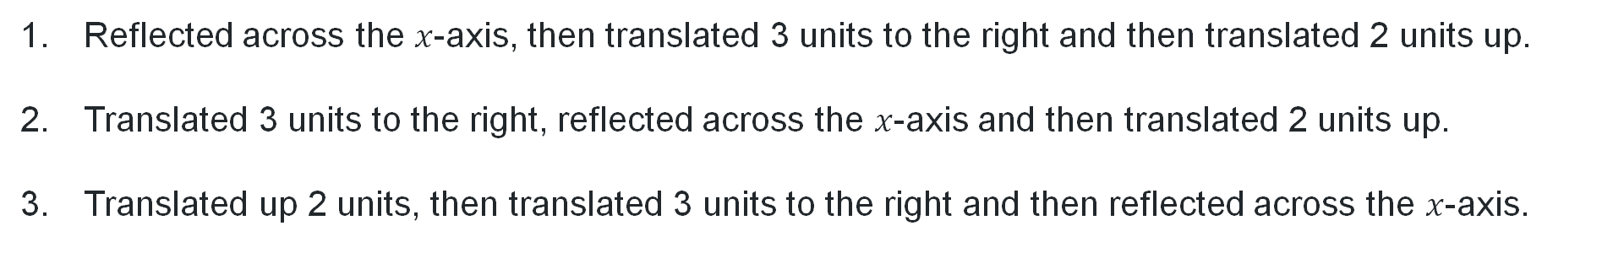
Consider the function $y=f(x)$
What would the new function be if…
Reflected across the $x$-axis, then translated 3 units to the right and then translated 2 units up.
Translated 3 units to the right, reflected across the $x$-axis and then translated 2 units up.
Translated up 2 units, then translated 3 units to the right and then reflected across the $x$-axis.
$y=−f\left(x−3\right)+2$
$y=−f\left(x−3\right)+2$
$y=−f\left(x−3\right)−2$
Why does one transformation differ from the others?

Slide 8
Connecting learning

Slide 9
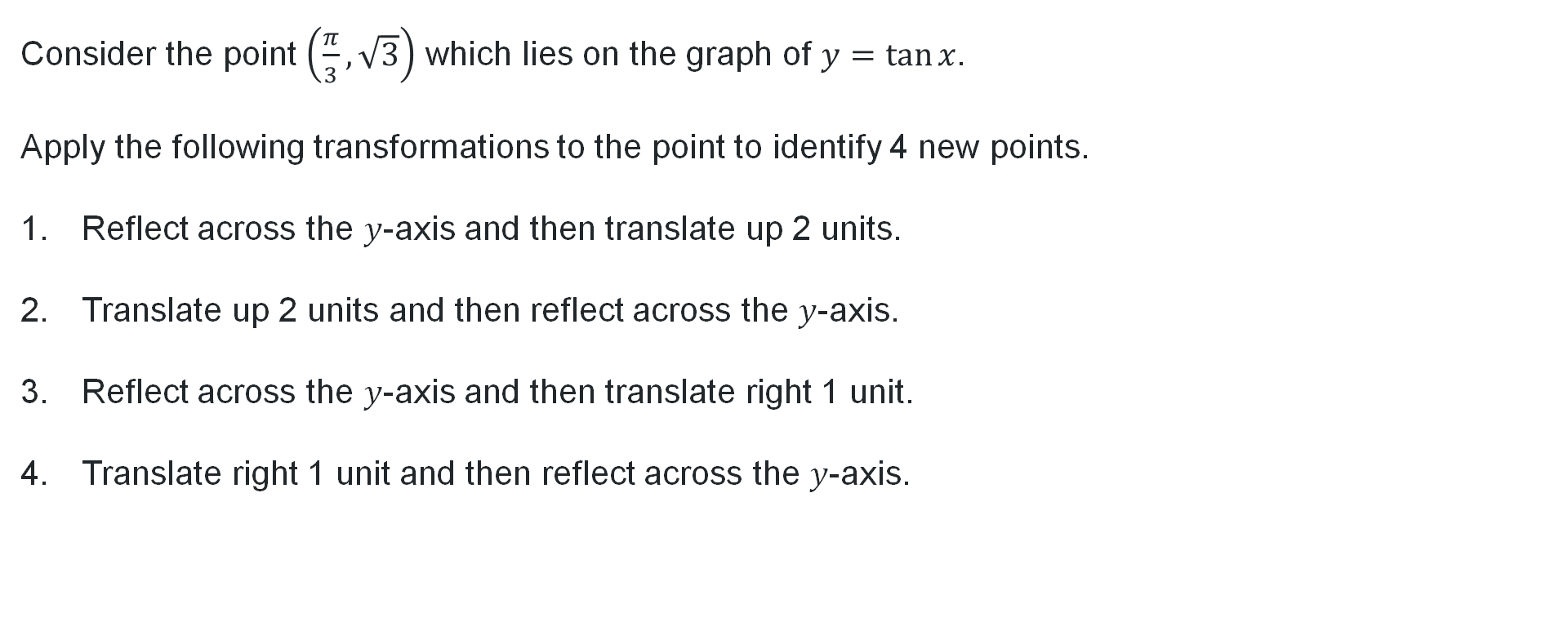
Multiple transformations on $y=\tan{x}$
Consider the point $\left(\frac{π}{3},\sqrt{3}\right)$ which lies on the graph of $y=\tan{x}$.
Apply the following transformations to the point to identify 4 new points.
Reflect across the $y$-axis and then translate up 2 units.
Translate up 2 units and then reflect across the $y$-axis.
Reflect across the $y$-axis and then translate right 1 unit.
Translate right 1 unit and then reflect across the $y$-axis.

Slide 10
Releasing responsibility

Slide 11
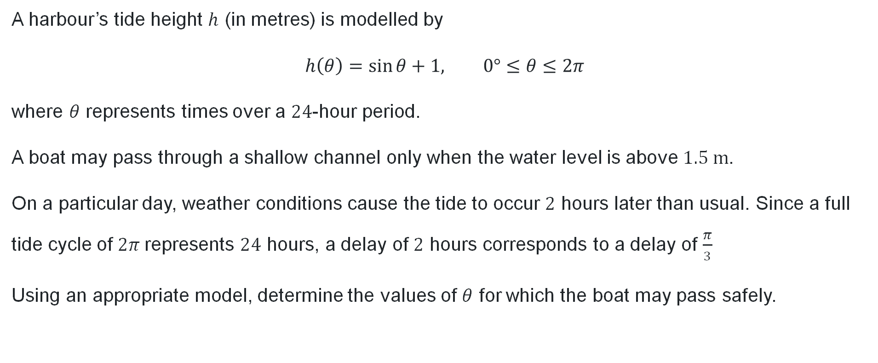
Worked example (1)
Question 1
A harbour’s tide height $h$ (in metres) is modelled by
$$h\left(θ\right)=\sin{θ}+1, 0°≤θ≤2π$$
where $θ$ represents times over a $24$-hour period.
A boat may pass through a shallow channel only when the water level is above $1.5 \text{m}$.
On a particular day, weather conditions cause the tide to occur $2$ hours later than usual. Since a full tide cycle of $2π$represents $24$ hours, a delay of $2$ hours corresponds to a delay of $\frac{π}{3}$
Using an appropriate model, determine the values of $θ$ for which the boat may pass safely.

Slide 12
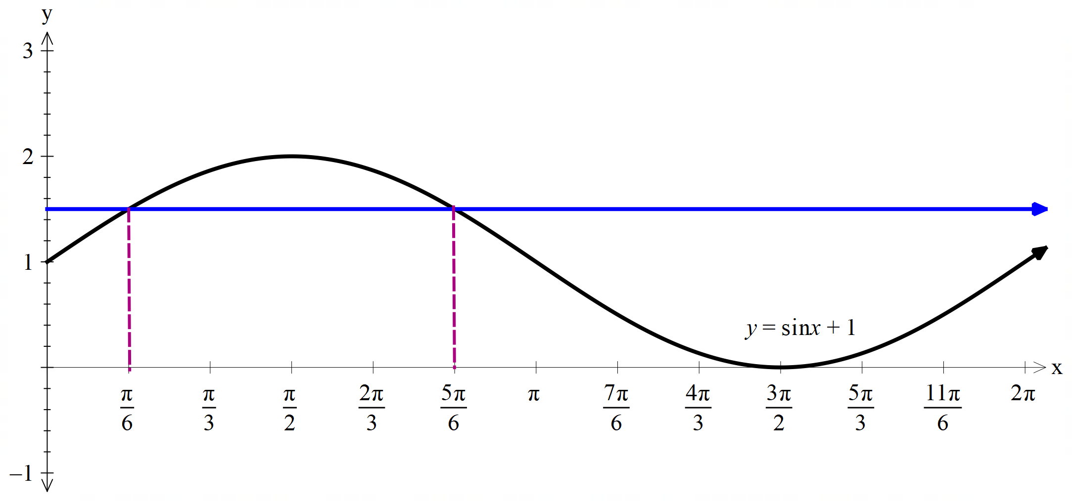
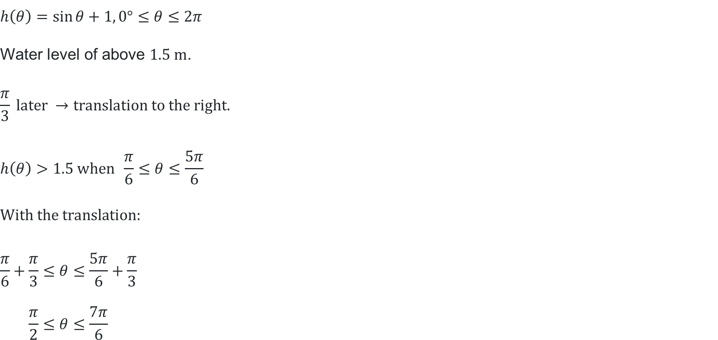
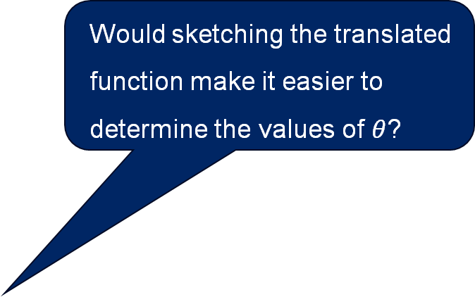
Worked example (2)
Would sketching the translated function make it easier to determine the values of $θ$?
How does the graph help verify the number of solutions?
Solution
$$h\left(θ\right)=\sin{θ}+1, 0°≤θ≤2π$$
$$\text{Water} \text{level} \text{of} \text{above} 1.5 \text{m}\text{.}$$
$$\frac{π}{3} \text{later} →\text{translation} \text{to} \text{the} \text{right}\text{.}$$
$$h\left(θ\right)>1.5 \text{when} \frac{π}{6}≤θ≤\frac{5π}{6}$$
$$\text{With} \text{the} \text{translation}\text{:}$$
$$\frac{π}{6}+\frac{π}{3}≤θ≤\frac{5π}{6}+\frac{π}{3} \\ \frac{π}{2}≤θ≤\frac{7π}{6}$$
What is the maximum height of the wave?

Slide 13
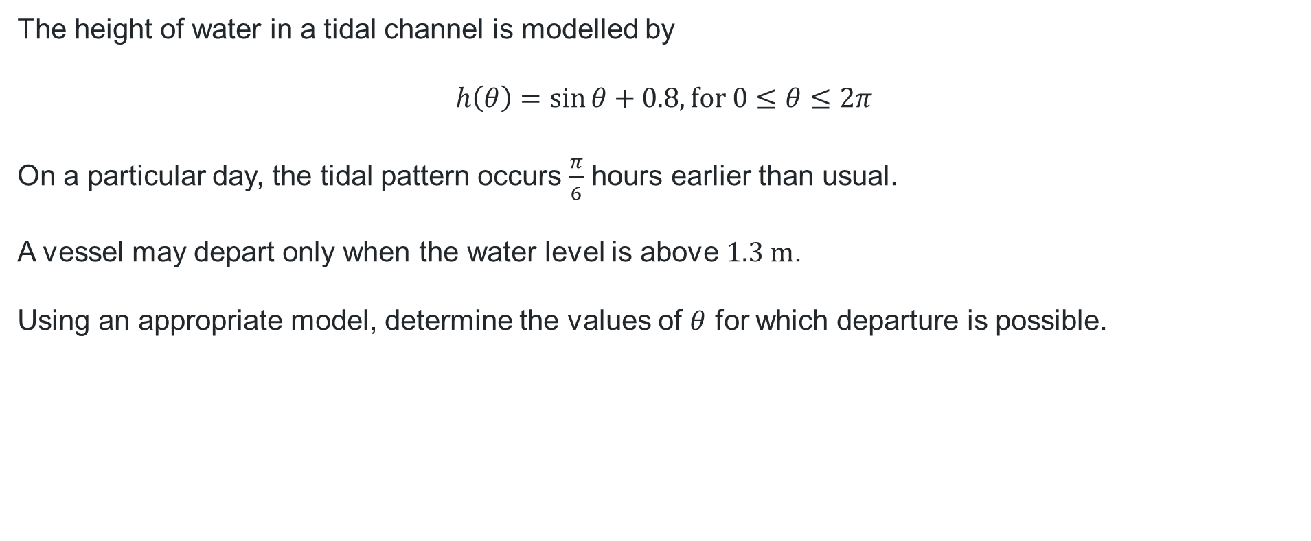
Your turn (1)
Question 2
The height of water in a tidal channel is modelled by
$$h\left(θ\right)=\sin{θ}+0.8, \text{for} 0≤θ≤2π$$
On a particular day, the tidal pattern occurs $\frac{π}{6}$ hours earlier than usual.
A vessel may depart only when the water level is above $1.3 \text{m}$.
Using an appropriate model, determine the values of $θ$ for which departure is possible.

Slide 14
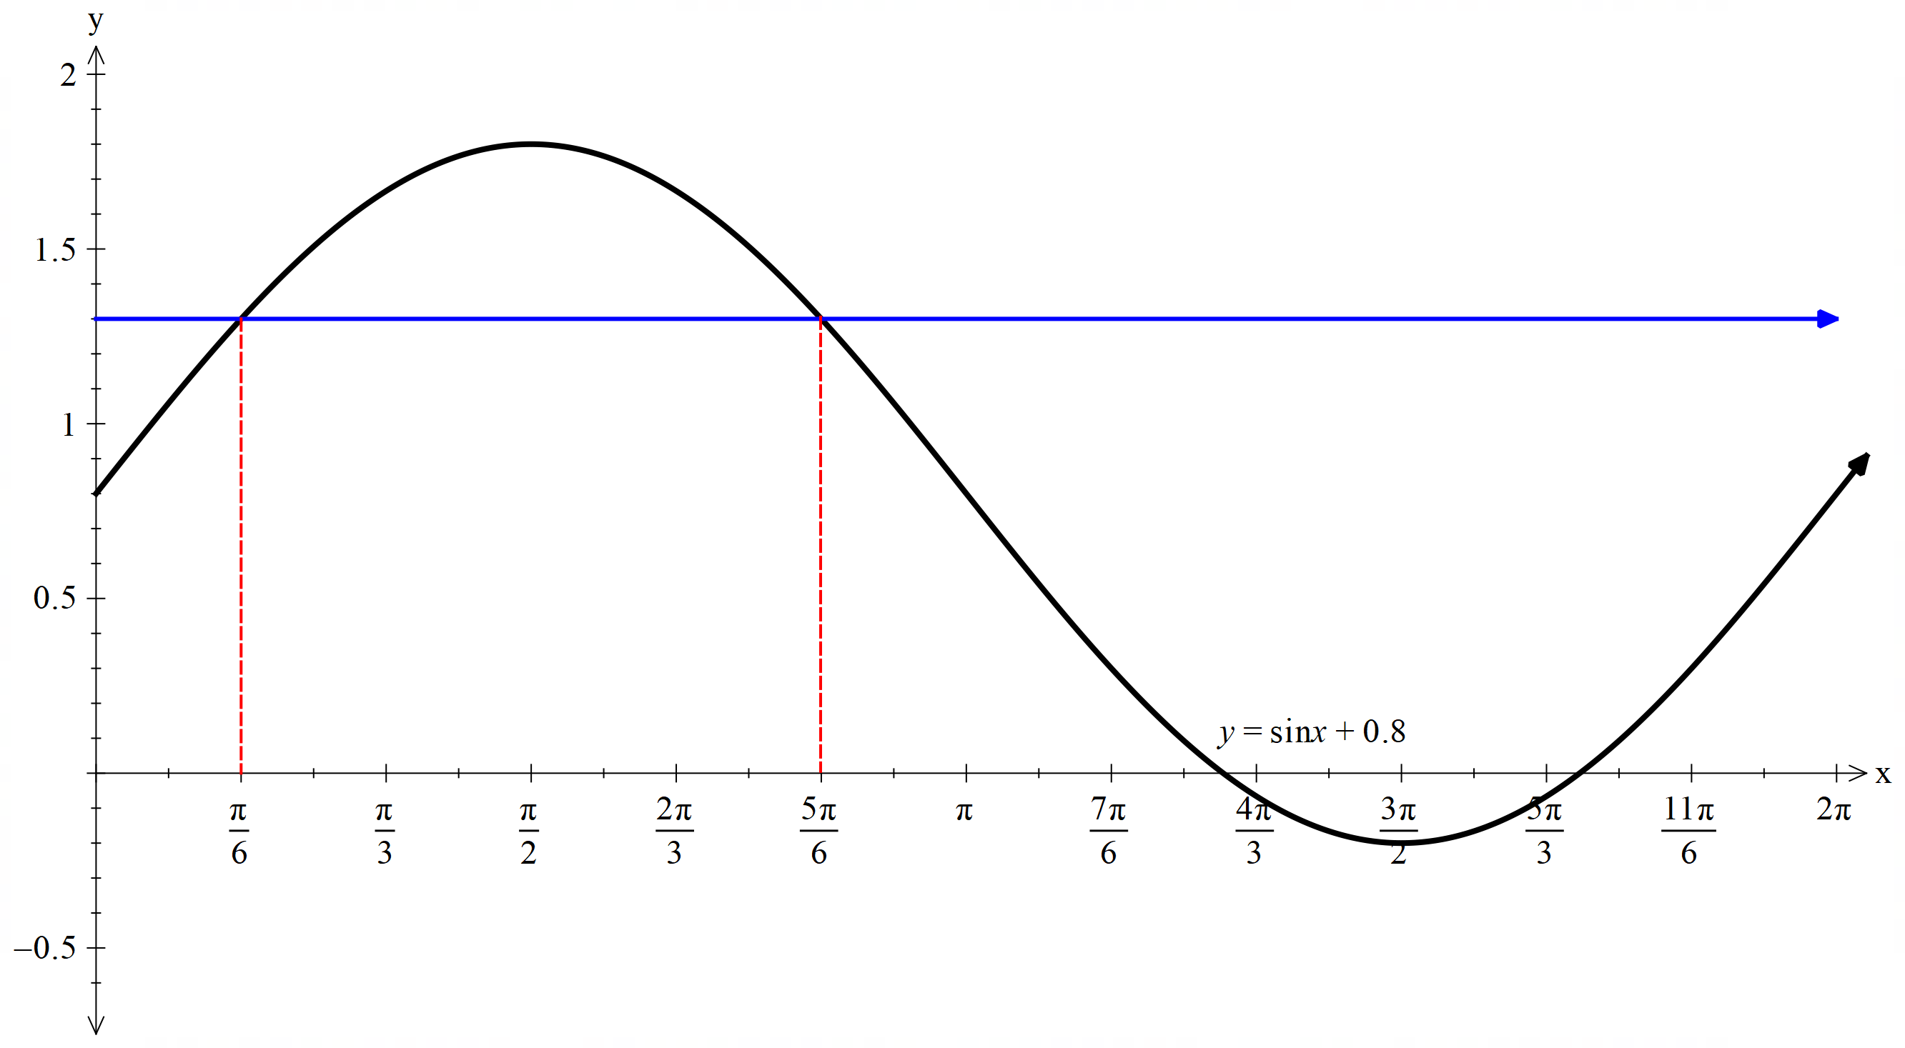

Your turn (2)
Solution
$$h\left(θ\right)=\sin{θ}+0.8, \text{for} 0≤θ≤2π\text{. }\text{Water} \text{level} \text{is} \text{above} 1.3 \text{m}\text{.}$$
$$\frac{π}{6} \text{earlier}→\text{translation} \text{to} \text{the} \text{left}\text{.}$$
$$h\left(θ\right)>1.3 when\frac{π}{6}≤θ≤\frac{5π}{6}$$
$$\text{With} \text{the} \text{translation}\text{:}$$
$$\frac{π}{6}−\frac{π}{6}≤θ≤\frac{5π}{6}−\frac{π}{6} \\ 0≤θ≤\frac{2π}{3}$$

Slide 15
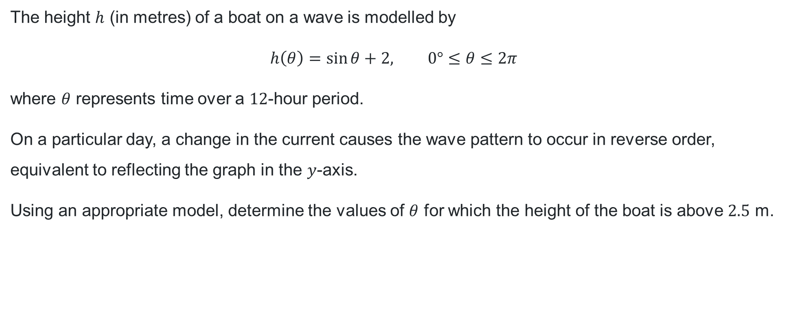
Worked example (3)
Question 3
The height $h$ (in metres) of a boat on a wave is modelled by
$$h\left(θ\right)=\sin{θ}+2, 0°≤θ≤2π$$
where $θ$ represents time over a $12$-hour period.
On a particular day, a change in the current causes the wave pattern to occur in reverse order, equivalent to reflecting the graph in the $y$-axis.
Using an appropriate model, determine the values of $θ$ for which the height of the boat is above $2.5$ m.

Slide 16
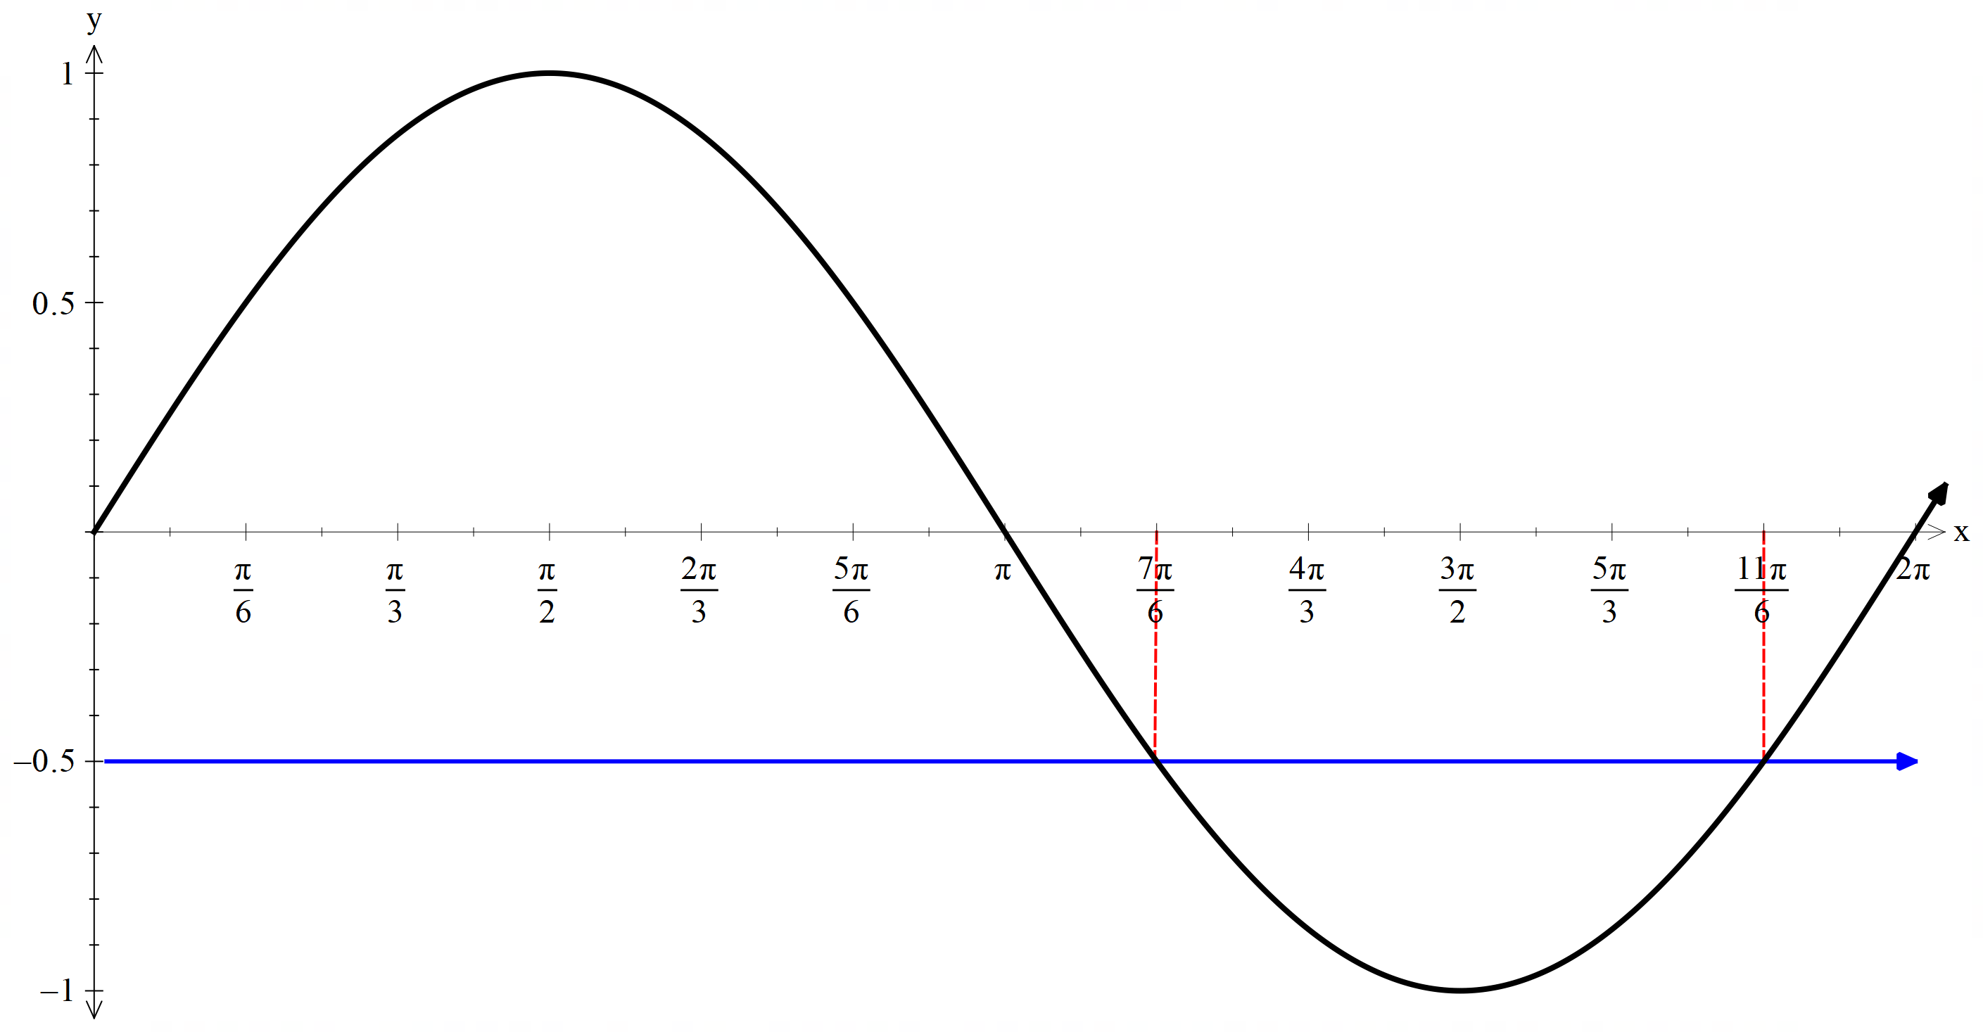
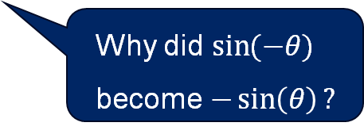
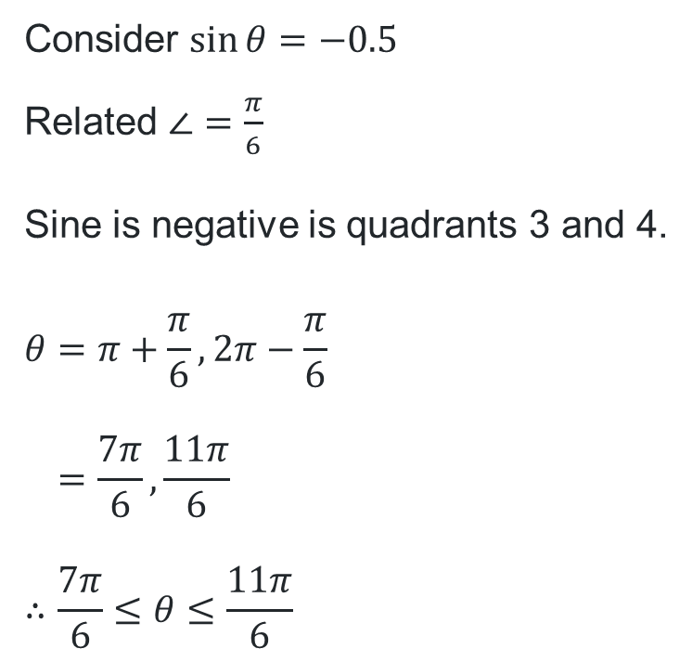
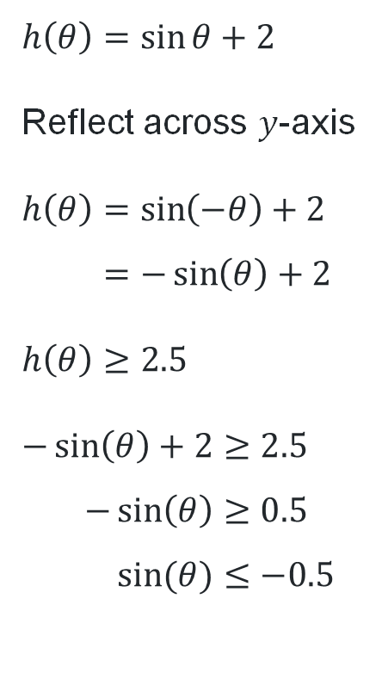
Worked example (4)
Solution
Why do we need to find a related angle?
$$h\left(θ\right)=\sin{θ}+2$$
Reflect across $y$-axis
$$h\left(θ\right)=\sin\left(−θ\right)+2 \\ =−\sin\left(θ\right)+2$$
$$h\left(θ\right)≥2.5$$
$$−\sin\left(θ\right)+2≥2.5 \\ −\sin\left(θ\right)≥0.5 \\ \sin{(θ)}≤−0.5$$
Consider $\sin{θ}=−0.5$
Related $∠=\frac{π}{6}$
Sine is negative is quadrants 3 and 4.
$$θ=π+\frac{π}{6}, 2π−\frac{π}{6} \\ =\frac{7π}{6},\frac{11π}{6} \\ ∴\frac{7π}{6}≤θ≤\frac{11π}{6}$$
Why did $\sin{(−θ)}$ become $−\sin\left(θ\right)?$

Slide 17
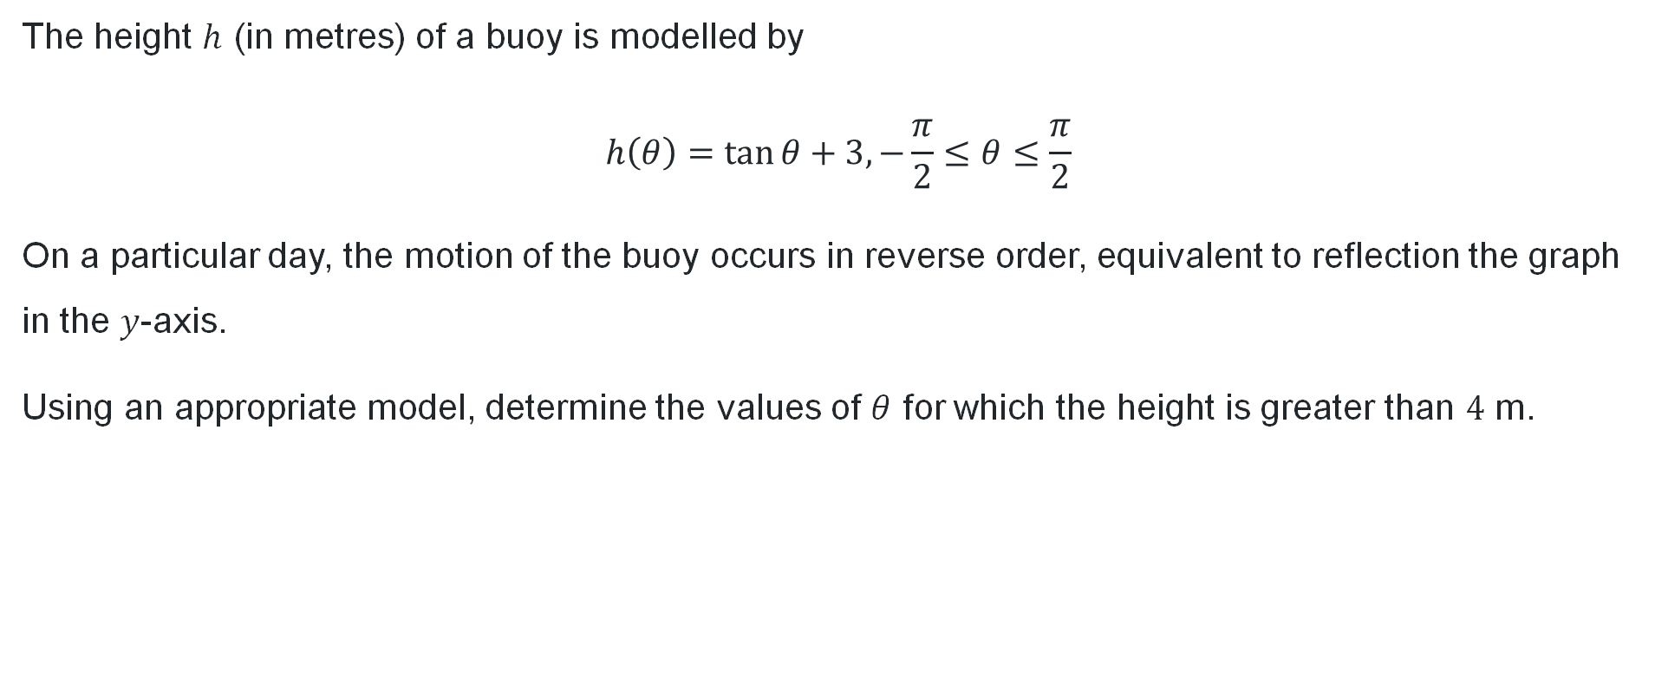
Your turn (3)
Question 4
The height $h$ (in metres) of a buoy is modelled by
$$h\left(θ\right)=\tan{θ}+3,−\frac{π}{2}≤θ≤\frac{π}{2}$$
On a particular day, the motion of the buoy occurs in reverse order, equivalent to reflection the graph in the $y$-axis.
Using an appropriate model, determine the values of $θ$ for which the height is greater than $4$ m.

Slide 18
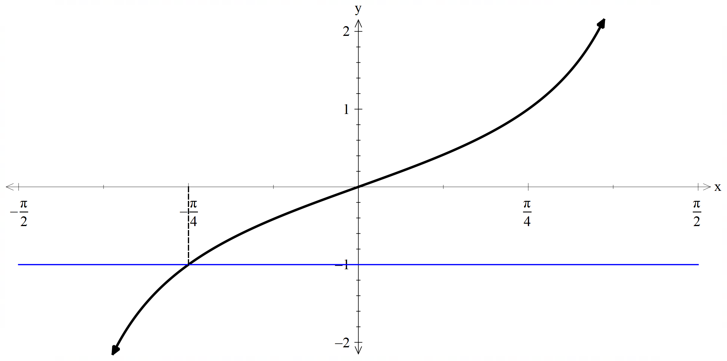
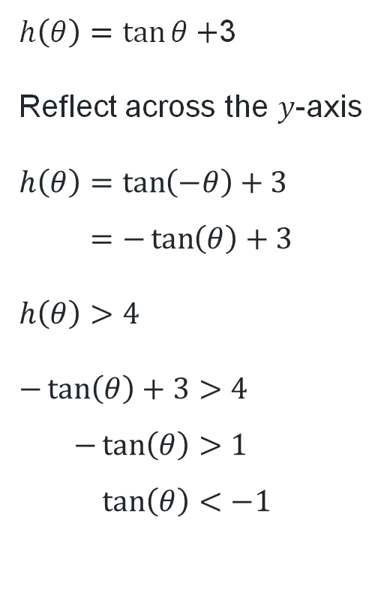
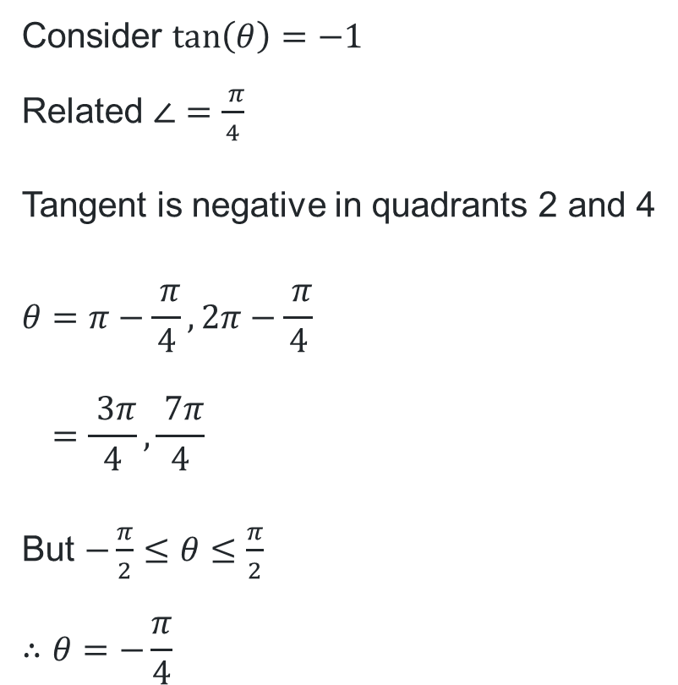
Your turn (4)
Solution
$h\left(θ\right)=\tan{θ}+$3
Reflect across the $y$-axis
$$h\left(θ\right)=\tan\left(−θ\right)+3 \\ =−\tan\left(θ\right)+3$$
$$h\left(θ\right)>4$$
$$−\tan\left(θ\right)+3>4 \\ −\tan\left(θ\right)>1 \\ \tan\left(θ\right)<−1$$
Consider $\tan\left(θ\right)=−1$
Related $∠=\frac{ π}{4}$
Tangent is negative in quadrants 2 and 4
$$θ=π−\frac{ π}{4}, 2π−\frac{ π}{4} \\ =\frac{ 3π}{4}, \frac{ 7π}{4}$$
But $−\frac{π}{2}≤θ≤\frac{π}{2}$
$$∴θ=−\frac{π}{4}$$

Slide 19

General translations
$$f\left(x\right)−c=\sin\left(x−b\right) \\ f\left(x\right)−c=\cos\left(x−b\right) \\ f\left(x\right)−c=\tan{(x−b)}$$

Slide 20
Independent practice

Slide 21
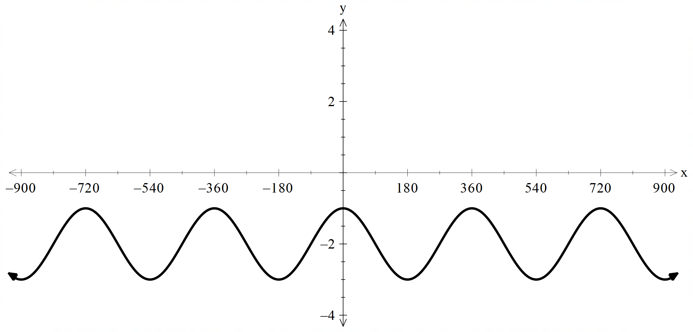
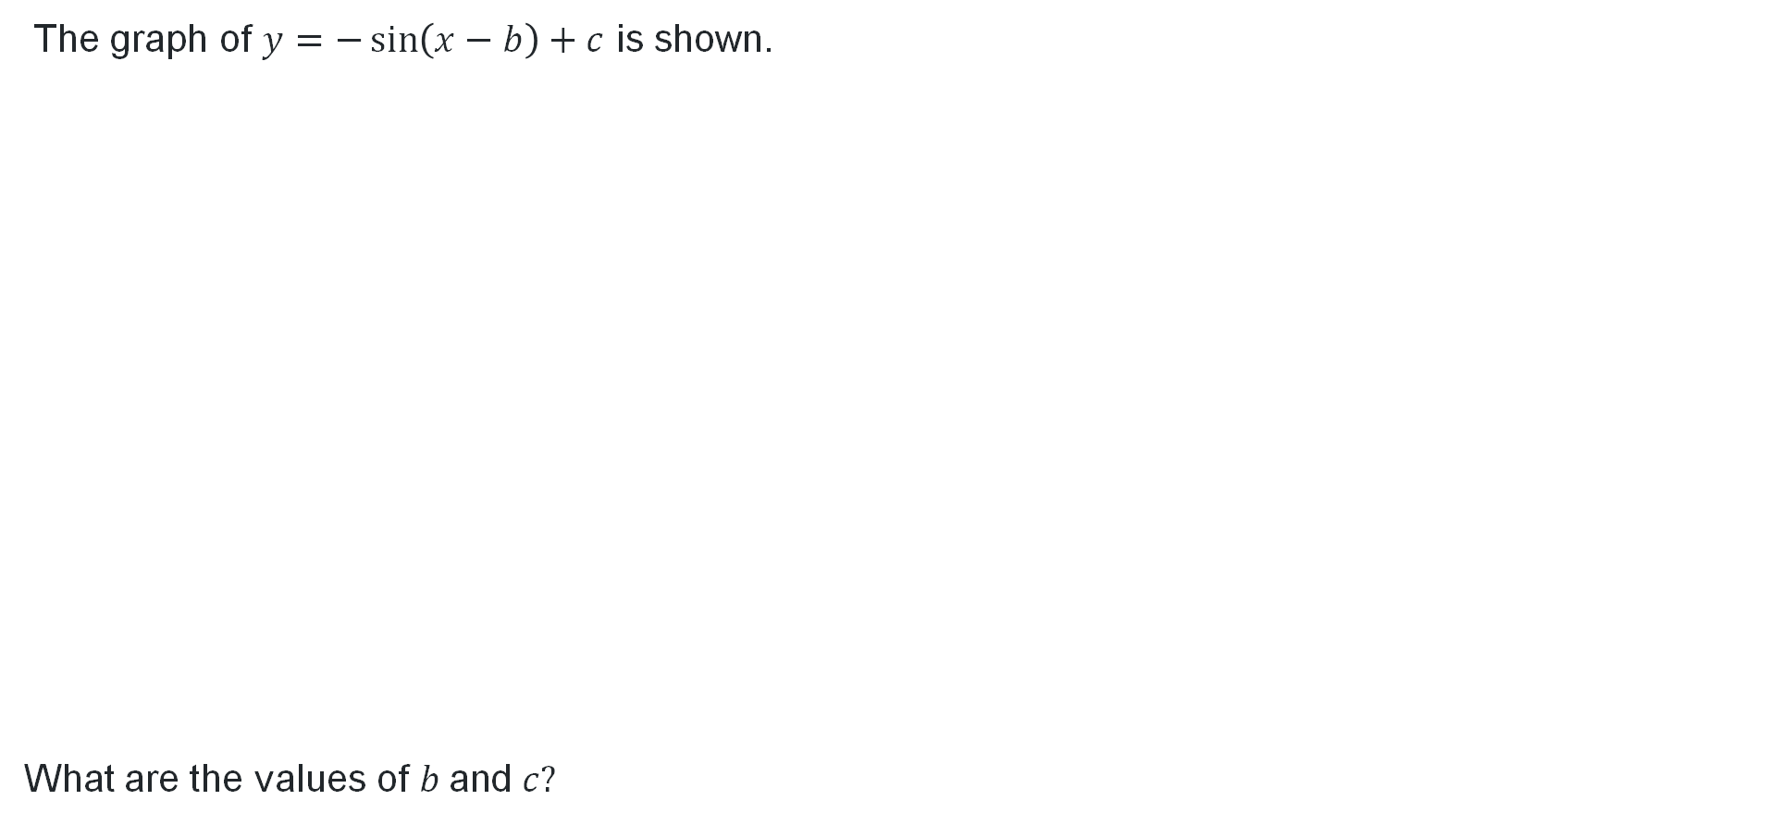
HSC-style question
The graph of $y=−\sin\left(x−b\right)+c$ is shown.
What are the values of $b \text{and} c?$

Slide 22

Approaching questions scaffold

Slide 23
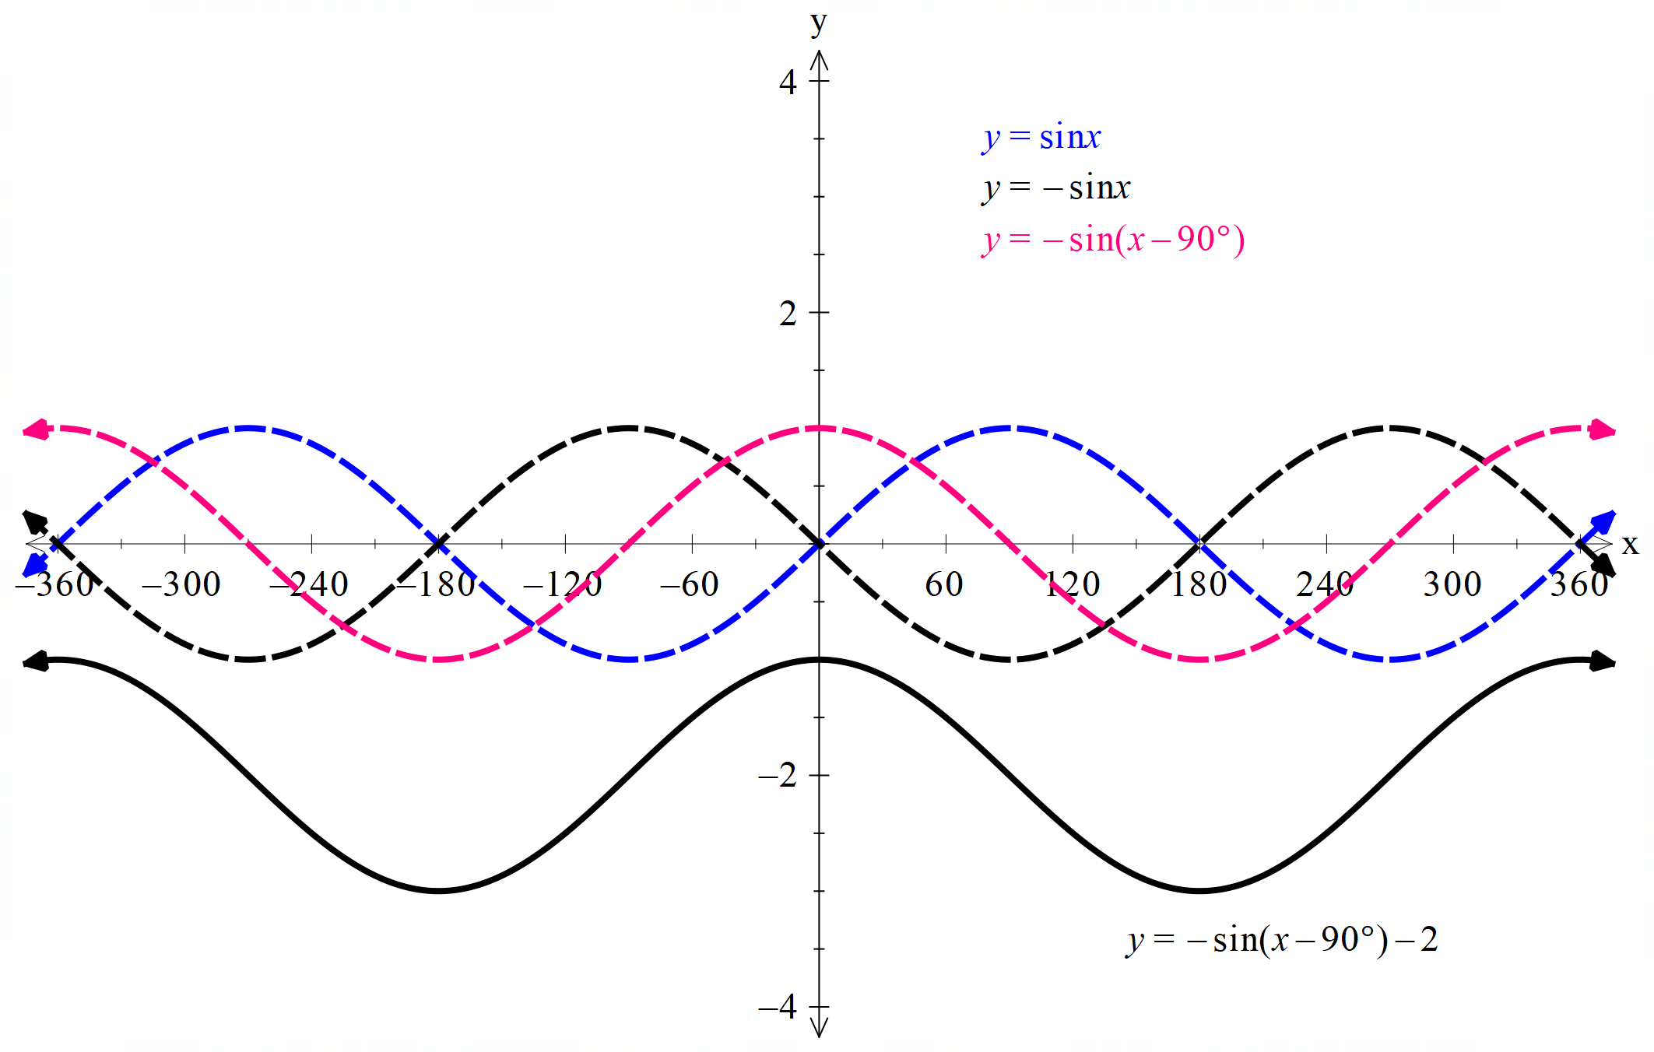
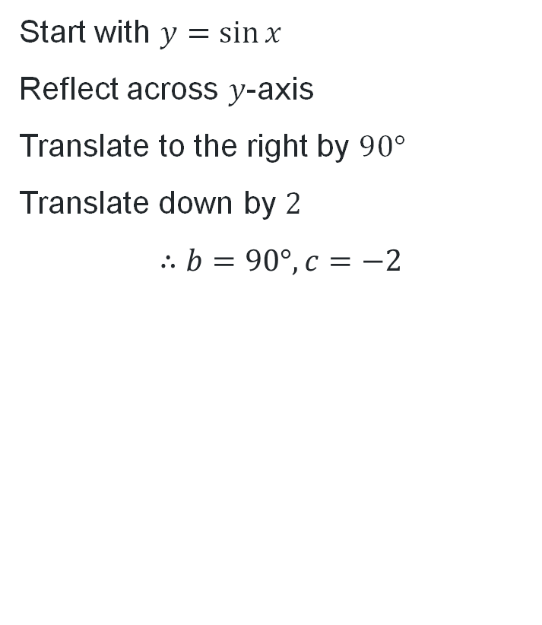
Solution (2)
Start with $y=\sin{x}$
Reflect across $y$-axis
Translate to the right by $90°$
Translate down by $2$
$$∴b=90°, c=−2$$

Slide 24
References
This presentation contains NSW Curriculum and syllabus content. The NSW Curriculum is developed by the NSW Education Standards Authority. This content is prepared by NESA for and on behalf of the Crown in the right of the State of New South Wales. The material is protected by Crown copyright.
Please refer to the NESA Copyright Disclaimer for more information https://www.nsw.gov.au/education-and-training/nesa/copyright.
NESA holds the only official and up-to-date versions of the NSW Curriculum and syllabus documents. Please visit NESA https://www.nsw.gov.au/education-and-training/nesa and NSW Curriculum https://curriculum.nsw.edu.au.
Mathematics Advanced 11-12 Syllabus © NSW Education Standards Authority (NESA) for and on behalf of the Crown in right of the State of New South Wales, 2024.

Slide 25
Copyright
© State of New South Wales (Department of Education), 2026
The copyright material published in this resource is subject to the Copyright Act 1968 (Cth) and is owned by the NSW Department of Education or, where indicated, by a party other than the NSW Department of Education (third-party material).
Copyright material available in this resource and owned by the NSW Department of Education is licensed under a Creative Commons Attribution 4.0 International (CC BY 4.0) license.
This license allows you to share and adapt the material for any purpose, even commercially.
Attribution should be given to © State of New South Wales (Department of Education), 2026.
Material in this resource not available under a Creative Commons license:
the NSW Department of Education logo, other logos and trademark-protected material
Material owned by a third party that has been reproduced with permission. You will need to obtain permission from the third party to reuse its material.
Links to third-party material and websites
Please note that the provided (reading/viewing material/list/links/texts) are a suggestion only and implies no endorsement, by the New South Wales Department of Education, of any author, publisher, or book title. School principals and teachers are best placed to assess the suitability of resources that would complement the curriculum and reflect the needs and interests of their students.
If you use the links provided in this document to access a third-party’s website, you acknowledge that the terms of use, including licence terms set out on the third-party’s website apply to the use which may be made of the materials on that third-party website or where permitted by the Copyright Act 1968 (Cth). The department accepts no responsibility for content on third-party websites.

