Slide 1

Transition from primary to high school
Supporting transition through the curriculum
School facilitated workshop 2
Notes:
Slide: School facilitated workshop 2: Supporting transition through the curriculum
Purpose: Title Slide​
Duration: 10 sec​
Script:
Welcome to the second transition from primary to high school workshop. The focus of today’s session is supporting transition through the curriculum.
CLICK

Slide 2

Acknowledgement of Country
We recognise the Ongoing Custodians of the lands and waterways where we work and live. We pay respect to Elders past and present as ongoing teachers of knowledge, songlines and stories.
We strive to ensure every Aboriginal and/or Torres Strait Islander learner in NSW achieves their potential through education.
‘Our place’ created by Class 2P from Glendore Public School as part of the 2020 Calendar for cultural diversity.
Notes:
Slide: Acknowledgement of Country​
Purpose: Acknowledge Country​
Duration: 1 min​
Script:
Read Slide
​
**Facilitator: Acknowledgment of Country can be changed to reflect individual school context.
CLICK

Slide 3
Agenda
Item | Duration
Setting the scene | 5 mins
Reflecting on current practice | 5 minutes
Exploring transition and continuity of learning | 15 minutes
Continuity of learning and NSW syllabuses | 15 minutes
Practices to support continuity of learning during transition | 15 minutes
Resources to support transition to high school planning | 5 minutes
Notes:
Slide: Agenda​
Purpose: Provide an overview of the workshop​
Duration: 30 sec​
Script:
​
Read slide​
​
CLICK​

Slide 4
Learning intentions and success criteria
Supporting transition through the curriculum
Participants will
Participants can
build understanding of continuity of learning in the curriculum
apply principles of continuity of learning to Stage 3 – 4 syllabuses
explore effective transition practices that support continuity of learning
develop awareness of available NSW Department of Education transition resources.
explain what continuity of learning is in the curriculum
identify how continuity of learning is reflected in NSW syllabuses
contextualise transition practices that support continuity of learning
locate NSW Department of Education resources to use in their context.
Notes:
Slide: Learning intentions and success criteria
Purpose: Outline the learning intentions and success criteria for the workshop
Duration: 1 minute
Script:​
In today’s workshop ‘Supporting transition through the curriculum’,
CLICK
Participants will:
build understanding of continuity of learning in the curriculum
apply principles of continuity of learning to Stage 3 – 4 syllabuses
explore effective transition practices that support continuity of learning
develop awareness of available NSW Department of Education transition resources.
CLICK
Participants can:
explain what continuity of learning is in the curriculum
apply principles of continuity of learning to Stage 3 – 4 syllabuses
contextualise transition practices that support continuity of learning
locate NSW Department of Education resources to use in their context.
CLICK

Slide 5
Setting the scene (1)
Notes:
Slide: Setting the scene
Purpose: Title slide
Duration: 5 seconds
Script:
Across the 5 school-facilitated workshops, staff will engage in professional learning aligned to the priorities outlined in Our Plan for Public Education and the Australian Professional Standards for Teachers.
CLICK

Slide 6
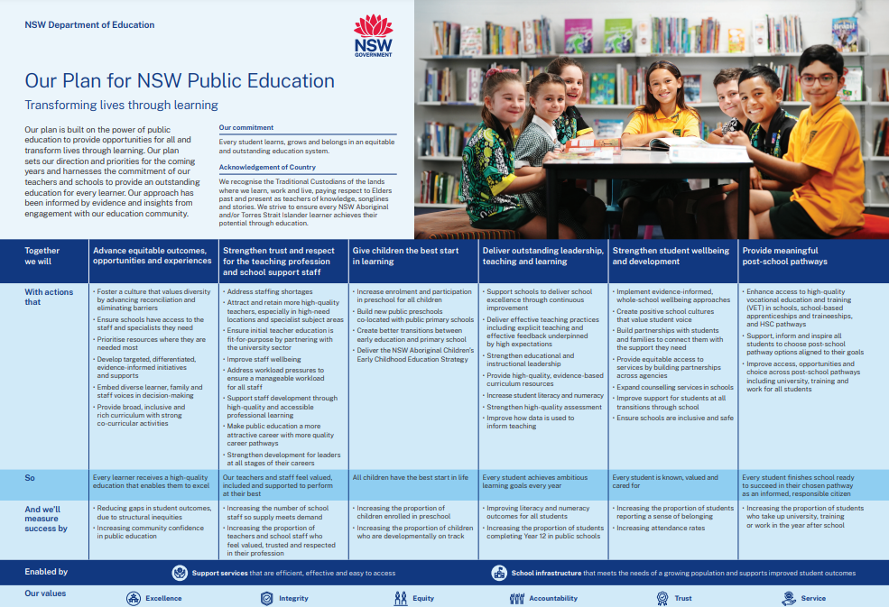
Setting the scene (2)
Transition in Our Plan for Public Education
Strengthen student wellbeing
and development
Improve support for students through all school transitions
Strengthen student wellbeing
and development
Improve support for students through all school transitions
Notes:
Slide: Setting the scene​ (2)
Purpose: Transition in Our Plan for Public Education​
Duration: 30 seconds​
Script:​​
​
Enabling effective transition from primary to high school is a key ingredient for successful delivery of Our Plan for Public Education. ​
The 5 Transition from primary to high school workshops provide schools and school leaders with access to information, practices and resources to support their work delivering on a number of focus areas.
These include:
CLICK ​
Strengthening student wellbeing and development
CLICK ​
Through:​
improving support for students through all school transitions ​
​
CLICK​

Slide 7
Setting the scene (3)
Transition in Our Plan for Public Education
Advance equitable outcomes, opportunities and experiences
Develop targeted, differentiated, evidence-informed initiatives and supports
Advance equitable outcomes, opportunities and experiences
Embed diverse learner, family and staff voices in decision-making
Develop targeted, differentiated, evidence-informed initiatives
and supports
Embed diverse learner, family and staff voices in decision-making
Provide broad, inclusive and
rich curriculum with strong
co-curricular activities
Provide broad, inclusive and
rich curriculum with strong
co-curricular activities
Notes:
Slide: Setting the scene​ (3)
Purpose: Transition in Our Plan for Public Education​
Duration: 30 seconds​
Script:​​
​
CLICK​
Advance equitable outcomes, opportunities and experiences
CLICK
Through:​
developing targeting, differentiated, evidence-informed initiatives and supports
CLICK
embedding diverse learner, family and staff voices in decision making, and
CLICK
providing broad, inclusive and rich curriculum with strong co-curricular activities .​
​
CLICK​
​

Slide 8
Setting the scene (4)
Transition in Our Plan for Public Education
Strengthen trust and respect for the teaching profession and school support staff
Support staff development through high-quality and accessible professional learning
Strengthen trust and respect for the teaching profession
and school support staff
Strengthen development for leaders at all stages of their careers
Support staff development through high-quality and accessible professional learning
Strengthen development for leaders at all stages of their careers
Notes:
Slide: Setting the scene​ (4)
Purpose: Transition in Our Plan for Public Education​
Duration: 30 seconds​
Script:​​
​
CLICK​
Strengthen trust and respect for the teaching profession and school support staff
CLICK
​Through:​
supporting staff development through high-quality and accessible professional learning and
CLICK​
strengthening development for leaders at all stages of their careers.​
​
CLICK​

Slide 9
Setting the scene (5)
Transition in Our Plan for Public Education
Deliver outstanding leadership, teaching and learning
Support schools to deliver school excellence through continuous improvement
Deliver outstanding leadership, teaching and learning
Support schools to deliver school excellence through continuous improvement
Improve how data is used to
inform teaching
Improve how data is used to
inform teaching
Notes:
Slide: Setting the scene​ (5)
Purpose: Transition in Our Plan for Public Education​
Duration: 30 seconds​
Script:​​
​
CLICK​
​
And finally,
deliver outstanding leadership, teaching and learning
CLICK​
Through:​
supporting schools to deliver school excellence through continuous improvement and
CLICK​
improving how data is used to inform teaching​.
​
CLICK

Slide 10




Australian Professional Standards for Teachers
Embedding the Australian Professional Standards for Teachers in transition practices
1.2.2 Structure teaching programs using research and collegial advice about how students learn.
2.3.2 Design and implement learning and teaching programs using knowledge of curriculum, assessment and reporting requirements.
6.2.2 Participate in learning to update knowledge and practice, targeted to professional needs and school and/or system priorities.
6.3.2 Contribute to collegial discussions and apply constructive feedback from colleagues to improve professional knowledge and practice.
Notes:
Slide: Australian Professional Standards for Teachers​
Purpose: Embedding the Australian Professional Standards for Teachers in transition practices​
Duration: 30 seconds​
Script:​
This workshop aligns to the Australian Professional Standards for Teachers you can see on this slide. ​
***Facilitator: Based on your context, you might also like to share the equivalent graduate, highly accomplished and lead standards with participants.​
​
CLICK

Slide 11
Reflecting on current practice
Notes:
Slide: Reflection on current practice
Purpose: Title slide
Duration: 5 seconds
Script:​
Read slide
CLICK

Slide 12

Reflect on current practice
Activity 1
Continuity of learning – strengths and areas for improvement
1
What do we know about continuity of learning and the curriculum?
2
What practices do we currently embed to support continuity of learning at transition points?
3
In what ways could these practices be strengthened?
Notes:
Slide: Activity 1: Continuity of learning- strengths and areas for improvement
Purpose: To reflect on current knowledge and practices
Duration: 5 minutes​
Script:​
​
To begin today’s workshop, we will spend some time reflecting on what we know about continuity of learning, our current transition practices that support continuity of learning, and identify any areas for improvement.
Discuss the following questions:
CLICK
What do we know about continuity of learning in the curriculum?
CLICK
What practices do we currently embed to support continuity of learning at transition points?
CLICK
In what ways could these practices be strengthened?
***Facilitator - select participants to share their responses to each question.
CLICK

Slide 13
Exploring transition and continuity of learning
Notes:
Slide: Exploring transition and continuity of learning
Purpose: Title slide
Duration: 5 seconds
Script:
Read slide
CLICK

Slide 14

Transition and continuity of learning
Supporting transition through the curriculum
Notes:
Slide: Transition and continuity of learning
Purpose: Video- Transition and continuity of learning (5:07)
Duration: 6 minutes
Script:
Curriculum sits at the heart of school improvement because it is the core of what schools do and how students experience and engage with learning.
We will now take a closer look at continuity of learning and how it supports effective transition to high school.
As we watch ‘Transition and continuity of learning’, consider how continuity of learning is defined, why it is important and the suggested strategies to strengthen continuity of learning to support a successful transition from primary to high school.
*** Facilitator- encourage note-taking whilst watching, as participants will be responding to questions after viewing ‘Transition and continuity of learning’.
CLICK

Slide 15

Stop and reflect
Transition and continuity of learning
1
How was continuity of learning defined, and why is it an important consideration during transition?
2
What strategies were identified that would support primary and high school teachers in understanding each student’s learning journey during transition?
3
How could these strategies be useful in our context?
Notes:
Slide: Stop and Reflect- Transition and continuity of learning
Purpose: To allow groups to reflect on the content of ‘Transition and continuity of learning’ and apply it to their context
Duration: 9 minutes​
Script:​
​
This is an opportunity to reflect on some of the key messages and strategies outlined in ‘Transition and continuity of learning’.
*** Facilitator- display each question one at a time. Provide participants with the opportunity to discuss in small groups and share responses with the wider group before moving to the next question.
In small groups, consider the information presented and discuss:
CLICK
How was continuity of learning defined, and why is it an important consideration during transition?
*** Facilitator- possible responses to guide the group discussion could include:
continuity of learning is when a student's current learning is informed by and builds on their prior learning
understanding a student's prior knowledge, skills, and previous exposure to the curriculum, teachers can develop more informed learning sequences that gradually build on existing learning experiences.
CLICK
What strategies were identified that would support primary and high school teachers in understanding each student’s learning journey during transition?
*** Facilitator- possible responses to guide the group discussion could include:
developing a deep understanding of syllabuses that come before and after the stage being taught
sharing diagnostic and formative assessments to determine where individuals are in their learning so that teaching can be differentiated and further learning progress can be monitored over time
conducting lesson observations or quality teaching rounds between stage three and stage four teachers
building communities of practice between primary and secondary schools that focus on effective pedagogies
participating in professional learning on effective pedagogies within networks to support consistent teaching practises between primary and high school.
CLICK
How could these strategies be useful in our context?
*** Facilitator- provide examples relevant to your context
CLICK​

Slide 16
Continuity of learning and NSW syllabuses (1)
Notes:
Slide: Continuity of learning and NSW syllabuses
Purpose: Title slide
Duration: 5 seconds
Script:
Read slide
CLICK

Slide 17
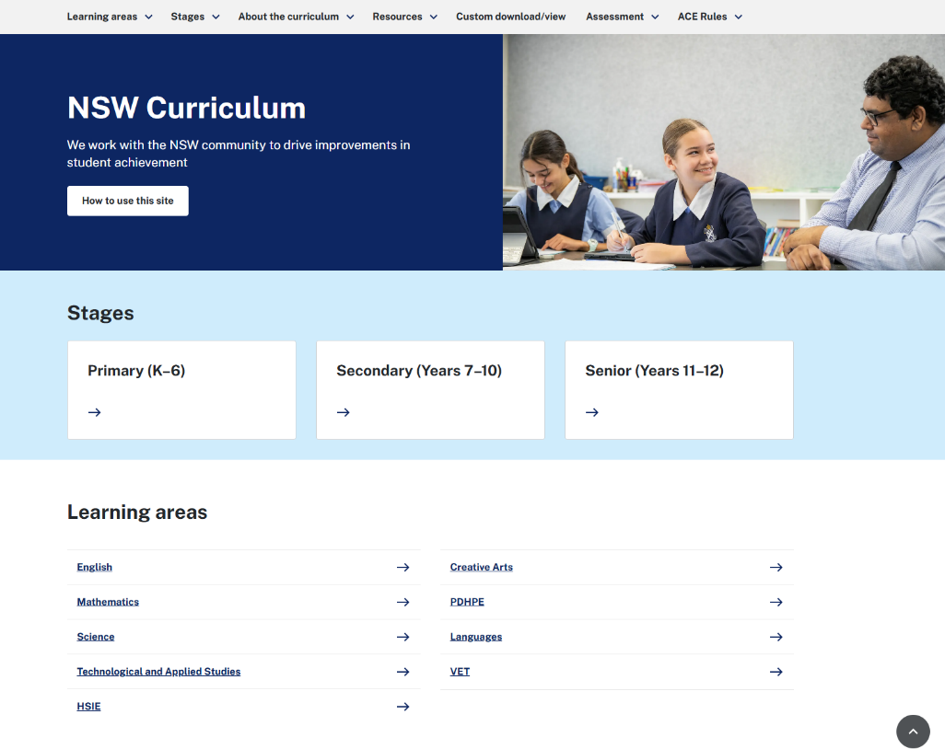
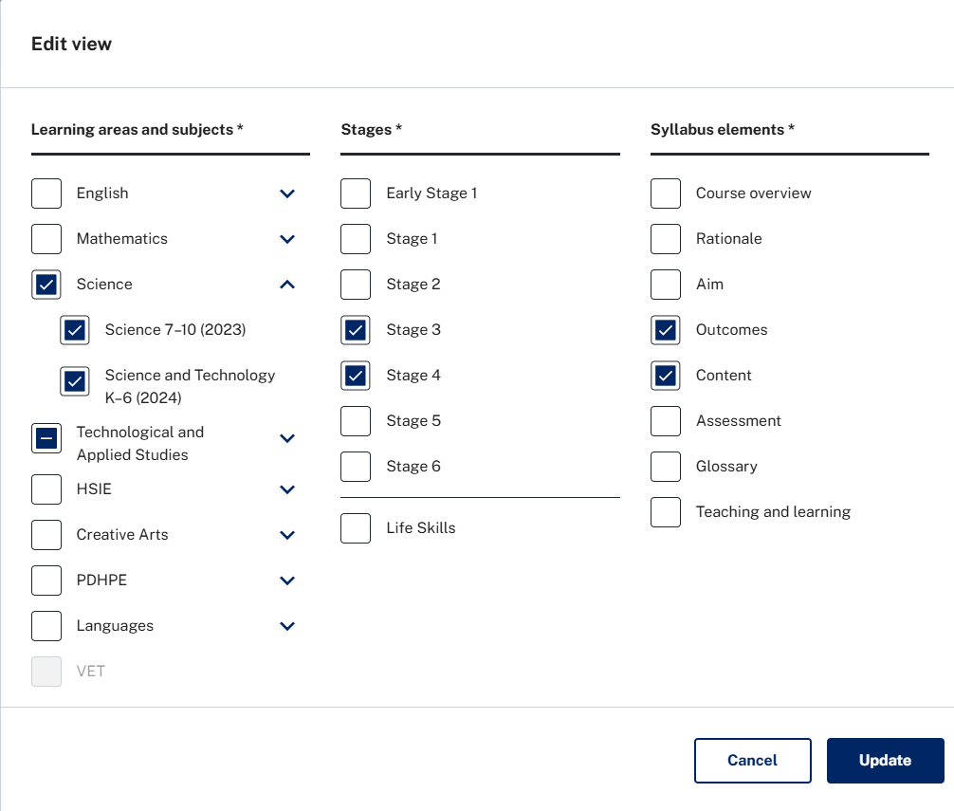
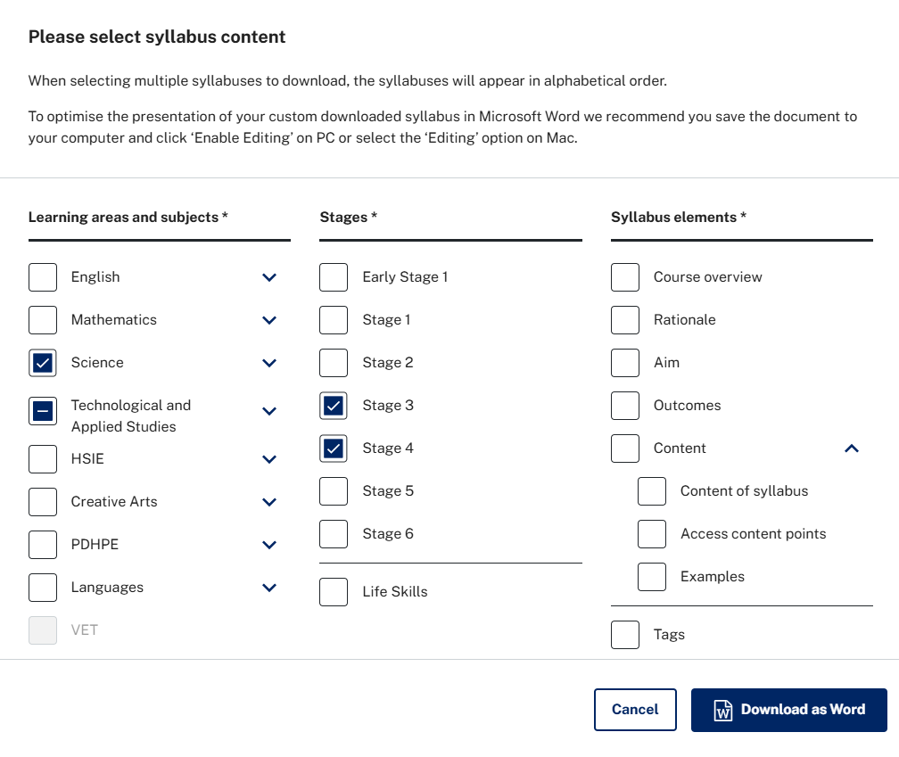
Continuity of learning and NSW syllabuses (2)
Accessing and comparing Stage 3 and Stage 4 NSW syllabuses
Home | NSW Curriculum | NSW Education Standards Authority
Notes:
Slide: Continuity of learning and NSW syllabuses
Purpose: Accessing and comparing the Stage 3 and Stage 4 NSW syllabuses
Duration: 2 minutes​
Script:
As outlined in ‘Transition and continuity of learning’, the New South Wales syllabuses provide a sequence of learning that builds on prior learning and lays the foundations to further students' knowledge, understanding, and skills.
Developing a deep understanding of syllabuses that come before and after the stage being taught can assist teachers to:
strengthen their understanding of syllabus content and the development of subject-specific knowledge
address learning needs and avoid unnecessary repetition and
develop more informed learning sequences that gradually build on existing learning experiences to support continuity of learning.
One way of identifying the continuity of learning evidenced within NSW syllabuses is to create a custom cross-stage syllabus view document, highlighting content and outcomes across Stages 3 and 4. This can be done by:
Go to Home | NSW Curriculum | NSW Education Standards Authority and select a Key Learning Area
CLICK

Slide 18
Continuity of learning and NSW syllabuses (3)
Accessing and comparing Stage 3 and Stage 4 NSW syllabuses
Notes:
Slide: Continuity of learning and NSW syllabuses
Purpose: Accessing and comparing the Stage 3 and Stage 4 NSW syllabuses
Duration: 2 minutes​
Script:
Select edit view.
Select the appropriate learning areas and subject, stages (3 and 4), and syllabus elements you would like to compare.
Click update.
CLICK

Slide 19
Continuity of learning and NSW syllabuses (4)
Accessing and comparing Stage 3 and Stage 4 NSW syllabuses
Notes:
Slide: Continuity of learning and NSW syllabuses
Purpose: Accessing and comparing the Stage 3 and Stage 4 NSW syllabuses
Duration: 2 minutes​
Script:
Click download as a word document.
The document produced will then provide details of the Stage 3 and Stage 4 outcomes and content in the selected key learning area (KLA) for easier comparison.
CLICK

Slide 20
Continuity of learning and the NSW syllabuses (5)
Example of syllabus alignment – Science and Technology
Science and Technology NSW syllabus (Stage 3)
Science and Technology NSW syllabus (Stage 4)
Our solar system is a part of one of billions of galaxies in the Universe
Recognise stars, galaxies, nebulae, exoplanets and black holes as astronomical features that exist beyond our solar system
Research how living things can travel and survive in space
Examine the development of our knowledge through discoveries and technologies, and how these benefit humankind
Describe how Aboriginal and/or Torres Strait Islander Peoples' Knowledges of the positions of the Sun, Moon and stars are used for navigation and wayfinding
Space science
Compare historical and current solar system models to show how models are modified or rejected due to new scientific evidence
Explain that predictable and observable phenomena on the Earth are caused by the relative positions of the Sun, the Earth and the Moon
Use physical models or virtual simulations to explain the cyclic patterns of lunar phases and eclipses of the Sun and Moon
Aboriginal and Torres Strait Islander Peoples’ Cultural Knowledges of astronomy
Investigate the similarities between Aboriginal and Torres Strait Islander accounts and mainstream scientific explanations about the phases of the Moon and how the phases affect tides
Explain how Aboriginal and Torres Strait Islander Peoples use stars to identify specific weather phenomena
Describe how Aboriginal and/or Torres Strait Islander Peoples predicted seasonal phenomena based on their observations of the stars and phases of the Moon to predict animal behaviour, plant cycles and tidal changes
Observing the Universe in context
Investigate how a recent advancement in science has increased knowledge of the world and the Universe
Recognise
Compare
Explain
Describe
Investigate
Explain
Describe
Investigate
Notes:
Slide: Continuity of learning and the NSW syllabuses
Purpose: Example of syllabus alignment in Science and Technology
Duration: 2 minutes
Script: ​
Here is an example of content from the NSW Science and Technology K-6 and 7-10 Syllabuses. The content being compared is from Stage 3 and Stage 4. There are a number of content similarities, ways skills develop in complexity, and new concepts introduced.
These include:
CLICK
Astronomical Features and Phenomena:
In Stage 3 students are introduced to astronomical features beyond our solar system, such as stars, galaxies, nebulae, exoplanets, and black holes.
CLICK
In Stage 4 students continue with space science, focusing on solar system models and observable phenomena caused by the Sun, Earth, and Moon.
CLICK
Similarities and content progression can also be seen in Aboriginal and Torres Strait Islander Peoples’ Knowledges:
In Stage 3 students describe how Indigenous knowledge systems relate to navigation and wayfinding using the Sun, Moon, and stars.
CLICK
In Stage 4 this is deepened by students investigating similarities between Indigenous accounts and scientific explanations, and by exploring how Indigenous peoples use stars and lunar phases to predict weather, seasons, and animal/plant cycles.
CLICK
Skills are also built upon across Stages 3 and 4. For example:
CLICK
In Stage 3, students recognise astronomical features and describe Indigenous knowledges.
CLICK
In Stage 4, students compare, explain, and investigate scientific models and Indigenous explanations, requiring higher-order thinking skills.
***Facilitator: Optional - ask participant to identify any other observed alignment in content or outcomes.

Slide 21
Practices to support continuity of learning during transition(1)
Notes:
Slide: Practices to support continuity of learning during transition
Purpose: Title slide
Duration: 5 seconds
Script:
Read slide
CLICK

Slide 22

Transition and continuity of learning
Supporting continuity of learning through effective transition practices
Notes:
Slide: Transition and continuity of learning
Purpose: Video- Sharing and collaboration across schools for successful transition (6:16)
Duration: 7 minutes
Script:
We are now going to explore how 2 schools, in the Tuggerah Lakes network, effectively plan, implement and evaluate transition practices to support continuity of learning during the transition from primary to high school.
This illustration of practice (IoP) showcases how they maximise student learning outcomes through strategic planning and implementation of transition practices.
The leaders and transition coordinators:
highlight the importance of collaboration in strengthening teaching practice to optimise learning
discuss the importance of developing clear communication and processes in planning for and implementing strategies to support continuity of learning
outline how transition processes were established to remove potential barriers and facilitate continuity of learning.
*** Facilitator- encourage note-taking whilst watching, as participants will be responding to questions after viewing ‘Sharing and collaboration across schools for successful transition’.
CLICK

Slide 23
Connect, extend, challenge
Activity 2
Transition to high school and the curriculum
Connect
How are the ideas and information connected to what you already know?
Extend
What new ideas or information extended your thinking?
Challenge
What challenges or questions emerge for you?
Notes:
Slide: Activity 2: Connect, extend, challenge
Purpose: Explore and connect to ideas presented in ‘Sharing and collaboration across schools for successful transition’
Duration: 5 minutes​
Script: ​
​
We will now take some time to reflect on the strategies and key messages highlighted in ‘Sharing and collaboration across schools for successful transition’. Take a moment to consider:
CLICK
Connect: How are the ideas and information connected to what you already know?
Extend: What new ideas or information extended your thinking?
Challenge: What challenges or questions emerge for you?
*** Facilitator: Select participants to share their responses.
​
CLICK​
​
​
​
​

Slide 24
Reflection
Sharing thoughts and actions
What is one key takeaway or action you can take to support transition and continuity of learning?
Notes:
Slide: Reflections
Purpose: Reflect on the session and identify action
Duration: 3 minutes​
Script:​
Read the slide.
*** Facilitators context: Provide an example of a key takeaway or action relevant to your context.

Slide 25
Resources to support transition to high school planning
Notes:
Slide: Resources to support transition to high school planning
Purpose: Title slide
Duration: 5 seconds
Script:​
Read slide.
CLICK

Slide 26
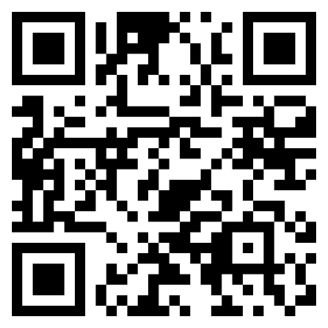
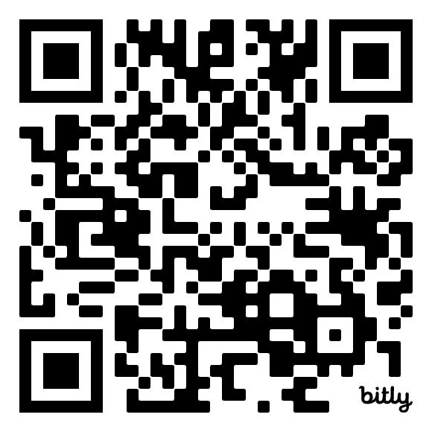
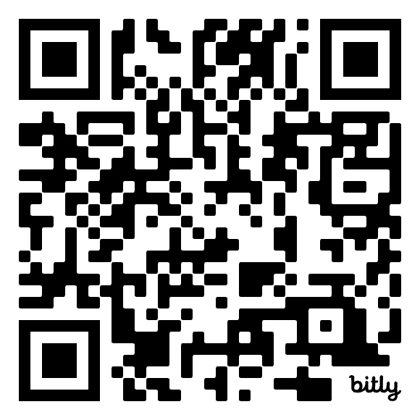
Resources to help support transition planning
Transition to high school – What Works Best in practice
Transition from primary to high school
Enhancing the transition to high school for students
Notes:
Slide: Resources to help support your transition planning​
Purpose: Resources to help support your transition planning​
Duration: 1 min​
Script: ​
​
There are a number of resources available to help support transition planning.
Scan the QR codes to explore resources that can strengthen transition to high school practices.​
You will need to log into your department portal to access the third QR code.
​
CLICK

Slide 27
Overview of Workshop 3
Strengthening continuity of learning through collaboration
Notes:
Slide: Overview of workshop 3
Purpose: Title slide
Duration: 5 seconds
Script:​
Read slide.
CLICK

Slide 28



Next workshop
Strengthening continuity of learning through collaboration
Collaboration
Explore the importance of collaboration and information sharing between primary and high schools to support student transition.
Transition practices
Consider strategies for developing a shared understanding of Year 6 and Year 7 curriculum content and pedagogical approaches.
Resources
Explore collaborative planning tools and inquiry models to enhance continuity of learning during the transition from primary to high school.
Notes:
Slide: Next workshop
Purpose: to provide an overview of workshop 3
Duration: 1 minute
Script:
In our next workshop, we will focus on strengthening continuity of learning through collaboration.
During this session we will:
explore the importance of collaboration and information sharing between primary and high schools to support student transition.
consider strategies for developing a shared understanding of Year 6 and Year 7 curriculum content and pedagogical approaches.
explore collaborative planning tools and inquiry models to enhance continuity of learning during the transition from primary to high school.
CLICK

Slide 29
Session evaluation
Notes:
Slide: Session evaluation
Purpose: Title slide
Duration: 5 seconds
Script:​
Read slide.
CLICK

Slide 30

Evaluation survey – participants
Workshop 2 – Supporting transition through the curriculum
Please complete the evaluation form to share your feedback about this workshop.
Facilitator: Click the link Transition from primary to high school workshop 2- participant survey – Copy form to duplicate the template and contextualise survey questions.
Workshop 2 – participant survey
Your insights will help us understand what worked well and how we can continue to improve future professional learning sessions.
Notes:
Slide: Evaluation survey - participants
Purpose: to provide feedback to the school facilitator to use to track data
Duration: 2 min
Script:
We would like for you to fill out a short survey to provide the school facilitator with feedback about the workshop.
Please use the survey code or link provided to do this. (When scanning the QR code people will be asked to fill in an email address. They need to use their NSW Department of Education email address to log in).
** Facilitator, Click the link on the slide to duplicate the template and contextualise survey questions. Then download and insert the link and QR code onto the slide.
CLICK

Slide 31
References
This presentation contains NSW Curriculum and syllabus content. The NSW Curriculum is developed by the NSW Education Standards Authority. This content is prepared by NESA for and on behalf of the Crown in the right of the State of New South Wales. The material is protected by Crown copyright.
Please refer to the NESA Copyright Disclaimer for more information https://educationstandards.nsw.edu.au/wps/portal/nesa/mini-footer/copyright.
NESA holds the only official and up-to-date versions of the NSW Curriculum and syllabus documents. Please visit the NSW Education Standards Authority (NESA) website https://educationstandards.nsw.edu.au/wps/portal/nesa/home and the NSW Curriculum website https://curriculum.nsw.edu.au.
Home | NSW Curriculum | NSW Education Standards Authority NESA (NSW Education Standards Authority) 2025. Accessed 15/09/2025
NSW Department of Education (2025) Transition from Primary to High School . Accessed 15/09/2025
Notes:
Slide: References
Purpose: links to documents referenced when developing this workshop
Duration: 5 seconds
Script:

Slide 32
Copyright
© State of New South Wales (Department of Education), 2025
The copyright material published in this resource is subject to the Copyright Act 1968 (Cth) and is owned by the NSW Department of Education or, where indicated, by a party other than the NSW Department of Education (third-party material).
Copyright material available in this resource and owned by the NSW Department of Education is licensed under a Creative Commons Attribution 4.0 International (CC BY 4.0) license.
This license allows you to share and adapt the material for any purpose, even commercially.
Attribution should be given to © State of New South Wales (Department of Education), 2025.
Material in this resource not available under a Creative Commons license:
the NSW Department of Education logo, other logos and trademark-protected material
Material owned by a third party that has been reproduced with permission. You will need to obtain permission from the third party to reuse its material.
Links to third-party material and websites
Please note that the provided (reading/viewing material/list/links/texts) are a suggestion only and implies no endorsement, by the New South Wales Department of Education, of any author, publisher, or book title. School principals and teachers are best placed to assess the suitability of resources that would complement the curriculum and reflect the needs and interests of their students.
If you use the links provided in this document to access a third-party’s website, you acknowledge that the terms of use, including licence terms set out on the third-party’s website apply to the use which may be made of the materials on that third-party website or where permitted by the Copyright Act 1968 (Cth). The department accepts no responsibility for content on third-party websites.

