Slide 1

Transition from primary to high school
Exploring the evidence base to support effective transition
School facilitated workshop 1
Notes:
Slide: School facilitated workshop 1: Exploring the evidence base to support effective transition ​
Purpose: Title Slide​
Duration: 10 sec​
Script:
Welcome to the first of 5 Transition from primary to high school workshops. The focus of todays session is exploring the evidence base to support effective transition.​
CLICK

Slide 2

Acknowledgement of Country
We recognise the Ongoing Custodians of the lands and waterways where we work and live. We pay respect to Elders past and present as ongoing teachers of knowledge, songlines and stories. We strive to ensure every Aboriginal and Torres Strait Islander learner in NSW achieves their potential through education.
‘Kariong – Our meeting place’ created by Stella Haynes from Cammeray Public School on Eora Country as part of the 2022 Calendar for cultural diversity.
Notes:
Slide: Acknowledgement of Country​
Purpose: Acknowledge Country​
Duration: 1 min​
Script:
Read Slide
​
**Facilitator Context: AOC can be changed to reflect individual school contexts
CLICK

Slide 3
Agenda
Item | Duration
Setting the scene | 5 mins
Reflecting on current practice | 10 minutes
Exploring the evidence base to support effective transition | 25 minutes
Identifying opportunities to strengthen transition | 15 minutes
Evaluation | 5 minutes
Notes:
Slide: Agenda​
Purpose: Provide an overview of the workshop​
Duration: 30 sec​
Script:
​
Read slide​
​
CLICK​

Slide 4
Learning intentions and success criteria
Exploring the evidence base to support effective transition
Participants will
Participants can
discuss the status of transition from primary to high school practices within their school setting
explore the evidence-base highlighting the importance, and key elements, of a successful transition
consider how evidence-based practices could be contextualised to strengthen students transition from primary to high school.
reflect on current transition practices and identify areas for improvement
identify the importance and key elements of a successful transition from primary to high school
identify and contextualise evidence-based practices to strengthen transition.
Notes:
Slide: Learning intentions and success criteria
Purpose: Outline the learning intentions and success criteria for the workshop
Duration: 1 minute
Script:​
Through engaging in Transition Workshop 1: Exploring the evidence-base to support effective transition:
Participants will:
discuss the status of transition from primary to high school practices within their school setting
explore the evidence-base highlighting the importance, and key elements, of a successful transition
consider how evidence-based practices could be contextualised to strengthen students transition from primary to high school.
CLICK
Participants can:
reflect on current transition practices and identify areas for improvement
identify the importance and key elements of a successful transition from primary to high school
identify and contextualise evidence-based practices to strengthen transition.
CLICK

Slide 5
Setting the scene
Notes:
Slide: Setting the scene
Purpose: Title slide
Duration: 10 seconds
Script:
Across the 5 school facilitated workshops, staff will engage in professional learning aligned to the priorities outlined in Our Plan for Public Education and the Australian Professional Standards for Teachers.
CLICK

Slide 6

Setting the scene (2)
Transition in Our Plan for Public Education
Strengthen student wellbeing
and development
Improve support for students through all school transitions
Strengthen student wellbeing
and development
Improve support for students through all school transitions
Notes:
Slide: Setting the scene​ (2)
Purpose: Transition in Our Plan for Public Education​
Duration: 30 seconds​
Script:​​
​
Enabling effective transition from primary to high school is a key ingredient for successful delivery of Our Plan for Public Education. ​
The 5 Transition from primary to high school workshops provide schools and school leaders with access to information, practices and resources to support their work delivering on a number of focus areas.
These include:
CLICK ​
Strengthening student wellbeing and development
CLICK ​
Through:​
improving support for students through all school transitions ​
​
CLICK​

Slide 7
Setting the scene (3)
Transition in Our Plan for Public Education
Advance equitable outcomes, opportunities and experiences
Develop targeted, differentiated, evidence-informed initiatives and supports
Advance equitable outcomes, opportunities and experiences
Embed diverse learner, family and staff voices in decision-making
Develop targeted, differentiated, evidence-informed initiatives
and supports
Embed diverse learner, family and staff voices in decision-making
Provide broad, inclusive and
rich curriculum with strong
co-curricular activities
Provide broad, inclusive and
rich curriculum with strong
co-curricular activities
Notes:
Slide: Setting the scene​ (3)
Purpose: Transition in Our Plan for Public Education​
Duration: 30 seconds​
Script:​​
​
CLICK​
Advance equitable outcomes, opportunities and experiences
CLICK
Through:​
developing targeting, differentiated, evidence-informed initiatives and supports
CLICK
embedding diverse learner, family and staff voices in decision making, and
CLICK
providing broad, inclusive and rich curriculum with strong co-curricular activities .​
​
CLICK​
​

Slide 8
Setting the scene (4)
Transition in Our Plan for Public Education
Strengthen trust and respect for the teaching profession and school support staff
Support staff development through high-quality and accessible professional learning
Strengthen trust and respect for the teaching profession
and school support staff
Strengthen development for leaders at all stages of their careers
Support staff development through high-quality and accessible professional learning
Strengthen development for leaders at all stages of their careers
Notes:
Slide: Setting the scene​ (4)
Purpose: Transition in Our Plan for Public Education​
Duration: 30 seconds​
Script:​​
​
CLICK​
Strengthen trust and respect for the teaching profession and school support staff
CLICK
​Through:​
supporting staff development through high-quality and accessible professional learning and
CLICK​
strengthening development for leaders at all stages of their careers.​
​
CLICK​

Slide 9
Setting the scene (5)
Transition in Our Plan for Public Education
Deliver outstanding leadership, teaching and learning
Support schools to deliver school excellence through continuous improvement
Deliver outstanding leadership, teaching and learning
Support schools to deliver school excellence through continuous improvement
Improve how data is used to
inform teaching
Improve how data is used to
inform teaching
Notes:
Slide: Setting the scene​ (5)
Purpose: Transition in Our Plan for Public Education​
Duration: 30 seconds​
Script:​​
​
CLICK​
​
And finally,
deliver outstanding leadership, teaching and learning
CLICK​
Through:​
supporting schools to deliver school excellence through continuous improvement and
CLICK​
improving how data is used to inform teaching​.
​
CLICK

Slide 10




Australian Professional Standards for Teachers
Embedding the Australian Professional Standards for Teachers in transition practices
1.2.2 Structure teaching programs using research and collegial advice about how students learn.
6.2.2 Participate in learning to update knowledge and practice, targeted to professional needs and school and/or system priorities.
6.3.2 Contribute to collegial discussions and apply constructive feedback from colleagues to improve professional knowledge and practice.
7.4.2 Participate in professional and community networks and forums to broaden knowledge and improve practice.
Notes:
Slide: Australian Professional Standards for Teachers​
Purpose: Embedding the Australian Professional Standards for Teachers in transition practices​
Duration: 30 seconds​
Script:​
This workshop aligns to the Australian Professional Standards for Teachers you can see on this slide. ​
***Facilitator Context: Based on your context, you might also like to share the equivalent graduate, highly accomplished and lead standards with participants.​
​
CLICK

Slide 11
Reflecting on current transition practices
Notes:
Slide: Reflection on current transition practices
Purpose: Title slide
Duration: 5 seconds
Script:​
We will now spend some time considering our current approach to transition from primary to high school.
CLICK

Slide 12




Reflect on current practice
Activity 1
Our current approach to transition
We like
The things that are working well and we would like to keep doing…
We wish
The things that could be improved…
We wonder
Things we are curious about, or we have heard about and would like to try…
Notes:
Slide: Activity 1: Reflect on current practice​
Purpose: Reflect on our current approach to transition​
Duration: 10 minutes​
Script: ​
​
The transition from primary to high school is a pivotal moment in a student's academic journey. It involves building relationships and understanding the diverse range of student transition needs.​
​
Transition from primary to high school is not new. We are already implementing transition practices within our school context that are effective. But as a school, we want to strengthen our approach to better support our students at this pivotal point in their schooling journey. ​
​
The purpose of Activity 1 is to spend some time identifying our existing transition practices and reflect on what: ​
CLICK
​
We like….
CLICK
the things that are going well and we would like to keep doing…​
CLICK
We wish…
CLICK
the things that could be improved…​
CLICK
We wonder…
CLICK
things we are curious about or have heard about and would like to try…​
CLICK
​​
***Facilitator to include examples from their school context. (Examples might include communication barriers, student information sharing.)​
​
CLICK​
​
​
​
​

Slide 13
Exploring the evidence base
Notes:
Slide: Exploring the evidence base ​
Purpose: Title slide​
Duration: 5 seconds​
Script:​ ​
​
In order to get a better understanding of how we can further strengthen our approach to transition, we will now explore the evidence base highlighting the importance of an effective transition, as well as practices that support a successful transition from primary to high school for students. ​
​
CLICK​

Slide 14

Why is a focus on transition from primary to high school important?
Successful transition practices
support students in managing new challenges like multiple classes, different teachers, increased workload, responsibilities, and travel
provide opportunities to form new peer relationships and an increased sense of belonging
enable students to adjust previously learned behaviour patterns to meet the demands of a more challenging environment
support students’ emotional and academic development
help maintain motivation and engagement.
Source: Transition to high school - What Works Best in practice
Notes:
Slide: Why is a focus on transition from primary to high school important?
Purpose: Highlighting the impact of successful transition practices on students
Duration: 2 minutes
Script:
Moving from primary school to high school is an important transition point for students. They are required to adjust to learning new and more complex subjects in a different environment, often surrounded by different peers and teachers.
How well students cope with this transition can have ongoing implications for their emotional and academic development, highlighting the importance of supporting students through implementing successful transition practices.
The Centre for Educational Statistics and Evaluation (CESE) outlines findings from 2 new studies from NSW Public schools in the Transition to high school- What Works Best in practice guide. This research highlights many benefits of successful transition practices on students academic and wellbeing outcomes.
A summary of findings indicate that successful transition practices:
support students in managing new challenges like multiple classes, different teachers, increased workload, responsibilities, and travel
provide opportunities to form new peer relationships and an increased sense of belonging
enable students to adjust previously learned behaviour patterns to meet the demands of a more challenging environment
support students’ emotional and academic development
help maintain motivation and engagement.
CLICK

Slide 15

Key elements of a successful transition
An overview of the 3 key elements
Learning
Engagement
Wellbeing
Academic support and
self-concept
Effective teaching practices
Challenge and skill development
High academic expectations
Valuing school outcomes
Attendance and positive school behaviour
Interest, effort and motivation
Growth orientation and perseverance
Positive learning behaviours
Parent and carer engagement
Feeling safe at school
Sense of belonging and inclusion
Positive relationships with peers
Teacher-student relationships
Support at home and school
Source: Understanding transition to high school
Notes:
Slide: Key elements of a successful transition
Purpose: Provide an overview of the 3 key elements to a successful transition for students
Duration: 2 minutes
Script:​
The key elements of a successful transition can be broken down into 3 domains, learning, wellbeing and engagement.
CLICK​
Learning​:
Considering student learning when designing transition practices is critical. When students’ learning experiences build on existing knowledge and skills, they feel secure, confident and connected to their new learning environment. Schools can help students to build upon their prior knowledge and skills, while also increasing their engagement, by supporting continuity of learning.
CLICK​
Engagement:
Facilitating opportunities for students to engage in aspects of their new school setting can also have a significant impact on students behaviour and motivation. Schools that create strong student engagement through their transition practices often achieve this by creating a welcoming, inclusive environment for students and their families. This environment encourages students to participate, and feel connected to and part of, the whole school community.
CLICK​
Wellbeing:
Embedding transition practices that support students mental, social, emotional and cultural wellbeing is just as important. It fosters an environment that supports students to cope with normal stressors, learn productively and participate in their school community. When transition practices support students to form new friendships and connect with staff across school settings they feel safer, develop a sense of belonging and inclusion in the new school environment.
CLICK​
CLICK

Slide 16

Check for understanding
True or false
1
Successful transition practices only focus on students’ academic development.
2
It is not important to involve parents and carers in transition practices.
3
A sense of belonging in the new school environment supports student engagement and motivation.
Notes:
Slide: Check for understanding ​
Purpose: Check understanding of the evidence so far
Duration: 1 minute​
Script:​
We’re going to take a moment to check our understanding of the evidence explored so far.​ Answer ‘true’ or ‘false’ to the following statements:
CLICK
Successful transition practices only focus on students’ academic development. (True)
CLICK
It is not important to involve parents and carers in transition practices. (False)
CLICK
A sense of belonging in the new school environment supports student engagement and motivation. (True)
​
CLICK

Slide 17
Practices that support a successful transition from primary to high school
Notes:
Slide: Practices that support a successful transition from primary to high school
Purpose: Title slide
Duration: 5 seconds
Script:​
To strengthen our approach to transition from primary to high school, we will now explore the key practices that support a successful transition for students.
CLICK

Slide 18
Practices supporting successful transition
Consultation with schools and a review of literature revealed six key areas
1
2
3
Transition starts early
with targeted supports for students with additional needs
Strong collaboration and information sharing between schools
Establishing a dedicated transition coordinator or team
4
5
6
Providing a range of programs to support diverse student needs
Building teachers’ understanding of Year 6 and 7 curriculum and pedagogy
Effective communication and engagement with parents/carers
Source: Transition to high school- What Works Best in practice
Notes:
Slide: Practices supporting successful transition to high school​
Purpose: Increase awareness of what the evidence base says about effective transition practices ​
Duration: 5 minutes​
Script:​
​
The evidence tells us that a successful transition to high school involves several key ingredients. These include:
CLICK
​
1. transition starts early with targeted supports for students with additional needs
​
2. strong collaboration and information sharing between schools​
​
3. establishing a dedicated transition coordinator or team​
​
4. providing a range of programs to support diverse student needs​
​
5. building teachers’ understanding of Year 6 and 7 curriculum and pedagogy​
6. effective communication and engagement with parents/carers​.
Optional: discuss how current transition practices align with the evidence-base. ​
CLICK​

Slide 19
A deeper dive into the evidence
Activity 2
CESE – Transition to high school – What works best in practice activity
1
2
Read and Highlight
Reflect
Read the allocated case study from the Transition to high school Reflection guide
highlight successful
transition practices
Consider how the highlighted insights:
align with current school practices
reveal gaps or areas for improvement
could be implemented in your setting.
You can download the Transition to High School and Reflection Guide here
Notes:
Slide: Activity 2: A deeper dive into the evidence​
Purpose: Explore CESE Transition to high school - Reflection guide
Duration: 10 minutes​
Script:​
​
For the next 10 minutes we are going to explore successful practices schools have embedded to support students transitioning from primary to high school.
** Facilitator- divide participants into groups. Allocate each group a case study from pages 1, 2, 3, 5, 6 of the Transition to high school reflection guide.
​
I am now going to divide you into small groups to allow discussion. ​Each group will receive one case study from the Transition to high school Reflection guide.
Step 1: Read and Highlight​
Read the case-study and highlight successful transition practices.
​Step 2: Reflect​
Discuss how these practices align and reveal gaps in the schools current transition practices and how they could be adapted and implemented in your school setting.
​
We will meet back in 10 minutes to share your groups' understanding. Please have one group member ready to present the groups responses to the reflection questions.
(NOTE: Reflection questions are also referenced on slide 20)​
CLICK

Slide 20

Reporting back
Reflecting on CESE’s What Works Best
1
Which strategies from the guide align with our current transition practices and why?
2
What challenges or gaps did the guide highlight in our current transition practices?
3
What is one actionable step our school could take to strengthen transition?
Notes:
Slide: Reporting back
Purpose: To allow groups to share their insights​
Duration: 15 minutes​
Script:​
​
Now we are going to provide each group with an opportunity to share their case study and insights from there discussion related to each of the prompting questions:
Which strategies from the guide align with our current transition practices and why?
What challenges or gaps did the guide highlight in our current transition practices?
What is one actionable step our school could take to strengthen transition?
CLICK​

Slide 21
Resources to support transition to high school planning
Notes:
Slide: Resources to support transition to high school planning
Purpose: Title slide
Duration: 5 seconds
Script:​
There are a number of resources available to help support our transition planning.
CLICK

Slide 22
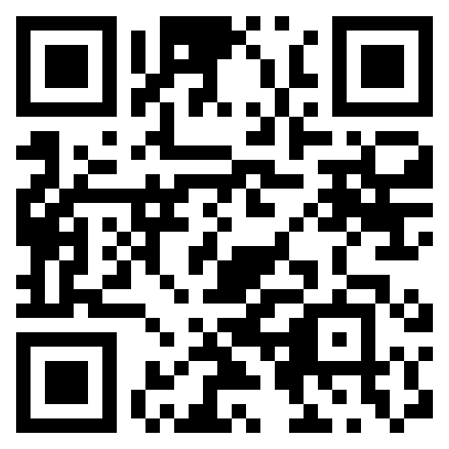
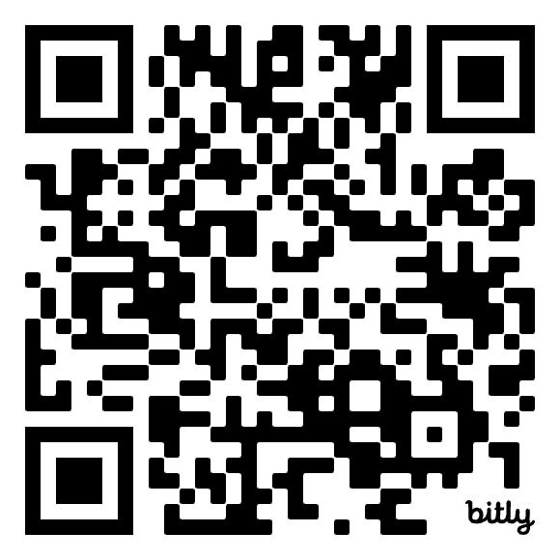
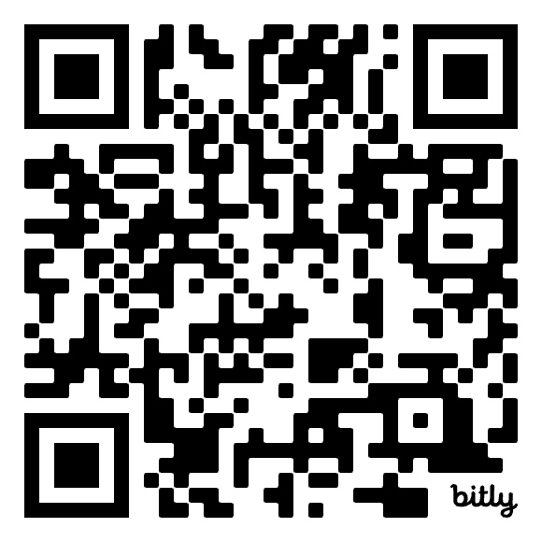
Resources to help support transition planning
Transition to high school – What Works Best in practice
Transition from primary to high school
Enhancing the transition to high school for students
Notes:
Slide: Resources to help support your transition planning​
Purpose: Resources to help support your transition planning​
Duration: 1 min​
Script: ​
​
Scan the QR codes to explore resources that can strengthen transition to high school practices.​
​
CLICK

Slide 23
Overview of Workshop 2
Supporting transition through the curriculum
Notes:
Slide: Overview of workshop 2
Purpose: Title slide
Duration: 5 seconds
Script:​
I will now provide you with an overview of the next Transition workshop: Supporting transition through the curriculum.
CLICK

Slide 24



Supporting transition through the curriculum
Next workshop
Continuity of learning
Explore what continuity of learning means and how to facilitate this during a student's transition from primary to high school.
Curriculum alignment
Understand how Stage 3 and Stage 4 syllabuses work together to support continuity of learning.
Staff collaboration
Explore strategies to build strong staff relationships that foster inclusion, wellbeing and successful transition.
Notes:
Slide: Supporting transition through the curriculum
Purpose: to provide an overview of workshop 2
Duration: 1 minute
Script:
In our next workshop, we will focus on building a deeper understanding of the knowledge and relationships essential for facilitating continuity of learning as students transition from primary to high school.
Here’s what you can expect to learn during this session:
First, we will unpack the concept of continuity of learning – what it means in the context of transition and how it can be facilitated to support students as they move from primary to high school
We will then examine how the Stage 3 and Stage 4 syllabuses connect and how this alignment will support students’ learning experiences across both settings.
This will be followed by looking at ways to support each other in building relationships that are crucial for effective transition, inclusion, and student wellbeing.
We will all have an opportunity to share our insights, engage in discussion and take part in activities designed to help us strengthen our collective practice.
CLICK

Slide 25
Session evaluation
Notes:
Slide: Session evaluation
Purpose: Title slide
Duration: 5 seconds
Script:​
CLICK

Slide 26

Evaluation survey- participants
Workshop 1 – Exploring the evidence base to support effective transition
Please complete the evaluation form to share your feedback about this workshop.
Facilitator: Click the link Transition from primary to high school workshop 1- participant survey – Copy form to duplicate the template and contextualise survey questions
Workshop 1 – participant survey
Your insights will help us understand what worked well and how we can continue to improve future professional learning sessions.
Notes:
Slide: Evaluation survey - participants
Purpose: to provide feedback to the school facilitator to use to track data
Duration: 2 min
Script:
We would like for you to fill out a short survey to provide the school facilitator with feedback about the workshop.
Please use the survey code or link provided to do this. (When scanning the QR code people will be asked to fill in an email address. They need to use their NSW Department of Education email address to log in).
** Facilitator, Click the link on the slide to duplicate the template and contextualise survey questions. Then download and insert the link and QR code onto the slide.
CLICK

Slide 27
References
This presentation contains NSW Curriculum and syllabus content. The NSW Curriculum is developed by the NSW Education Standards Authority. This content is prepared by NESA for and on behalf of the Crown in the right of the State of New South Wales. The material is protected by Crown copyright.
Please refer to the NESA Copyright Disclaimer for more information https://educationstandards.nsw.edu.au/wps/portal/nesa/mini-footer/copyright.
NESA holds the only official and up-to-date versions of the NSW Curriculum and syllabus documents. Please visit the NSW Education Standards Authority (NESA) website https://educationstandards.nsw.edu.au/wps/portal/nesa/home and the NSW Curriculum website https://curriculum.nsw.edu.au.
Transition to high school – What Works Best in practice practical guide (nsw.gov.au) CESE (Centre for Education Statistics and Evaluation) (2024), NSW Department of Education.
Transition to high school – What Works Best in practice reflection guide (nsw.gov.au) CESE (Centre for Education Statistics and Evaluation) (2024), NSW Department of Education.
Understanding transition to high school CESE (Centre for Education Statistics and Evaluation) (2024), NSW Department of Education.
Notes:
Slide: References
Purpose: Links to document referenced when developing this workshop
Duration: 5 seconds
Script:

Slide 28
Copyright
© State of New South Wales (Department of Education), 2025
The copyright material published in this resource is subject to the Copyright Act 1968 (Cth) and is owned by the NSW Department of Education or, where indicated, by a party other than the NSW Department of Education (third-party material).
Copyright material available in this resource and owned by the NSW Department of Education is licensed under a Creative Commons Attribution 4.0 International (CC BY 4.0) license.
This license allows you to share and adapt the material for any purpose, even commercially.
Attribution should be given to © State of New South Wales (Department of Education), 2025.
Material in this resource not available under a Creative Commons license:
the NSW Department of Education logo, other logos and trademark-protected material
Material owned by a third party that has been reproduced with permission. You will need to obtain permission from the third party to reuse its material.
Links to third-party material and websites
Please note that the provided (reading/viewing material/list/links/texts) are a suggestion only and implies no endorsement, by the New South Wales Department of Education, of any author, publisher, or book title. School principals and teachers are best placed to assess the suitability of resources that would complement the curriculum and reflect the needs and interests of their students.
If you use the links provided in this document to access a third-party’s website, you acknowledge that the terms of use, including licence terms set out on the third-party’s website apply to the use which may be made of the materials on that third-party website or where permitted by the Copyright Act 1968 (Cth). The department accepts no responsibility for content on third-party websites.

