Slide 1
Che ore sono?
What time is it? – times on the hour and past the hour

Slide 2
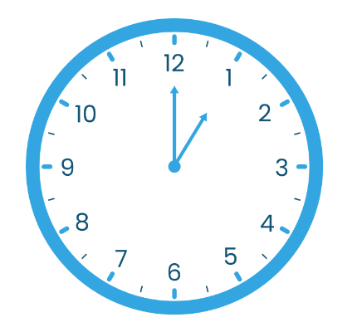
Che ore sono? Che ora è? (1 of 2)
What time is it?
È l’una.

Slide 3
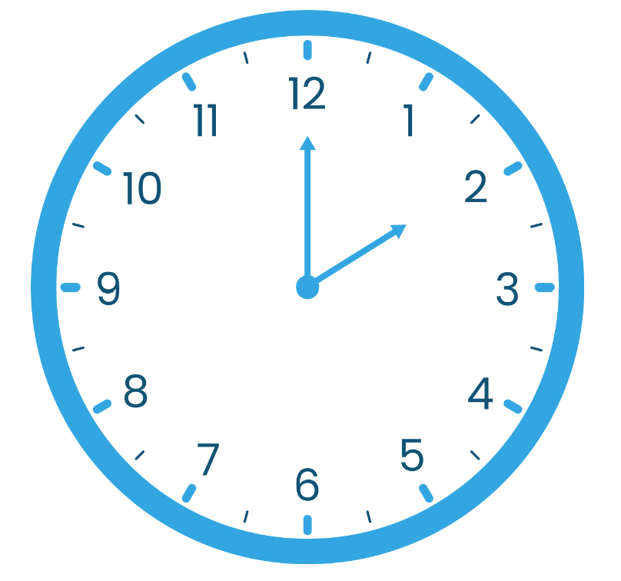
Che ore sono? (1 of 14)
What time is it?
Sono le due.

Slide 4
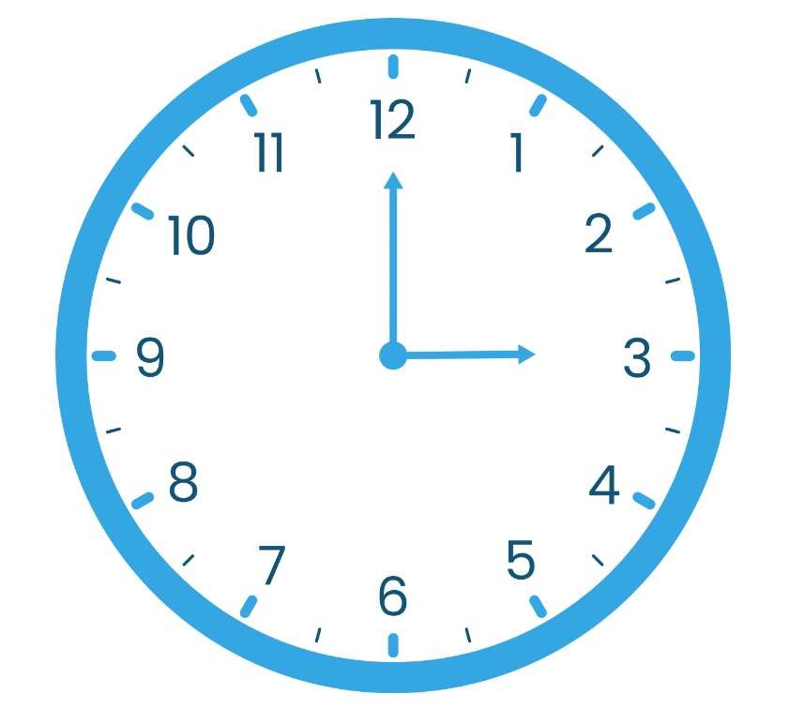
Che ore sono? (2 of 14)
What time is it?
Sono le tre.

Slide 5
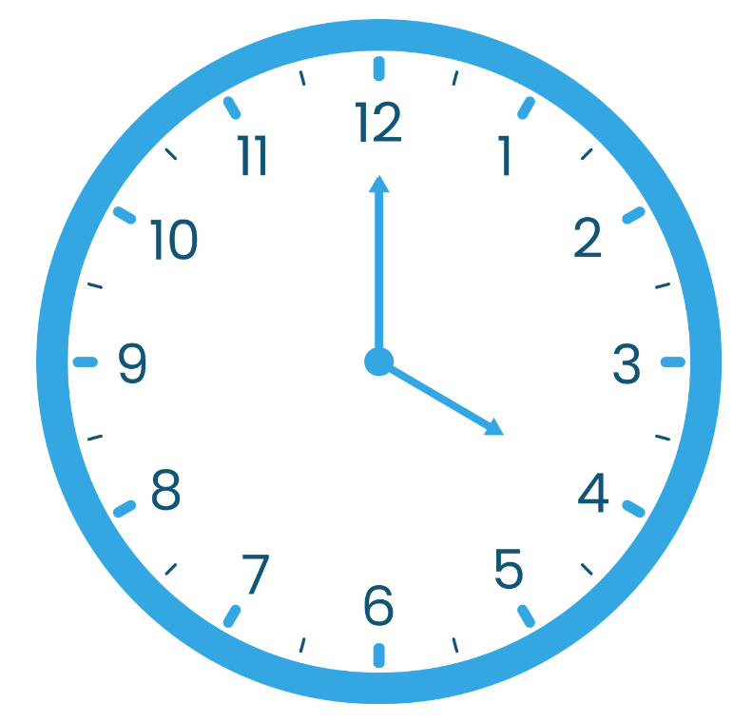
Che ore sono? (3 of 14)
What time is it?
Sono le quattro.

Slide 6
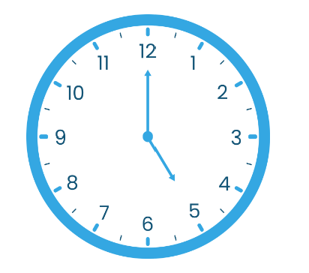
Che ore sono? (4 of 14)
What time is it?
Sono le cinque.

Slide 7
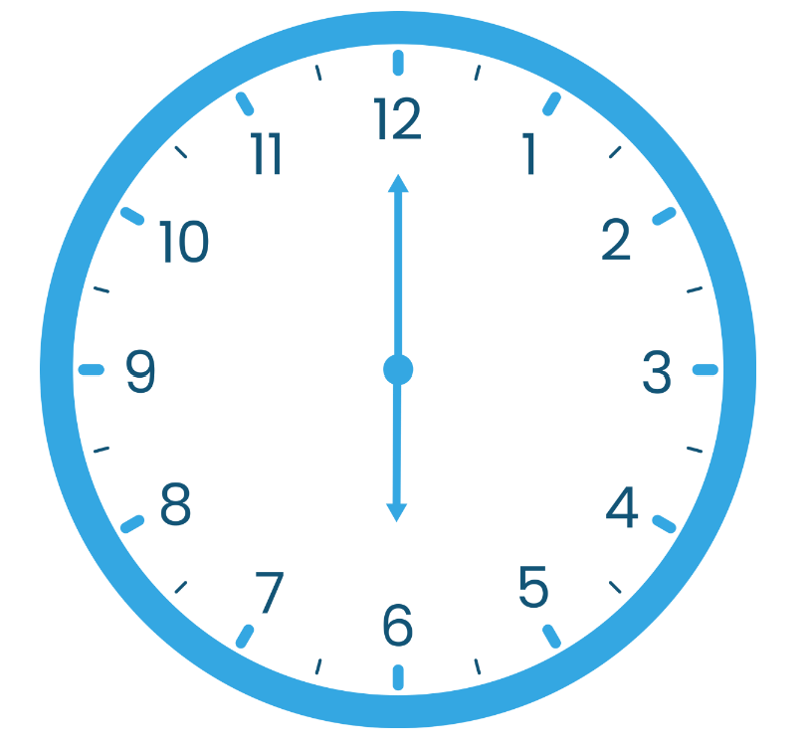
Che ore sono? (5 of 14)
What time is it?
Sono le sei.

Slide 8
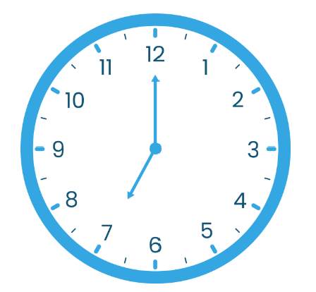
Che ore sono? (6 of 14)
What time is it?
Sono le sette.

Slide 9
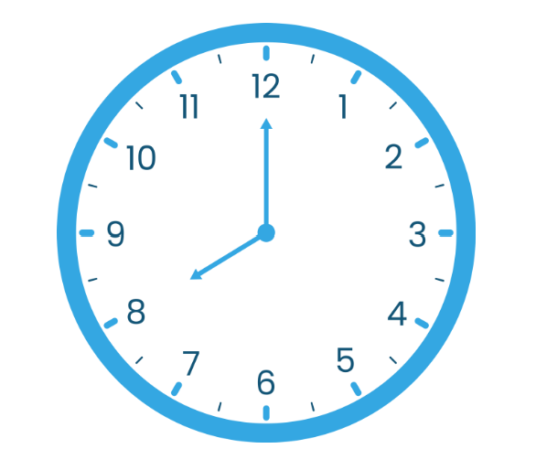
Che ore sono? (7 of 14)
What time is it?
Sono le otto.

Slide 10
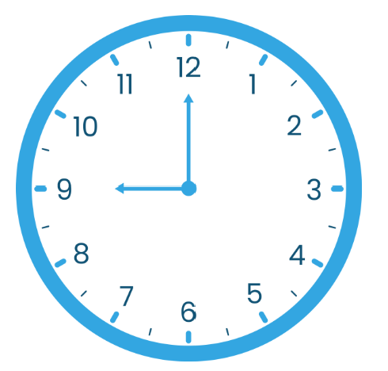
Che ore sono? (8 of 14)
What time is it?
Sono le nove.

Slide 11
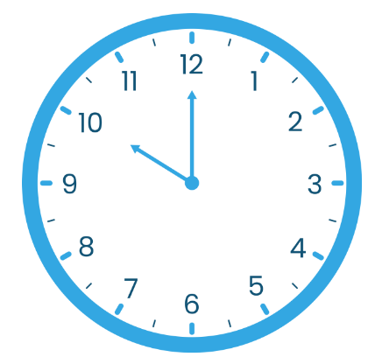
Che ore sono? (9 of 14)
What time is it?
Sono le dieci.

Slide 12
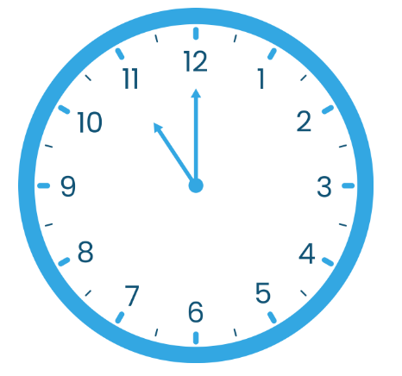
Che ore sono? (10 of 14)
What time is it?
Sono le undici.

Slide 13
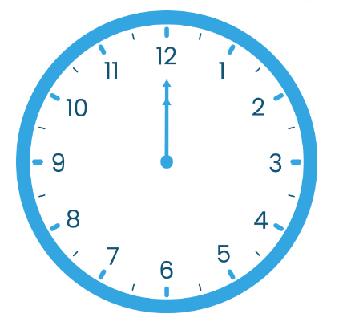
Che ore sono? (11 of 14)
What time is it?
Sono le dodici.

Slide 14

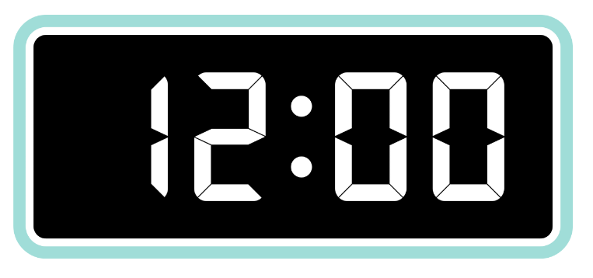

Che ore sono? Che ora è? (2 of 2)
What time is it?
È mezzogiorno
È mezzanotte

Slide 15
Che ore sono? (12 of 14)
2:05 Sono le due e cinque
2:07 Sono le due e sette
2:08 Sono le due e otto
3:10 Sono le tre e dieci
3:15 Sono le tre e quindici
4:20 Sono le quattro e venti
4:25 Sono le quattro e venticinque

Slide 16
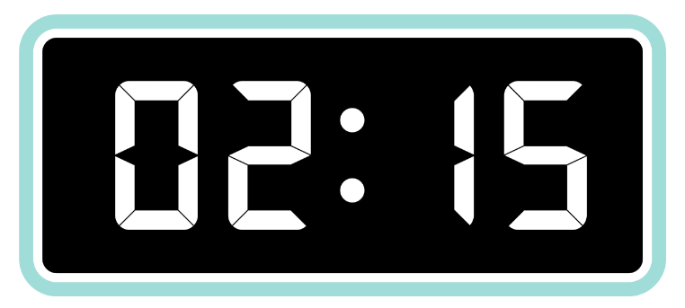
Che ore sono? (13 of 14)
Sono le due e un quarto.

Slide 17
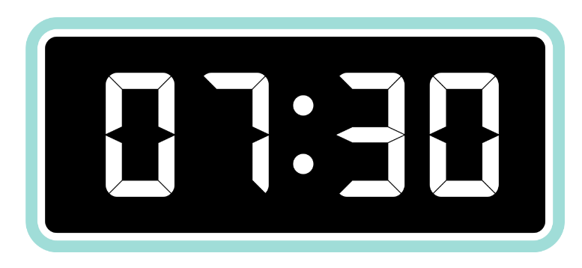
Che ore sono? (14 of 14)
Sono le sette e mezza.

Slide 18

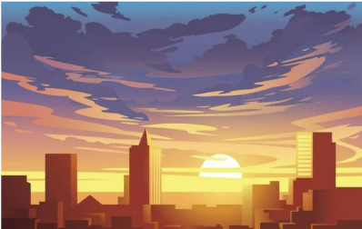
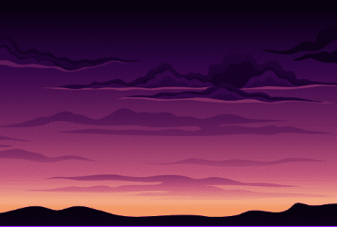
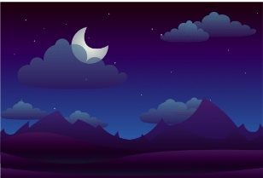
I momenti della giornata
di mattina
del pomeriggio
di sera
di notte

Slide 19
References
This presentation contains NSW Curriculum and syllabus content. The NSW Curriculum is developed by the NSW Education Standards Authority. This content is prepared by NESA for and on behalf of the Crown in the right of the State of New South Wales. The material is protected by Crown copyright.
Please refer to the NESA Copyright Disclaimer for more information https://educationstandards.nsw.edu.au/wps/portal/nesa/mini-footer/copyright.
NESA holds the only official and up-to-date versions of the NSW Curriculum and syllabus documents. Please visit the NSW Education Standards Authority (NESA) website https://educationstandards.nsw.edu.au/wps/portal/nesa/home and the NSW Curriculum website https://curriculum.nsw.edu.au.
Modern Languages K–10 © Syllabus NSW Education Standards Authority (NESA) for and on behalf of the Crown in right of the State of New South Wales, 2023.

Slide 20
Copyright
© State of New South Wales (Department of Education), 2024
The copyright material published in this resource is subject to the Copyright Act 1968 (Cth) and is owned by the NSW Department of Education or, where indicated, by a party other than the NSW Department of Education (third-party material).
Copyright material available in this resource and owned by the NSW Department of Education is licensed under a Creative Commons Attribution 4.0 International (CC BY 4.0) license.
This licence allows you to share and adapt the material for any purpose, even commercially.
Attribution should be given to © State of New South Wales (Department of Education), 2024.
Material in this resource not available under a Creative Commons license:
the NSW Department of Education logo, other logos and trademark-protected material
Material owned by a third party that has been reproduced with permission. You will need to obtain permission from the third party to reuse its material.
Links to third-party material and websites
Please note that the provided (reading/viewing material/list/links/texts) are a suggestion only and implies no endorsement, by the New South Wales Department of Education, of any author, publisher, or book title. School principals and teachers are best placed to assess the suitability of resources that would complement the curriculum and reflect the needs and interests of their students.
If you use the links provided in this document to access a third party’s website, you acknowledge that the terms of use, including license terms set out on the third-party’s website apply to the use which may be made of the materials on that third-party website or where permitted by the Copyright Act 1968 (Cth). The department accepts no responsibility for content on third-party websites.

