Slide 1
Which one? – Yang mana?

Slide 2

Asking ‘Which one?’
Yang mana?
To specify items when shopping, you may need to ask or be asked ‘Which one?’.
We can ask:
Yang mana?
We can ask this question on its own or add an item beforehand.
For example:
Topi yang mana?
Ukiran yang mana?
Mau beli sarung yang mana?
Notes:
For the teacher:
Translations of examples:
Which hat?
Which carving?
Which sarong do you want to buy?

Slide 3
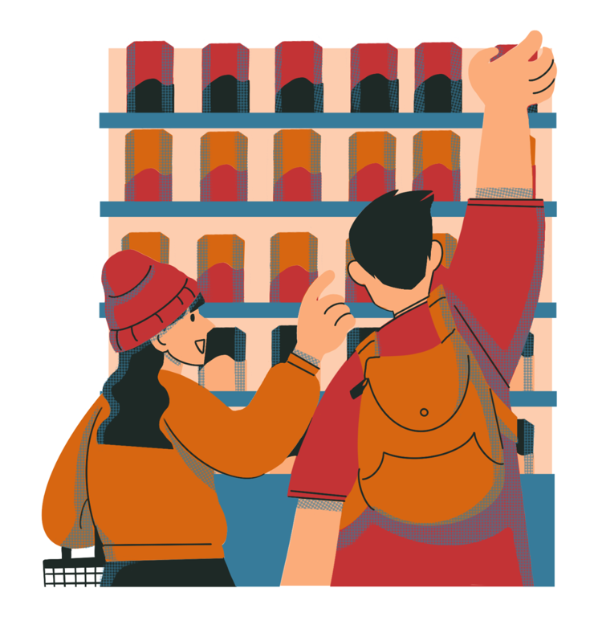
Saying which one you want
Yang…
To answer the question Yang mana?, we can say:
Yang…
Don’t forget to add an adjective at the end of the sentence, to specify the item. For example:
Yang hijau.
Yang kecil.
Saya mau beli sarung yang biru.
Notes:
For the teacher:
Translations of examples:
The green one.
The small one.
I want to buy the blue sarong.
Note about ‘yang’
The question Yang mana? can provide an opportunity to discuss the word yang in the Indonesian language. Yang can mean ‘who’, ‘which is’, ‘that’, ‘the one’ or ‘the one who’. Yang can be used to separate an noun and an adjective, and can give more emphasis to an adjective. For example, the phrases ‘sarung biru’ and ‘sarung yang biru’ are both correct grammatically and refer to a blue sarong. In a context where there are many sarongs of different colours, someone might say ‘sarung yang biru’ to emphasise that they are referring to ‘the blue sarong’ or ‘the blue one’. Yang is also frequently used to separate adjectives when there is more than one being used. For example, rok panjang yang biru (a long skirt that’s blue).

Slide 4

Let’s practise! Yang mana?
You will be given a number card.
Each slide will display a choice of 2 items. Each time the slide changes, a number will be called out in Indonesian. If it is your number, call out Saya!
You will be asked the question Yang mana?
Respond by specifying which item you want. For example, Yang biru.
Notes:
For the teacher:
Give each student a number card (from the unit of work resources).
As you move through each slide, call out a number in Indonesian (for example, Dua belas!).
The student who has the number 12 card should identify themselves by calling out Saya!’
Ask the student Yang mana?
The student should respond by specifying which item they want from the choices displayed on the slide. For example, if the slide shows a picture of a big and small carving, the student can answer Yang besar or Yang kecil.
After moving through the 10 item slides, return to the beginning again. This time, have students work in pairs and follow the same pattern. Display each slide and students take turns asking each other Yang mana? and responding in Indonesian.

Slide 5
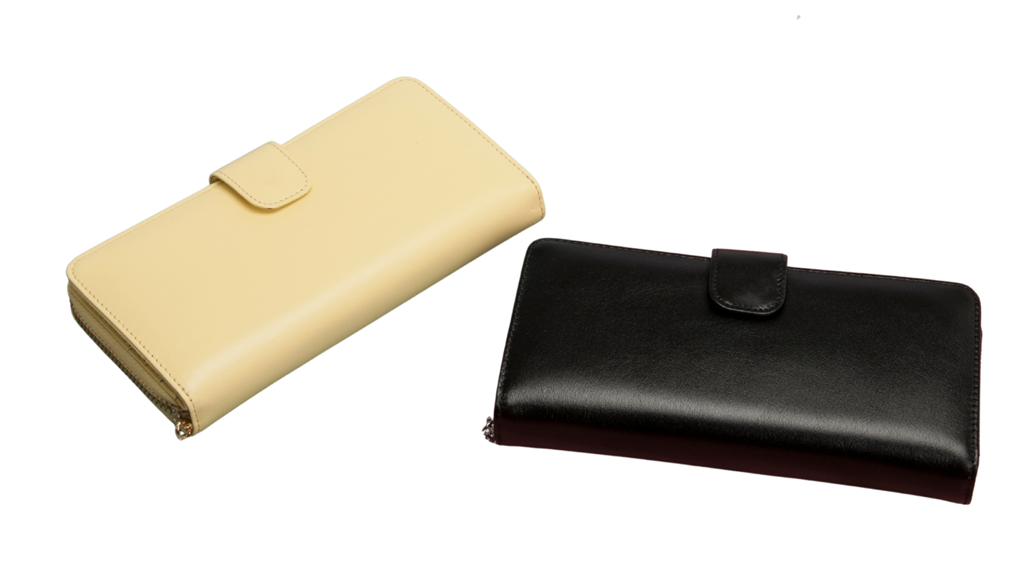
Item 1
Notes:
Teacher asks: Yang mana?
Student responds: Yang kuning or Yang hitam.

Slide 6
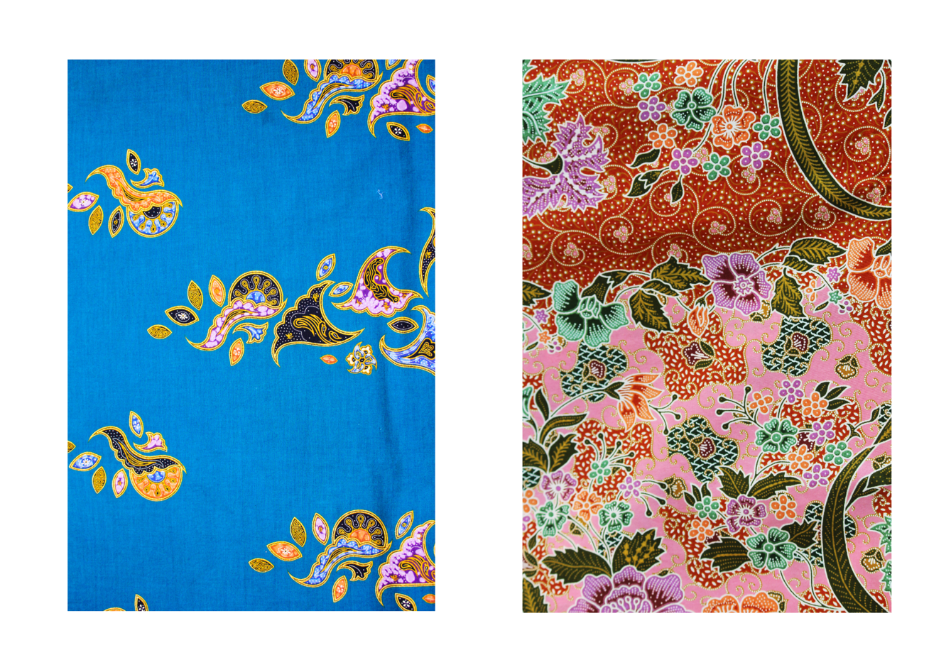
Item 2
Notes:
Teacher asks: Yang mana?
Student responds: Yang biru or Yang merah muda.

Slide 7
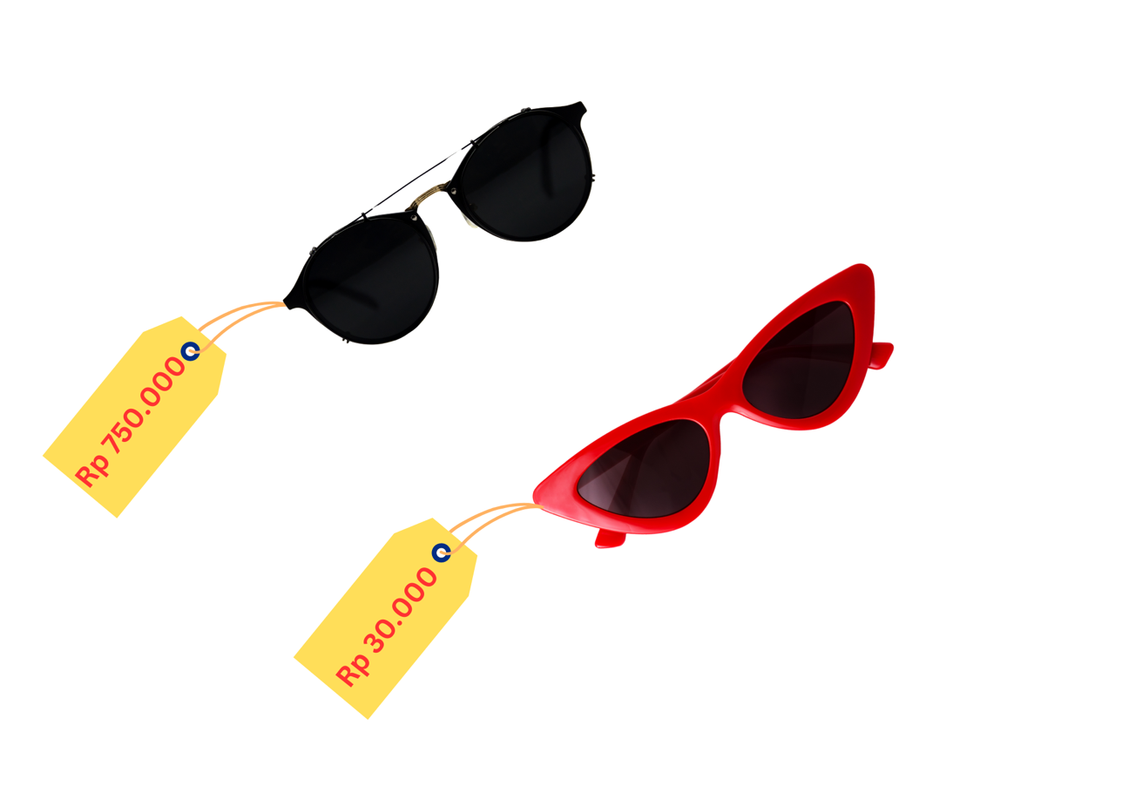
Item 3
Notes:
Teacher asks: Yang mana?
Student responds: Yang mahal or Yang murah.

Slide 8
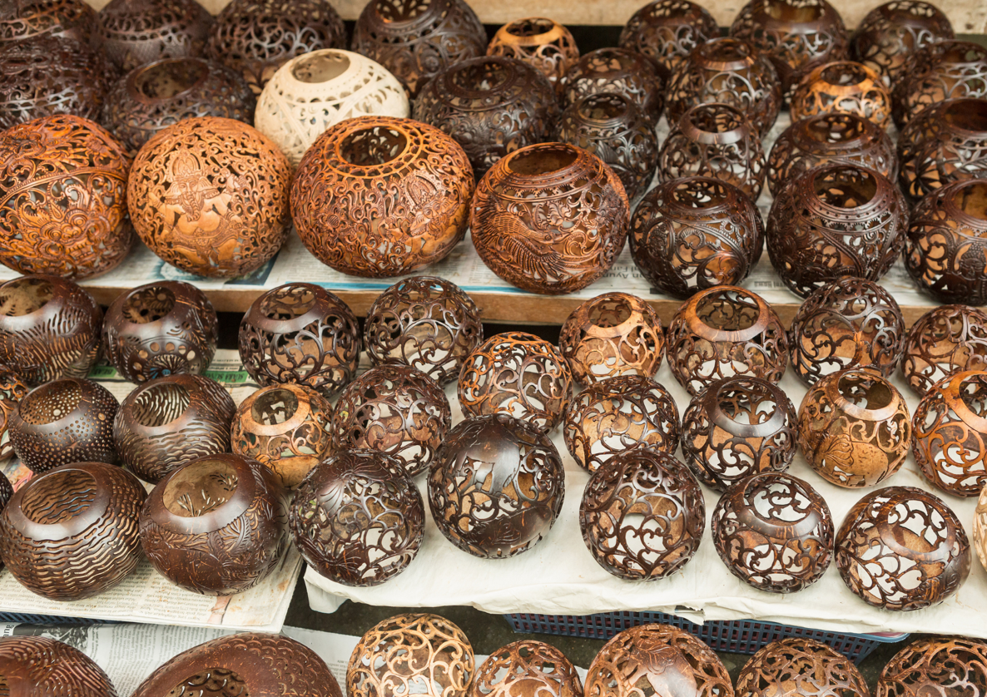
Item 4
Notes:
Teacher asks: Yang mana?
Student responds: Yang besar or Yang kecil.

Slide 9
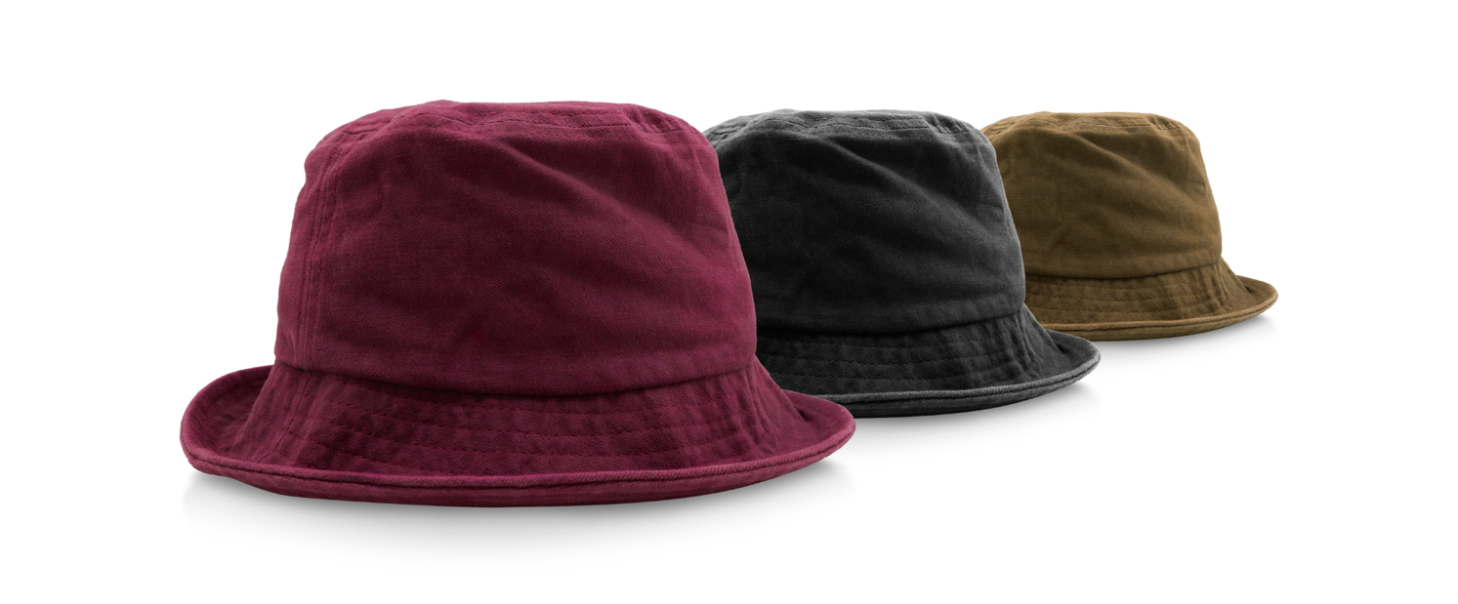
Item 5
Notes:
Teacher asks: Yang mana?
Student responds: Yang ungu, Yang hitam or Yang cokelat.

Slide 10
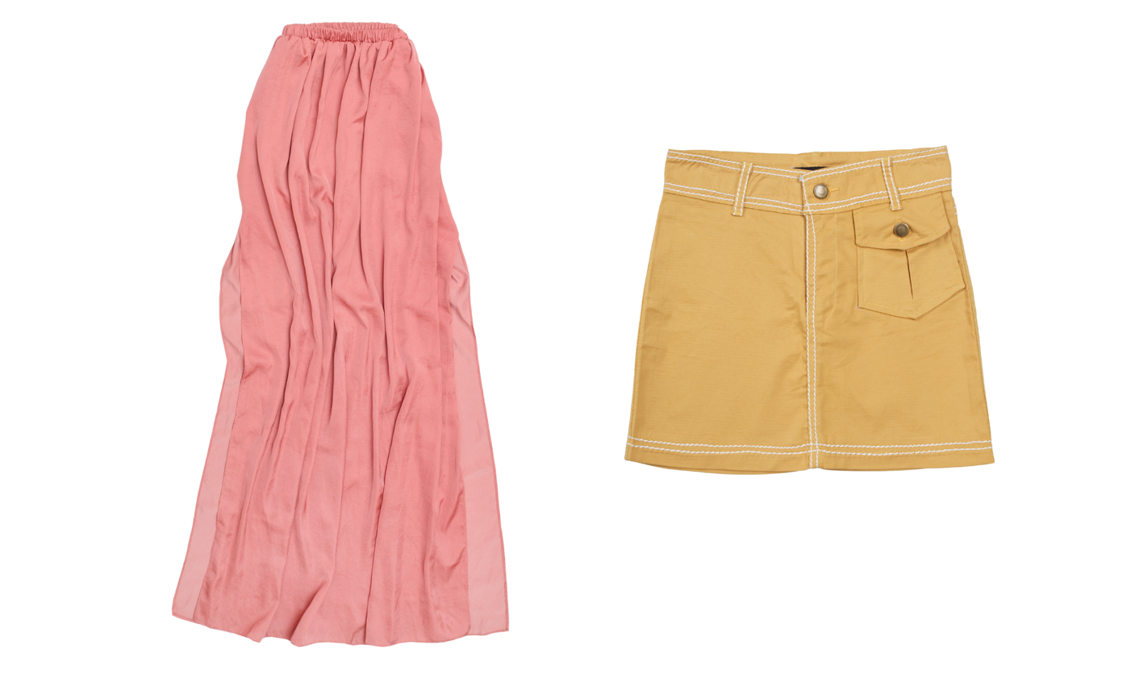
Item 6
Notes:
Teacher asks: Yang mana?
Student responds: Yang panjang or Yang pendek.

Slide 11
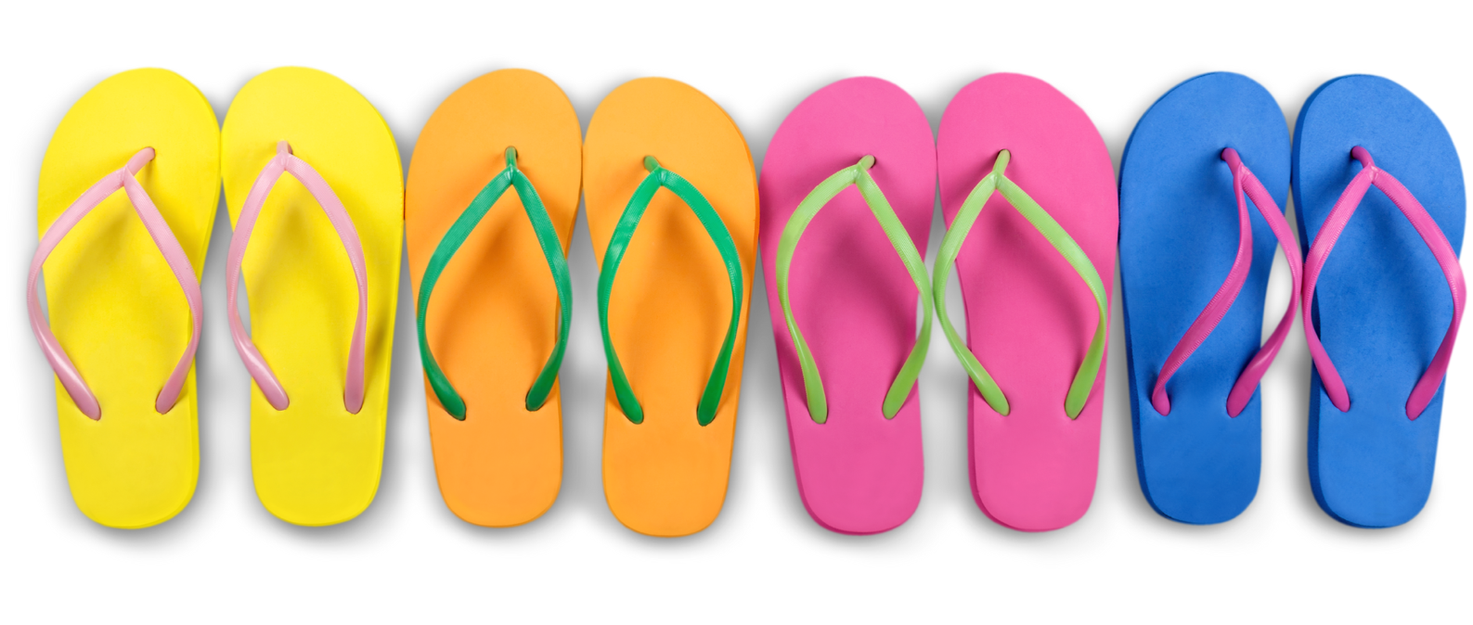
Item 7
Notes:
Teacher asks: Yang mana?
Student responds: Yang kuning, yang jingga, yang merah muda or Yang biru.

Slide 12
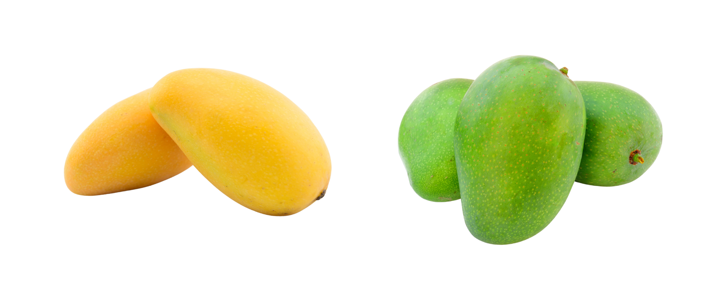
Item 8
Notes:
Teacher asks: Yang mana?
Student responds: Yang kuning or Yang hijau.

Slide 13
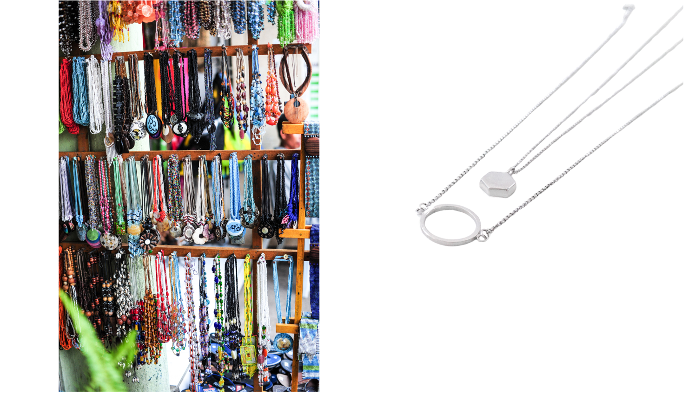
Item 9
Notes:
Teacher asks: Yang mana?
Student responds: Yang asli or Yang modern.

Slide 14
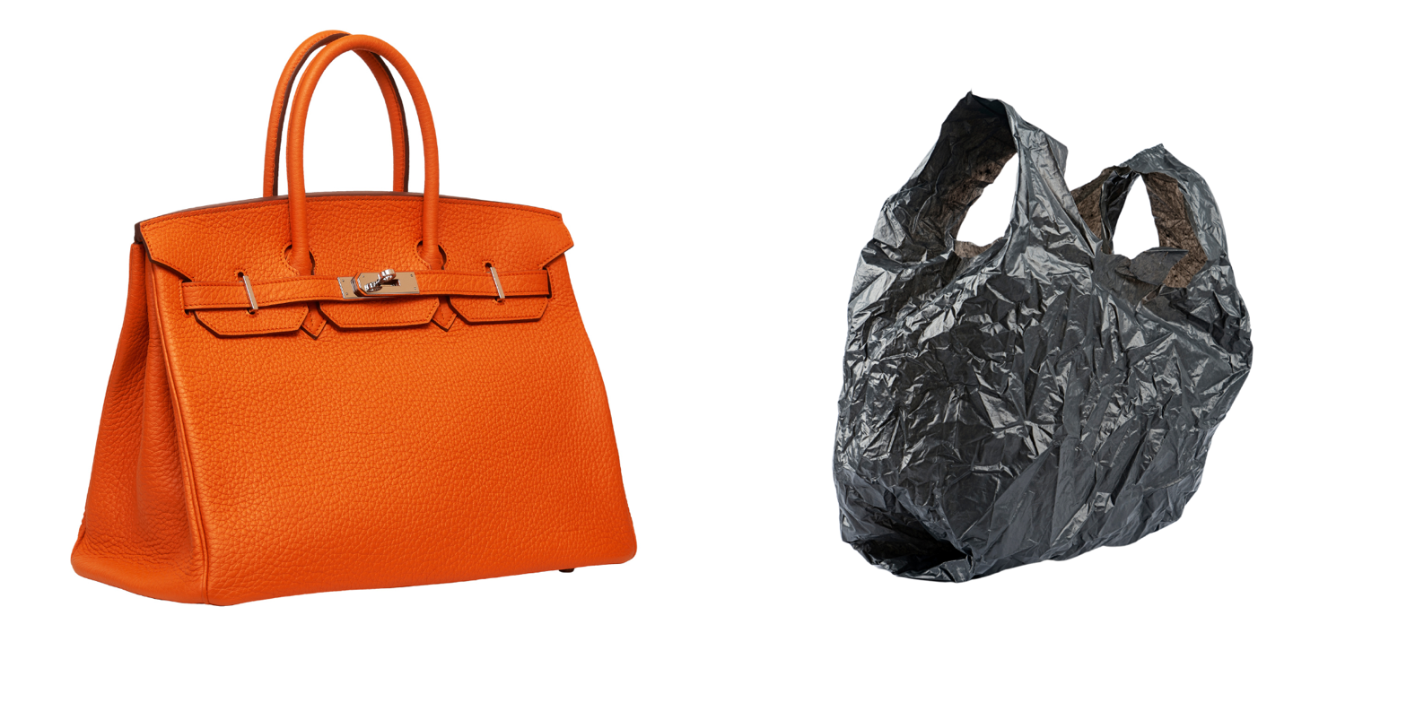
Item 10
Notes:
Teacher asks: Yang mana?
Student responds: Yang berkualitas tinggi, Yang mahal, Yang jingga, Yang murah or Yang hitam.

Slide 15
Copyright
© State of New South Wales (Department of Education), 2024
The copyright material published in this resource is subject to the Copyright Act 1968 (Cth) and is owned by the NSW Department of Education or, where indicated, by a party other than the NSW Department of Education (third-party material).
Copyright material available in this resource and owned by the NSW Department of Education is licensed under a Creative Commons Attribution 4.0 International (CC BY 4.0) license.
This license allows you to share and adapt the material for any purpose, even commercially.
Attribution should be given to © State of New South Wales (Department of Education), 2024.
Material in this resource not available under a Creative Commons license:
the NSW Department of Education logo, other logos and trademark-protected material
Material owned by a third party that has been reproduced with permission. You will need to obtain permission from the third party to reuse its material.
Links to third-party material and websites
Please note that the provided (reading/viewing material/list/links/texts) are a suggestion only and implies no endorsement, by the New South Wales Department of Education, of any author, publisher, or book title. School principals and teachers are best placed to assess the suitability of resources that would complement the curriculum and reflect the needs and interests of their students.
If you use the links provided in this document to access a third party’s website, you acknowledge that the terms of use, including licence terms set out on the third-party’s website apply to the use which may be made of the materials on that third-party website or where permitted by the Copyright Act 1968 (Cth). The department accepts no responsibility for content on third-party websites.
Notes:
Slide not shared

