Slide 1
Shopping places – Tempat berbelanja

Slide 2
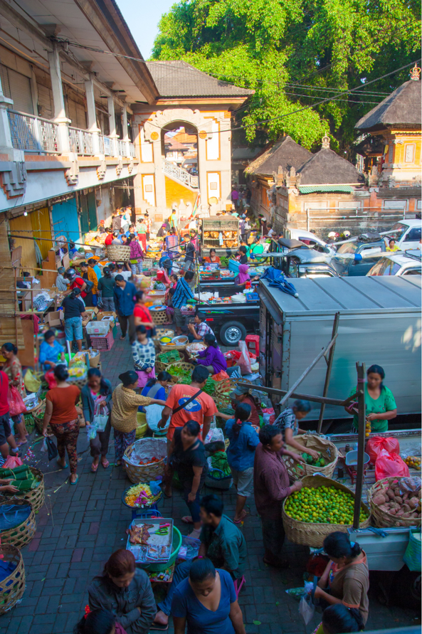
pasar
Notes:
Pasar means ‘market’.

Slide 3
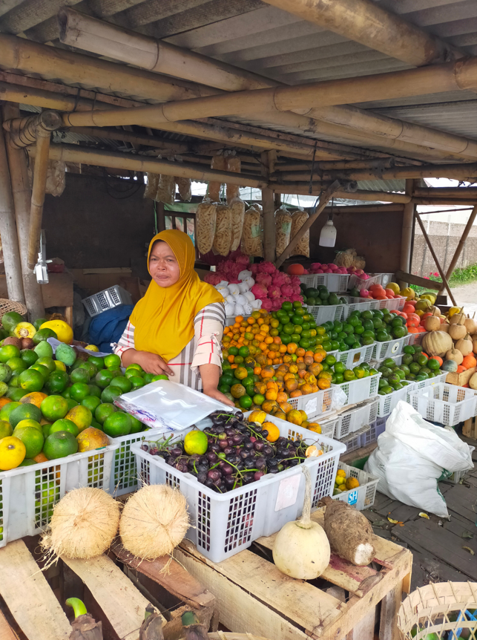
pasar buah
Notes:
Pasar buah means ‘fruit market’.

Slide 4
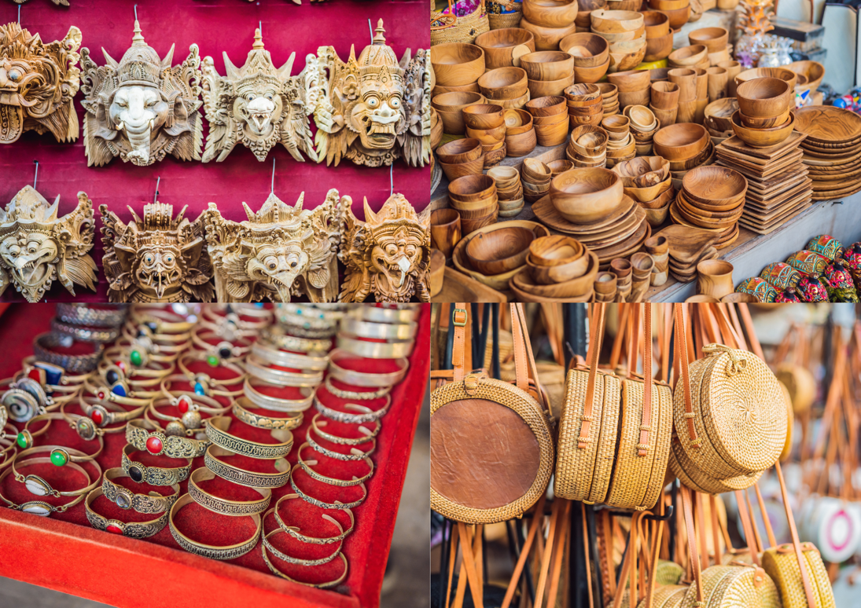
pasar seni
Notes:
Pasar seni means ‘art market’. This is a place where handicrafts and art are sold.

Slide 5
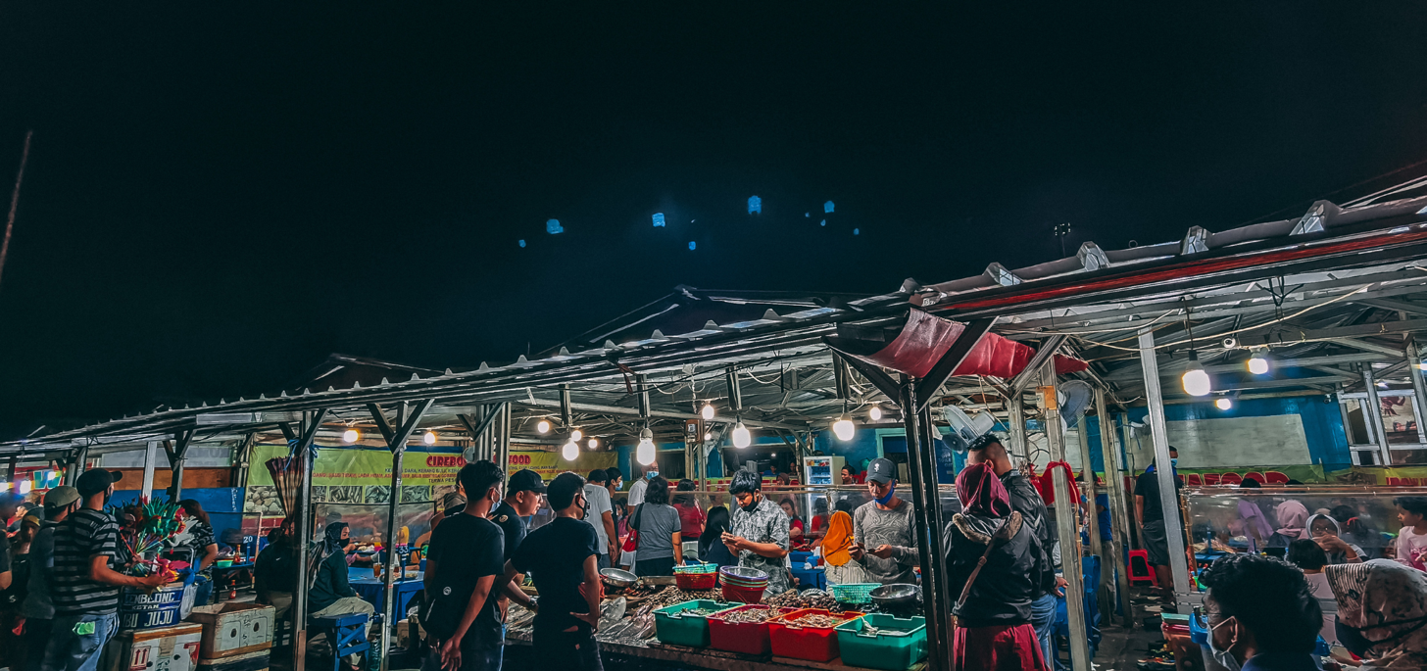
pasar malam
Notes:
Pasar malam means ‘night market’.

Slide 6
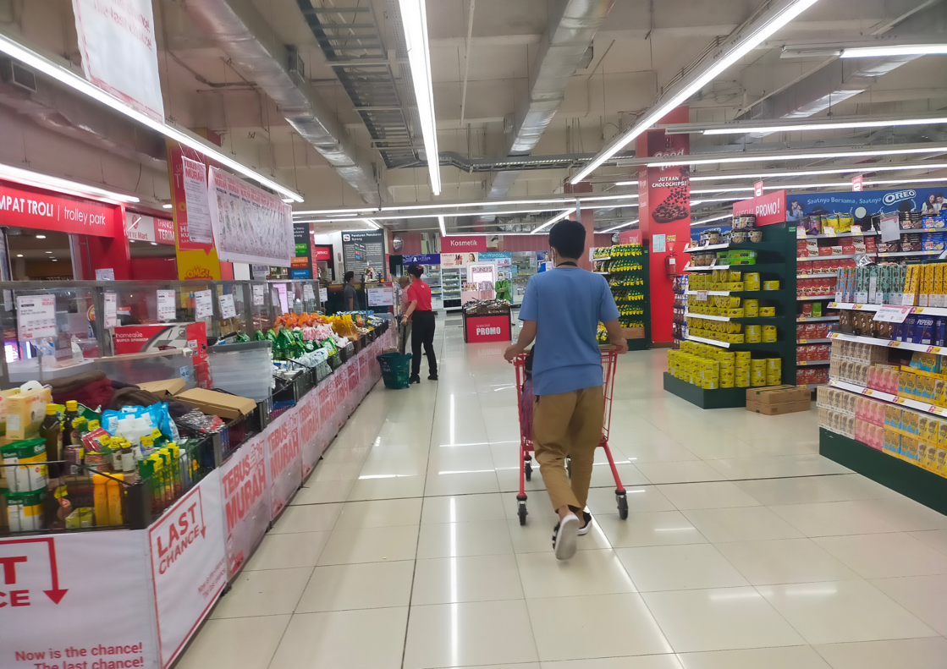
pasar swalayan
Notes:
Pasar swalayan means ‘supermarket’. In Indonesia, the word supermarket is also used.

Slide 7
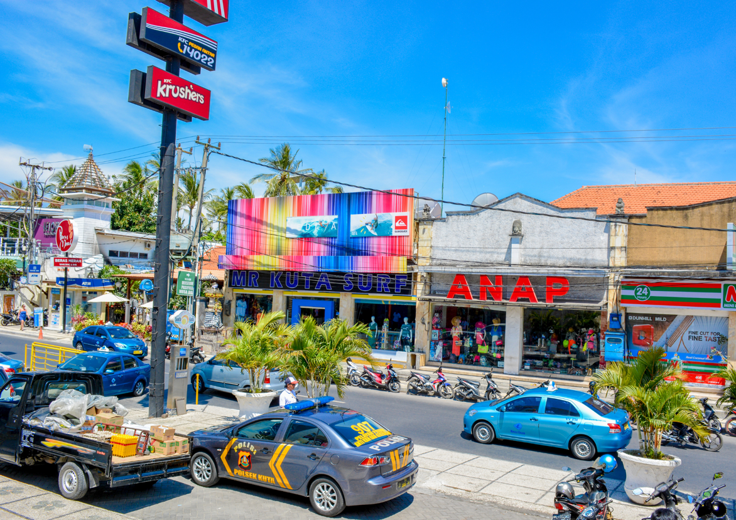
toko
Notes:
Toko means ‘shop’.

Slide 8
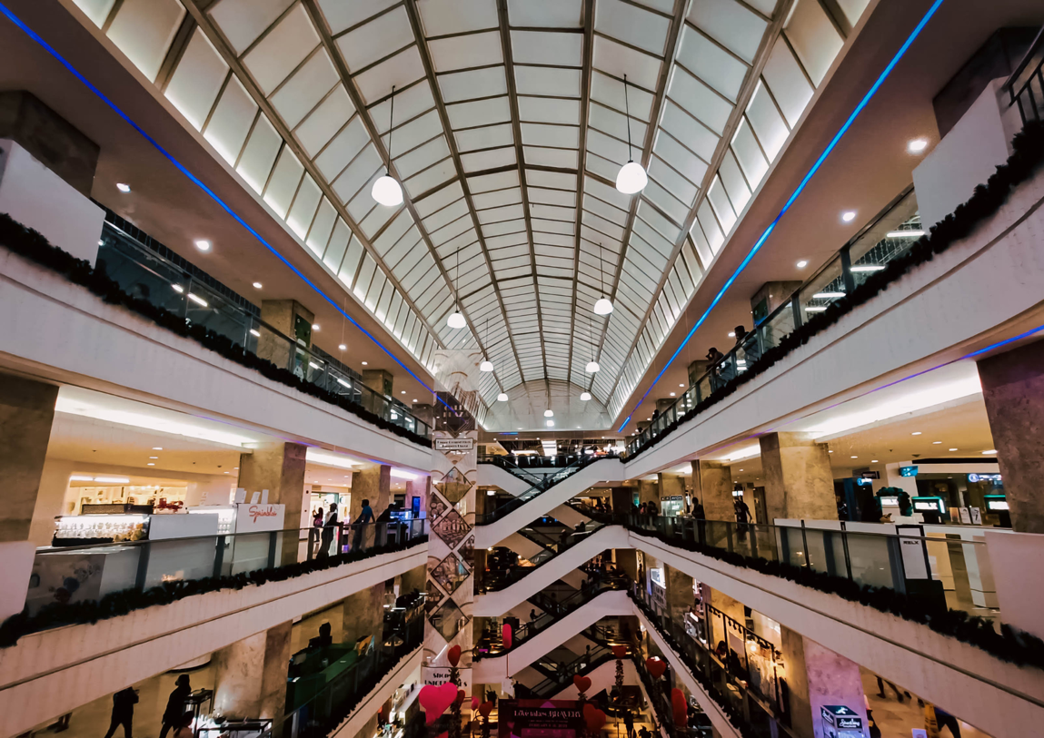
mal
Notes:
Mal means ‘mall’.

Slide 9
Summary
pasar
pasar buah
pasar seni
pasar malam
pasar swalayan
toko
mal

Slide 10
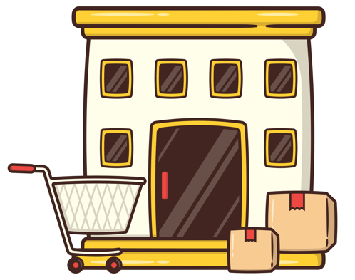
Using ke
We use ke to mean ‘to’ or ‘to go to’ when we are talking about going to a place.
For example:
Saya ke pasar.
Saya ke pasar swalayan.
Saya mau ke mal.
Remember that tense is based on context, so a sentence like Saya ke toko could have varying meanings. It could mean:
I am going to the shop. OR
I went to the shop.
Notes:
For the teacher:
Translations of examples:
I am going to the market.
I went to the supermarket.
I want to go to the mall.
Note about tense:
These examples provide an opportunity to discuss tense in the Indonesian language and how it is based on context. The example sentence ‘Saya ke toko’ could have a variety of meanings, and on its own it is unclear whether it has already happened, is happening right now or will happen in the future. Discuss with students some examples of how context could reveal when the event is taking place. For example, if someone was being asked ‘What did you do on the weekend?’ and they answered ‘Saya ke toko’, we could assume that it is past tense. This means that time indicators and overall context are important in Indonesian.

Slide 11

Using di and di mana
We use di to mean ‘in’, ‘at’ or ‘on’ when we are talking about a place.
For example:
Saya beli sarung di Yogyakarta.
Saya beli durian di pasar buah.
We use di mana to mean ‘where?’ when asking about a place.
For example:
Kamu mau berbelanja di mana?
Saya beli suvenir di mana?
Notes:
For the teacher:
Translations of examples:
I bought a sarong in Yogyakarta.
I bought a durian at the fruit market.
Where do you want to shop?
Where do I buy souvenirs?

Slide 12
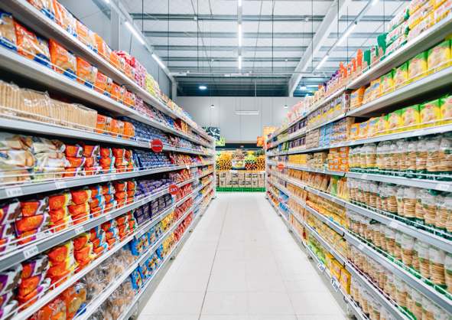
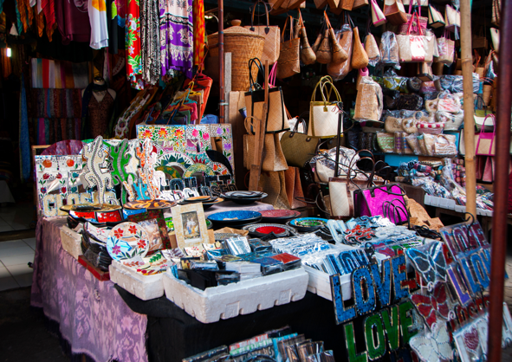
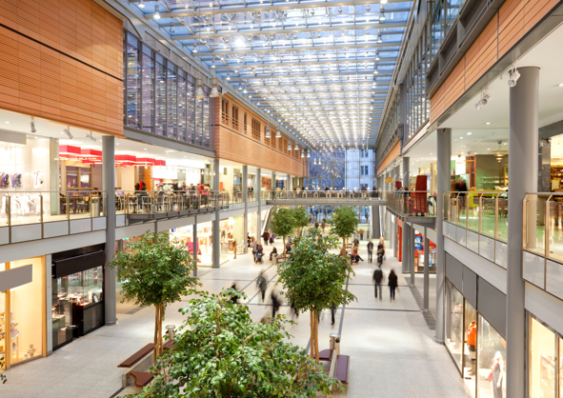
Kamu mau berbelanja di mana?
Look at the photos of different shopping places below. Write a sentence in Indonesian about where you want to shop and the reason why you want to shop there. Use karena to give your reason.
For example, Saya mau ke pasar karena saya mau beli suvenir.
Notes:
I want to go to the market because I want to buy souvenirs.

Slide 13
Copyright
© State of New South Wales (Department of Education), 2024
The copyright material published in this resource is subject to the Copyright Act 1968 (Cth) and is owned by the NSW Department of Education or, where indicated, by a party other than the NSW Department of Education (third-party material).
Copyright material available in this resource and owned by the NSW Department of Education is licensed under a Creative Commons Attribution 4.0 International (CC BY 4.0) license.
This license allows you to share and adapt the material for any purpose, even commercially.
Attribution should be given to © State of New South Wales (Department of Education), 2024.
Material in this resource not available under a Creative Commons license:
the NSW Department of Education logo, other logos and trademark-protected material
Material owned by a third party that has been reproduced with permission. You will need to obtain permission from the third party to reuse its material.
Links to third-party material and websites
Please note that the provided (reading/viewing material/list/links/texts) are a suggestion only and implies no endorsement, by the New South Wales Department of Education, of any author, publisher, or book title. School principals and teachers are best placed to assess the suitability of resources that would complement the curriculum and reflect the needs and interests of their students.
If you use the links provided in this document to access a third party’s website, you acknowledge that the terms of use, including licence terms set out on the third-party’s website apply to the use which may be made of the materials on that third-party website or where permitted by the Copyright Act 1968 (Cth). The department accepts no responsibility for content on third-party websites.
Notes:
Slide not shared

