Slide 1
How much is it? – Berapa harganya?

Slide 2
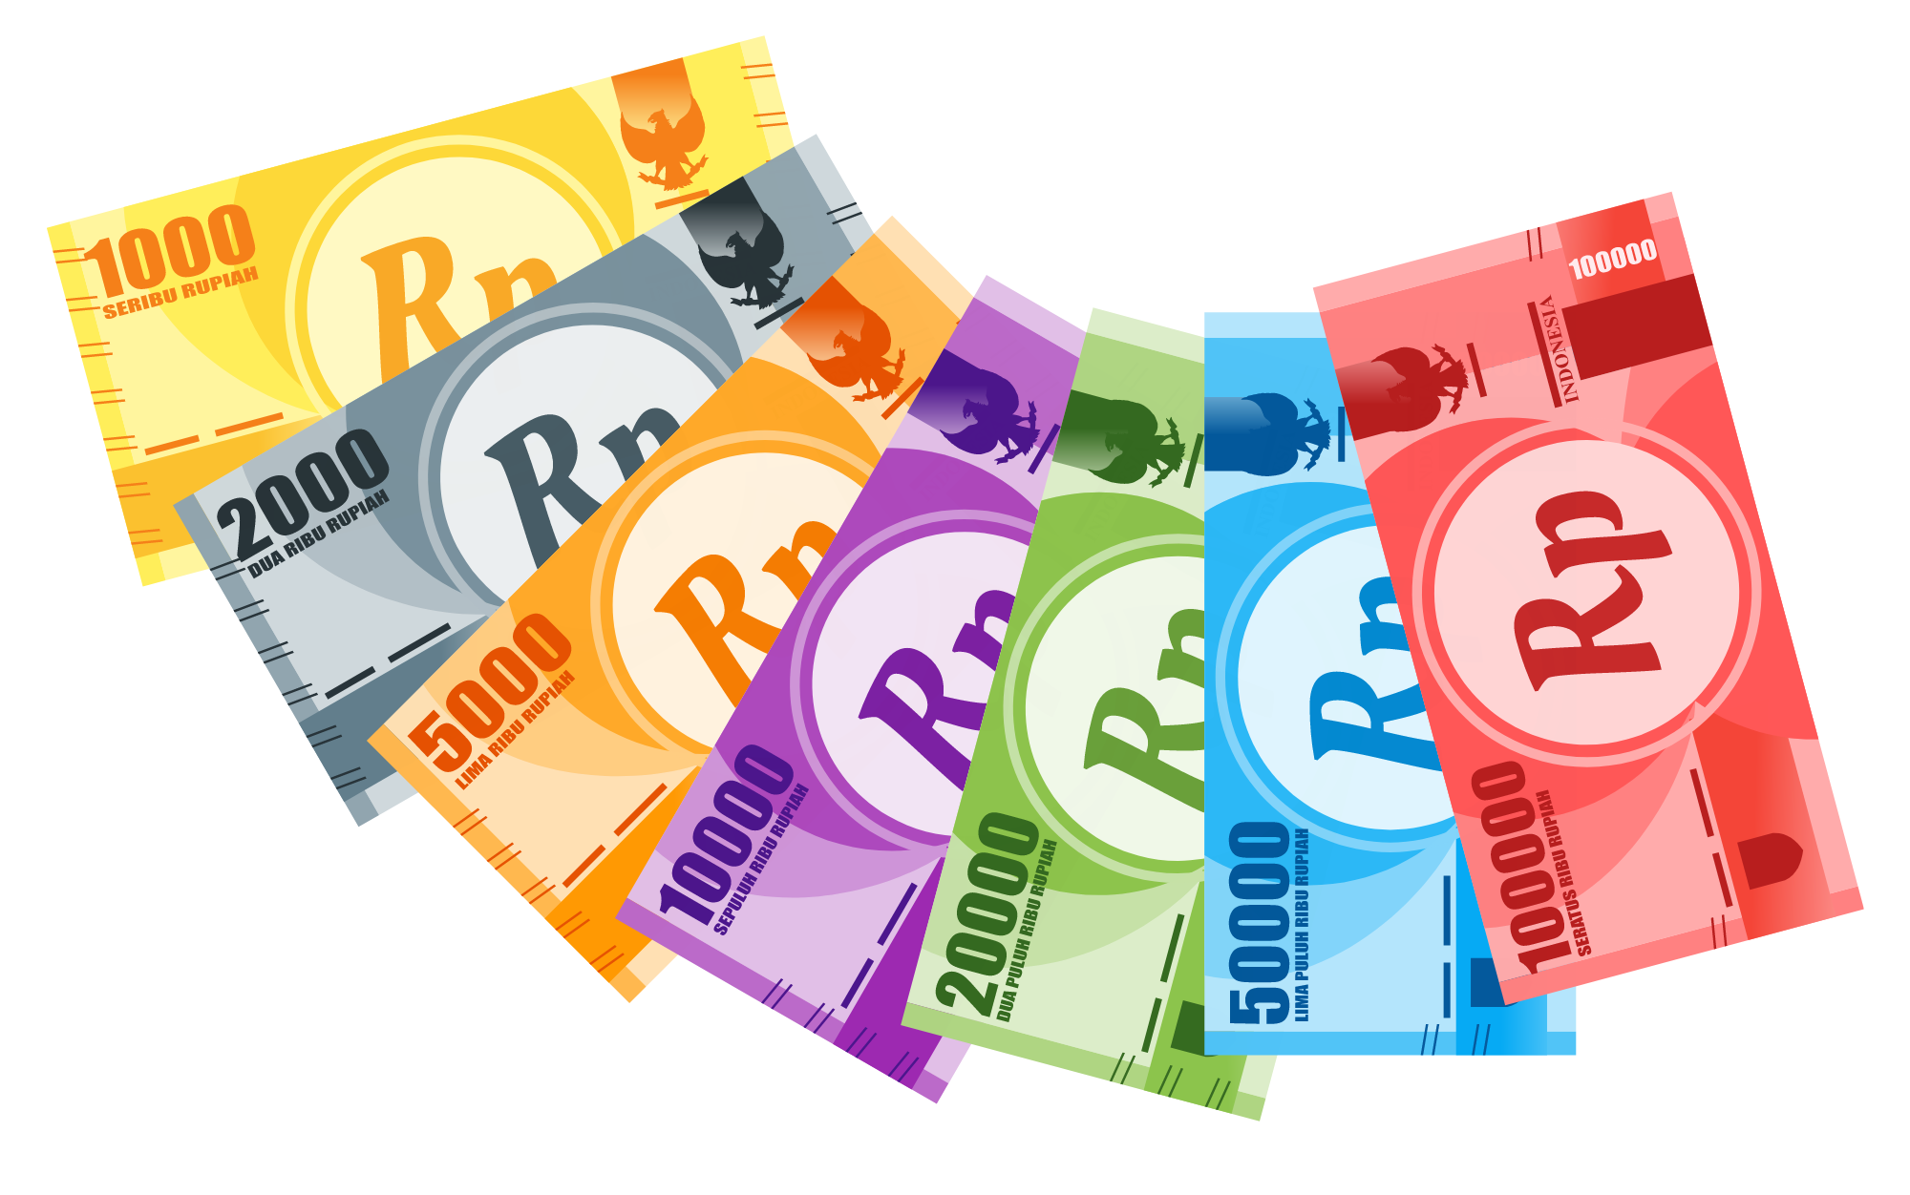
Asking how much something is
How much is it?
To ask someone how much something is, we can ask:
Berapa harganya?
Berapa means ‘how much’ or ‘how many’.
Harga means ‘price’ or ‘cost’.
-nya is a suffix, which in this case can mean ‘it’
or ‘the’.
How do you think you could reply when someone asks you Berapa harganya?
Notes:
For the teacher:
The –nya suffix may need to be discussed with students, depending on prior learning. Students may be aware that the –nya suffix can be used as the possessive form of the pronoun dia (to mean his/her). Here, the –nya suffix has a different function, acting similar to ‘the’ or ‘it’ in English. Berapa harganya? would therefore literally translate to ‘How much does IT cost?’ or What is THE cost?’.

Slide 3
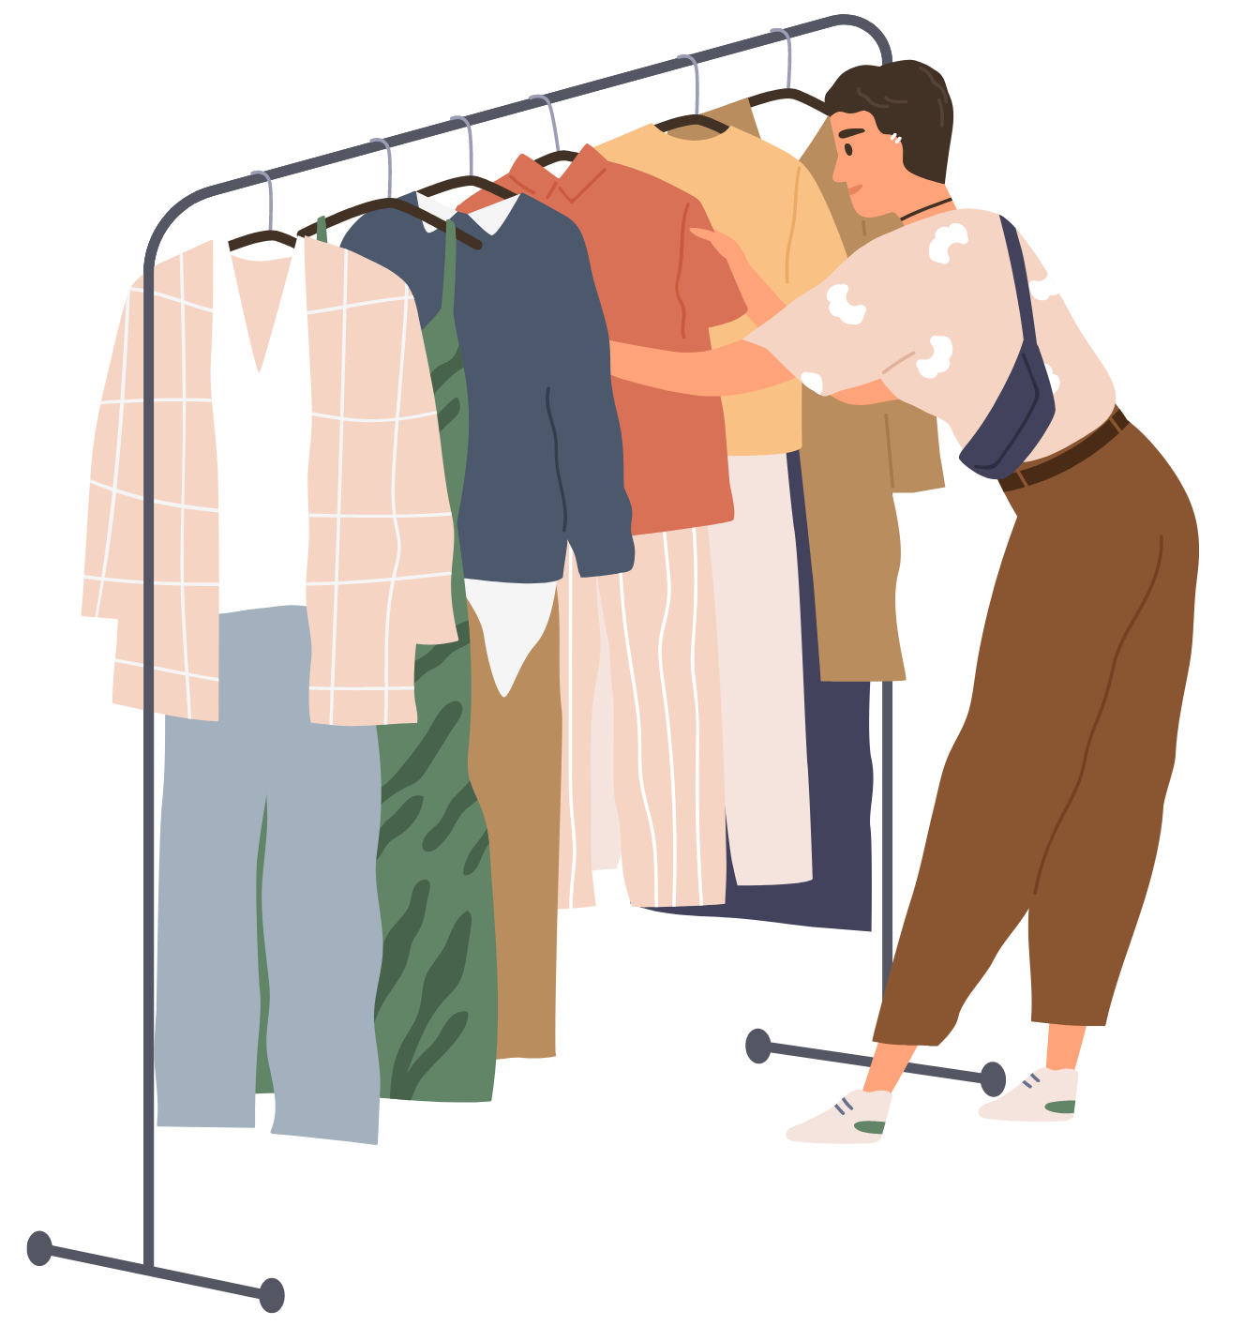
Saying the price of something
The price is …
To answer the question Berapa harganya?,
we can say:
Harganya…
Don’t forget to add the price at the end of the sentence. For example:
Harganya lima ribu rupiah.
Harganya dua puluh ribu rupiah.
Harganya seratus ribu rupiah.
Notes:
For the teacher:
Translations of examples:
The price is 5 thousand rupiah.
The price is twenty thousand rupiah.
The price is one hundred thousand rupiah.

Slide 4
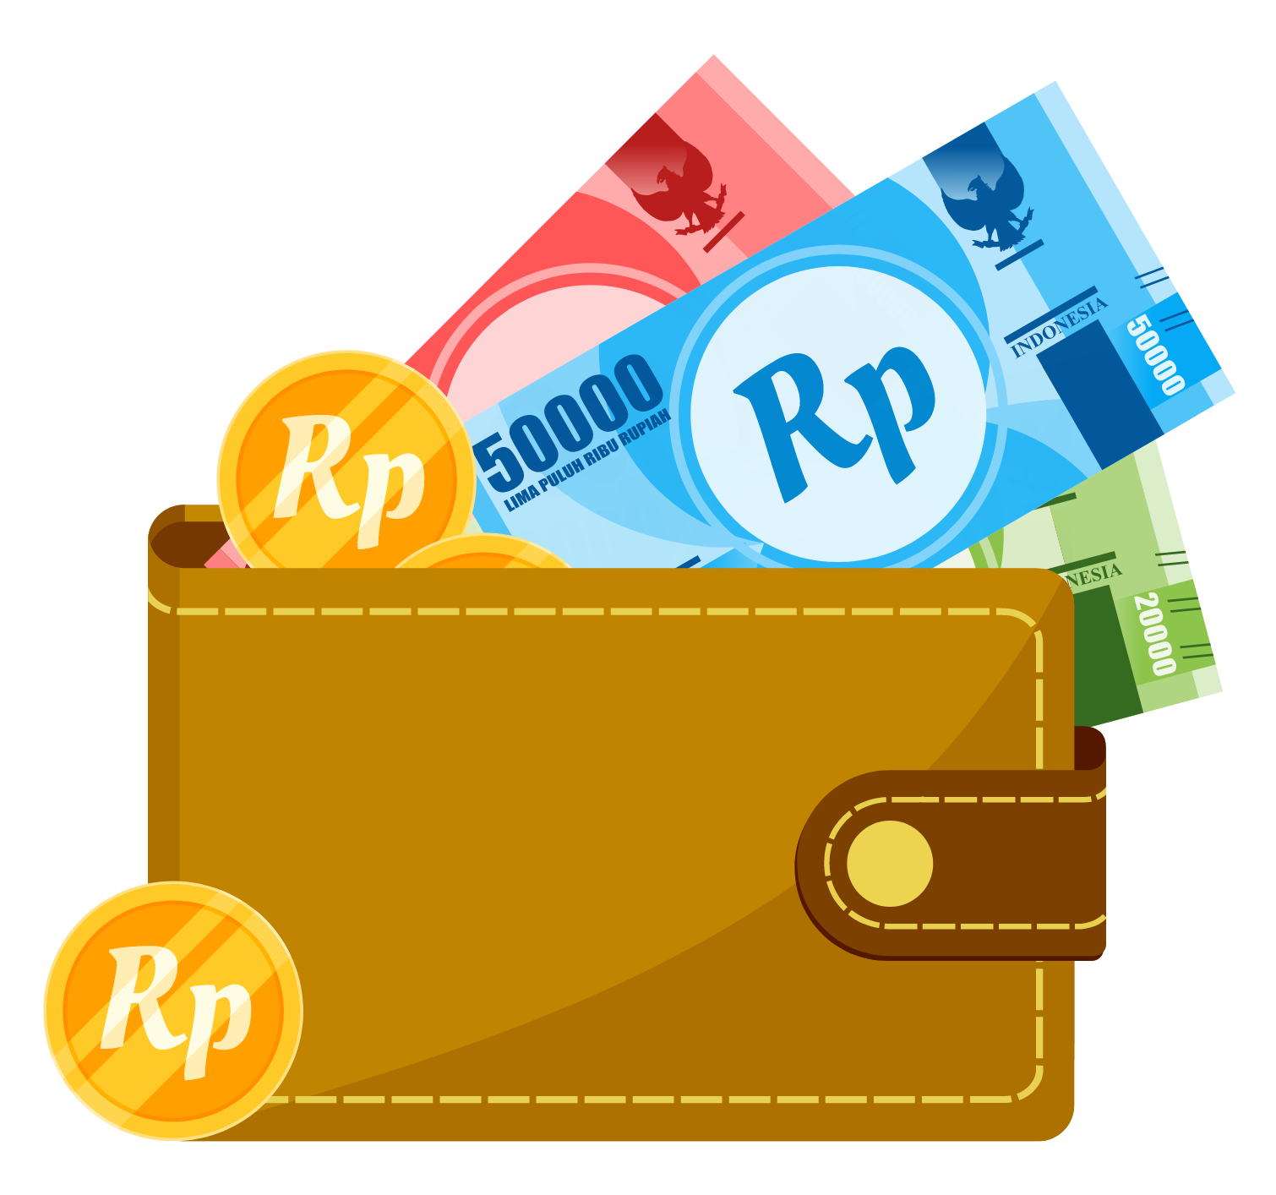
Asking how much a specific item is
How much is …?
To ask someone how much a specific item is,
we can ask:
Berapa harga…?
Don’t forget to add the item you are asking about at the end of the question. For example:
Berapa harga ikan? (How much is the fish?)
Berapa harga durian? (How much is the durian?)
Berapa harga beras? (How much is rice?)
Notes:
For the teacher:
Translations of examples:
How much is the fish?
How much is the durian?
How much is rice?

Slide 5
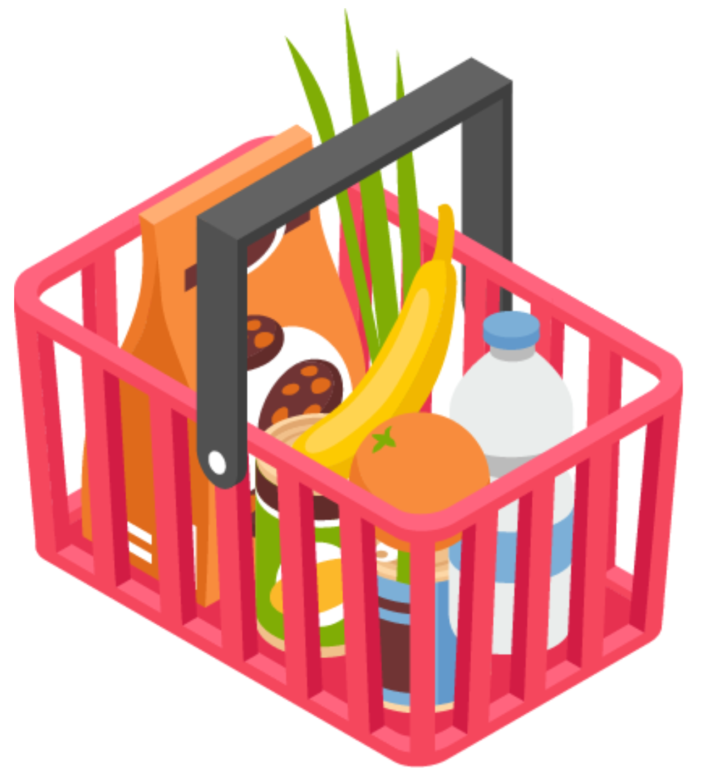
Saying how much a specific item is
How much is …?
To say how much a specific item is, we can say:
Harga… [item and price]
For example:
Harga ikan lima belas ribu rupiah.
Harga durian delapan puluh ribu rupiah.
Harga beras dua puluh ribu rupiah sekilo.
Notes:
For the teacher:
Translations of examples:
The price of the fish is 15 thousand rupiah.
The price of the durian is 80 thousand rupiah.
The price of the rice is 20 thousand rupiah a kilo.

Slide 6
Copyright
© State of New South Wales (Department of Education), 2024
The copyright material published in this resource is subject to the Copyright Act 1968 (Cth) and is owned by the NSW Department of Education or, where indicated, by a party other than the NSW Department of Education (third-party material).
Copyright material available in this resource and owned by the NSW Department of Education is licensed under a Creative Commons Attribution 4.0 International (CC BY 4.0) license.
This license allows you to share and adapt the material for any purpose, even commercially.
Attribution should be given to © State of New South Wales (Department of Education), 2024.
Material in this resource not available under a Creative Commons license:
the NSW Department of Education logo, other logos and trademark-protected material
Material owned by a third party that has been reproduced with permission. You will need to obtain permission from the third party to reuse its material.
Links to third-party material and websites
Please note that the provided (reading/viewing material/list/links/texts) are a suggestion only and implies no endorsement, by the New South Wales Department of Education, of any author, publisher, or book title. School principals and teachers are best placed to assess the suitability of resources that would complement the curriculum and reflect the needs and interests of their students.
If you use the links provided in this document to access a third party’s website, you acknowledge that the terms of use, including licence terms set out on the third-party’s website apply to the use which may be made of the materials on that third-party website or where permitted by the Copyright Act 1968 (Cth). The department accepts no responsibility for content on third-party websites.
Notes:
Slide not shared

