Slide 1
Describing items when shopping

Slide 2
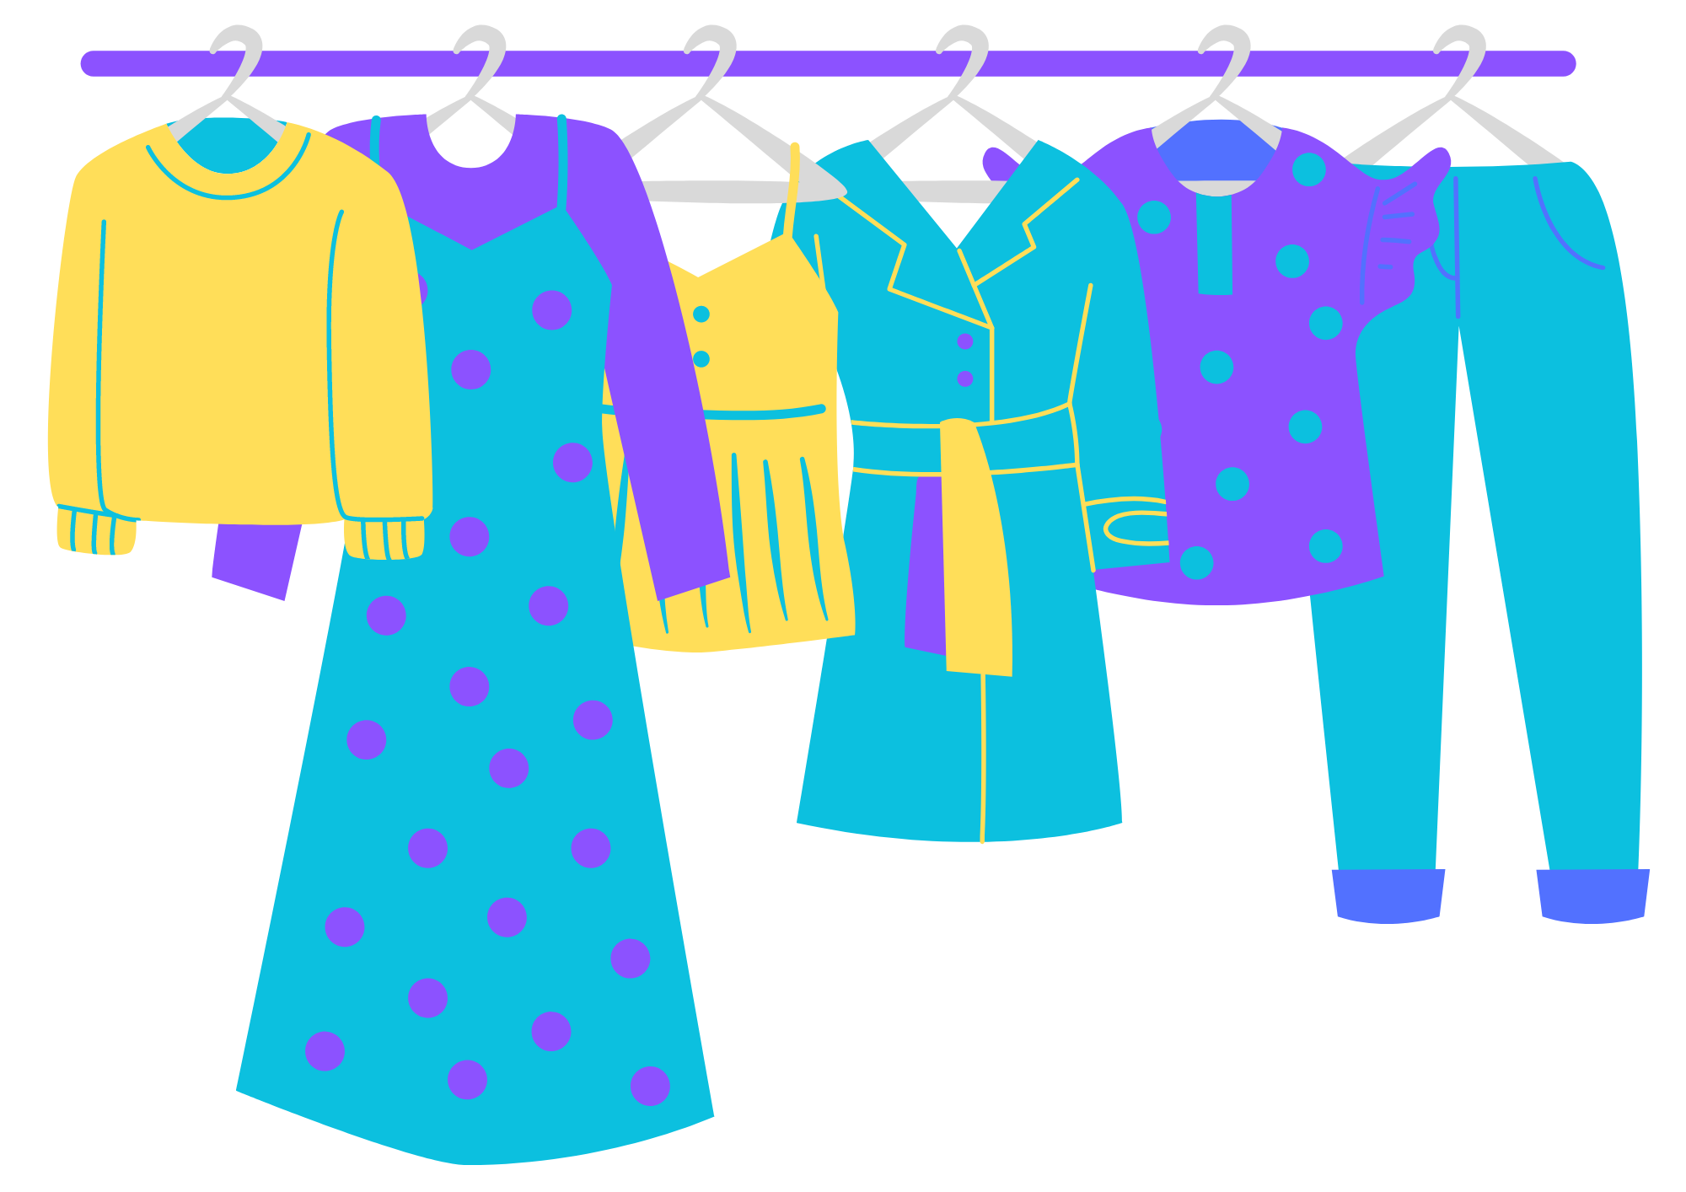
Using Bagaimana…?
We use the question word bagaimana when asking for a description of something.
For example:
Bagaimana dia? (What is she/he like?)
Remember that ini can mean ‘this’ and itu can mean ‘that’.
For example:
Bagaimana sarung ini?
Bagaimana ukiran itu?
The next slides will introduce some adjectives that you can use to describe items when shopping.
Notes:
For the teacher:
Translations of examples:
What is this sarong like?
What is that carving like?

Slide 3
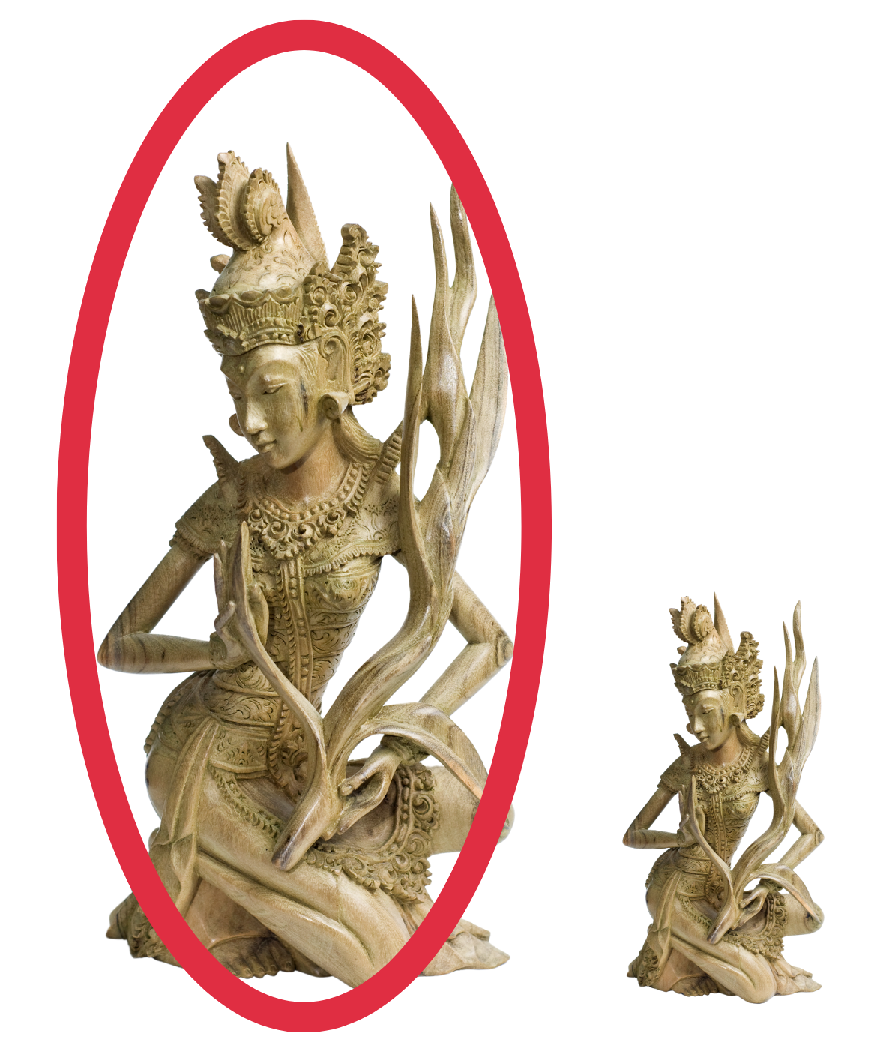
besar
Bagaimana ukiran ini?
Ukiran ini besar.
Notes:
Besar means ‘big’.

Slide 4
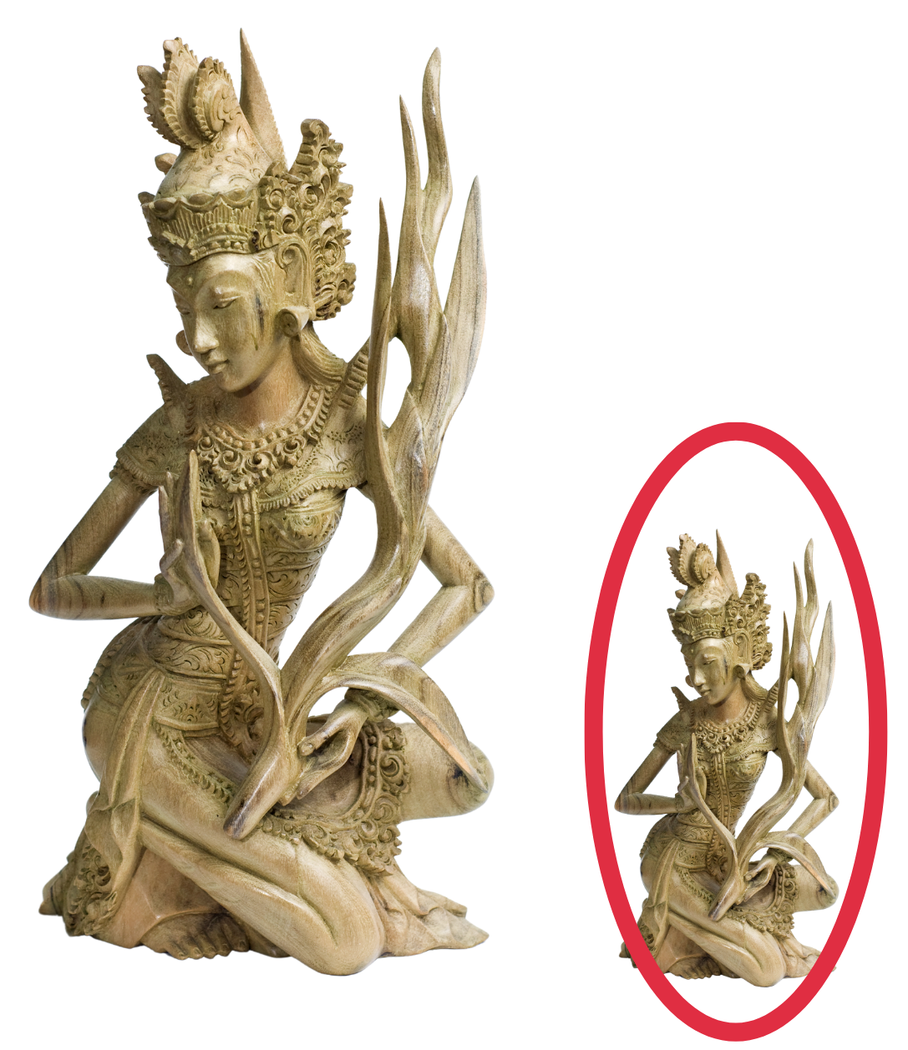
kecil
Bagaimana ukiran ini?
Ukiran ini kecil.
Notes:
Kecil means ‘small’.

Slide 5
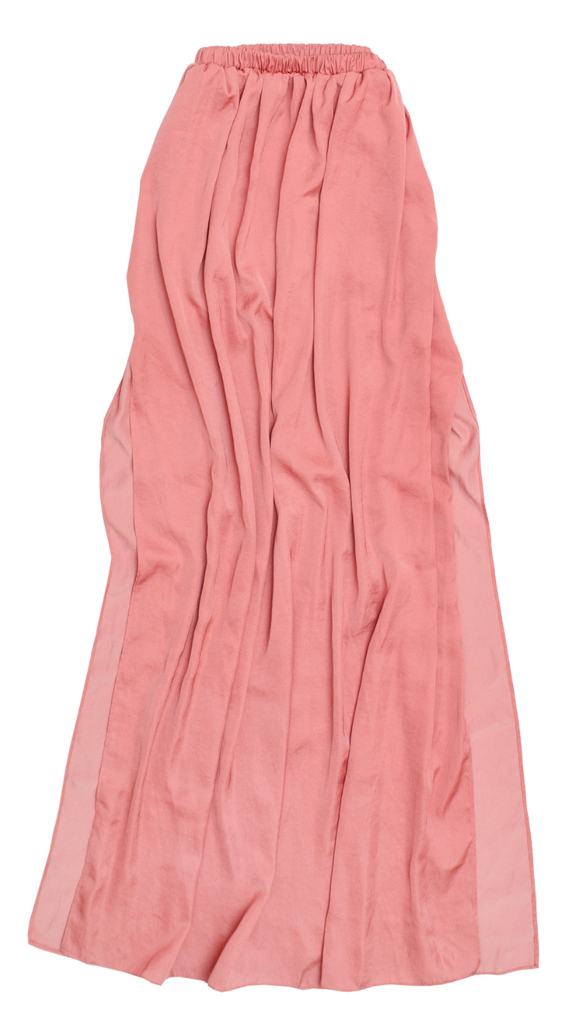
panjang
Bagaimana rok ini?
Rok ini panjang.
Notes:
Panjang means ‘long’.

Slide 6
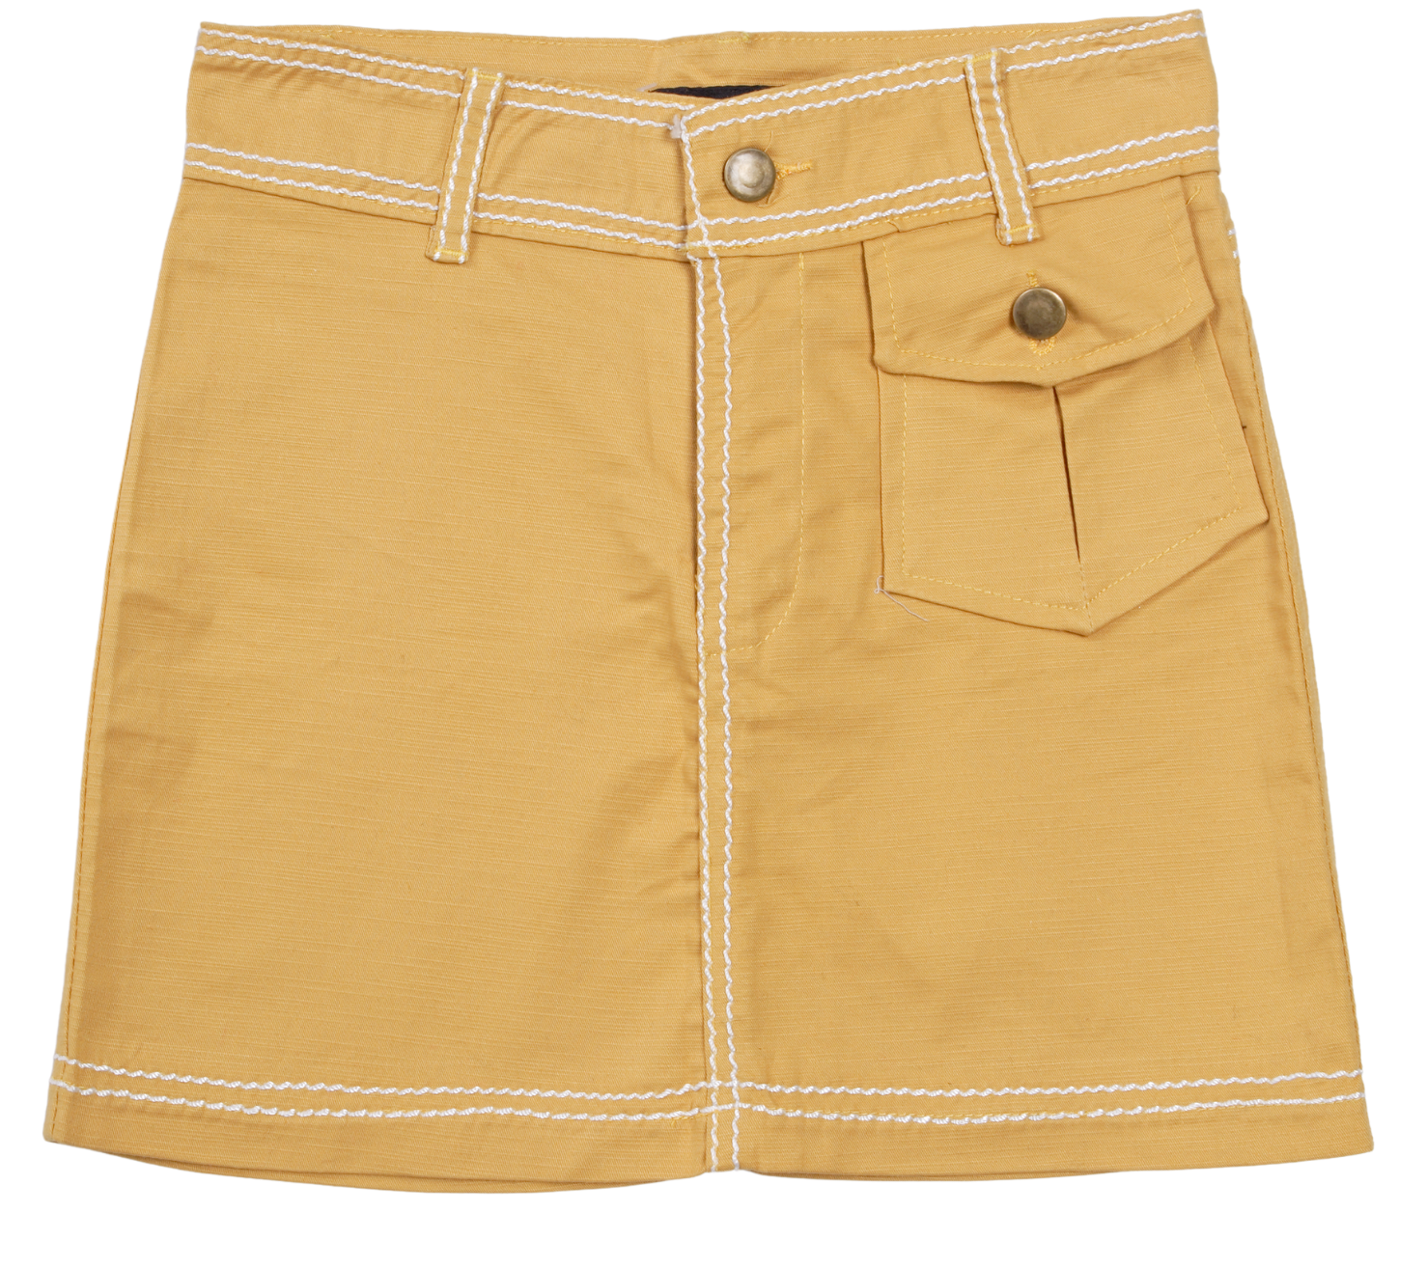
pendek
Bagaimana rok ini?
Rok ini pendek.
Notes:
Pendek means ‘short’.

Slide 7
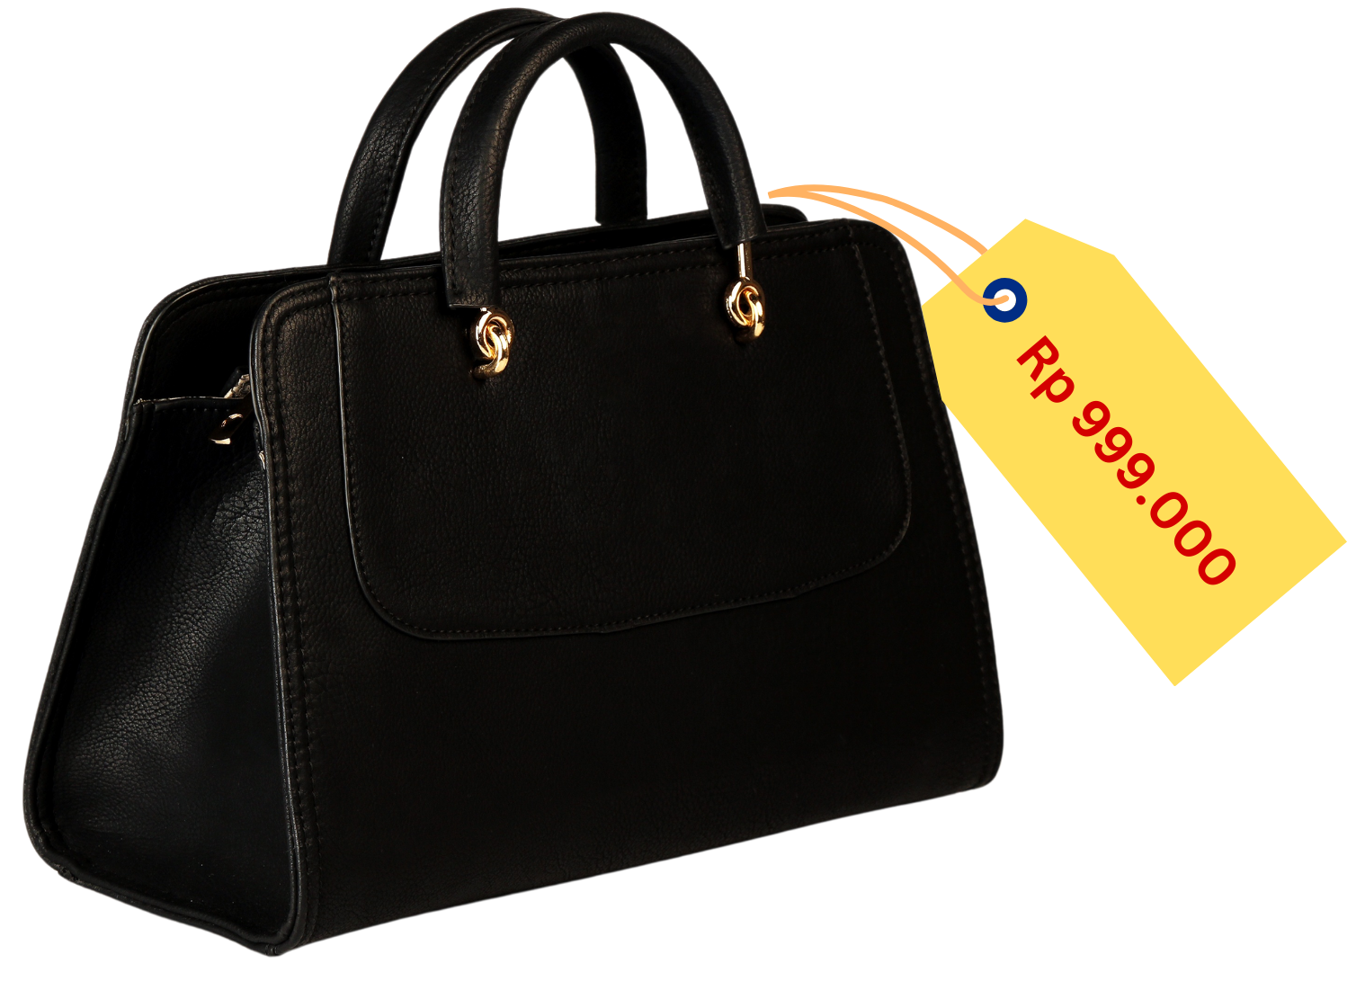
mahal
Bagaimana tas ini?
Tas ini mahal.
Notes:
Mahal means ‘expensive’.

Slide 8
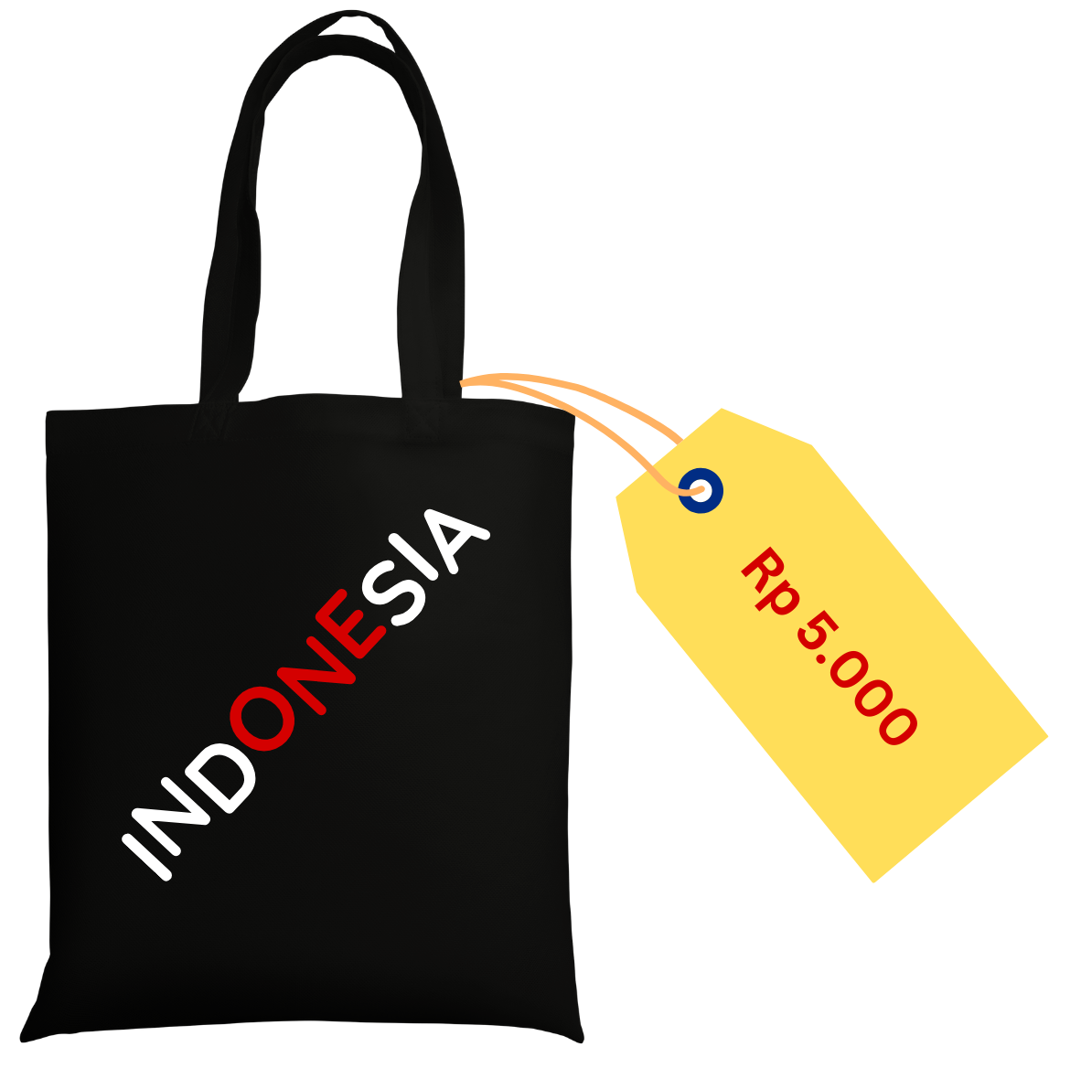
murah
Bagaimana tas ini?
Tas ini murah.
Notes:
Murah means ‘cheap’.

Slide 9
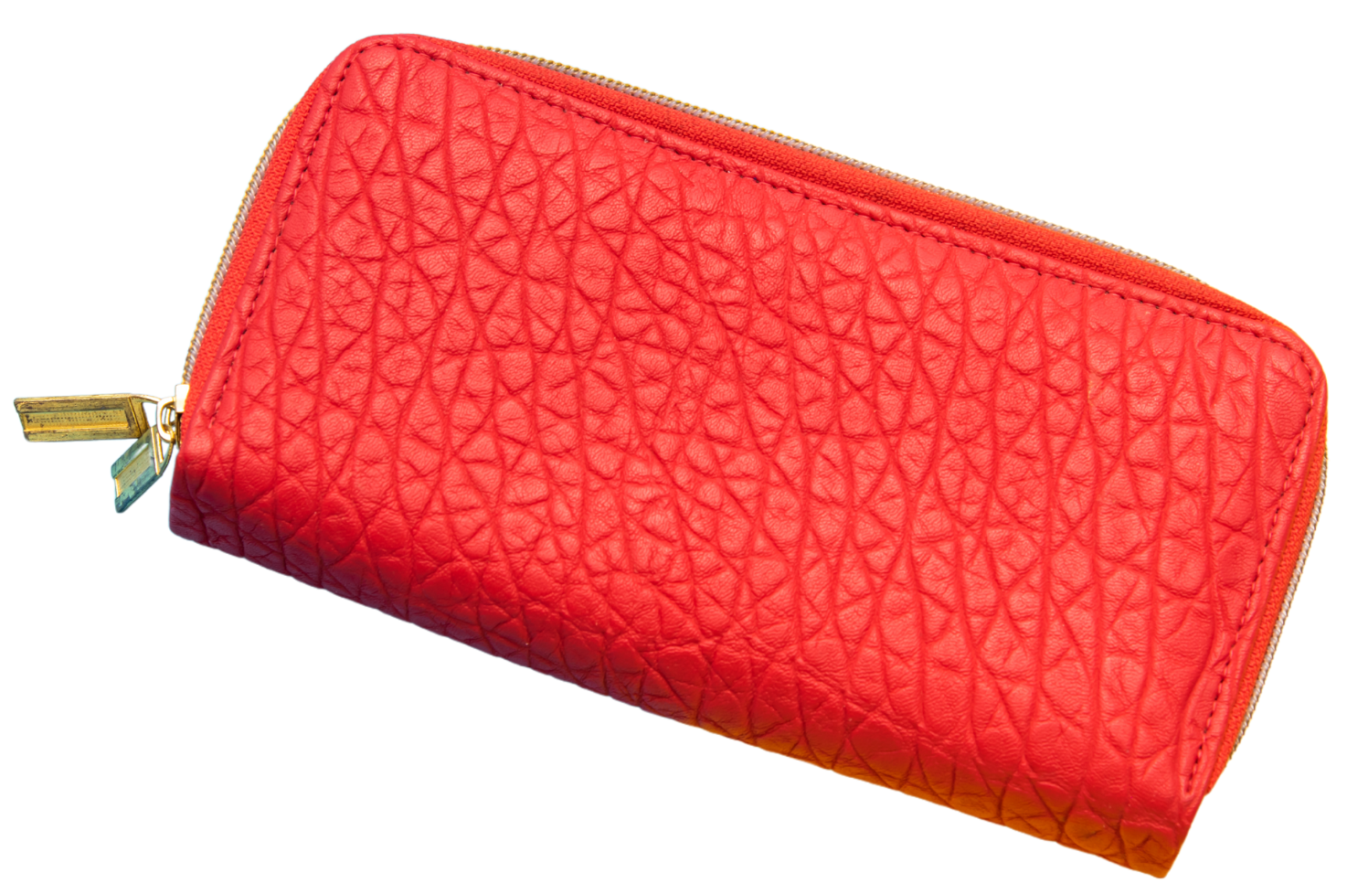
trendi
Bagaimana dompet ini?
Dompet ini trendi.
Notes:
Trendi means ‘trendy’.

Slide 10
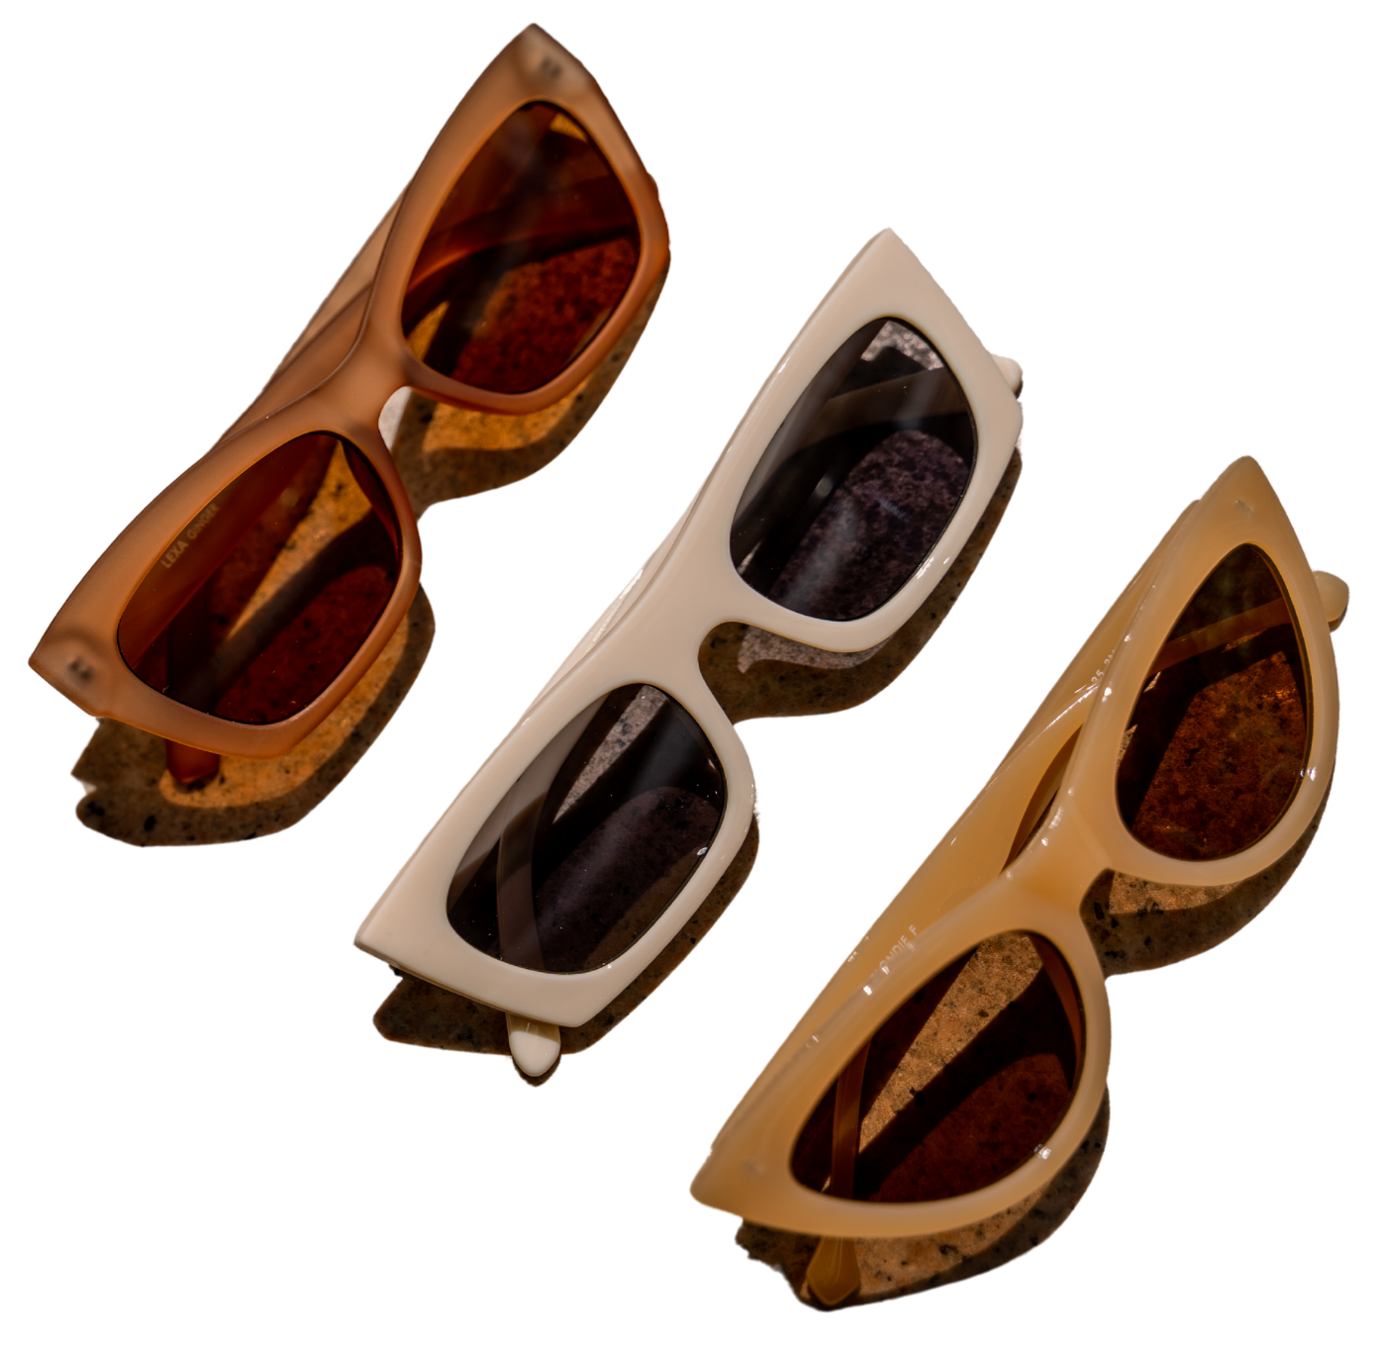
modern
Bagaimana kacamata hitam ini?
Kacamata hitam ini modern.
Notes:
Modern means ‘modern’.

Slide 11
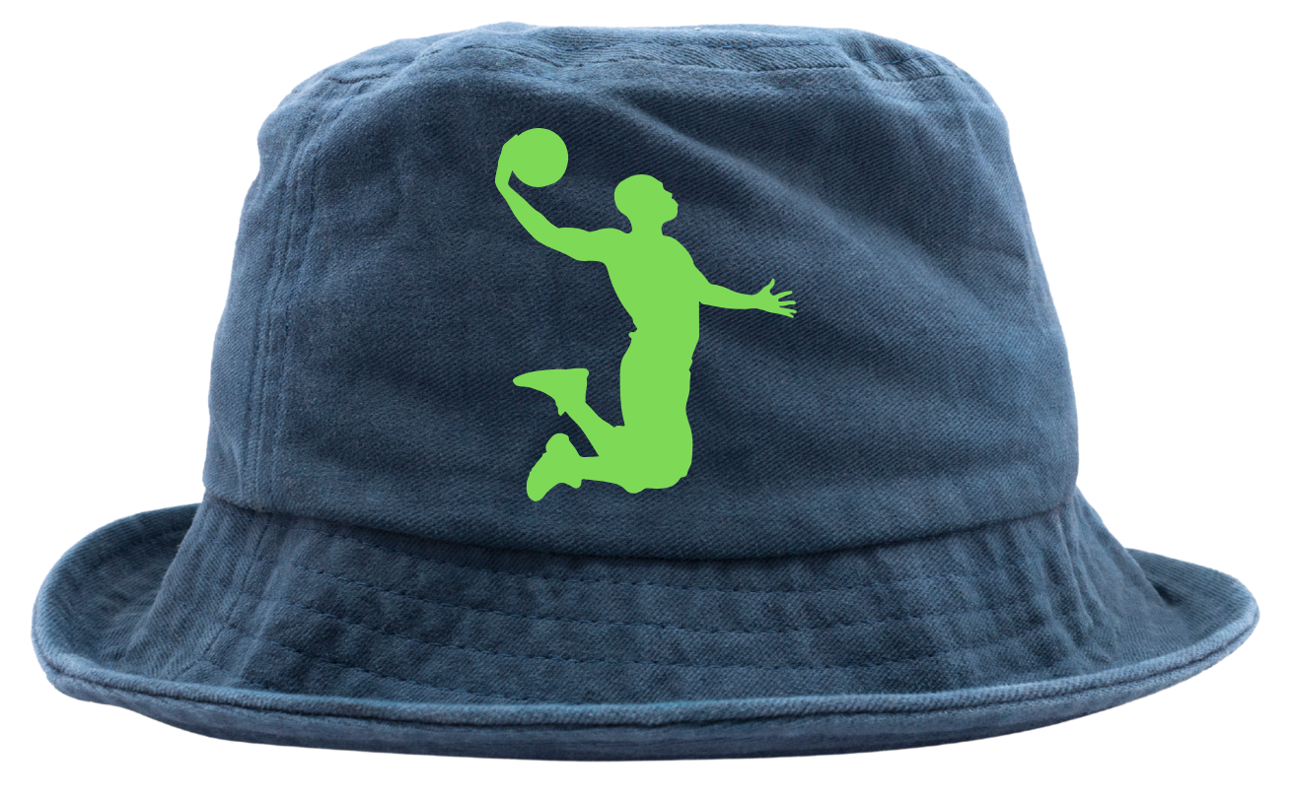
keren
Bagaimana topi ini?
Topi ini keren.
Notes:
Keren means ‘cool’.

Slide 12
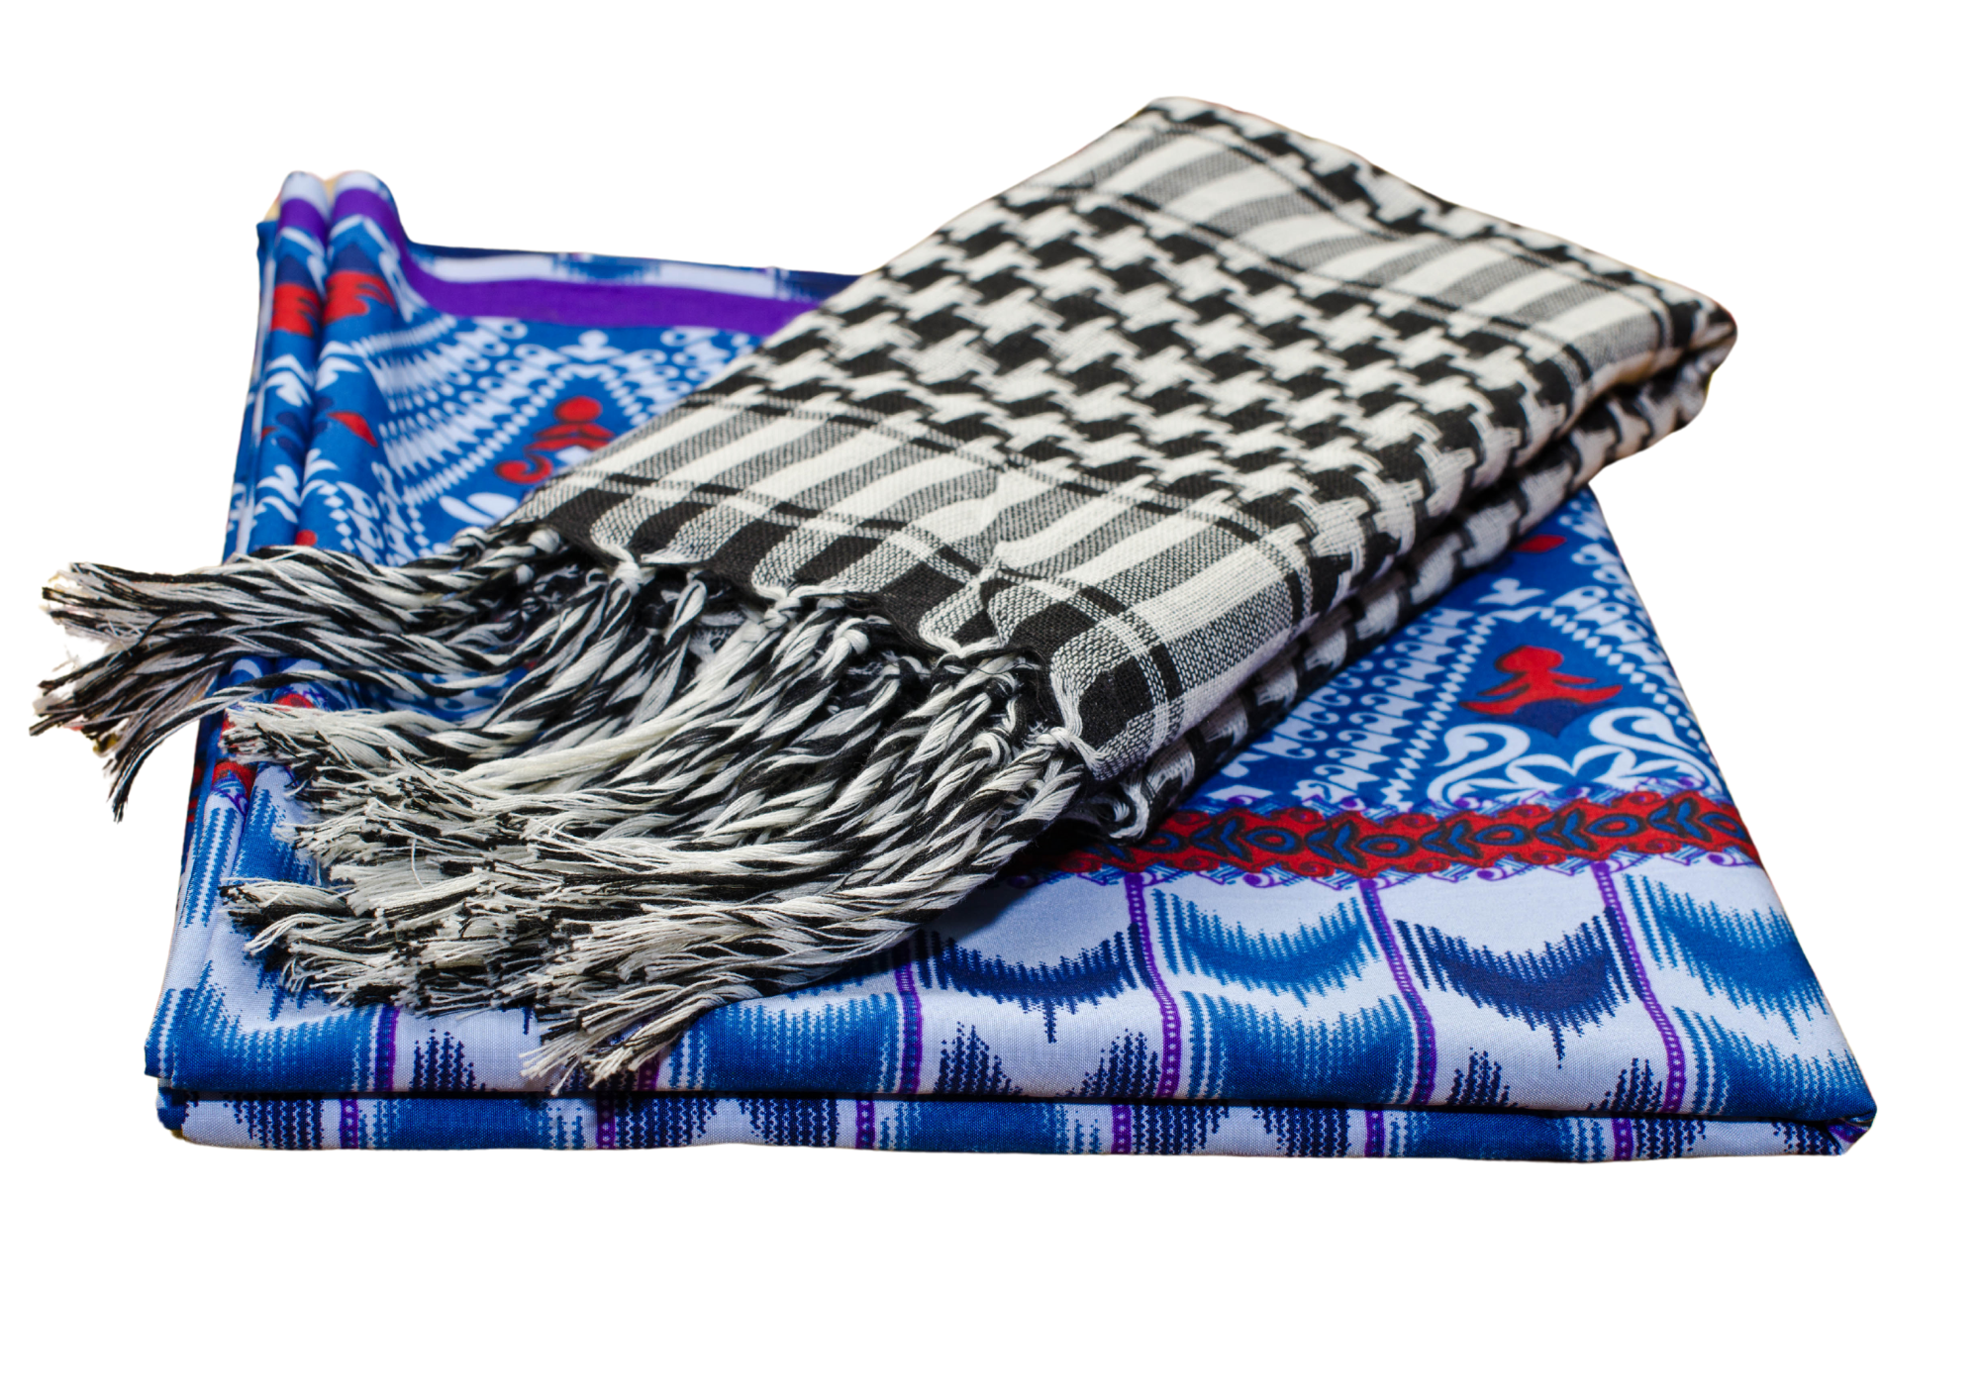
asli
Bagaimana sarung ini?
Sarung ini asli.
Notes:
Asli means ‘authentic’ or ‘original’.

Slide 13
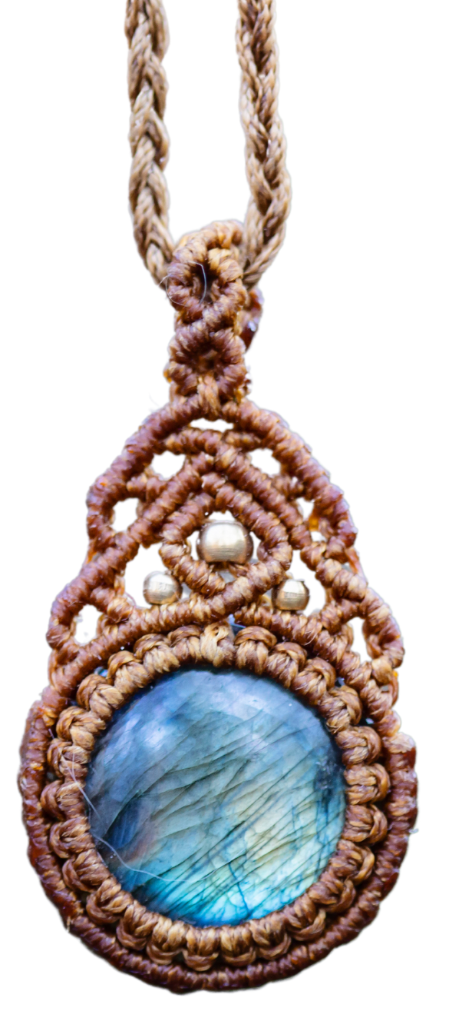
berkualitas tinggi
Bagaimana kalung ini?
Kalung ini berkualitas tinggi.
Notes:
Berkualitas tinggi means ‘of high quality’.

Slide 14
Summary
besar
kecil
panjang
pendek
mahal
murah
trendi
modern
keren
asli
berkualitas tinggi

Slide 15
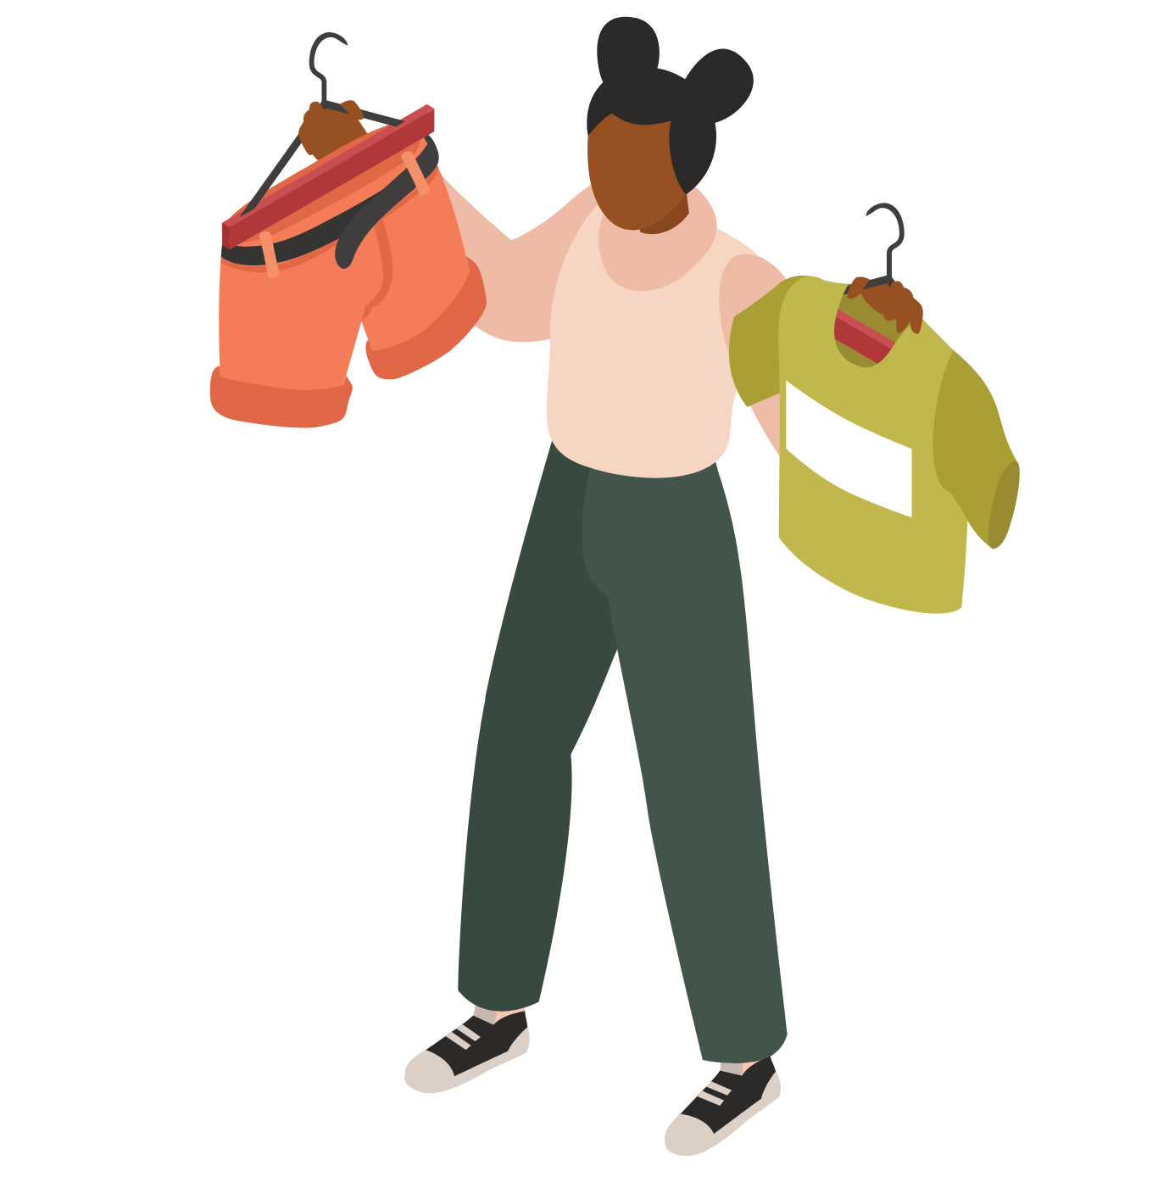
Adding further details using adverbs
You can use the 3 adverbs below to add more detail when describing an item.
Sekali means ‘very’ or ‘really’. It is placed after an adjective.
Sedikit means ‘a little bit’. It is placed before an adjective.
Terlalu means ‘too’. It is placed before an adjective.
For example:
Sandal jepit ini trendi sekali.
Kaus ini sedikit kecil.
Kalung itu terlalu mahal.
Notes:
For the teacher:
Translations of examples:
These flip-flops are very trendy.
This t-shirt is a little bit small.
That necklace is too expensive.

Slide 16
Copyright
© State of New South Wales (Department of Education), 2024
The copyright material published in this resource is subject to the Copyright Act 1968 (Cth) and is owned by the NSW Department of Education or, where indicated, by a party other than the NSW Department of Education (third-party material).
Copyright material available in this resource and owned by the NSW Department of Education is licensed under a Creative Commons Attribution 4.0 International (CC BY 4.0) license.
This license allows you to share and adapt the material for any purpose, even commercially.
Attribution should be given to © State of New South Wales (Department of Education), 2024.
Material in this resource not available under a Creative Commons license:
the NSW Department of Education logo, other logos and trademark-protected material
Material owned by a third party that has been reproduced with permission. You will need to obtain permission from the third party to reuse its material.
Links to third-party material and websites
Please note that the provided (reading/viewing material/list/links/texts) are a suggestion only and implies no endorsement, by the New South Wales Department of Education, of any author, publisher, or book title. School principals and teachers are best placed to assess the suitability of resources that would complement the curriculum and reflect the needs and interests of their students.
If you use the links provided in this document to access a third party’s website, you acknowledge that the terms of use, including licence terms set out on the third-party’s website apply to the use which may be made of the materials on that third-party website or where permitted by the Copyright Act 1968 (Cth). The department accepts no responsibility for content on third-party websites.
Notes:
Slide not shared

