Slide 1
Adverbs of frequency
Notes:
Teacher notes:
From prior learning, many of these adverbs should be familiar to students already, for example, molto, spesso, regolarmente, sempre and non…mai. Remind them they are used in Italian to indicate how often you do an activity.
After going through the slides, note that they go before or after the verb, except sempre and mai which always come after the verb.
Di solito normally goes at the beginning of the sentence.

Slide 2
Adverbs of frequency 1
non…mai
raramente
qualche volta
ogni tanto
di solito
normalmente
regolarmente
spesso
sempre
Notes:
Teacher notes:
Drill the adverbs from bottom to top and ask students which ones they recognise and their meaning in English. Ask them to guess what the other adverbs might mean given the scale represented in the slide.

Slide 3
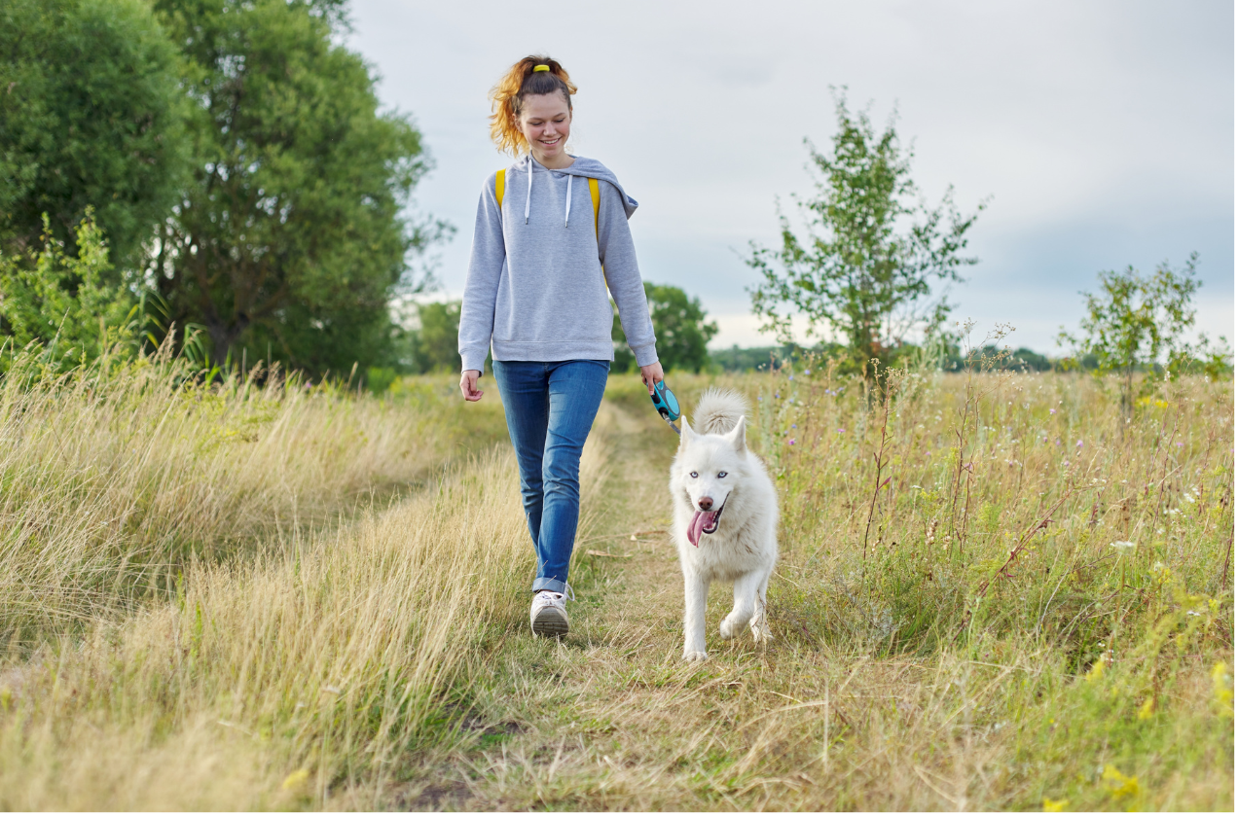
Faccio sempre una passeggiata.
Notes:
Teacher notes:
Slides 3 to 8 can be used to question students about how often they do particular activities until they feel confident using the adverbs in sentences.
Choral repetition of the sentence.

Slide 4
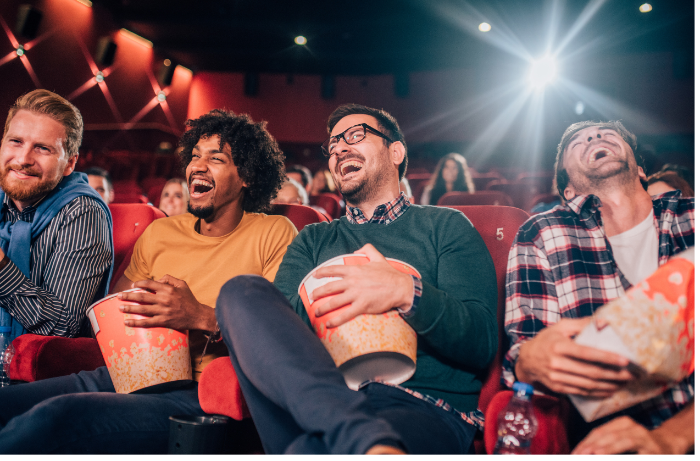
Vai spesso al cinema.
Notes:
Teacher notes:
Choral repetition of the sentence.

Slide 5
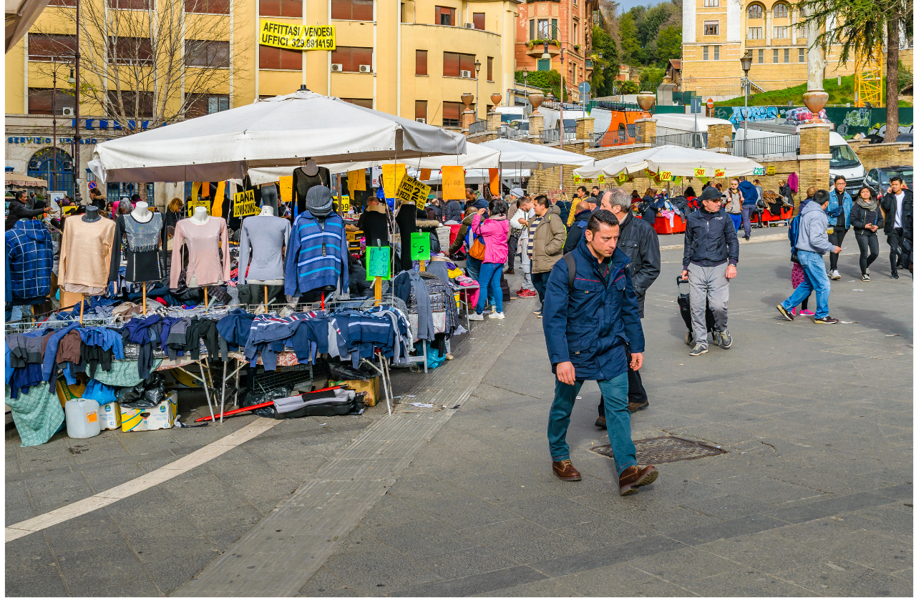
Facciamo regolarmente lo shopping.
Notes:
Teacher notes:
Choral repetition of the sentence.

Slide 6
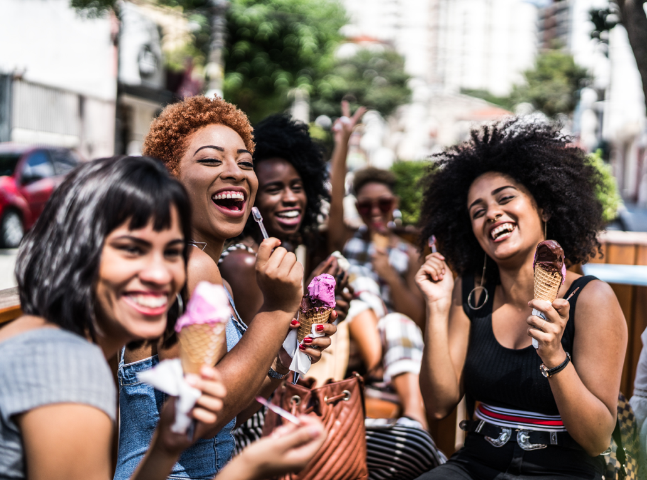
Di solito esce con le amiche.
Normalmente esce con le amiche.
Notes:
Teacher notes:
Choral repetition of the sentence.
Note that di solito and normalmente are both placed at the beginning of the sentence.

Slide 7
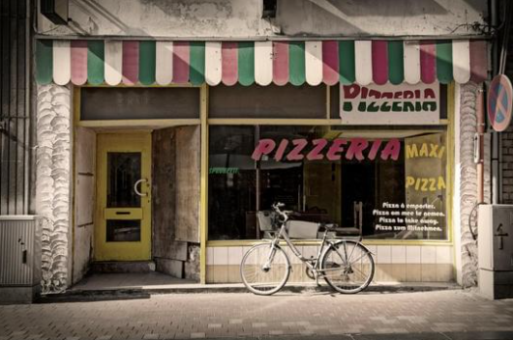
Va qualche volta in pizzeria.
Va ogni tanto in pizzeria.
Notes:
Teacher notes:
Choral repetition of the sentence.

Slide 8
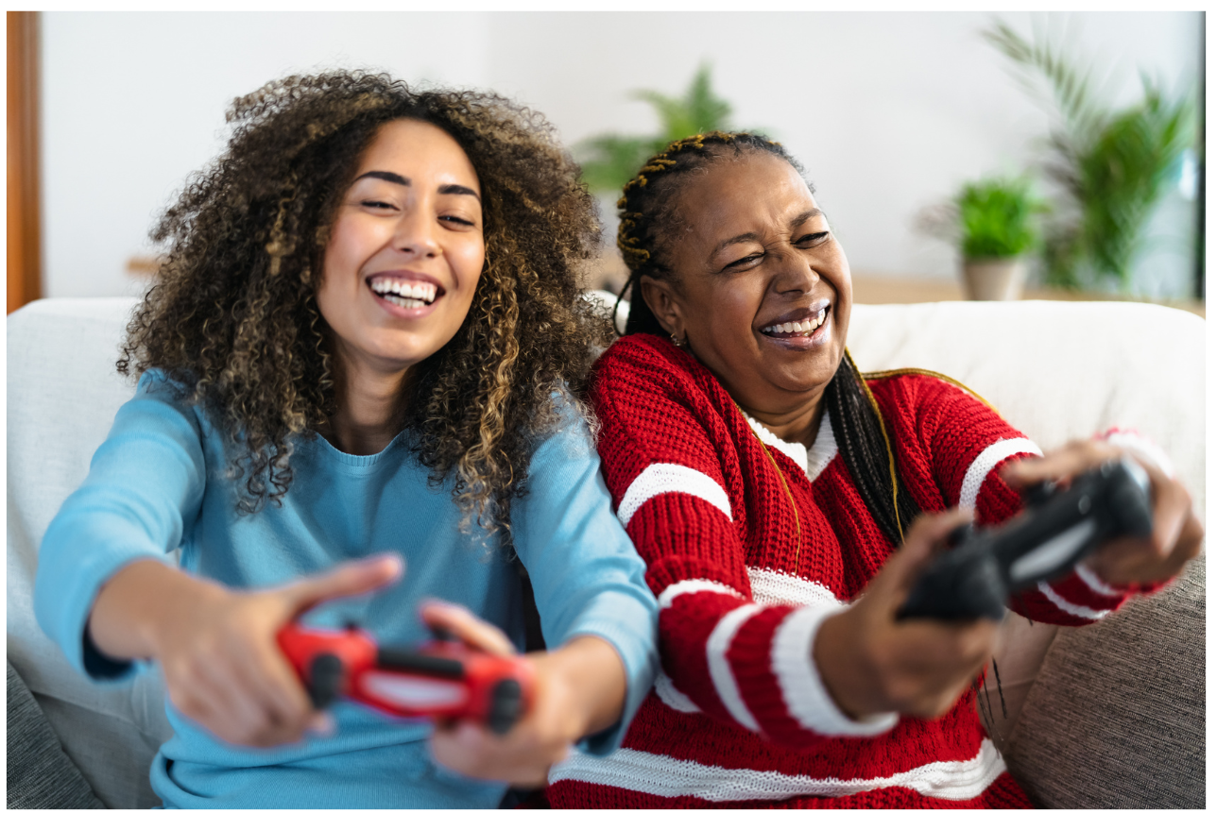
Giocate raramente ai videogiochi.
Notes:
Teacher notes:
Choral repetition of the sentence.

Slide 9
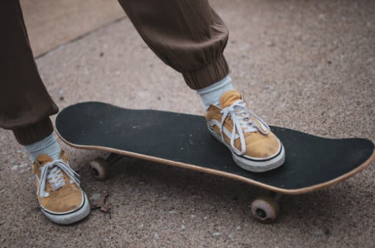
Non faccio mai lo skateboard.
Notes:
Teacher notes:
Choral repetition of the sentence.

Slide 10
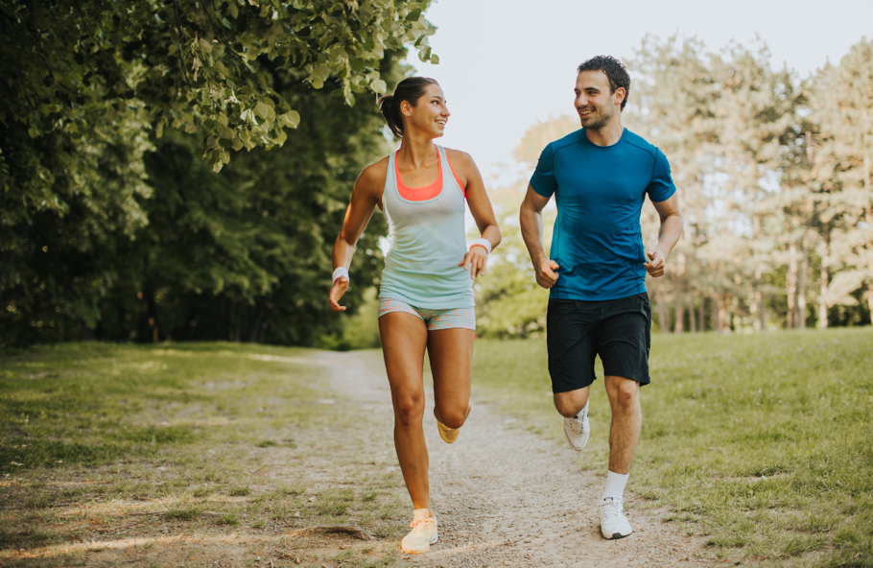
Vai a correre?
Ogni giorno
Vado sempre a correre.
Una volta alla settimana
Vado spesso/regolarmente a correre.
Due volte al mese
Vado ogni tanto/qualche volta a correre.
Tre volte all’anno
Vado raramente a correre.
Notes:
Teacher notes:
Use these examples to remind students of the expressions once/twice a week/month/year and their prepositional contractions – alla, al, all’
Choral repetition of the phrases.
Ask students how they could answer the question, for each frequency shown, using the adverbs of frequency from the previous slides. Do the first one together, for example Vado sempre a correre.
Work through the remaining examples, revealing the answer each time.

Slide 11

Copyright
© State of New South Wales (Department of Education), 2024
The copyright material published in this resource is subject to the Copyright Act 1968 (Cth) and is owned by the NSW Department of Education or, where indicated, by a party other than the NSW Department of Education (third-party material).
Copyright material available in this resource and owned by the NSW Department of Education is licensed under a Creative Commons Attribution 4.0 International (CC BY 4.0) license.
This license allows you to share and adapt the material for any purpose, even commercially.
Attribution should be given to © State of New South Wales (Department of Education), 2024.
Material in this resource not available under a Creative Commons license:
the NSW Department of Education logo, other logos and trademark-protected material
material owned by a third party that has been reproduced with permission. You will need to obtain permission from the third party to reuse its material.
Links to third-party material and websites
Please note that the provided (reading/viewing material/list/links/texts) are a suggestion only and implies no endorsement, by the New South Wales Department of Education, of any author, publisher, or book title. School principals and teachers are best placed to assess the suitability of resources that would complement the curriculum and reflect the needs and interests of their students.
If you use the links provided in this document to access a third-party's website, you acknowledge that the terms of use, including licence terms set out on the third-party's website apply to the use which may be made of the materials on that third-party website or where permitted by the Copyright Act 1968 (Cth). The department accepts no responsibility for content on third-party websites.
Notes:
Slide not shared

