Slide 1
Leisure activities
Notes:
Teacher note:
Slides 2 to 16 practise the infinitive and io forms of the verbs.

Slide 2
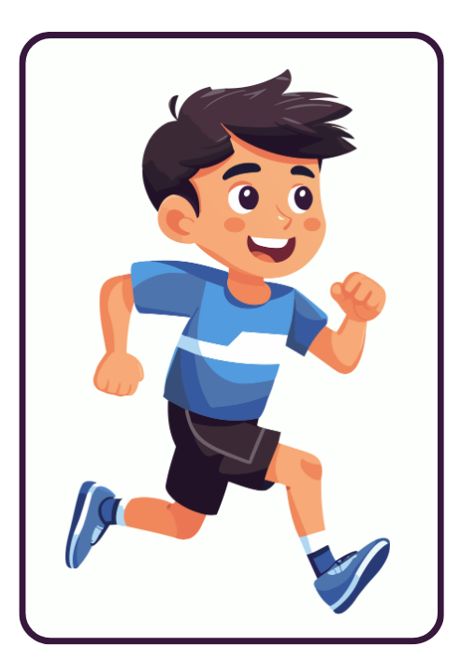
andare a correre
Vado a correre.
Notes:
Teacher notes:
CLICK TO REVEAL the correct verb conjugation.
Ask additional questions such as:
Quando vai a correre?
Vai a correre dopo la scuola o prima di andare a scuola?
Con chi vai a correre?
Vai a correre con i tuoi amici?

Slide 3
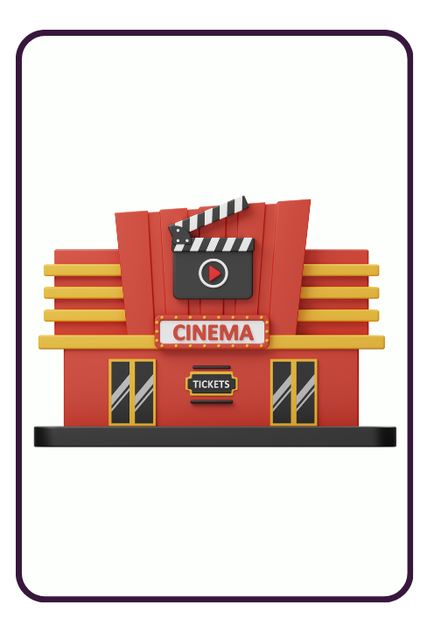
andare al cinema
Vado al cinema.
Notes:
Teacher notes:
CLICK TO REVEAL the correct verb conjugation.
Ask additional questions such as:
Quando vai al cinema?
Vai al cinema dopo scuola o il fine settimana?
Con chi vai al cinema?
Vai al cinema con i tuoi amici?

Slide 4
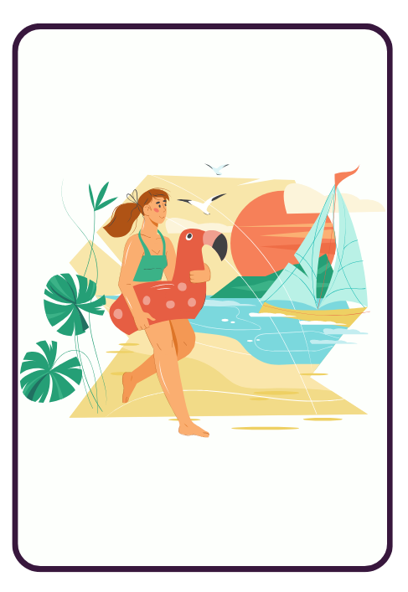
andare alla spiaggia
Vado alla spiaggia.
Notes:
Teacher notes:
CLICK TO REVEAL correct verb conjugation.
Ask additional questions such as:
Quando vai alla spiaggia?
Con chi vai alla spiaggia?
Vai alla spiaggia con la tua famiglia?

Slide 5
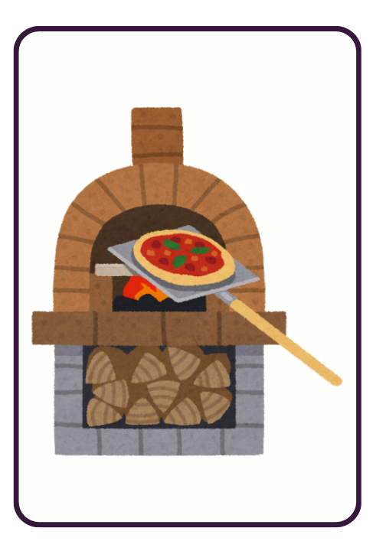
andare in pizzeria
Vado in pizzeria.
Notes:
Teacher notes:
CLICK TO REVEAL correct verb conjugation.
Ask additional questions such as:
Quando vai in pizzeria?
Con chi vai in pizzeria?
Vai in pizzeria con la tua famiglia?

Slide 6

andare in città
Vado in città.
Notes:
Teacher notes:
CLICK TO REVEAL correct verb conjugation.
Ask additional questions such as:
Quando vai in città?
Perché vai in città?
Vai in città con la tua famiglia?

Slide 7
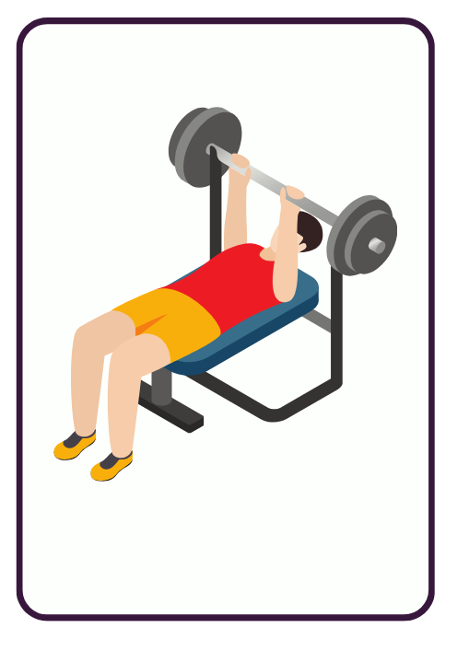
andare in palestra
Vado in palestra.
Notes:
Teacher notes:
CLICK TO REVEAL correct verb conjugation.
Ask additional questions such as:
Quando vai in palestra?
Perché vai in palestra?
Con chi vai in palestra?

Slide 8
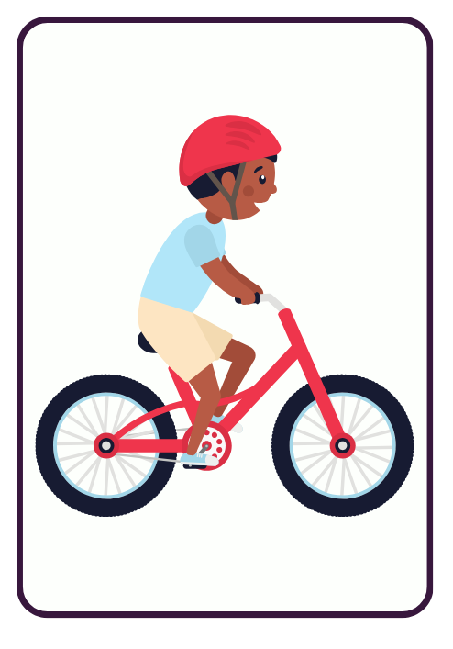
fare un giro in bici
Faccio un giro in bici.
Notes:
Teacher notes:
CLICK TO REVEAL correct verb conjugation.
Ask additional questions such as:
Ti piace fare un giro in bici?
Con chi fai un giro in bici?

Slide 9
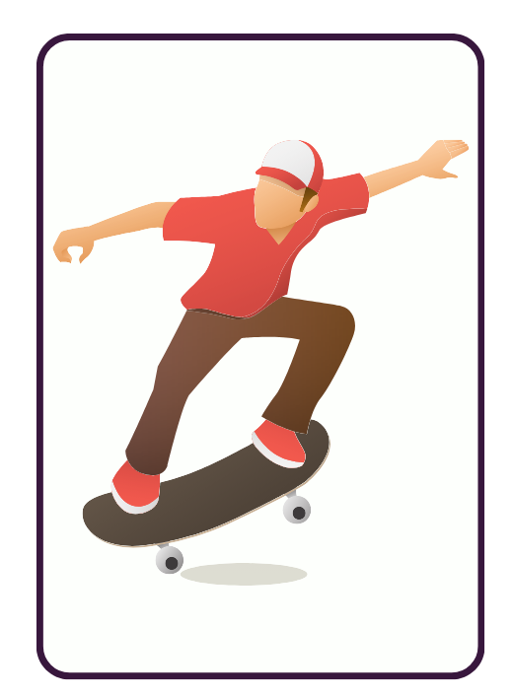
fare lo skateboard
Faccio lo skateboard.
Notes:
Teacher notes:
CLICK TO REVEAL correct verb conjugation.
Ask additional questions such as:
Ti piace fare lo skateboard?
Con chi fai lo skateboard?

Slide 10
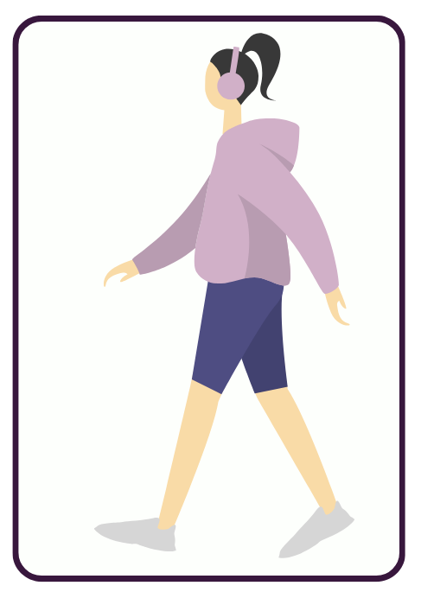
fare una passeggiata
Faccio una passeggiata.
Notes:
Teacher notes:
CLICK TO REVEAL correct verb conjugation.
Ask additional questions such as:
Quando fai una passeggiata?
Con chi fai una passeggiata?
Fai una passeggiata con la tua famiglia?

Slide 11
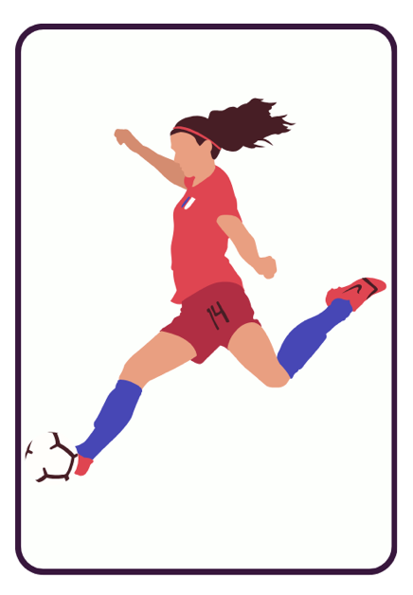
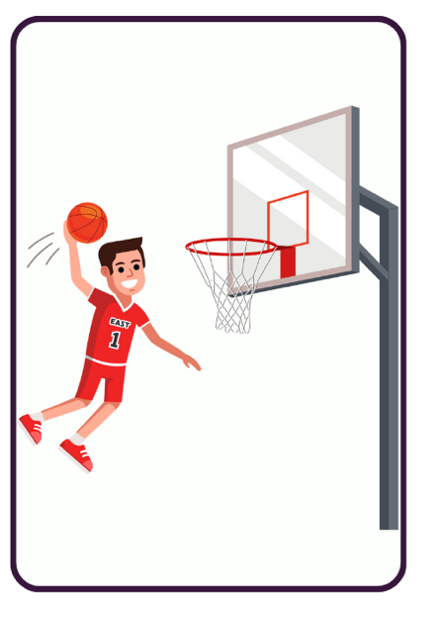
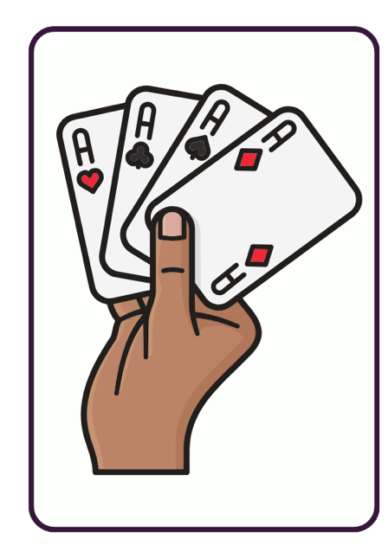
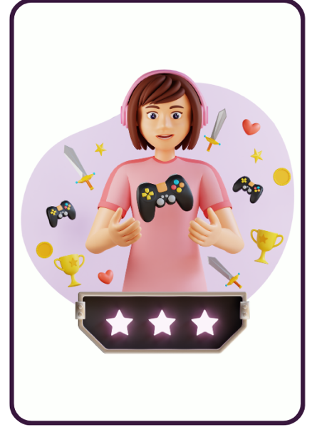
giocare a – to play (game or sport)
Gioco a calcio.
Gioco a pallacanestro.
Gioco a carte.
Gioco ai videogiochi.
Notes:
Teacher notes:
CLICK TO REVEAL correct verb conjugation.
Ask additional questions such as:
Quando giochi a…?
Giochi a…dopo la scuola o prima della scuola?
Con chi giochi a…?
Giochi a…con i tuoi amici?
Point out to students that ai is used with videogiochi.

Slide 12
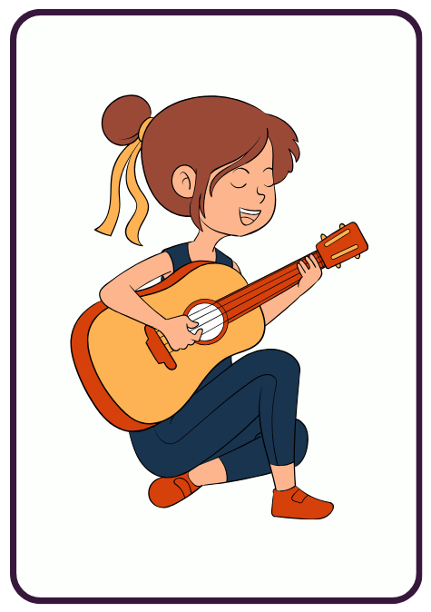
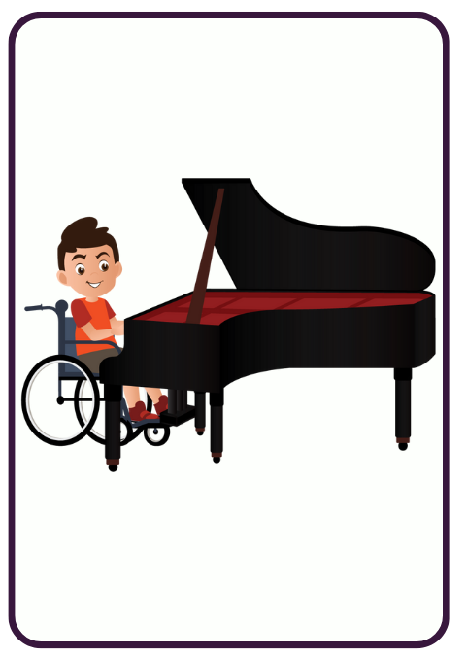
suonare – to play (instrument)
Suono la chitarra.
Suono il pianoforte.
Notes:
Teacher notes:
CLICK TO REVEAL correct verb conjugation.
Ask additional questions such as:
Quando suoni…?
Suoni…dopo la scuola o prima della scuola?

Slide 13
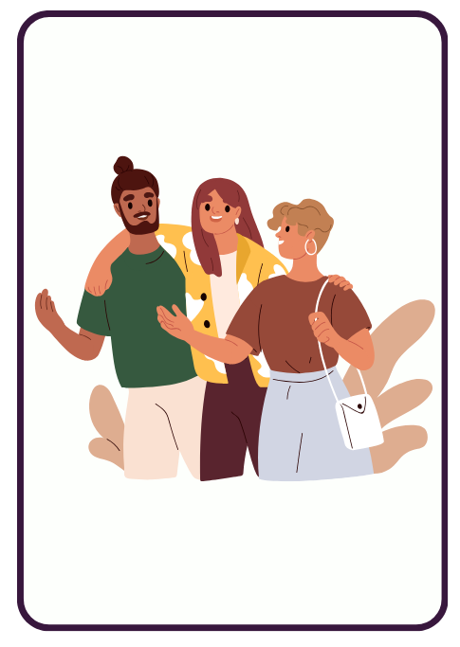
uscire con gli amici
Esco con gli amici.
Notes:
Teacher notes:
CLICK TO REVEAL correct verb conjugation.
Ask additional questions such as:
Esci con gli amici?
Con chi esci?
Quando esci?
Esci dopo la scuola o il fine settimana?
Dove vai?

Slide 14
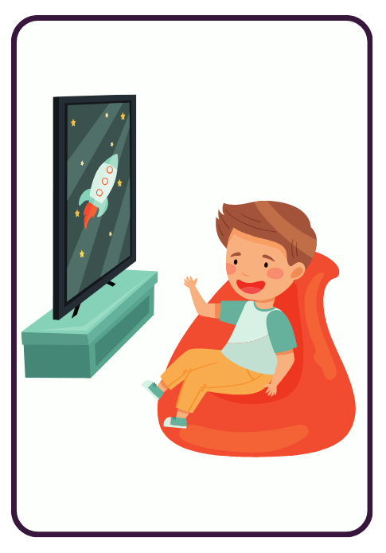
guardare la TV/Netflix
Guardo la TV/Netflix.
Notes:
Teacher notes:
CLICK TO REVEAL correct verb conjugation.
Ask additional questions such as:
Guardi la TV?
Preferisci guardare Netflix?
Qual’è il tuo programma preferito?

Slide 15

usare i social (media)
Uso i social (media).
Notes:
Teacher notes:
CLICK TO REVEAL correct verb conjugation.
Ask additional questions such as:
Usi i social media?
Usi i social media molto?
Qual’è la tua app preferita?

Slide 16

chattare online
Chatto online.
Notes:
Teacher notes:
CLICK TO REVEAL correct verb conjugation.
Ask additional questions such as:
Chatti online?
Ti piace chattare online?
Quando chatti online?
Chatti online il fine settimana?
Quanto tempo passi a chattare online?

Slide 17
List of leisure activities
Italian | English
andare a correre | to go running/for a run
andare al cinema | to go to the movies
andare alla spiaggia | to go to the beach
andare in pizzeria/città/palestra | to go to the pizzeria/city/gym
fare un giro in bici | to go bike riding/for a bike ride
fare lo skateboard/una passeggiata | to go skateboarding/for a walk
giocare a calcio/pallacanestro/carte | to play soccer/basketball/cards
giocare ai videogiochi | to play videogames
suonare il pianoforte/la chitarra | to play the piano/the guitar
uscire con gli amici | to go out with friends
guardare la TV/Netflix | to watch TV/Netflix
usare i social (media) | to use social media
chattare online | to chat online

Slide 18
Irregular verb – uscire
Notes:
Teacher notes:
Students might not have seen this verb before. This is a resource to familiarise them with the complete conjugation of uscire. It is broken into 2 parts: singular verb forms then plural verb forms. To avoid cognitive overload, it is suggested to drill the singular forms first then the plural.

Slide 19
Singular conjugations of uscire
Subject pronoun | Verb conjugation
io | esco
tu | esci
lui/lei | esce
Notes:
Teacher notes:
Drill then ask students to note these down in their books or devices.

Slide 20
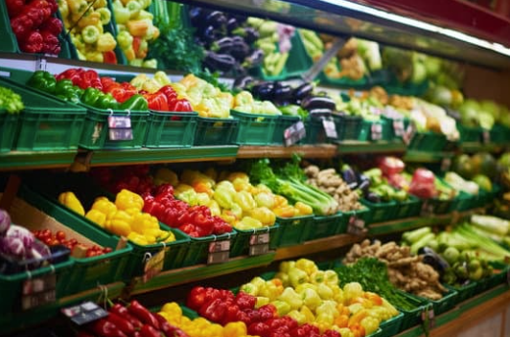
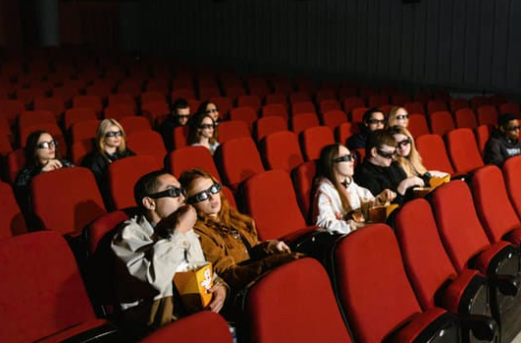
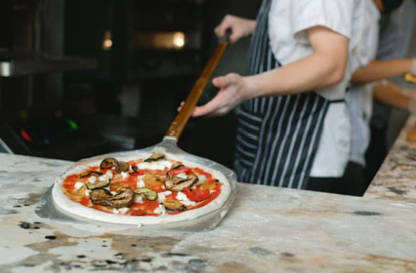
uscire (singular conjugations)
(io)
(tu)
(lui/lei)
Esco a fare la spesa.
Esci a vedere un film.
Esce a mangiare pizza.
Notes:
Teacher notes:
Similar to andare a + infinitive, which means to go and do something, uscire can also be followed by a + infinitive meaning to go out to do something.
Using the slide animations, show each image and see if students can provide the sentence matching the pronoun. Then CLICK to reveal the sample answer. Other answers are possible, for example:
Esco al supermercato.
Esci al cinema.
Esce in pizzeria.

Slide 21
Plural conjugations of uscire
Subject pronoun | Verb conjugation
noi | usciamo
voi | uscite
loro | escono
Notes:
Teacher notes:
Drill then ask students to note these down in their books or devices.

Slide 22


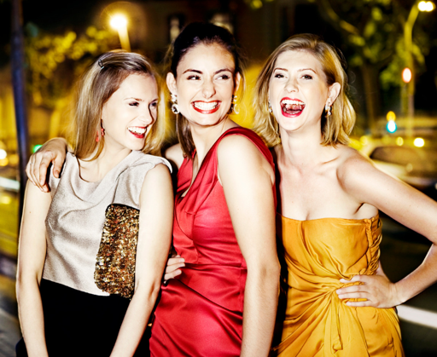
uscire (plural conjugations)
(Noi) usciamo a fare lo shopping.
(Voi) uscite questo pomeriggio?
(Loro) escono insieme la sera.
Notes:
Teacher notes:
CLICK TO REVEAL each sentence with matching image and practise pronunciation with students.

Slide 23

Copyright
© State of New South Wales (Department of Education), 2024
The copyright material published in this resource is subject to the Copyright Act 1968 (Cth) and is owned by the NSW Department of Education or, where indicated, by a party other than the NSW Department of Education (third-party material).
Copyright material available in this resource and owned by the NSW Department of Education is licensed under a Creative Commons Attribution 4.0 International (CC BY 4.0) license.
This license allows you to share and adapt the material for any purpose, even commercially.
Attribution should be given to © State of New South Wales (Department of Education), 2024.
Material in this resource not available under a Creative Commons license:
the NSW Department of Education logo, other logos and trademark-protected material
material owned by a third party that has been reproduced with permission. You will need to obtain permission from the third party to reuse its material.
Links to third-party material and websites
Please note that the provided (reading/viewing material/list/links/texts) are a suggestion only and implies no endorsement, by the New South Wales Department of Education, of any author, publisher, or book title. School principals and teachers are best placed to assess the suitability of resources that would complement the curriculum and reflect the needs and interests of their students.
If you use the links provided in this document to access a third-party's website, you acknowledge that the terms of use, including licence terms set out on the third-party's website apply to the use which may be made of the materials on that third-party website or where permitted by the Copyright Act 1968 (Cth). The department accepts no responsibility for content on third-party websites.
Notes:
Slide not shared

