Slide 1
Questions about daily routines
Notes:
Teacher notes:
Remind students about using intonation when speaking to create a question from a statement in Italian and adding a question mark when writing.
Ask students if they remember how to use the negative construction before beginning.
Point out to students that Quando…? is a general question about when something happens (When …?) – students can answer with a general time, such as la mattina, or with a specific time; by comparison A che ora…? is asking what time something happens.
Once students have practised answering these questions as a class, they can work in pairs to ask and respond to the questions on the slide. Display each slide and give them time to interact.

Slide 2
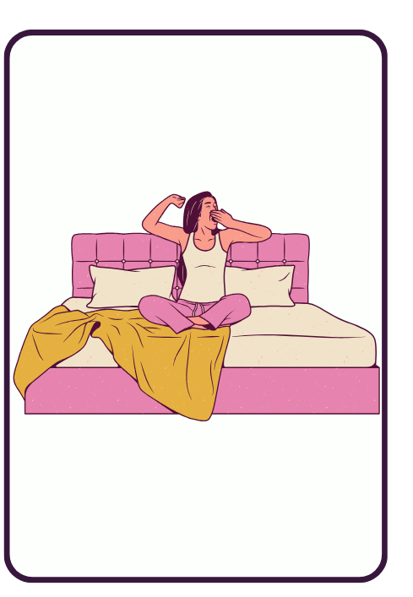
A che ora ti svegli?

Slide 3
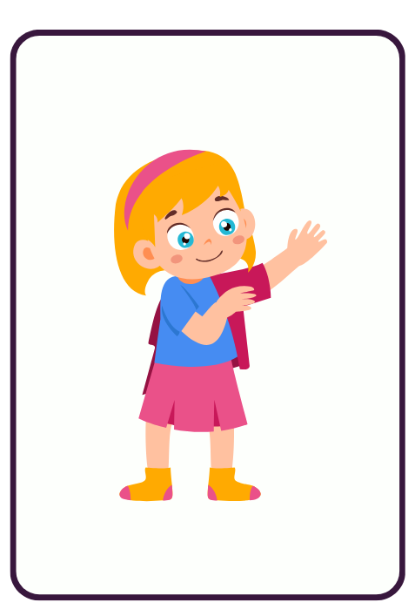
Ti vesti nella tua camera da letto o in bagno?

Slide 4
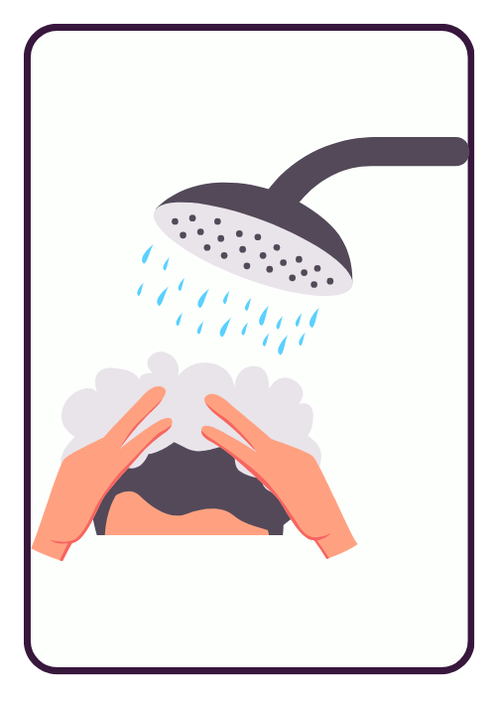
Quando fai la doccia? La mattina, il pomeriggio o la sera?
Notes:
Teacher notes:
Students might want to use the negative form here if they have baths. Non faccio la doccia, (perché) faccio il bagno.

Slide 5
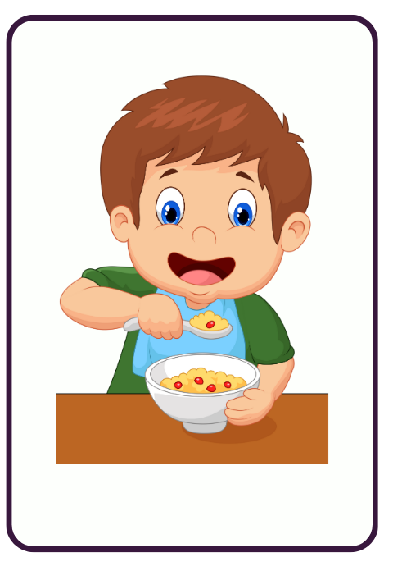
Fai colazione la mattina?
Notes:
Teacher notes:
For advanced proficiency or high potential and gifted students you could ask Che cosa mangi?; Chi prepara la tua colazione?; Mangi da solo/a o insieme alla famiglia?

Slide 6
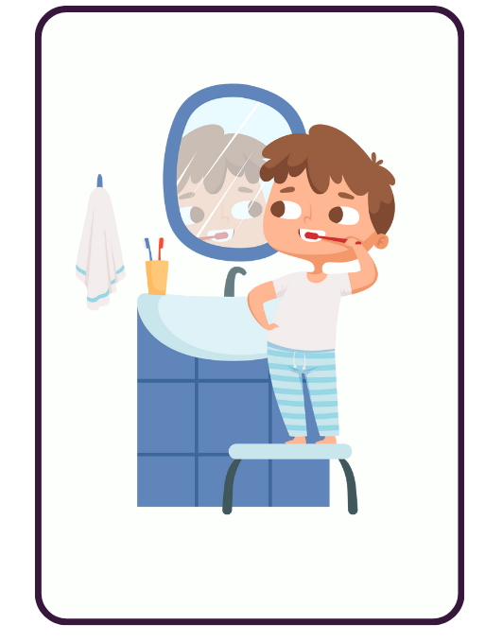
Ti lavi i denti quando ti alzi o dopo colazione?
Notes:
Teacher notes:
For advanced proficiency students you could ask Qualche volta ti lavi i denti ogni giorno?

Slide 7
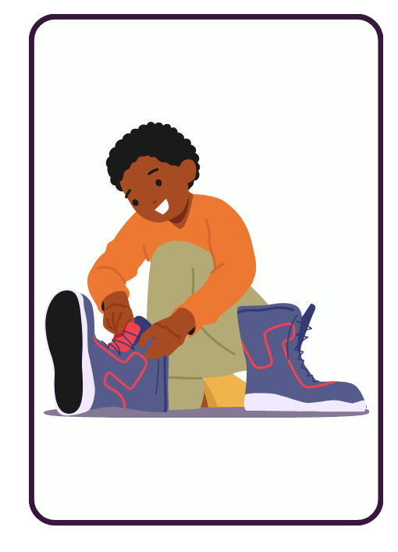
Ti prepari per andare a scuola la mattina o la sera?

Slide 8
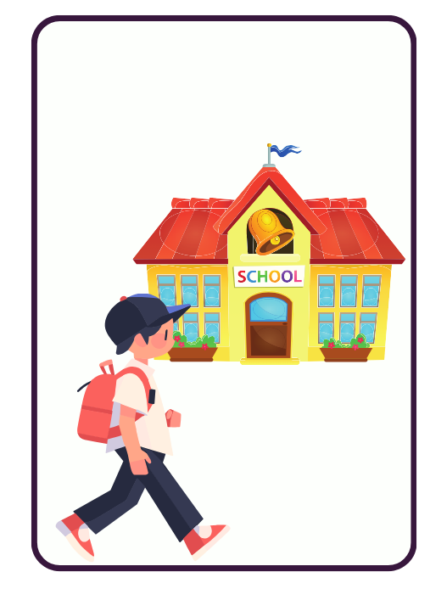
Come vai a scuola?
Notes:
Teacher notes:
You could also ask A che ora vai a scuola?; Vai a scuola da solo o con un amico/una amica?

Slide 9
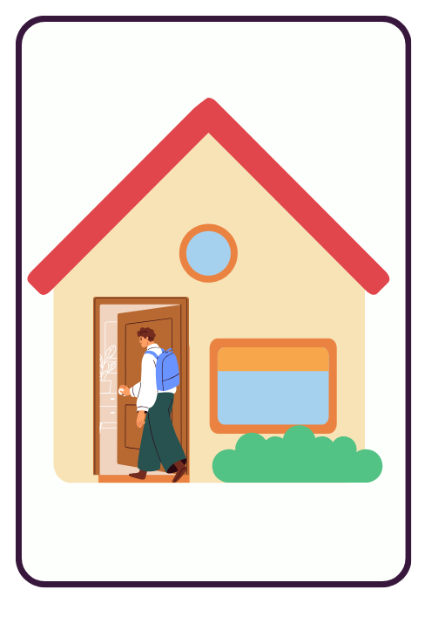
A che ora torni a casa durante la settimana?

Slide 10
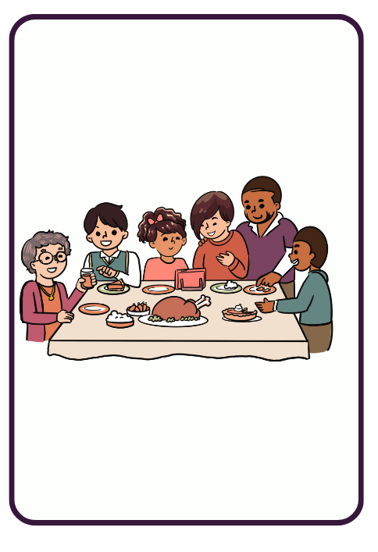
Ceni con la famiglia ogni sera?

Slide 11
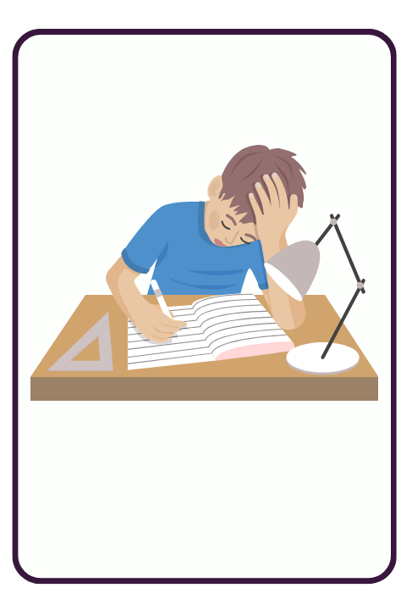
Quando fai i compiti?
Notes:
Teacher notes:
For advanced proficiency or high potential and gifted students you could ask Per quanto tempo ogni giorno?; Hai molti compiti da fare?

Slide 12
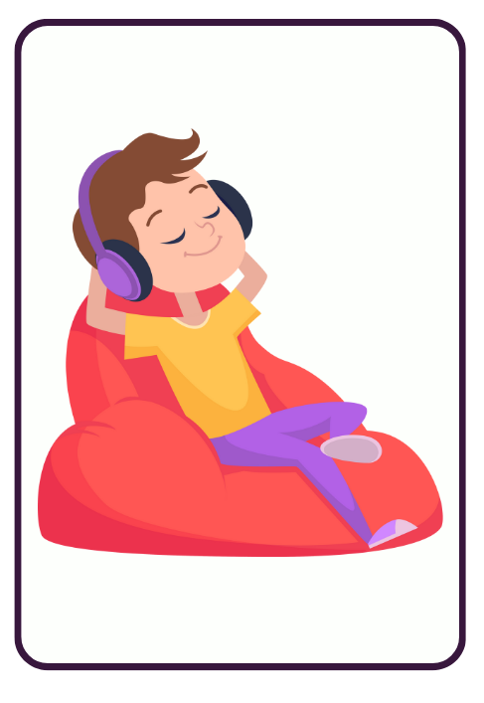
Ti riposi ogni giorno?
Notes:
Teacher notes:
For advanced proficiency or high potential and gifted students you could ask additional questions such as Che cosa fai per riposarti?; Ti riposi il fine settimana?; Che cosa fai?

Slide 13
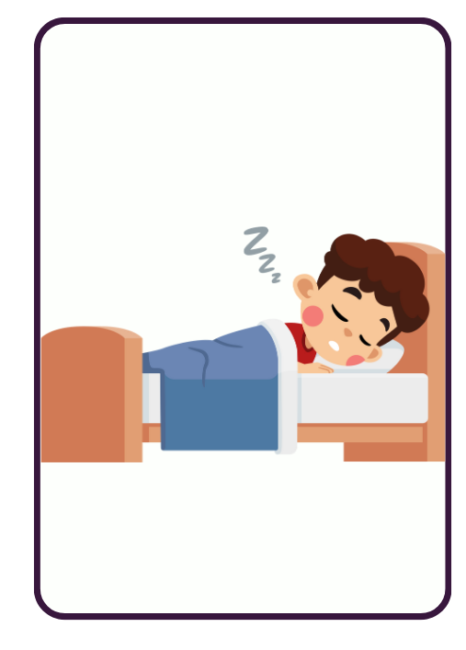
Ti addormenti presto o tardi?

Slide 14

Copyright
© State of New South Wales (Department of Education), 2024
The copyright material published in this resource is subject to the Copyright Act 1968 (Cth) and is owned by the NSW Department of Education or, where indicated, by a party other than the NSW Department of Education (third-party material).
Copyright material available in this resource and owned by the NSW Department of Education is licensed under a Creative Commons Attribution 4.0 International (CC BY 4.0) license.
This license allows you to share and adapt the material for any purpose, even commercially.
Attribution should be given to © State of New South Wales (Department of Education), 2024
Material in this resource not available under a Creative Commons license:
the NSW Department of Education logo, other logos and trademark-protected material
material owned by a third party that has been reproduced with permission. You will need to obtain permission from the third party to reuse its material.
Links to third-party material and websites
Please note that the provided (reading/viewing material/list/links/texts) are a suggestion only and implies no endorsement, by the New South Wales Department of Education, of any author, publisher, or book title. School principals and teachers are best placed to assess the suitability of resources that would complement the curriculum and reflect the needs and interests of their students.
If you use the links provided in this document to access a third-party's website, you acknowledge that the terms of use, including licence terms set out on the third-party's website apply to the use which may be made of the materials on that third-party website or where permitted by the Copyright Act 1968 (Cth). The department accepts no responsibility for content on third-party websites.
Notes:
Slide not shared

