Slide 1
Che ore sono?
What time is it?

Slide 2
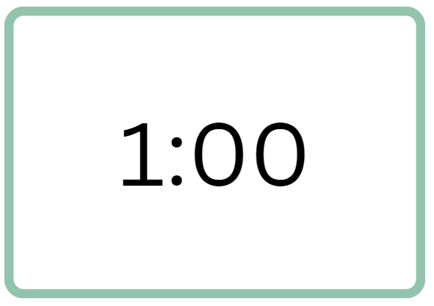
Che ore sono? (1)
È l’una.
Notes:
Teacher notes:
Use slides 2 to 6 to revise the time.
CLICK TO REVEAL the time and ask students to give the time in Italian.
CLICK TO REVEAL È l’una.
Drill orally.

Slide 3
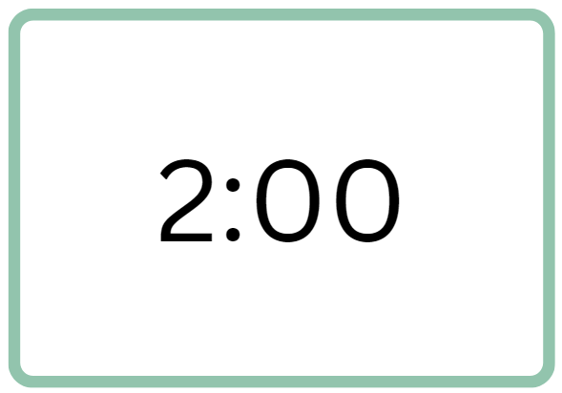
Che ore sono? (2)
Sono le due.
Notes:
Teacher notes:
Revision.
CLICK TO REVEAL the time and ask students to give the time in Italian.
CLICK TO REVEAL Sono le due.
Drill orally.

Slide 4
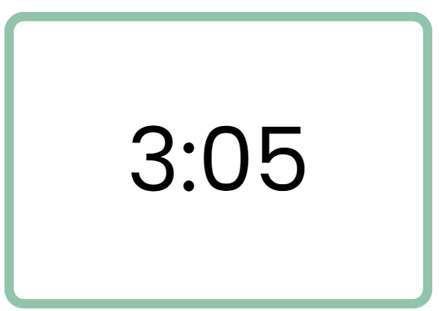
Che ore sono? (3)
Sono le tre e cinque.
Notes:
Teacher notes:
Revision.
CLICK TO REVEAL the time and ask students to give the time in Italian.
CLICK TO REVEAL Sono le tre e cinque.
Drill orally.

Slide 5
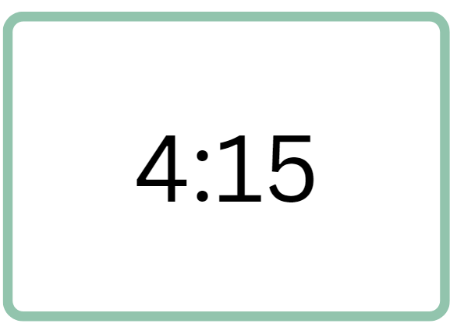
Che ore sono? (4)
Sono le quattro e quindici.
Sono le quattro e un quarto.
Notes:
Teacher notes:
Revision.
CLICK TO REVEAL the time and ask students to give the 2 options of time in Italian.
CLICK TO REVEAL Sono le quattro e quindici or sono le quattro e un quarto.
Drill orally.

Slide 6
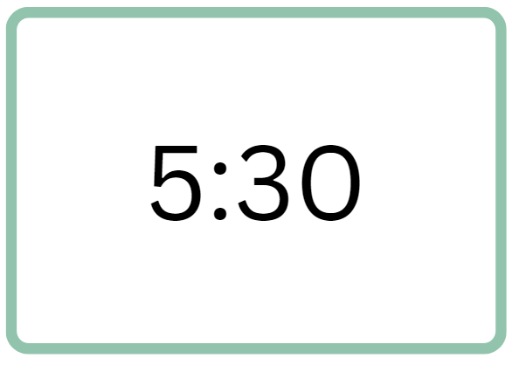
Che ore sono? (5)
Sono le cinque e trenta.
Sono le cinque e mezzo/a.
Notes:
Teacher notes
Revision.
CLICK TO REVEAL the time and ask students to give the two options in Italian.
CLICK TO REVEAL Sono le cinque e trenta. Or sono le cinque e mezzo/a.
Drill orally.

Slide 7
Telling the time to the hour

Slide 8
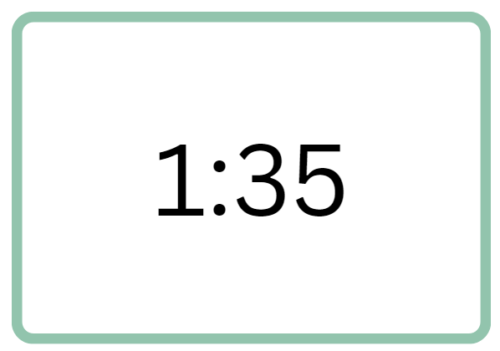
Che ore sono? (6)
È l’una e trentacinque.
Sono le due meno venticinque.
Notes:
Teacher notes:
Moving on to minutes to the hour.
Remind students that there are different ways to give the time.
CLICK TO REVEAL the time and ask students to give the time in English: 1:35 and ‘25 to 2’.
Ask students to give the time 1:35 in Italian.
CLICK TO REVEAL È l’una e trentacinque.
Tell them to say minutes to the hour, you use meno. Ask if they can guess how to say 25 minutes to 2 using meno.
CLICK TO REVEAL Sono le due meno venticinque.
Drill orally both expressions.

Slide 9
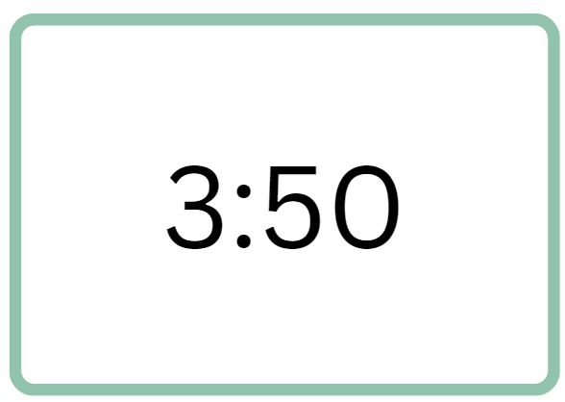
Che ore sono? (7)
Sono le tre e cinquanta.
Sono le quattro meno dieci.
Notes:
Teacher notes:
Ask students to give the time 3:50 in Italian.
CLICK TO REVEAL Sono le tre e cinquanta.
Ask if they can guess how to say 10 minutes to 4 using meno.
CLICK TO REVEAL Sono le quattro meno dieci.
Drill orally both expressions.

Slide 10
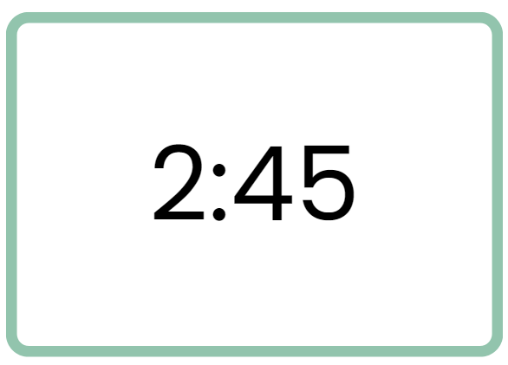
Che ore sono? (8)
Sono le due e quarantacinque.
Sono le tre meno un quarto.
Notes:
Teacher notes:
Follow the prompts from the previous slides to drill these times.
Explain that after 35 minutes past the hour, Italians generally use meno. For example, Italians would be more likely to say sono le sette meno venti in place of sono le sei e quaranta.

Slide 11
24-hour time

Slide 12
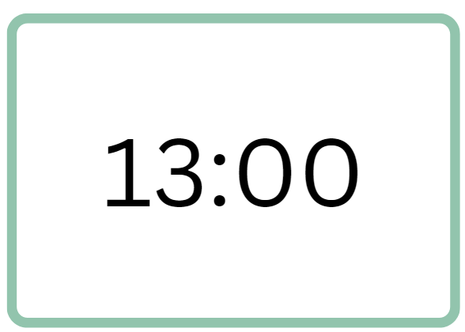
Che ore sono? (9)
Sono le tredici.
Notes:
Teacher notes:
CLICK TO REVEAL the time.
Ask students to guess how you would say this time.
CLICK TO REVEAL Sono le tredici.
Point out that Italians use 24-hour time a lot, particularly when travelling.
Ask them how you would say 1:00 in the afternoon (l’una di pomeriggio) to remind them of the different ways of expressing time.

Slide 13
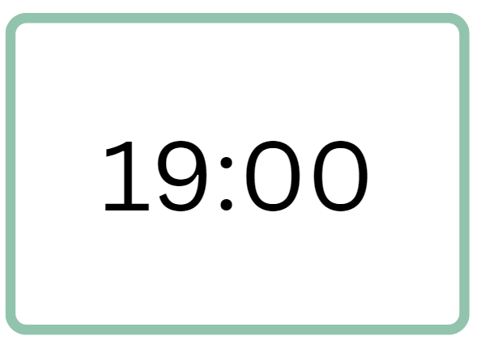
Che ore sono? (10)
Sono le diciannove.
Notes:
Teacher notes:
CLICK TO REVEAL the time.
Ask students to guess how you would say this time.
CLICK TO REVEAL Sono le diciannove.
Ask them how you would say 7:00 in the evening (sono le sette di sera) to remind them of the different ways of expressing time.

Slide 14
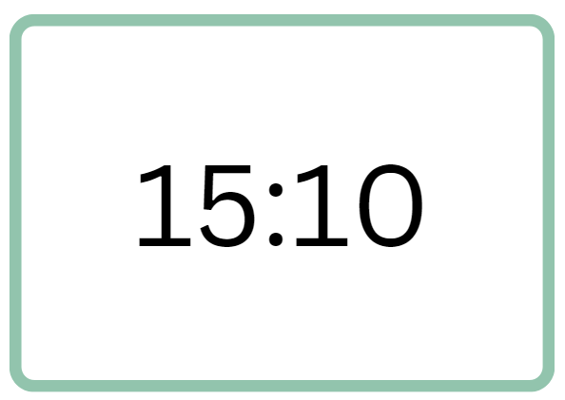
Che ore sono? (11)
Sono le quindici e dieci.
Notes:
Teacher notes:
CLICK TO REVEAL the time.
Ask students to guess how you would say this time.
CLICK TO REVEAL Sono le quindici e dieci.

Slide 15
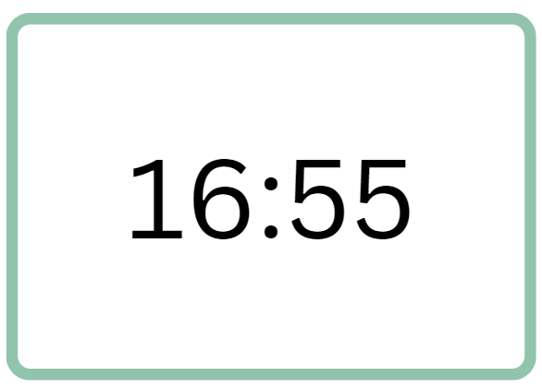
Che ore sono? (12)
Sono le sedici e cinquantacinque.
Sono le diciassette meno cinque.
Notes:
Teacher notes:
CLICK TO REVEAL the time.
Ask students to guess how you would say this time. There are two ways.
CLICK TO REVEAL Sono le sedici e cinquantacinque or Sono le diciassette meno cinque.

Slide 16
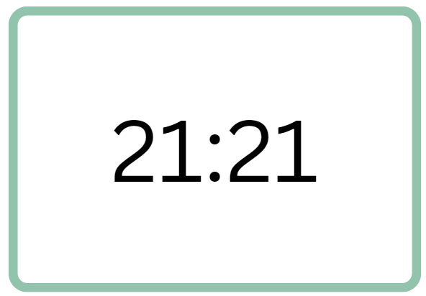
Che ore sono? (13)
Sono le ventuno e ventuno.
Notes:
Teacher notes:
CLICK TO REVEAL the time.
Ask students to guess how you would say this time.
CLICK TO REVEAL Sono le ventuno e ventuno.

Slide 17
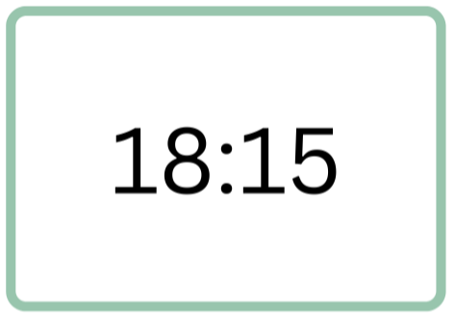
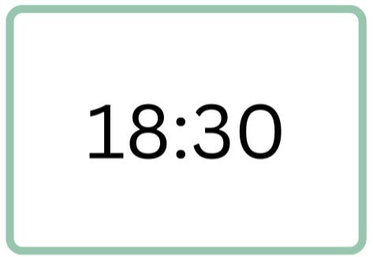
Che ore sono? (14)
Sono le diciotto e quindici.
Sono le diciotto e trenta.
Notes:
Teacher notes:
Point out that, when using 24-hour time, Italians do not use un quarto or e mezza. Instead, they say the number of minutes, for example, sono le diciotto e quindici or sono le diciotto e trenta (not sono le diciotto e un quarto or sono le diciotto e mezza).

Slide 18
A che ora…?
Notes:
Teacher notes:
Using slides 18 to 28, display the picture of a daily routine activity on the board. In their books or devices, students construct the question appropriate to the picture (for example, A che ora ti svegli?). Students may work in pairs, if preferred. Click on the slide to reveal the question, and allow time to discuss any errors students may have made in conjugating the verb. Then reveal the answer stem, providing a prompt for students to construct a response to the question. Allow time for students to write their response to each question. If the image is an activity that students don’t complete, encourage them to communicate this authentically using a negative structure. Remind students to practise using the 24-hour time structure when appropriate. Progress through the slides, pausing to allow time for students to construct each question and answer. When students have created and answered all questions, use slide 29 to guide interactions between students.
You can also ask students to ask other students the question. If support is needed you can add in the language structures. For example,
Student A: A che ora ti svegli?
Student B: Mi sveglio alle sette.
Teacher to Student A or any other student: A che ora si sveglia, Antonio?
Student C: Antonio si sveglia alle sette.

Slide 19
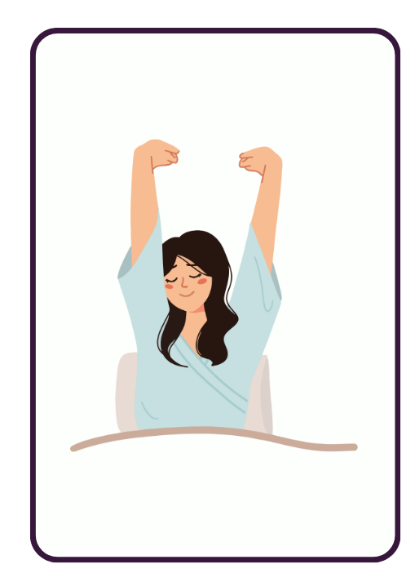
A che ora ti svegli?
Mi sveglio alle…
Notes:
Teacher notes:
Ask students to create the question, before revealing and discussing any errors made with conjugations in the tu form and/or with reflexive pronouns.
Then CLICK TO REVEAL the answer stem, allowing time for students to create their answer.

Slide 20
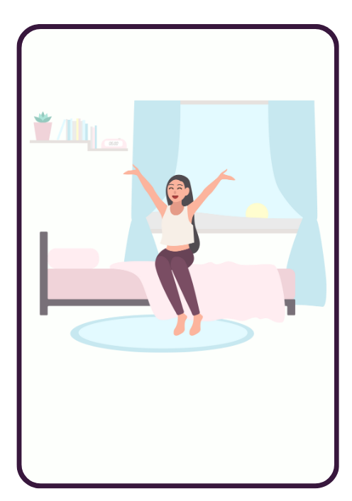
A che ora ti alzi?
Mi alzo alle…
Notes:
Teacher notes:
Ask students to create the question, before revealing and discussing any errors made with conjugations in the tu form and/or with reflexive pronouns.
Then CLICK TO REVEAL the answer stem, allowing time for students to create their answer.

Slide 21
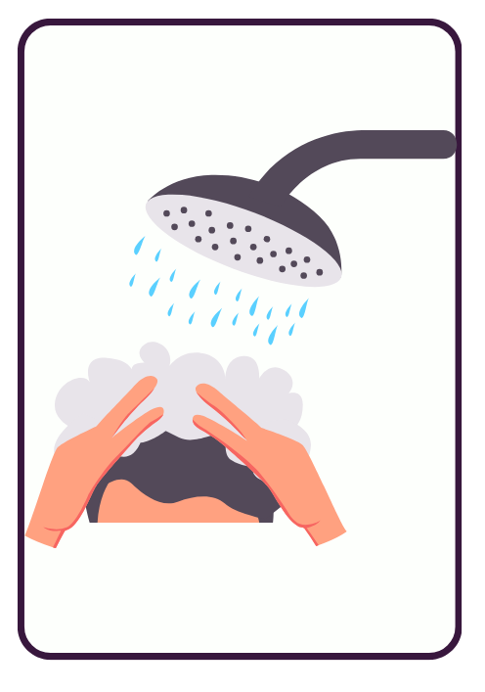
A che ora fai la doccia?
Faccio la doccia alle…

Slide 22
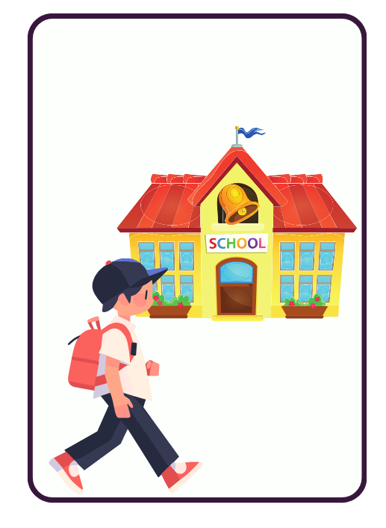
A che ora vai a scuola?
Vado a scuola alle…

Slide 23
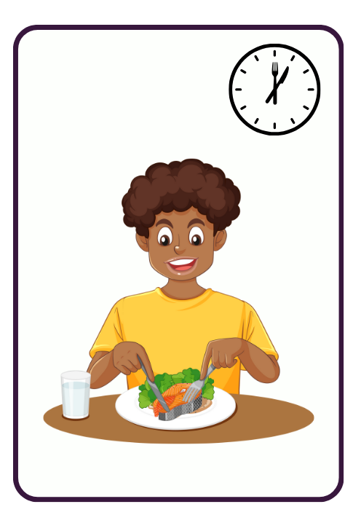
A che ora pranzi?
Pranzo alle…

Slide 24
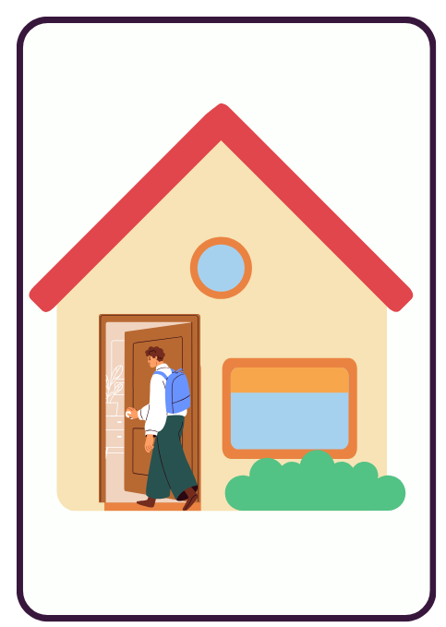
A che ora torni a casa?
Torno a casa alle…

Slide 25
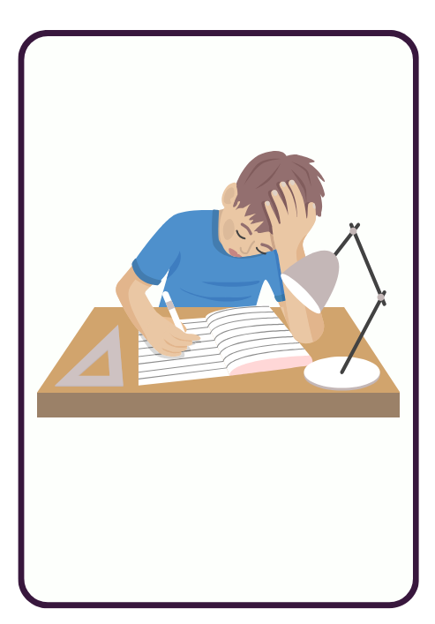
A che ora fai i compiti?
Faccio i compiti alle…

Slide 26
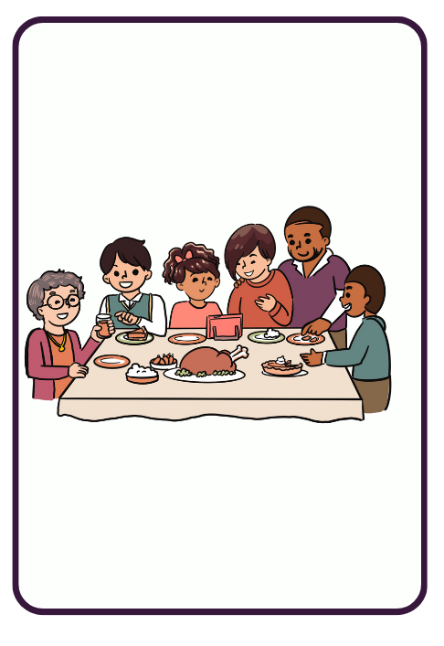
A che ora ceni?
Ceno alle…

Slide 27
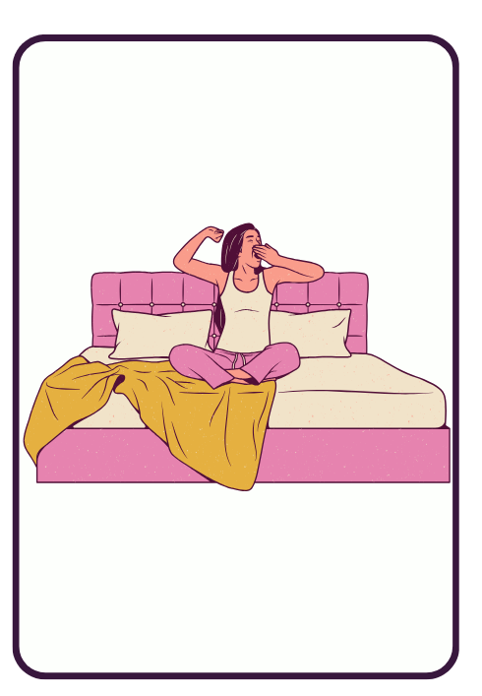
A che ora vai a letto?
Vado a letto alle…

Slide 28
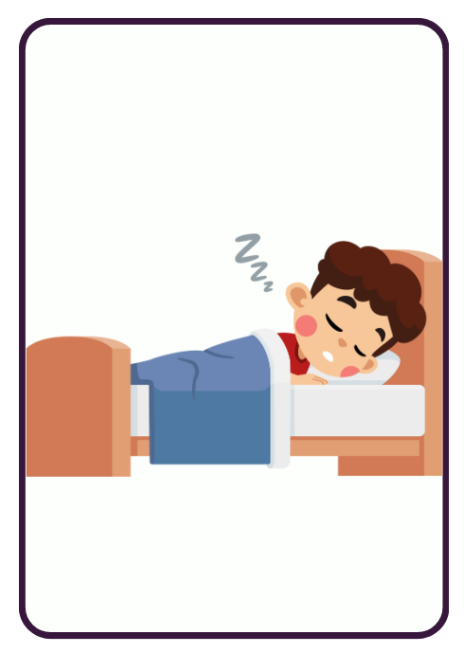
A che ora ti addormenti?
Mi addormento alle…

Slide 29
A che ora…?

Slide 30
Copyright
© State of New South Wales (Department of Education), 2024
The copyright material published in this resource is subject to the Copyright Act 1968 (Cth) and is owned by the NSW Department of Education or, where indicated, by a party other than the NSW Department of Education (third-party material).
Copyright material available in this resource and owned by the NSW Department of Education is licensed under a Creative Commons Attribution 4.0 International (CC BY 4.0) license.
This license allows you to share and adapt the material for any purpose, even commercially.
Attribution should be given to © State of New South Wales (Department of Education), 2024.
Material in this resource not available under a Creative Commons license:
the NSW Department of Education logo, other logos and trademark-protected material
Material owned by a third party that has been reproduced with permission. You will need to obtain permission from the third party to reuse its material.
Links to third-party material and websites
Please note that the provided (reading/viewing material/list/links/texts) are a suggestion only and implies no endorsement, by the New South Wales Department of Education, of any author, publisher, or book title. School principals and teachers are best placed to assess the suitability of resources that would complement the curriculum and reflect the needs and interests of their students.
If you use the links provided in this document to access a third-party’s website, you acknowledge that the terms of use, including licence terms set out on the third-party’s website apply to the use which may be made of the materials on that third-party website or where permitted by the Copyright Act 1968 (Cth). The department accepts no responsibility for content on third-party websites.

