Slide 1
Revision of irregular verb andare
Notes:
Teacher notes:
Remind students they have seen the verb andare before. Ask if they remember what it means.
This is a resource to revise the complete conjugation of andare as an irregular verb.
It is broken into 2 parts: singular verb forms then plural verb forms. To avoid cognitive overload, it is suggested to revise the singular forms first, then the plural. Note that there is familiar vocabulary from previous units of work in the sentences that accompany each conjugation.
Suggested questions for revision are also included.

Slide 2
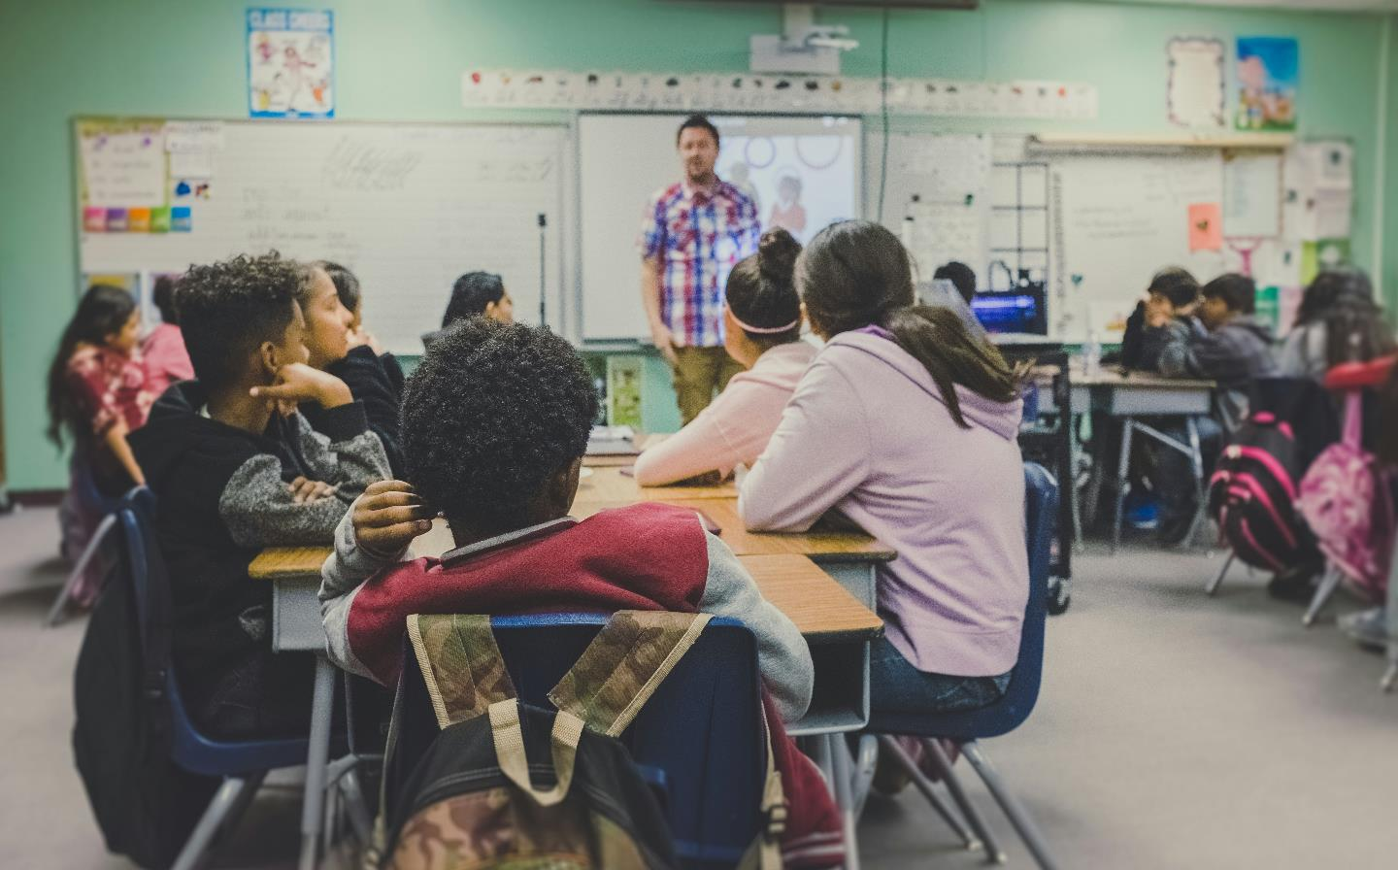
andare a scuola
Notes:
Teacher notes:
Ask students if they remember how to say ‘to go to school’?
CLICK to reveal andare a scuola
Revise the singular conjugations of the verb by asking them if they remember how to say:
I go to school – Vado a scuola.
You go to school – Vai a scuola.
He goes to school – Va a scuola.
She goes to school – Va a scuola.
Remind students, as with the regular verbs they have been practising, it is common in Italian not to use the personal pronoun.
However, in the case of Va a scuola, ask students how they would be able to determine if the sentence means ‘He is going to school’ or ‘She is going to school’. Remind them of the importance of the context, ensuring that the subject of the sentence has been made clear prior to this sentence, or the meaning will not be clear. If in doubt, the subject pronoun or name should be used.
Remind students that andare is generally followed by the preposition a (to).

Slide 3
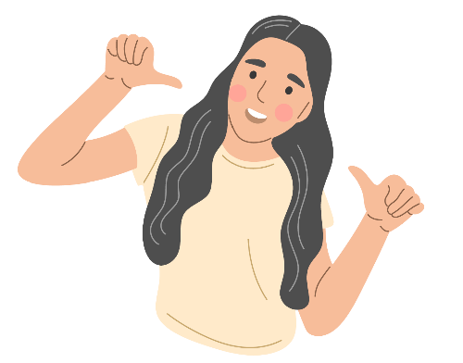



Let’s practise! – andare a scuola (1)
Notes:
Teacher notes:
Use the 4 images on the slide – me, you, he and she – to practise the conjugations.
I go to school – Vado a scuola.
You go to school – Vai a scuola.
He goes to school – Va a scuola.
She goes to school – Va a scuola.
Point to the image and have students repeat the correct conjugation. When students are confident, ask individual students for the conjugation which matches the image you point to each time.

Slide 4

Let’s practise! – andare a scuola (2)
A che ora vai a scuola?
Vado a scuola alle otto.
Come vai a scuola?
Vado a scuola a piedi.
A che ora va a scuola?
Va a scuola alle otto.
Come va a scuola?
Va a scuola a piedi.
Notes:
Teacher notes:
Use this slide to practise asking a range of students when and how they go to school – models are provided to scaffold responses:
A che ora vai a scuola?
Vado a scuola alle otto.
Come vai a scuola?
Vado a scuola a piedi.
When ready, introduce asking about a third person (CLICK, CLICK). For example, ask student A how what time they get to school, or how they get to school; then ask student B about student A – what time does he/she get to school and how does he/she get to school. Slide animations reveal scaffolds.

Slide 5
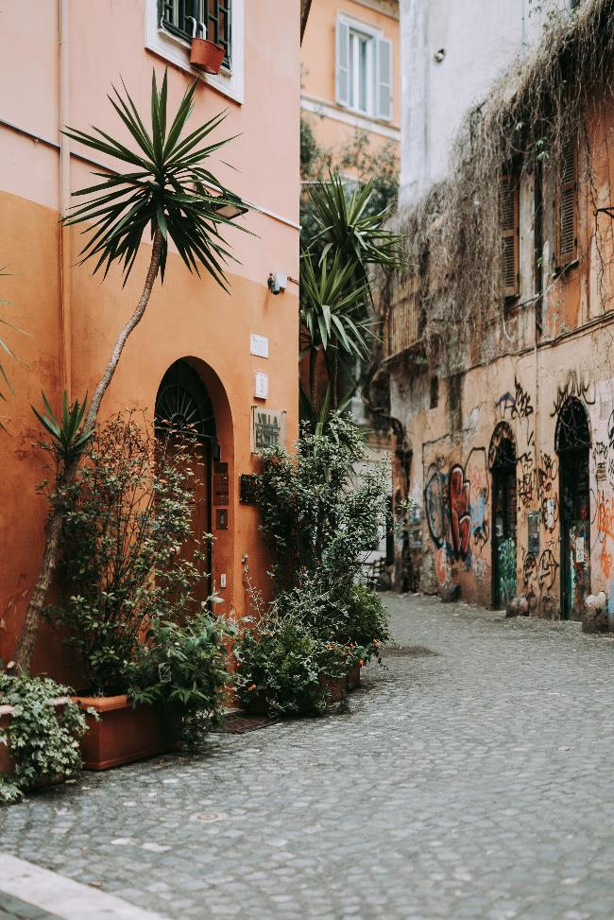
andare a casa
Notes:
Teacher notes:
Ask students if they remember how to say ‘to go home’.
CLICK to reveal andare a casa
Revise to go to my/your house = Andare a casa mia/tua
Use choral repetition as necessary.

Slide 6
Let’s practise! – andare a casa (1)
Notes:
Teacher notes:
Use the 4 images on the slide – me, you, he and she – to practise the conjugations.
I go to school – Vado a casa.
You go to school – Vai a casa.
He goes to school – Va a casa.
She goes to school – Va a casa.
Point to the image and have students repeat the correct conjugation. When students are confident, ask individual students for the conjugation which matches the image you point to each time.

Slide 7

Let’s practise! – andare a casa (2)
A che ora vai a casa?
Vado a casa alle tre.
Come vai a casa?
Vado a casa in autobus.
A che ora va a casa?
Va a casa alle tre.
Come va a casa?
Va a casa in autobus.
Notes:
Teacher notes:
Use this slide to practise asking a range of students when and how they go home.

Slide 8
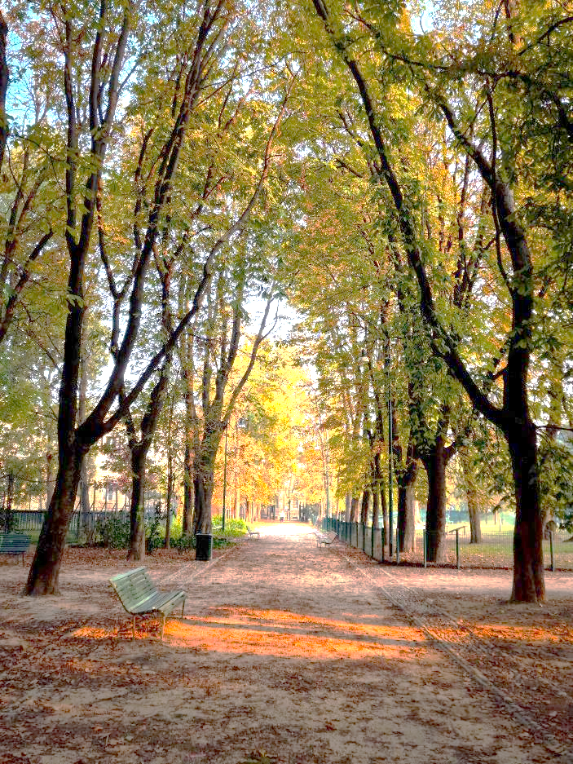
andare al parco
Notes:
Teacher notes:
Ask students if they remember how to say ‘to go to the park’.
CLICK to reveal andare al parco
Ask students if they remember the rule a + il = al for al parco?
Use choral repetition as necessary.

Slide 9
Let’s practise! – andare al parco (1)
Notes:
Teacher notes:
Use the 4 images on the slide – me, you, he and she – to practise the conjugations.
I go to school – Vado al parco.
You go to school – Vai al parco.
He goes to school – Va al parco.
She goes to school – Va al parco.
Point to the image and have students repeat the correct conjugation. When students are confident, ask individual students for the conjugation which matches the image you point to each time.

Slide 10

Let’s practise! – andare al parco (2)
Vai al parco?
Sì, vado al parco.
No, non vado mai al parco.
Va al parco?
Sì, va al parco.
No, non va mai al parco.
Notes:
Teacher notes:
Use this slide to practise asking a range of students if they go to the park.

Slide 11
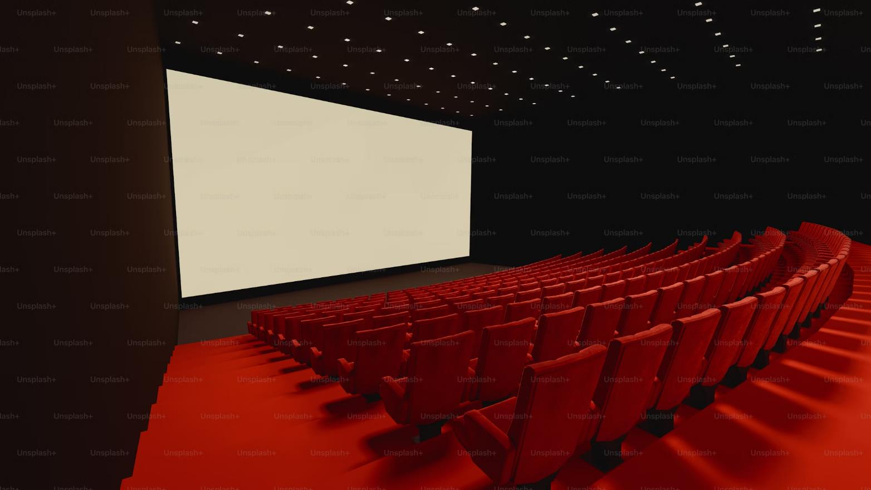
andare al cinema
Notes:
Teacher notes:
Ask students if they remember how to say ‘to go to the movies/cinema’.
CLICK to reveal andare al cinema
Use choral repetition as necessary.

Slide 12
Let’s practise! – andare al cinema (1)
Notes:
Teacher notes:
Use the 4 images on the slide – me, you, he and she – to practise the conjugations.
I go to school – Vado al cinema.
You go to school – Vai al cinema.
He goes to school – Va al cinema.
She goes to school – Va al cinema.
Point to the image and have students repeat the correct conjugation. When students are confident, ask individual students for the conjugation which matches the image you point to each time.

Slide 13

Let’s practise! – andare al cinema (2)
Vai al cinema?
Sì, vado al cinema.
No, non vado mai al cinema.
Con chi vai al cinema?
Vado al cinema con mio fratello.
Come vai al cinema?
Vado al cinema in bici.
Va al cinema?
Sì, va al cinema.
No, non va mai al cinema.
Con chi va al cinema?
Va al cinema con suo fratello.
Come va al cinema?
Va al cinema in bici.
Notes:
Teacher notes:
Use this slide to practise asking a range of students if they go to the cinema.

Slide 14
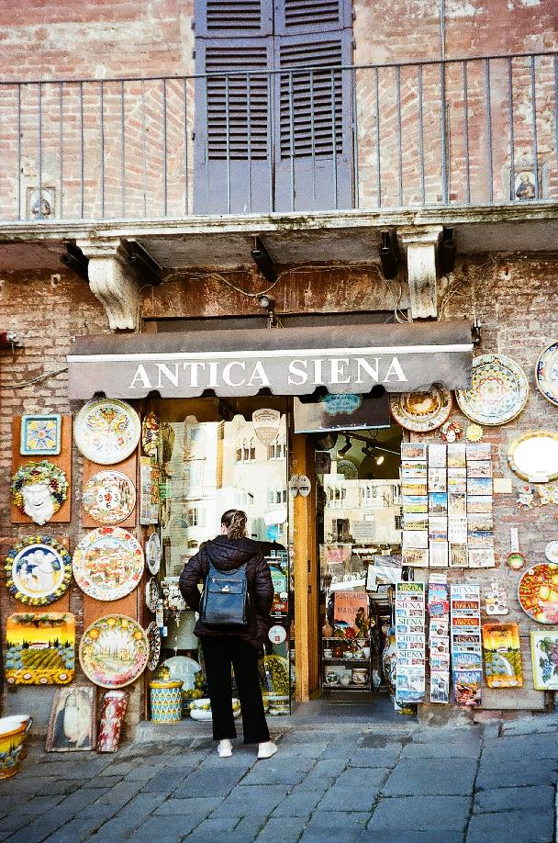
andare al negozio
Notes:
Teacher notes:
Ask students if they remember how to say ‘to go to the shop’.
CLICK to reveal andare al negozio
Use choral repetition as necessary.
Use questions to practise revision of the conjugations such as:
Quando…?
Come vai/va…?
Con chi vai/va …?
(Scaffolding has been removed at this point – add scaffolding back in, if required for your students.)

Slide 15
Let’s practise! – andare al negozio
Notes:
Teacher notes:
Use the 4 images on the slide – me, you, he and she – to practise the conjugations.
I go to the shop – Vado al negozio.
You go to the shop – Vai al negozio.
He goes to the shop – Va al negozio.
She goes to the shop – Va al negozio.
Point to the image and have students repeat the correct conjugation. When students are confident, ask individual students for the conjugation which matches the image you point to each time.

Slide 16
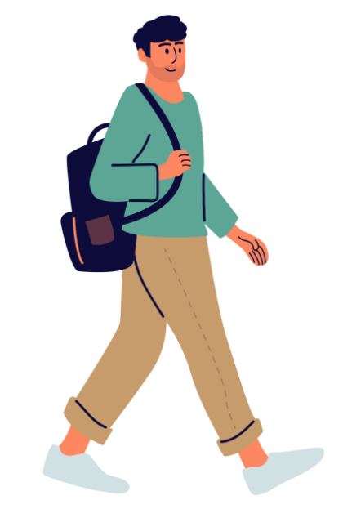
Singular
andare – to go
Subject pronoun | Verb conjugation
io | vado
tu | vai
lui/lei | va
Notes:
Teacher notes:
Conjugation of the singular forms of andare.

Slide 17
Translate (1)
I go to school at 8.
I go to school by bus.
You go to school at 8:30.
He goes home by bike.
She goes home at 3.
I don’t go to the park.
He goes to the park on foot.
She goes to the cinema with Luca.
She never goes to the cinema.
I go to the shop by car.
Vado a scuola alle otto.
Vado a scuola in autobus.
Vai a scuola alle otto e mezza.
Va a casa in bici
Va a casa alle tre.
Non vado al parco.
Va al parco a piedi.
Va al cinema con Luca.
Non va mai al cinema.
Vado al negozio in macchina.
Notes:
Teacher notes:
Depending on student ability, this slide could be completed individually or in small groups.
(CLICK to reveal answers.)
For students requiring additional support, provide the English sentences on a page, with the Italian sentences cut out into strips. Students then match the English to the Italian.

Slide 18
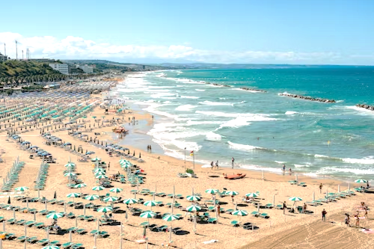
andare alla spiaggia
Notes:
Teacher notes:
In the next slides, focus on revising the plural conjugations of the verb andare.
Ask students if they remember how to say ‘to go to the beach’.
CLICK to reveal andare alla spiaggia
This is an example of andare alla. Ask students why the preposition has changed from al to alla. Students must identify la spaggia as a feminine noun, therefore a + la = alla

Slide 19





Let’s practise! – andare alla spiaggia
Notes:
Teacher notes:
Use the 3 images on the slide – we, you (plural) and they – to practise the conjugations.
We go to the beach – Andiamo alla spiaggia.
You (pl.) go to the beach – Andate alla spiaggia.
They go to the beach – Vanno alla spiaggia.
Point to the image and have students repeat the correct conjugation. When students are confident, ask individual students for the conjugation which matches the image you point to each time.

Slide 20
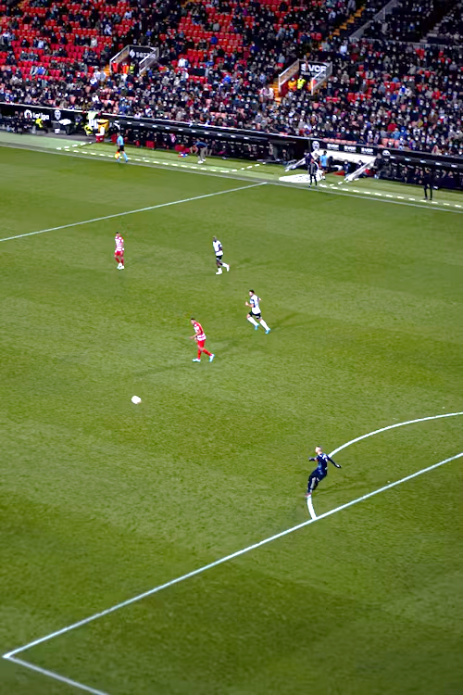
andare allo stadio
Notes:
Teacher notes:
Ask students if they remember how to say ‘to go to the stadium’.
CLICK andare allo stadio
Ask students why the preposition has changed to allo stadio? Remind students of the rule a + lo = allo.
Use choral repetition as necessary.
Use questions to practise the conjugations such as:
Quando…?
Come andate…?
Con chi andate…?
Perché andate …?

Slide 21
Let’s practise! – andare allo stadio
Notes:
Teacher notes:
Use the 3 images on the slide – we, you (plural) and they – to practise the conjugations.
We go to the stadium – Andiamo allo stadio.
You (pl.) go to the stadium – Andate allo stadio.
They go to the stadium – Vanno allo stadio.
Point to the image and have students repeat the correct conjugation. When students are confident, ask individual students for the conjugation which matches the image you point to each time.

Slide 22
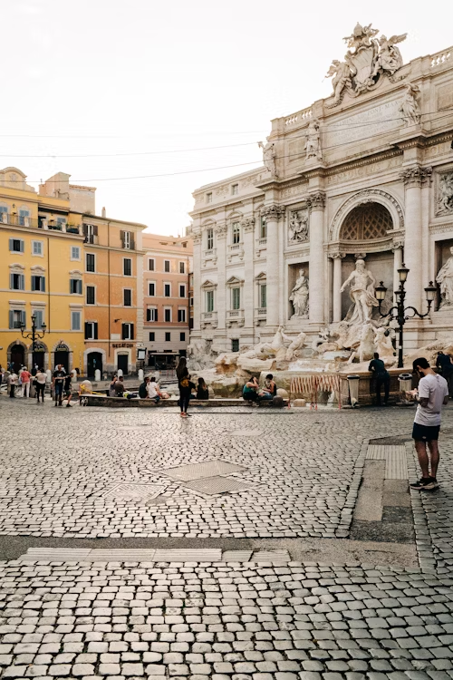
andare in città
Notes:
Teacher notes:
Ask students if they remember how to say ‘to go to the city’.
CLICK andare in città
Remind students that some expressions with andare use andare in not andare a. Remind students that in is used with most countries, states, regions, with addresses (in via …, in piazza …), and rooms of the house.
Use choral repetition as necessary.

Slide 23
Let’s practise! – andare in città
Notes:
Teacher notes:
Use the 3 images on the slide – we, you (plural) and they – to practise the conjugations.
We go to the city – Andiamo in città.
You (pl.) go to the city – Andate in città.
They go to the city – Vanno in città.
Point to the image and have students repeat the correct conjugation. When students are confident, ask individual students for the conjugation which matches the image you point to each time.

Slide 24
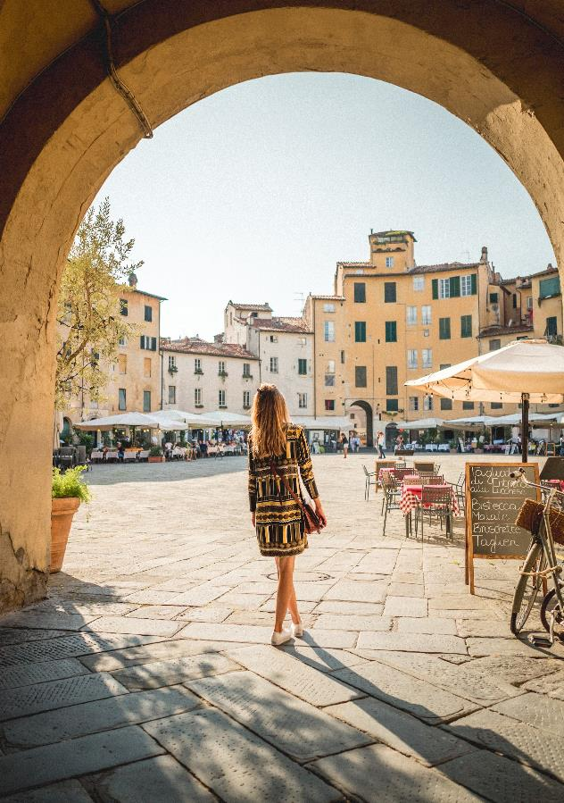
andare in piazza
Notes:
Teacher notes:
Ask students if they remember how to say ‘to go to the square’.
CLICK andare in piazza
Use choral repetition as necessary.
All of the photos used in the slides are from areas around Italy. Use them to discuss or do a ‘Plus, Minus, Interesting’ activity on each to make comparisons between places in Australia, Italy and other countries students have been to.
Remind students of the cultural significance of la piazza in most Italian towns and cities – as a place to meet friends or family, stroll, look at the shops or enjoy a drink or bite to eat.

Slide 25
Let’s practise! – andare in piazza
Notes:
Teacher notes:
Use the 3 images on the slide – we, you (plural) and they – to practise the conjugations.
We go to the square – Andiamo in piazza.
You (pl.) go to the square – Andate in piazza.
They go to the square – Vanno in piazza.
Point to the image and have students repeat the correct conjugation. When students are confident, ask individual students for the conjugation which matches the image you point to each time.

Slide 26
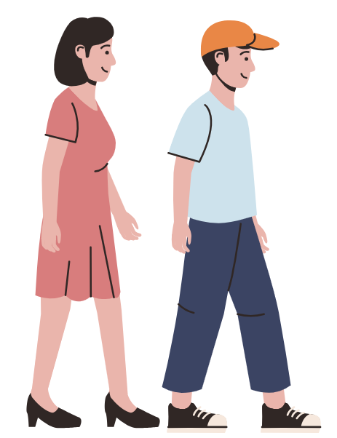
Plural
andare – to go
Subject pronoun | Verb conjugation
noi | andiamo
voi | andate
loro | vanno
Notes:
Teacher notes:
Full conjugation of the plural forms of andare. More choral repetition. Ask students to make sentences with these forms using the vocabulary presented or prior knowledge.

Slide 27
Translate (2)
We go to the square at 4.
You (pl.) go to the city by bus.
We go to the beach at 9.
They don’t go to the stadium.
They go to the stadium by car.
Do you (pl.) go to the city?
Will we go to the beach?
Andiamo in piazza alle quattro.
Andate in città in autobus.
Andiamo alla spiaggia alle nove.
Non vanno allo stadio.
Vanno allo stadio in macchina.
Andate in città?
Andiamo alla spiaggia?
Notes:
Teacher notes:
Depending on student ability, this slide could be completed individually or in small groups.
(CLICK to reveal answers.)
For students requiring additional support, provide the English sentences on a page, with the Italian sentences cut out into strips. Students then match the English to the Italian.

Slide 28
Andare
Singular
io | vado
tu | vai
lui/lei | va
Plural
noi | andiamo
voi | andate
loro | vanno
Notes:
Teacher notes:
Full conjugation of the plural forms of andare. More choral repetition. Ask students to make sentences with these forms using the vocabulary presented or prior knowledge.
Ensure that students have written down these conjugations in their books/device and on their anchor chart.

Slide 29
Copyright
© State of New South Wales (Department of Education), 2024
The copyright material published in this resource is subject to the Copyright Act 1968 (Cth) and is owned by the NSW Department of Education or, where indicated, by a party other than the NSW Department of Education (third-party material).
Copyright material available in this resource and owned by the NSW Department of Education is licensed under a Creative Commons Attribution 4.0 International (CC BY 4.0) license.
This license allows you to share and adapt the material for any purpose, even commercially.
Attribution should be given to © State of New South Wales (Department of Education), 2024.
Material in this resource not available under a Creative Commons license:
the NSW Department of Education logo, other logos and trademark-protected material
material owned by a third party that has been reproduced with permission. You will need to obtain permission from the third party to reuse its material.
Links to third-party material and websites
Please note that the provided (reading/viewing material/list/links/texts) are a suggestion only and implies no endorsement, by the New South Wales Department of Education, of any author, publisher, or book title. School principals and teachers are best placed to assess the suitability of resources that would complement the curriculum and reflect the needs and interests of their students.
If you use the links provided in this document to access a third-party's website, you acknowledge that the terms of use, including licence terms set out on the third-party's website apply to the use which may be made of the materials on that third-party website or where permitted by the Copyright Act 1968 (Cth). The department accepts no responsibility for content on third-party websites.
Notes:
Slide not shared

