Slide 1
Regular verb conjugations
Notes:
Teacher notes:
Use this PowerPoint to revise regular -are, -ere and -ire verb conjugations.

Slide 2
Subject pronouns – revision
Singular (Italian) | Singular (English)
io | I
tu | you
lui | he
lei | she
Plural (Italian) | Plural (English)
noi | we
voi | you
loro | they
Notes:
Teacher notes:
This slide is included as a support for students if necessary. Point out that Italians do not use these subject pronouns as we do in English – they are usually omitted.

Slide 3
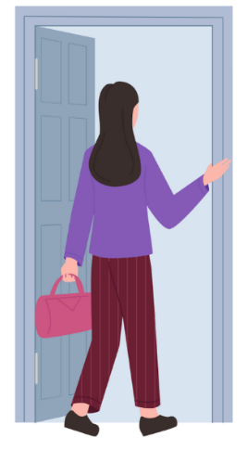
Regular –are verbs
tornare – to return or go back
Singular (Italian)
io torno
tu torni
lui torna
lei torna
Plural (Italian)
noi torniamo
voi tornate
loro tornano
Notes:
Teacher notes:
Revise endings of regular -are verbs.
Ask students to give the conjugations of the new verbs for this unit, pranzare and cenare, based on this model.

Slide 4
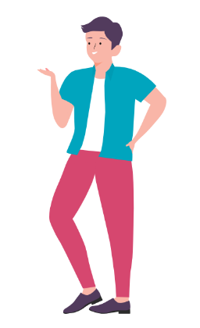
Regular –ere verbs
mettere – to put
Singular (Italian)
io metto
tu metti
lui mette
lei mette
Plural (Italian)
noi mettiamo
voi mettete
loro mettono
Notes:
Teachers notes:
Revise endings of regular -ere verbs.
Ask students to give the conjugations of the prior learning verb leggere based on this model. Take care with the pronunciation of the hard ‘g’ for leggo and leggono, compared to the soft g for leggi, legge, leggete and leggiamo.

Slide 5
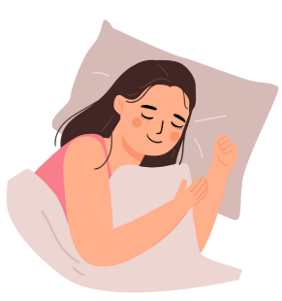
Regular –ire verbs
dormire – to sleep
Singular (Italian)
io dormo
tu dormi
lui dorme
lei dorme
Plural (Italian)
noi dormiamo
voi dormite
loro dormono
Notes:
Teacher notes:
Revise endings of regular -ire verbs.
Students have been introduced to vestirsi through the daily routine vocabulary, which means ‘to dress oneself’. Ask students to conjugate vestire (‘to dress’) based on this model.

Slide 6
Copyright
© State of New South Wales (Department of Education), 2024
The copyright material published in this resource is subject to the Copyright Act 1968 (Cth) and is owned by the NSW Department of Education or, where indicated, by a party other than the NSW Department of Education (third-party material).
Copyright material available in this resource and owned by the NSW Department of Education is licensed under a Creative Commons Attribution 4.0 International (CC BY 4.0) licence.
This license allows you to share and adapt the material for any purpose, even commercially.
Attribution should be given to © State of New South Wales (Department of Education), 2024.
Material in this resource not available under a Creative Commons license:
the NSW Department of Education logo, other logos and trademark-protected material
material owned by a third party that has been reproduced with permission. You will need to obtain permission from the third party to reuse its material.
Links to third-party material and websites
Please note that the provided (reading/viewing material/list/links/texts) are a suggestion only and implies no endorsement, by the New South Wales Department of Education, of any author, publisher, or book title. School principals and teachers are best placed to assess the suitability of resources that would complement the curriculum and reflect the needs and interests of their students.
If you use the links provided in this document to access a third-party's website, you acknowledge that the terms of use, including licence terms set out on the third-party's website apply to the use which may be made of the materials on that third-party website or where permitted by the Copyright Act 1968 (Cth). The department accepts no responsibility for content on third-party websites.
Notes:
Slide not shared

