Slide 1
Daily routine verbs

Slide 2
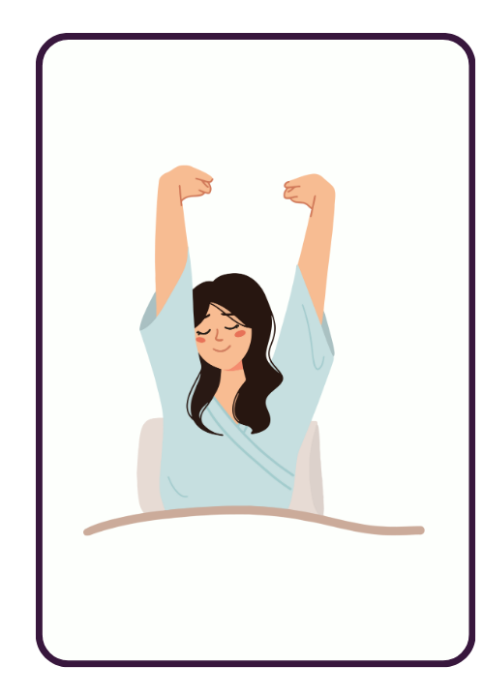
Mi sveglio.
Notes:
Teacher notes:
Introduce first person conjugations. Direct students to repeat after the teacher. Matching actions could also be introduced.
Mi sveglio = I wake up.

Slide 3
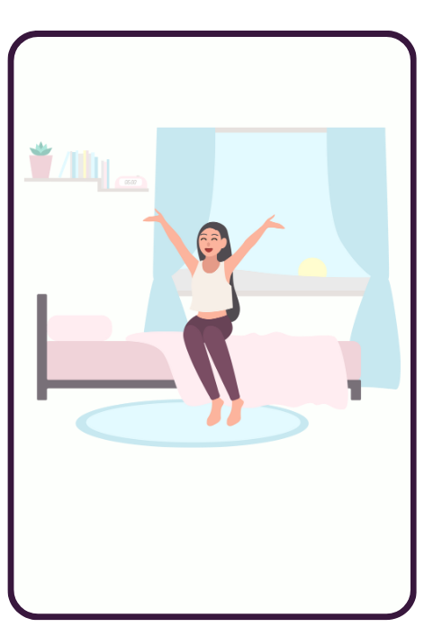
Mi alzo.
Notes:
Mi alzo = I get up.

Slide 4
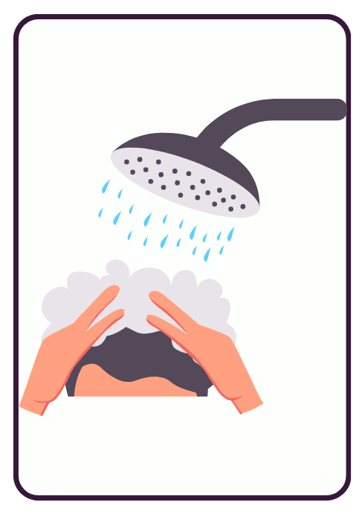
Faccio la doccia.
Notes:
Faccio la doccia = I have a shower.

Slide 5
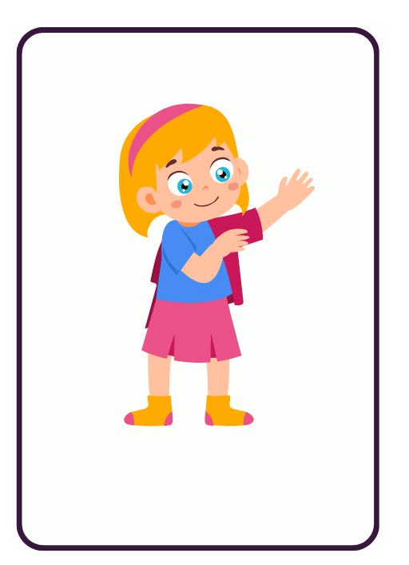
Mi vesto.
Notes:
Mi vesto = I get (myself) dressed.

Slide 6
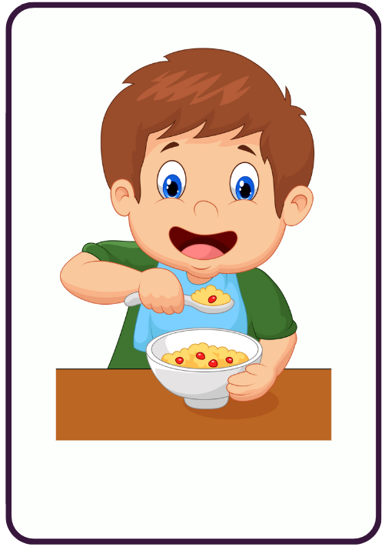
Faccio colazione.
Notes:
Faccio colazione = I have breakfast.

Slide 7
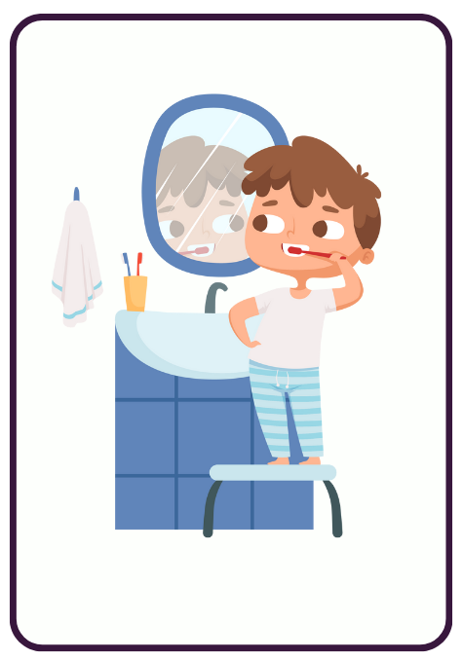
Mi lavo i denti.
Notes:
Mi lavo i denti = I brush my teeth.

Slide 8
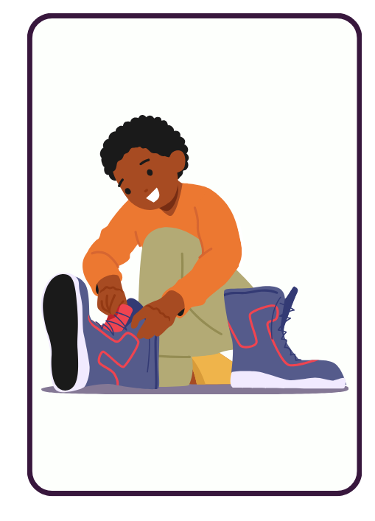
Mi preparo.
Notes:
Mi preparo = I get ready (I prepare myself).

Slide 9
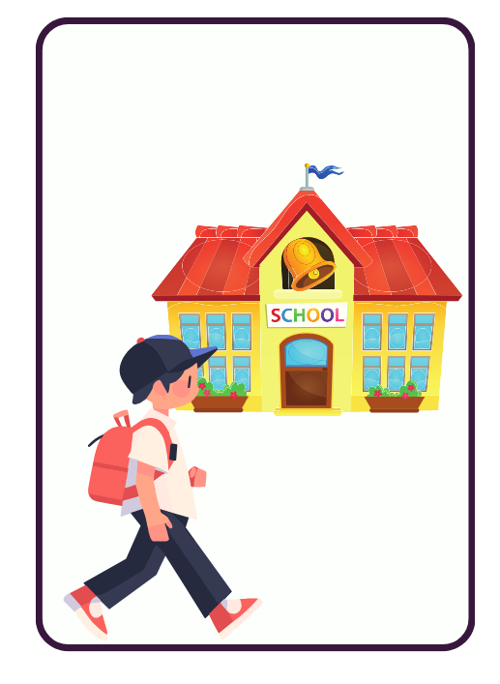
Vado a scuola.
Notes:
Vado a scuola = I go to school.

Slide 10
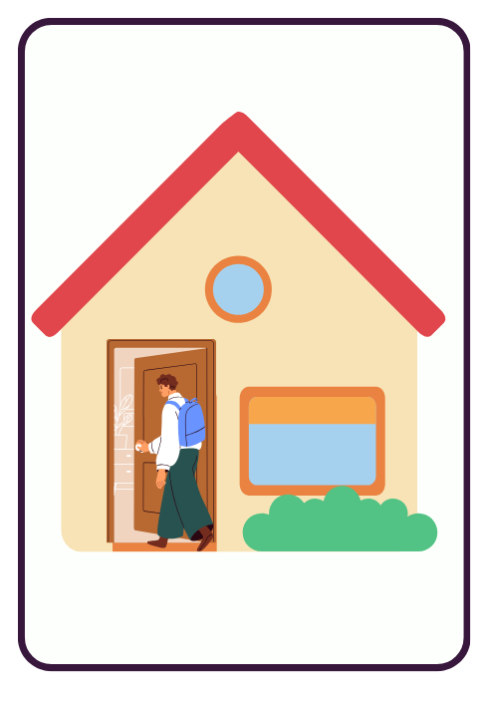
Torno a casa.
Notes:
Torno a casa = I return home.

Slide 11
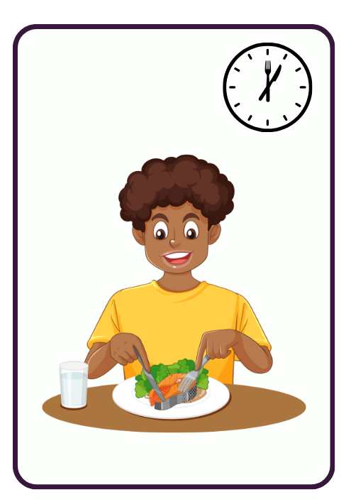
Pranzo.
Notes:
Pranzo = I have lunch.

Slide 12
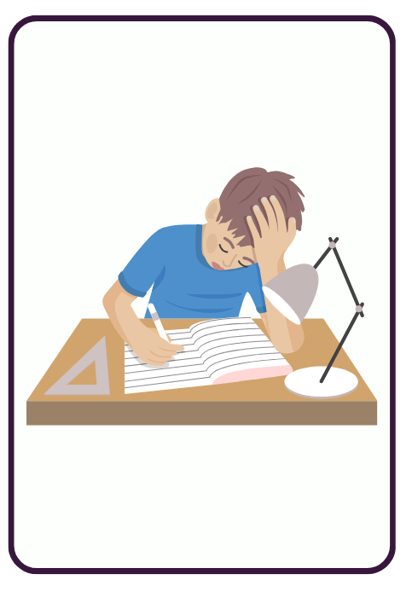
Faccio i compiti.
Notes:
Faccio i compiti = I do my homework.

Slide 13
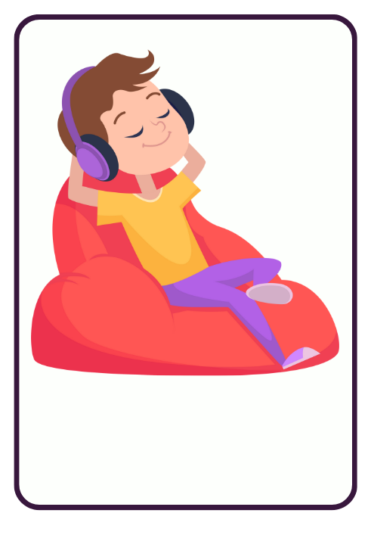
Mi riposo.
Notes:
Mi riposo = I have a rest (I rest myself).

Slide 14
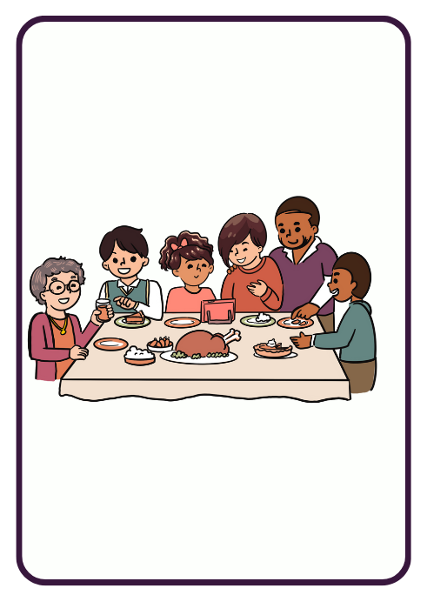
Ceno con la famiglia.
Notes:
Ceno con la famiglia = I have dinner with my family.

Slide 15
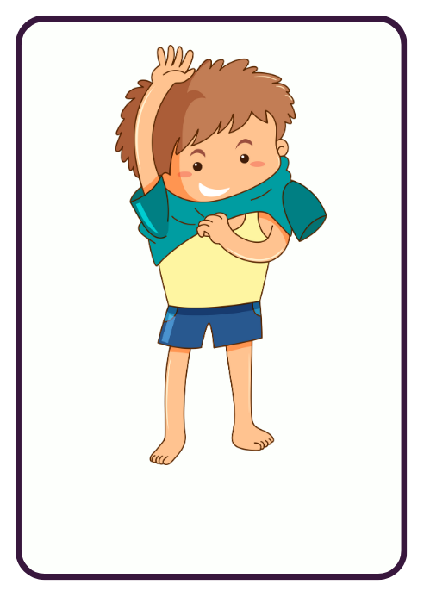
Mi spoglio.
Notes:
Mi spoglio = I get undressed (I undress myself).

Slide 16
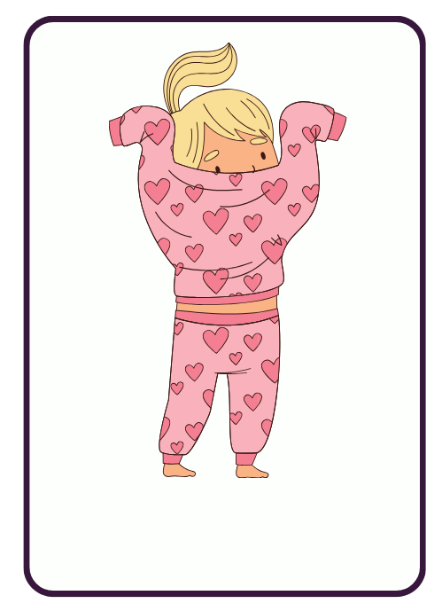
Mi metto il pigiama.
Notes:
Mi metto il pigiama = I put on my pyjamas.

Slide 17
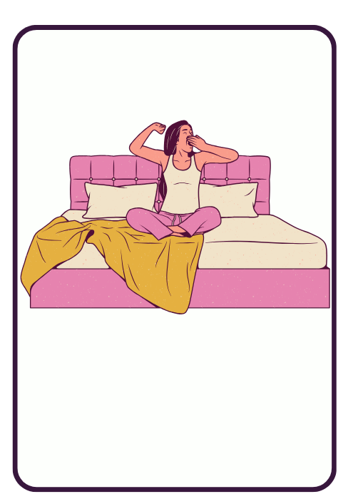
Vado a letto.
Notes:
Vado a letto = I go to bed.

Slide 18
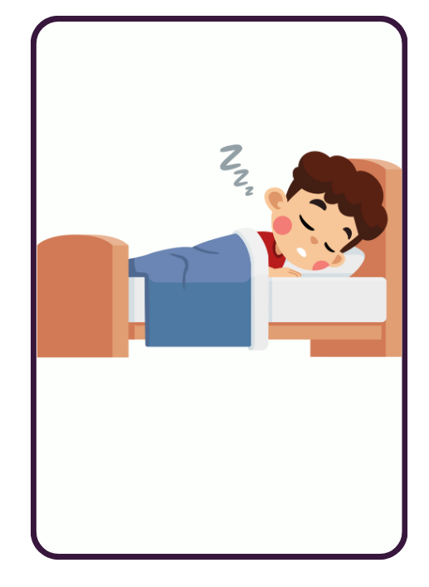
Mi addormento.
Notes:
Mi addormento = I go to sleep.
Teacher notes:
Move to the next slide for a summary of present tense daily routine verbs in the first person.

Slide 19
Daily routine verbs in the first person
Mi sveglio
Mi alzo
Faccio la doccia
Mi vesto
Faccio colazione
Mi lavo i denti
Mi preparo
Vado a scuola
Torno a casa
Pranzo
Faccio i compiti
Mi riposo
Ceno con la famiglia
Mi spoglio
Mi metto il pigiama
Vado a letto
Mi addormento

Slide 20
Activity
Notes:
Teacher notes:
Use the number cards provided with the unit to choose a student to provide the Italian sentence to match each slide.

Slide 21
Question 1
Cosa fai?
Mi sveglio.
Notes:
Teacher notes:
Click to reveal.

Slide 22
Question 2
Cosa fai?
Mi alzo.
Notes:
Teacher notes:
Click to reveal.

Slide 23
Question 3
Cosa fai?
Faccio la doccia.
Notes:
Teacher notes:
Click to reveal.

Slide 24
Question 4
Cosa fai?
Mi vesto.
Notes:
Teacher notes:
Click to reveal.

Slide 25
Question 5
Cosa fai?
Faccio colazione.
Notes:
Teacher notes:
Click to reveal.

Slide 26
Question 6
Cosa fai?
Mi lavo i denti.
Notes:
Teacher notes:
Click to reveal.

Slide 27
Question 7
Cosa fai?
Mi preparo.
Notes:
Teacher notes:
Click to reveal.

Slide 28
Question 8
Cosa fai?
Vado a scuola.
Notes:
Teacher notes:
Click to reveal.

Slide 29
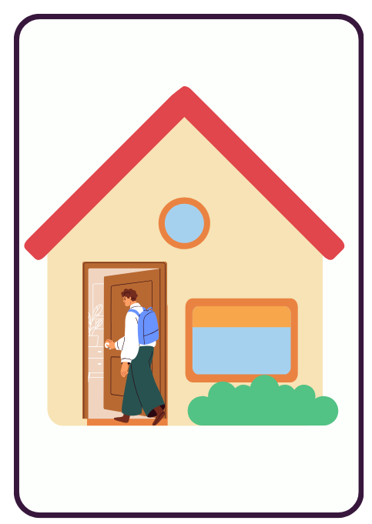
Question 9
Cosa fai?
Torno a casa.
Notes:
Teacher notes:
Click to reveal.

Slide 30
Question 10
Cosa fai?
Pranzo.
Notes:
Teacher notes:
Click to reveal.

Slide 31
Question 11
Cosa fai?
Faccio i compiti.
Notes:
Teacher notes:
Click to reveal.

Slide 32
Question 12
Cosa fai?
Mi riposo.
Notes:
Teacher notes:
Click to reveal.

Slide 33
Question 13
Cosa fai?
Ceno con la famiglia.
Notes:
Teacher notes:
Click to reveal.

Slide 34
Question 14
Cosa fai?
Mi spoglio.
Notes:
Teacher notes:
Click to reveal.

Slide 35
Question 15
Cosa fai?
Mi metto il pigiama.
Notes:
Teacher notes:
Click to reveal.

Slide 36
Question 16
Cosa fai?
Vado a letto.
Notes:
Teacher notes:
Click to reveal.

Slide 37
Question 17
Cosa fai?
Mi addormento.
Notes:
Teacher notes:
Click to reveal.

Slide 38
The negative form

Slide 39

Using non and non…mai
Use non to say what you do not do.
Mi lavo i denti → Non mi lavo i denti.
Use non… mai to say what you never do.
Mi lavo i denti → Non mi lavo mai i denti.
Notes:
Teacher notes:
Point out to students the placement of non (always before the verb) and non…mai (around the reflexive structure) in the sentence.
Practise this structure in the following slides.
Each slide will have the sentence in the first person. Use the number cards provided with the unit to choose a student to give the negative form of each sentence.

Slide 40
Sentence 1
Mi sveglio alle sette.
Non mi sveglio alle sette.
Non mi sveglio mai alle sette.
Notes:
Teacher notes:
CLICK TO REVEAL
Non mi sveglio alle sette.
Non mi sveglio mai alle sette.

Slide 41
Sentence 2
Faccio colazione alle sette e mezza.
Non faccio colazione alle sette e mezza.
Non faccio mai colazione alle sette e mezza.
Notes:
Teacher notes:
CLICK TO REVEAL
Non faccio colazione alle sette e mezza.
Non faccio mai colazione alle sette e mezza.

Slide 42
Sentence 3
Faccio la doccia la mattina.
Non faccio la doccia la mattina.
Non faccio mai la doccia la mattina.
Notes:
Teacher notes:
CLICK TO REVEAL
Non faccio la doccia la mattina.
Non faccio mai la doccia la mattina.

Slide 43
Sentence 4
Mi lavo i denti dopo colazione.
Non mi lavo i denti dopo colazione.
Non mi lavo mai i denti dopo colazione.
Notes:
Teacher notes:
CLICK TO REVEAL
Non mi lavo i denti dopo colazione.
Non mi lavo mai i denti dopo colazione.

Slide 44
Sentence 5
Faccio i compiti.
Non faccio i compiti.
Non faccio mai i compiti.
Notes:
Teacher notes:
CLICK TO REVEAL
Non faccio i compiti.
Non faccio mai i compiti.

Slide 45
Copyright
© State of New South Wales (Department of Education), 2024
The copyright material published in this resource is subject to the Copyright Act 1968 (Cth) and is owned by the NSW Department of Education or, where indicated, by a party other than the NSW Department of Education (third-party material).
Copyright material available in this resource and owned by the NSW Department of Education is licensed under a Creative Commons Attribution 4.0 International (CC BY 4.0) license.
This license allows you to share and adapt the material for any purpose, even commercially.
Attribution should be given to © State of New South Wales (Department of Education), 2024.
Material in this resource not available under a Creative Commons license:
the NSW Department of Education logo, other logos and trademark-protected material
Material owned by a third party that has been reproduced with permission. You will need to obtain permission from the third party to reuse its material.
Links to third-party material and websites
Please note that the provided (reading/viewing material/list/links/texts) are a suggestion only and implies no endorsement, by the New South Wales Department of Education, of any author, publisher, or book title. School principals and teachers are best placed to assess the suitability of resources that would complement the curriculum and reflect the needs and interests of their students.
If you use the links provided in this document to access a third-party’s website, you acknowledge that the terms of use, including licence terms set out on the third-party’s website apply to the use which may be made of the materials on that third-party website or where permitted by the Copyright Act 1968 (Cth). The department accepts no responsibility for content on third-party websites.

