Slide 1
Τι ώρα είναι;
What time is it? – times on the hour and past the hour
Notes:
Teacher notes:
Use these slides to revise time on the hour and introduce the phrases for expressing past the hour: και [number of minutes], και τέταρτο and και μισή.

Slide 2

Τι ώρα είναι; (1 of 16)
What time is it?
Είναι μία η ώρα.

Slide 3

Τι ώρα είναι; (2 of 16)
What time is it?
Είναι δύο η ώρα.

Slide 4
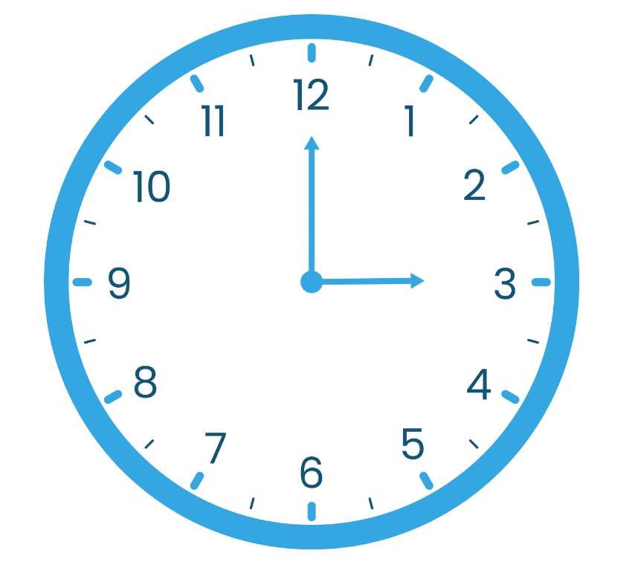
Τι ώρα είναι; (3 of 16)
What time is it?
Είναι τρεις η ώρα.

Slide 5

Τι ώρα είναι; (4 of 16)
What time is it?
Είναι τέσσερις η ώρα.

Slide 6
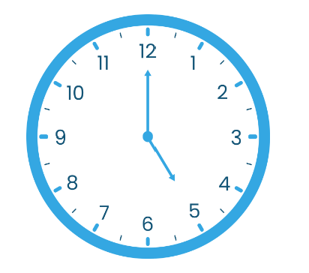
Τι ώρα είναι; (5 of 16)
What time is it?
Είναι πέντε η ώρα.

Slide 7

Τι ώρα είναι; (6 of 16)
What time is it?
Είναι έξι η ώρα.

Slide 8

Τι ώρα είναι; (7 of 16)
What time is it?
Είναι επτά η ώρα.

Slide 9
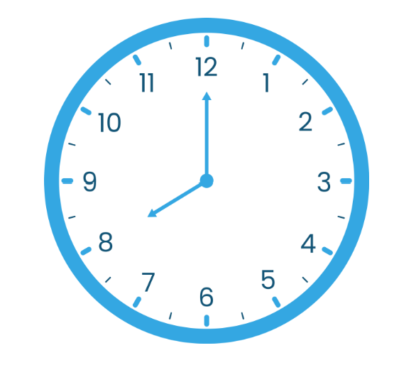
Τι ώρα είναι; (8 of 16)
What time is it?
Είναι οκτώ η ώρα.

Slide 10

Τι ώρα είναι; (9 of 16)
What time is it?
Είναι εννέα/εννιά η ώρα.

Slide 11

Τι ώρα είναι; (10 of 16)
What time is it?
Είναι δέκα η ώρα.

Slide 12

Τι ώρα είναι; (11 of 16)
What time is it?
Είναι έντεκα η ώρα.

Slide 13

Τι ώρα είναι; (12 of 16)
What time is it?
Είναι δώδεκα η ώρα.

Slide 14

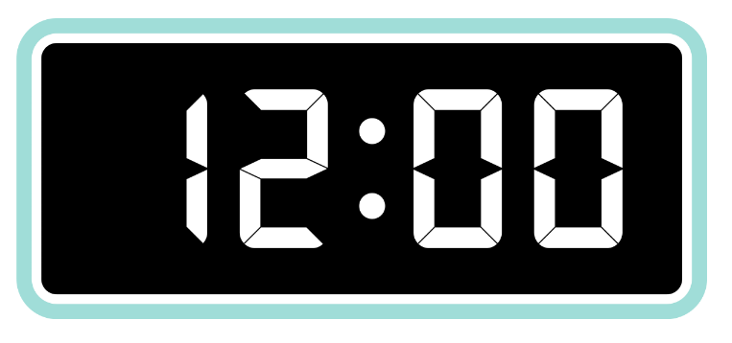

Τι ώρα είναι; (13 of 16)
What time is it?
Είναι μεσημέρι.
Είναι μεσάνυχτα.

Slide 15

Τι ώρα είναι; (14 of 16)
What time is it?
2:05 Είναι δύο και πέντε
2:07 Είναι δύο και επτά
2:08 Είναι δύο και οχτώ
3:10 Είναι τρεις και δέκα
3:15 Είναι τρεις και δεκαπέντε/τέταρτο​
4:20 Είναι τέσσερις και είκοσι
4:25 Είναι τέσσερις και είκοσι πέντε​

Slide 16

Τι ώρα είναι; (15 of 16)
Είναι δύο και τέταρτο ​
Είναι δυο και δεκαπέντε

Slide 17

Τι ώρα είναι; (16 of 16)
Είναι επτά και τριάντα​.
Είναι επτά και μισή​.

Slide 18
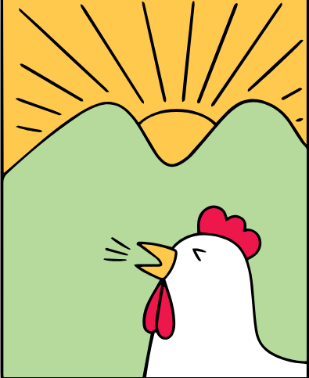



Moments of the day
το πρωί
το απόγευμα
το βράδυ
τη νύχτα
Notes:
Teacher notes:
Consider using this slide for high potential and gifted students.

Slide 19
Copyright
© State of New South Wales (Department of Education), 2025
The copyright material published in this resource is subject to the Copyright Act 1968 (Cth) and is owned by the NSW Department of Education or, where indicated, by a party other than the NSW Department of Education (third-party material).
Copyright material available in this resource and owned by the NSW Department of Education is licensed under a Creative Commons Attribution 4.0 International (CC BY 4.0) license.
This licence allows you to share and adapt the material for any purpose, even commercially.
Attribution should be given to © State of New South Wales (Department of Education), 2025.
Material in this resource not available under a Creative Commons license:
the NSW Department of Education logo, other logos and trademark-protected material
Material owned by a third party that has been reproduced with permission. You will need to obtain permission from the third party to reuse its material.
Links to third-party material and websites
Please note that the provided (reading/viewing material/list/links/texts) are a suggestion only and implies no endorsement, by the New South Wales Department of Education, of any author, publisher, or book title. School principals and teachers are best placed to assess the suitability of resources that would complement the curriculum and reflect the needs and interests of their students.
If you use the links provided in this document to access a third party’s website, you acknowledge that the terms of use, including license terms set out on the third-party’s website apply to the use which may be made of the materials on that third-party website or where permitted by the Copyright Act 1968 (Cth). The department accepts no responsibility for content on third-party websites.

