Slide 1
Schooling in Greece – Το σχολείο στην Ελλάδα

Slide 2
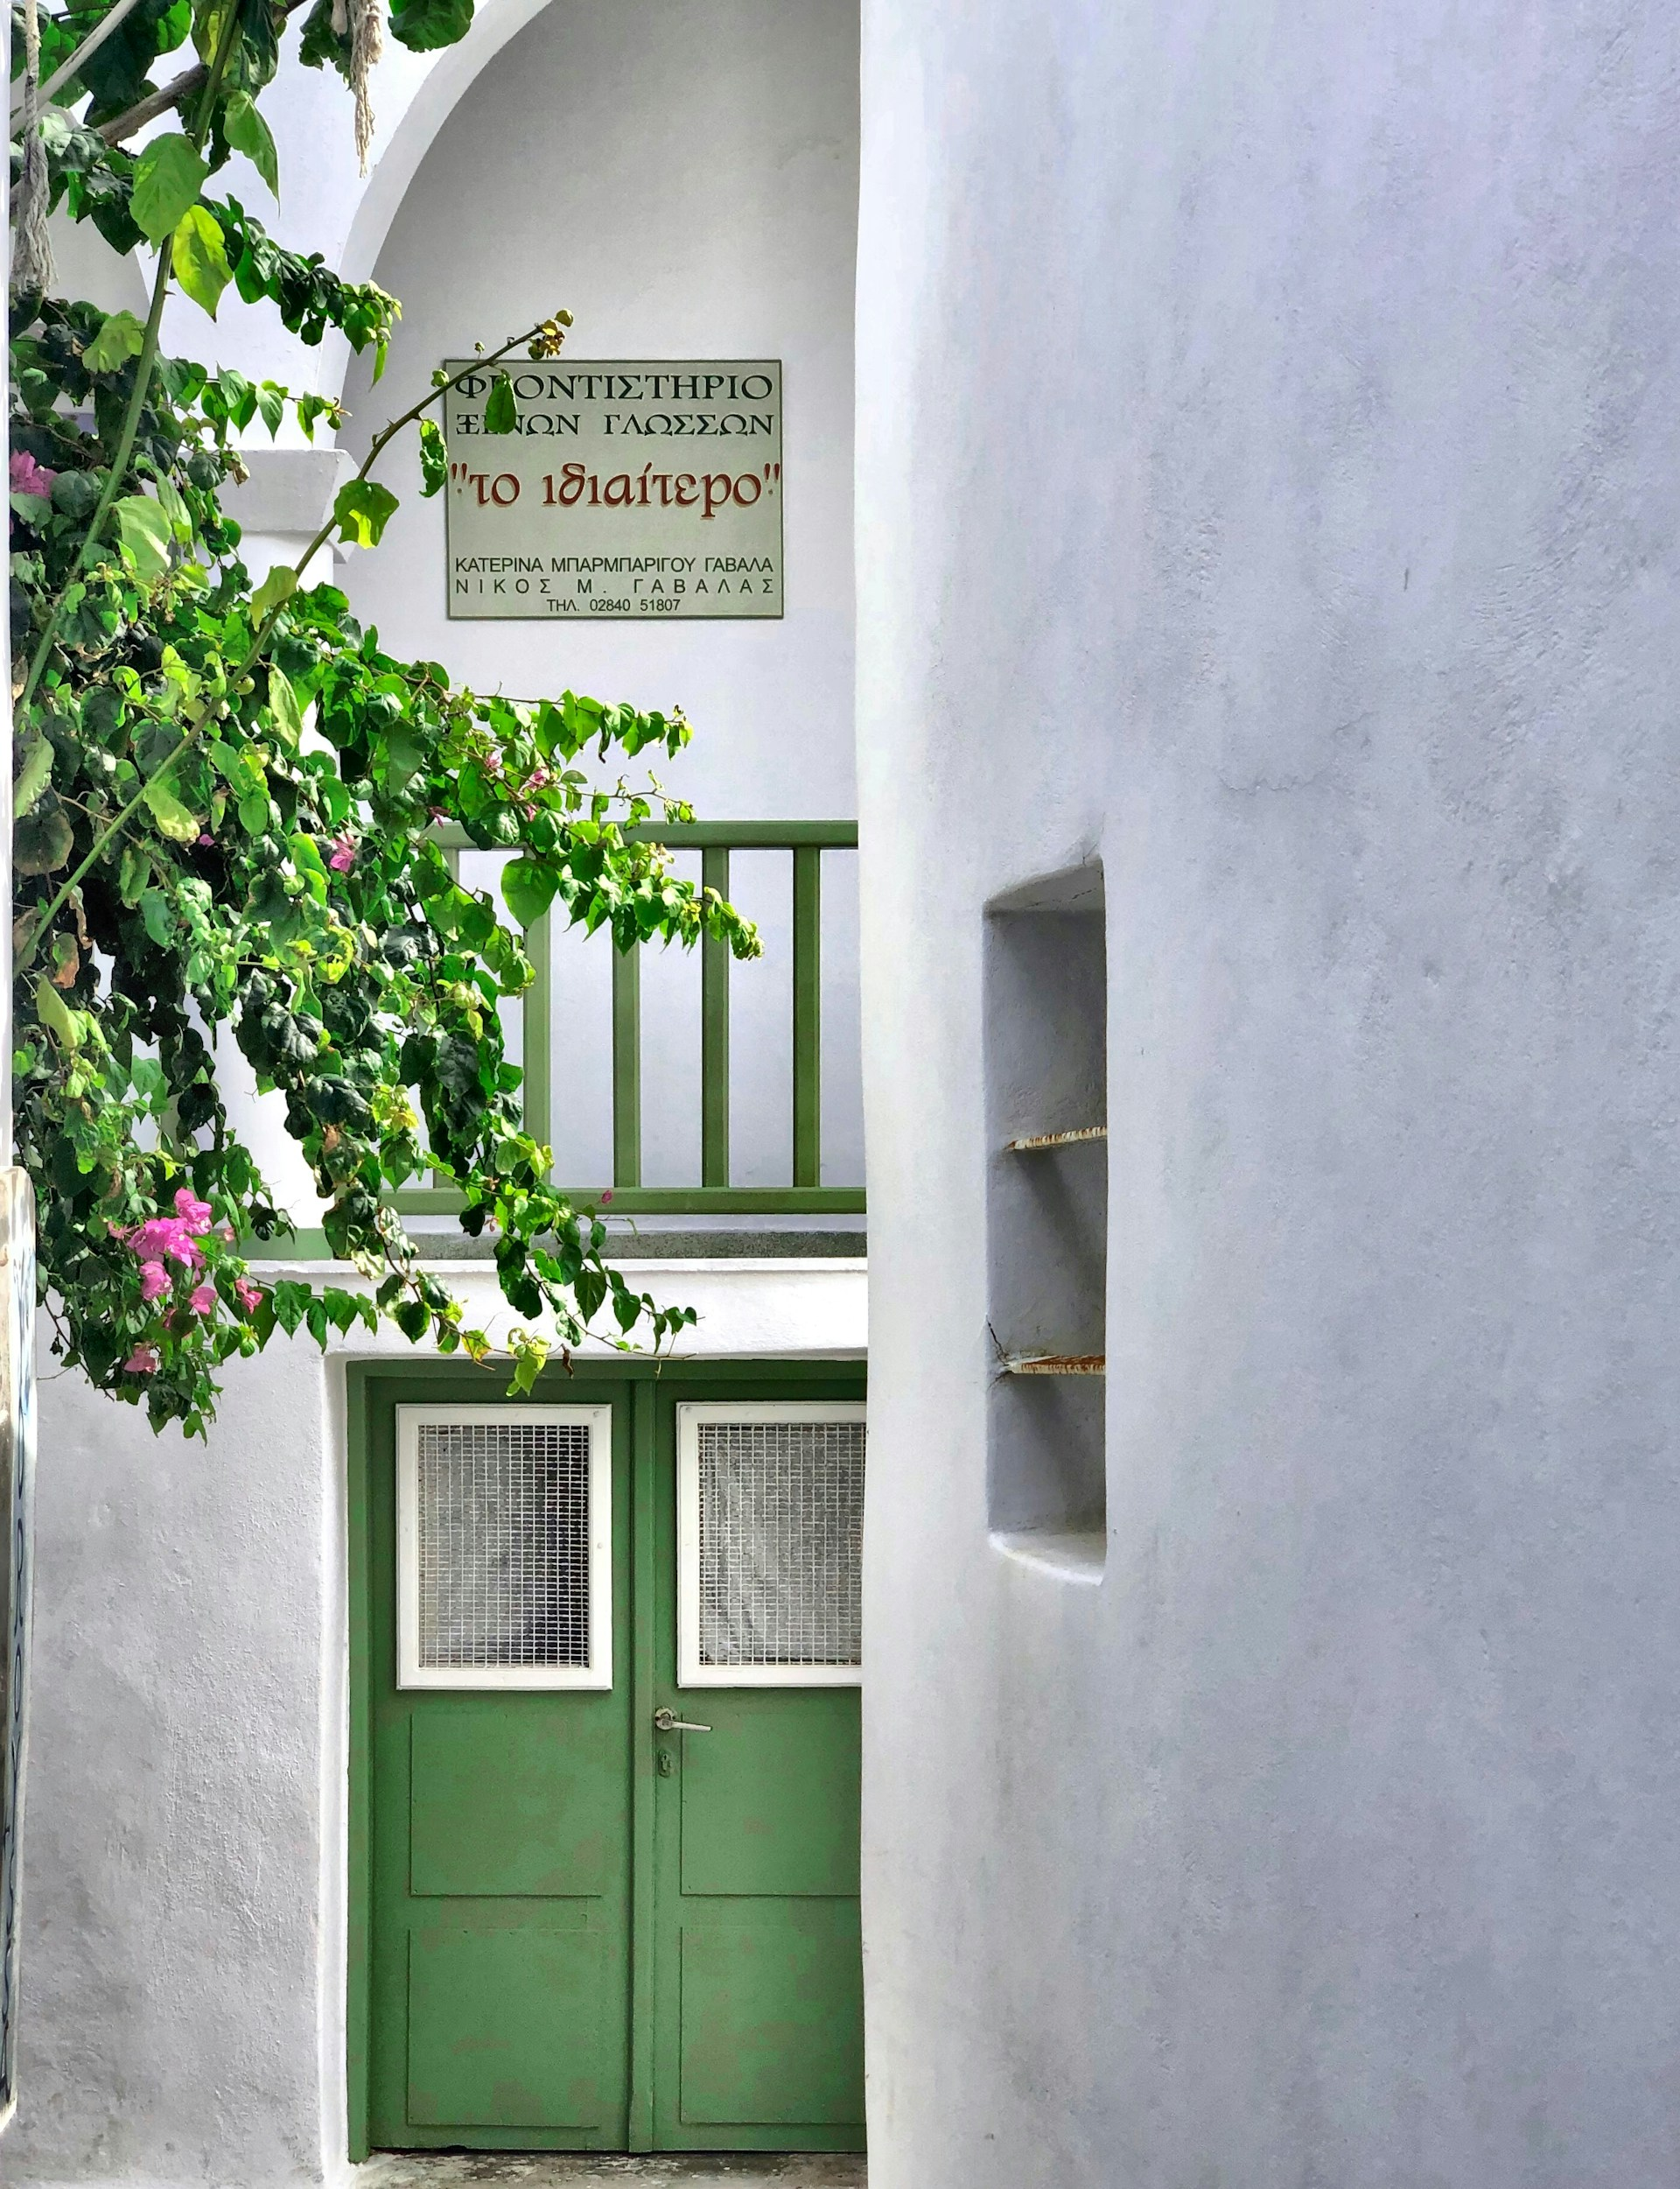
School levels
Preschool (Νηπιαγωγείο) – ages 4 to 6
Formal education in Greece has 3 different stages:
Primary school (Δημοτικό) – ages 6 to 11 (1st to 6th grade)
Middle school (Γυμνάσιο) – ages 12 to 14 (7th to 9th grade)
High school (Λύκειο) – ages 15 to 17 (10th to 12th grade)
Universities and technical education institutes provide post-school education.
Education in Greece is compulsory for children ages 6 to 15.
Photo by Depina Galani on Unsplash

Slide 3
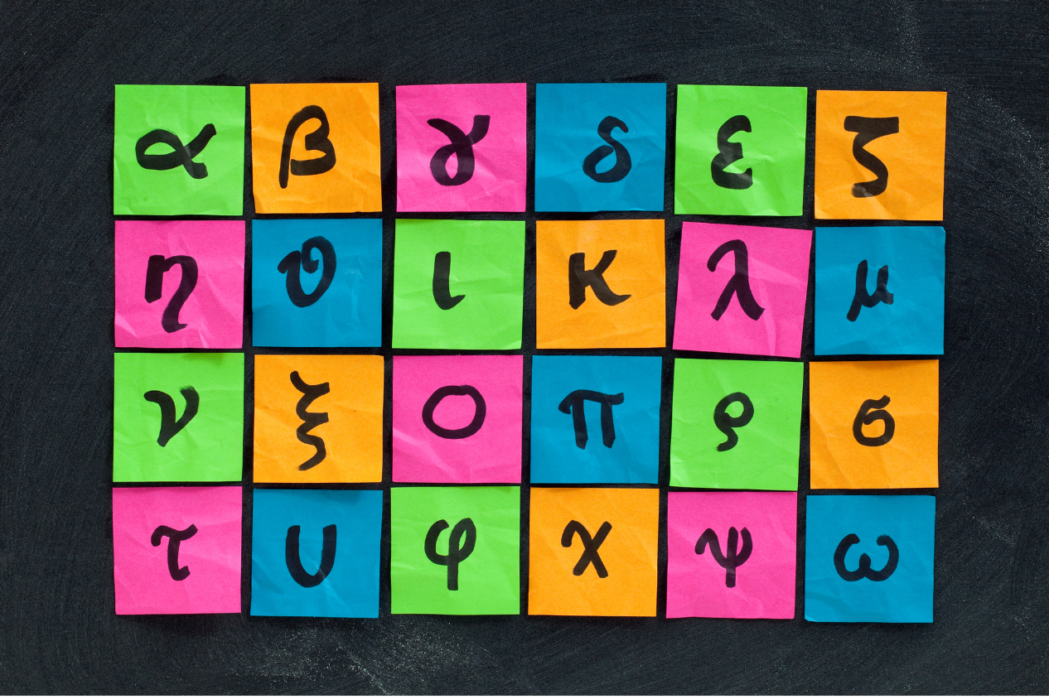
School subjects
In primary school, students learn core subjects such as mathematics, science, social studies and languages.
In middle school, students learn subjects like modern Greek, ancient Greek, mathematics, science (physics, chemistry, biology), history, English, social studies, music, art, PE, technology and a foreign language (French, German or Italian).
In high school, students can choose between academic subjects, which prepare them for university, or vocational subjects which prepare them for the workforce.

Slide 4
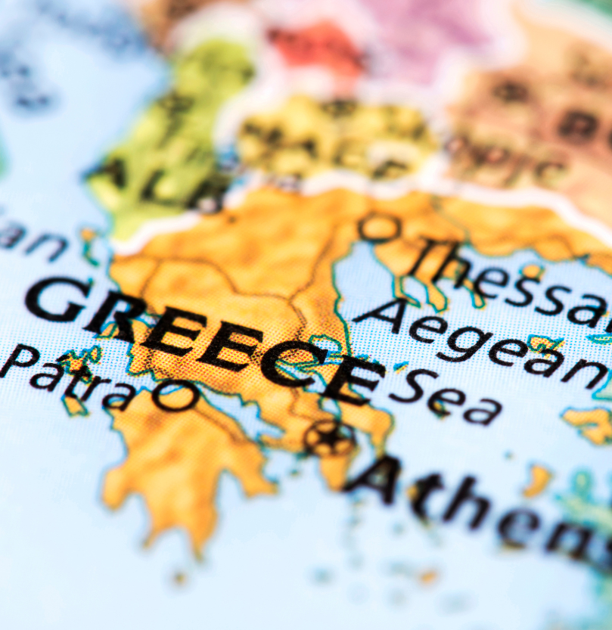
Daily school structure
Primary schools (Δημοτικό) typically start around 8:15 am and finish around 1:15 pm.
Middle and high schools (Γυμνάσιο and Λύκειο) typically start at 8:00 am and finish between 2 pm and 2:30 pm, depending on the grade and school.
Extra-curricular activities in high schools are offered, for example, art, sport and cultural programs.

Slide 5
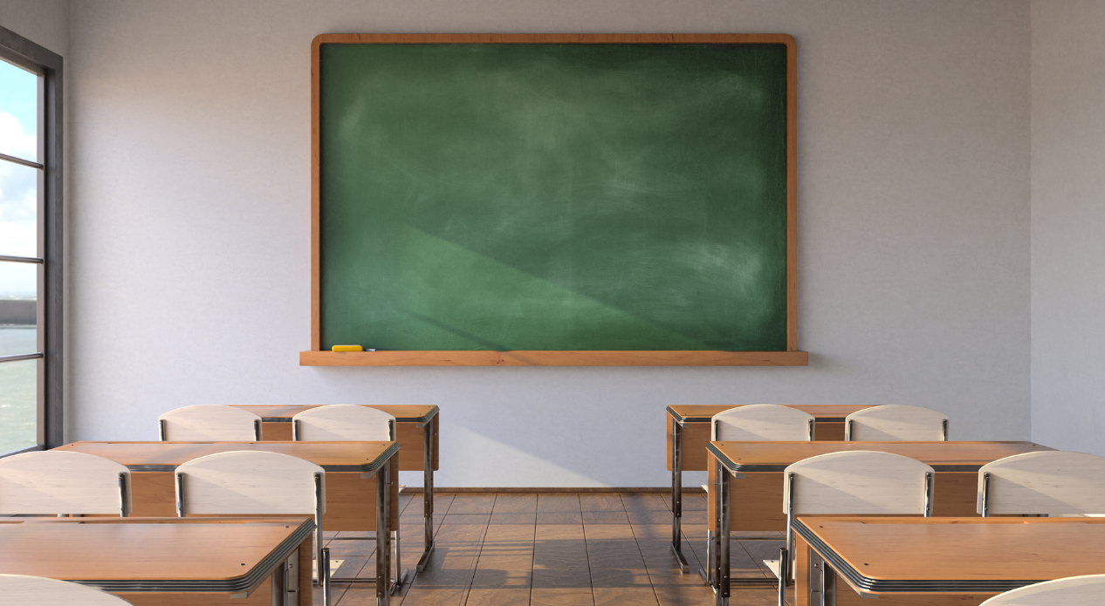
Interesting facts
The government provides a national curriculum that schools follow.
Religious classes are mandatory unless parents/carers fill out an exemption form.
Students are not permitted to use mobile phones while at school.
School holidays include Christmas, Greek Independence Day, Easter, National Anniversary Day, a 3-month summer holiday, national public holidays and local holidays.

Slide 6
Γυμνάσιο timetable
Time | Monday | Tuesday | Wednesday | Thursday | Friday
8:00-8:15 | Assembly | Assembly | Assembly | Assembly | Assembly
8:15-9:00 | Modern Greek | Mathematics | Modern Greek | Mathematics | Modern Greek
9:00-9:15 | Break | Break | Break | Break | Break
9:15-10:00 | Ancient Greek | Physics | Ancient Greek | Physics | History
10:00-10:15 | Break | Break | Break | Break | Break
10:15-11:00 | History | Chemistry | History | Chemistry | English
11:00-11:15 | Break | Break | Break | Break | Break
11:15-12:00 | English | Biology | English | Biology | Social studies
12:00-12:15 | Break | Break | Break | Break | Break
12:15-1:00 | Social studies | Music | Social studies | Music | PE
1:00-1:15 | Break | Break | Break | Break | Break
1:15-2:00 | Second foreign language | Art | Second foreign language | Art | Second foreign language
Notes:
Teacher notes:
Here is a typical timetable for middle school (Γυμνάσιο) to discuss with students.

Slide 7
See, Think, Wonder
After reading these slides and watching the video, think about your answers to the questions below.
See: What did you see or notice about schooling in Greece?
Think: What do you think you would find most interesting if you went to school in Greece?
Wonder: What do you wonder would be different or challenging for you if you went to school in Greece?
Write your answers down and then share in a class discussion.
Notes:
Teacher notes:
After displaying and discussing the slides, and watching the video (What is the public school system like in Greece? https://www.youtube.com/watch?v=iBytpEKFX9Y), students complete a See, Think, Wonder activity. Ask students to think about their answers to the 3 questions. Students can write their responses in their books, or the teacher can use an online tool such as Mentimeter to collect and display responses. If students require additional prompting, use the sample questions below to assist them.
See: What did you see or notice about schooling in Greece? Did you see anything interesting? What did you see that was similar to school in Australia? What did you see that was different to school in Australia?
Think: What do you think about school in Greece? Do you think it would be enjoyable?
Wonder: What do the slides/video make you wonder about school in Greece? What questions do you have about school in Greece?
Provide the opportunity for students to share and compare their responses in a class discussion.

Slide 8
Copyright
© State of New South Wales (Department of Education), 2025
The copyright material published in this resource is subject to the Copyright Act 1968 (Cth) and is owned by the NSW Department of Education or, where indicated, by a party other than the NSW Department of Education (third-party material).
Copyright material available in this resource and owned by the NSW Department of Education is licensed under a Creative Commons Attribution 4.0 International (CC BY 4.0) licence.
This licence allows you to share and adapt the material for any purpose, even commercially.
Attribution should be given to © State of New South Wales (Department of Education), 2025.
Material in this resource not available under a Creative Commons licence:
the NSW Department of Education logo, other logos and trademark-protected material
Material owned by a third party that has been reproduced with permission. You will need to obtain permission from the third party to reuse its material.
Links to third-party material and websites
Please note that the provided (reading/viewing material/list/links/texts) are a suggestion only and implies no endorsement, by the New South Wales Department of Education, of any author, publisher, or book title. School principals and teachers are best placed to assess the suitability of resources that would complement the curriculum and reflect the needs and interests of their students.
If you use the links provided in this document to access a third party’s website, you acknowledge that the terms of use, including licence terms set out on the third-party’s website apply to the use which may be made of the materials on that third-party website or where permitted by the Copyright Act 1968 (Cth). The department accepts no responsibility for content on third-party websites.
Notes:
Slide not shared

