Slide 1
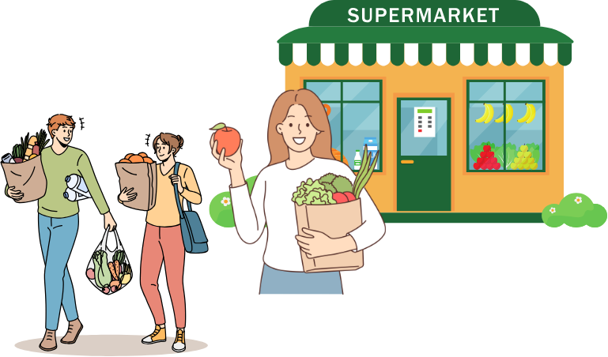
Shopping expressions
한국의 시장 문화
Stage 4 – Korean

Slide 2

Asking for a discount
깎아주세요!
When it comes to shopping at a Korean market, you can always test your luck for a better price!
You could say:
(조금) 깎아주세요!
(jo geum) gga-ga ju-se-yo!
Please give me a (bit of) discount!
Or, you could offer a price by saying:
[price]에 해주세요.
[price]e hae-ju-se-yo.
Please do [price].

Slide 3
Making an offer
[price] 해주세요.
₩1,500?
₩4,200?
₩3,500?
₩2,800?
₩900?
1,500 해주세요. Or 천 오백 해주세요.
4,200 해주세요. Or 사천 이백 해주세요.
3,500 해주세요. Or 삼천 오백 해주세요.
2,800 해주세요 . Or 이천 팔백 해주세요.
900 해주세요 . Or 구백 해주세요.
Notes:
Use the price on the slide to allow students to practise making an offer. CLICK to reveal the correct answers.

Slide 4
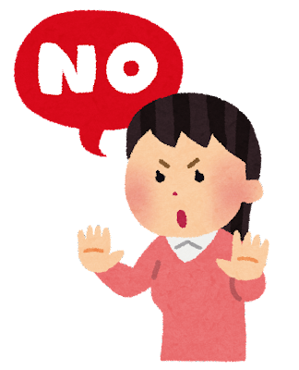
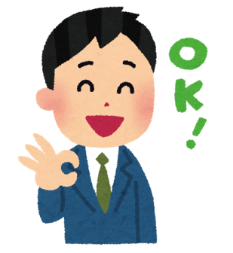
Accepting or rejecting a price
알겠어요!
The shopkeeper could accept the offer by saying:
Or the shopkeeper could reject the offer by saying:
알겠어요. [Price] 돼요.
al-ge-sseo-yo. [Price] dwae yo.
Okay. I can do [price].
[price] 안돼요.
[price] an-dwae-yo.
I can’t do [price].

Slide 5
I can/I can’t
돼요/안돼요.
₩1,500? ✔️
₩4,200? ❌
₩3,500? ❌
₩2,800? ✔️
₩900? ✔️
1,500원 돼요. Or 천오백 원 돼요.
4,200원 안 돼요. Or 사천 이백원 안 돼요.
3,500원 안 돼요. Or 삼천오백 원 안 돼요.
2,800원 돼요. Or 이천팔백 원 돼요.
900원 돼요. Or 구백 원 돼요.
Notes:
Use the cues on the slide to allow students to practise accepting or rejecting the offer. CLICK to reveal the correct answers.

Slide 6

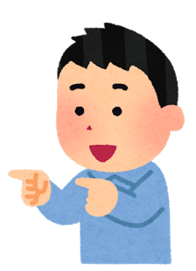
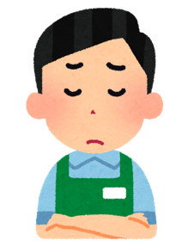
Tip 1 – be direct
깎아 주세요!
Tip 1 – be direct
이것은 얼마예요?
식혜는 3,500원 이에요.
비싸요. 깎아 주세요!
안돼요.
Notes:
When haggling there are some tips to follow.
Read the conversation on the slide.
What is the item being discussed? (Shikhye)
What does the customer say about the price? (Too expensive)
Does the shopkeeper agree to a discount? (No)

Slide 7
Tip 2 – offer a price
[price] 해주세요
Tip 2 – offer a price
이것은 얼마예요?
식혜는 3,500원 이에요.
비싸요. 2,500원 해주세요!
음… 너무 싸요.
Notes:
Why doesn’t the shopkeeper accept this offer?

Slide 8

Tip 3 – limit your budget
[amount] 없어요.
Tip 3 – limit your budget
이것은 얼마예요?
식혜는 3,500원 이에요.
3,500원… 없어요. 2,500원 돼요?
아… 알겠어요.
Notes:
Does the shopkeeper accept this offer? (yes)
What phrase does he use? (Ah, OK)
What do you think 아 means? (Oh/ah)

Slide 9

Copyright
© State of New South Wales (Department of Education), 2024
The copyright material published in this resource is subject to the Copyright Act 1968 (Cth) and is owned by the NSW Department of Education or, where indicated, by a party other than the NSW Department of Education (third-party material).
Copyright material available in this resource and owned by the NSW Department of Education is licensed under a Creative Commons Attribution 4.0 International (CC BY 4.0) license.
This license allows you to share and adapt the material for any purpose, even commercially.
Attribution should be given to © State of New South Wales (Department of Education), 2024.
Material in this resource not available under a Creative Commons license:
the NSW Department of Education logo, other logos and trademark-protected material
material owned by a third party that has been reproduced with permission. You will need to obtain permission from the third party to reuse its material.
Links to third-party material and websites
Please note that the provided (reading/viewing material/list/links/texts) are a suggestion only and implies no endorsement, by the New South Wales Department of Education, of any author, publisher, or book title. School principals and teachers are best placed to assess the suitability of resources that would complement the curriculum and reflect the needs and interests of their students.
If you use the links provided in this document to access a third-party's website, you acknowledge that the terms of use, including licence terms set out on the third-party's website apply to the use which may be made of the materials on that third-party website or where permitted by the Copyright Act 1968 (Cth). The department accepts no responsibility for content on third-party websites.
Notes:
Slide not shared

