Slide 1
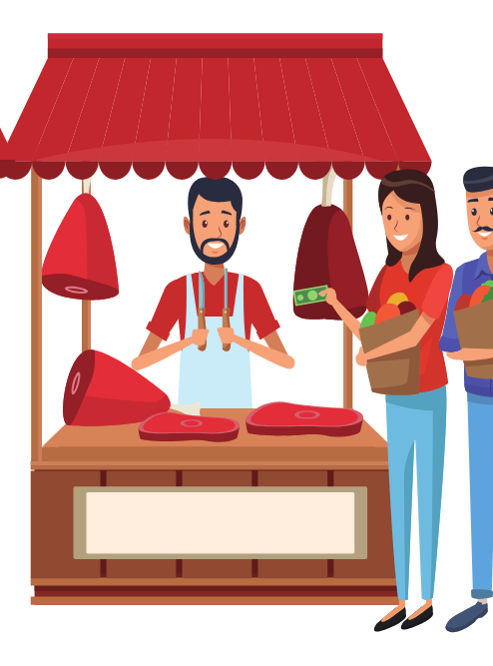
Asking the price
얼마예요?
Stage 4 – Korean

Slide 2
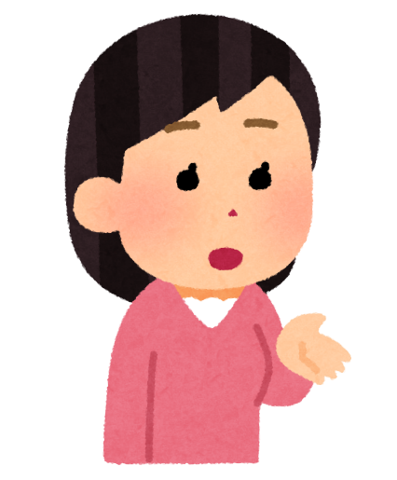
Asking how much something is
얼마예요?
To ask how much something is, you can use the general question:
얼마예요?
(eol-ma-e-yo?)

Slide 3
How much is [item]?
[item] 은/는 얼마예요?
To ask how much a specific item is, use the structure:
[item]은/는 얼마예요?
([item] eun/neun eol-ma-e-yo?)

Slide 4
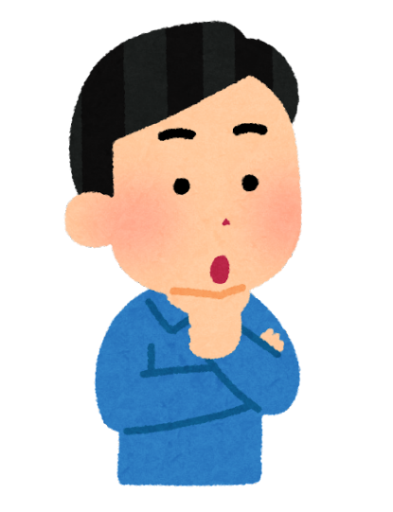


Topic particle neun
는
Identify the topic particle in the question:
토마토는 얼마예요?
Notes:
Identify the topic marker that follows the word 토마토.

Slide 5

Topic particle eun
은
Identify the topic particle in the question:
수박은 얼마예요?
Notes:
Identify the topic marker that follows the word 수박.

Slide 6
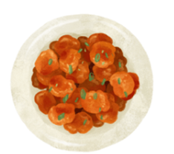


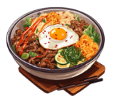
Topic particle practice
Identify the correct topic particle
Complete the question with the correct food or drink and topic particle.
치킨
은
얼마예요?
바나나
는
얼마예요?
콜라
는
얼마예요?
비빔밥
은
얼마예요?
Notes:
Click to reveal the food or drink and the topic marker for each question.

Slide 7
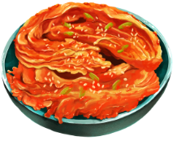
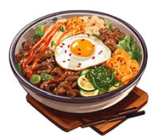

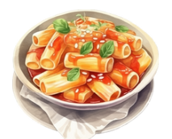
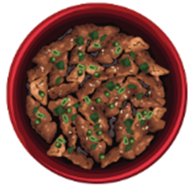
Now, it’s your turn!
~원이에요?
Ask how much each item on the slide costs.
김치는 얼마예요?
비빔밥은 얼마예요?
라면은 얼마예요?
떡볶이는 얼마예요?
불고기는 얼마예요?
Notes:
Click to reveal the correct responses.

Slide 8
Answering the question
~원이에요?
토마토는 얼마예요?
토마토는 천 원이에요.
Notes:
How much are the tomatoes?

Slide 9
Answering the question (2)
~원이에요?
수박는 얼마예요?
수박는 삼천 원이에요.
Notes:
How much is the watermelon?

Slide 10

Answering the question (3)
~원이에요?
딸기는 얼마예요?
딸기는 오백 원이에요.
Notes:
How much are the strawberries?

Slide 11







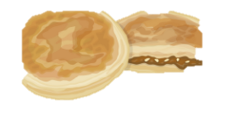


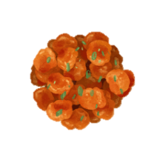
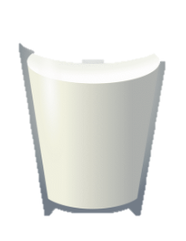

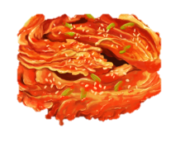

Let’s keep practising!
Asking how much something is
Use the items below to practise asking and saying how much each item costs.
1
₩ 31,000
6
₩ 6,000
11
₩ 2,000
2
₩ 16,000
7
₩ 3,000
12
₩ 2,500
₩ 9,800
₩ 2,000
₩ 4,000
3
8
13
₩ 2,700
₩ 15,000
₩ 2,300
4
9
14
₩ 9,900
₩ 1,000
5
₩ 2,900
10
15
Notes:
Students practise writing the question ~원이에요? and answer ~은/는 [price] 원이에요 in their book.
수박은 얼마예요? How much is the watermelon (subak)? 삼만 천 원이에요. Its sam-man-cheon-won.
감은 얼마예요? How much is the persimmon (gam)? 만 육천 원이에요. It’s man-yook-cheon-won.
오렌지는 얼마예요? How much is the orange (orenji)? 구천팔백 원이에요. It’s gu-cheon-pal-baek-won.
상추는 얼마예요? How much is the lettuce (sangchu)? 이천칠백 원이에요. It’s e-cheon-chil-baek-won.
피망은 얼마예요? How much is the capsicum (pimang)? 이 천구백 원이에요. It’s e-cheon-gu-baek-won.
비빔밥은 얼마예요? How much is the bibimbap? 육 천 원이에요. It’s yuk-cheon-won.
라면은 얼마예요? How much is the noodle (ramyeon)? 삼 천 원이에요. It’s sam-cheon-won.
호떡은 얼마예요? How much is the hoddeok? 이 천 원이에요. Its e-cheon-won.
치킨은 얼마예요? How much is the chicken (chikin)? 만 오 천 원이에요. It’s man-o-cheon-won.
김치는 얼마예요? How much is the kimchi? 구천 원이에요. It’s gu-cheon-won.
차는 얼마예요? How much is the tea (cha)? 이 천 원이에요. It’s e-cheon-won.
식혜는 얼마예요? How much is the sweet rice drink (shikhye)? 이천오백 원이에요. It’s e-cheon-o-baek-won.
커피는 얼마예요? How much is the coffee (keopi)? 사 천 원이에요. It’s sa-cheon-won.
우유는 얼마예요? How much is the milk (uyu)? 이천삼백 원이에요. It’s e-cheon-sam-baek-won.
물은 얼마예요? How much is the water (mul)? 천 원이에요. It’s cheon-won.
.

Slide 12
Copyright
© State of New South Wales (Department of Education), 2024
The copyright material published in this resource is subject to the Copyright Act 1968 (Cth) and is owned by the NSW Department of Education or, where indicated, by a party other than the NSW Department of Education (third-party material).
Copyright material available in this resource and owned by the NSW Department of Education is licensed under a Creative Commons Attribution 4.0 International (CC BY 4.0) license.
This license allows you to share and adapt the material for any purpose, even commercially.
Attribution should be given to © State of New South Wales (Department of Education), 2024.
Material in this resource not available under a Creative Commons license:
the NSW Department of Education logo, other logos and trademark-protected material
material owned by a third party that has been reproduced with permission. You will need to obtain permission from the third party to reuse its material.
Links to third-party material and websites
Please note that the provided (reading/viewing material/list/links/texts) are a suggestion only and implies no endorsement, by the New South Wales Department of Education, of any author, publisher, or book title. School principals and teachers are best placed to assess the suitability of resources that would complement the curriculum and reflect the needs and interests of their students.
If you use the links provided in this document to access a third-party's website, you acknowledge that the terms of use, including licence terms set out on the third-party's website apply to the use which may be made of the materials on that third-party website or where permitted by the Copyright Act 1968 (Cth). The department accepts no responsibility for content on third-party websites.
Notes:
Slide not shared

