Slide 1
Korean won (₩)
Won (원)
Stage 4 – Korean

Slide 2
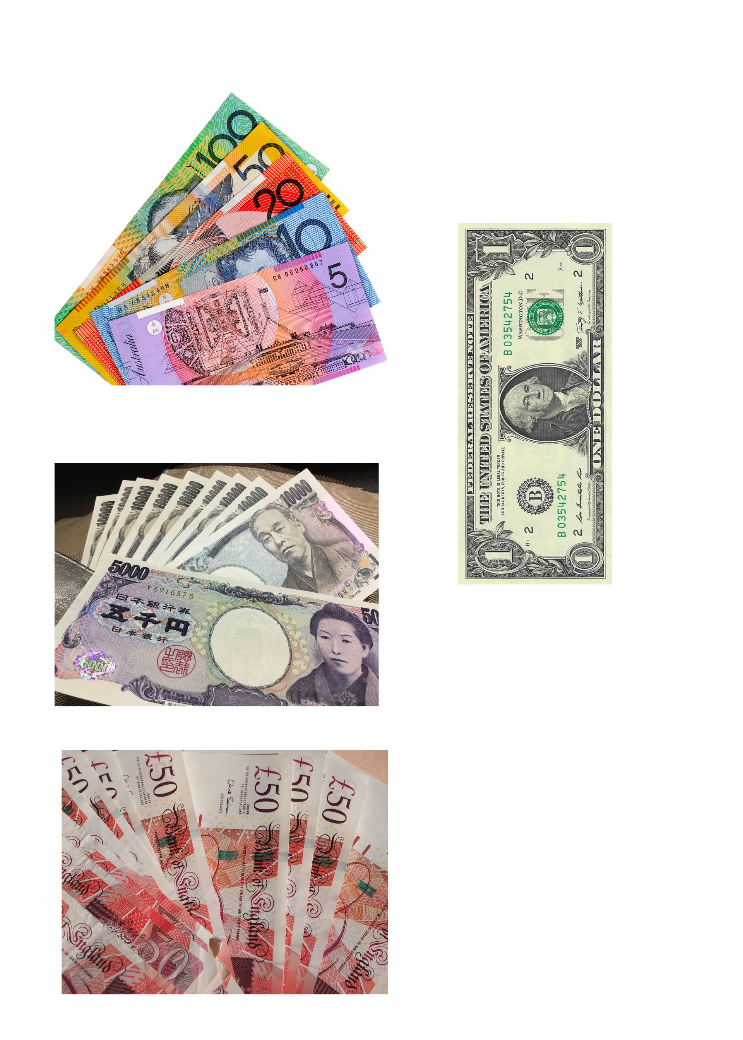
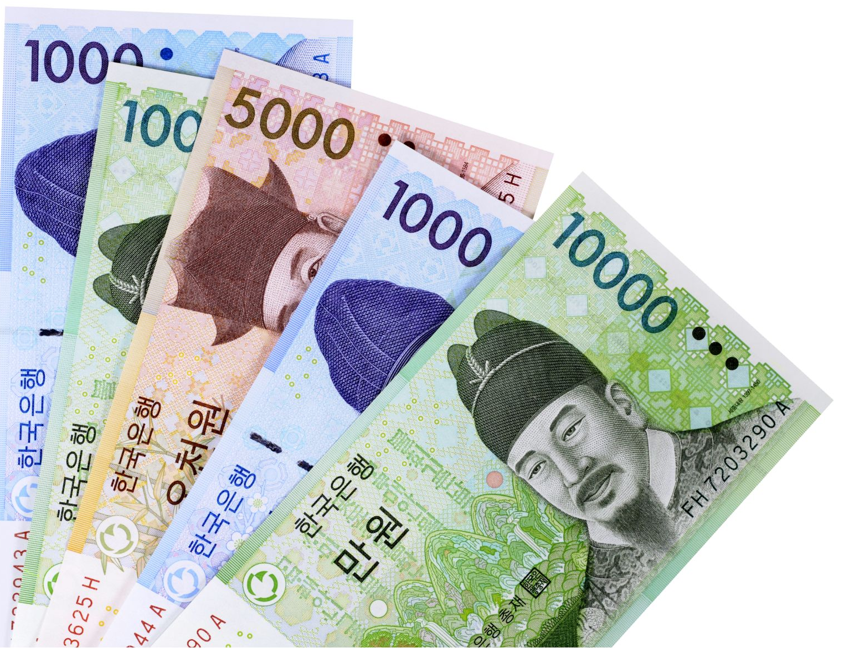
Money around the world
Do you recognise these currencies?

Slide 3
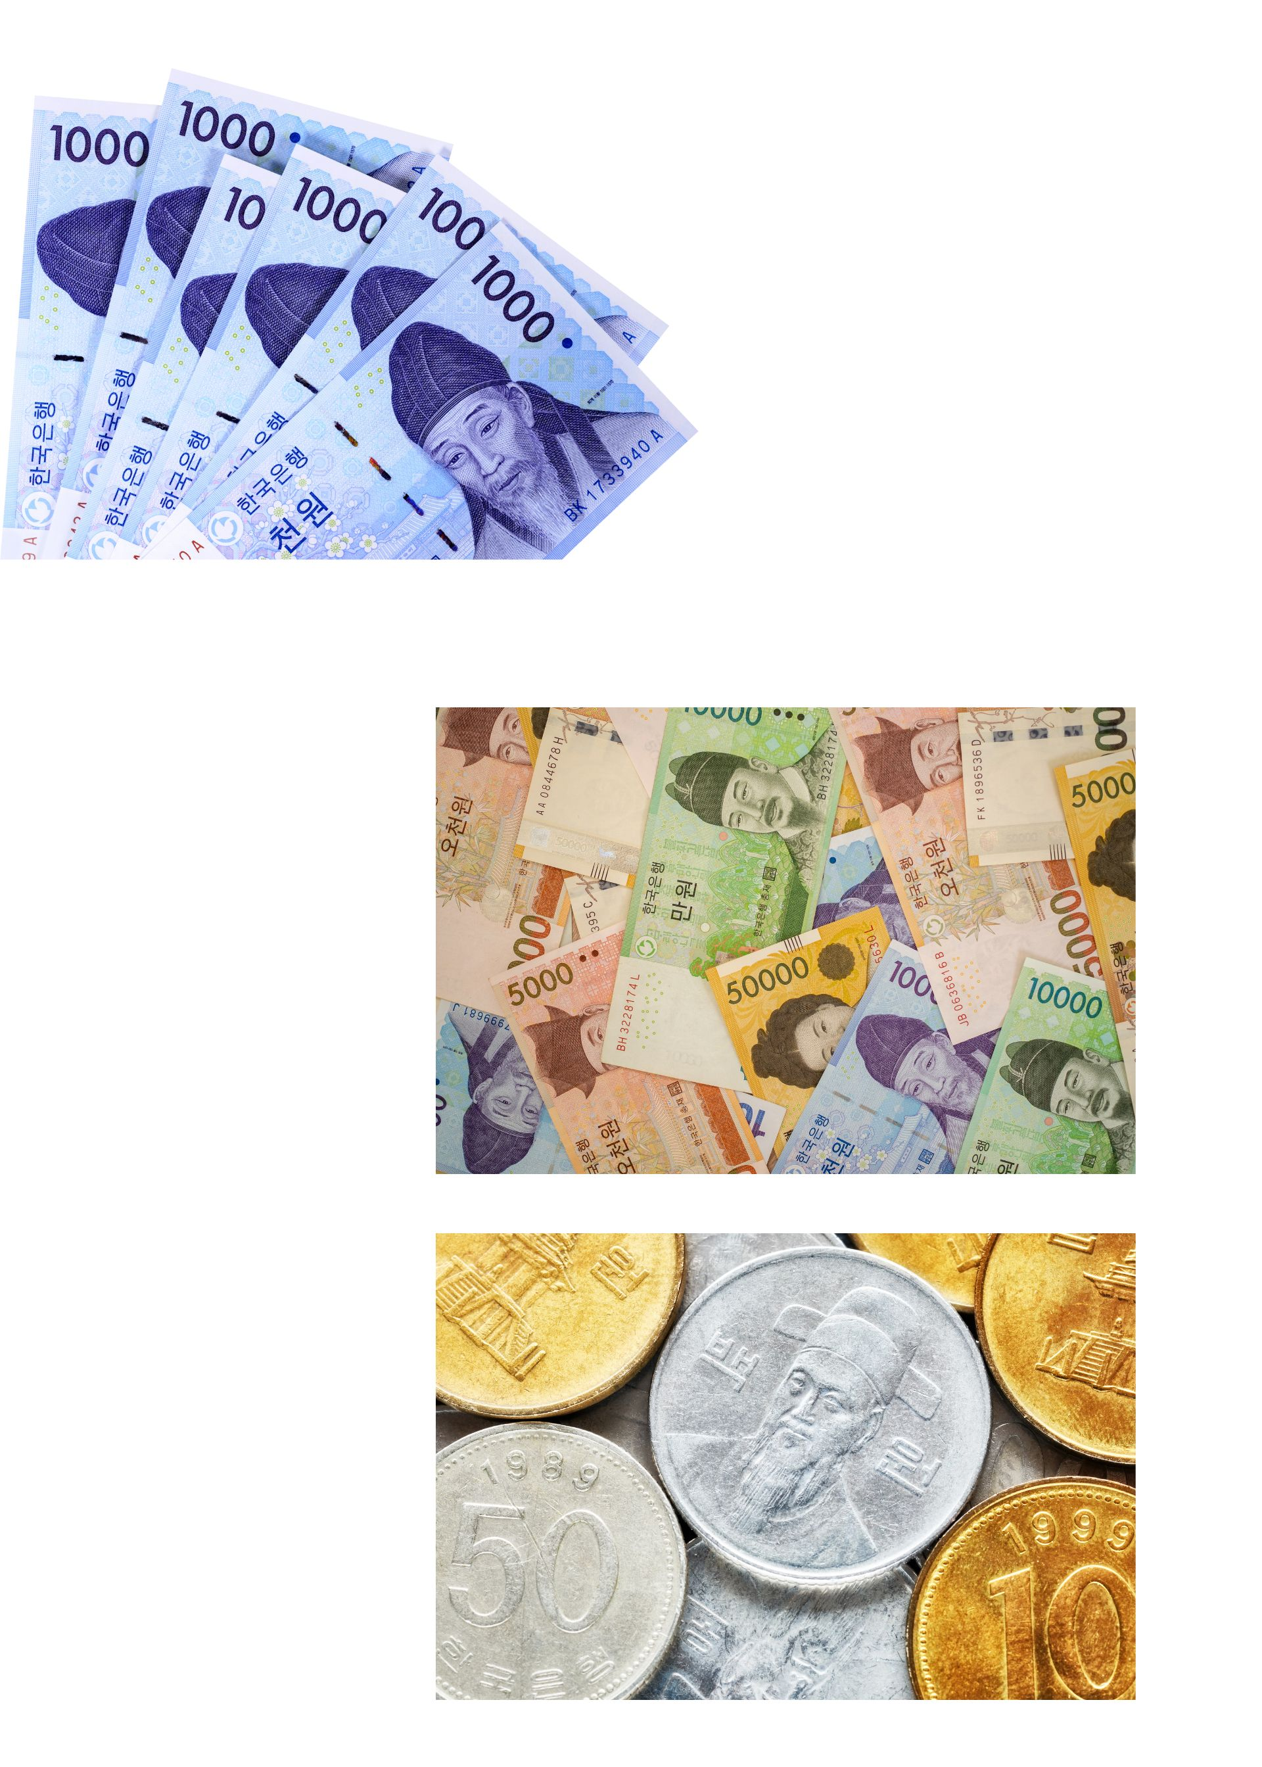
Korean notes and coins
Notes:
Blue note 1,000 원
Orange note 5,000 원
Green note 10,000 원
Gold note 50,000 원
There are 4 different types of coins:
500 원
100 원
50 원
10 원

Slide 4
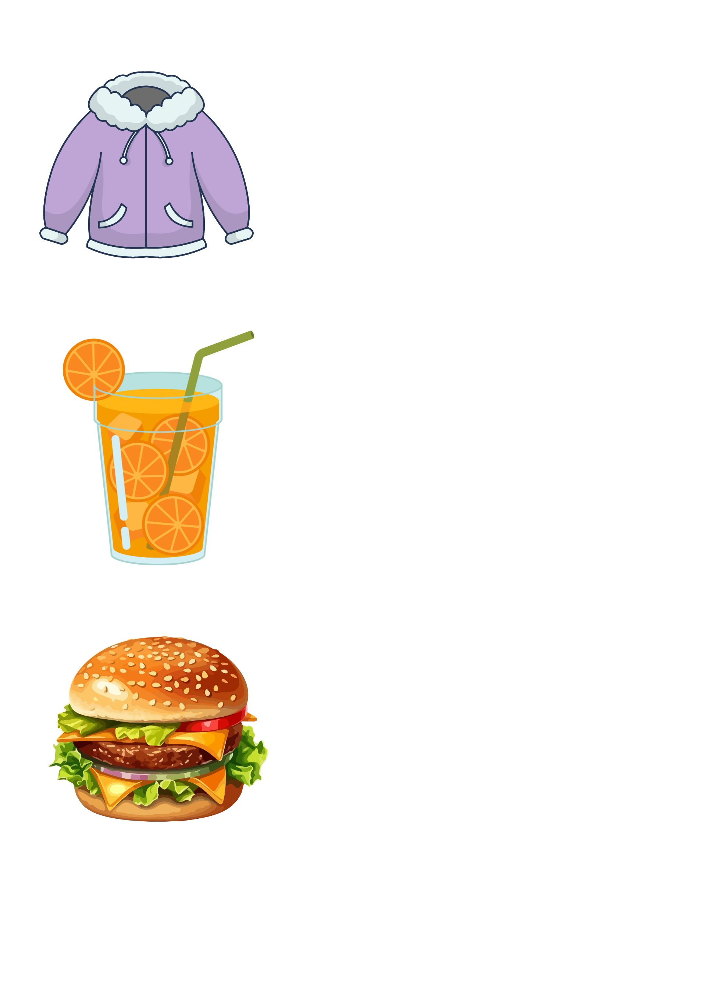
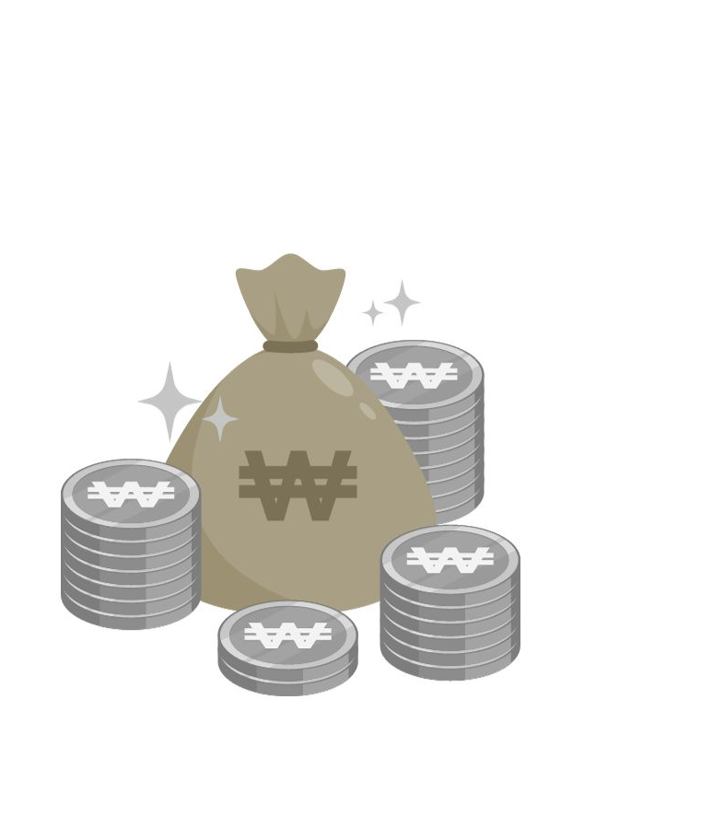
Korean won ₩
얼마예요?
Respond to the question 얼마예요? for each item below using the structure ~원 이에요.
Write the answers in your book.
₩25,000
₩6,700
₩5,700

Slide 5
How much are the items?
Check your answers
₩25,000
이만 오천 원 이에요.
₩6,700
육천 칠천 원 이에요.
₩5,700
오천칠백 원 이에요.
Notes:
Allow students time to check their own responses with the correct responses for each question.

Slide 6
Copyright
© State of New South Wales (Department of Education), 2024
The copyright material published in this resource is subject to the Copyright Act 1968 (Cth) and is owned by the NSW Department of Education or, where indicated, by a party other than the NSW Department of Education (third-party material).
Copyright material available in this resource and owned by the NSW Department of Education is licensed under a Creative Commons Attribution 4.0 International (CC BY 4.0) license.
This license allows you to share and adapt the material for any purpose, even commercially.
Attribution should be given to © State of New South Wales (Department of Education), 2024.
Material in this resource not available under a Creative Commons license:
the NSW Department of Education logo, other logos and trademark-protected material
Material owned by a third-party that has been reproduced with permission. You will need to obtain permission from the third-party to reuse its material.
Links to third-party material and websites
Please note that the provided (reading/viewing material/list/links/texts) are a suggestion only and implies no endorsement, by the New South Wales Department of Education, of any author, publisher, or book title. School principals and teachers are best placed to assess the suitability of resources that would complement the curriculum and reflect the needs and interests of their students.
If you use the links provided in this document to access a third-party’s website, you acknowledge that the terms of use, including licence terms set out on the third-party’s website apply to the use which may be made of the materials on that third-party website or where permitted by the Copyright Act 1968 (Cth). The department accepts no responsibility for content on third-party websites.
Notes:
Slide not shared

