Slide 1

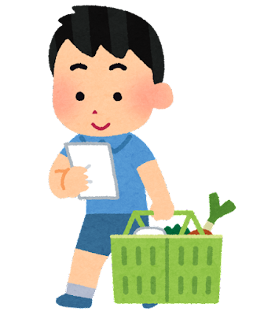
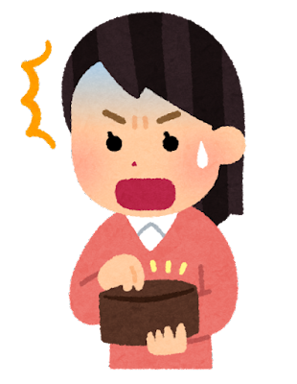
Counting in Korean
Stage 4 – Korean

Slide 2
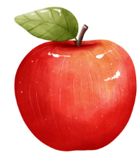



Pure Korean numbers
Count these items
Use Pure Korean numbers to count the number of each item.
1.
2.
3.
4.

Slide 3
Counting things in Korean
Counter words in the market
In Korean, items are counted using specific counters according to the item. Here are some examples of different counters you might hear in the Korean market.
~개 is used to count things in general.
~인분 is used to count the number of servings when ordering food.
~병 is used to count bottles.
~잔 is used to count cups (of drinks).
~그램/킬로 is used to measure grams and kilograms.
~묶음 is used to count bundles.

Slide 4
~개 (gae)
Counting suffix
In this unit, we will be focusing on learning how to count using the suffix:
~개 (gae)
We will also use ~잔 (for counting cups) and ~인분 (for counting servings) later in the unit.

Slide 5



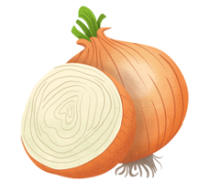
How many?
Counting using the counter word ~개 (gae)
Count the items using the counter word ~개:
1.
한 개
2.
두 개
3.
세 개
4.
네 개

Slide 6
How many [food]?
~몇 개 있어요?
Count the items using the counter word ~개:
Add the food item to the structure
[food] 이/가[number]개:
1.
한 개
1. 가 한 개 있어요.
2.
두 개
2. 옥 수 수가 두 개 있어요.
3.
세 개
3. 오 렌 지가 세 개 있어요.
4.
네 개
4. 양 파가 네 개 있어요.

Slide 7
Copyright
© State of New South Wales (Department of Education), 2024
The copyright material published in this resource is subject to the Copyright Act 1968 (Cth) and is owned by the NSW Department of Education or, where indicated, by a party other than the NSW Department of Education (third-party material).
Copyright material available in this resource and owned by the NSW Department of Education is licensed under a Creative Commons Attribution 4.0 International (CC BY 4.0) license.
This license allows you to share and adapt the material for any purpose, even commercially.
Attribution should be given to © State of New South Wales (Department of Education), 2024.
Material in this resource not available under a Creative Commons license:
the NSW Department of Education logo, other logos and trademark-protected material
Material owned by a third-party that has been reproduced with permission. You will need to obtain permission from the third-party to reuse its material.
Links to third-party material and websites
Please note that the provided (reading/viewing material/list/links/texts) are a suggestion only and implies no endorsement, by the New South Wales Department of Education, of any author, publisher, or book title. School principals and teachers are best placed to assess the suitability of resources that would complement the curriculum and reflect the needs and interests of their students.
If you use the links provided in this document to access a third-party’s website, you acknowledge that the terms of use, including licence terms set out on the third-party’s website apply to the use which may be made of the materials on that third-party website or where permitted by the Copyright Act 1968 (Cth). The department accepts no responsibility for content on third-party websites.
Notes:
Slide not shared

