Slide 1
Fruits and vegetables – 과일, 야채
Stage 4 – Korean

Slide 2
Fruits (gwa-il)
과일

Slide 3

Tomato
토마토
(to-ma-to)

Slide 4
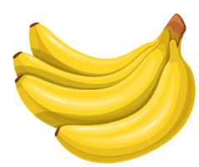
Banana
바나나
(ba-na-na)

Slide 5
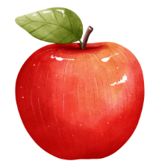
Apple
사과
(sa-gwa)

Slide 6

Grape
포도
(po-do)

Slide 7

Orange
오렌지
(o-ren-ji)

Slide 8
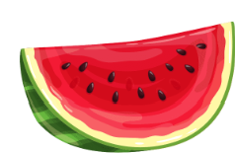
Watermelon
수박
(su-bak)

Slide 9

Strawberry
딸기
(ddal-gi)

Slide 10
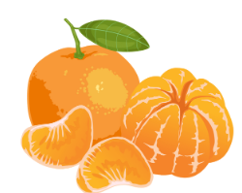
Tangerine
귤
(gyul)

Slide 11

melon
참외
(cham-oe)

Slide 12
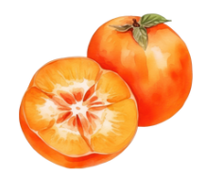
Persimmon
감
(gam)

Slide 13
Vegetables (ya-chae)
야채

Slide 14

Corn
옥수수
(ok-su-su)

Slide 15

Lettuce
상추
(sang-chu)

Slide 16

Capsicum
피망
(pi-mang)

Slide 17
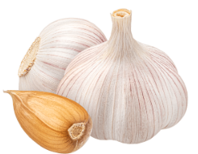
Garlic
마늘
(ma-neul)

Slide 18
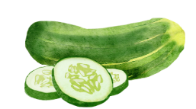
Cucumber
오이
(o-i)

Slide 19
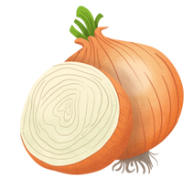
Onion
양파
(yang-pa)

Slide 20
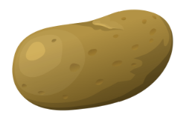
Potato
감자
(gam-ja)

Slide 21

Carrot
당근
(dang-geun)

Slide 22
Is this a fruit?
Is this a vegetable?
(gwa-il-ieyo? ya-chae-yeyo? )
과일이에요?
야채예요?

Slide 23
Fruit or vegetable? tomato
Notes:
과일이에요? 야채예요? (gwa-il ieyo? ya-chae yeyo?)
뭐예요? (mwoyeyo?)

Slide 24

Fruit or vegetable? garlic
Notes:
과일이에요? 야채예요? (gwa-il ieyo? ya-chae yeyo?)
뭐예요? (mwoyeyo?)

Slide 25

Fruit or vegetable? apple
Notes:
과일이에요? 야채예요? (gwa-il ieyo? ya-chae yeyo?)
뭐예요? (mwoyeyo?)

Slide 26
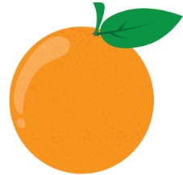
Fruit or vegetable? orange
Notes:
과일이에요? 야채예요? (gwa-il ieyo? ya-chae yeyo?)
뭐예요? (mwoyeyo?)

Slide 27
Fruit or vegetable? watermelon
Notes:
과일이에요? 야채예요? (gwa-il ieyo? ya-chae yeyo?)
뭐예요? (mwoyeyo?)

Slide 28

Fruit or vegetable? persimmon
Notes:
과일이에요? 야채예요? (gwa-il ieyo? ya-chae yeyo?)
뭐예요? (mwoyeyo?)

Slide 29
Fruit or vegetable? onion
Notes:
과일이에요? 야채예요? (gwa-il ieyo? ya-chae yeyo?)
뭐예요? (mwoyeyo?)

Slide 30

Fruit or vegetable? grapes
Notes:
과일이에요? 야채예요? (gwa-il ieyo? ya-chae yeyo?)
뭐예요? (mwoyeyo?)

Slide 31
Fruit or vegetable? potato
Notes:
과일이에요? 야채예요? (gwa-il ieyo? ya-chae yeyo?)
뭐예요? (mwoyeyo?)

Slide 32
Fruit or vegetable? banana
Notes:
과일이에요? 야채예요? (gwa-il ieyo? ya-chae yeyo?)
뭐예요? (mwoyeyo?)

Slide 33
Fruit or vegetable? carrot
Notes:
과일이에요? 야채예요? (gwa-il ieyo? ya-chae yeyo?)
뭐예요? (mwoyeyo?)

Slide 34
Fruit or vegetable? strawberry
Notes:
과일이에요? 야채예요? (gwa-il ieyo? ya-chae yeyo?)
뭐예요? (mwoyeyo?)

Slide 35

Fruit or vegetable? tangerine
Notes:
과일이에요? 야채예요? (gwa-il ieyo? ya-chae yeyo?)
뭐예요? (mwoyeyo?)

Slide 36
Fruit or vegetable? melon
Notes:
과일이에요? 야채예요? (gwa-il ieyo? ya-chae yeyo?)
뭐예요? (mwoyeyo?)

Slide 37
Fruit or vegetable? lettuce
Notes:
과일이에요? 야채예요? (gwa-il ieyo? ya-chae yeyo?)
뭐예요? (mwoyeyo?)

Slide 38
Fruit or vegetable? capsicum
Notes:
과일이에요? 야채예요? (gwa-il ieyo? ya-chae yeyo?)
뭐예요? (mwoyeyo?)

Slide 39
Fruit or vegetable? cucumber
Notes:
과일이에요? 야채예요? (gwa-il ieyo? ya-chae yeyo?)
뭐예요? (mwoyeyo?)

Slide 40

Fruit or vegetable? corn
Notes:
과일이에요? 야채예요? (gwa-il ieyo? ya-chae yeyo?)
뭐예요? (mwoyeyo?)

Slide 41
뭐가 있어요?
What is there?

Slide 42
Copyright
© State of New South Wales (Department of Education), 2024
The copyright material published in this resource is subject to the Copyright Act 1968 (Cth) and is owned by the NSW Department of Education or, where indicated, by a party other than the NSW Department of Education (third-party material).
Copyright material available in this resource and owned by the NSW Department of Education is licensed under a Creative Commons Attribution 4.0 International (CC BY 4.0) license.
This license allows you to share and adapt the material for any purpose, even commercially.
Attribution should be given to © State of New South Wales (Department of Education), 2024.
Material in this resource not available under a Creative Commons license:
the NSW Department of Education logo, other logos and trademark-protected material
material owned by a third party that has been reproduced with permission. You will need to obtain permission from the third party to reuse its material.
Links to third-party material and websites
Please note that the provided (reading/viewing material/list/links/texts) are a suggestion only and implies no endorsement, by the New South Wales Department of Education, of any author, publisher, or book title. School principals and teachers are best placed to assess the suitability of resources that would complement the curriculum and reflect the needs and interests of their students.
If you use the links provided in this document to access a third-party's website, you acknowledge that the terms of use, including licence terms set out on the third-party's website apply to the use which may be made of the materials on that third-party website or where permitted by the Copyright Act 1968 (Cth). The department accepts no responsibility for content on third-party websites.
Notes:
Slide not shared

