Slide 1
Dans ma maison il y a… – In my house there is …
Les pièces de la maison – The rooms of the house
Notes:
Use this resource to practise the structures:
Qu’est-ce que c’est ? C’est la porte.
Il y a…chez toi? Oui, il y en a chez moi or Non, il n’y en a pas chez moi.

Slide 2
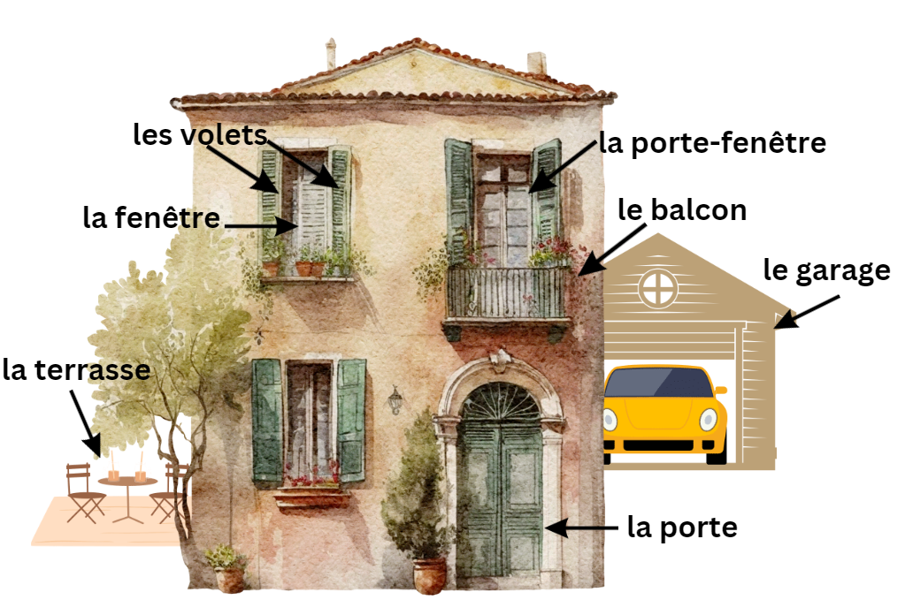
House vocabulary

Slide 3
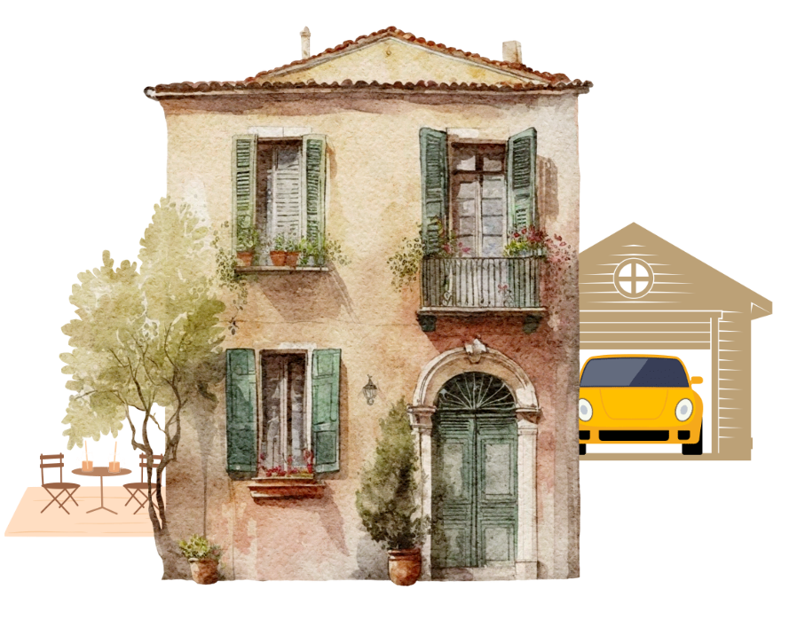
The house

Slide 4
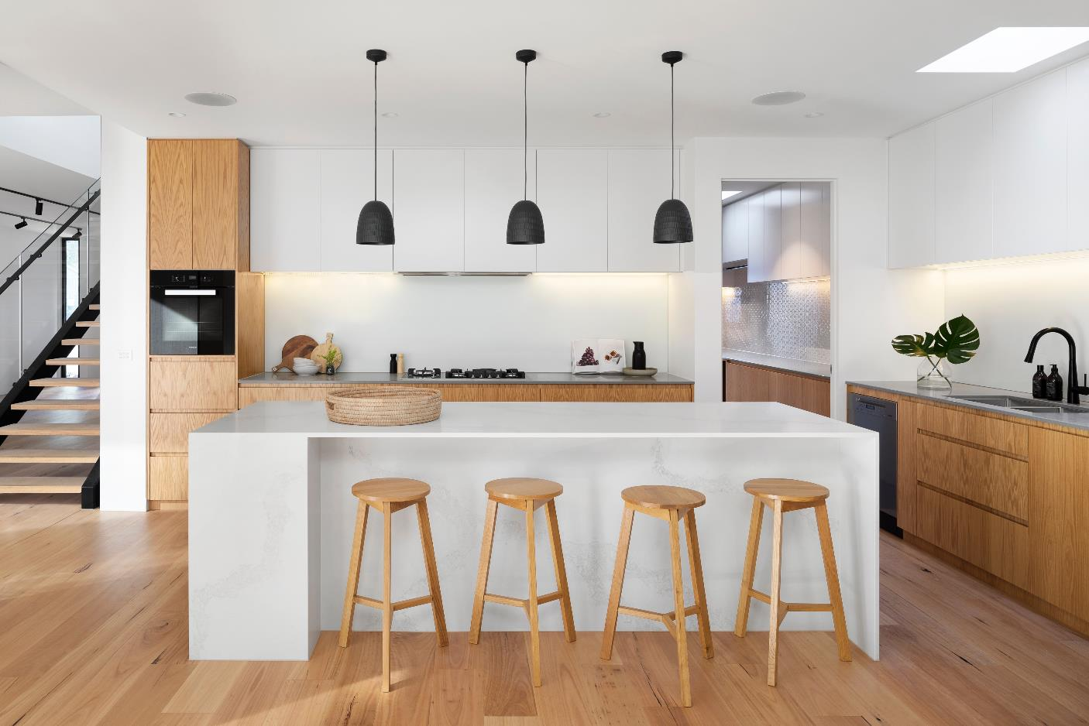
The kitchen
Image licensed under Unsplash License.
Notes:
la cuisine: the kitchen

Slide 5
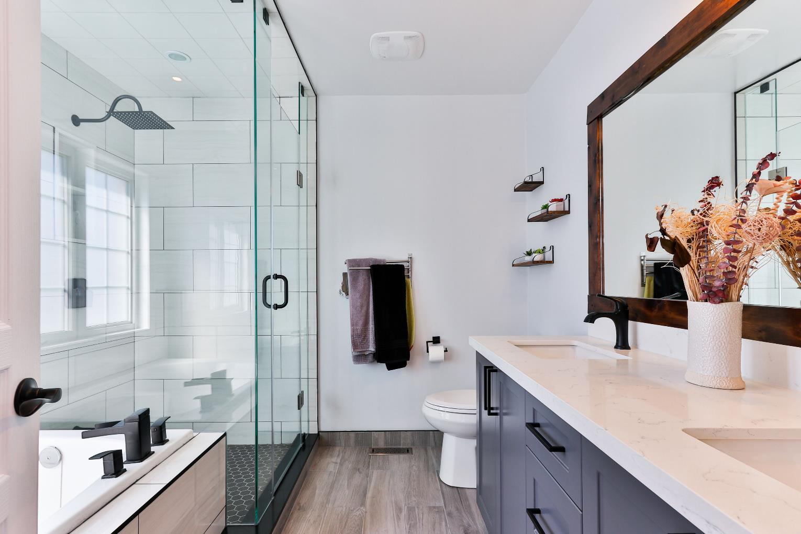
The bathroom
Image licensed under Unsplash License.
Notes:
la salle de bains: the bathroom

Slide 6
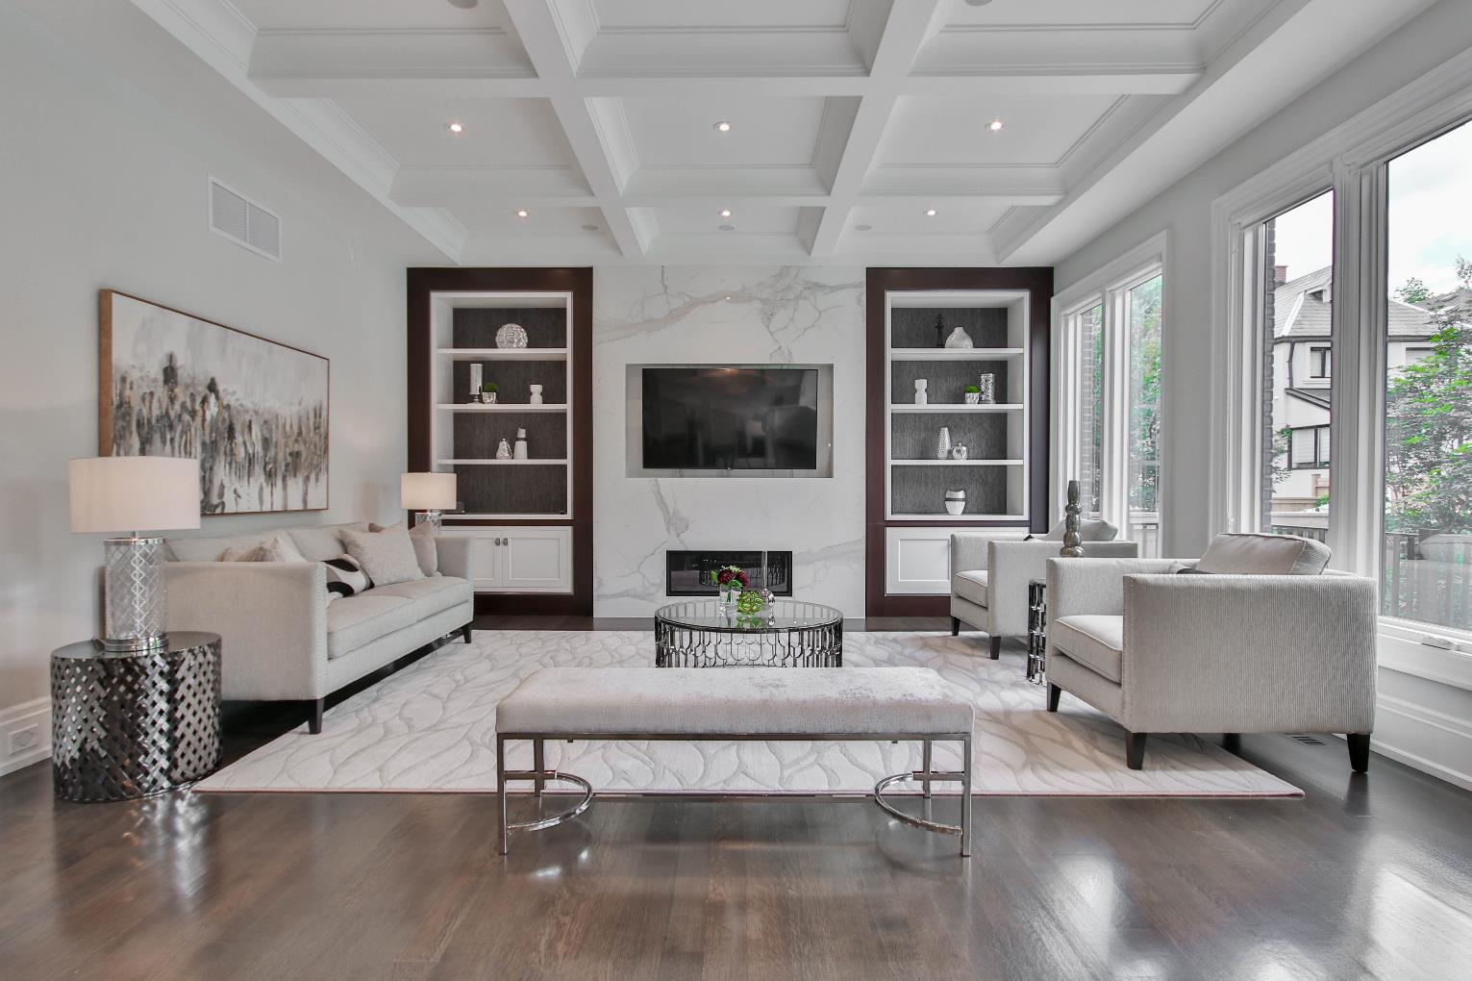
The loungeroom
Image licensed under Unsplash License.
Notes:
le salon: the loungeroom

Slide 7
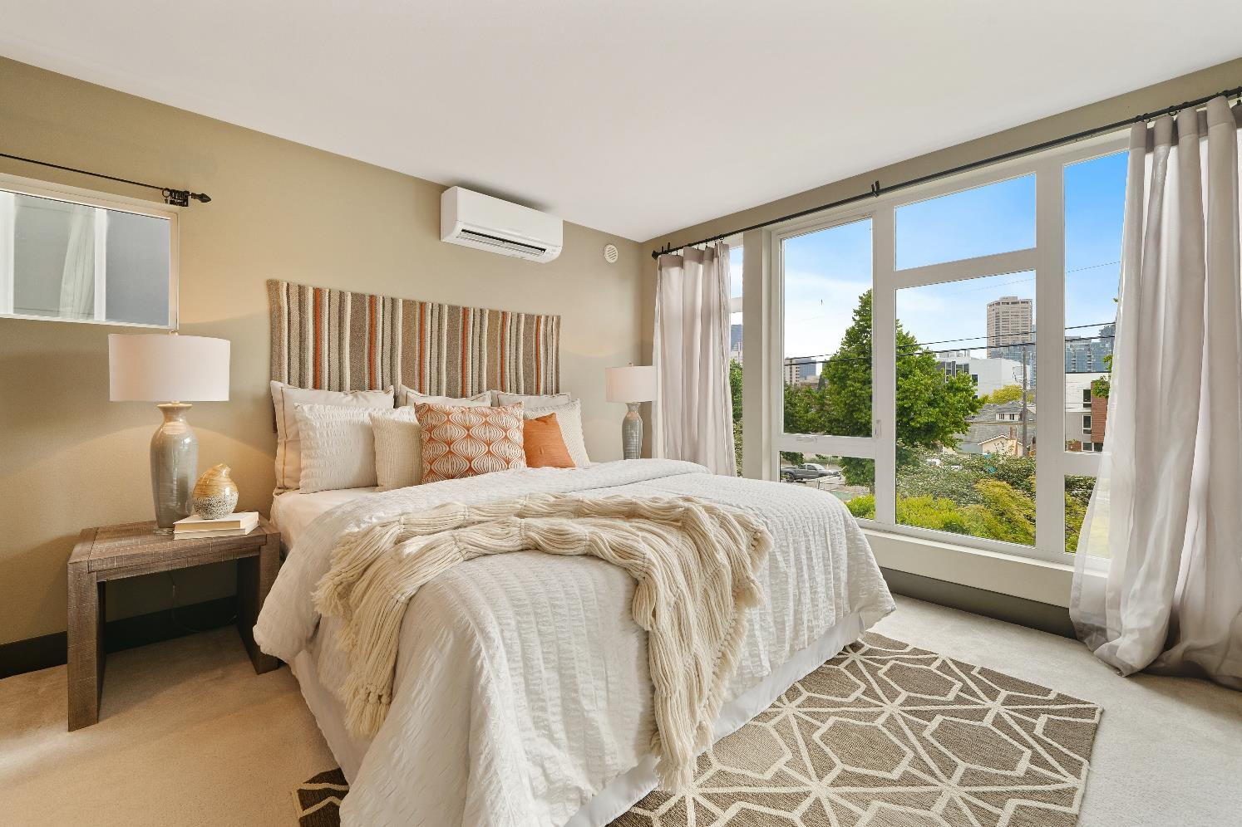
The bedroom
Image licensed under Unsplash License.
Notes:
la chambre: the bedroom

Slide 8
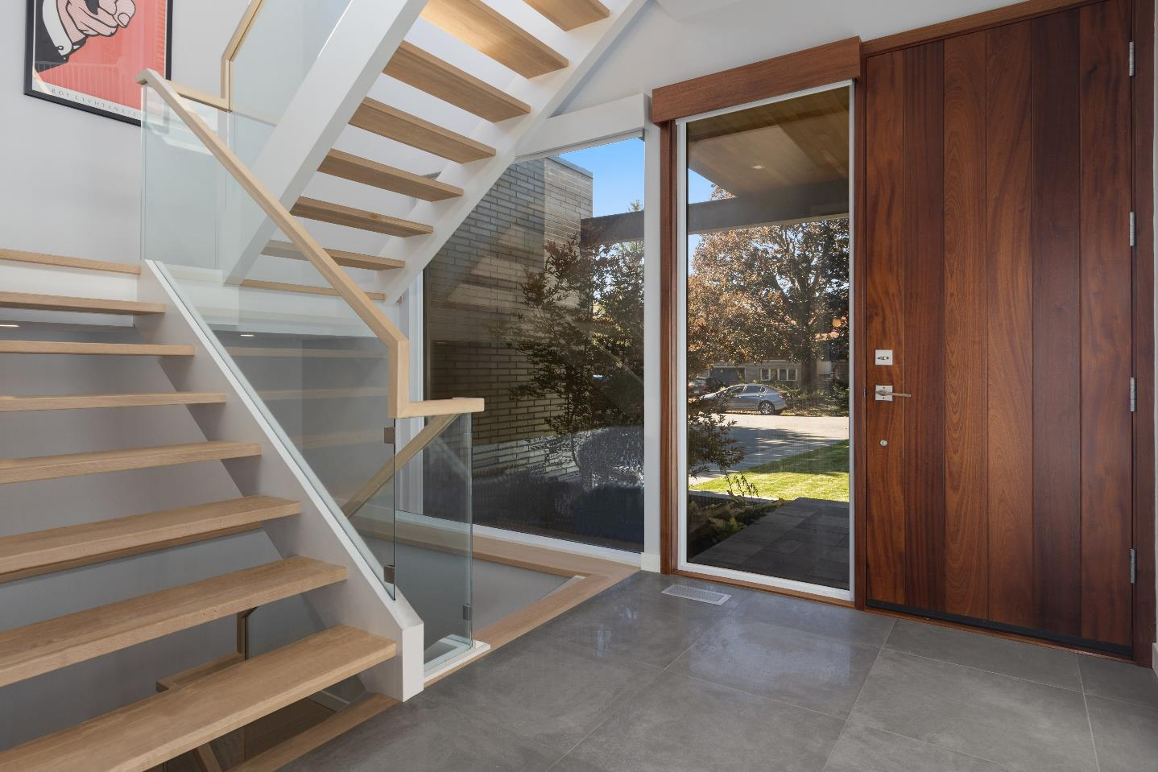
The stairs
Image licensed under Unsplash License.
Notes:
l’escalier: the stairs

Slide 9
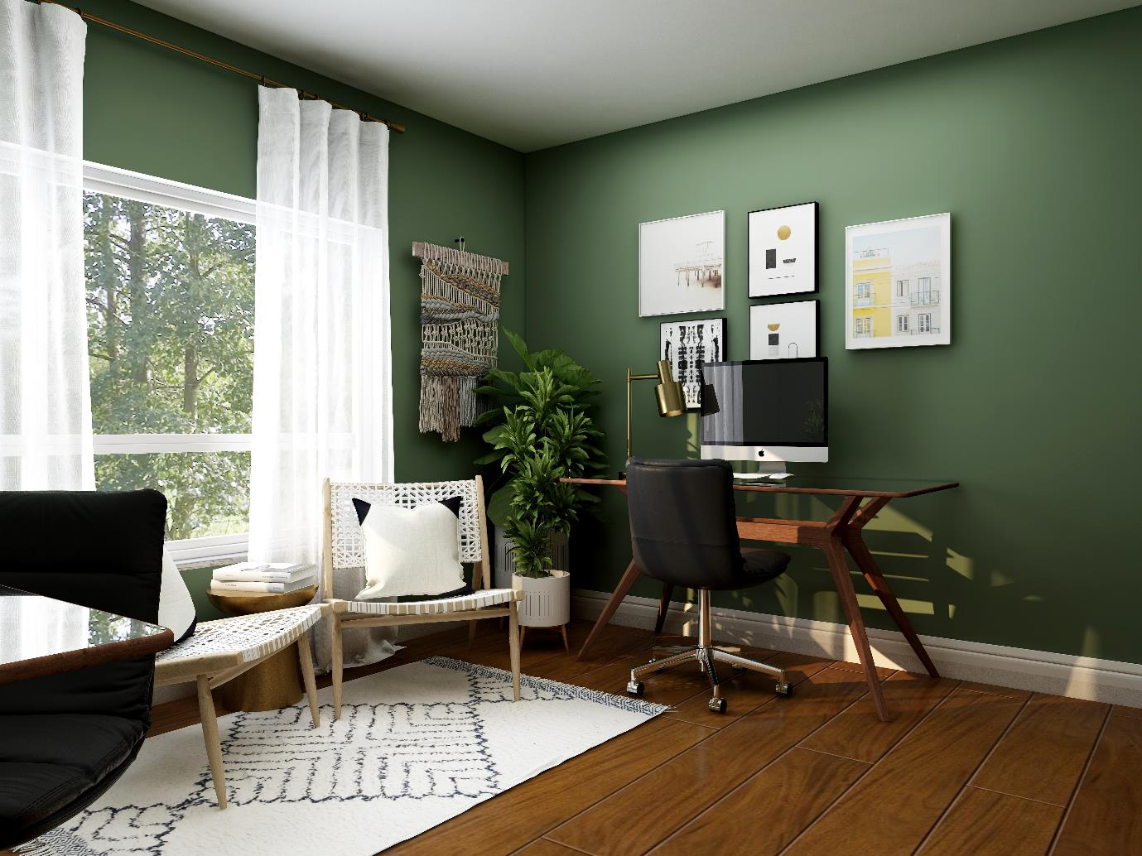
The study
Image licensed under Unsplash License.
Notes:
le bureau: the office/study

Slide 10
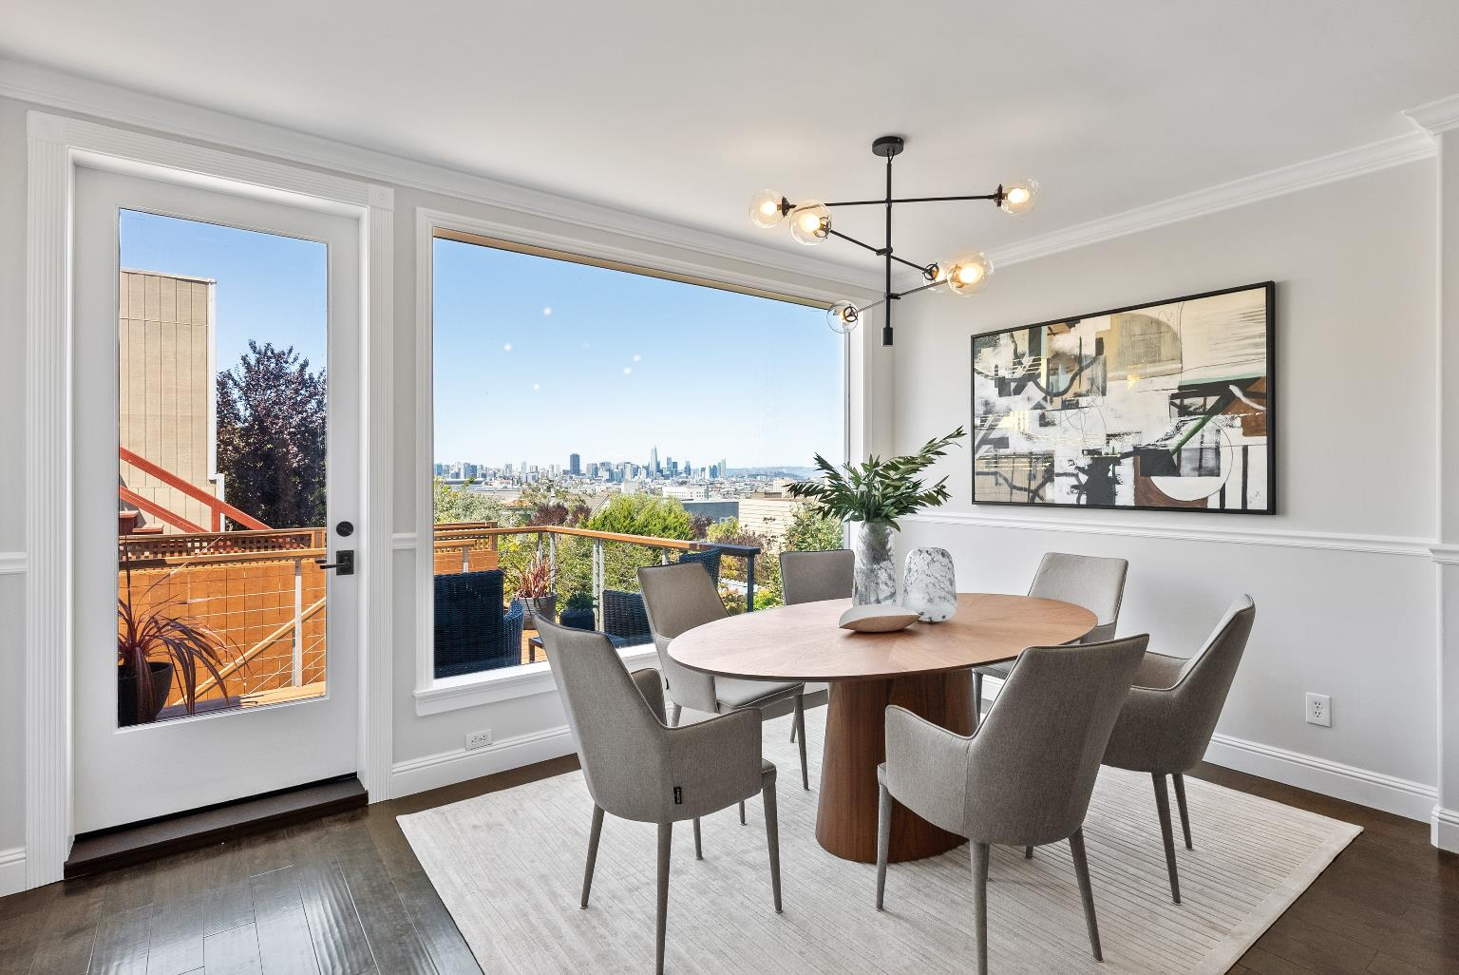
The dining room
Image licensed under Unsplash License.
Notes:
la salle à manger: the dining room

Slide 11
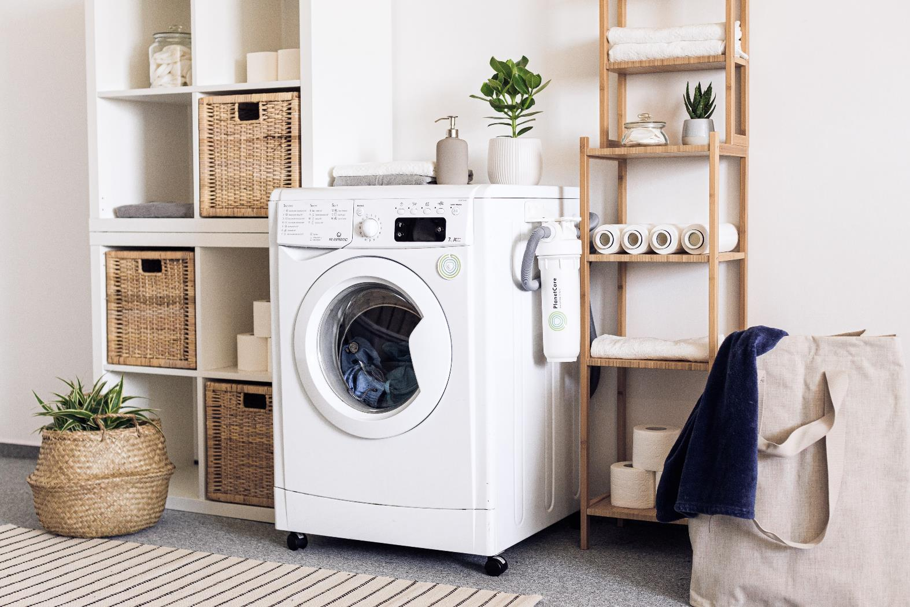
The laundry
Image licensed under Unsplash License.
Notes:
la buanderie: the laundry

Slide 12
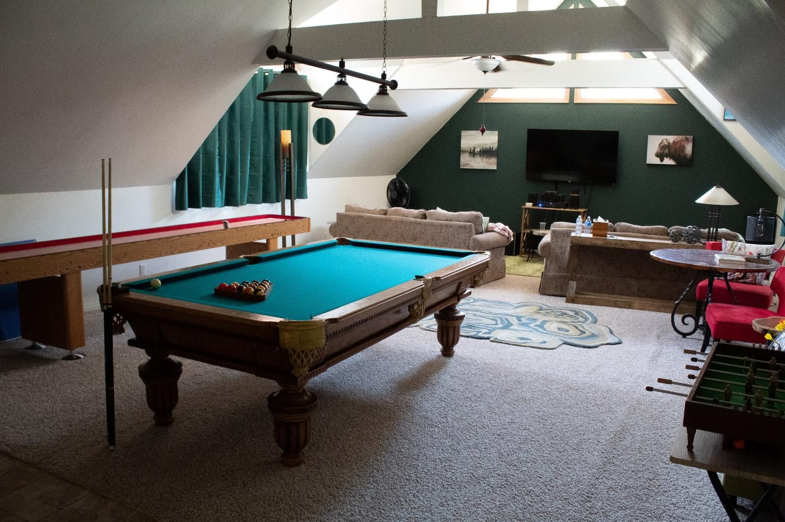
The games room
Image licensed under Unsplash License.
Notes:
la salle de jeux: the games room

Slide 13
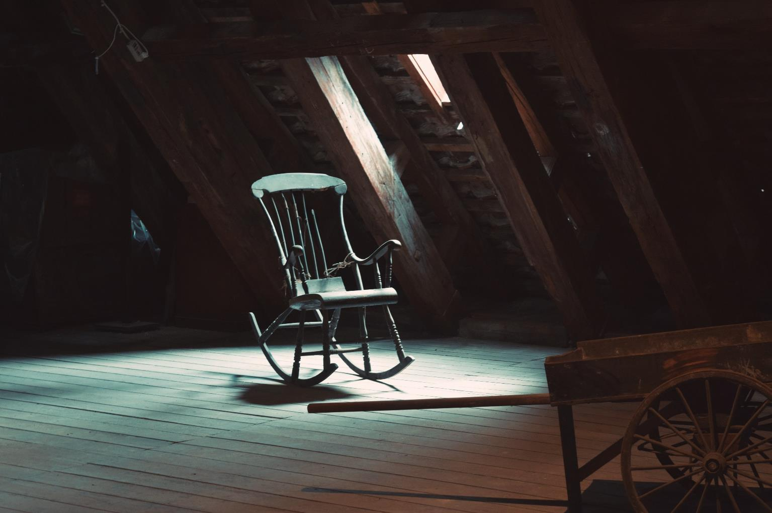
The attic
Image licensed under Unsplash License.
Notes:
le grenier: the attic

Slide 14
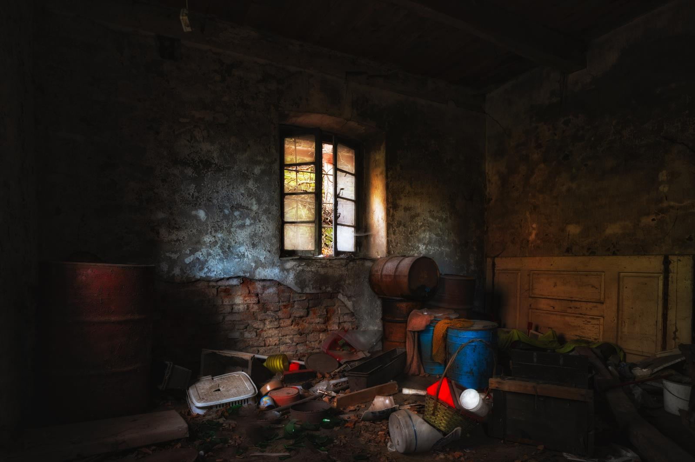
The basement
Image licensed under Unsplash License.
Notes:
le sous-sol: the basement/cellar

Slide 15
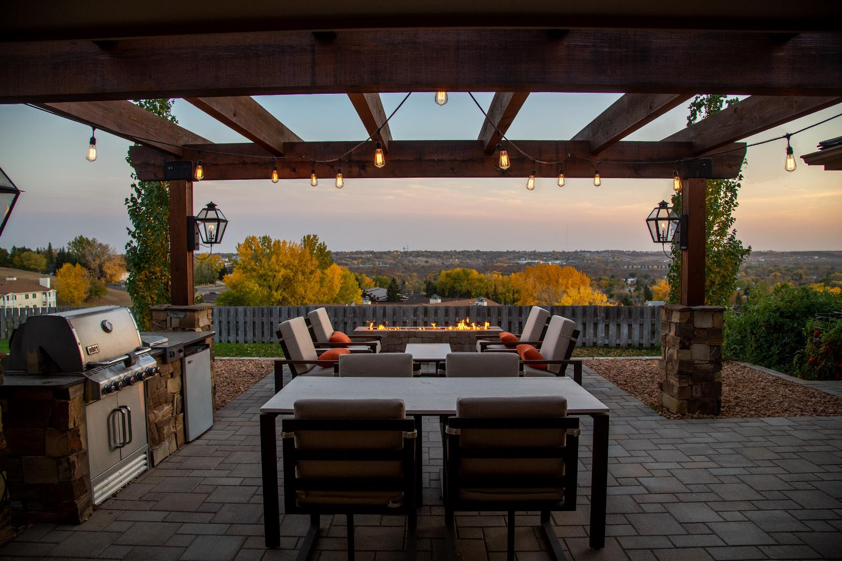
The patio
Image licensed under Unsplash License.
Notes:
la terrasse: the patio

Slide 16
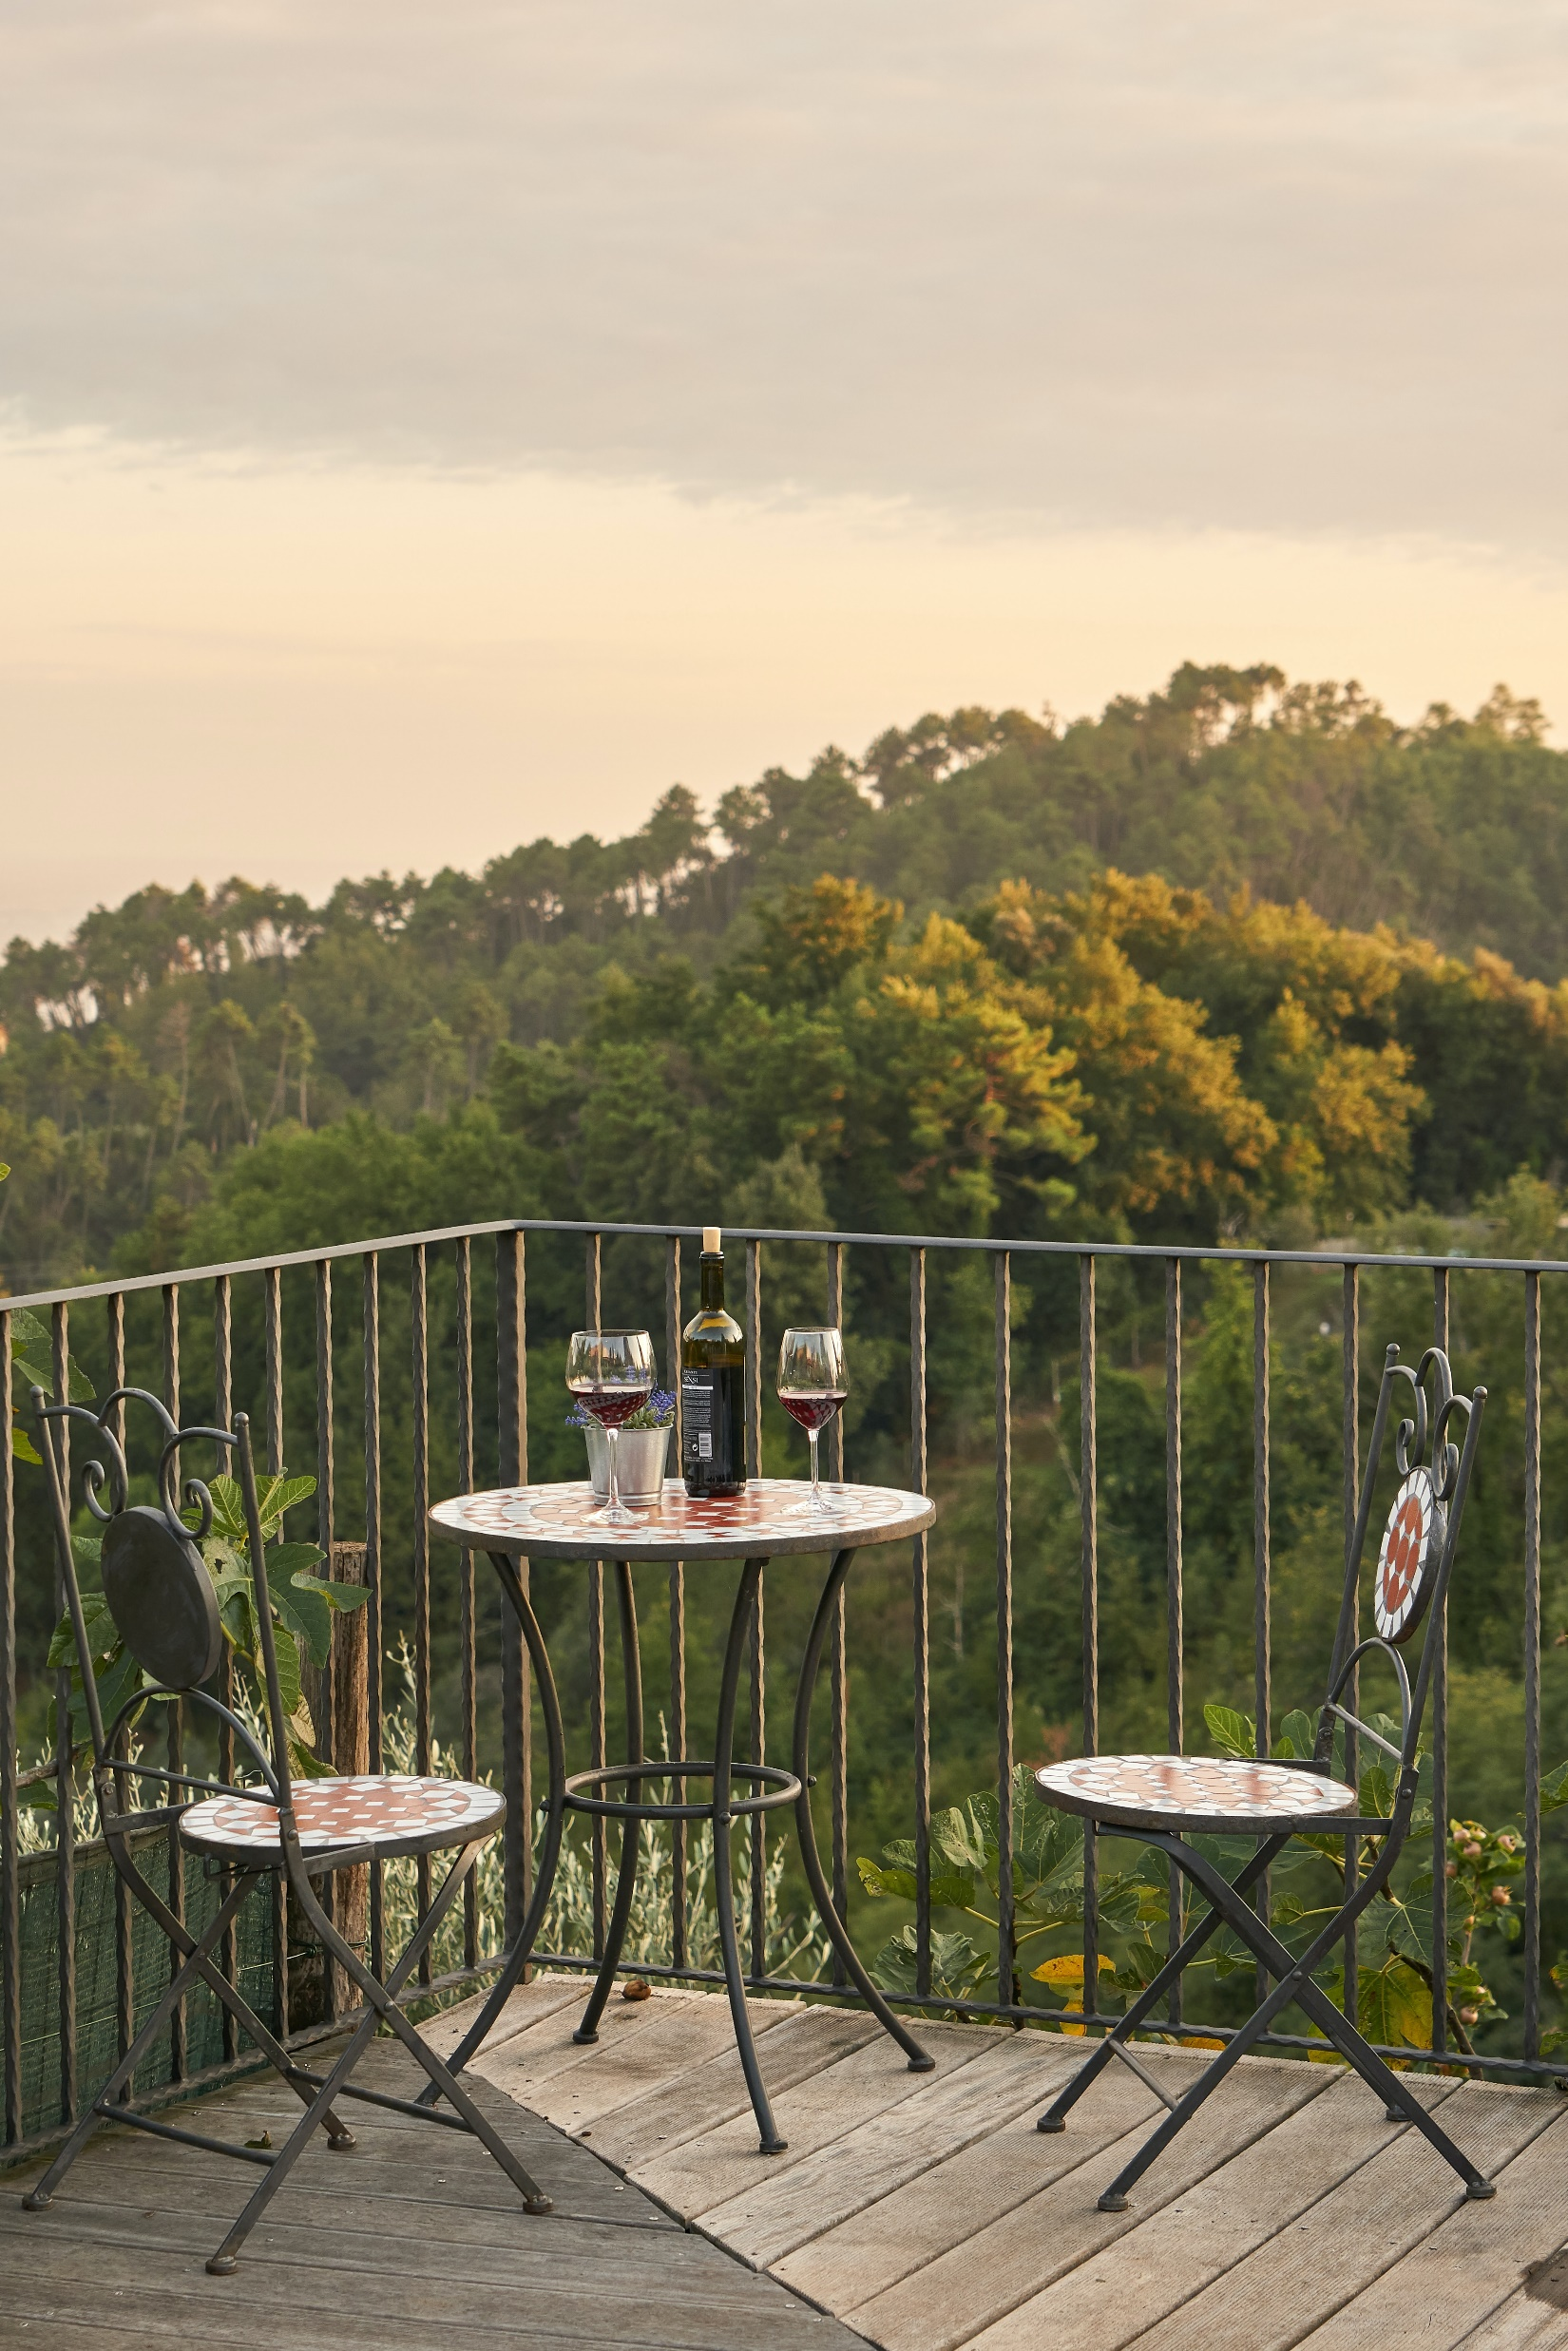
The balcony
Image licensed under Unsplash License.
Notes:
le balcon: the balcony

Slide 17
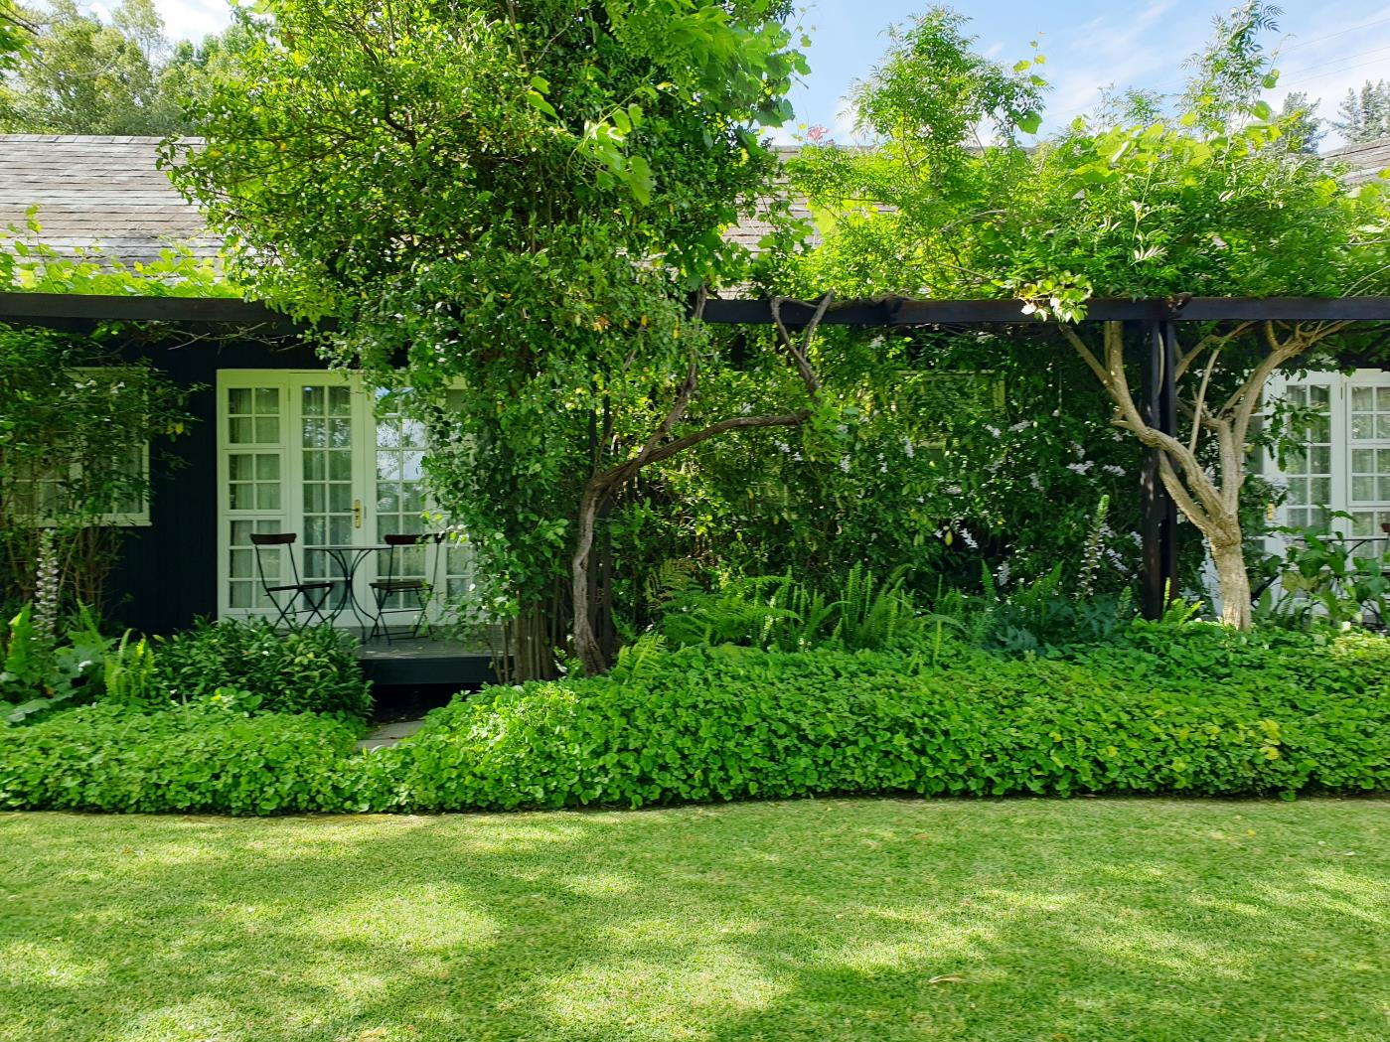
The garden
Image licensed under Unsplash License.
Notes:
le jardin: the garden

Slide 18
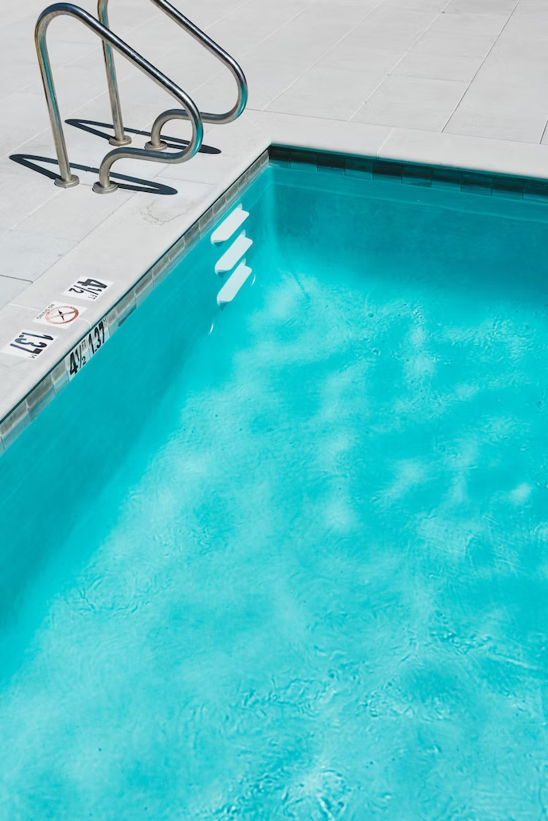
The pool
Image licensed under Unsplash License.
Notes:
la piscine: the pool

Slide 19
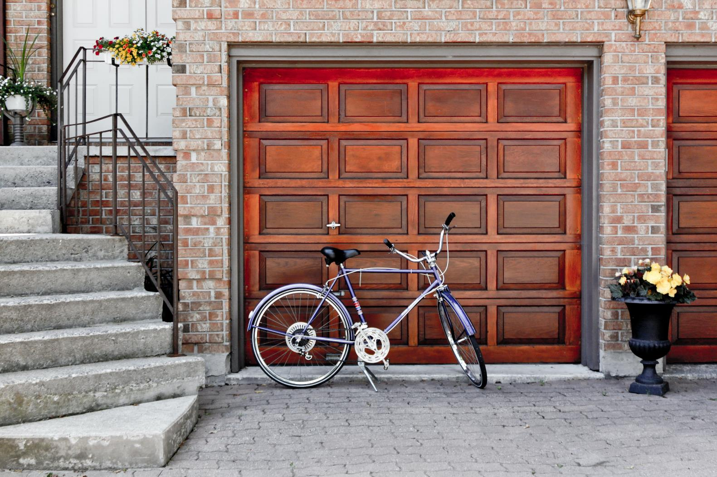
The garage
Image licensed under Unsplash License.
Notes:
le garage: the garage

Slide 20
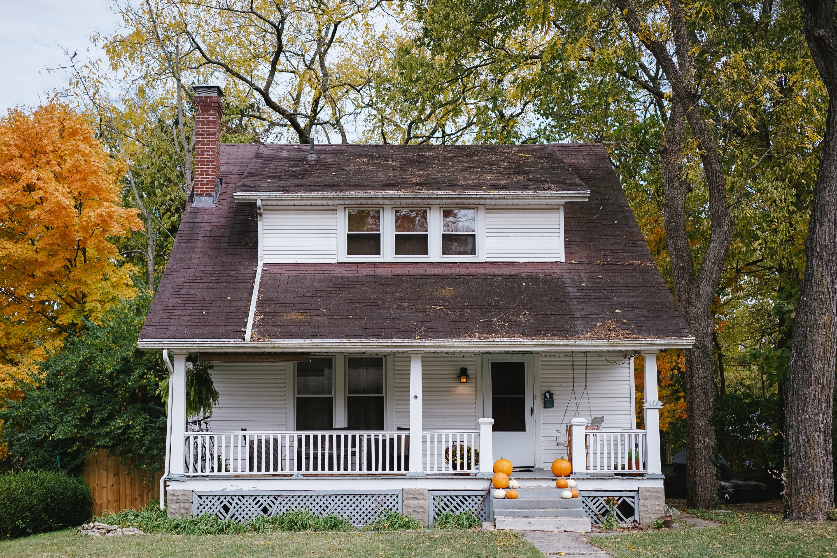
A two-storey house
le premier étage
le rez de chaussée
Image licensed under Unsplash License.
Notes:
une maison à deux étages: a 2-storey house
le premier étage: first floor
le rez de chaussée: ground floor

Slide 21
Copyright
© State of New South Wales (Department of Education), 2023
The copyright material published in this resource is subject to the Copyright Act 1968 (Cth) and is owned by the NSW Department of Education or, where indicated, by a party other than the NSW Department of Education (third-party material).
Copyright material available in this resource and owned by the NSW Department of Education is licensed under a Creative Commons Attribution 4.0 International (CC BY 4.0) licence.
This license allows you to share and adapt the material for any purpose, even commercially.
Attribution should be given to © State of New South Wales (Department of Education), 2023.
Material in this resource not available under a Creative Commons license:
the NSW Department of Education logo, other logos and trademark-protected material
Material owned by a third party that has been reproduced with permission. You will need to obtain permission from the third party to reuse its material.
Links to third-party material and websites
Please note that the provided (reading/viewing material/list/links/texts) are a suggestion only and implies no endorsement, by the New South Wales Department of Education, of any author, publisher, or book title. School principals and teachers are best placed to assess the suitability of resources that would complement the curriculum and reflect the needs and interests of their students.
If you use the links provided in this document to access a third party’s website, you acknowledge that the terms of use, including licence terms set out on the third-party’s website apply to the use which may be made of the materials on that third-party website or where permitted by the Copyright Act 1968 (Cth). The department accepts no responsibility for content on third-party websites.

