Slide 1
My home

Slide 2
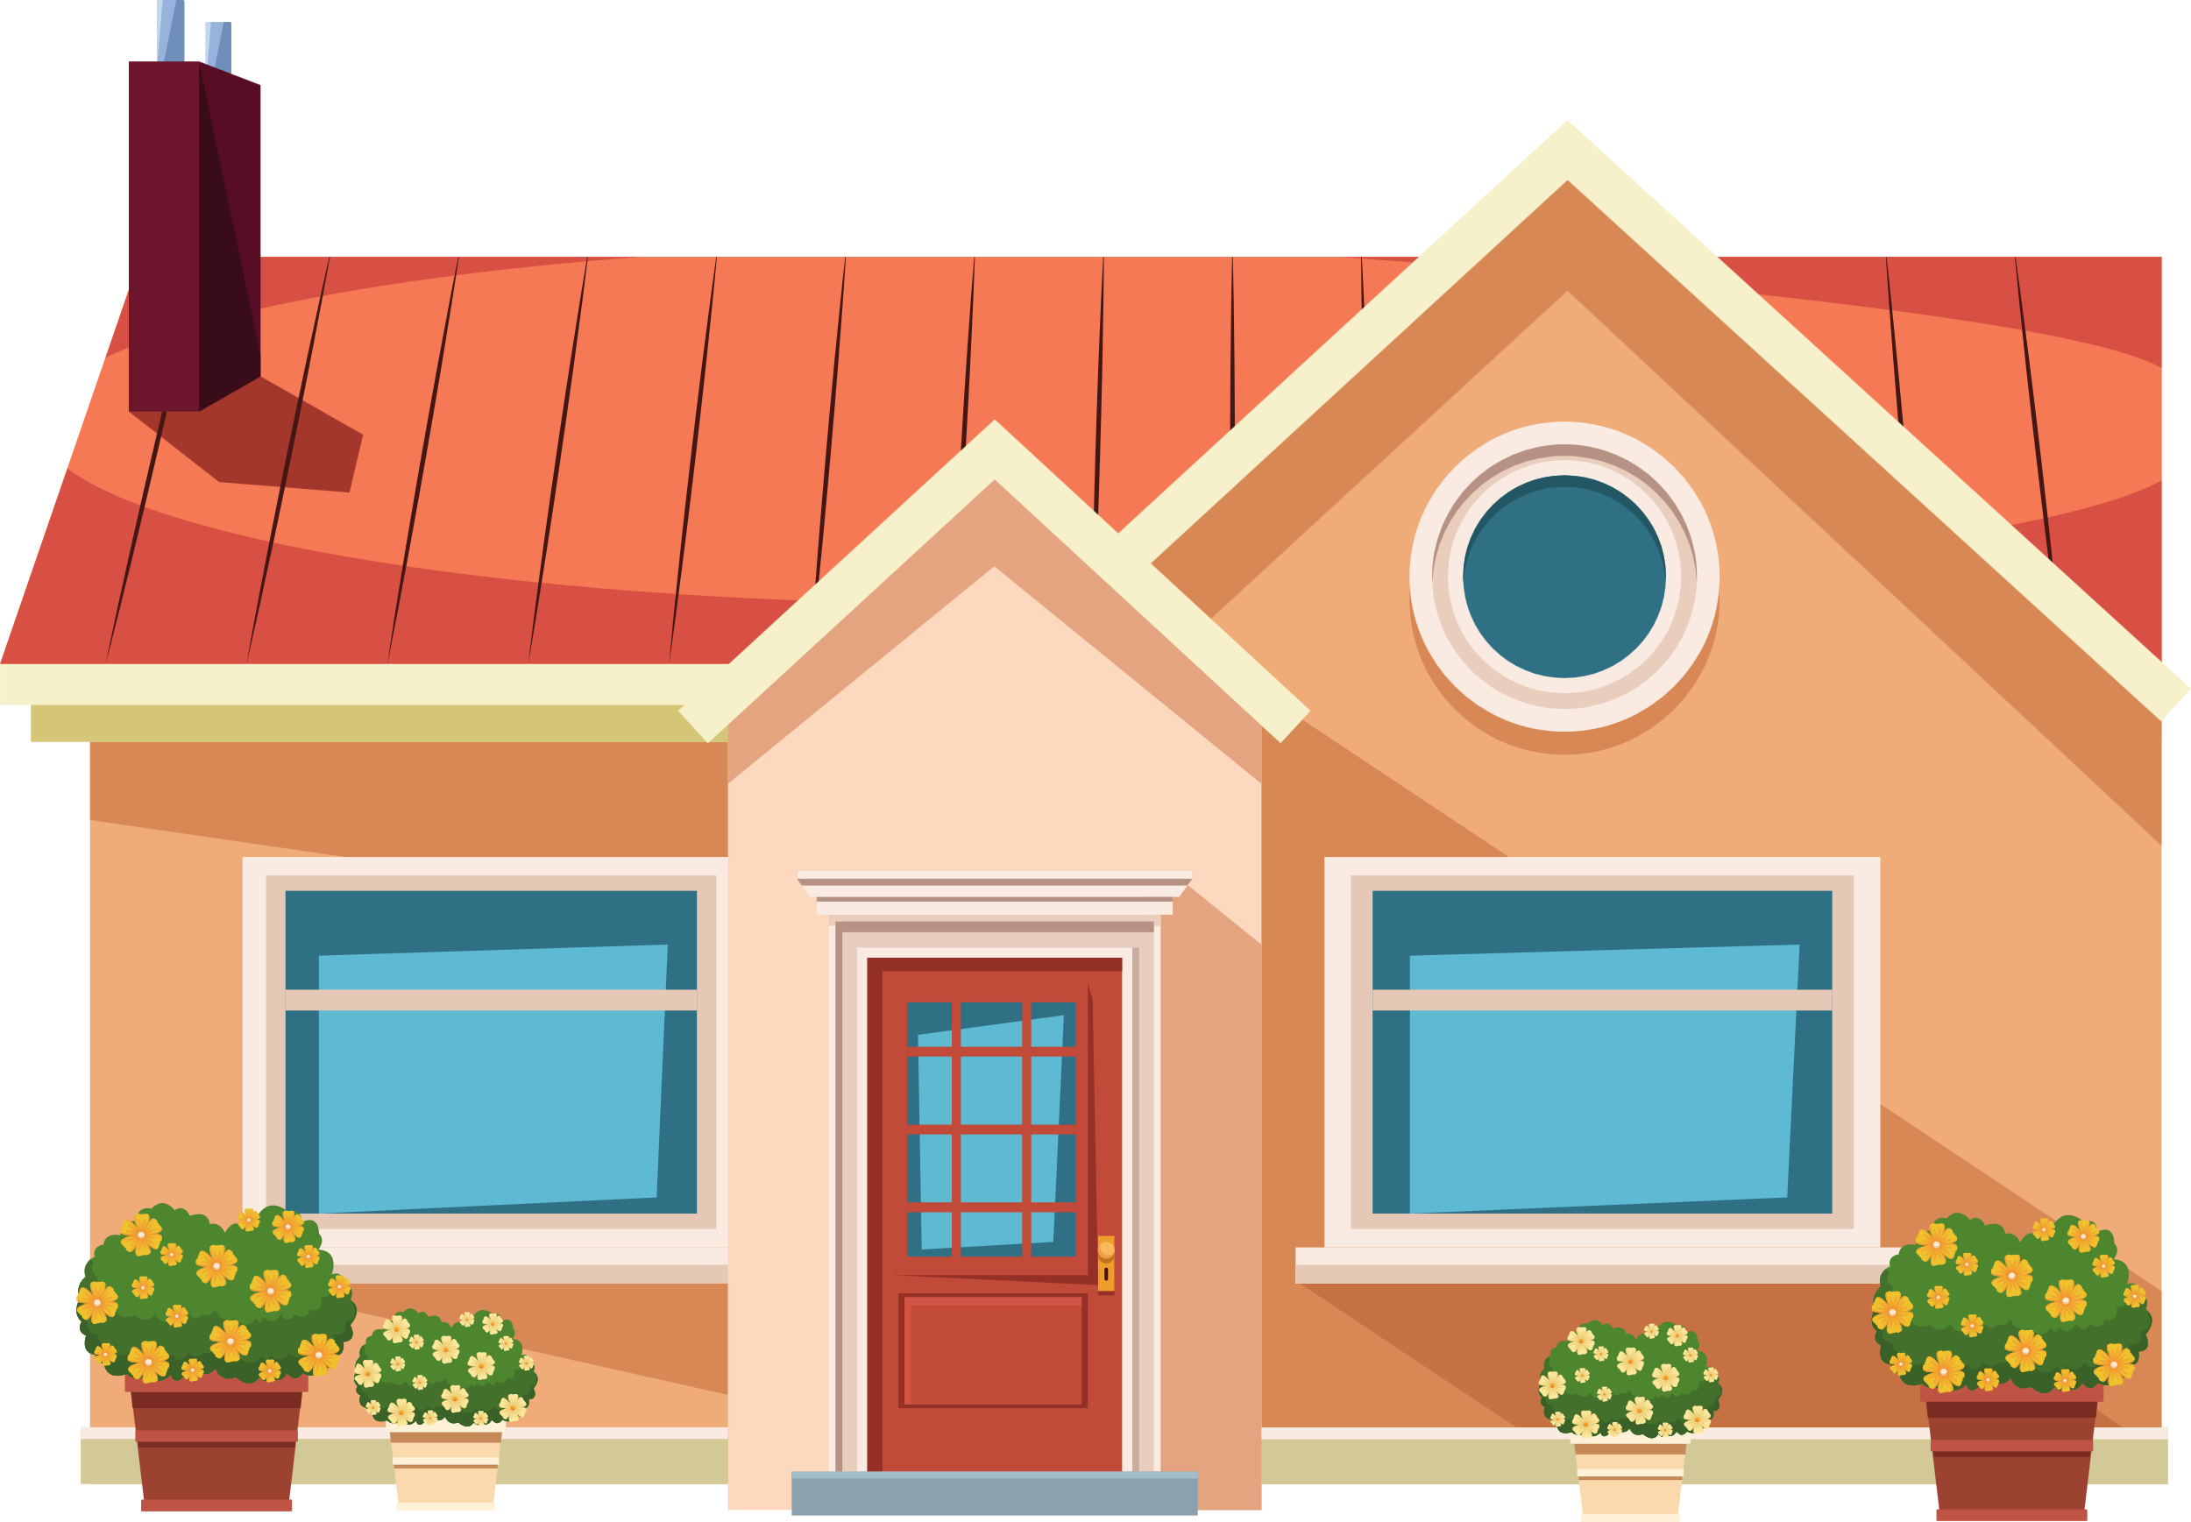


This is my house.
There is a red door.

Slide 3
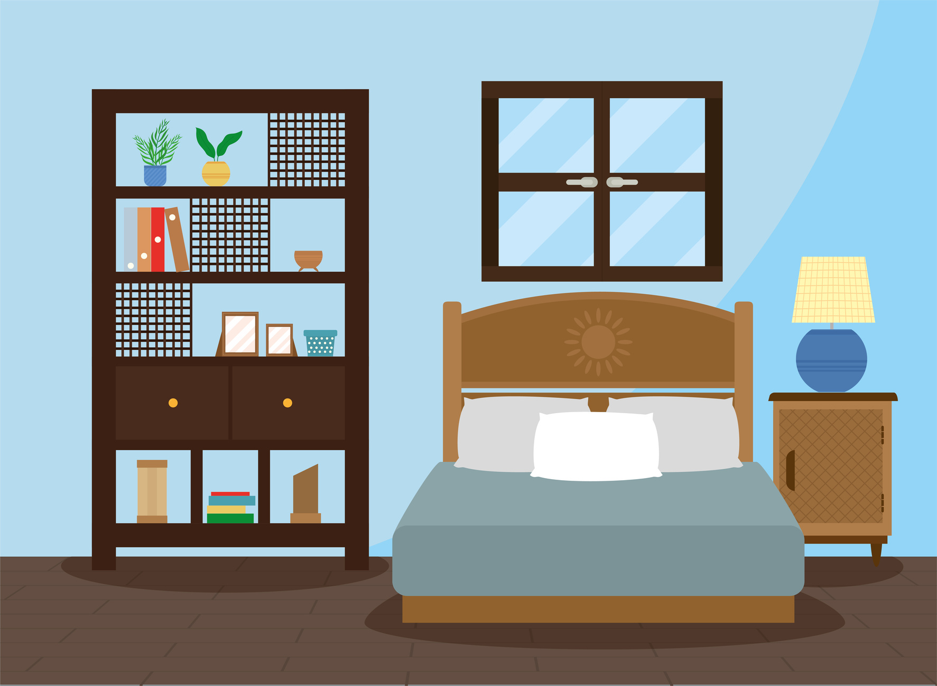
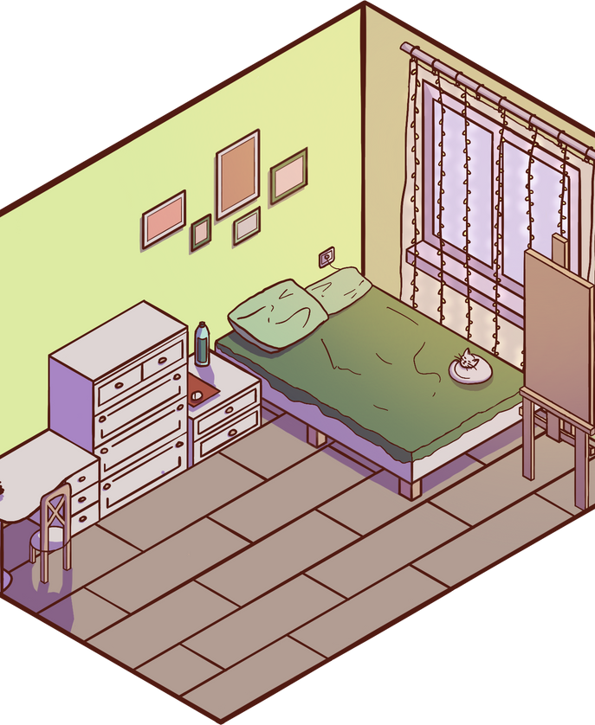
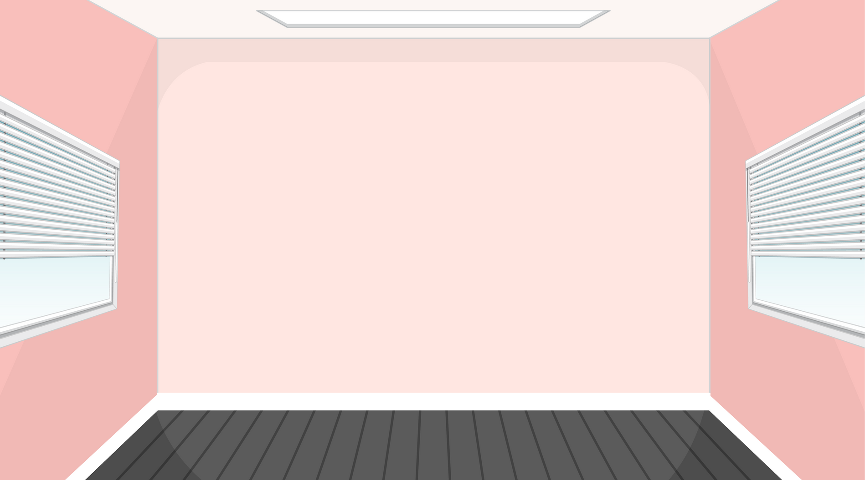
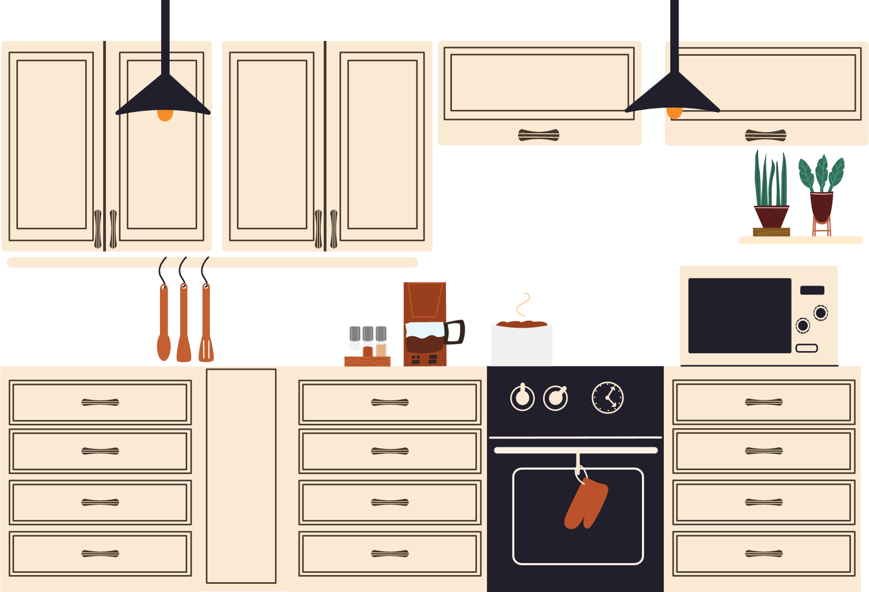
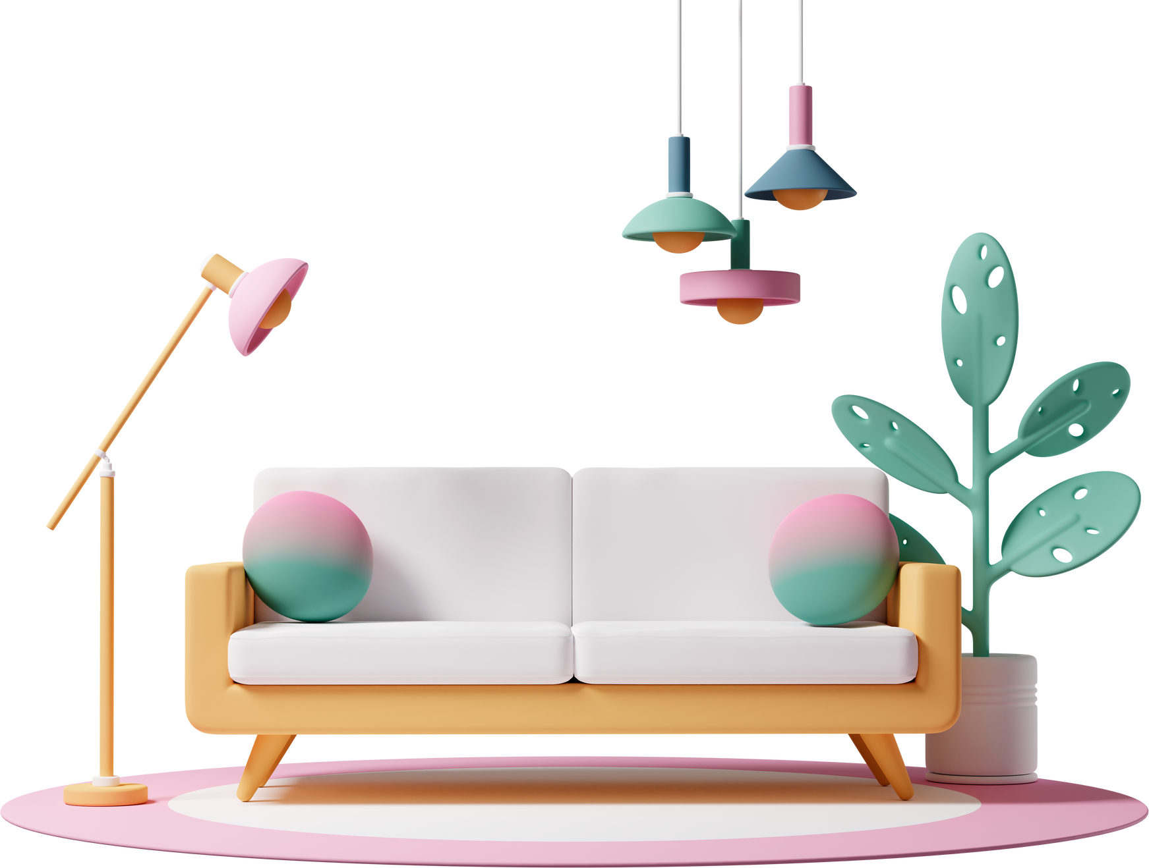
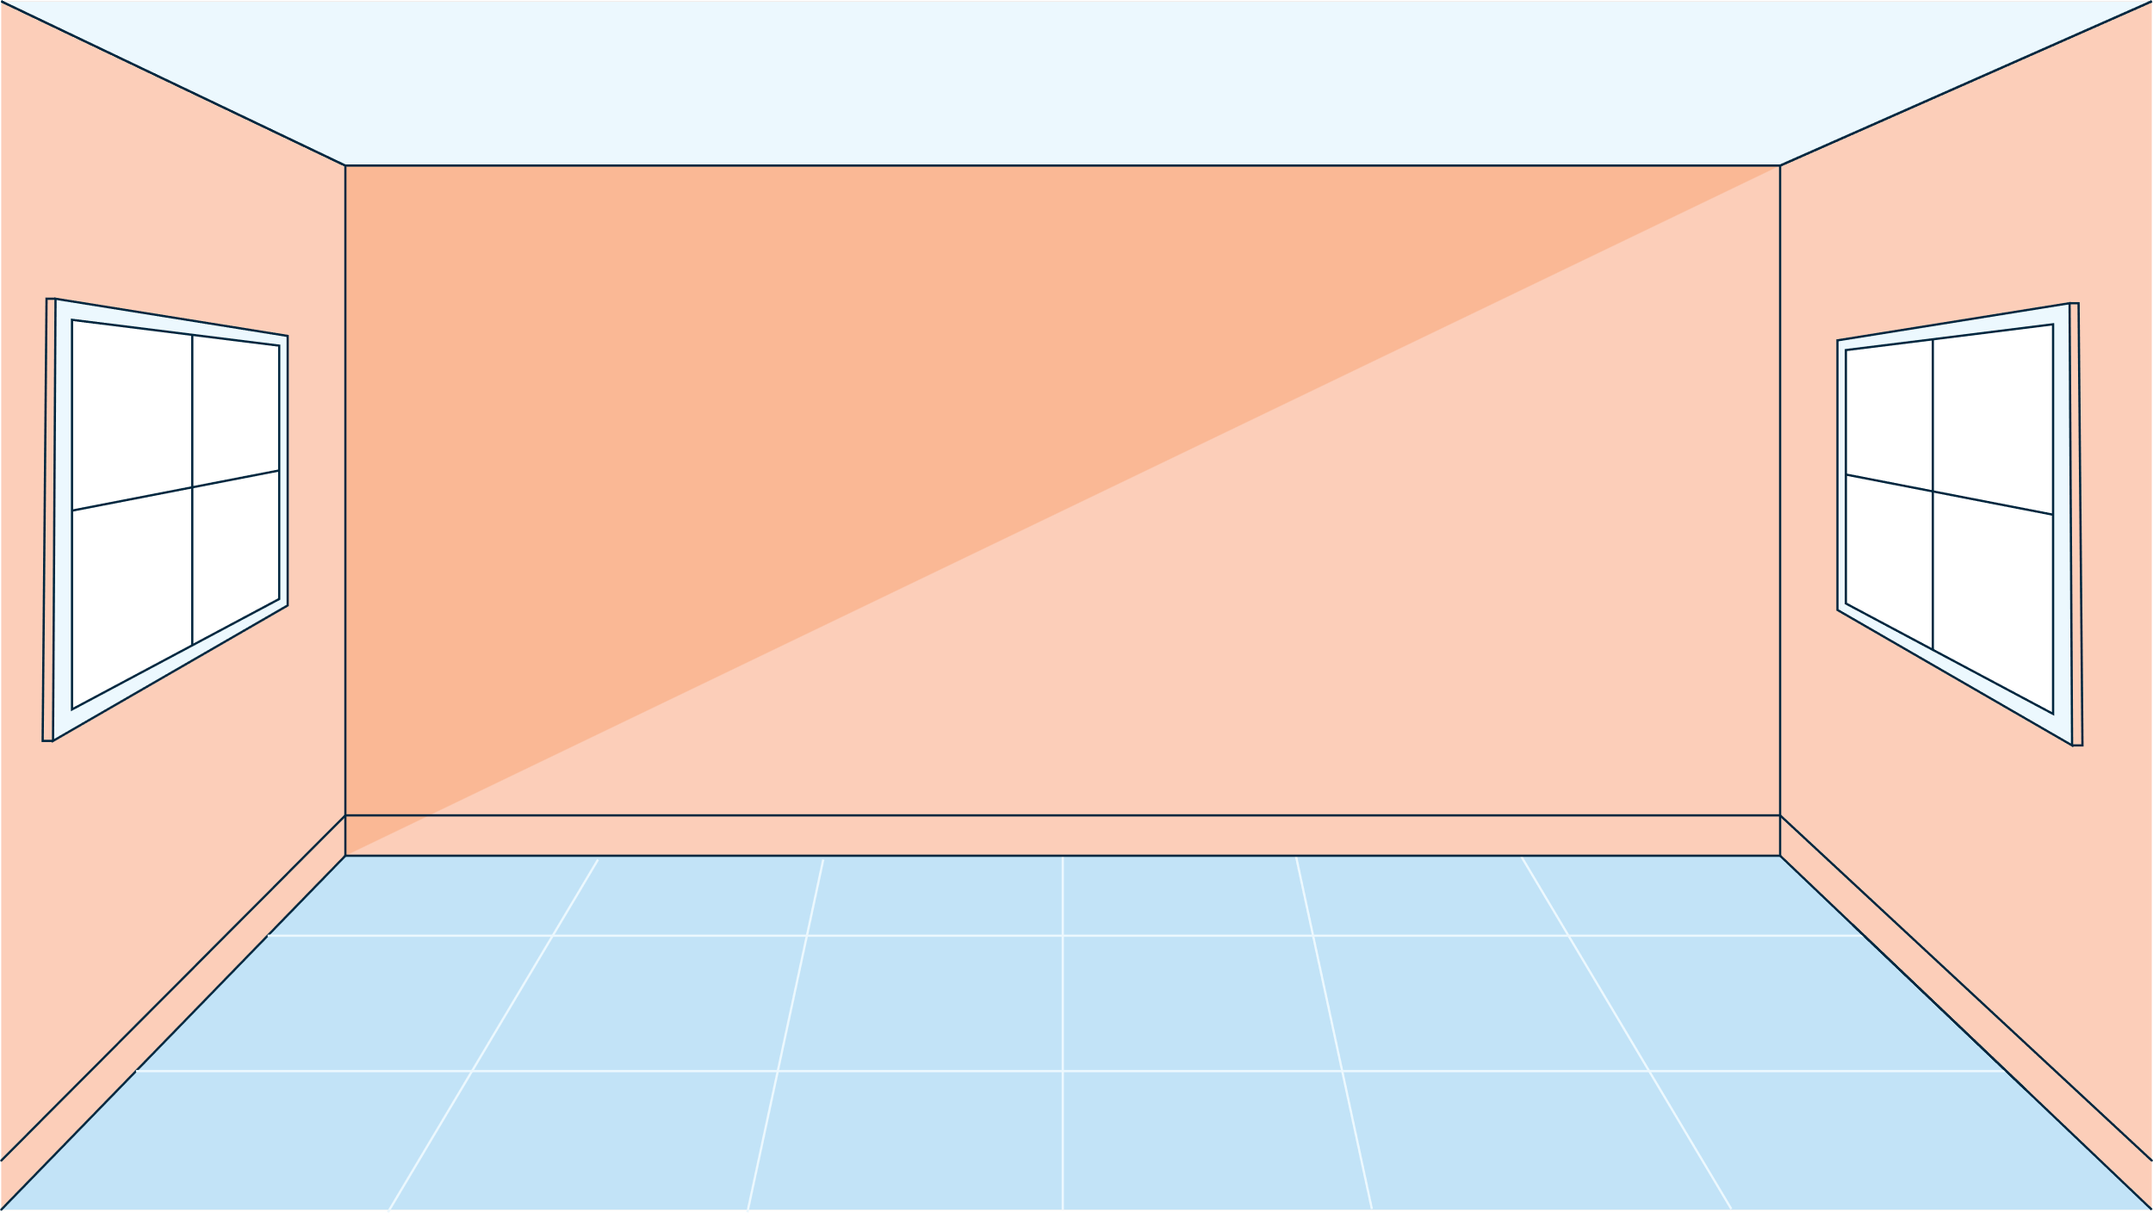
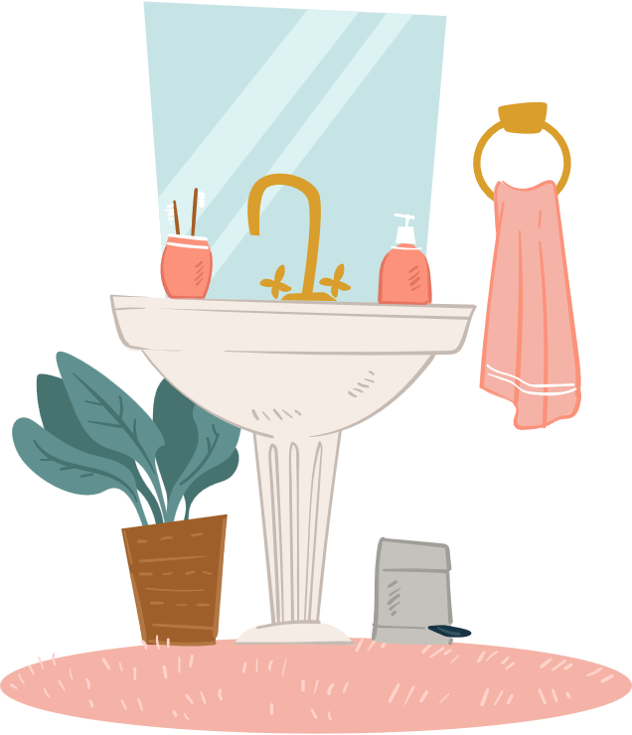
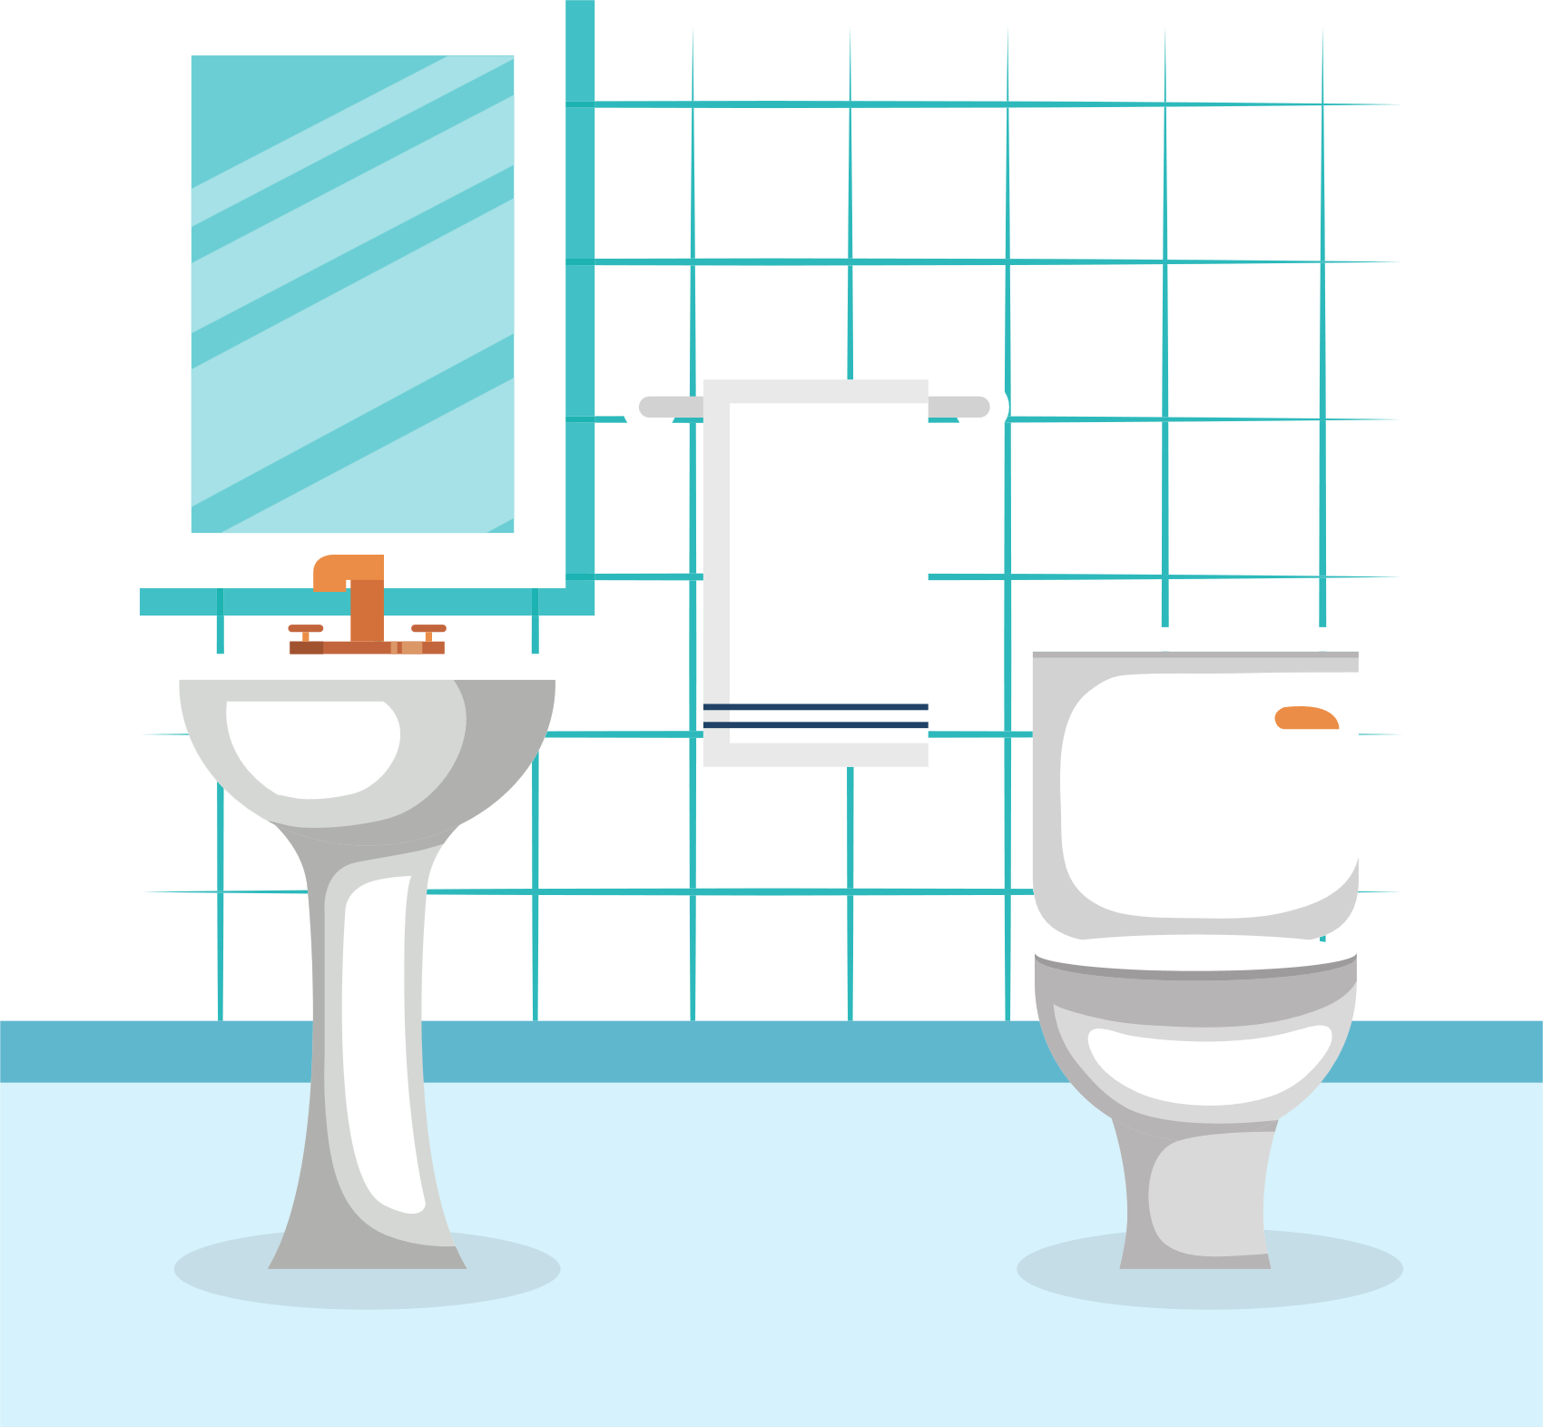
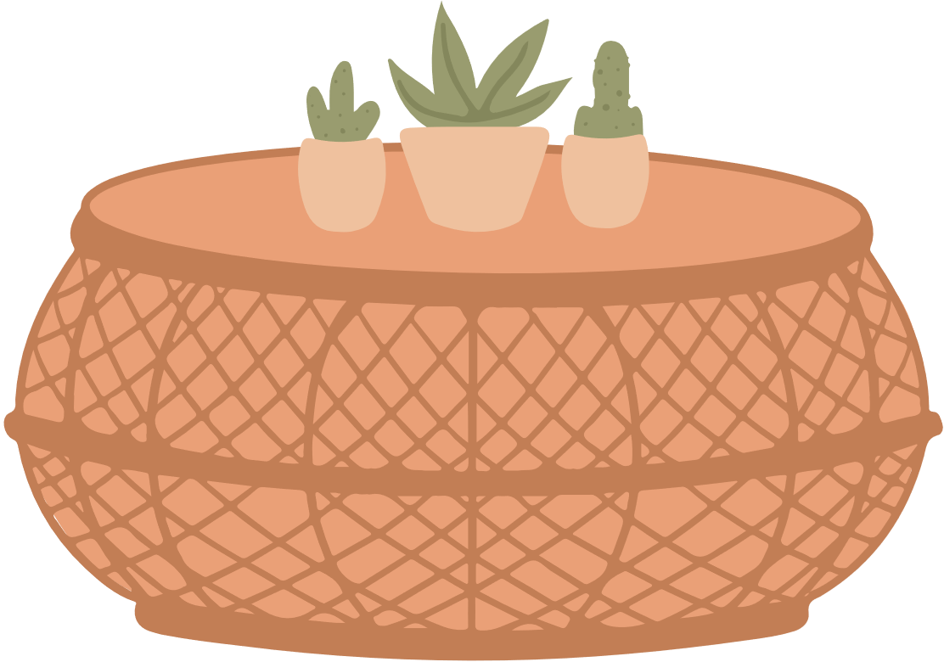
There are...
2 bedrooms
1 kitchen
1 living room
2 bathrooms

Slide 4
There is a small garden.

Slide 5
There are yellow flowers in the garden.

Slide 6
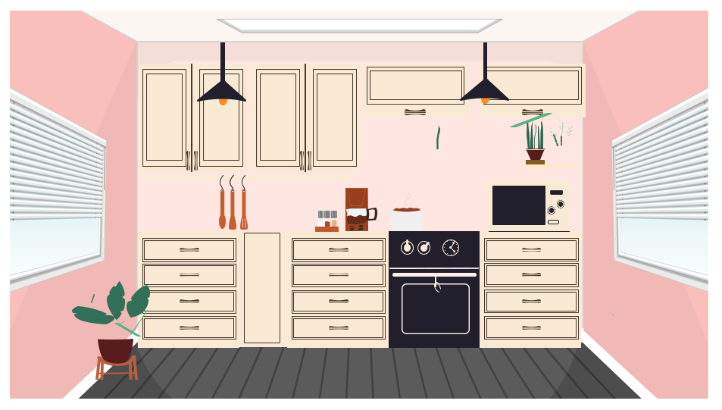
My mum likes the new kitchen. It has a pink wall.

Slide 7
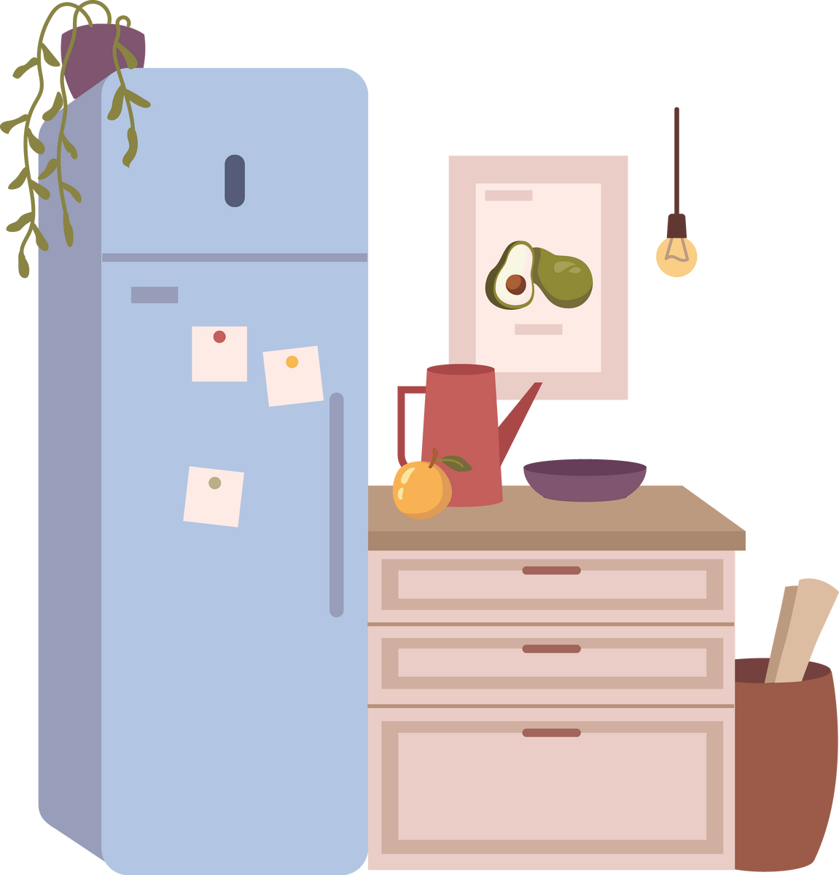
The cupboard is next to the fridge.

Slide 8
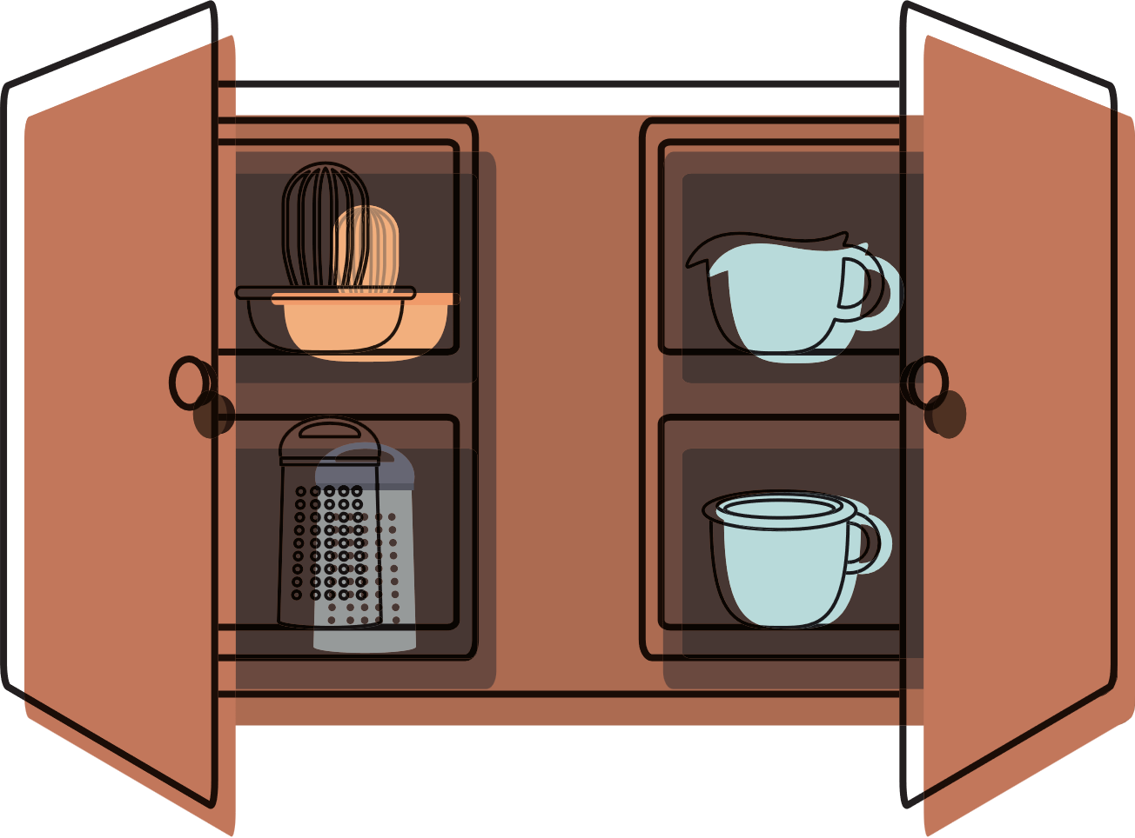
There are pots and pans in the cupboard.

Slide 9
The living room is very big.

Slide 10


The TV is on the green wall.

Slide 11
The lamp is next to the sofa.
There is a green plant in the white pot.

Slide 12
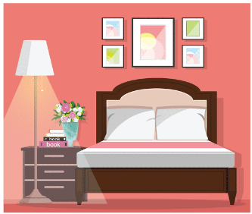
There are 2 bedrooms.
My bedroom is next to my parents’ bedroom.

Slide 13
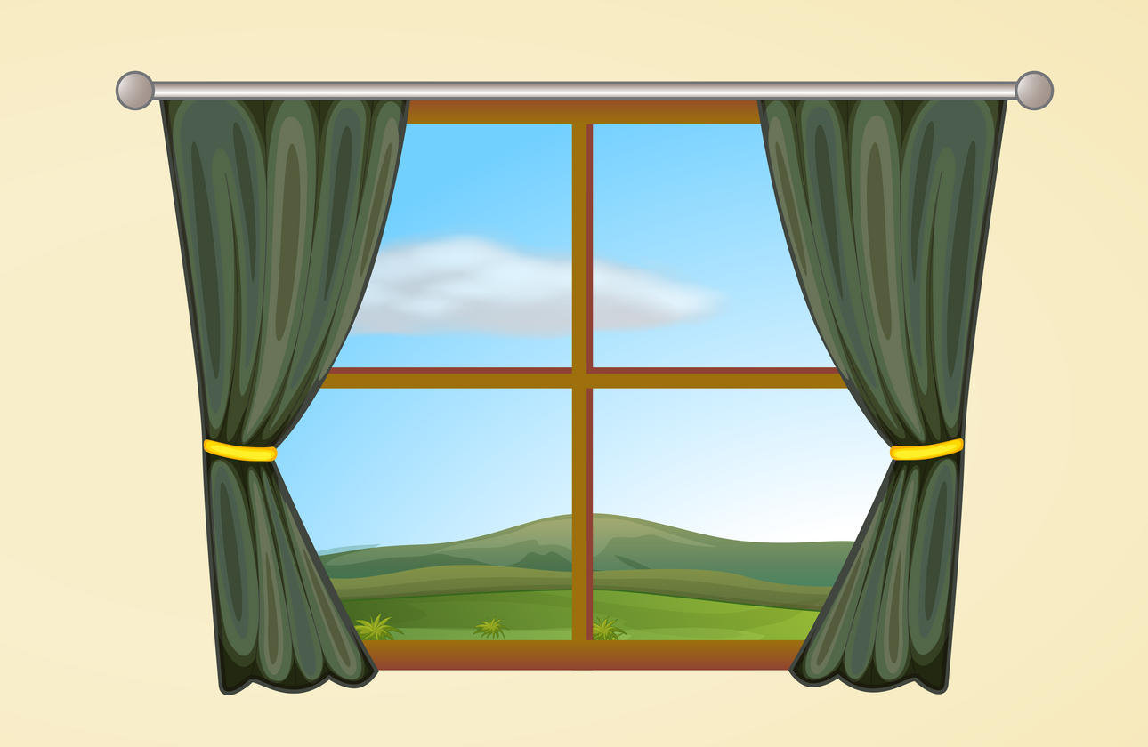
I like looking out to a beautiful garden from my window.

Slide 14

© State of New South Wales (Department of Education) 2023

