Slide 1
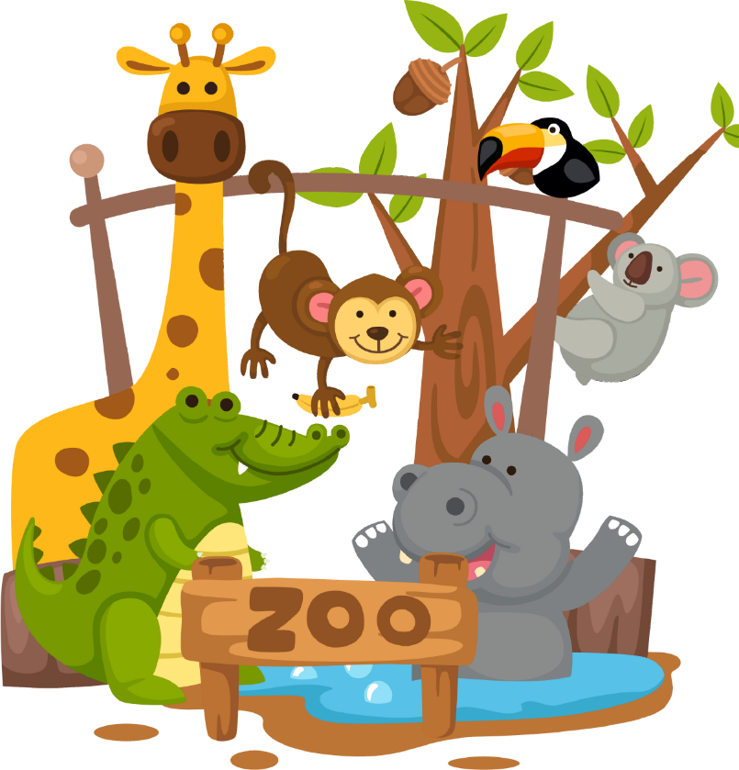
Zoo much fun
Stage 3 Chinese

Slide 2

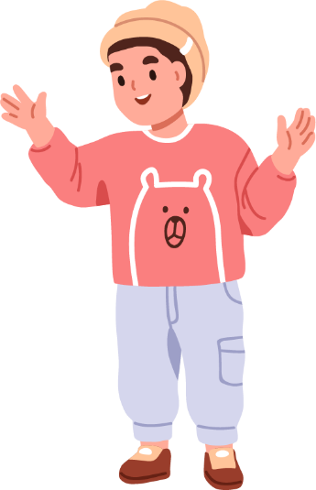
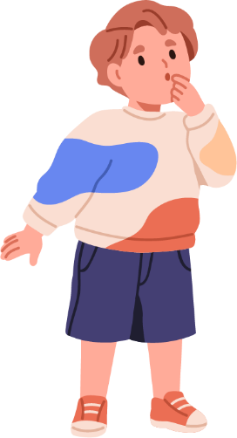
Mingming is David’s cousin. He came to Sydney from China for holidays.
David
Mingming

Slide 3
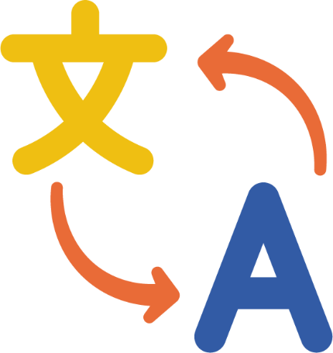
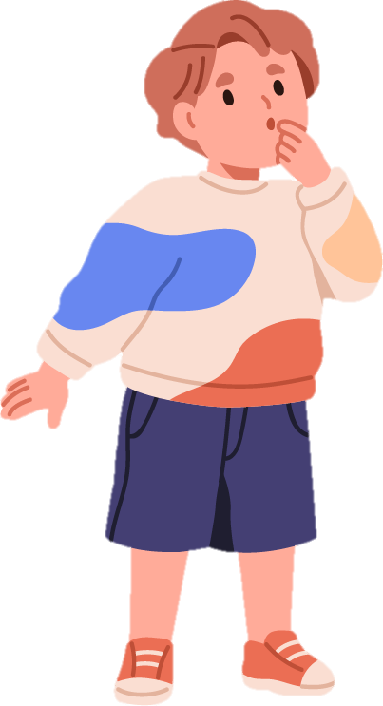
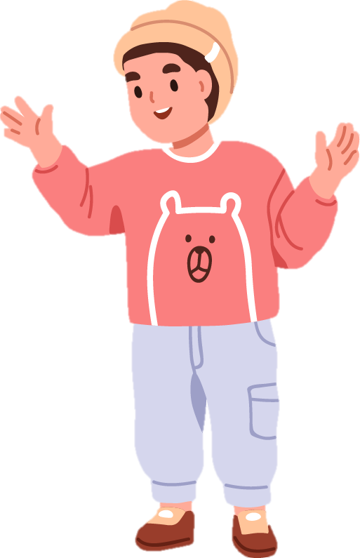

Mingming is learning English and David is learning Chinese.

Slide 4
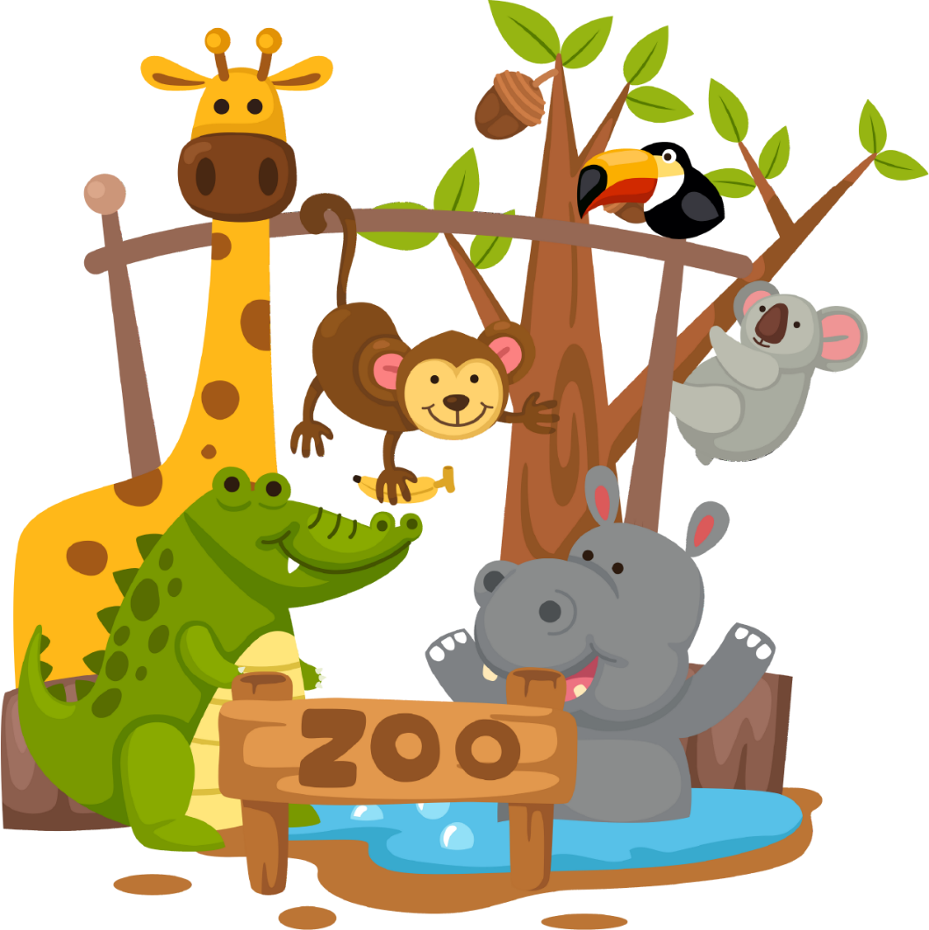
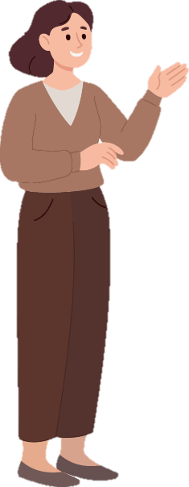
Mingming likes animals. David and his mum take Mingming to the zoo.

Slide 5

Let’s go and see the shizi first!

Slide 6

Do you mean rock?

Slide 7
No. It’s shizi (lion).

Slide 8
Could you say it again, please?

Slide 9
Shizi (lion)

Slide 10
What does it look like?

Slide 11
It is big. It is yellow. It has a golden mane.

Slide 12


Ah! You’re talking about a lion, not a rock

Slide 13
I wonder what lions eat!

Slide 14

Lions are carnivores. They eat meat.

Slide 15
What is its habitat?
The habitat of a lion is grasslands.

Slide 16
Can you please speak slower?
The habitat of a lion is grasslands. (says slower)

Slide 17
I see …

Slide 18
Do you mean lions are carnivores and their habitat is grasslands?

Slide 19
Yes!

Slide 20

Mingming, what animal do you want to see next?

Slide 21
David, how do you say daishu in English?

Slide 22
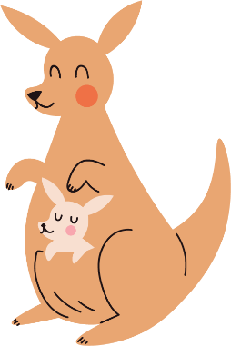
Kangaroo

Slide 23
Great! Where do kangaroos live?
Kangaroos live in grasslands.

Slide 24
Okay! What do Kangaroos eat?
Kangaroos are herbivores. They eat grass.

Slide 25
Great! Let’s go and see other animals.

Slide 26
David and Mingming saw many animals in the zoo. They were tired, but very happy.

Slide 27
Copyright
© State of New South Wales (Department of Education), 2024
The copyright material published in this resource is subject to the Copyright Act 1968 (Cth) and is owned by the NSW Department of Education or, where indicated, by a party other than the NSW Department of Education (third-party material).
Copyright material available in this resource and owned by the NSW Department of Education is licensed under a Creative Commons Attribution 4.0 International (CC BY 4.0) license.
This license allows you to share and adapt the material for any purpose, even commercially.
Attribution should be given to © State of New South Wales (Department of Education), 2024.
Material in this resource not available under a Creative Commons license:
the NSW Department of Education logo, other logos and trademark-protected material
Material owned by a third party that has been reproduced with permission. You will need to obtain permission from the third party to reuse its material.
Links to third-party material and websites
Please note that the provided (reading/viewing material/list/links/texts) are a suggestion only and implies no endorsement, by the New South Wales Department of Education, of any author, publisher, or book title. School principals and teachers are best placed to assess the suitability of resources that would complement the curriculum and reflect the needs and interests of their students.
If you use the links provided in this document to access a third party’s website, you acknowledge that the terms of use, including licence terms set out on the third-party’s website apply to the use which may be made of the materials on that third-party website or where permitted by the Copyright Act 1968 (Cth). The department accepts no responsibility for content on third-party websites.

