Slide 1
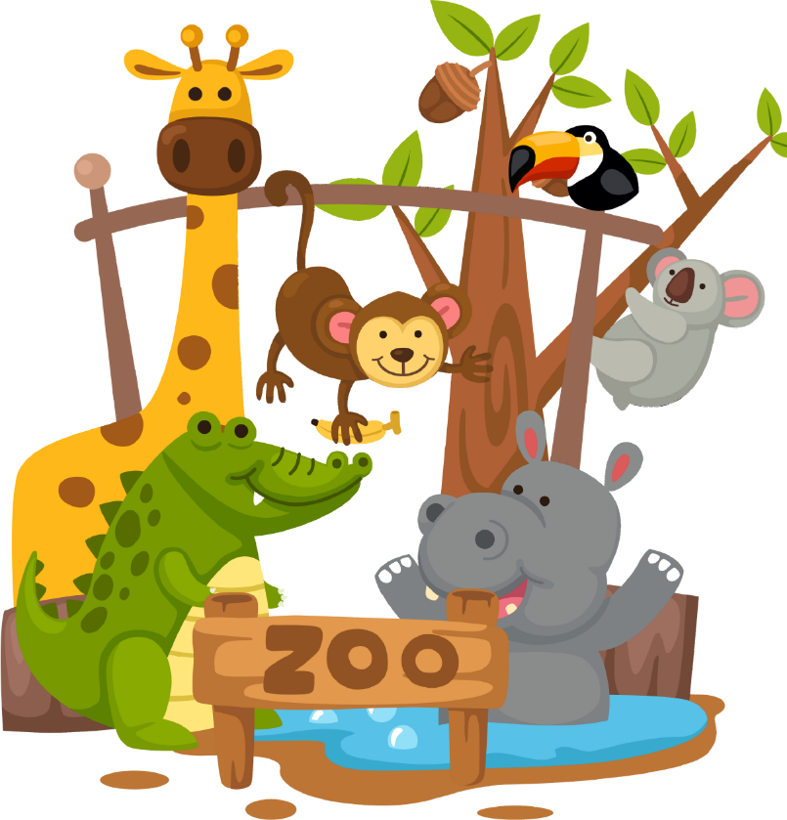
Zoo much fun
(中⽂版)
Stage 3 Chinese

Slide 2

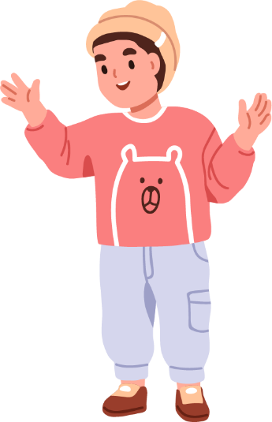
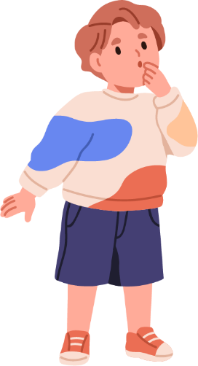
Mingming是David的表哥. 他从中国来悉尼度假.
David
Mingming

Slide 3
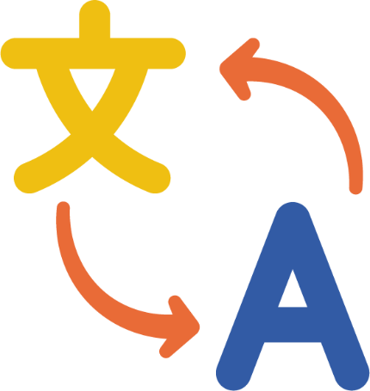
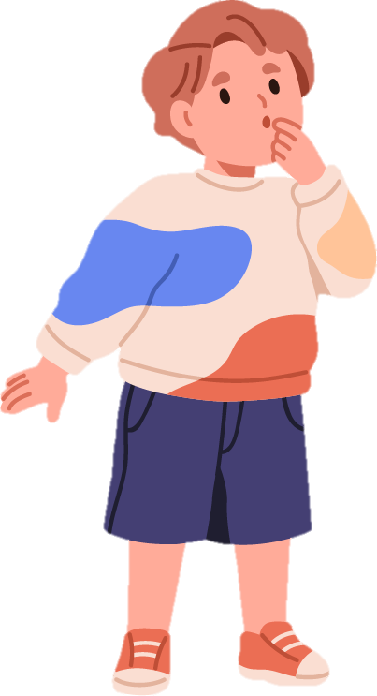
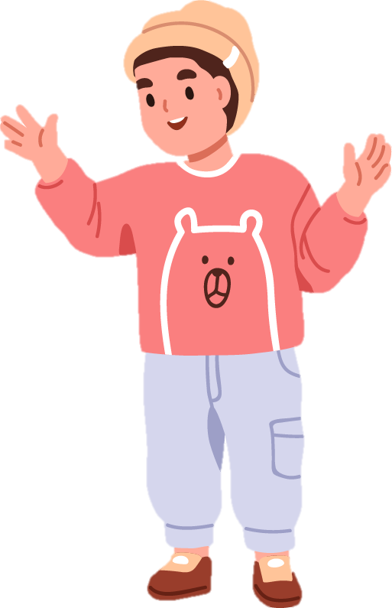

Mingming在学英文. David在学中文.

Slide 4
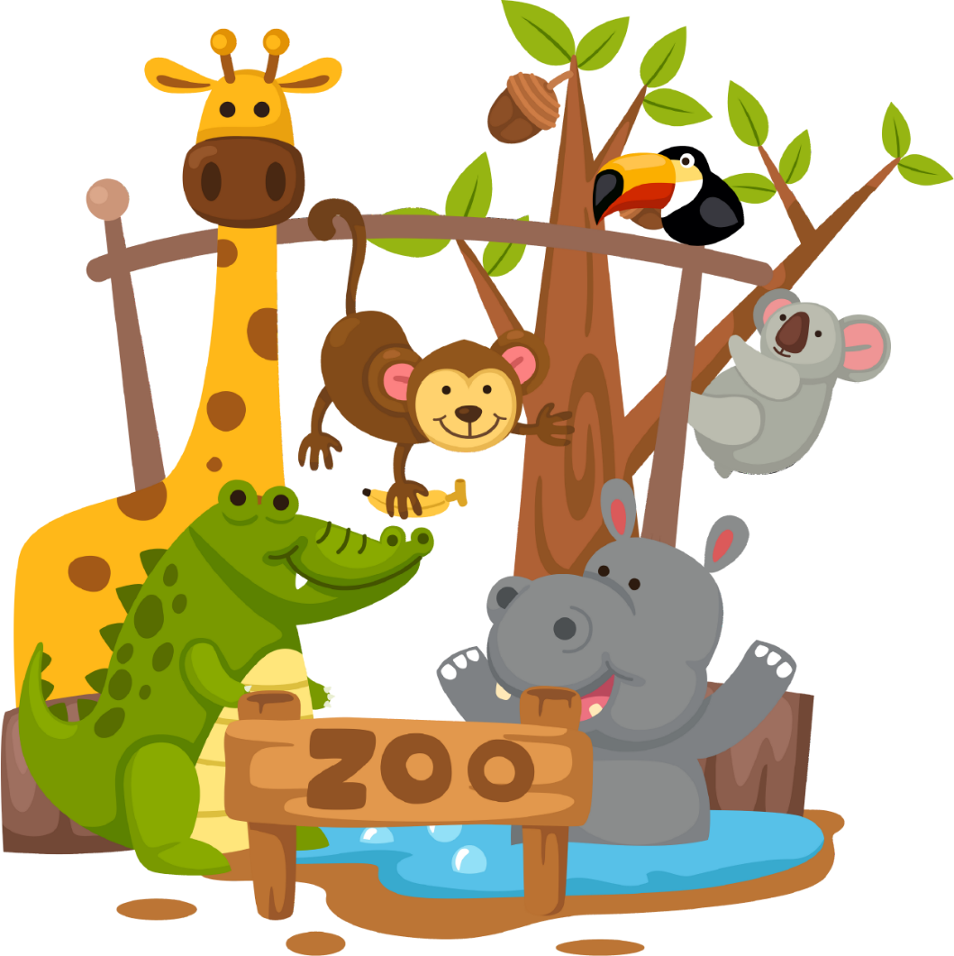
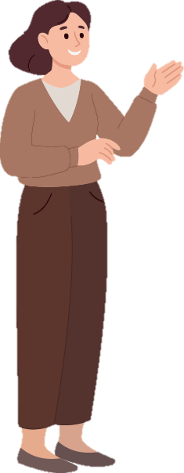
Mingming喜欢动物.​
David和他妈妈带
Mingming去动物园.

Slide 5

我们先去看石子!

Slide 6

你是指石子吗?

Slide 7
不是, 是狮子.

Slide 8
你能再说一遍吗?

Slide 9
狮子

Slide 10
它长什么样?

Slide 11
它很大.它是黄色的.​
它有金色鬣毛.

Slide 12


Ah, 你指 狮子不是 石子!​

Slide 13
狮子吃什么?​

Slide 14
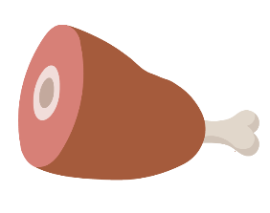
狮子是肉食动物.​ 它吃肉.

Slide 15
狮子的栖息地是什么?​
狮子的栖息地是草原.

Slide 16
你能说慢一点吗？​
狮子的栖息地是草原.

Slide 17
我懂了.

Slide 18
你是说狮子是肉食动物和它们的栖息地是草原吗？

Slide 19
是的.

Slide 20
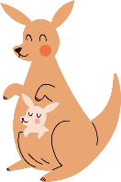
Mingming, 你还想要看什么动物?​

Slide 21
David, 袋鼠的英文翻译是什么?​

Slide 22

Kangaroo

Slide 23
太棒了! 袋鼠住在哪里?​
袋鼠住在草原里.

Slide 24
袋鼠吃什么？​
袋鼠是草食动物.​
它吃草.

Slide 25
好!
我们再去看其他的动物吧!

Slide 26
David和Mingming 在动物园看到了许多动物. ​
他们很累但很开心.

Slide 27
Copyright
© State of New South Wales (Department of Education), 2024
The copyright material published in this resource is subject to the Copyright Act 1968 (Cth) and is owned by the NSW Department of Education or, where indicated, by a party other than the NSW Department of Education (third-party material).
Copyright material available in this resource and owned by the NSW Department of Education is licensed under a Creative Commons Attribution 4.0 International (CC BY 4.0) license.
This license allows you to share and adapt the material for any purpose, even commercially.
Attribution should be given to © State of New South Wales (Department of Education), 2024.
Material in this resource not available under a Creative Commons license:
the NSW Department of Education logo, other logos and trademark-protected material
Material owned by a third party that has been reproduced with permission. You will need to obtain permission from the third party to reuse its material.
Links to third-party material and websites
Please note that the provided (reading/viewing material/list/links/texts) are a suggestion only and implies no endorsement, by the New South Wales Department of Education, of any author, publisher, or book title. School principals and teachers are best placed to assess the suitability of resources that would complement the curriculum and reflect the needs and interests of their students.
If you use the links provided in this document to access a third party’s website, you acknowledge that the terms of use, including licence terms set out on the third-party’s website apply to the use which may be made of the materials on that third-party website or where permitted by the Copyright Act 1968 (Cth). The department accepts no responsibility for content on third-party websites.

