Slide 1
Learning map – How’s the weather?
Stage 2 – Korean

Slide 2




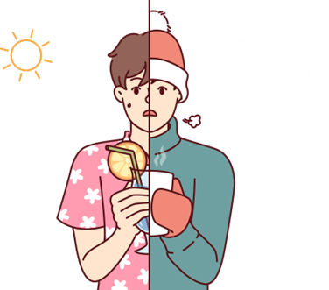
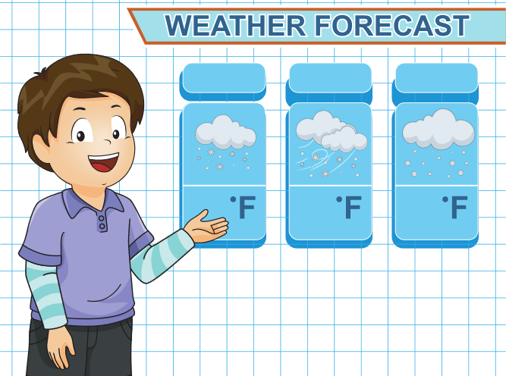




Learning map – How’s the weather?
Stage 2
Weather
Locations and activities
Weather forecast
Sentence building
Assessment criteria and practice task
Language review
Feedback and goal setting
Final task (Diary entry)

Slide 3
Learning map – 날씨 어때요?
Stage 2
날씨
장소와 활동
날씨 예보
문장 만들기
연습과제
언어 복습
피드백
최종 과제 (일기쓰기)

Slide 4

© State of New South Wales (Department of Education) 2023

