Slide 1
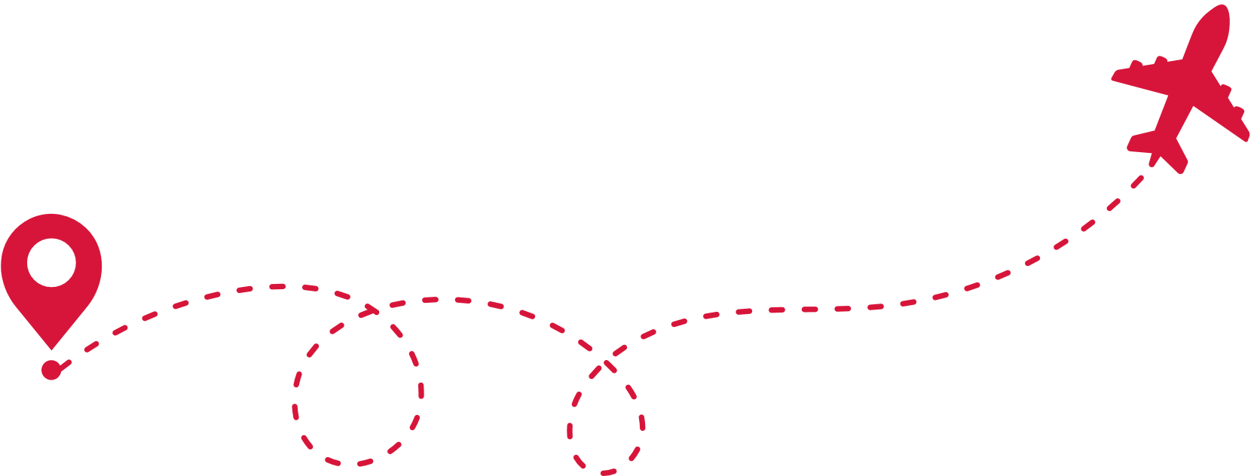
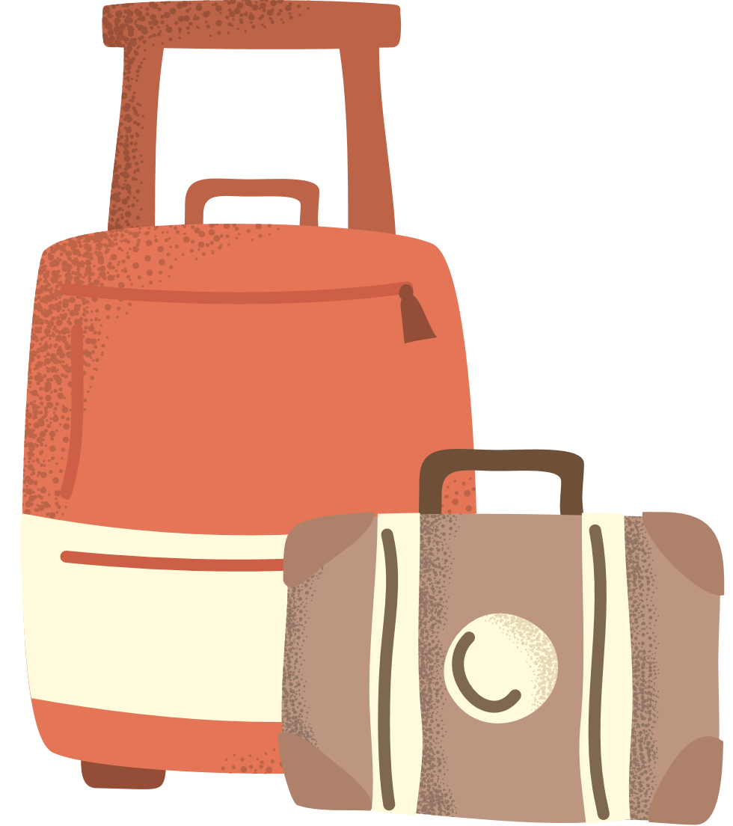
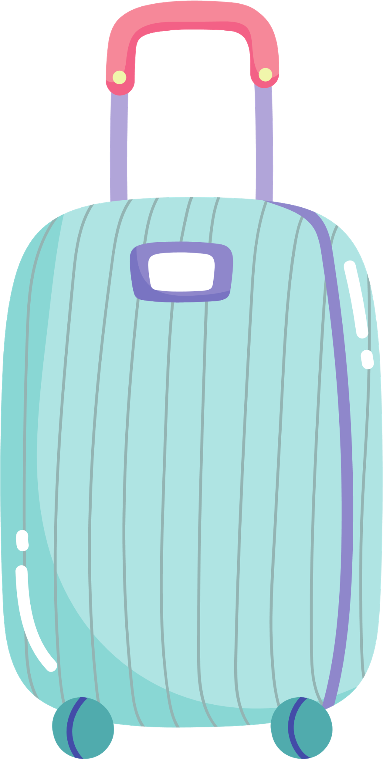
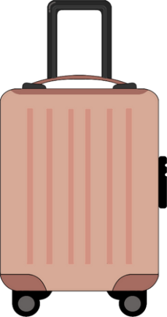
bāo li yǒu shén me
包里有什么？
Stage 1 Chinese

Slide 2
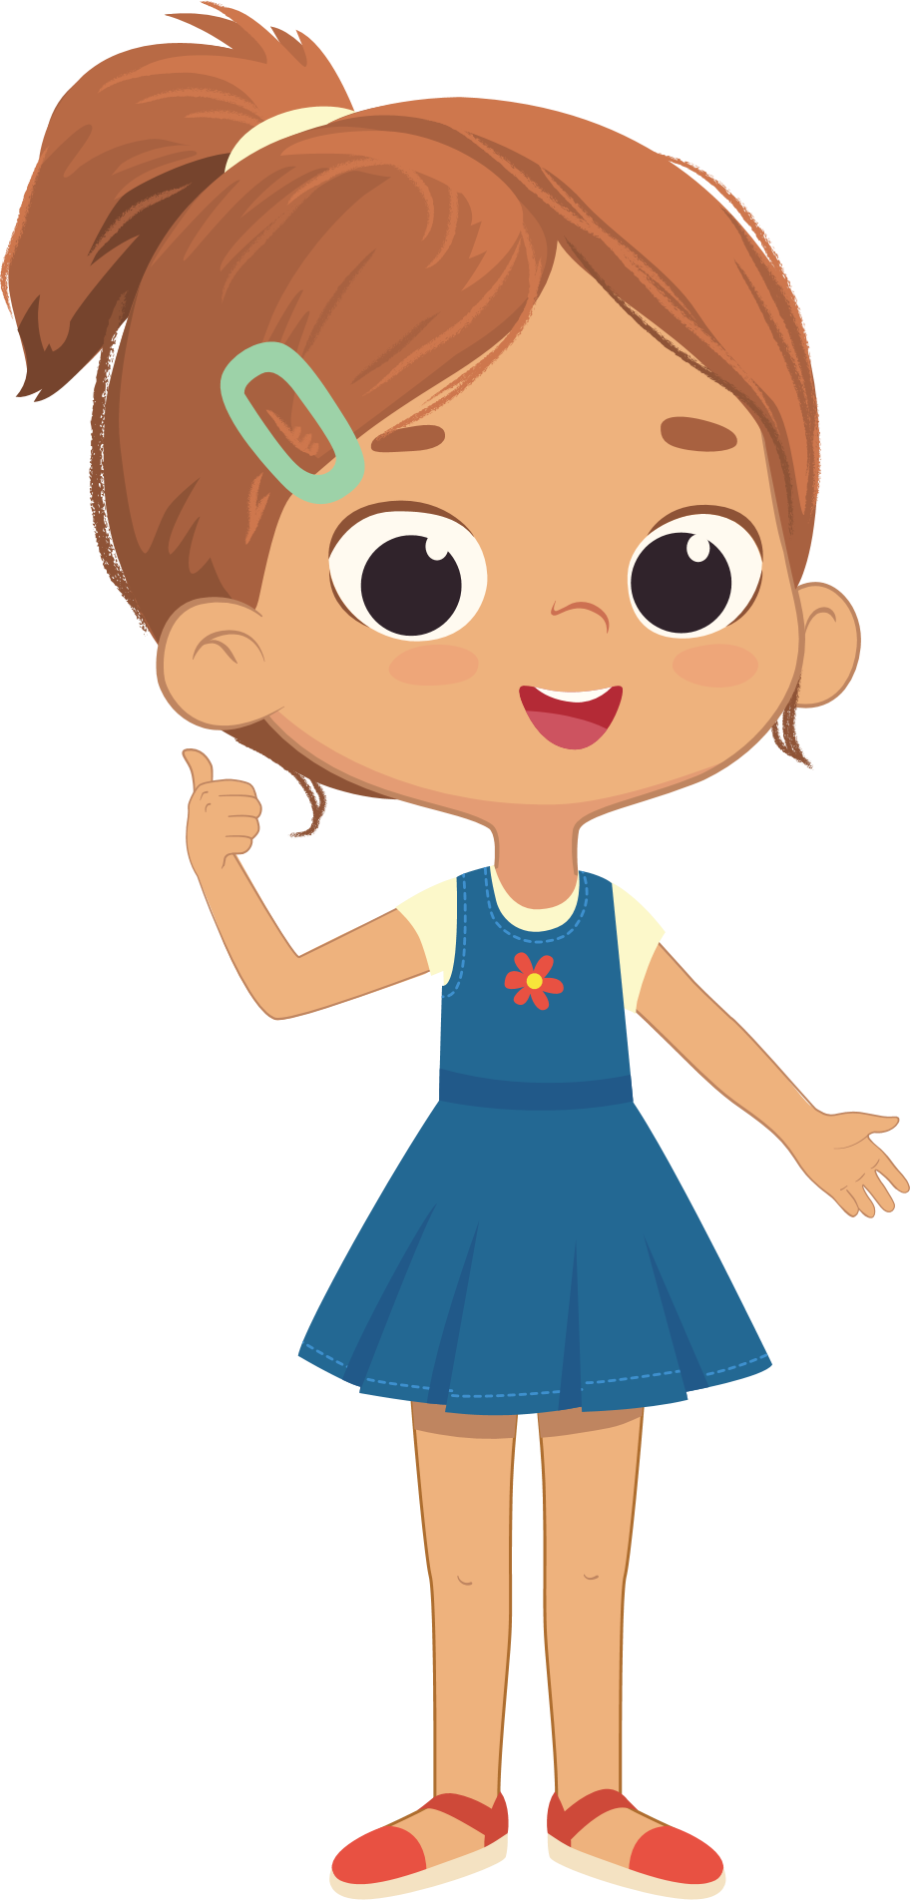
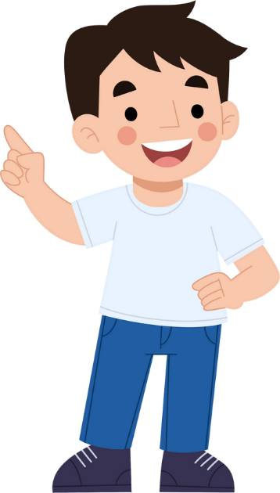
wǒ yào qù
我要去 dù jià
度假！

Slide 3
nǐ yào qù nǎr
你要去哪儿 dù jià
度假？

Slide 4
wǒ yào qù
我要去 xīn jiā pō
新加坡 !

Slide 5
Lì lì xīnjiāpō
丽丽，新加坡 xià tiān hěn rè, nǐ yào
夏天很热，你要 dài
带...

Slide 6

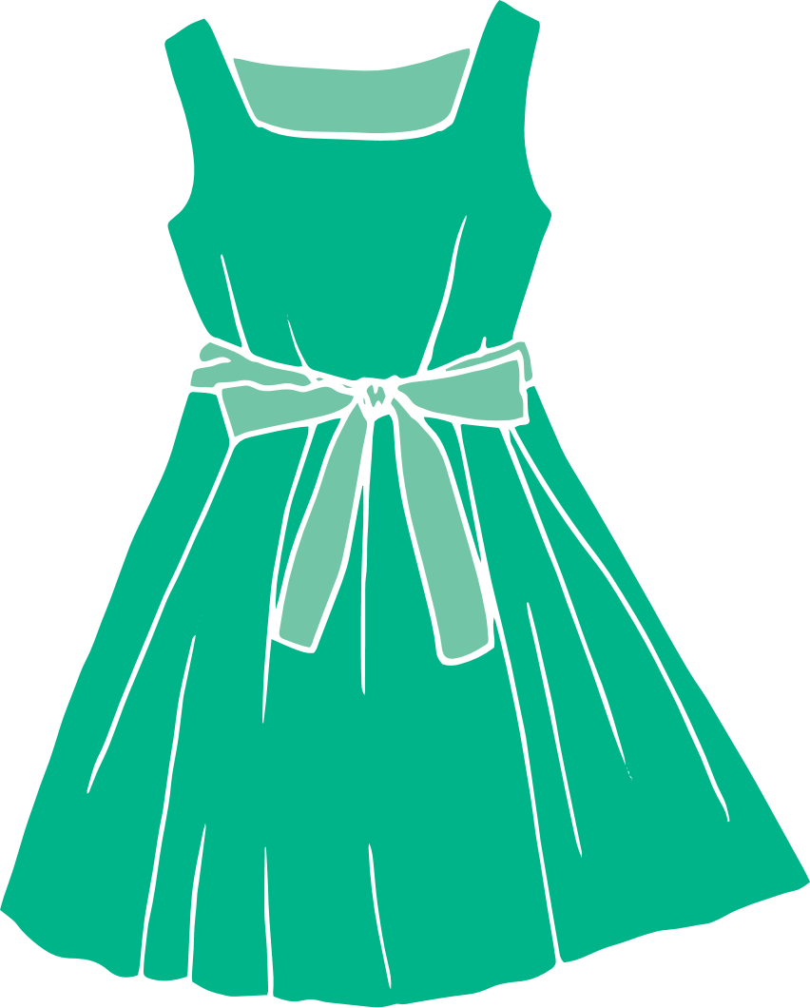
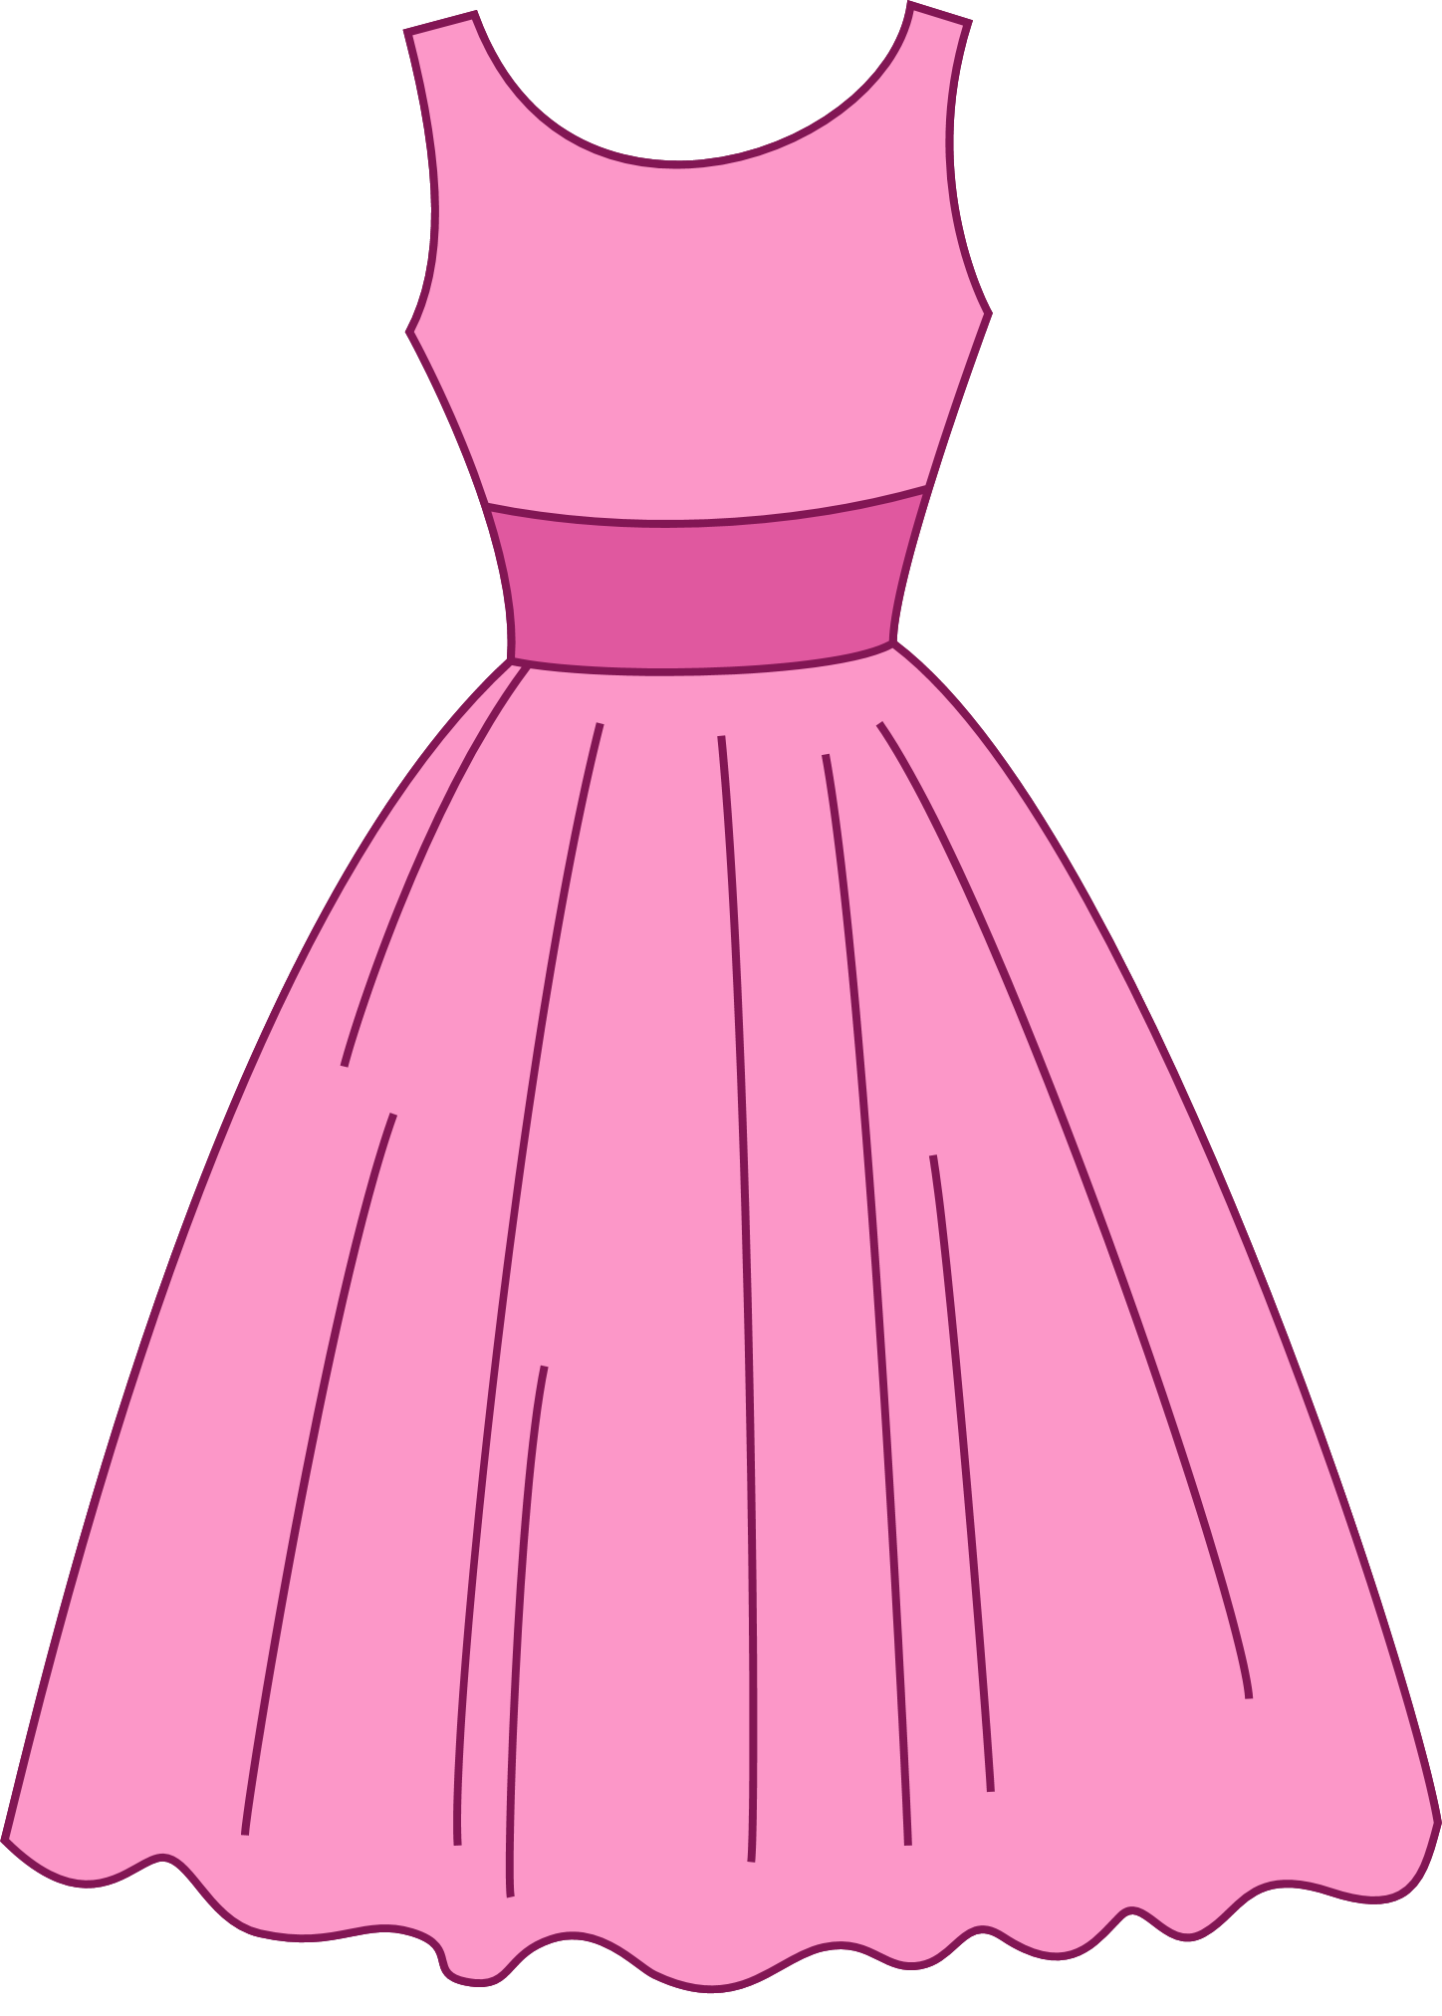
liányīqún
连衣裙

Slide 7
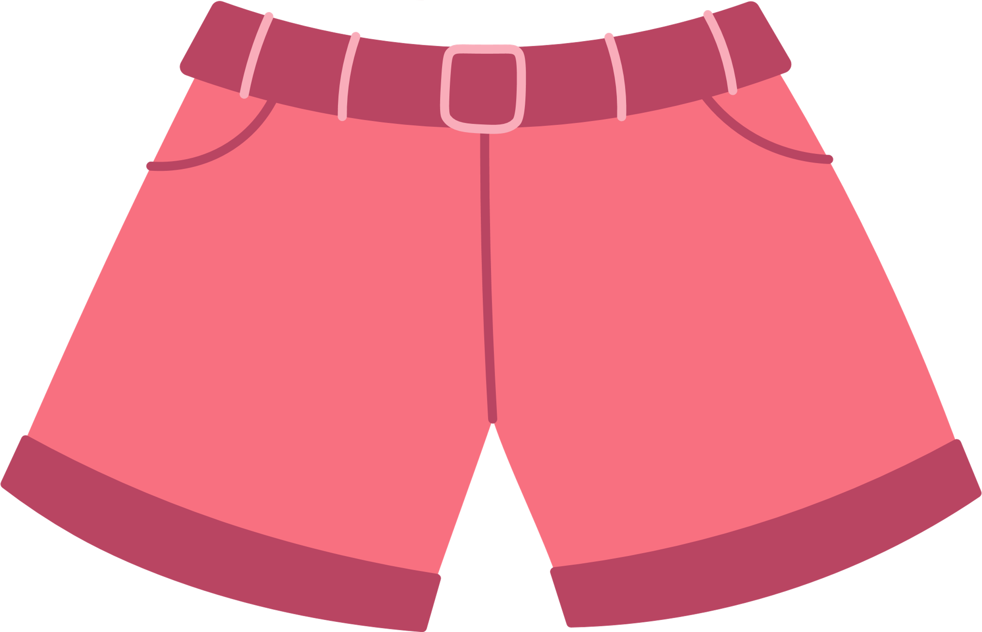
duǎnkù
短裤

Slide 8


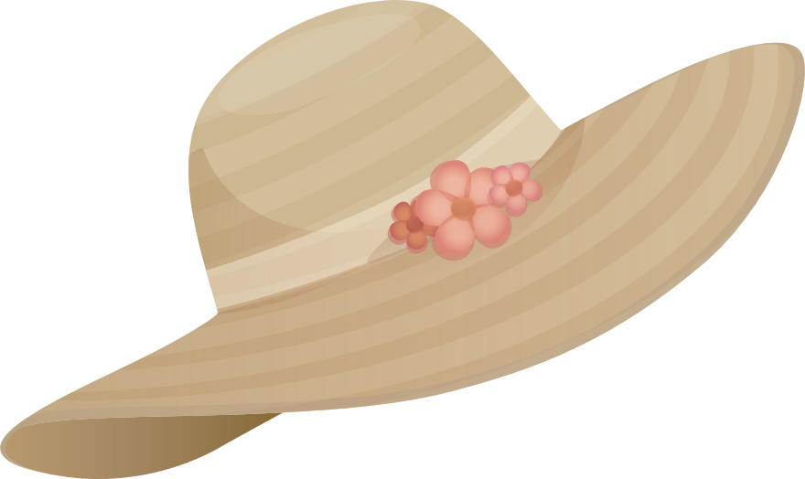
màozi
帽子

Slide 9
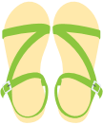
liángxié
凉鞋

Slide 10
tiānqì hěn rè, nǐ yào dài liányī qún
天气很热，你要带连衣裙、 duǎnkù, màozi hé liángxié
短裤、帽子和凉鞋。

Slide 11
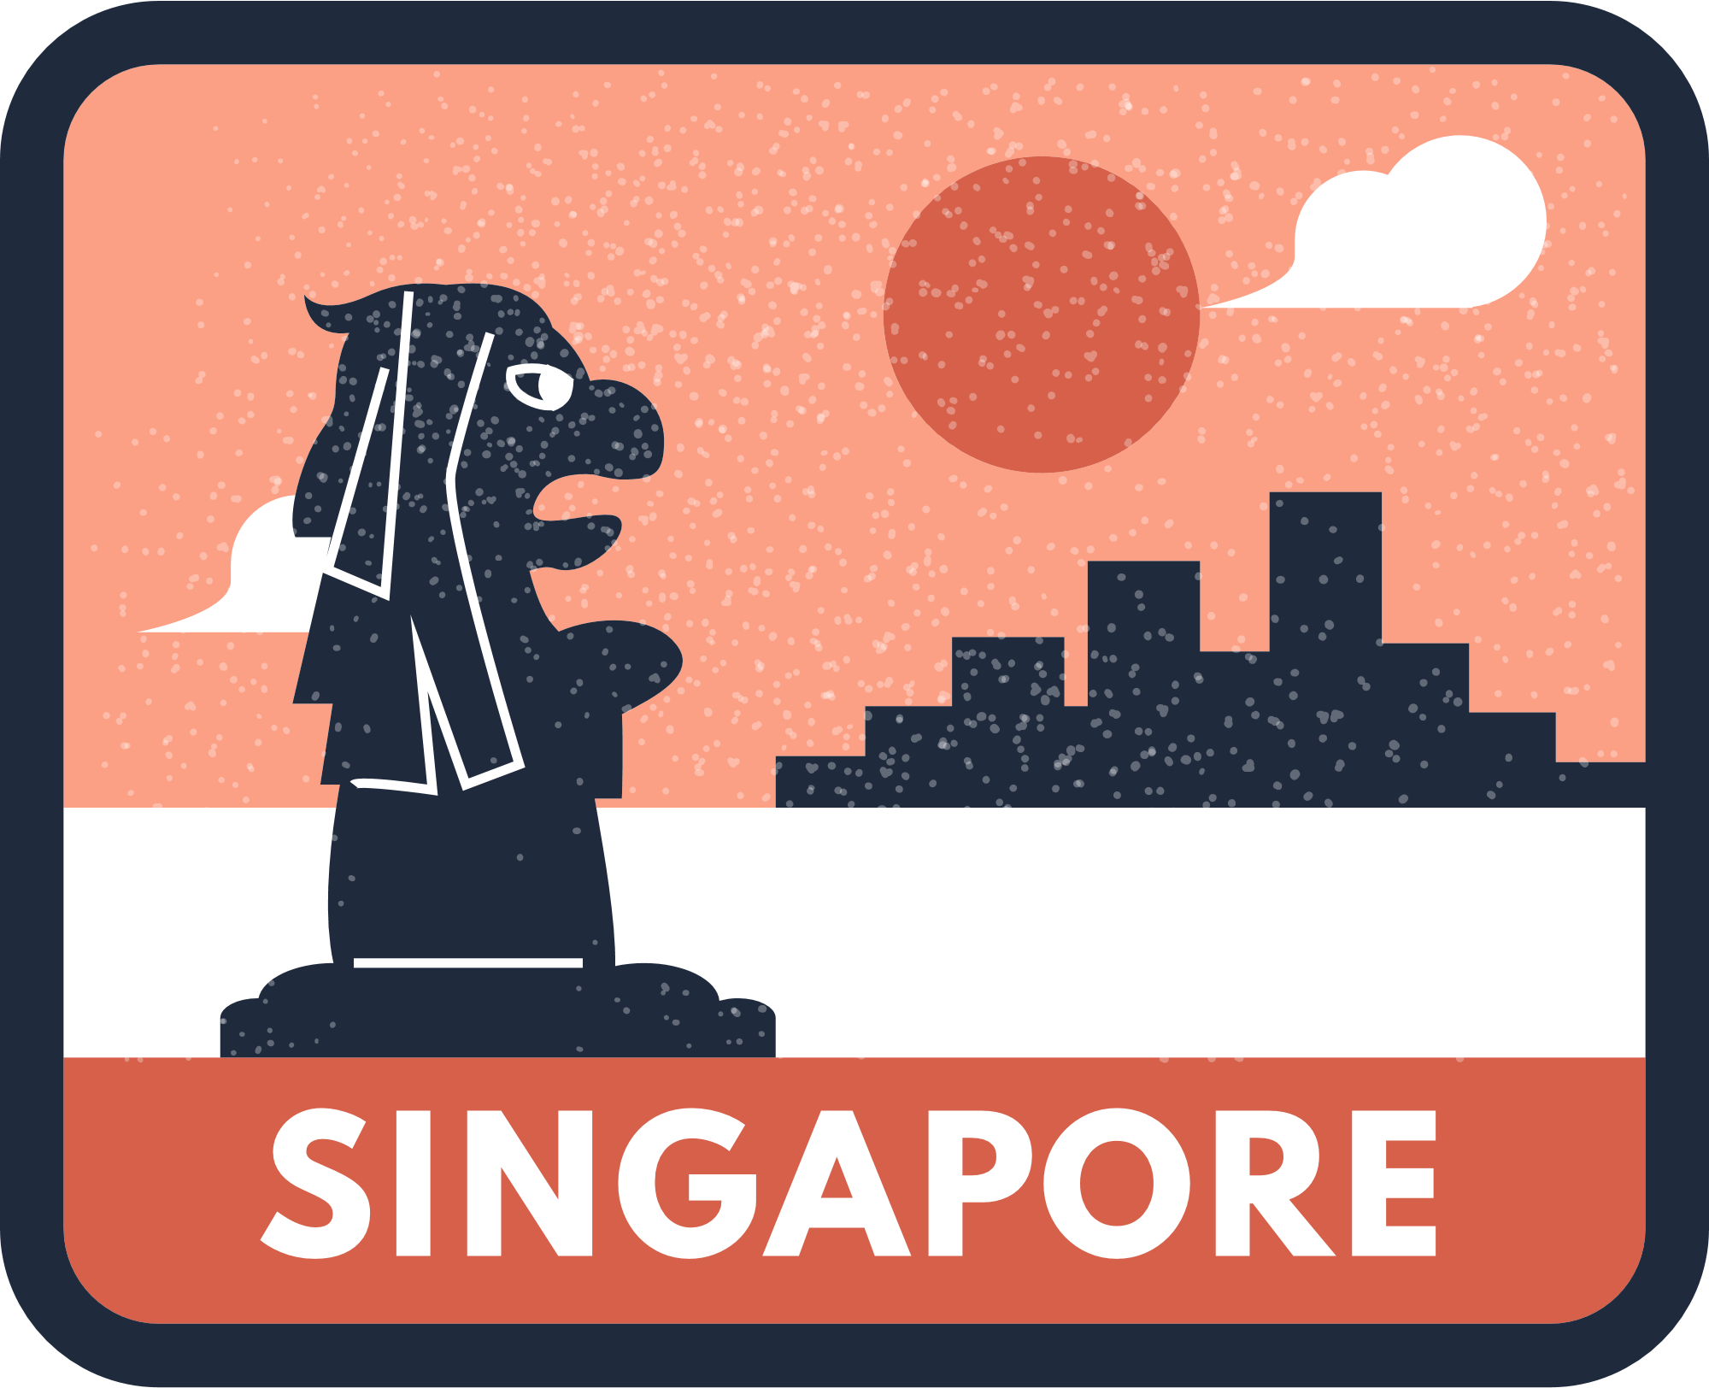

wǒ yào qù dùjià la
我要去度假啦！

Slide 12
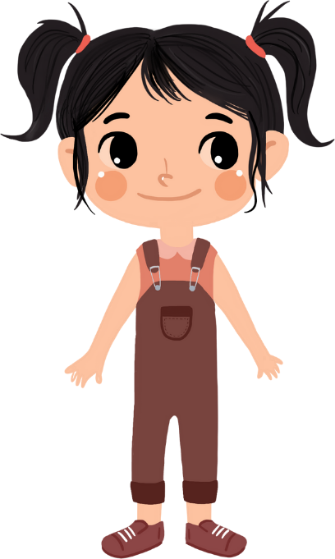
wǒ yào qù
我要去 dù jià
度假！(1)

Slide 13
nǐ yào qù nǎr
你要去哪儿 dù ià
度假？ (2)

Slide 14
wǒ yào qù
我要去 zhōngguó
中国！

Slide 15
Àilì sī, zhōngguó dōngtiān
爱丽丝, 中国冬天 fēichánglěng, nǐ yào
非常冷，你要 dài
带...

Slide 16
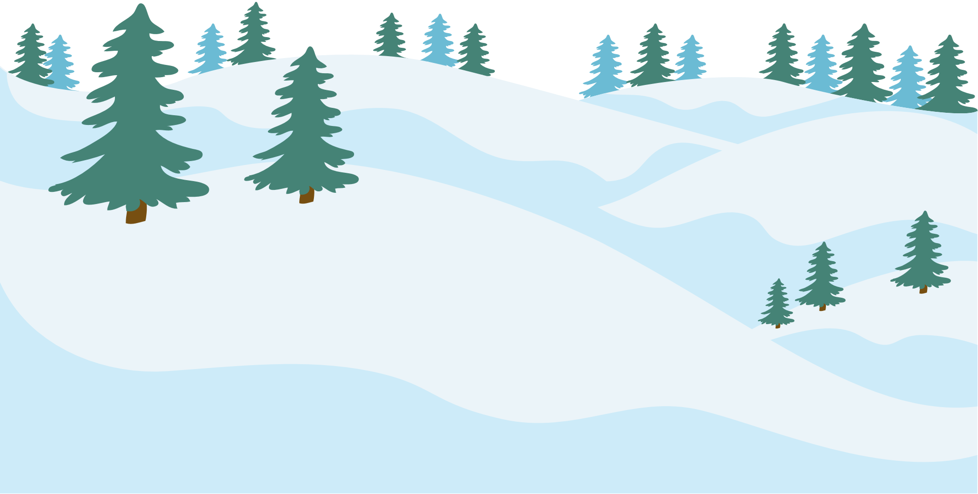
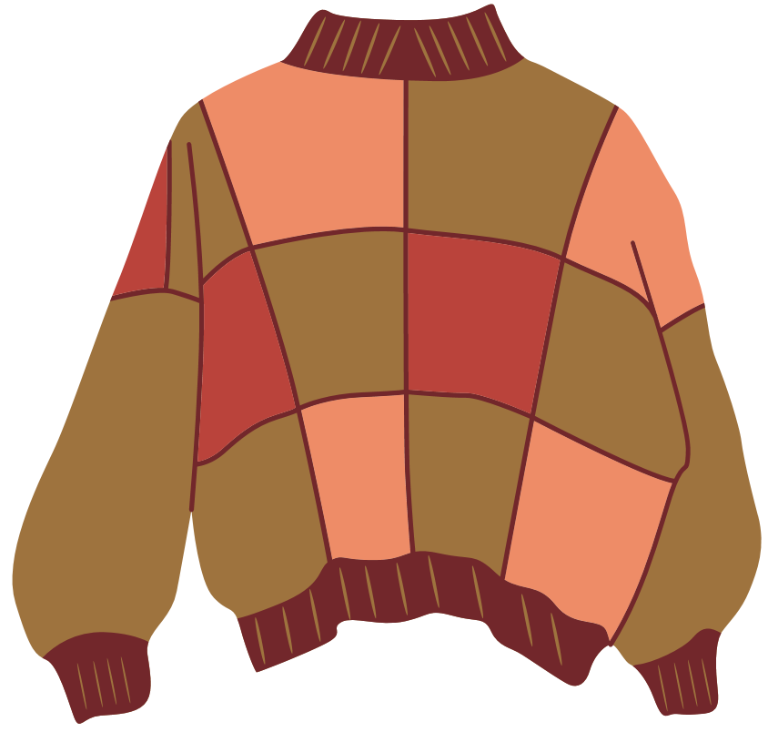
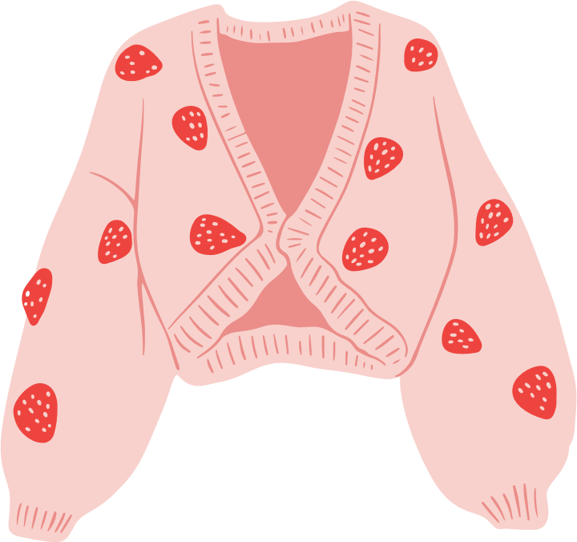
máoyī
毛衣

Slide 17
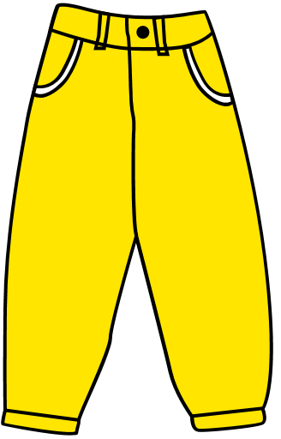
kùzi
裤子

Slide 18
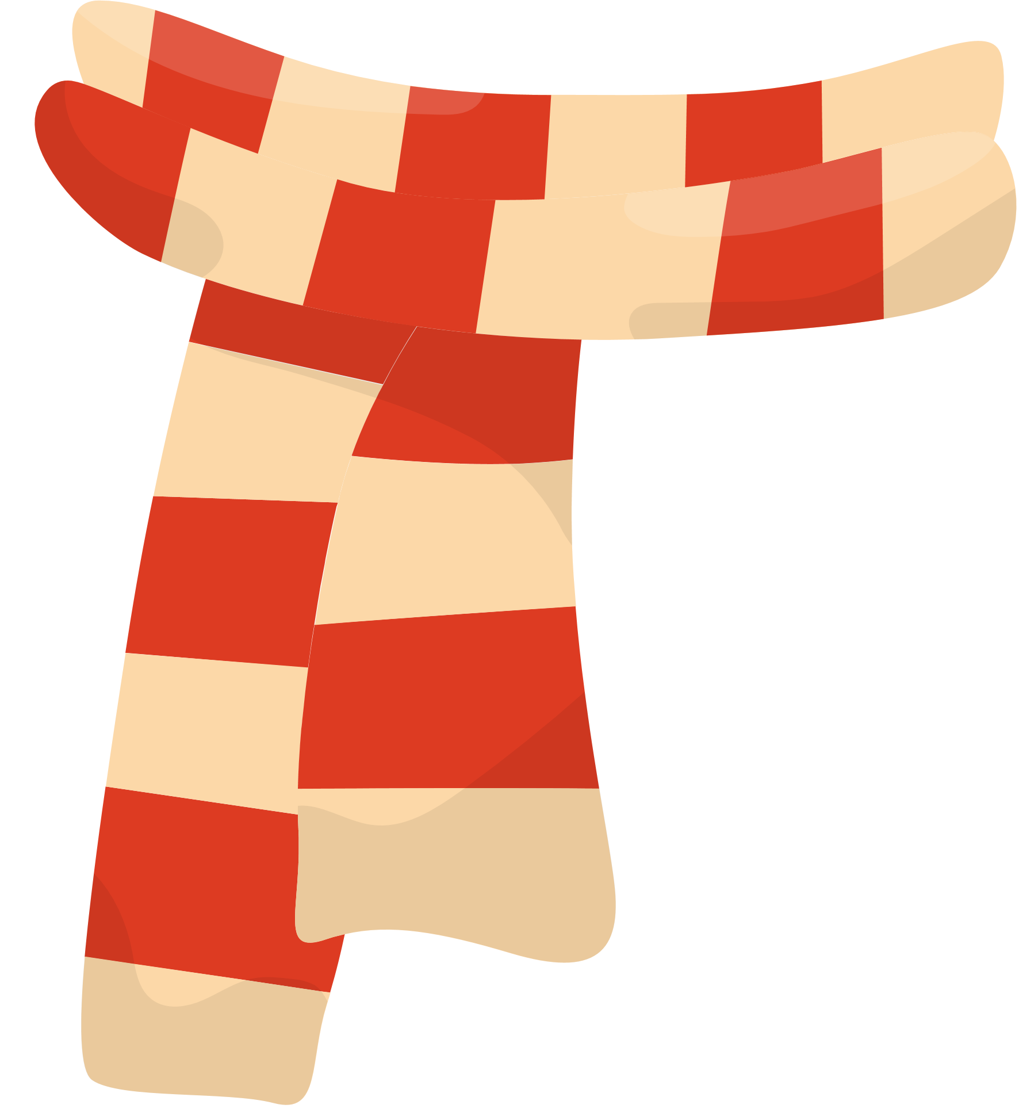
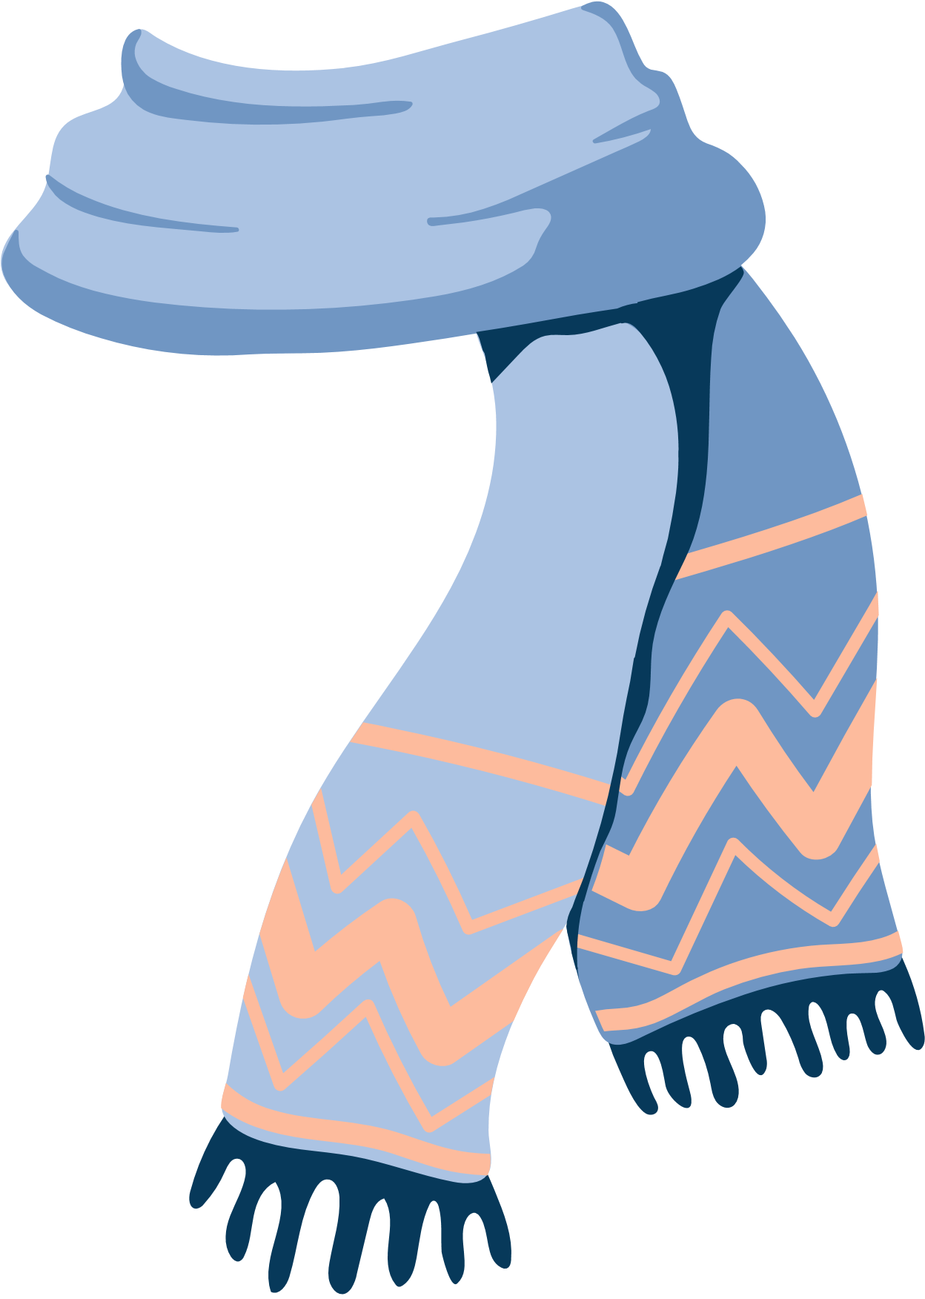
wéi jīn
围巾

Slide 19
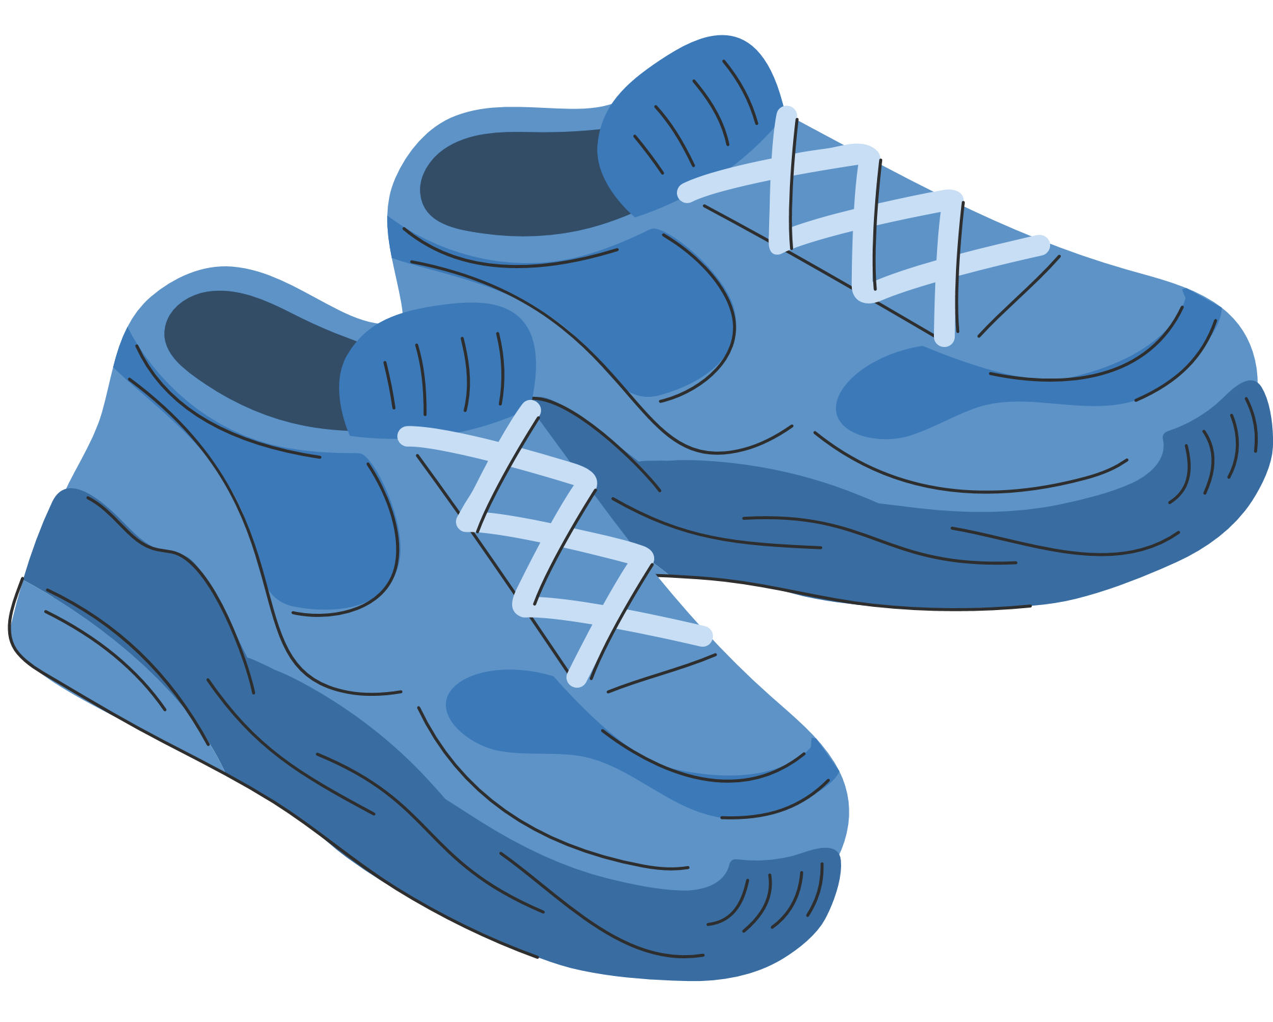
xiézi
鞋子

Slide 20

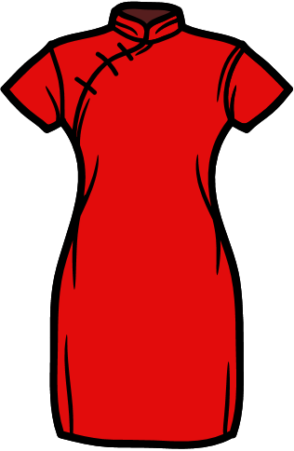
Àilì sī, nǐ hái yào
爱丽丝, 你还要 dài
带
qipao

Slide 21
tiānqì fēichánglěng, nǐ yào dài máoyī
天气非常冷，你要带毛衣、 kùzi, wéijīn hé xiézi
裤子、围巾和鞋子。

Slide 22
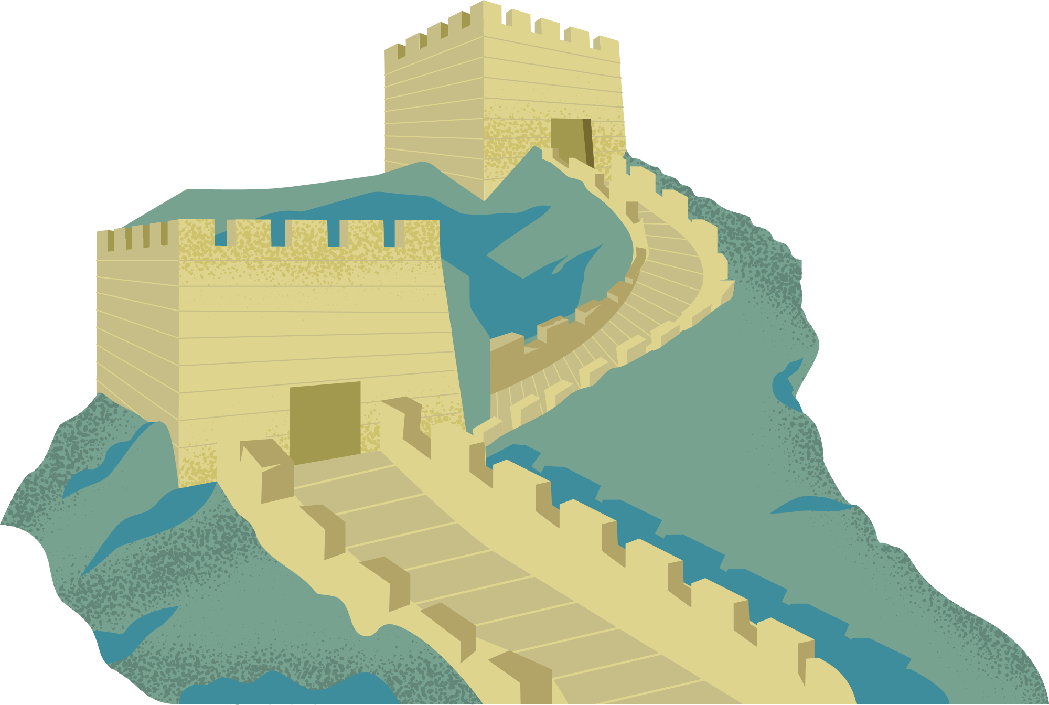

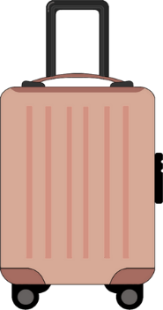

wǒ yào qù dùjià la
我要去度假啦！ (3)

Slide 23
Jiàqī kuàilè!
假期快乐！

Slide 24
Copyright
© State of New South Wales (Department of Education), 2024
The copyright material published in this resource is subject to the Copyright Act 1968 (Cth) and is owned by the NSW Department of Education or, where indicated, by a party other than the NSW Department of Education (third-party material).
Copyright material available in this resource and owned by the NSW Department of Education is licensed under a Creative Commons Attribution 4.0 International (CC BY 4.0) licence.
This licence allows you to share and adapt the material for any purpose, even commercially.
Attribution should be given to © State of New South Wales (Department of Education), 2024.
Material in this resource not available under a Creative Commons licence:
the NSW Department of Education logo, other logos and trademark-protected material
Material owned by a third party that has been reproduced with permission. You will need to obtain permission from the third party to reuse its material.
Links to third-party material and websites
Please note that the provided (reading/viewing material/list/links/texts) are a suggestion only and implies no endorsement, by the New South Wales Department of Education, of any author, publisher, or book title. School principals and teachers are best placed to assess the suitability of resources that would complement the curriculum and reflect the needs and interests of their students.
If you use the links provided in this document to access a third party’s website, you acknowledge that the terms of use, including licence terms set out on the third-party’s website apply to the use which may be made of the materials on that third-party website or where permitted by the Copyright Act 1968 (Cth). The department accepts no responsibility for content on third-party websites.

