Slide 1
Class scavenger hunt

Slide 2








How to play!
On each slide, there will be something you need to find. Your job is to find that object in the classroom.

Slide 3

Get a ruler.

Slide 4

Get a pencil.

Slide 5

Get a book.

Slide 6

Get a glue stick.

Slide 7

Get a rubber.

Slide 8
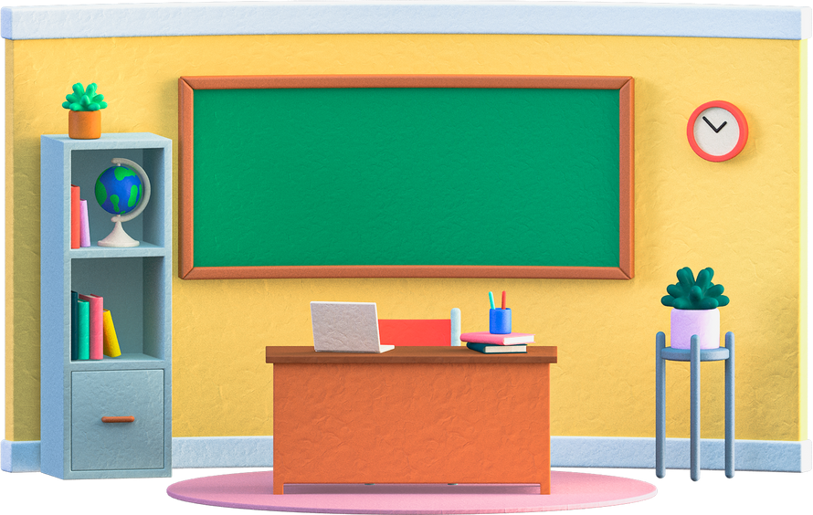
Well done!

Slide 9

© State of New South Wales (Department of Education) 2023

