Slide 1
My Classroom

Slide 2




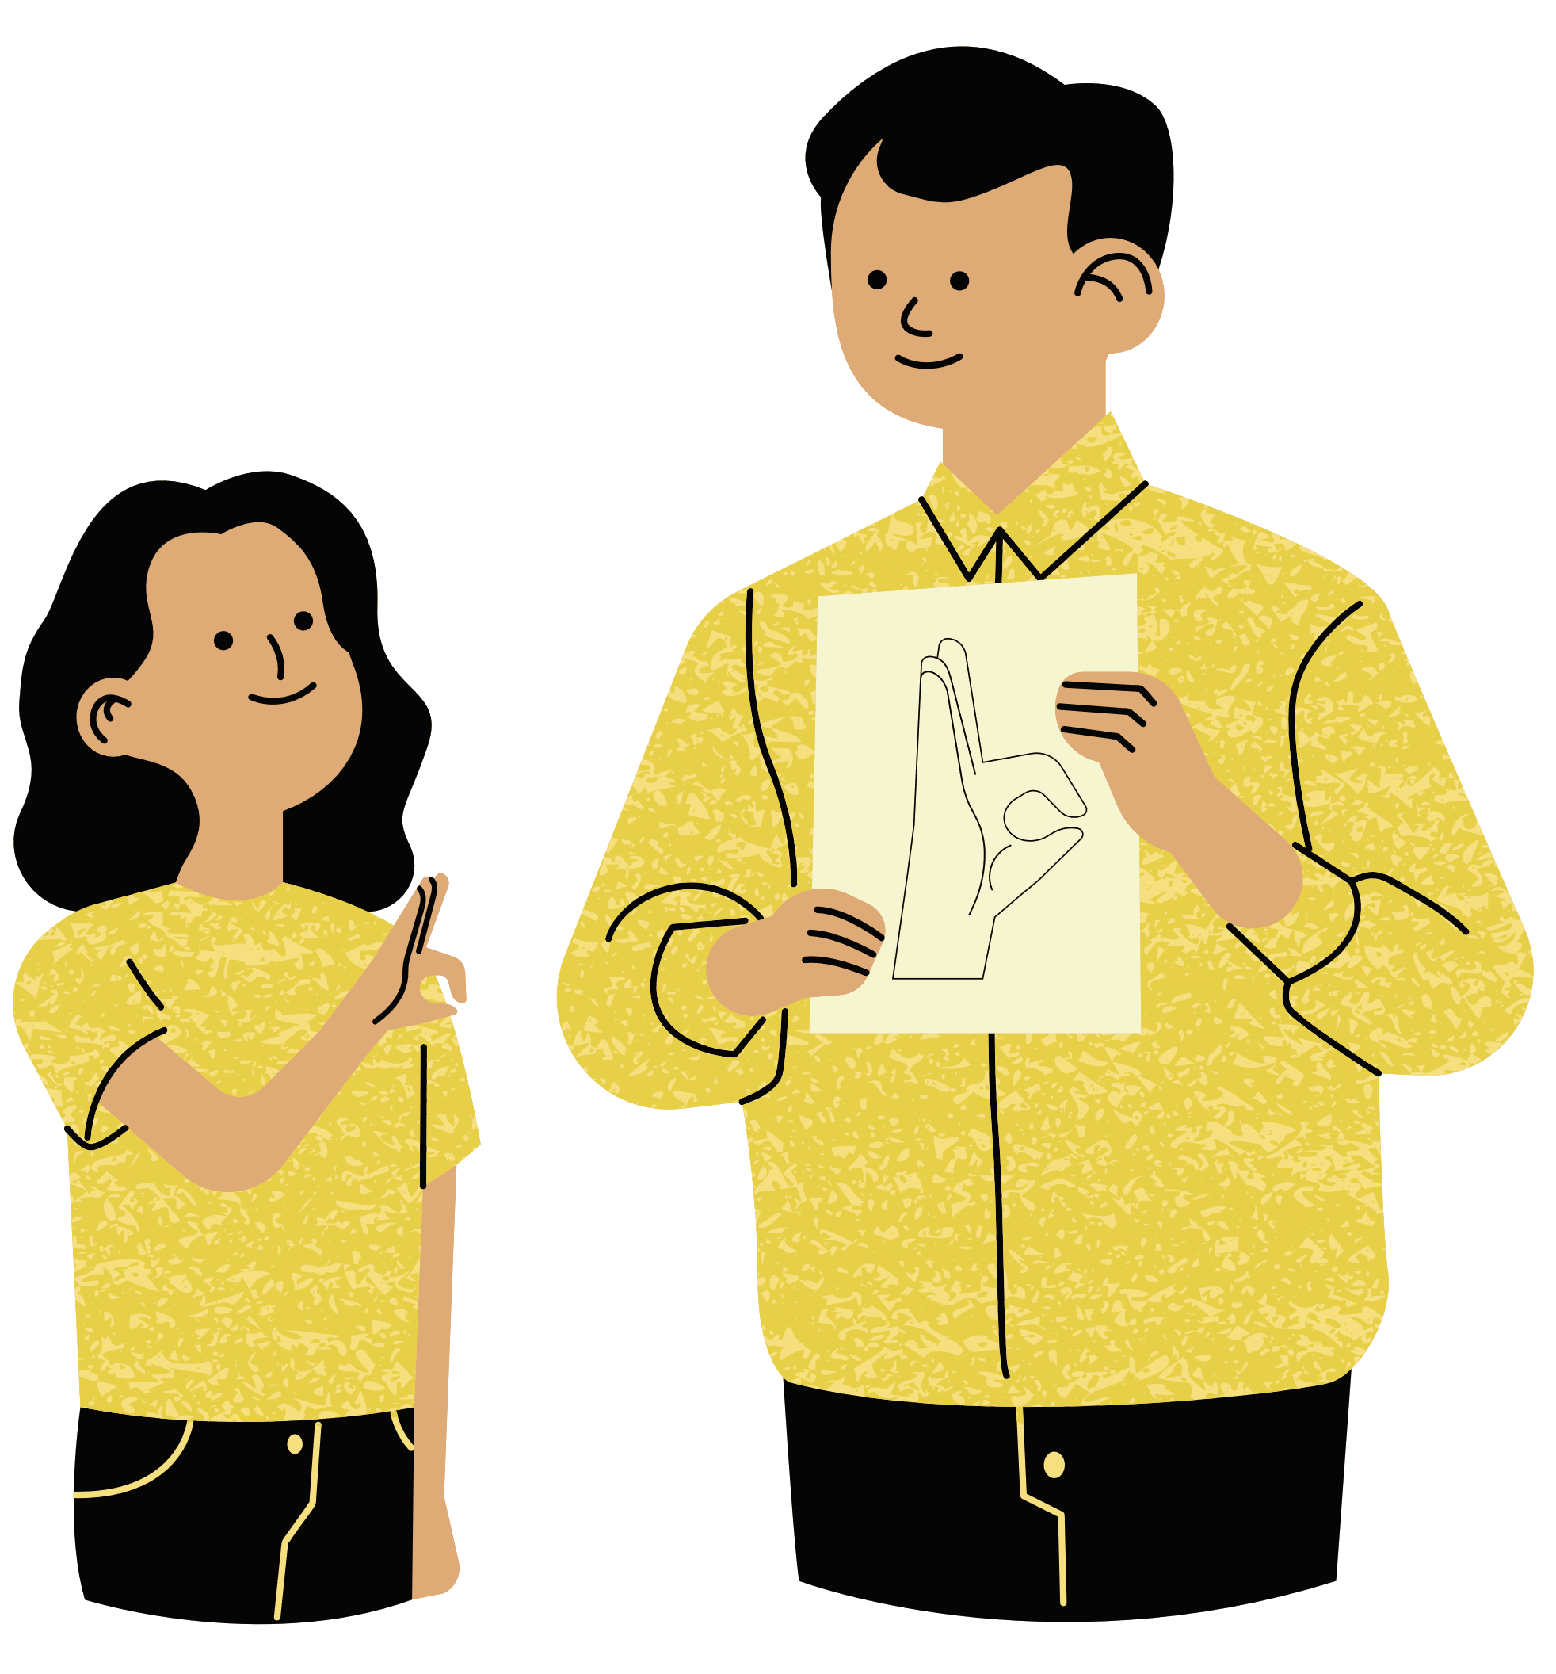




In my classroom the teacher says...

Slide 3

sit down.

Slide 4
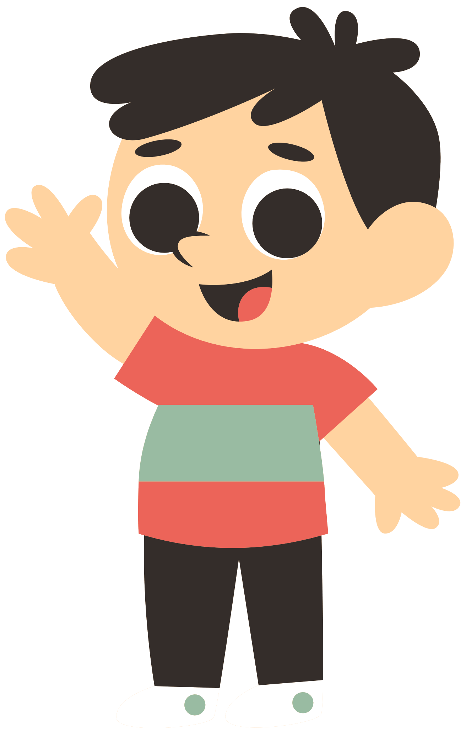
stand up.

Slide 5
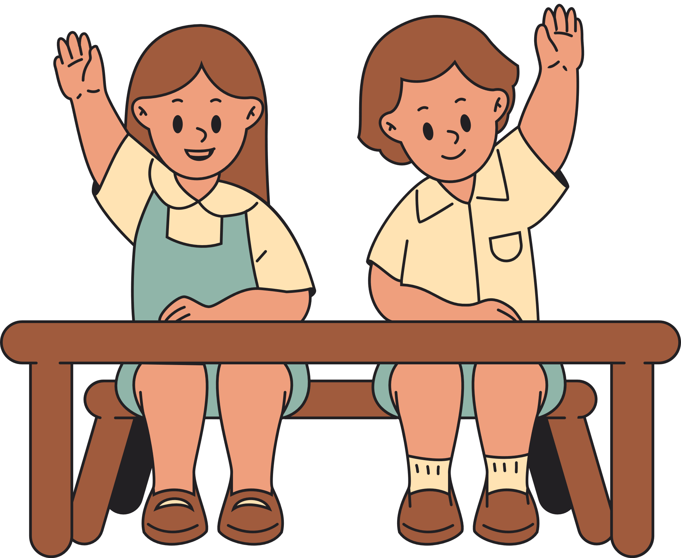
hand up.

Slide 6
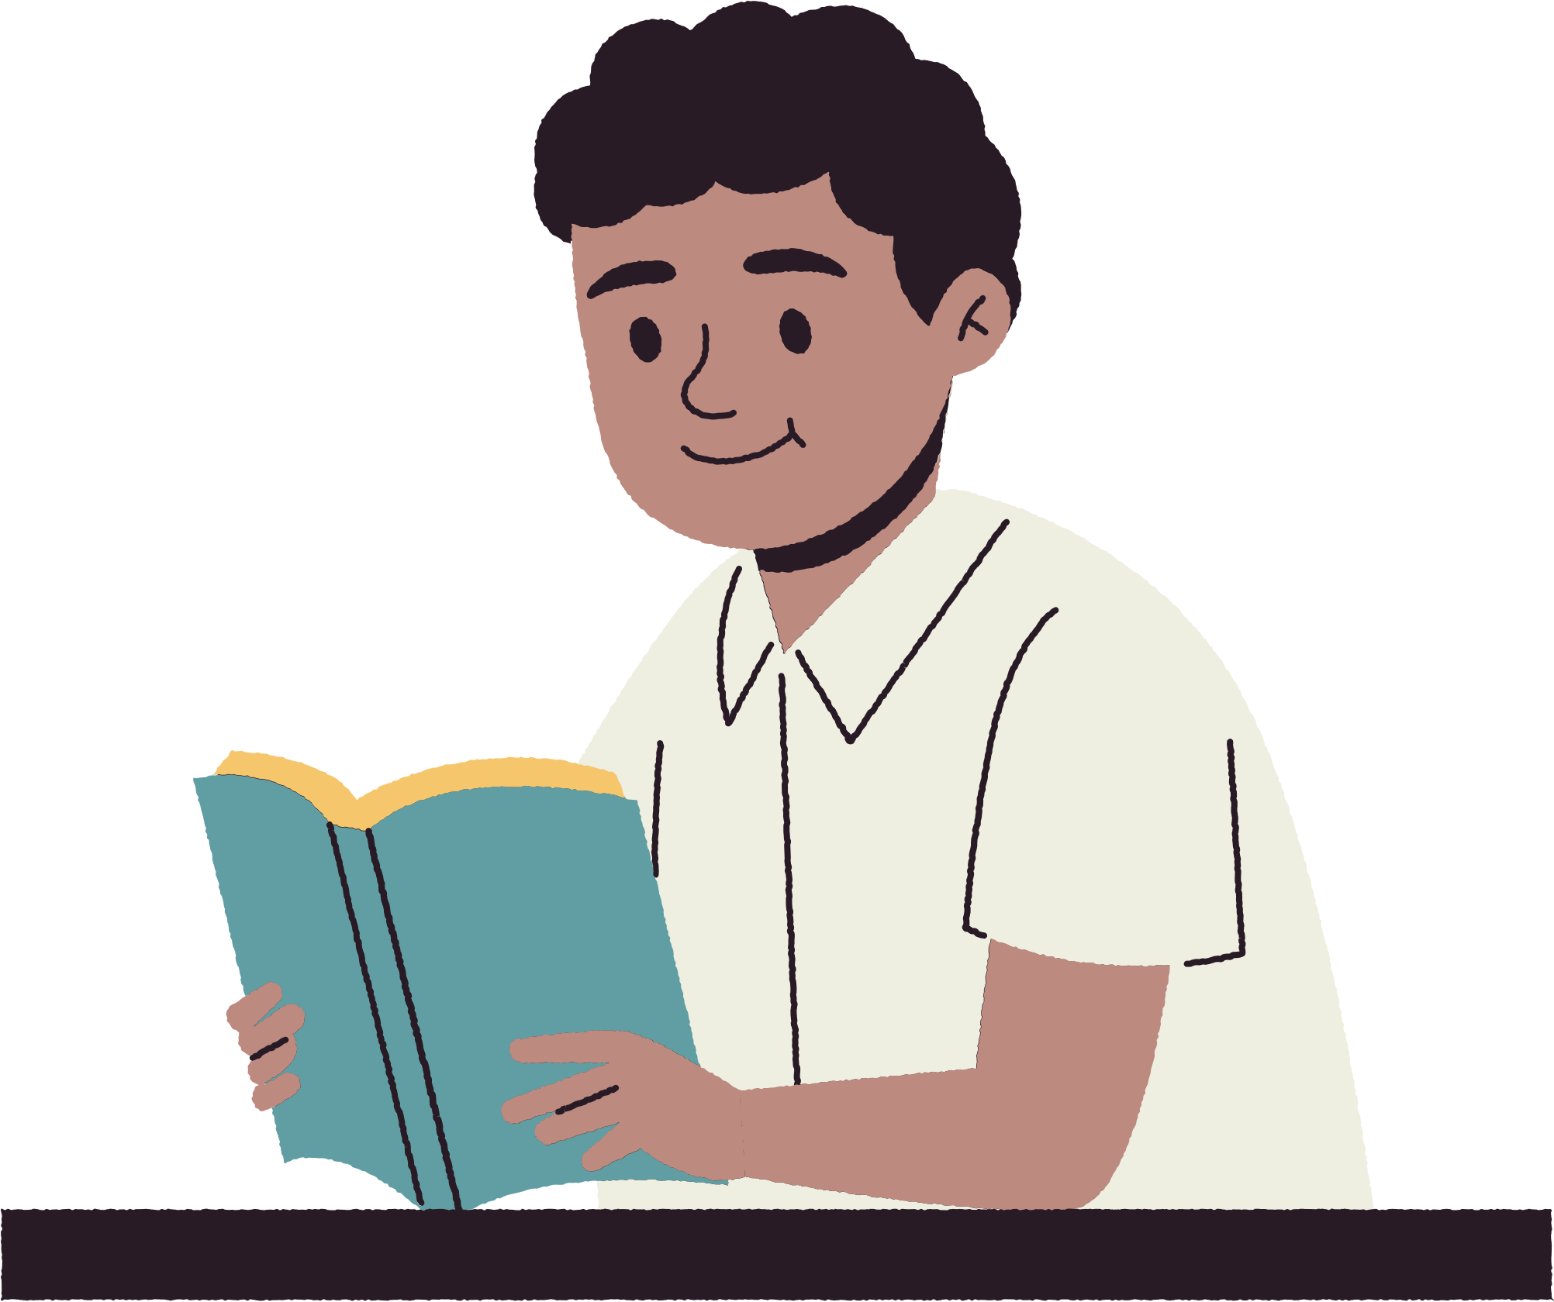
open your book.

Slide 7

close your book.

Slide 8

get a pencil.

Slide 9

get your bag.

Slide 10
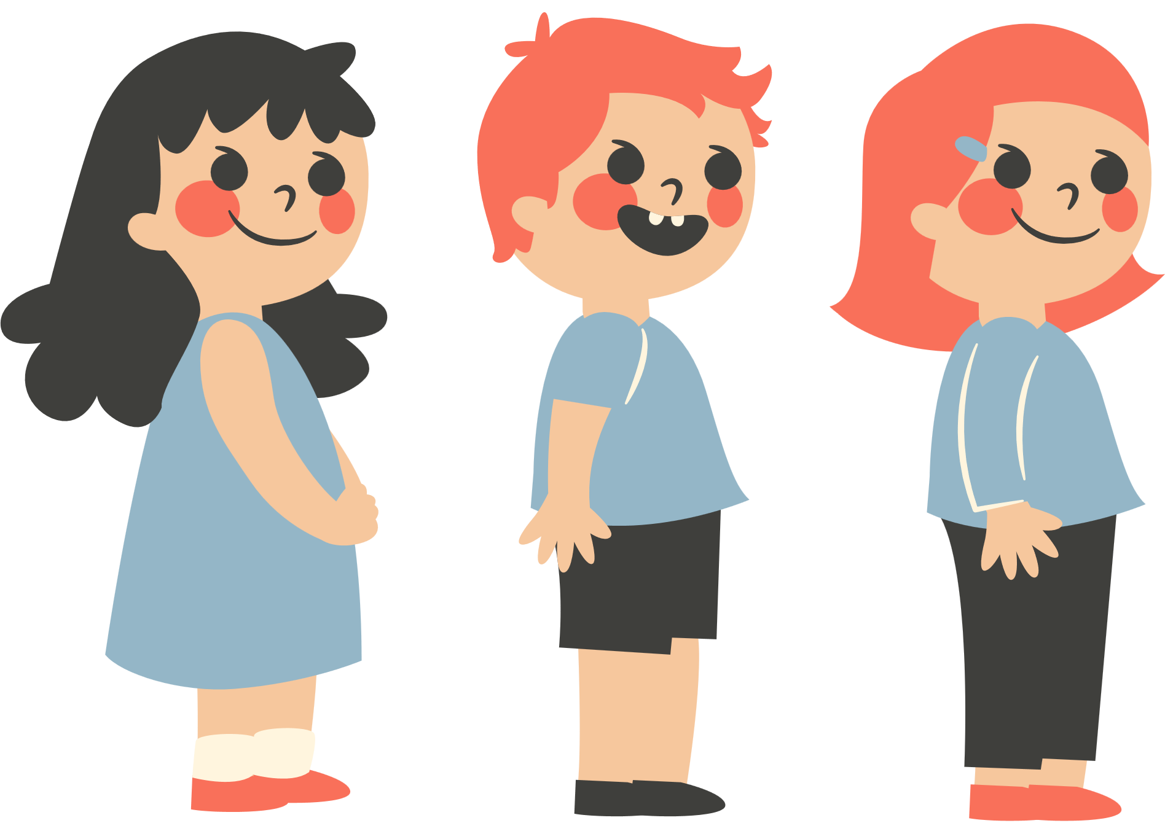
line up.

Slide 11

© State of New South Wales (Department of Education) 2023

