Slide 1
Instructions for use
This resource is not a teaching and learning program. It should be used in conjunction with Historical Investigation Learning Program and Historical Investigation Resource Booklet.
Classroom teachers are encouraged to add and adapt slides as required to meet the needs of their students.
Save a copy of the file to make changes to the slide deck. Go to File > Download a Copy (this downloads a copy to the computer to edit in the PowerPoint app).
To convert the PowerPoint to Google Slides
  Upload the file into Google Drive and open it.
  Go to File > Save as Google Slides.
  (Note – conversion may cause formatting changes in the slides.)

Slide 2
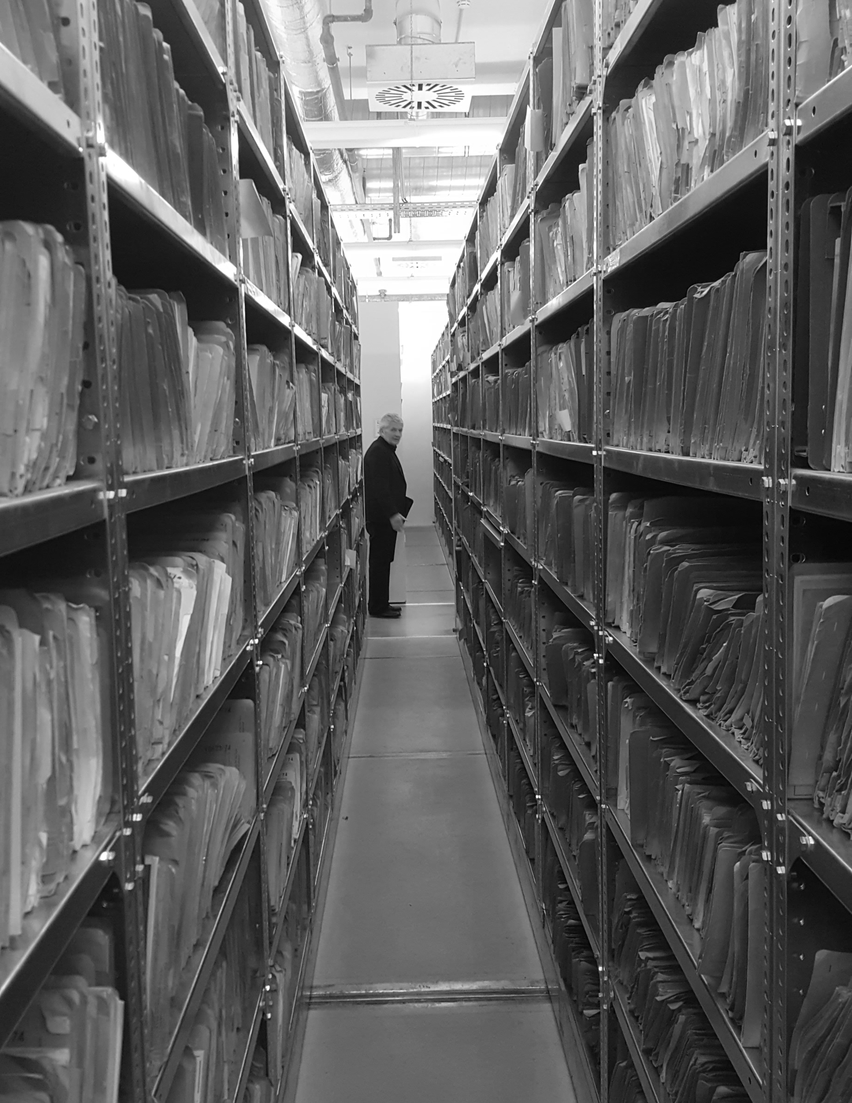
Historical investigation
Stage 6 – Year 11
Modern History
Hubertus Knabe via Wikimedia Commons / CC-BY-SA 4.0

Slide 3
Learning sequence 1 – Acquiring historical information
Historical investigation
Notes:
Notes for teachers:
This PowerPoint slide show is designed to support teachers to explicitly teach students how to corroborate evidence in one source with evidence in 1-3 other sources.
Corroboration is an essential skill for students completing the Modern History course and it is particularly important that students develop this skill when completing Unit 4: Source analysis: interpreting the evidence for the Nazi regime in power 1933–1939 of the Core study: Democracy and dictatorship 1919–1939.

Slide 4
Learning intentions and success criteria
We are learning about
The process of acquiring historical information and conducting historical investigations
The process of analysing sources
We can
[classroom teacher to insert co-constructed success criteria]
[classroom teacher to insert co-constructed success criteria]
[classroom teacher to insert co-constructed success criteria].
Notes:
Notes for teachers:
Learning intentions and success are best co-constructed with students. Adapt the learning intention as required and add matching success criteria.
For more information See ⁠AITSL or the NSW Department of Education explicit teaching strategies, ⁠Sharing learning intentions and ⁠Sharing success criteria
LISC is not necessarily presented at the beginning of the lesson. Teacher needs to consider most effectual time to introduce
LISC should be revisited during the lesson to support students' evaluation of their learning
This exemplar of source interpretation draws on a collection of sources related to the First World War. Students should be encouraged to recall prior knowledge of the First World War developed in Stage 5.

Slide 5
Assessment task – Historical investigation
Type of task: Research essay
Suggested total weighting: 35%
Suggested total marks: 70 marks
Date/time of submission: [insert here as per school requirements]
Special requirements: [insert here as per school requirements]
Notes:
Notes for teachers:
Use this slide to support explanation of the Historical investigation assessment task. Teachers may wish to use this slide deck in combination with the sample assessment task aligned with this program of learning.
Teachers should explain that the development of a research essay via historical investigation is an iterative process.
Teachers should update the slide with school-determined assessment weightings, total marks, special requirements and submission date/processes.

Slide 6
Task description
In this task, you are required to:
Select an area of interest, from modern or early modern history (circa 1400 to the present)
Investigate and research the chosen area of interest
Communicate your findings in the form of a [insert word limit as per school requirements] research essay and submit all parts of the task by the due date.
Notes:
Notes for teachers:
Use this slide to support explanation of the key actions (bolded) that students are required to undertake as a part of the historical investigation task.
Teachers should reinforce that the development of a research essay via historical investigation is an iterative process.
Teachers should update the slide with school-determined word limits.

Slide 7
Part 1: proposal (10 marks)
Your proposal should include:
Introduction: what is the key question and why do they matter?
Research objectives: what are you aiming to achieve?
Approach: what theory is informing your research and why is it suitable?
Methodology: what procedure will you use to answer your question?
Key sources: what sources do you anticipate using to answer your question?
Notes:
Notes for teachers:
Use this slide to support explanation of part 1. Note: this slide summarises the content that is available in full on the sample assessment task notification.
Teachers should reinforce that the development of a research essay via historical investigation is an iterative process.
Teachers should update the slide with school-determined task adjustments.

Slide 8
Part 2: literature review (10 marks)
Your literature review should include:
Analysis of existing research: what are the big historical debates that intersect with your research?
Contribution to existing research: what is your working thesis and how does it contribute to existing answers to your question?
Going beyond existing research: how does your research offer new answers to the questions that you are asking?
Notes:
Notes for teachers:
Use this slide to support explanation of part 2. Note: this slide summarises the content that is available in full on the sample assessment task notification.
Teachers should reinforce that the development of a research essay via historical investigation is an iterative process.
Teachers should update the slide with school-determined task adjustments.

Slide 9
Part 3: essay and bibliography (50 marks)
Your essay and bibliography should include:
Hook: illustrate the question or problem that your essay engages with.
Introduction: summarise the content of your proposal and literature review.
Essay body: analyse your primary sources according to your methodology and interpret them according to the priorities that are dictated by your approach. Compare and contrast your conclusions to existing secondary material.
Key Implications: how does your research change our understanding of the past or writing about the past?
Conclusion: summary of your findings and any new questions that those findings pose.
Notes:
Notes for teachers:
Use this slide to support explanation of opart 3. Note: this slide summarises the content that is available in full on the sample assessment task notification.
Highlight that 40 marks are allocated to the essay and 10 marks are allocated to the bibliography (see sample task notification).
Teachers should reinforce that the development of a research essay via historical investigation is an iterative process.
Teachers should update the slide with school-determined task adjustments.

Slide 10
References
This presentation contains NSW Curriculum and syllabus content. The NSW Curriculum is developed by the NSW Education Standards Authority. This content is prepared by NESA for and on behalf of the Crown in the right of the State of New South Wales. The material is protected by Crown copyright.
Please refer to the NESA Copyright Disclaimer for more information https://www.nsw.gov.au/education-and-training/nesa/copyright.
NESA holds the only official and up-to-date versions of the NSW Curriculum and syllabus documents. Please visit NESA https://www.nsw.gov.au/education-and-training/nesa and NSW Curriculum https://curriculum.nsw.edu.au.
AITSL (Australian Institute for Teaching and School Leadership Limited) (n.d.) Learning intentions and success criteria [PDF 251 KB], AITSL, accessed 6 March 2025.
CESE (Centre for Education Statistics and Evaluation) (2020a) What works best: 2020 update, NSW Department of Education, accessed 20 September 2024.
CESE (2020b) What works best in practice, NSW Department of Education, accessed 20 September 2024.
Modern History 11–12 © Syllabus NSW Education Standards Authority (NESA) for and on behalf of the Crown in right of the State of New South Wales, 2024.
NESA (NSW Education Standards Authority) (2022) ‘Advice on units’, Programming, NESA website, accessed 20 September 2024.
NESA (NSW Education Standards Authority) (2022) ‘Programming’, Understanding the curriculum, NESA website, accessed 20 September 2024.

Slide 11
Copyright
© State of New South Wales (Department of Education), 2026
The copyright material published in this resource is subject to the Copyright Act 1968 (Cth) and is owned by the NSW Department of Education or, where indicated, by a party other than the NSW Department of Education (third-party material).
Copyright material available in this resource and owned by the NSW Department of Education is licensed under a Creative Commons Attribution 4.0 International (CC BY 4.0) license.
This license allows you to share and adapt the material for any purpose, even commercially.
Attribution should be given to © State of New South Wales (Department of Education), 2026.
Material in this resource not available under a Creative Commons license:
the NSW Department of Education logo, other logos and trademark-protected material
Material owned by a third party that has been reproduced with permission. You will need to obtain permission from the third party to reuse its material.
Links to third-party material and websites
Please note that the provided (reading/viewing material/list/links/texts) are a suggestion only and implies no endorsement, by the New South Wales Department of Education, of any author, publisher, or book title. School principals and teachers are best placed to assess the suitability of resources that would complement the curriculum and reflect the needs and interests of their students.
If you use the links provided in this document to access a third-party’s website, you acknowledge that the terms of use, including licence terms set out on the third-party’s website apply to the use which may be made of the materials on that third-party website or where permitted by the Copyright Act 1968 (Cth). The department accepts no responsibility for content on third-party websites.

