Slide 1
Instructions for use
This resource is not a teaching and learning program. It should be used in conjunction with Ancient History (Year 11) – sample program of learning – The investigation of ancient sites and sources.
Classroom teachers are encouraged to add and adapt slides as required to meet the needs of their students.
Save a copy of the file to make changes to the slide deck. Go to File > Download a Copy (this downloads a copy to the computer to edit in the PowerPoint app).
To convert the PowerPoint to Google Slides:
  Upload the file into Google Drive and open it.
  Go to File > Save as Google Slides.
  (Note – conversion may cause formatting changes in the slides.)

Slide 2

Conducting online research
Ancient history – Year 11
The investigation of ancient sites and sources
Term 1
This work has been generated using artificial intelligence. Any copyright subsisting in
this work is owned by © State of New South Wales (Department of Education) 2025.

Slide 3
Learning intentions and success criteria
We are learning to
develop a plan for online research.
We can
identify appropriate databases to use for historical research
plan search strings to use in online databases.
Notes:
Notes for teachers:
Learning intentions and success criteria are best co-constructed with students. Adapt the learning intention as required and add matching success criteria.
For more information See ⁠AITSL or the NSW Department of Education explicit teaching strategies, ⁠Sharing learning intentions and ⁠Sharing success criteria
LISC is not necessarily presented at the beginning of the lesson. Teacher needs to consider most effectual time to introduce
LISC should be revisited during the lesson to support students' evaluation of their learning

Slide 4


What sites do you use for research?
Thumbs up, thumbs down
Google
Online Encyclopedia
Google can be useful for finding sources. However, it will not tell you the academic quality of these sources. Anyone can publish a website. The information they provide on it may not be accurate.
Online encyclopaedias are a good starting point for research. However, they often do not provide detail on specific areas.
Wikipedia
ChatGPT
Wikipedia has increased in quality, however as a wiki it is editable by nature. This means non-experts can add and edit information. Check the references, these may be more suitable sources.
AI platforms like ChatGPT do not conduct research. Rather, they predict a text response based on data. ‘Hallucinations’ (making up information and references) are common. These tools are suited to supporting writing, not research.
Notes:
Notes for teachers:
This slide has animations. View in slideshow mode to see animations.
Students indicate whether they have used a site for research before with thumbs up for yes and thumbs down for no.

Slide 5
Academic online sources
Libraries
Museum websites
State Library NSW and local libraries provide access to a range of print and digital resources. Membership is free and, in many cases, can be completed online.
Many museums provide their collections online, such as British Museum collection, Smithsonian Open Access and The Met Collection.
Archaeologists
Many archaeologists have a blog, engage in podcasts and produce online videos to communicate their findings. Conduct background research on the archaeologist to ensure they are experts in the field you are studying.
Journal articles
e–books
Google Scholar is a useful search engine for journal articles. It links to free full-text when available. Some paid resources are available through library memberships, such as select JSTOR collections.
Google Books is a useful search engine for books. Full view or preview book content is provided where copyright allows. You can filter results by available view, publication type and date range.
Notes:
Notes for teachers:
This slide has animations. View in slideshow mode to see animations.
Explain to students they need to start moving away from generic sites and start using more academic sources that are peer reviewed to support authenticity in their information.

Slide 6

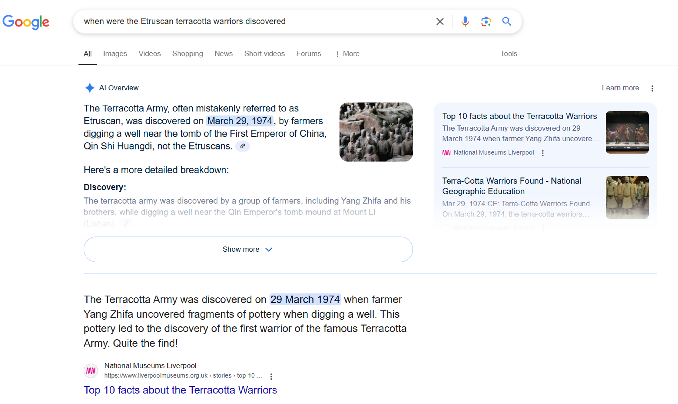
Importance of search strings
Search strings are the words you use in a search engine
Specific search strings using Boolean search operators support accessing suitable sources in a shorter timeframe
Etruscan terracotta warriors example
  Less effective search string: when were the Etruscan terracotta warriors discovered
Terracotta Warriors from
China were included in the
search results
Google and the Google logo are trademarks of Google LLC
Notes:
Notes for teachers:
This slide has animations. View in slideshow mode to see animations.

Slide 7
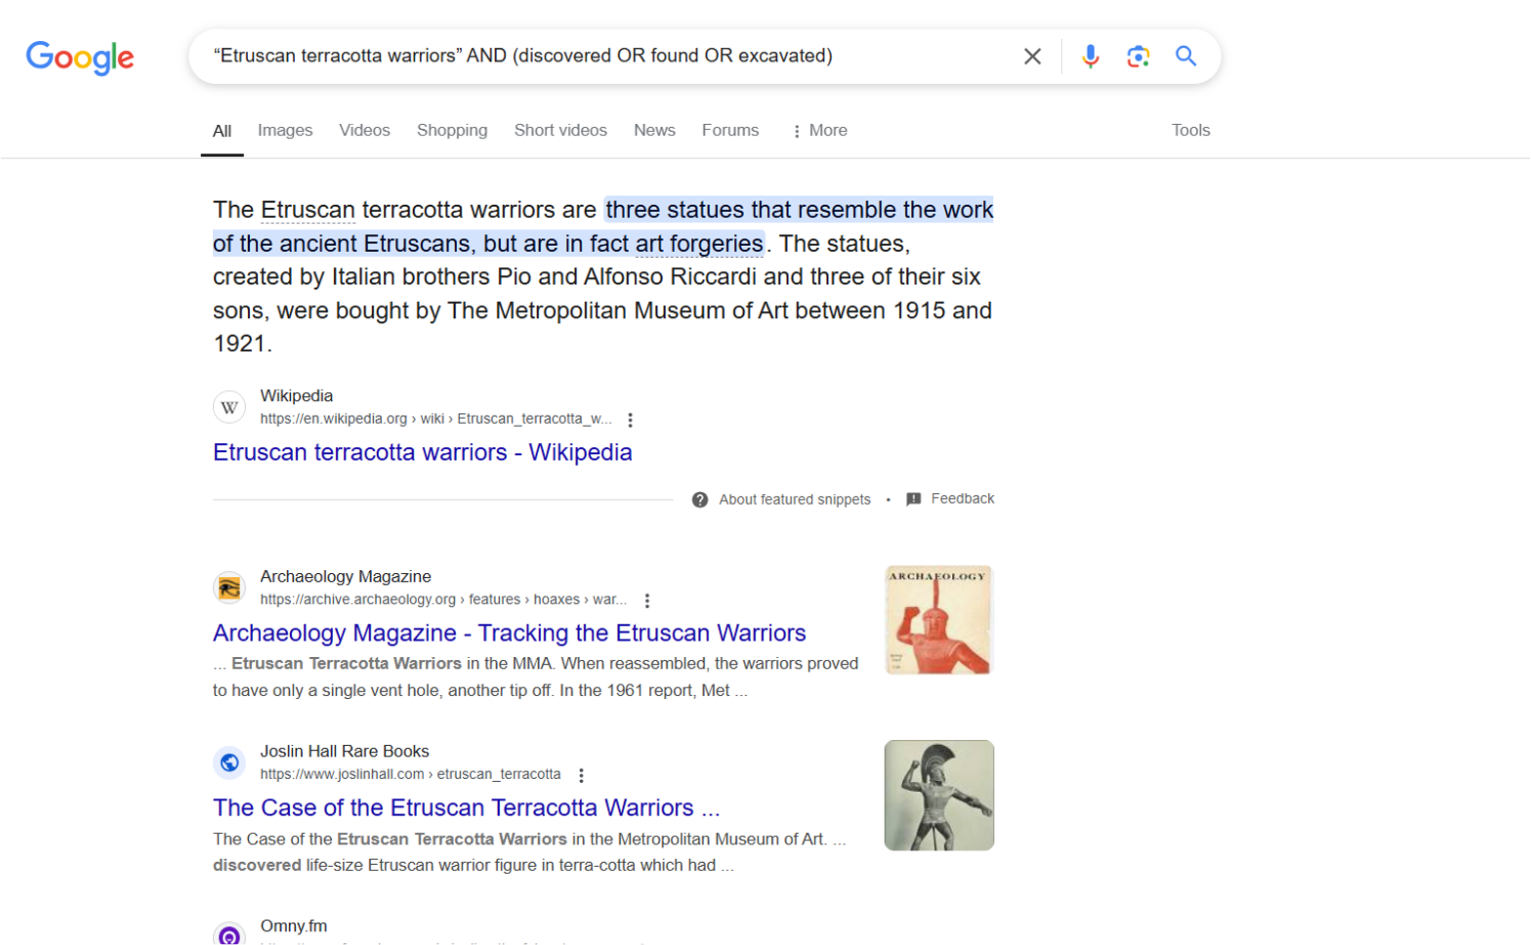
Importance of search strings
Search strings are the words you use in a search engine
Specific search strings using Boolean search operators support accessing suitable sources in a shorter timeframe
Etruscan terracotta warriors example
  Less effective search string: when were the Etruscan terracotta warriors discovered
  More effective search string: “Etruscan terracotta warriors” AND (discovered OR found OR excavated)
These results are for the
Etruscan terracotta warriors
Google and the Google logo are trademarks of Google LLC
Notes:
Notes for teachers:
This slide has animations. View in slideshow mode to see animations.

Slide 8
Planning search strings
Identify key words in the inquiry question and sub questions
1
Brainstorm synonyms and antonyms for the key words
2
Create combinations using Boolean search operators
3
Select a combination to use as the first search string
4
Edit search strings as you learn more about the topic
5
Notes:
Notes for teachers:
Pause here to allow students to complete steps 1–2 for the artefact they are researching.

Slide 9
Boolean search operators
AND
Narrows the search to records containing both terms.
OR
Expands the search to records that contain any of the terms.
NOT (–)
Narrows the search to records that do not contain the following term.
“Quotation marks”
Narrows the search to records containing the exact phrase.
Asterisk*
Expands a search to include all words with the letters before or after the asterisk.
(Parentheses)
The search parameters within the parentheses will be performed first by the search engine.
Notes:
Notes for teachers:
This slide has animations. View in slideshow mode to see animations.
Explain these Boolean search operators are used by most search engines. They support making a search more targeted to get effective sources earlier in their online research

Slide 10

Check for understanding
Mini whiteboards
Write the Boolean search operator for each use as it appears.
The options are:
The search parameters within the parentheses will be performed first by the search engine.
Expands a search to include all words with the letters before or after
AND
OR
NOT (-)
“Quotation marks”
Asterisk*
(Parentheses)
Narrows the search to records that do not contain the following term.
Expands the search
to records that contain any of the terms.
Narrows the search to records containing the exact phrase.
Narrows the search to records containing both terms.
Notes:
Notes for teachers:
This slide has animations. View in slideshow mode to see animations.
Reteach Boolean operators if students do not demonstrate understanding
If students demonstrate competency, pause for students to create at least one search string for their research. Share with the class.

Slide 11

Assess source authenticity
Always corroborate the information
you find using multiple sources
Not all websites are authoritative sources. Consider:
      Is the author clearly identified?
        Are they an expert in the field?
      Is there a date on the webpage?
        Is it recent?
      Is the language used factual or is opinion evident?
      Does the website appear legitimate?
        Is the organisation well known?
        Are there contact details?
Notes:
Notes for teachers:
This slide has animations. View in slideshow mode to see animations.

Slide 12
Copyright
© State of New South Wales (Department of Education), 2025
The copyright material published in this resource is subject to the Copyright Act 1968 (Cth) and is owned by the NSW Department of Education or, where indicated, by a party other than the NSW Department of Education (third-party material).
Copyright material available in this resource and owned by the NSW Department of Education is licensed under a Creative Commons Attribution 4.0 International (CC BY 4.0) license.
This license allows you to share and adapt the material for any purpose, even commercially.
Attribution should be given to © State of New South Wales (Department of Education), 2025.
Material in this resource not available under a Creative Commons license:
the NSW Department of Education logo, other logos and trademark-protected material
Material owned by a third party that has been reproduced with permission. You will need to obtain permission from the third party to reuse its material.
Links to third-party material and websites
Please note that the provided (reading/viewing material/list/links/texts) are a suggestion only and implies no endorsement, by the New South Wales Department of Education, of any author, publisher, or book title. School principals and teachers are best placed to assess the suitability of resources that would complement the curriculum and reflect the needs and interests of their students.
If you use the links provided in this document to access a third-party’s website, you acknowledge that the terms of use, including licence terms set out on the third-party’s website apply to the use which may be made of the materials on that third-party website or where permitted by the Copyright Act 1968 (Cth). The department accepts no responsibility for content on third-party websites.

