Slide 1
Instructions for use
This resource is not a teaching and learning program. It should be used in conjunction with Ancient History (Year 11) – sample program of learning – The investigation of ancient sites and sources.
Classroom teachers are encouraged to add and adapt slides as required to meet the needs of their students.
Save a copy of the file to make changes to the slide deck. Go to File > Download a Copy (this downloads a copy to the computer to edit in the PowerPoint app).
To convert the PowerPoint to Google Slides:
  Upload the file into Google Drive and open it.
  Go to File > Save as Google Slides.
  (Note – conversion may cause formatting changes in the slides.)

Slide 2
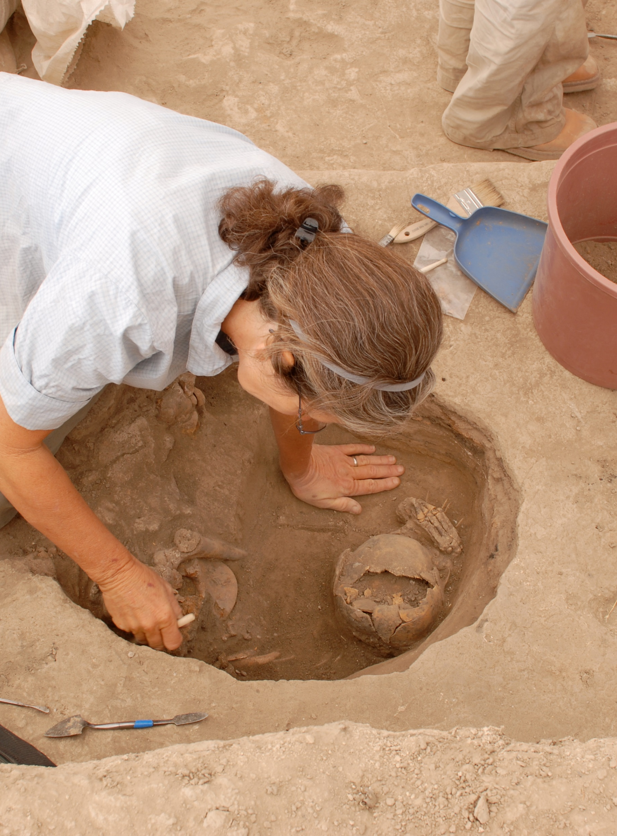
Analysing archaeological sources
Ancient history – Year 11
The investigation of ancient sites and sources
Term 1
DSC_0006 by Dr. Colleen Morgan is licensed under CC BY 2.0

Slide 3
Learning intentions and success criteria
We are learning
about different types of sources
to ask appropriate questions of archaeological sources.
We can
differentiate between different types of sources
analyse archaeological sources when conducting an historical inquiry.
Notes:
Notes for teachers:
For more information See ⁠AITSL or the NSW Department of Education explicit teaching strategies, ⁠Sharing learning intentions and ⁠Sharing success criteria
LISC is not necessarily presented at the beginning of the lesson. Teacher needs to consider most effectual time to introduce
LISC should be revisited during the lesson to support students' evaluation of their learning

Slide 4
Types of sources
Notes:
Teacher notes:
This section is to activate prior learning

Slide 5
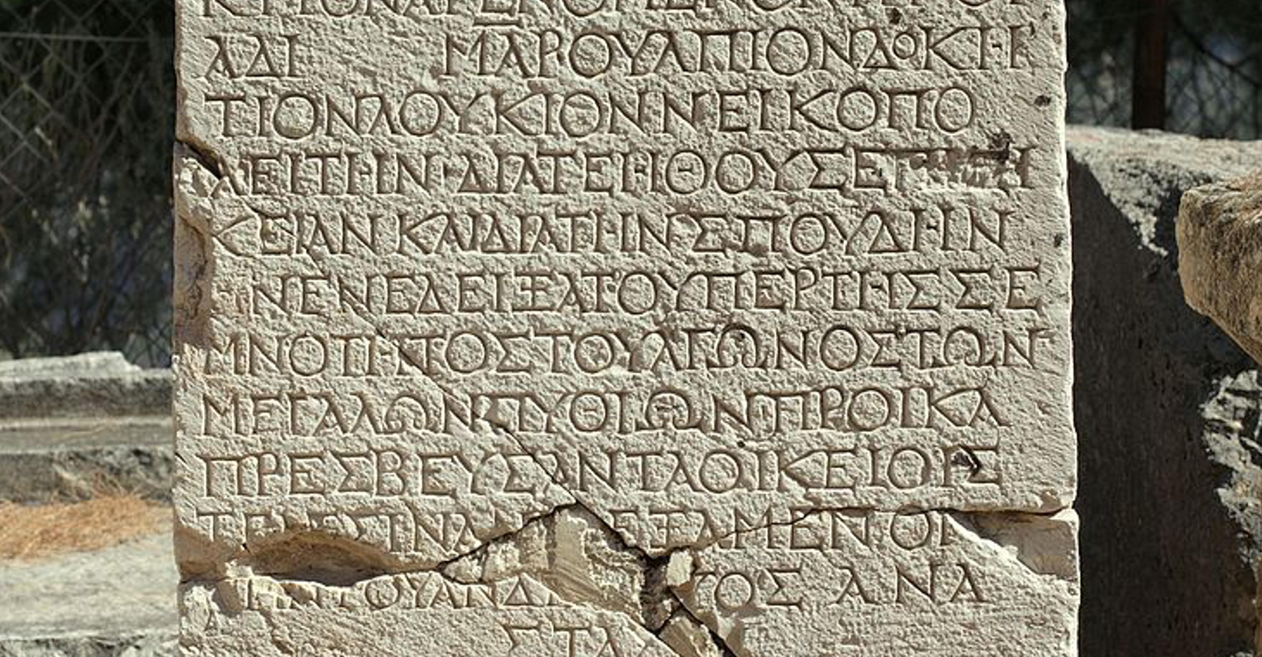
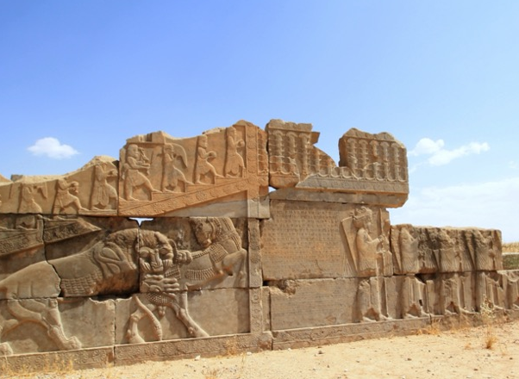
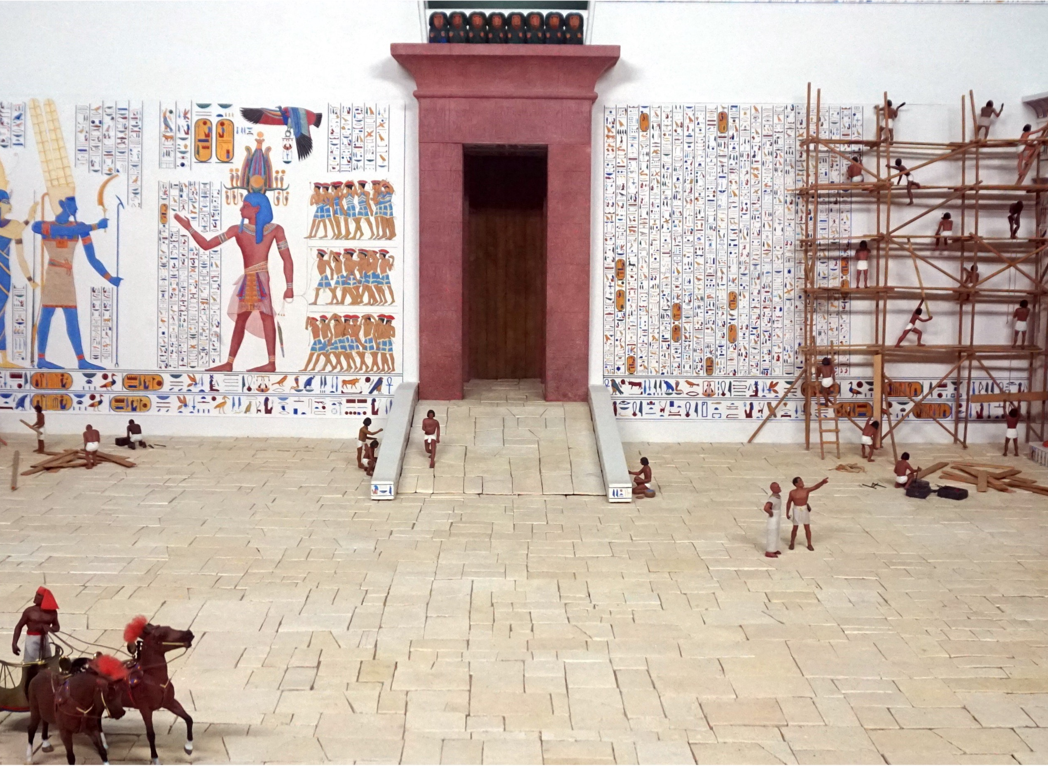
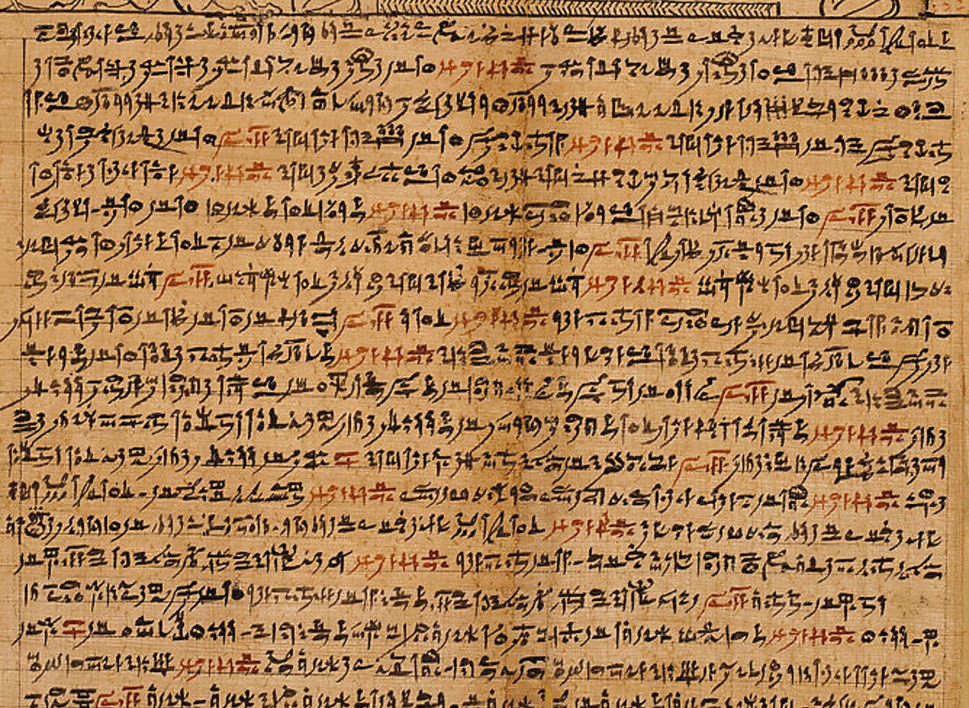
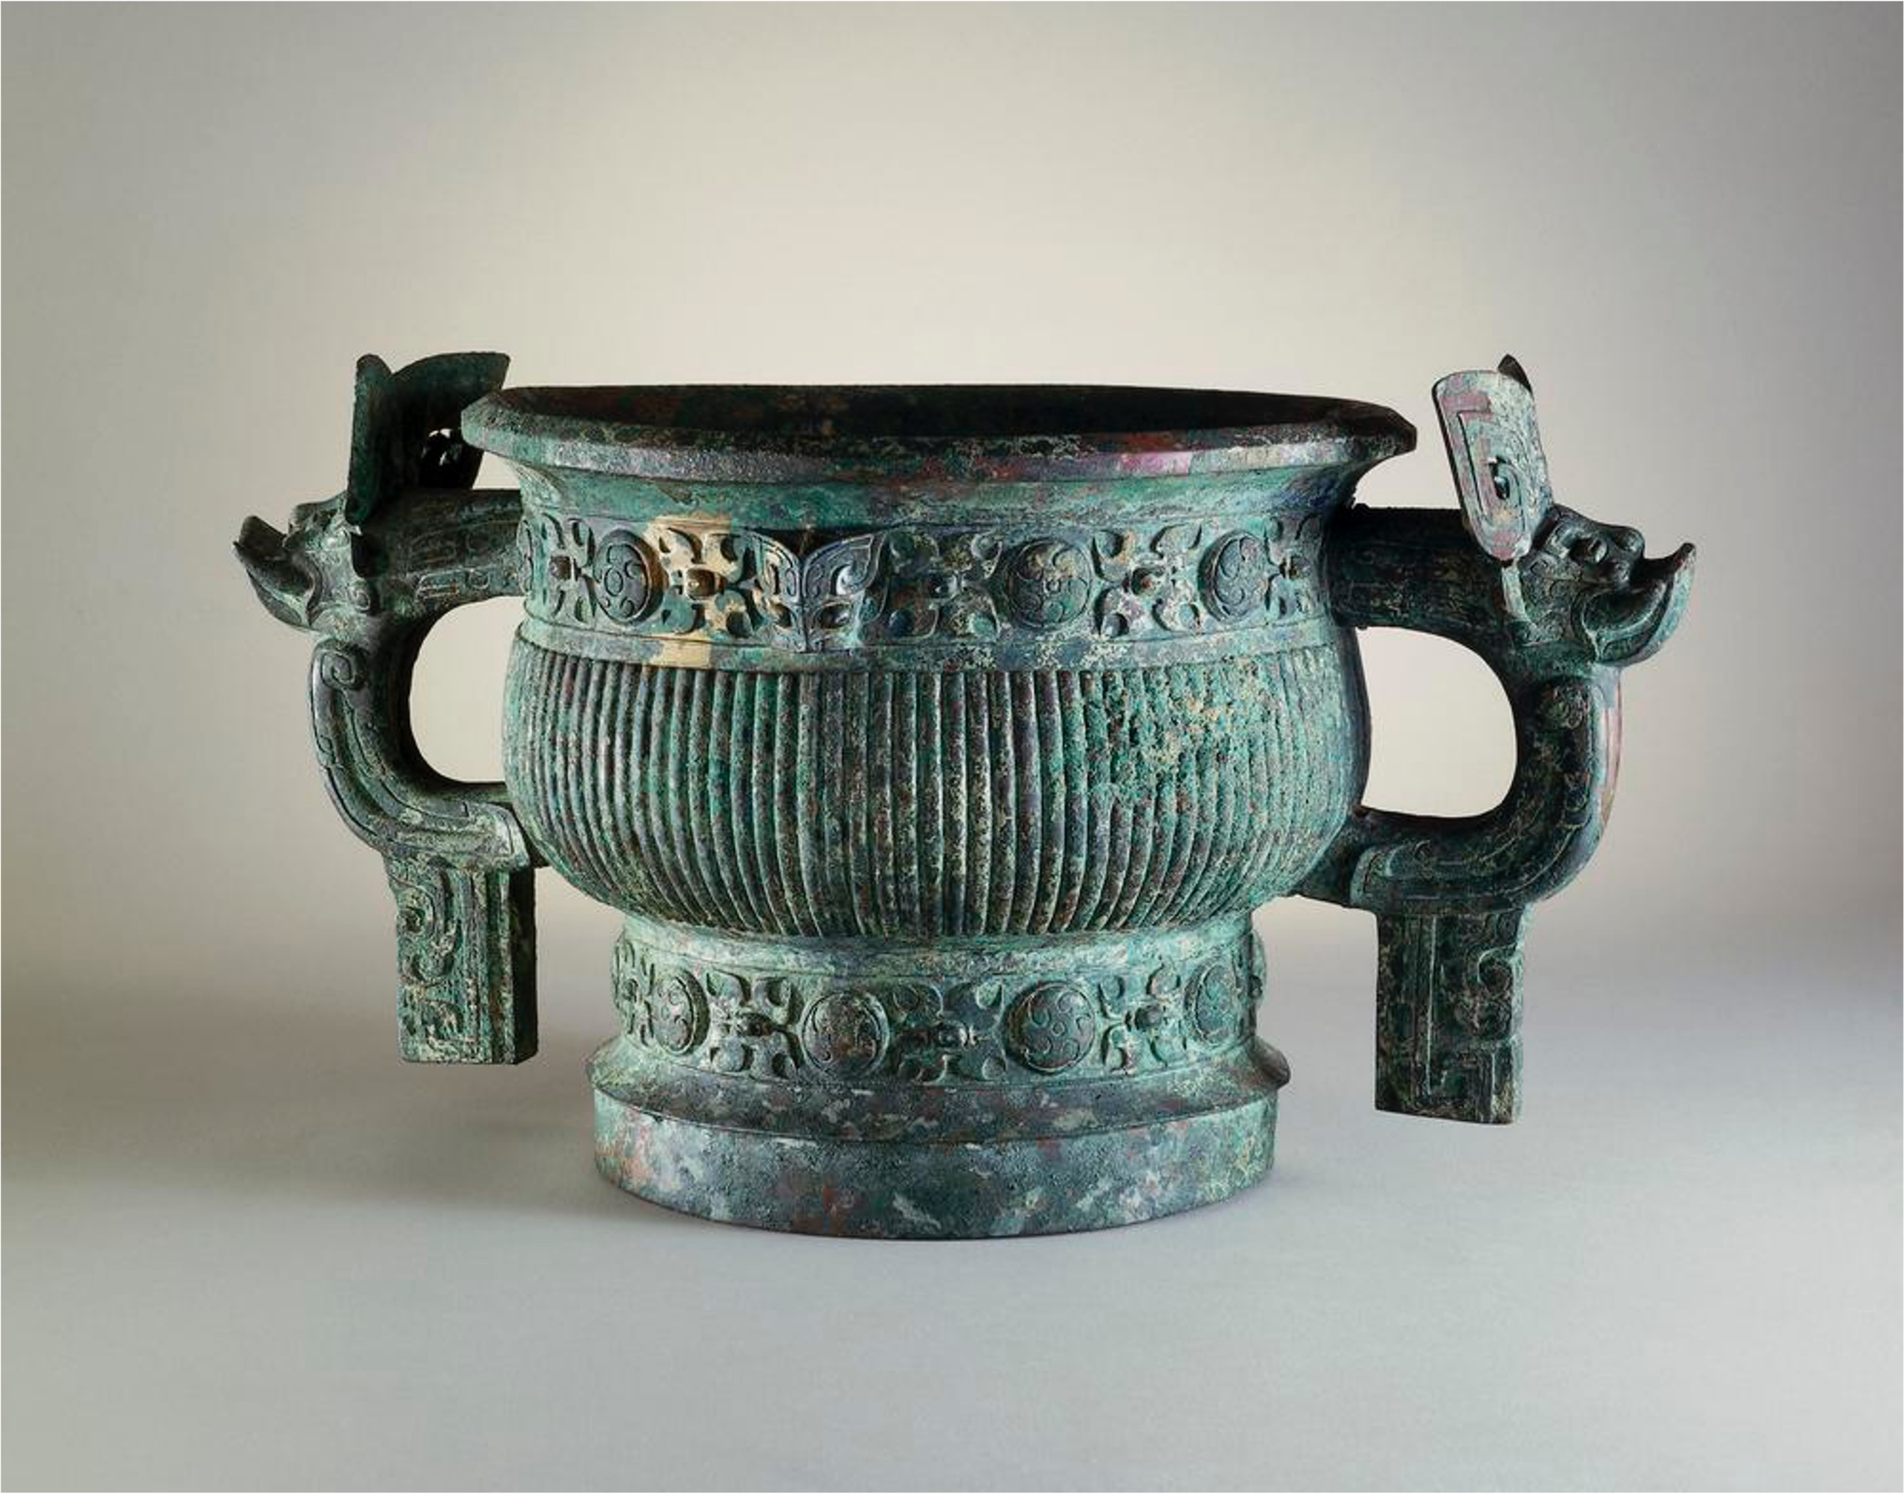
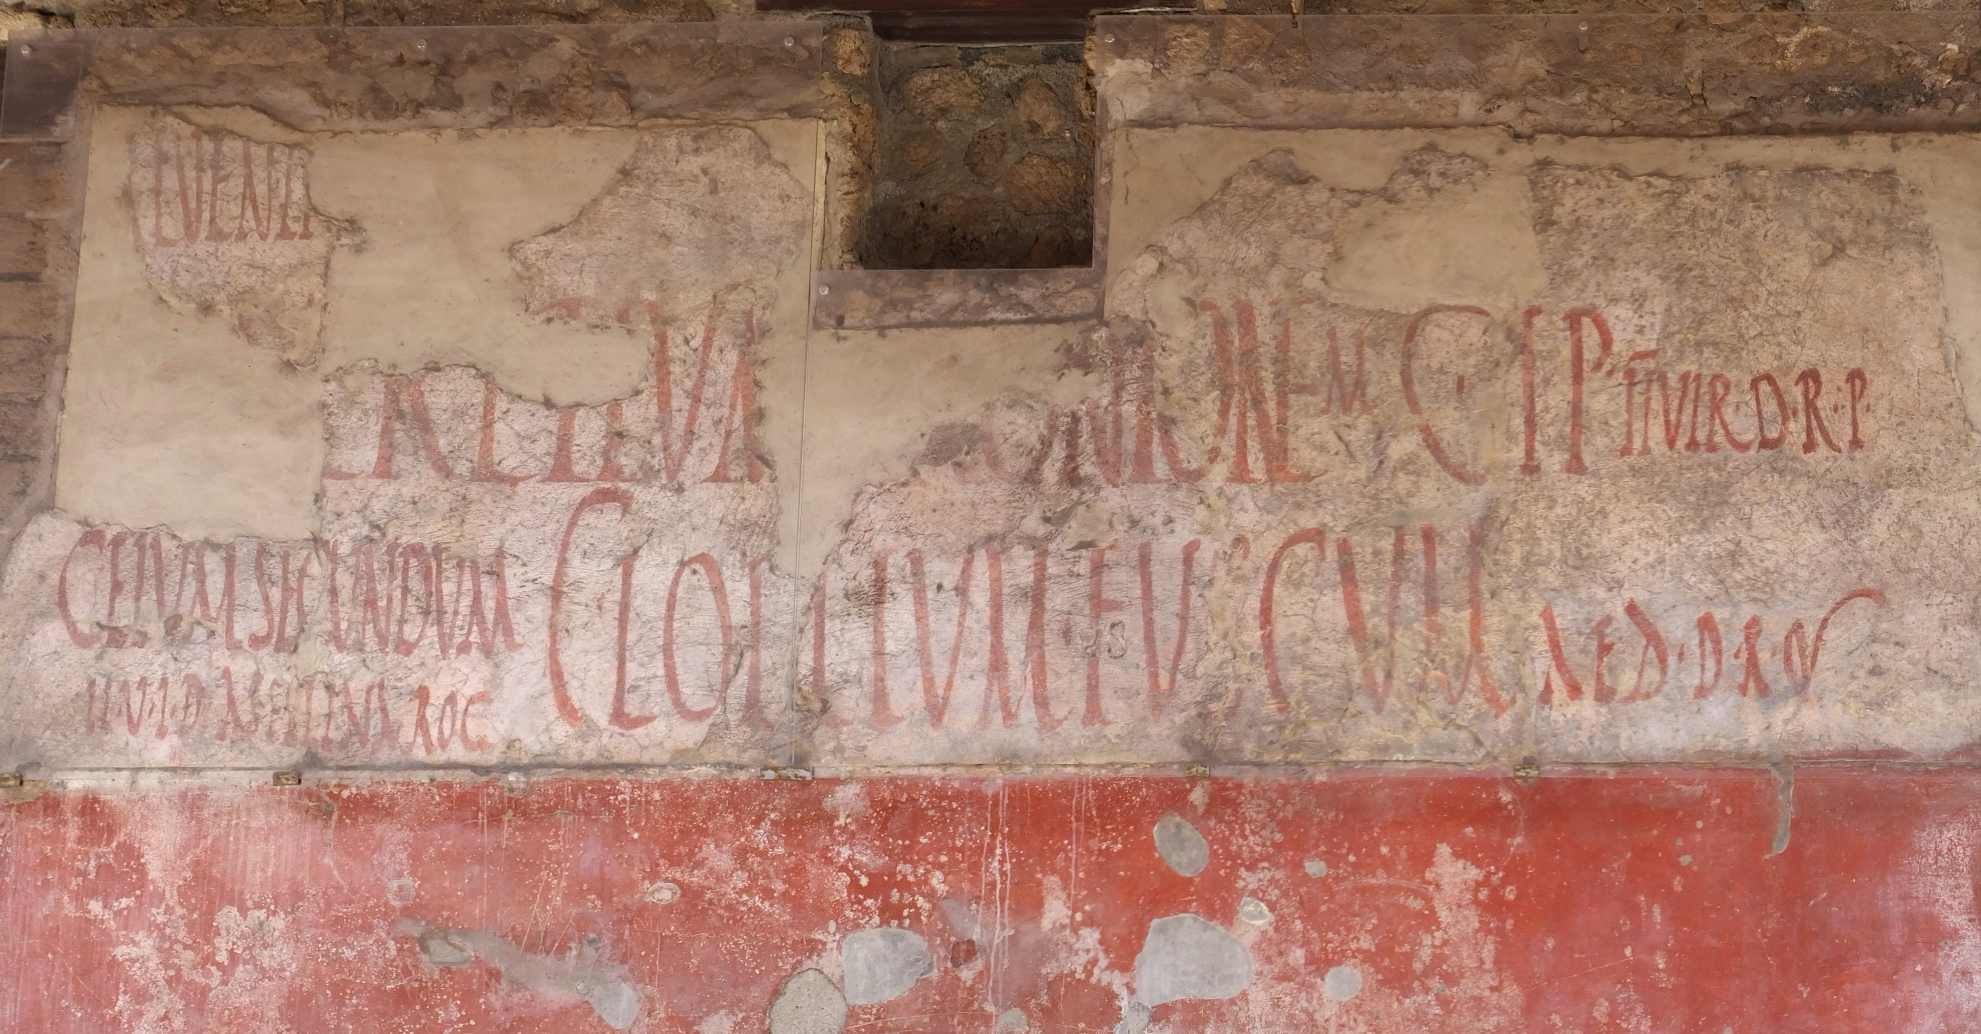
Types of sources
Categorise by time
Primary sources – from the time being studied
Secondary sources – from after the time being studied
Ancient Greek inscription, Delphi, 060055 by Zde is licensed under CC BY-SA 4.0.
Categorise by construction:
Literary sources – constructed using language; both written and oral
Archaeological sources – physical objects also known as artefacts
Persepolis by Blondinrikard Fröberg is licensed under CC BY 2.0
The Temple of Ramesses III at Medinet Habu model at the Milwaukee Public Museum in Milwaukee, Wisconsin by Michael Barera is licensed under CC BY-SA 4.0
Book of the Dead of the Priest of Horus, Imhotep (Imuthes) by Metropolitan Museum of Art is available in the public domain.
Epigraphic sources – inscriptions, including ancient graffiti.
167747001 © The Trustees of the British Museum. Shared under a Creative Commons Attribution-NonCommercial-ShareAlike 4.0 International (CC BY-NC-SA 4.0) licence
Pompeii 220 by Amphipolis is licensed under CC BY-SA 2.0.
Notes:
Teacher notes:
This slide has animations. View in slideshow mode to see animations.
The purpose of this slide is to activate prior learning from History 7–10.
The following slide provides a check for understanding to assess students have prior knowledge required to engage with lesson activities.

Slide 6

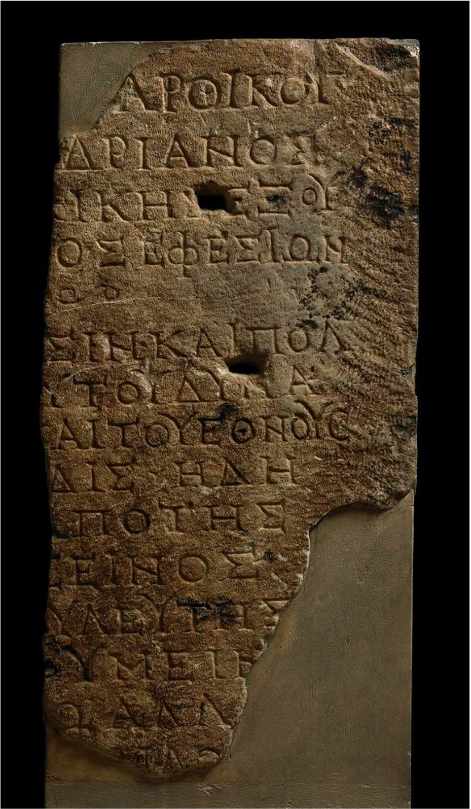
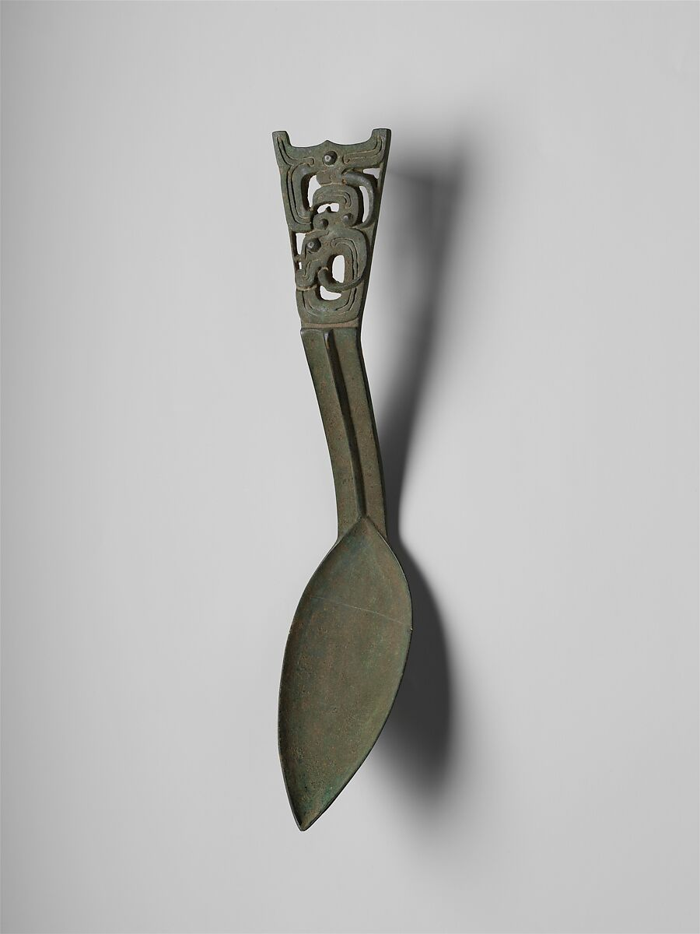
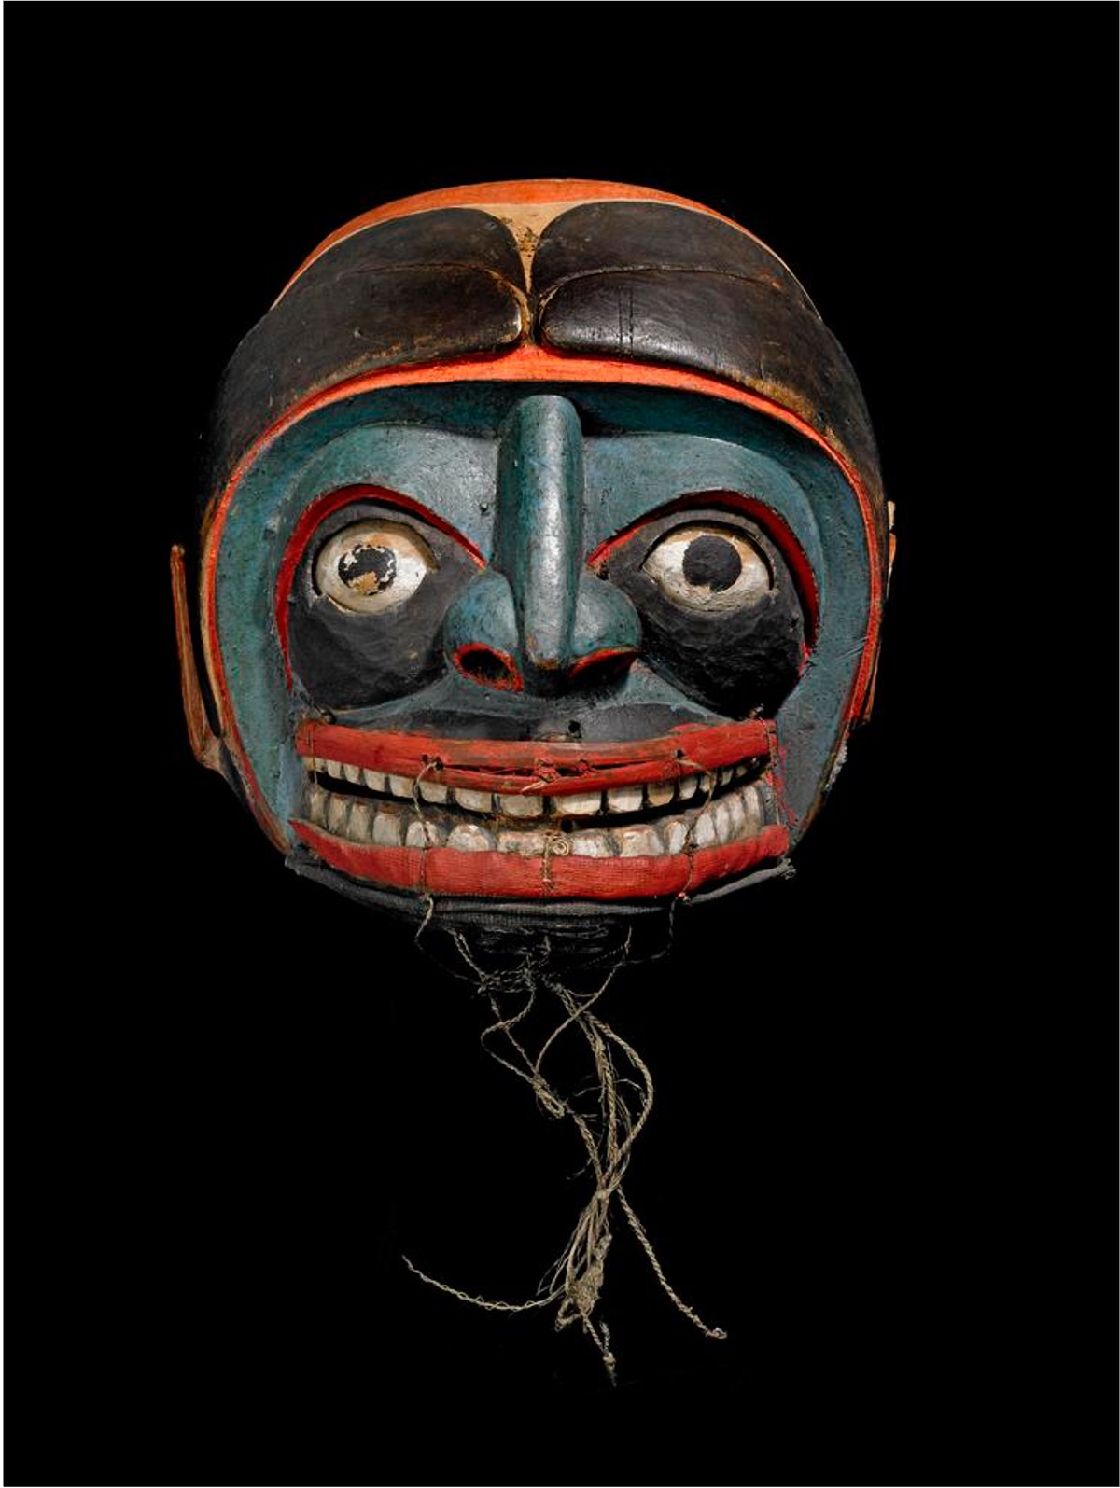
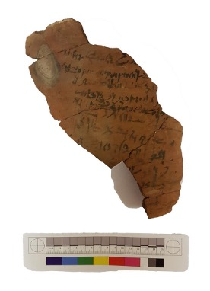
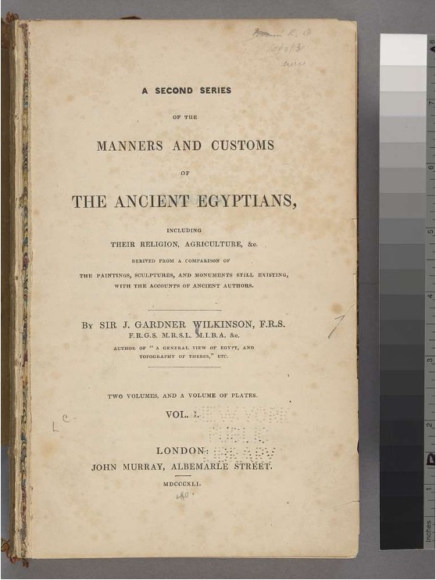
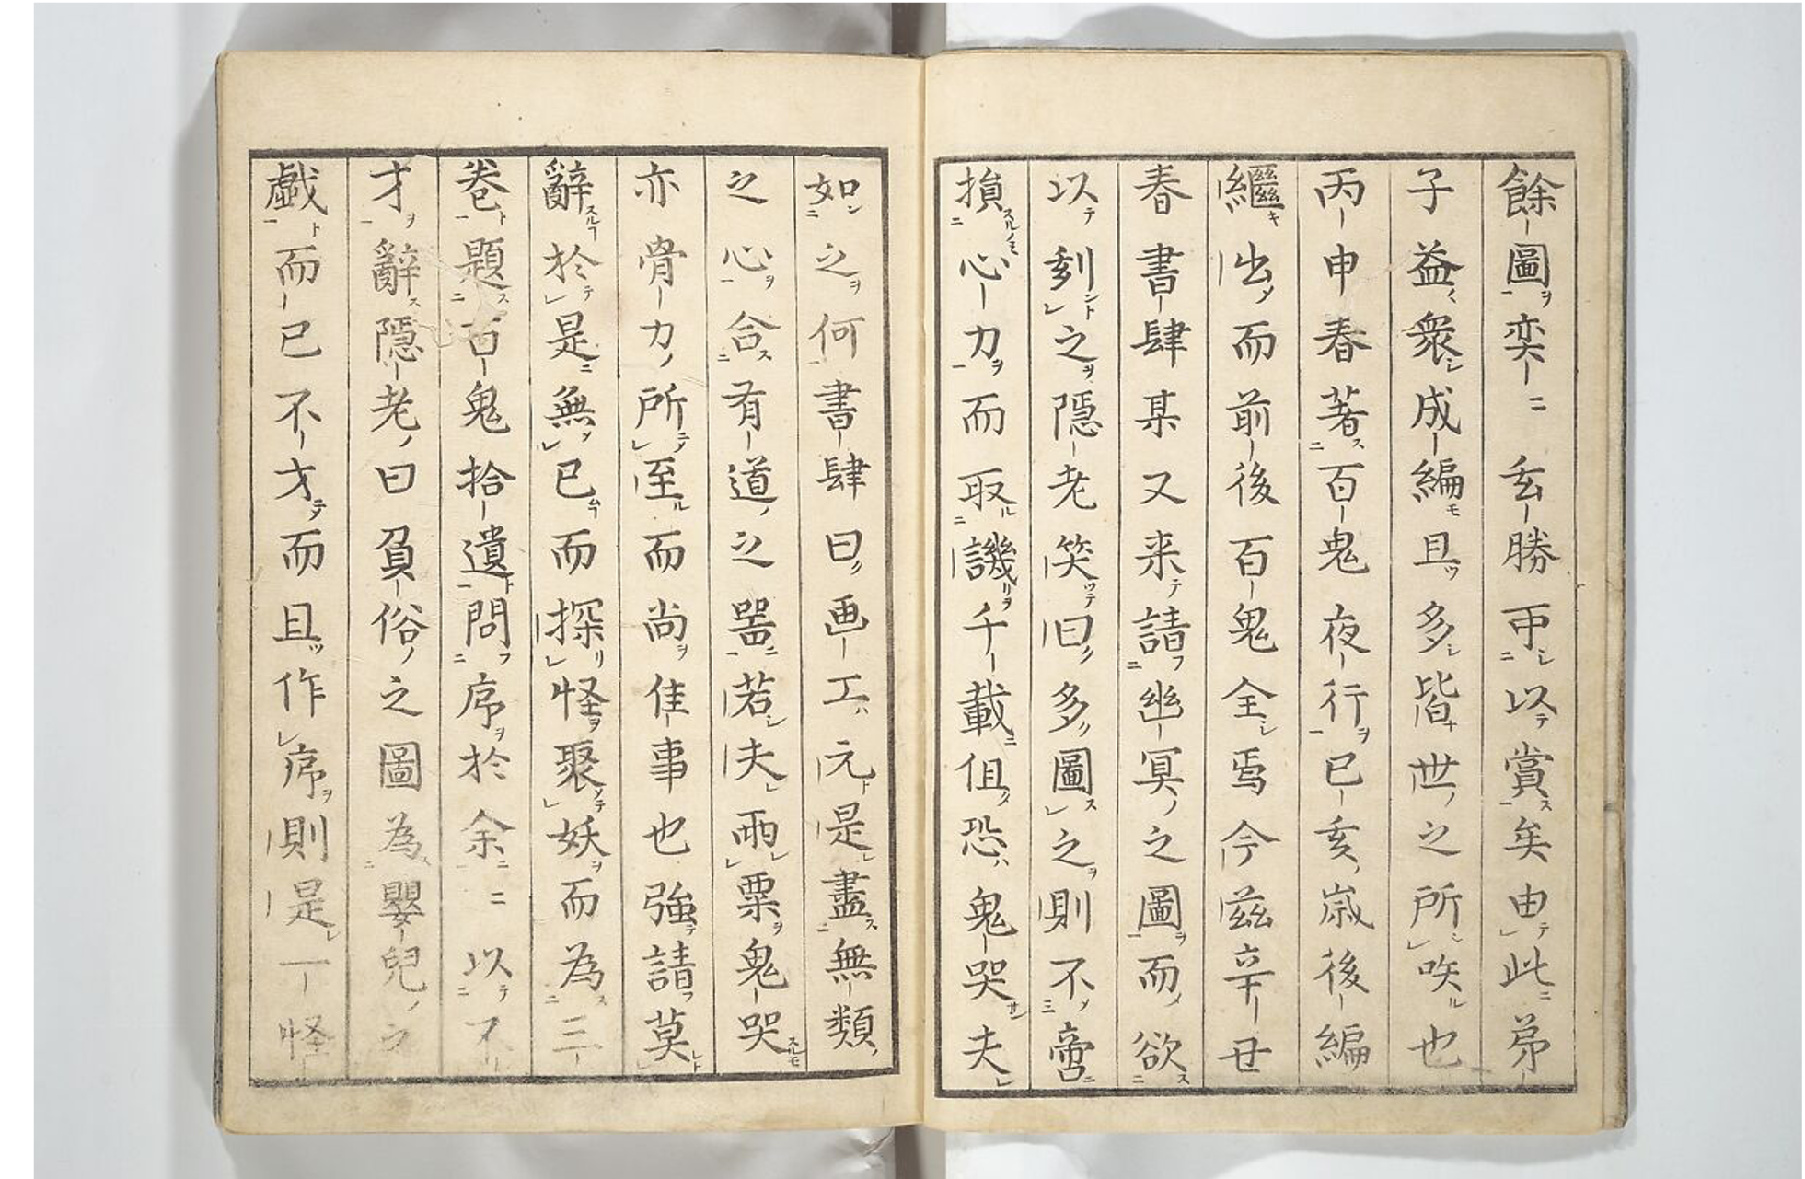

Check for understanding
Gesture voting
Types of sources
For each source coming up on the screen, vote:
1 finger up – literary source
2 fingers up – archaeological source
3 fingers up – epigraphic sources
Epigraphic
One Hundred Monsters Ancient and Modern (Hyakki shūi) by
Metropolitan Museum of Art is available in the public domain.
Literary
Archaeological
Archaeological
Literary
Epigraphic
1613352461 (jar; ostracon) © The Trustees of the British Museum.
Shared under a Creative Commons Attribution-NonCommercial-ShareAlike 4.0
International (CC BY-NC-SA 4.0) licence.
1613352461 (jar; ostracon) © The Trustees of the British Museum.
Shared under a Creative Commons Attribution-NonCommercial-ShareAlike 4.0
International (CC BY-NC-SA 4.0) licence.
321893001 (Medicine mask) © The Trustees of the British Museum. Shared under a
Creative Commons Attribution-NonCommercial-ShareAlike 4.0 International
(CC BY-NC-SA 4.0) licence.
Spoon by Metropolitan Museum of Art is available in the public domain.
Title page, Ser. 2, vol. 1. (A second series of the Manners and customs of
the Ancient Egyptians) by New York Public Library is available in the public domain.
Notes:
Teacher notes:
This slide has animations. View in slideshow mode to see animations.
Answers:
Archaeological
Literary
Archaeological
Epigraphic
Literary
Epigraphic
Reteach source types before progressing if students do not demonstrate sound understanding. Run through previous slide and ask students to write the source types in their books. Conduct a similar check for understanding with different sources after reteaching.
Gesture voting considerations:
establish norms, such as a signal, so that all students respond at the same time
Identify where students are physically required to place their gesture
Gestures are highly and instantly visible to all learners. Could be contagious and be copied. To ensure success:
Maintain the imposition of thinking time
Consider ways in which students may be restricted from seeing other students' answers. Such as: answer with eyes closed, answer in front of chest, backs to their group.

Slide 7
Archaeological source analysis

Slide 8
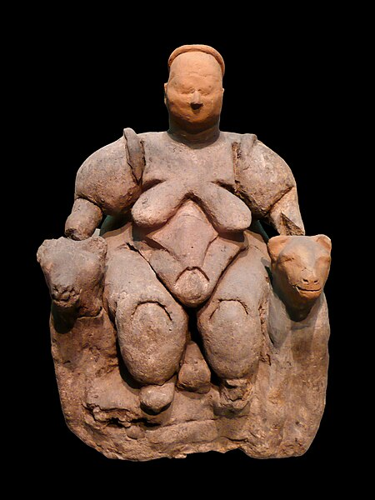
Questioning archaeological sources
Collect the facts
What is it?
A handmade female figurine seated on a bench with feline (possibly leopard) arm rests on either side. The figurine’s head and right armrest are modern reconstructions as they were missing when the artefact was discovered.
What is it made from?
Baked clay.
What size is it?
It is 20.3 centimetres high.
Seated Woman of Çatalhöyük on black background by Nevit Dilmen is licensed under CC BY-SA 3.0.
Notes:
Teacher notes:
This slide has animations. View in slideshow mode to see animations.
Explain the difference between the terms source and evidence. The image is a source. When we analyse the source, we extract evidence that can be used to interpret the past.
This is one of the most famous statues from the site of Çatalhöyük – one of the oldest settlement sites in the world, located in the interior of Türkiye on the plains of Cappadocia.
The artefact is now located at the Museum of Anatolian Civilizations in Ankara, Türkiye.

Slide 9
Questioning archaeological sources
Collect the facts
Who made it?
The sculptor is unknown.
When was it made?
The artefact is dated from circa 7000–6000 BCE.
Where was it found?
Çatalhöyük archaeological site in modern day central Turkiye by James Mellaart.
What was found near it?
Mellaart’s excavation found 40 houses and figurines, pottery and wall art. Similar female figurines were found, most smaller in size.
Seated Woman of Çatalhöyük on black background by Nevit Dilmen is licensed under CC BY-SA 3.0.
Notes:
Teacher notes:
This slide has animations. View in slideshow mode to see animations.
This is one of the most famous statues from the site of Çatalhöyük – one of the oldest settlement sites in the world, located in the interior of Türkiye on the plains of Cappadocia.
The artefact is now located at the Museum of Anatolian Civilizations in Ankara, Türkiye.

Slide 10
Questioning archaeological sources
Start interpreting based on the facts
What do we see in the source?
A female figure with a voluptuous features including large breasts and hips. She is seated between two large felines, resting her hands on their backs. There is a round shape between her legs.
What could this mean?
Voluptuous features may represent agricultural and/or human fertility. Felines may represent strength; a taming and control over nature. Round shape might be a baby’s head during birth or the skull of a reputable forefather.
Seated Woman of Çatalhöyük on black background by Nevit Dilmen is licensed under CC BY-SA 3.0.
Notes:
Teacher notes:
This slide has animations. View in slideshow mode to see animations.
This is one of the most famous statues from the site of Çatalhöyük – one of the oldest settlement sites in the world, located in the interior of Türkiye on the plains of Cappadocia.
The artefact is now located at the Museum of Anatolian Civilizations in Ankara, Türkiye.

Slide 11
Questioning archaeological sources
Start interpreting based on the facts
What was its function?
It may have been a decorative piece or a religious object.
What is its significance?
Many similar figures were found at the site. They may signify the importance of a possible female goddess.
Why do we think this?
Similar figurines have been found in other sites from around the time, interpreted as religious objects used to represent a ‘mother-goddess’, the earliest known deity worshipped by humans. Felines are used to represent strength in many ancient works.
Seated Woman of Çatalhöyük on black background by Nevit Dilmen is licensed under CC BY-SA 3.0.
Notes:
Teacher notes:
This slide has animations. View in slideshow mode to see animations.
Conduct a class discussion about the artefact at the end. What interpretations do students have for the artefact?

Slide 12




How do we get the facts?
Other artefacts from the site and/or time
Published works by archaeologists and historians
Ancient texts (not available for prehistoric artefacts)
Background knowledge from previous research
Source A: ‘Mother-goddess’ figurine found at Çatalhöyük, dated to 7000–6000 BCE
Seated Woman of Çatalhöyük on black background by Nevit Dilmen is licensed under CC BY-SA 3.0.
Notes:
Teacher notes:
This slide has animations. View in slideshow mode to see animations.
Discuss information provided underneath a source in an examination can provide some facts to support analysis. This textbox is animated to show emphasis when clicked.

Slide 13

How do we know our interpretation is right?
We don’t
Archaeologists and historians must always
be open to changing
their interpretation
Interpretations may
change based on new finds, different viewpoints and further analysis
Base interpretations
on facts as much as possible
Notes:
Teacher notes:
This slide has animations. View in slideshow mode to see animations.

Slide 14
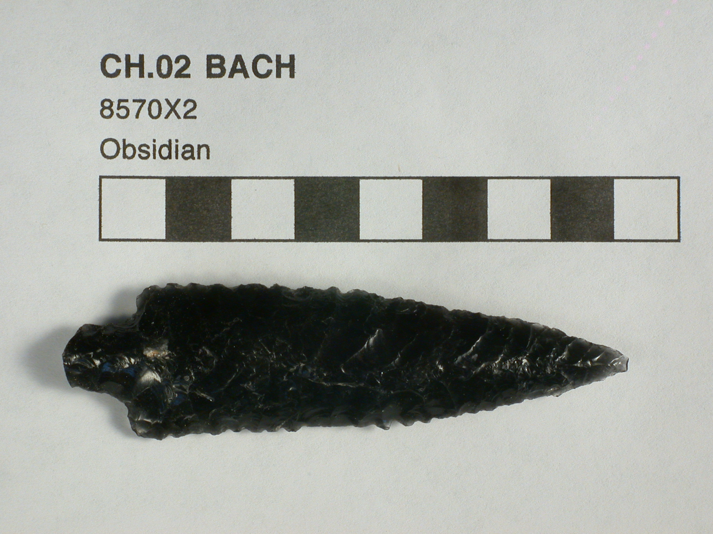
Analyse together
What is it?
A rock that appears to have been shaped into a point.
Collect the facts
What is it made from?
Obsidian – naturally occurring volcanic glass.
What size is it?
Approximately 8.5 centimetres.
Who made it?
The creator is unknown.
When was it made?
Circa 7000–5700 BCE.
Where was it found?
20020710_mal_048 by Remixing Çatalhöyük is licensed under CC BY-NC 2.0.
In a ‘foundation deposit’ beneath the floor in the entry to Building 3 at Çatalhöyük.
Notes:
Teacher notes:
This slide has animations. View in slideshow mode to see animations.
Complete the following slides as a class with students writing responses in Table – Archaeological source analysis scaffold (see Teaching support resource).

Slide 15
Analyse together
Collect the facts, start interpreting based on the facts
What was found near it?
A second obsidian arrowhead style rock surrounded with ash and small animal bones.
What do we see in the source?
Obsidian shaped into a point on one end and a tang on the other. Appears to have sharp edges. Appears to have been purposefully shaped.
What do we see in the source?
This may have been purposefully shaped to a sharp point at one end. The tang may have been used to attach the artefact to something else, such as a piece of wood, that may have deteriorated over time.
20020710_mal_048 by Remixing Çatalhöyük is licensed under CC BY-NC 2.0.
Notes:
Teacher notes:
This slide has animations. View in slideshow mode to see animations.
Complete the following slides as a class with students writing responses in an Archaeological source analysis scaffold (see Teacher support resource).

Slide 16
Analyse together
Start interpreting based on the facts
What was its function?
An arrowhead used for hunting, perhaps a weapon. May have been stored in the entry for protection.
What is its significance?
Shows inhabitants skill in carving obsidian into this shape and used locally sourced materials.
Why do we think this?
Similar in shape to other arrowheads from that time. Animal bones found near the artefact suggest it was used for hunting. Neolithic people considered the entry of a home to be a powerful boundary so may have stored arrowheads there for protection.
20020710_mal_048 by Remixing Çatalhöyük is licensed under CC BY-NC 2.0.
Notes:
Teacher notes:
This slide has animations. View in slideshow mode to see animations.
Complete the following slides as a class with students writing responses in an Archaeological source analysis scaffold (see Teacher support resource).

Slide 17
References
This presentation contains NSW Curriculum and syllabus content. The NSW Curriculum is developed by the NSW Education Standards Authority. This content is prepared by NESA for and on behalf of the Crown in the right of the State of New South Wales. The material is protected by Crown copyright.
Please refer to the NESA Copyright Disclaimer for more information https://educationstandards.nsw.edu.au/wps/portal/nesa/mini-footer/copyright.
NESA holds the only official and up-to-date versions of the NSW Curriculum and syllabus documents. Please visit the NSW Education Standards Authority (NESA) website https://educationstandards.nsw.edu.au/wps/portal/nesa/home and the NSW Curriculum website https://curriculum.nsw.edu.au.
Ancient History 11–12 Syllabus © NSW Education Standards Authority (NESA) for and on behalf of the Crown in right of the State of New South Wales, 2024.
Amphipolis (27 November 2014) Pompeii 220 [photograph], Flickr, accessed 5 April 2025.
Barera M (20 November 2022) File:Milwaukee Public Museum November 2022 163 (crossroads of civilization--Temple of Ramesses III at Medinet Habu).jpg - Wikimedia commons [image], Wikimedia Commons, accessed 5 April 2025.
Çatalhöyük R (20 September 2007) 20020710_mal_048 [photograph], Flickr, accessed 5 April 2025.
Dilmen N (8 March 2012) File:seated woman of çatalhöyük on black background.jpg - wikimedia commons [image], Wikimedia Commons, accessed 5 April 2025.
Dr._Colleen_Morgan (25 July 2008) DSC_0006 [photograph], Flickr, accessed 5 April 2025.
Fröberg B (13 June 2015) Persepolis [photograph], Flickr, accessed 5 April 2025.

Slide 18
References
This presentation contains NSW Curriculum and syllabus content. The NSW Curriculum is developed by the NSW Education Standards Authority. This content is prepared by NESA for and on behalf of the Crown in the right of the State of New South Wales. The material is protected by Crown copyright.
Please refer to the NESA Copyright Disclaimer for more information https://educationstandards.nsw.edu.au/wps/portal/nesa/mini-footer/copyright.
NESA holds the only official and up-to-date versions of the NSW Curriculum and syllabus documents. Please visit the NSW Education Standards Authority (NESA) website https://educationstandards.nsw.edu.au/wps/portal/nesa/home and the NSW Curriculum website https://curriculum.nsw.edu.au.
Sekien T (1781) One hundred monsters ancient and modern (Hyakki shūi) [image], The Metropolitan Museum of Art, accessed 5 April 2025.
The British Museum (n.d.-a) Block (1868,0620.64) [image], British Museum, accessed 5 April 2025.
——(n.d.-b) Gui (1977,0404.1) [image], British Museum, accessed 5 April 2025.
——(n.d.-c) Jar; ostracon (EA58917) [image], British Museum, accessed 5 April 2025.
——(n.d.-d) Mask (Am.7184) [image], British Museum, accessed 5 April 2025.
The Metropolitan Museum of Art (n.d.-a) Book of the Dead of the Priest of Horus, Imhotep (Imuthes) [image], The Metropolitan Museum of Art, accessed 5 April 2025.
——(n.d.-b) Spoon (bi) [image], The Metropolitan Museum of Art, accessed 5 April 2025.

Slide 19
References
This presentation contains NSW Curriculum and syllabus content. The NSW Curriculum is developed by the NSW Education Standards Authority. This content is prepared by NESA for and on behalf of the Crown in the right of the State of New South Wales. The material is protected by Crown copyright.
Please refer to the NESA Copyright Disclaimer for more information https://educationstandards.nsw.edu.au/wps/portal/nesa/mini-footer/copyright.
NESA holds the only official and up-to-date versions of the NSW Curriculum and syllabus documents. Please visit the NSW Education Standards Authority (NESA) website https://educationstandards.nsw.edu.au/wps/portal/nesa/home and the NSW Curriculum website https://curriculum.nsw.edu.au.
Wilkinson JG (1841) Title page, ser. 2, vol. 1. (A second series of the manners and customs of the ancient Egyptians.), NYPL Digital Collections, accessed 5 April 2025.
Zde (29 August 2006) File:Ancient Greek inscription, Delphi, 060055.jpg - Wikimedia Commons [image], Wikimedia Commons, accessed 5 April 2025.

Slide 20
Copyright
© State of New South Wales (Department of Education), 2025
The copyright material published in this resource is subject to the Copyright Act 1968 (Cth) and is owned by the NSW Department of Education or, where indicated, by a party other than the NSW Department of Education (third-party material).
Copyright material available in this resource and owned by the NSW Department of Education is licensed under a Creative Commons Attribution 4.0 International (CC BY 4.0) license.
This license allows you to share and adapt the material for any purpose, even commercially.
Attribution should be given to © State of New South Wales (Department of Education), 2025.
Material in this resource not available under a Creative Commons license:
the NSW Department of Education logo, other logos and trademark-protected material
Material owned by a third party that has been reproduced with permission. You will need to obtain permission from the third party to reuse its material.
Links to third-party material and websites
Please note that the provided (reading/viewing material/list/links/texts) are a suggestion only and implies no endorsement, by the New South Wales Department of Education, of any author, publisher, or book title. School principals and teachers are best placed to assess the suitability of resources that would complement the curriculum and reflect the needs and interests of their students.
If you use the links provided in this document to access a third-party’s website, you acknowledge that the terms of use, including licence terms set out on the third-party’s website apply to the use which may be made of the materials on that third-party website or where permitted by the Copyright Act 1968 (Cth). The department accepts no responsibility for content on third-party websites.

