Slide 1
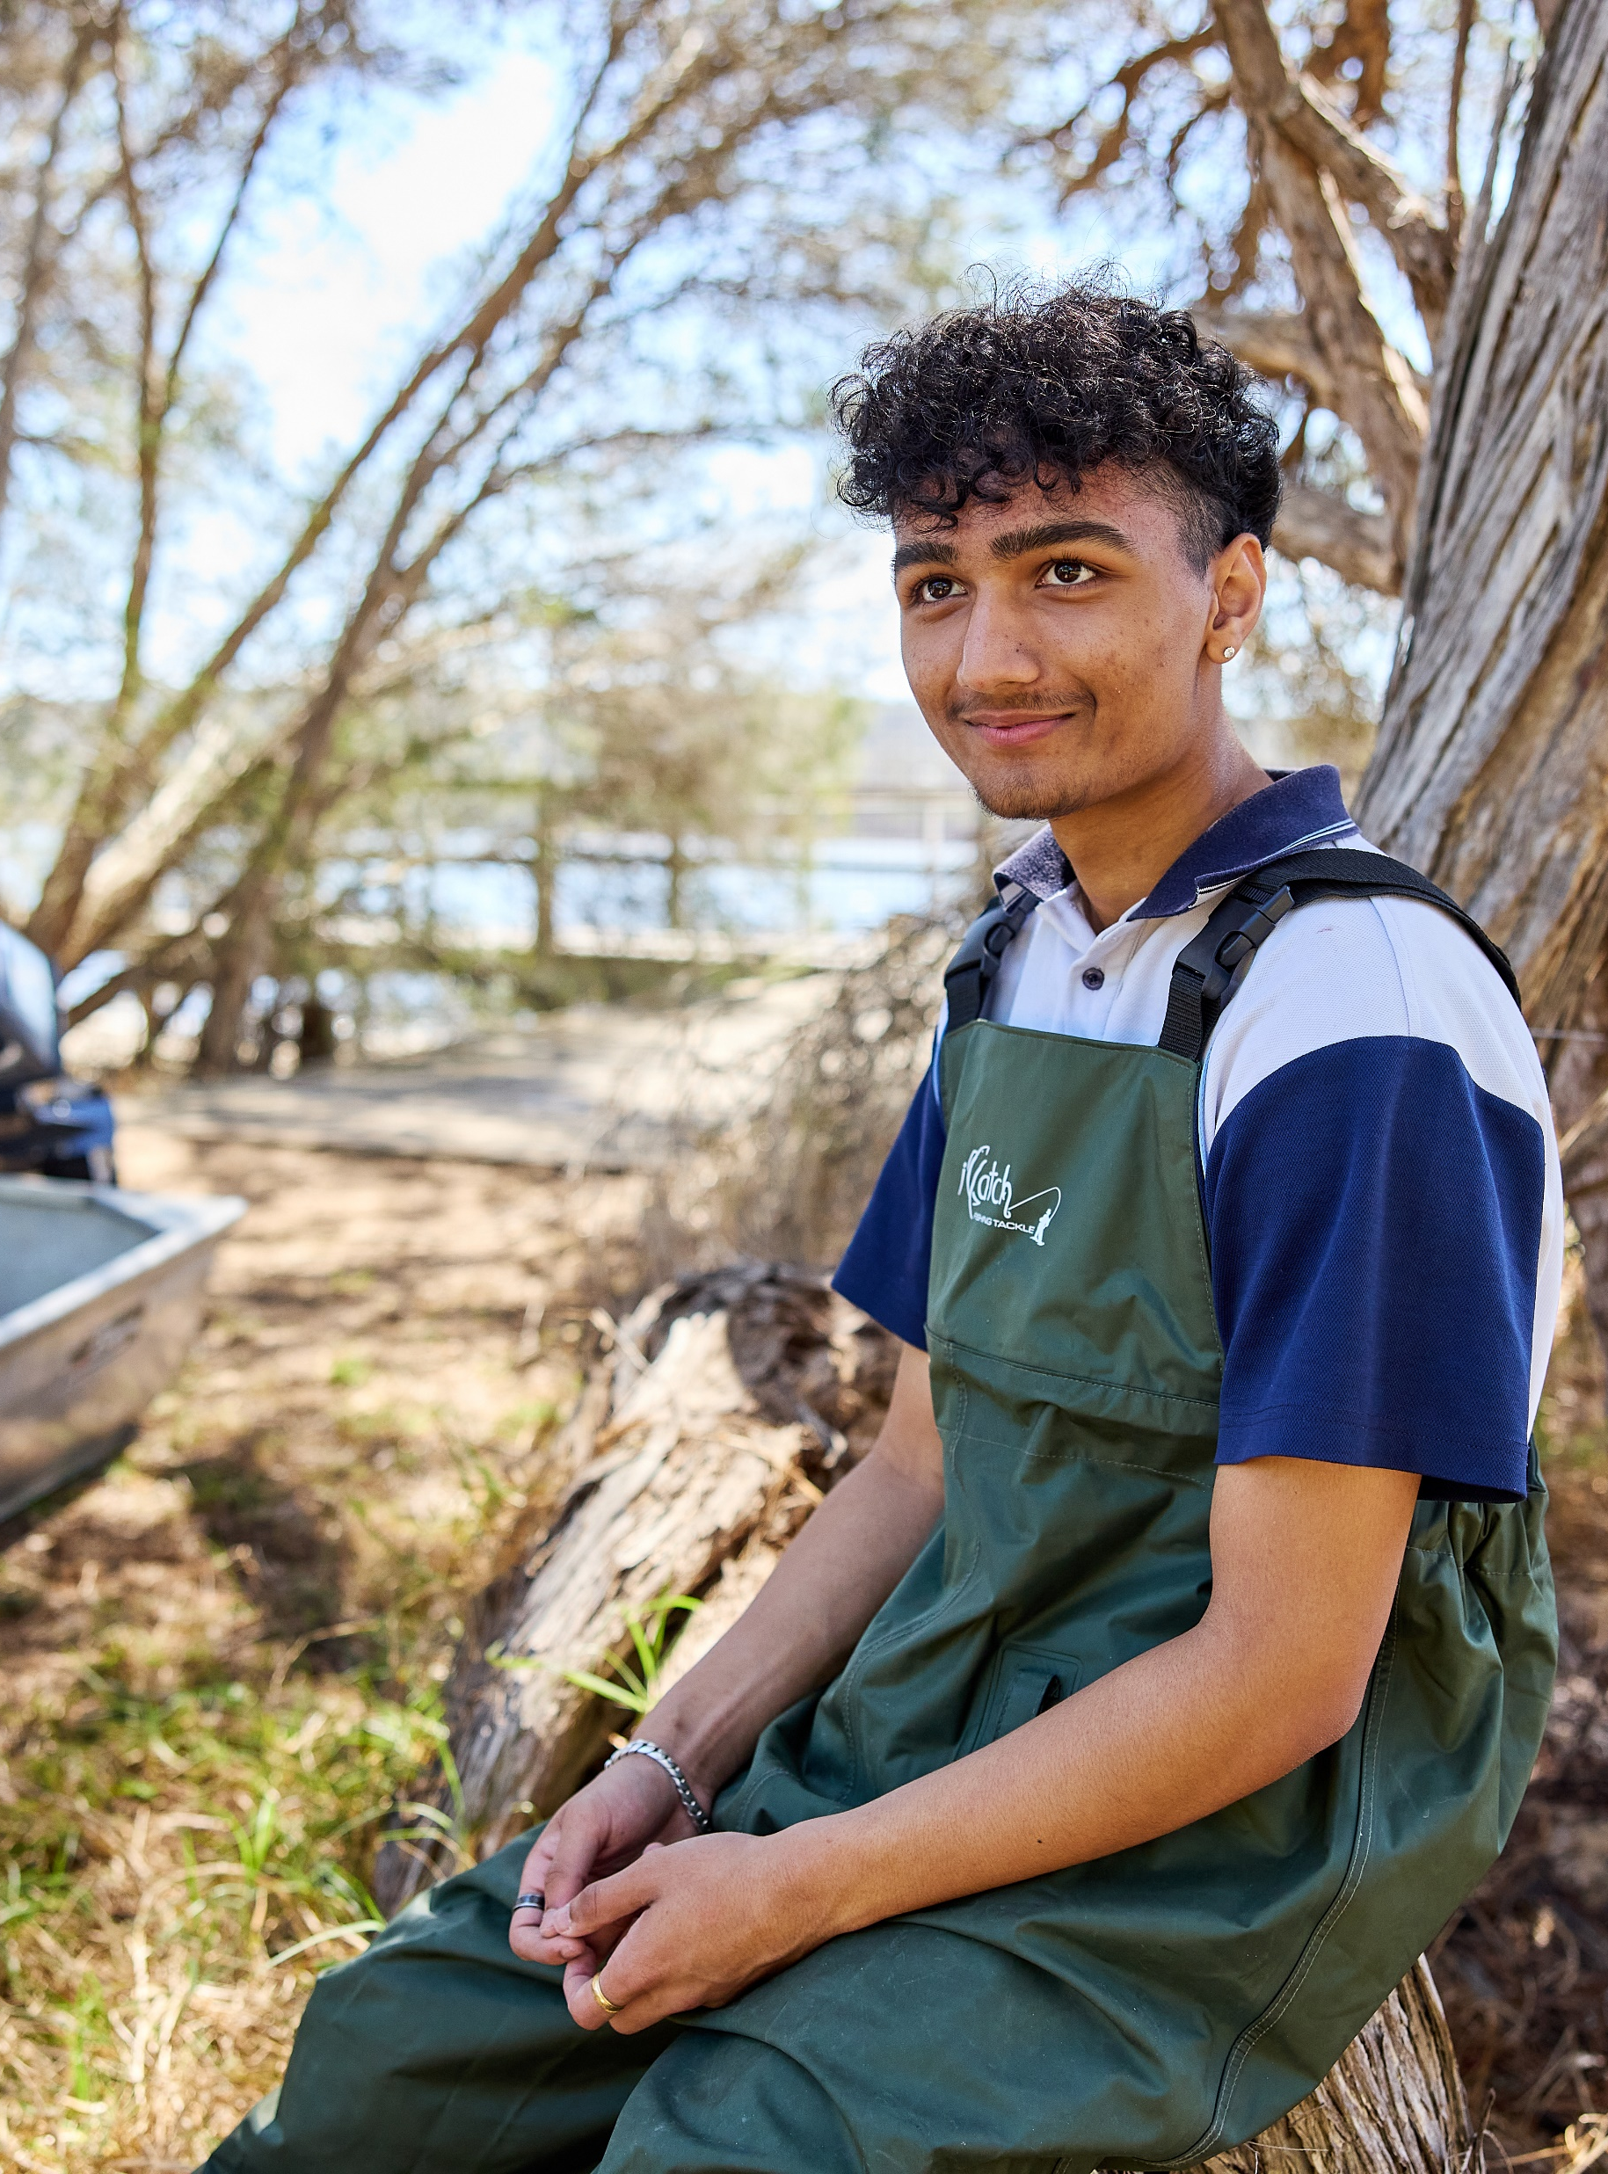
Lesson 5 – geographical inquiry
Stage 5 geography
Biomes and sustainable agriculture
[TEACHER NAME]

Slide 2
Learning intentions and success criteria
We are learning to
identify the steps included in a geographical inquiry
propose, plan, conduct and communicate a geographical inquiry
We can
develop well reasoned and logical significant geographical questions
use significant geographical questions to pose a suitable hypothesis
plan effectively for a geographical inquiry
identify ways to collect, select and record data
Notes:
Notes for teachers:
Learning intentions and success criteria are best co-constructed with students. Adapt the learning intention as required and add matching success criteria.
For more information See ⁠AITSL or the NSW Department of Education explicit teaching strategies, ⁠Sharing learning intentions and ⁠Sharing success criteria
LISC is not necessarily presented at the beginning of the lesson. Teacher needs to consider most effectual time to introduce
LISC should be revisited during the lesson to support students' evaluation of their learning

Slide 3
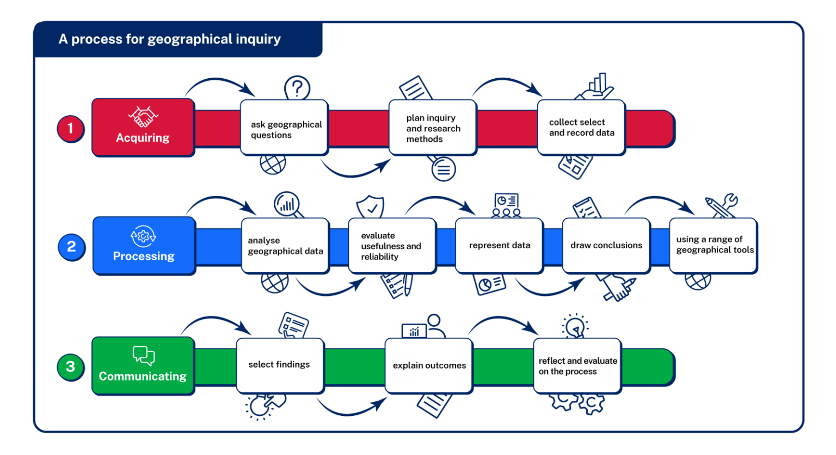
The geographical inquiry process
Notes:
Note – link to Sustainable biomes and agriculture Learning Sequence 1 – Lesson 18 (developing a hypothesis) in the program and student resource booklet. Additional support materials are provided for geographical inquiry in these resources as well as the assessment support material.

Slide 4


Geographical inquiry
Duration 2:59
Notes:
Transcript for geographical inquiry video:
The screen shows a blue sky with clouds. Text on the screen reads, ‘Curriculum Secondary Learners – HSIE. Teaching geographical skills series. Geographical inquiry. Presented by Melissa Ellis.’]
Melissa Ellis
Hello. A geographical inquiry is a process by which students learn about and deepen their understanding of geography.
[Presenter is standing in front of a decorative background. In the bottom right-hand corner of the screen, the text reads, ‘Melissa Ellis. HSIE Curriculum Support Project Officer.’]
It involves individual, or collaborative, investigations that start with geographical questions and proceed through the collection, evaluation, interpretation, and analysis of information to develop a set of conclusions and proposals for action.
[Screen shows a video of teenage students in a classroom working together at their desks.]
Students apply their geographical skills and use geographical tools during an inquiry. Fieldwork provides opportunities for students to be involved in an active inquiry outside the classroom.
[Screen shows a series of videos, including young people walking with backpacks on a grassy mountain, a close-up view of a compass and map, and a young person walking through trees.]
The stages of inquiry are acquiring geographical information by identifying an issue or problem, developing geographical questions to investigate the issue or problem, collecting primary geographical data, gather geographical information from secondary sources, and recording their information. Secondly, in a geographical inquiry, students will need to process geographical information, evaluate data and information for reliability and bias, represent data and information in appropriate forms, interpreting data and information gathered, analysing the finding and results to draw conclusions. Thirdly, in an inquiry, they have to communicate geographical information, communicate the results using a variety of strategies, reflect on findings of the investigation, propose actions, and predict outcomes, where appropriate students can take action.
[Description not needed: The visuals in this part of the video only support what is spoken; the visuals do not provide additional information.]
A geographical inquiry does not have to follow the complete sequence just outlined. Teachers may provide students with a data set and allow students to interpret and analyse the data provided. Students may be presented with all the information and propose action or may pose a question they want to answer and strategies they would choose when conducting an inquiry.
[Screen shows a video of teenage students in a classroom working together at their desks. The presenter then reappears on the screen.]
So, to sum it up, a geographical inquiry will include some or all of the following, acquiring geographical information, processing geographical information, communicating geographical information. All the best with your inquiries.
Text on the screen reads, ‘Acknowledgements. NSW Geography K-10 syllabus © NSW Education Standards Authority (NESA) for and on behalf of the Crown in right of the State of New South Wales 2015. See the NESA website for additional copyright information. NSW Department of Education Curriculum Secondary Learners. Southern Cross School of Distance Education.’
The screen shows an Indigenous artwork. The artwork features a landscape with native Australian animals. It is titled, ‘Our Country’ by Garry Purchase. The text at the top of the screen reads, ‘Filming of these videos has taken place on Bundjalung land.’ Video concludes by displaying the NSW Government logo.]
[End of transcript]
[End of transcript]

Slide 5
Asking significant geographical questions
Significant geographical question
How do soil moisture and pH levels affect macadamia nut productivity in the subtropical biome of northern NSW?
Hypothesis
Optimal soil moisture levels (around field capacity) and slightly acidic soil conditions (pH around 6.0–6.5) will positively correlate with higher macadamia nut productivity.
Annotation
This example explicitly demonstrates an A-range level of geographical questioning and hypothesis formulation—clear, specific, testable, and explicitly linked to geographical concepts (soil moisture, pH, productivity).
WAGOLL – Macadamia farming (subtropical biome)
Notes:
Explain to students that significant geographical questions help us to deeply investigate issues and understand places better.
Highlight the importance of being specific and detailed when formulating a question, as shown in the macadamia farming example.
Emphasise the role of these questions in guiding the type of data collected and the methods used during fieldwork.
Suggest to students that a well-crafted question typically focuses on clear relationships between variables (e.g., rainfall, soil conditions, productivity).
For example, "Notice how this significant geographical question is very specific. It clearly identifies what we want to learn about—the relationship between soil moisture, pH, and macadamia productivity. It is detailed enough that we know exactly what data we’ll need to collect."
Teaching advice:
Note – link to Sustainable biomes and agriculture Learning Sequence 1 – Lesson 18 (developing a hypothesis) in the program and student resource booklet. Additional support materials are provided here.
·Adjustments to support students: Provide explicit sentence starters (e.g., "My hypothesis is clearly…").
·Extension for gifted students: Encourage explicit linking of local inquiry findings to broader global implications (e.g., "Local soil issues clearly illustrate global agricultural sustainability challenges…").

Slide 6
Asking significant geographical questions
Significant geographical question
How does seasonal rainfall variability impact dairy milk production in the NSW grassland biome?
Hypothesis
Increased rainfall variability negatively impacts dairy milk production by affecting pasture quality and availability.
Annotation
Clear evidence of geographically significant questioning and a well-formulated hypothesis, clearly predicting a relationship and aligned to agricultural productivity in the grassland biome context.
WAGOLL – Dairy farming (grassland biome)
Notes:
Reinforce that a hypothesis is essentially an educated prediction or statement that we test through fieldwork or data analysis.
Highlight clearly why it's important for hypotheses to be specific, testable, and directly linked to the geographical question posed.
Use the example explicitly to discuss how clearly stated hypotheses can guide effective data collection, e.g., linking rainfall or pH levels directly to expected productivity outcomes.
Clearly indicate to students that a strong hypothesis often predicts specific relationships (e.g., "If rainfall increases, productivity will increase").

Slide 7
Planning an inquiry research process
WAGOLL – Coffee production (tropical biome)
Geographical skill or tool | Definition | Justification
Scatter graph | A graph to clearly show the relationship between two variables | Clearly shows how rainfall relates to coffee bean yield
Field interviews | Structured conversations to gather local expert knowledge | Provides detailed insights from coffee farmers on productivity challenges
Choropleth map | A map using colour shades clearly indicating spatial data patterns | Clearly visualises regional differences in coffee productivity
Annotation:
Explicit justification and selection of geographical methods aligned to hypothesis. Choices are relevant, justified clearly and demonstrate extensive geographical understanding.
Notes:
Talk aloud ‘Choosing the right tools is essential for gathering accurate data. Think about why you might choose a quadrat rather than just counting plants randomly—using a quadrat provides consistent, comparable data. Always justify clearly why your chosen tools best suit your inquiry.’
Activity – Use ‘Selecting appropriate geographical tools for inquiry’ and ‘Geographical fieldwork tools – general advice’ in the assessment support materials for sustainable biomes and agriculture to develop students understanding of the range of geographical tools that may be appropriate for their specific inquiry.
Explicitly point out the structured table and discuss why careful planning and justification of methods are essential to geographical inquiry.
Clearly explain each selected tool or method (scatter graphs, field interviews, choropleth maps) and explicitly outline how each will contribute uniquely to understanding coffee production.
Model the justification process clearly: "I selected scatter graphs to clearly visualise the relationship between rainfall and yield because..."
Suggest students use the explicit scaffold provided to clarify their reasoning about tool selection.

Slide 8
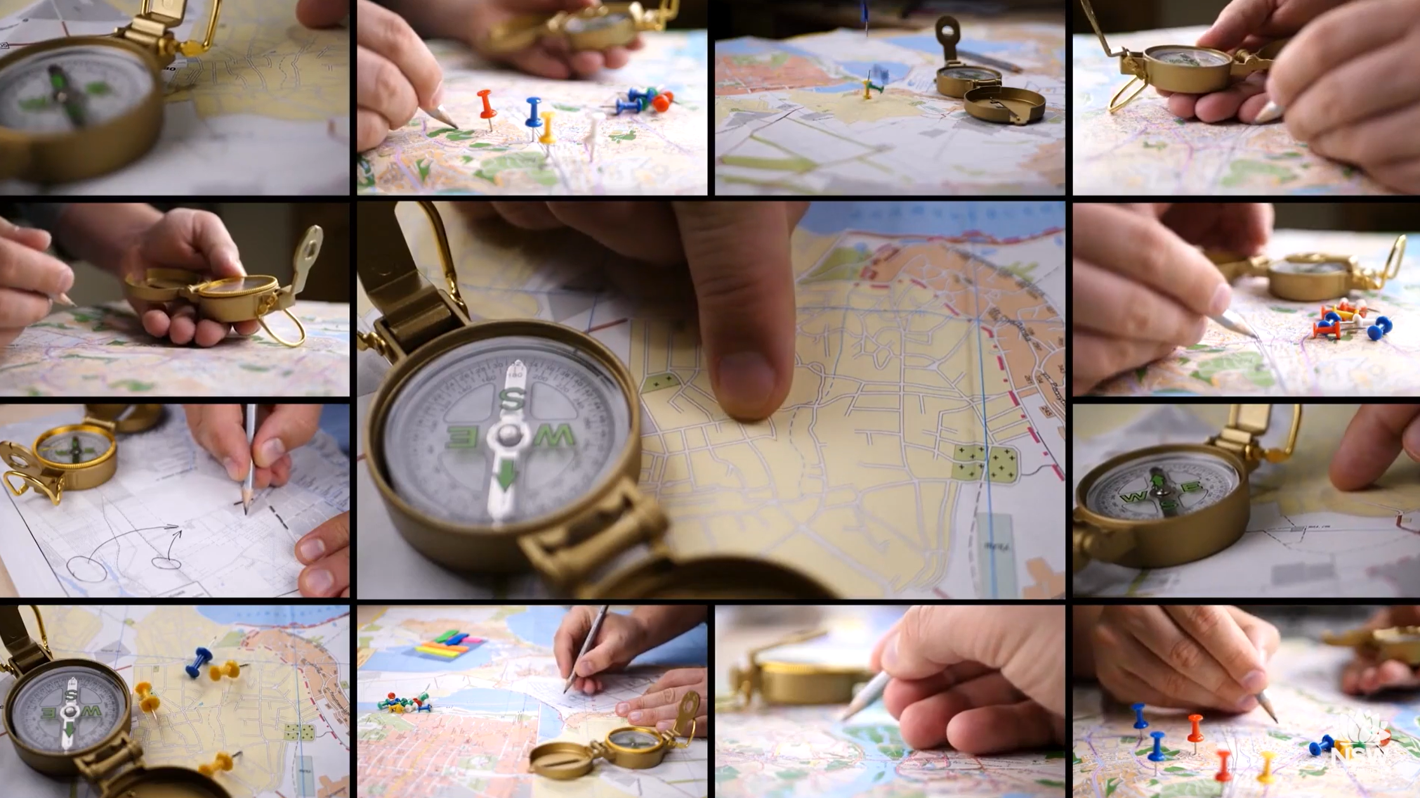

Using geographical tools and equipment
Duration 5:01
Notes:
Transcript for Field instruments video
[Screen shows a blue sky with clouds. Text on the screen reads, ‘Curriculum Secondary Learners – HSIE. Teaching geographical skills series. Field instruments. Presented by Melissa Ellis.’]
Melissa Ellis
Geography is the study of the world we live in. Geographers are always asking questions about places and things they see. Some of the most important questions are what is it I am seeing? How did this happen? And why are these things changing?
[Presenter is standing in front of a decorative background. In the bottom right-hand corner of the screen, the text reads, ‘Melissa Ellis. HSIE Curriculum Support Project Officer.’]
In this episode, we are learning about field instruments geographers use and where they are useful when learning about geography.
[Screen shows a montage of images of hands plotting coordinates on maps using a compass.]
Let's start with the weather. Weather is the daily condition or state of the atmosphere. So when we are studying the state of the atmosphere, we're exploring the different elements like temperature, humidity, rainfall, air pressure, clouds, and wind.
[Screen shows a series of video snippets, including a sun shining through clouds, the wind blowing over sand dunes, and dark clouds.]
We use a thermometer to measure air temperature.
[Screen shows an image of a thermometer rising to 30 degrees Celsius. Above the image, the screen reads, ‘thermometer’.]
Often we study climatic graphs, which illustrate the average temperature for a location each month over a year.
[Screen shows an image of a combination graph – a bar graph and line graph. Text on the screen reads, ‘Weather Station. New York City’. The image shows temperature and rainfall in a table at the bottom of the graph.]
Humidity is the moisture in the air. Tropical locations generally have high levels of humidity while deserts have low levels of humidity.
[Screen shows a series of video snippets, including a dense green forest covered in mist, and sand dunes.]
We measure humidity using a hot and dry bulb thermometer.
[Screen shows a close-up image of a clock with two smaller gauges. One gauge on the left has text beneath it that reads, ‘Humidity’. It has a dial pointing to ‘20’ with text that reads, ‘Very dry’. The numbers on the gauge range from zero to 100, with 100 being ‘Humid’. The small gauge on the right measures temperature in Fahrenheit.]
Rainfall is measured using a rain gauge. Rainfall is often collected and averaged over each month for the duration of a year and illustrated on a climatic graph.
[Screen shows rain falling. The screen then shows an image of a plastic cylinder attached to a piece of wood. It has a smaller cylinder inside it with ruler markings from the bottom to the top. The ruler measures from zero to 100 millimetres.]
We use a barometer to measure air pressure. Air pressure is very important because it affects other weather elements.
[Screen shows an image of a gauge with two bars that sit along the circumference of the gauge. One is measuring millimetres and the other is measuring millibars. The gauge has three hands. Two of the hands are in the shape of arrows and are facing right. The text above reads, Fair’. One has the shape of a crescent moon on its tip and is facing left. The text above reads, ‘Rain’. The text that appears between the words ‘Fair’ and ‘Rain’ reads, ‘Change’. The text above the entire image reads, ‘Barometer’.]
Low-pressure systems usually present rainfall to a location while high-pressure systems present fine and settled weather.
[Screen shows a pink image of the east of Australia. Over New South Wales, there is a white letter ‘L’ in a blue box. The blue box is surrounded by irregular circles marked with white lines. Each circle is numbered, starting from 850 in the centre, to 880, 900, and a line with 1000 to the left of 900. A smaller circle sits off the coast of South Australia with the number 880 within the 1000 line. The image zooms left to show Western Australia with a white letter ‘H’ in a red box. The red box is surrounded by irregular circles marked with white lines. Each circle around the smaller circle is numbered from 1040, to 1030, to 1020. On the outside of these circles, north of the red box is a smaller irregular circle. This circle has the number 950, as well as a line to its right with the number 990.]
Identifying clouds can be really interesting. Your school may have a cloud chart. These will illustrate the sorts of clouds you are observing.
[Screen shows clouds moving quickly across a blue sky.]
We measure wind using an anemometer. An anemometer only measures wind speed, not the direction it's coming from.
[Screen shows an image of a short metal post and 3 hollow cones attached to 3 spokes, all facing in the same direction. The text above image reads, ‘Anemometer’.]
You will need a wind vane for that. We always state wind as the direction it is coming from.
[Screen shows an image of a metal horse. Under the horse are 4 horizontal posts that read, ‘N’, ‘E’, ‘S’ and ‘W’. The instrument is attached to a roof.]
In the field, geographers use many different types of maps. A common map is a topographic map. Topographic maps are a useful tool for predicting distance, slope, and land use.
[Screen shows an image of a 3-dimensional rectangular slice of a mountain. The slice shows a river and layers of the earth. To the right of the image, it reads, ‘Landscape’. Above the landscape are 4 dotted lines travelling up to a 2-dimensional pink rectangle. On the rectangle, there are dark blue lines that follow the shape of the mountain, a thick light blue line above the river, and some dark blue and red dots. One of the dark blue lines is circled and labelled, ‘Contour’. Image zooms into the pink rectangle and numbers appear on each contour line along the bottom edge. These numbers read, ‘200’, ‘220’, ‘240’, ‘260’ and ‘280’. The text above the image reads, ‘Topographic map’.]
When using a topographic map in the field, you will likely use a compass. Geographers learn to orientate the map to face the north using the compass and the north point on the map. If you do not have a compass, you can always find north using your watch. Did you know halfway between 12 facing the sun and the hour hand on your watch will point north?
[Screen shows an image of a compass, a person holding a map with a compass and an analogue watch.]
We measure the distance in the field using a surveyor's wheel, also commonly known as a click wheel. When drawing a sketch map, you should use the surveyor's wheel to measure the distance and develop a scale for your map.
[Screen shows presenter walking in the grass as they push a yellow wheel on a long stick.]
Clinometer, a small light, robust, and inexpensive instrument for measuring height, you may need to measure the height of trees or a building to make recommendations. Students sometimes make their own clinometer and go out to measure the height of trees or buildings in their school.
[Text on screen reads, ‘Clinometer’ above an image of a small metal instrument with a gauge. Numbers are arranged in a semicircle on the gauge. The numbers start at 90 on both the left and right side and decrease by 10s to zero on the bottom edge. The instrument is branded, ‘Suunto’. The screen then shows a video from the base of a tree, moving slowly upwards along the trunk.]
GIS, Geographic Information Systems, you will be more familiar with GIS than you think. If you have used Google Maps to find your way to a new place, you've used GIS maps. Many GIS tools are great for geography because they show exact data, for example, the latitude and longitude of a site you were studying. GIS is also very useful for finding the height above sea level for a site of study.
[Screen shows a Google map of Barnetts Lookout. The screen shows a cursor click on the pin drop tool. Coordinates for ‘Berowra Heights’ appear at the bottom of the map. The screen then shows the cursor click on the ‘terrain’ option of the map. This causes contour lines to appear on the map.]
Try geocaching. This is a fun way to learn to use GIS.
Cameras. It's often said the best camera is the camera you are carrying. Your phone is a great tool to use in geography. It can be used to take photos of a site you are studying and refer to later. Or if fortunate enough to have a drone and permission to fly the drone, you can get a bird's eye view. Photographs are particularly useful when recording changes at a location over time.
[Screen shows a video of someone sitting on the ground in the bush. They are using their phone as a camera. The screen then shows a video of someone using a drone with the sun setting behind them.]
That is a summary of the most common field instruments we use in geography. Happy fieldwork.

Slide 9
Collect, select and record
Hints and tips for selecting data – Cotton farming (Grasslands biome)
Primary data
For example, soil samples and moisture tests
Clearly label all collected samples with the date, location, and method used
Secondary data
For example, rainfall statistics, crop yields from local agriculture offices
Use reliable government sources or established agricultural institutions
Take photographs clearly showing data collection in the field
Notes:
Talk aloud "When collecting data, it’s crucial to be systematic. For example, always label your soil samples clearly with the location and date. Using photos effectively helps you remember exactly what you observed, which is very important when you’re analysing data later.“
Clearly outline the importance of systematic data collection: accurate, clearly labelled records improve reliability and ease of analysis.
Give explicit examples: "Always label your soil or water samples clearly with date, location, and collection method so that your data remains accurate."
Suggest practical tips clearly: e.g., "Taking clear photographs can effectively support your analysis and remind you later exactly what you observed in the field."
Emphasise clearly the ethical importance of minimal disturbance to environments while collecting data.
This approach demonstrates ethical practices and detailed planning.
Additional notes
Introduction to collecting data: When collecting data, it's very important to be organised and systematic. For example, if you're investigating macadamia farming, you might conduct soil tests to measure soil pH and moisture levels. Clearly labelling samples—such as writing down exactly where and when you collected the soil samples—makes your data reliable and useful.
Photographic evidence: Taking clear photos of your fieldwork helps you later recall details clearly. For instance, photographing soil conditions or pests on coffee plants can visually support your observations and help you clearly communicate findings in your final report.
Consistency in data collection: Ensure you use the same method consistently. If you're counting pests on cotton plants, always use the same sized area or method each time. This consistency improves reliability and comparability of your data.
Ethical considerations: Remember ethical considerations—such as gaining permission to conduct surveys with dairy farmers or ensuring minimal disturbance when taking soil samples on farms. Being ethical protects environments and maintains trust.

Slide 10
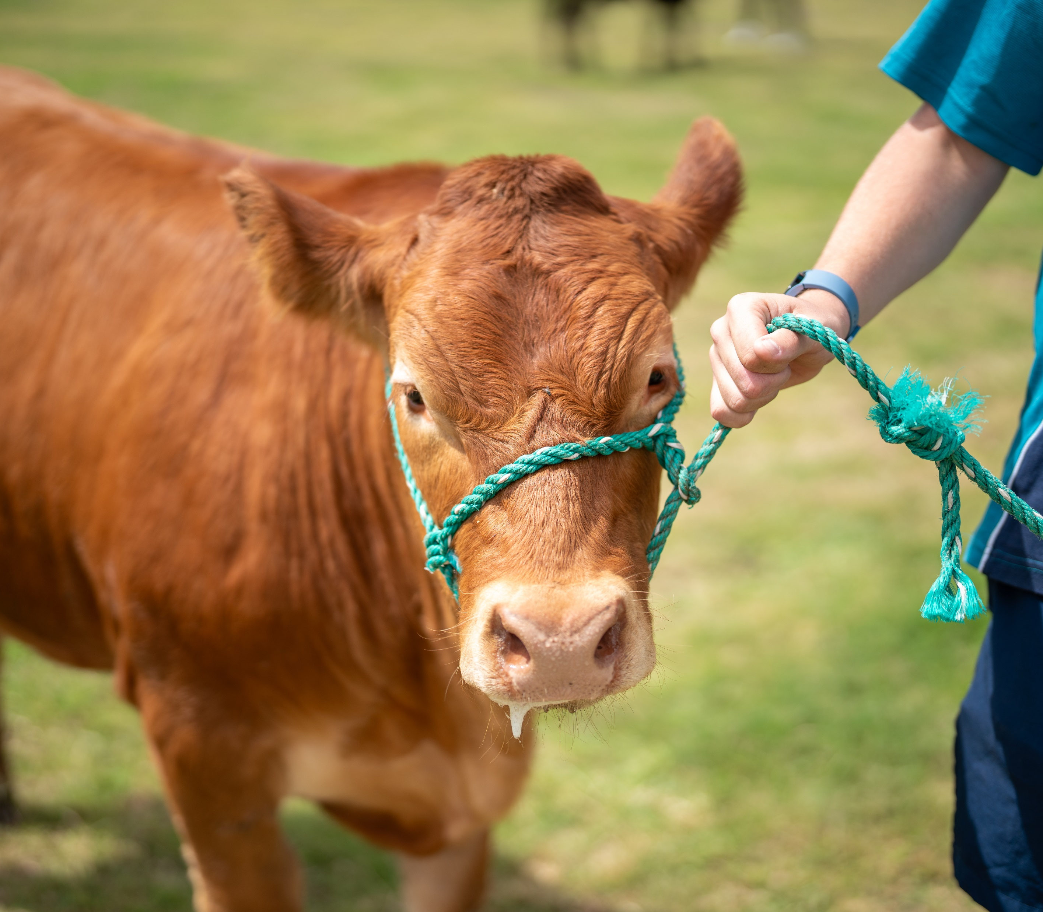
Collect, select and record
Hints and tips for collecting data
Choose clearly relevant data aligned directly with your geographical question and hypothesis
Select data sets covering multiple years to show clear trends
Notes:
Examples:
Dairy farming (grassland biome):
Collecting data on dairy farms might involve measuring pasture height or soil moisture. Clearly record these details at regular intervals, as pasture quality directly influences milk production. Photos showing pasture conditions can visually support your written observations.
Cotton farming (semi-arid biome):
For cotton farming, carefully recording pest infestations or water usage is essential. Clearly label your data—such as how many pests per cotton plant—so it’s easy to interpret later. Using structured data sheets helps clearly organise this information, making your analysis clearer and more accurate.

Slide 11

Collect, select and record
Hints and tips for collecting data
Use clearly structured tables with labels for clarity
Include metadata (where, when, how data was collected)
Notes:
Examples:
Macadamia farming (subtropical biome):
Imagine collecting data on macadamia farms; you'll likely test soil pH regularly because macadamias prefer slightly acidic soil (around 6.0-6.5). Make sure each sample is clearly marked with the exact location on the farm and the date you tested it.
Coffee production (tropical biome):
If researching coffee production, you might collect rainfall data to see how it affects coffee yields. Clearly document rainfall measurements daily at consistent times. Select relevant rainfall data, perhaps focusing on months crucial for coffee bean development.

Slide 12
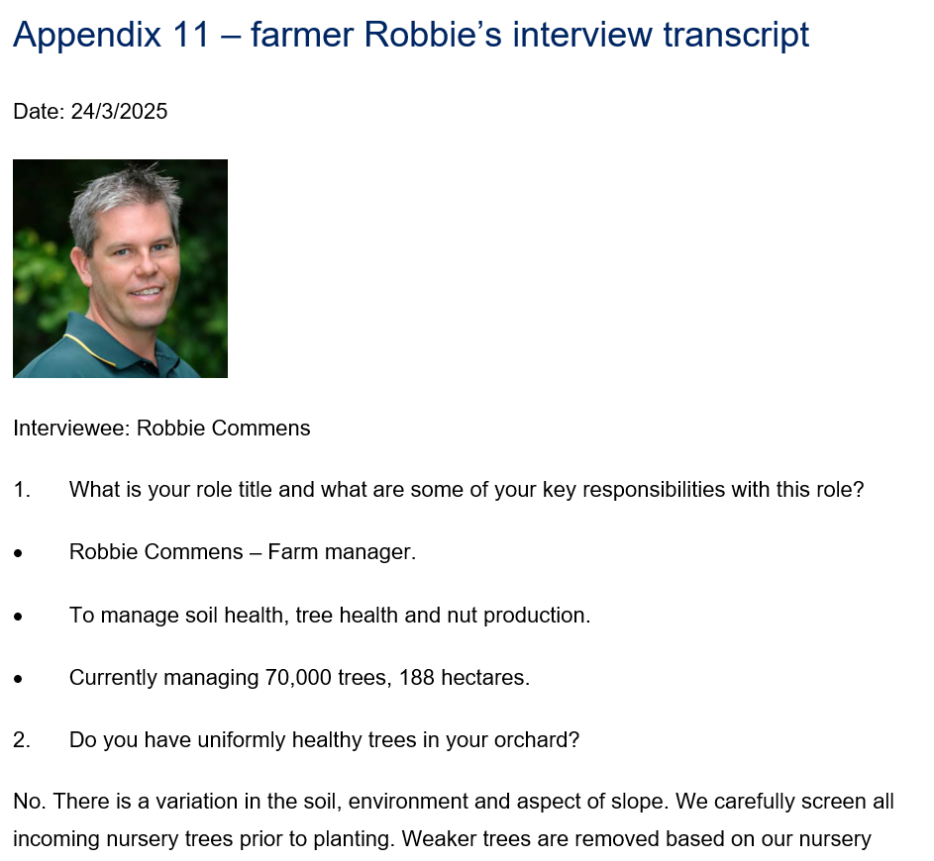
Interview example activity
Designing interview questions
Review farmer Robbie's interview transcript
Consider how these questions and answers could be used to support a geographical inquiry related to macadamia farming
Design a draft significant geographical question and hypothesis that may have been the starting point for the development of these questions
Now, use the questions as a scaffold to design 5 to 6 interview questions that you could use as data to support your own geographical inquiry hypothesis

Slide 13
References
This presentation contains NSW Curriculum and syllabus content. The NSW Curriculum is developed by the NSW Education Standards Authority. This content is prepared by NESA for and on behalf of the Crown in the right of the State of New South Wales. The material is protected by Crown copyright.
Please refer to the NESA Copyright Disclaimer for more information https://educationstandards.nsw.edu.au/wps/portal/nesa/mini-footer/copyright.
NESA holds the only official and up-to-date versions of the NSW Curriculum and syllabus documents. Please visit the NSW Education Standards Authority (NESA) website https://educationstandards.nsw.edu.au/wps/portal/nesa/home and the NSW Curriculum website https://curriculum.nsw.edu.au.
Geography 7-10 © Syllabus NSW Education Standards Authority (NESA) for and on behalf of the Crown in right of the State of New South Wales, 2024.

Slide 14
Copyright
© State of New South Wales (Department of Education), 2025
The copyright material published in this resource is subject to the Copyright Act 1968 (Cth) and is owned by the NSW Department of Education or, where indicated, by a party other than the NSW Department of Education (third-party material).
Copyright material available in this resource and owned by the NSW Department of Education is licensed under a Creative Commons Attribution 4.0 International (CC BY 4.0) license.
This license allows you to share and adapt the material for any purpose, even commercially.
Attribution should be given to © State of New South Wales (Department of Education), 2025.
Material in this resource not available under a Creative Commons license:
the NSW Department of Education logo, other logos and trademark-protected material
Material owned by a third party that has been reproduced with permission. You will need to obtain permission from the third party to reuse its material.
Links to third-party material and websites
Please note that the provided (reading/viewing material/list/links/texts) are a suggestion only and implies no endorsement, by the New South Wales Department of Education, of any author, publisher, or book title. School principals and teachers are best placed to assess the suitability of resources that would complement the curriculum and reflect the needs and interests of their students.
If you use the links provided in this document to access a third-party’s website, you acknowledge that the terms of use, including licence terms set out on the third-party’s website apply to the use which may be made of the materials on that third-party website or where permitted by the Copyright Act 1968 (Cth). The department accepts no responsibility for content on third-party websites.

