Slide 1
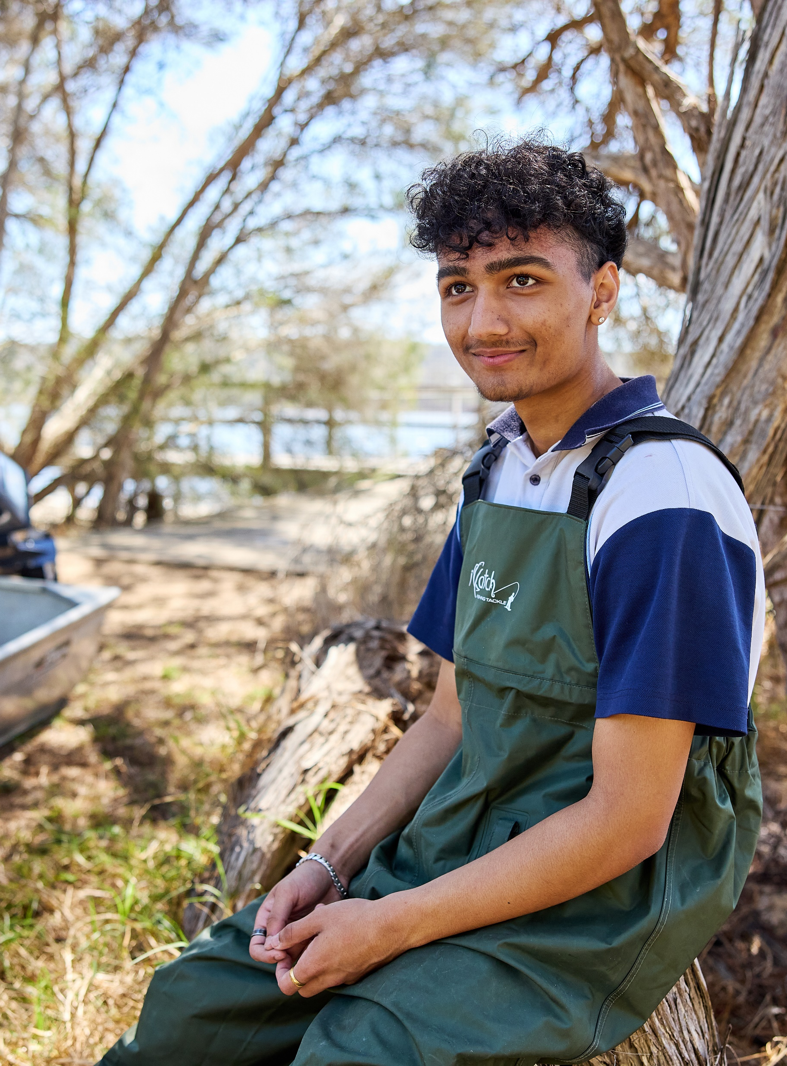
Lesson 4 – ternary graphs
Stage 5 geography
Biomes and sustainable agriculture
[TEACHER NAME]

Slide 2
Learning intentions and success criteria
We are learning to
identify key features of a ternary graph
identify the purpose of a ternary graph
We can
describe ternary graph features
use ternary graphs to determine soil texture.
Notes:
Notes for teachers:
Learning intentions and success criteria are best co-constructed with students. Adapt the learning intention as required and add matching success criteria.
For more information See ⁠AITSL or the NSW Department of Education explicit teaching strategies, ⁠Sharing learning intentions and ⁠Sharing success criteria
LISC is not necessarily presented at the beginning of the lesson. Teacher needs to consider most effectual time to introduce
LISC should be revisited during the lesson to support students' evaluation of their learning

Slide 3
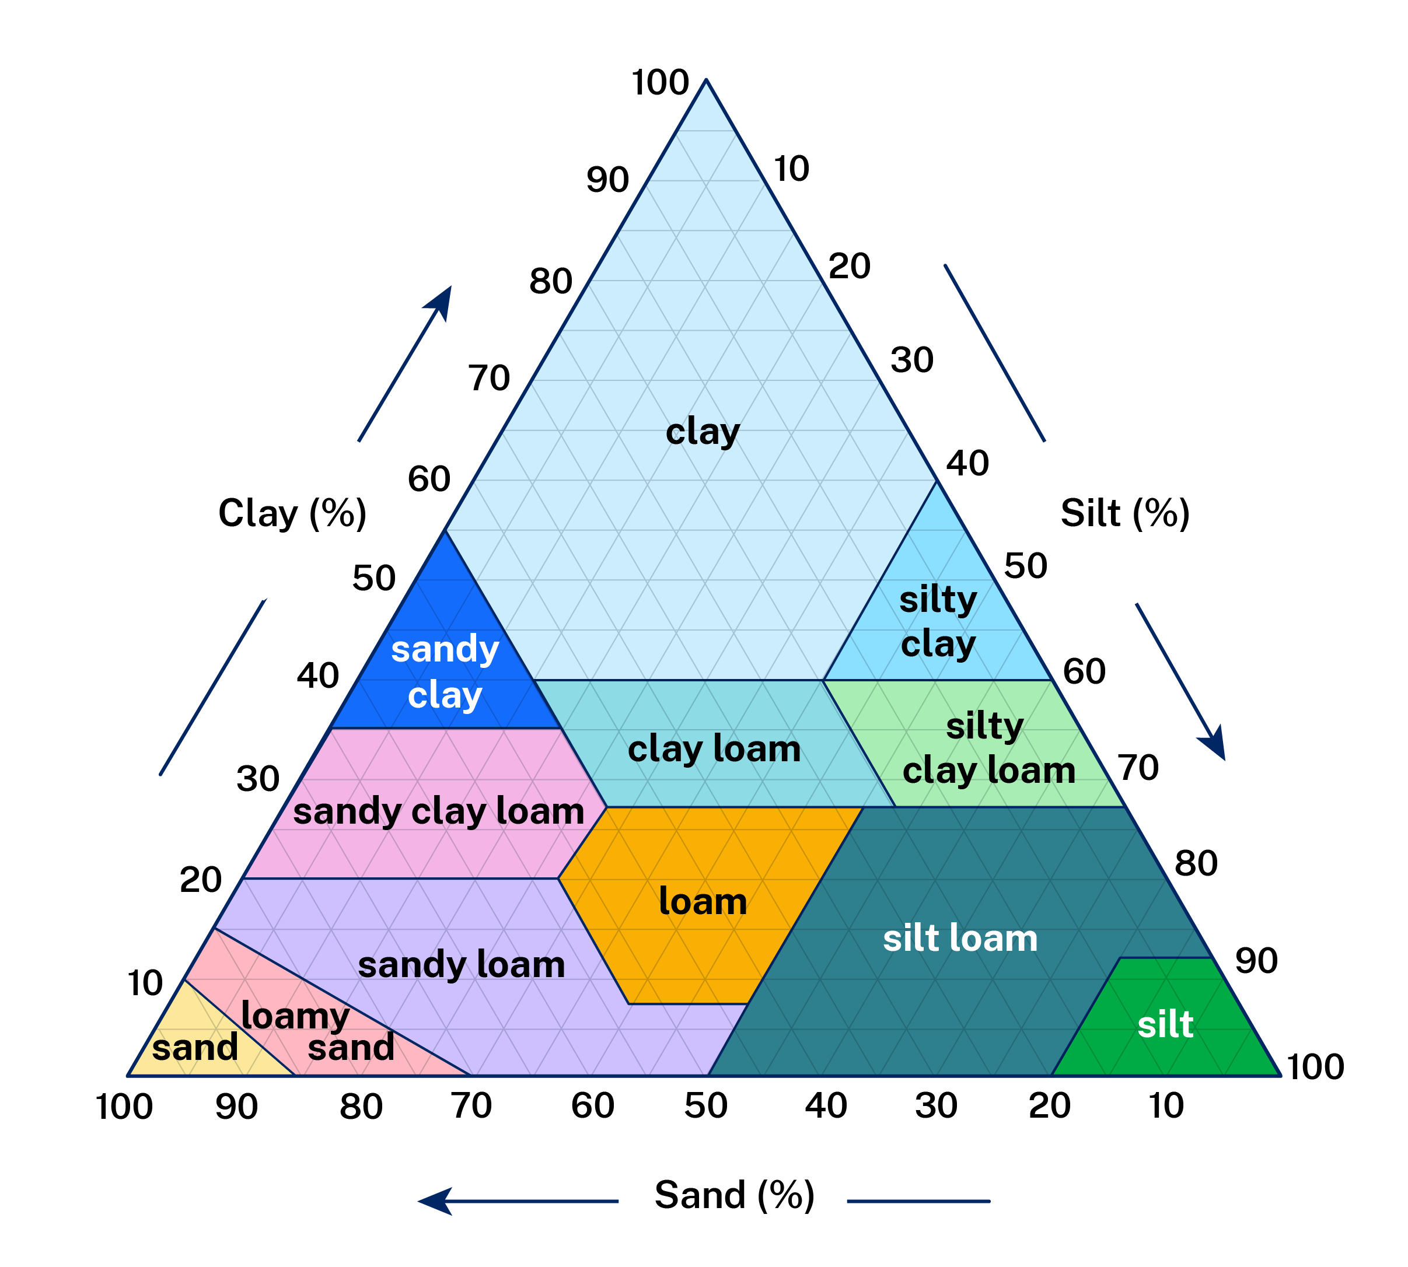

Ternary graph is a 3 axis graph
2
1
The 3 soil types
must add up to 100%
3
Notes:
A ternary graph has 3 axis.
The ternary graph displayed is graphing 3 features of soil that contribute to soil texture and our ability to classify soil types.
Soil texture is a measurement of the percentage of sand, silt and clay in a soil sample.
Check for understanding by asking choral response questions:
How many sides exist on a ternary graph? Answer: three.
How much does each factor or variable need to add up to? Answer: 100.
Soil texture is a product of what three factors? Answer: clay, silt and sand.

Slide 4

Determining soil texture using a ternary graph
I do
10% sand
60% silt
30% clay
Notes:
Conduct an ‘I do’ gradual release of responsibility exercise.
Demonstrate finding 10% sand, 60% silt and 30% clay.
Note – all add up to 100%.
Answer: silty clay loam.

Slide 5

Determining texture using a ternary graph
We do
60% sand
10% silt
30% clay
Notes:
60% sand
10% silt
30% clay.
Answer: Sandy clay loam.

Slide 6

Determining soil texture using a ternary graph
You do
20% sand
20% silt
60% clay
Notes:
20% sand
20% silt
60% clay.
Answer: Clay.

Slide 7




Traffic light reflection
I need to improve on…
I’m getting there!
I am still working on…
I get it!
I am most proud of…

Slide 8
References
This presentation contains NSW Curriculum and syllabus content. The NSW Curriculum is developed by the NSW Education Standards Authority. This content is prepared by NESA for and on behalf of the Crown in the right of the State of New South Wales. The material is protected by Crown copyright.
Please refer to the NESA Copyright Disclaimer for more information https://educationstandards.nsw.edu.au/wps/portal/nesa/mini-footer/copyright.
NESA holds the only official and up-to-date versions of the NSW Curriculum and syllabus documents. Please visit the NSW Education Standards Authority (NESA) website https://educationstandards.nsw.edu.au/wps/portal/nesa/home and the NSW Curriculum website https://curriculum.nsw.edu.au.
Geography 7-10 © Syllabus NSW Education Standards Authority (NESA) for and on behalf of the Crown in right of the State of New South Wales, 2024.

Slide 9
Copyright
© State of New South Wales (Department of Education), 2025
The copyright material published in this resource is subject to the Copyright Act 1968 (Cth) and is owned by the NSW Department of Education or, where indicated, by a party other than the NSW Department of Education (third-party material).
Copyright material available in this resource and owned by the NSW Department of Education is licensed under a Creative Commons Attribution 4.0 International (CC BY 4.0) license.
This license allows you to share and adapt the material for any purpose, even commercially.
Attribution should be given to © State of New South Wales (Department of Education), 2025.
Material in this resource not available under a Creative Commons license:
the NSW Department of Education logo, other logos and trademark-protected material
Material owned by a third party that has been reproduced with permission. You will need to obtain permission from the third party to reuse its material.
Links to third-party material and websites
Please note that the provided (reading/viewing material/list/links/texts) are a suggestion only and implies no endorsement, by the New South Wales Department of Education, of any author, publisher, or book title. School principals and teachers are best placed to assess the suitability of resources that would complement the curriculum and reflect the needs and interests of their students.
If you use the links provided in this document to access a third-party’s website, you acknowledge that the terms of use, including licence terms set out on the third-party’s website apply to the use which may be made of the materials on that third-party website or where permitted by the Copyright Act 1968 (Cth). The department accepts no responsibility for content on third-party websites.

