Slide 1

Lesson 3 – latitude and longitude
Stage 5 geography
Biomes and sustainable agriculture
[TEACHER NAME]

Slide 2
Learning intentions and success criteria
We are learning to
identify latitude and longitude on a map
locate places on a map
We can
locate places on earth by identifying their location in the hemispheres
use lines of latitude and longitude to locate places.
Notes:
Notes for teachers:
Learning intentions and success criteria are best co-constructed with students. Adapt the learning intention as required and add matching success criteria.
For more information See ⁠AITSL or the NSW Department of Education explicit teaching strategies, ⁠Sharing learning intentions and ⁠Sharing success criteria
LISC is not necessarily presented at the beginning of the lesson. Teacher needs to consider most effectual time to introduce
LISC should be revisited during the lesson to support students' evaluation of their learning

Slide 3
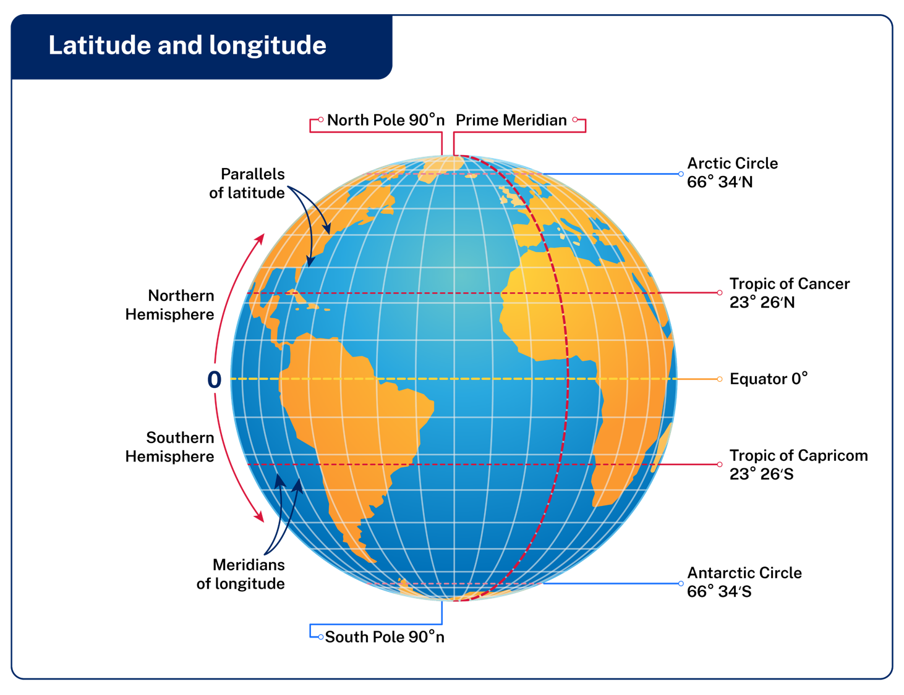

Slide 4
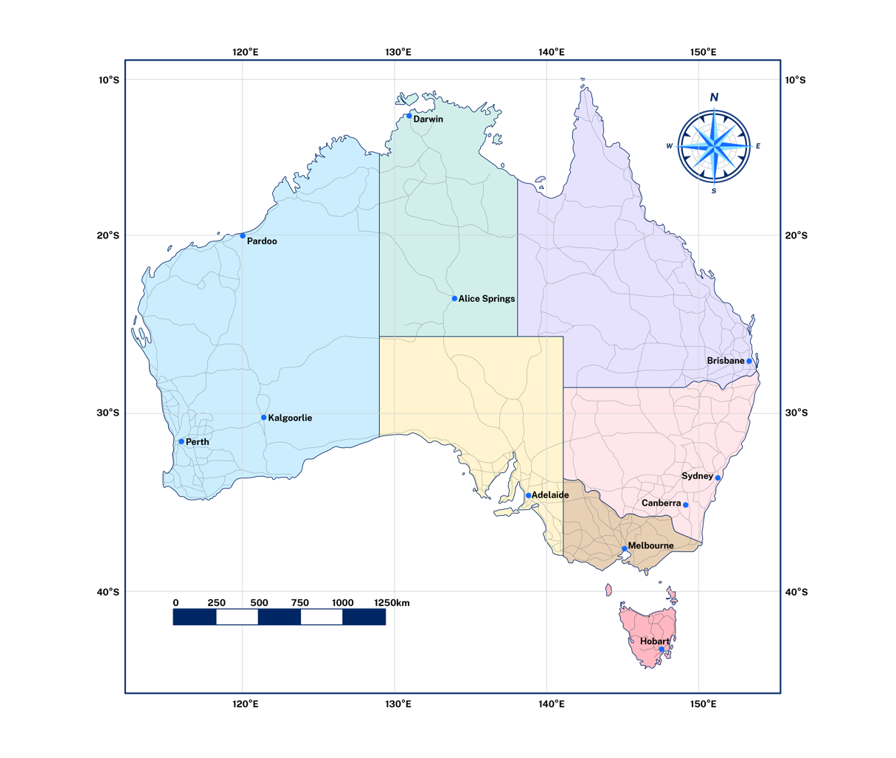
Determining latitude and longitude
I do
Pardoo
Darwin
Alice Springs
Notes:
Pardoo 20°S 119°E
Darwin 12°S 130°E
Alice Springs 23°S 133°E

Slide 5
Determining latitude and longitude
We do
Kalgoorlie
Perth
Hobart
Notes:
Kalgoorlie 31°S 121°E
Perth 32°S 115°E
Hobart 43°S 147°E

Slide 6
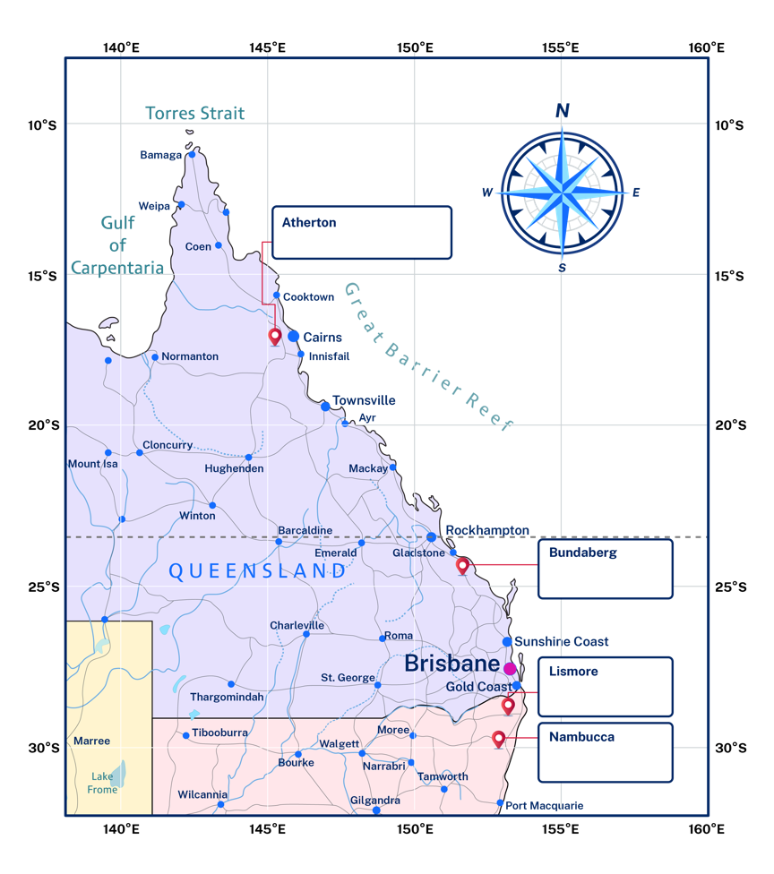
Determining latitude and longitude
You do
Atherton
Bundaberg
Lismore
Nambucca
Notes:
Atherton 17°S 145°E
Bundaberg 24°S 151°E
Lismore 28°S 153°E
Nambucca 30°S 152°E

Slide 7

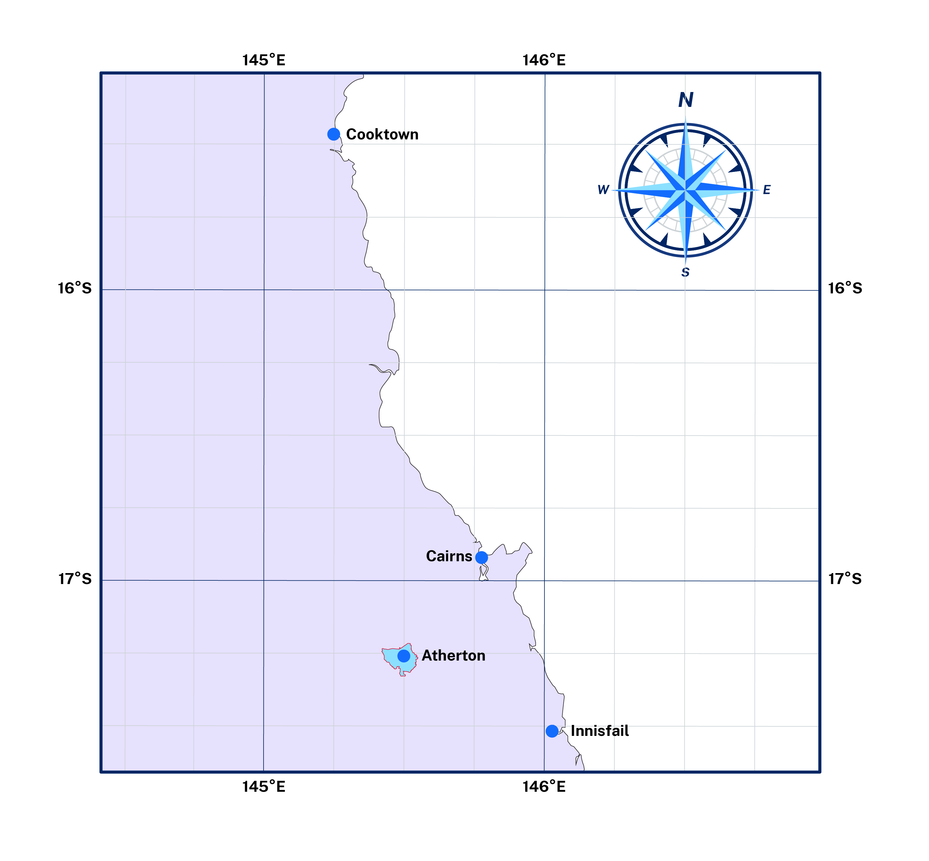
Determining latitude and longitude
I do
Notes:
Teacher description of finding latitude and longitude down to degrees and minutes using the two diagrams displayed on screen.
Every degree can be further divided into 60 minutes. In the example grids are divided into grid square of 20 minutes making estimation of the location more precise.
Work through an example finding:
Atherton 17°16’S 145°29’E
Cooktown 15°28’S 145°15’E
Identify that we can be more precise by dividing the minutes further into 60 seconds. There is no illustration here for this. Teachers may choose to find and use a map that illustrates degrees, minutes and seconds.

Slide 8
Checking for understanding
Choral responses
Latitude and longitude are ……………….. across the globe used to provide coordinates for identifying the exact location of places.
They are measured in degrees (°), minutes (’) and ………………..(”) that represent their angle from the centre of the Earth.
There are ……………….. minutes in every degree, and ……………….. seconds in every minute.
Latitude is always recorded before ……………….. (‘la’ before ‘lo’ following alphabetical rules).
Notes:
imaginary
seconds
60 minutes and 60 seconds.
longitude

Slide 9
Determining latitude and longitude
We do
Notes:
Innisfail 17°31’E 146°01’E

Slide 10
Determining latitude and longitude
You do
Notes:
Cairns 16°55’S 145°47’E.

Slide 11
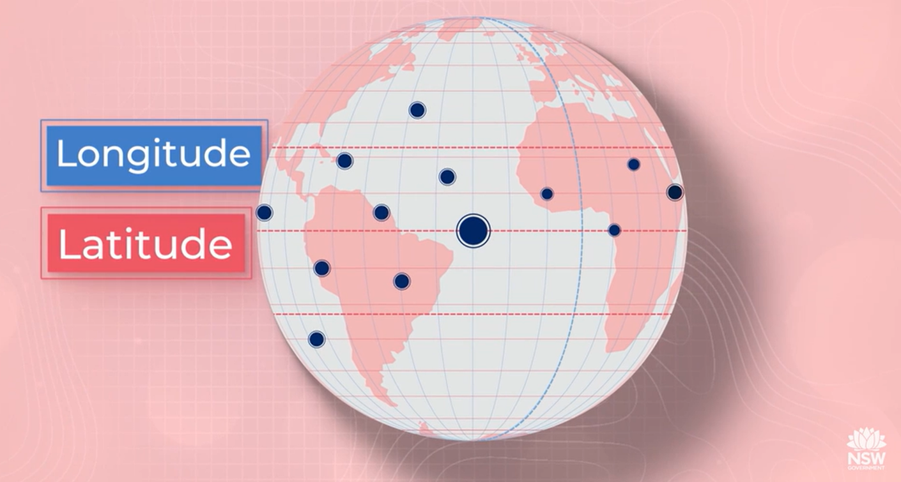

Need more explanation?
Latitude and longitude (duration 4:24)
Notes:
Possible teacher questions and responses based on the video that can be used to check for understanding:
True/False Questions
Latitude lines are sometimes called meridians.
Answer: False.
Explainer: Longitude lines are called meridians, not latitude lines.
The Prime Meridian runs through Greenwich, England.
Answer: True.
Explainer: The Prime Meridian is an important line of longitude that passes through Greenwich and is the reference point for measuring longitude.
Latitude is always written before longitude when giving coordinates.
Answer: True.
Explainer: Latitude comes before longitude, following the alphabetical order of "A" for latitude and "O" for longitude.
Longitude measures distances east and west of the equator.
Answer: False.
Explainer: Longitude measures distances east and west of the Prime Meridian, not the equator.
Each degree of latitude can be broken down into 60 minutes, and each minute into 60 seconds.
Answer: True.
Explainer: This system allows for very precise location measurements.
Short Answer Questions
What is the difference between latitude and longitude?
Answer: Latitude lines run parallel to the equator in an east-west direction and measure how far north or south a point is from the equator. Longitude lines run from the North Pole to the South Pole and measure how far east or west a point is from the Prime Meridian.
Explainer: Latitude is horizontal, while longitude is vertical, and they work together to pinpoint locations on Earth.
Why is the equator considered a significant latitude line?
Answer: The equator is significant because it divides the Earth into the northern and southern hemispheres and is the baseline for measuring latitude, marked as 0 degrees latitude.
Explainer: The equator is central to understanding the latitude system and helps define hemispheres.
Why are coordinates important in geography?
Answer: Coordinates are important in geography because they provide a precise system for identifying the exact location of any place on Earth using latitude and longitude.
Explainer: By combining latitude and longitude, geographers can accurately pinpoint locations, aiding in navigation, mapping, and spatial analysis.

Slide 12
References
This presentation contains NSW Curriculum and syllabus content. The NSW Curriculum is developed by the NSW Education Standards Authority. This content is prepared by NESA for and on behalf of the Crown in the right of the State of New South Wales. The material is protected by Crown copyright.
Please refer to the NESA Copyright Disclaimer for more information https://educationstandards.nsw.edu.au/wps/portal/nesa/mini-footer/copyright.
NESA holds the only official and up-to-date versions of the NSW Curriculum and syllabus documents. Please visit the NSW Education Standards Authority (NESA) website https://educationstandards.nsw.edu.au/wps/portal/nesa/home and the NSW Curriculum website https://curriculum.nsw.edu.au.
Geography 7-10 © Syllabus NSW Education Standards Authority (NESA) for and on behalf of the Crown in right of the State of New South Wales, 2024.

Slide 13
Copyright
© State of New South Wales (Department of Education), 2025
The copyright material published in this resource is subject to the Copyright Act 1968 (Cth) and is owned by the NSW Department of Education or, where indicated, by a party other than the NSW Department of Education (third-party material).
Copyright material available in this resource and owned by the NSW Department of Education is licensed under a Creative Commons Attribution 4.0 International (CC BY 4.0) license.
This license allows you to share and adapt the material for any purpose, even commercially.
Attribution should be given to © State of New South Wales (Department of Education), 2025.
Material in this resource not available under a Creative Commons license:
the NSW Department of Education logo, other logos and trademark-protected material
Material owned by a third party that has been reproduced with permission. You will need to obtain permission from the third party to reuse its material.
Links to third-party material and websites
Please note that the provided (reading/viewing material/list/links/texts) are a suggestion only and implies no endorsement, by the New South Wales Department of Education, of any author, publisher, or book title. School principals and teachers are best placed to assess the suitability of resources that would complement the curriculum and reflect the needs and interests of their students.
If you use the links provided in this document to access a third-party’s website, you acknowledge that the terms of use, including licence terms set out on the third-party’s website apply to the use which may be made of the materials on that third-party website or where permitted by the Copyright Act 1968 (Cth). The department accepts no responsibility for content on third-party websites.

