Slide 1

Lesson 2 – climate graphs
Stage 4 geography
Biomes and sustainable agriculture
[TEACHER NAME]

Slide 2
Learning intentions and success criteria
We are learning to
identify key features of climate tables and graphs
calculate maximum, minimum, and range using climate data
We can
recognise climate tables and graphs
use climate data to construct climate graphs
interpret climate tables and graphs.
Notes:
Notes for teachers:
Learning intentions and success criteria are best co-constructed with students. Adapt the learning intention as required and add matching success criteria.
For more information See ⁠AITSL or the NSW Department of Education explicit teaching strategies, ⁠Sharing learning intentions and ⁠Sharing success criteria
LISC is not necessarily presented at the beginning of the lesson. Teacher needs to consider most effectual time to introduce
LISC should be revisited during the lesson to support students' evaluation of their learning

Slide 3
Activating prior knowledge
Complete the sentences
Weather is the state of the fill-in-the-blank at any given time. It describes temperature, precipitation and other conditions.
Climate is the fill-in-the-blank types of weather, including seasonal variations, experienced by a place or region over a long period of time.
Climate tables show fill-in-the-blank sets of data. These are temperature and rainfall.
All good graphs must include a fill-in-the-blank and labels.
Notes:
atmosphere
average
two
title

Slide 4
Climate tables
Sample climate table – The Amazon Rainforest
Months of the year.
Month | J | F | M | A | M | J | J | A | S | O | N | D
Average temperature (°C) | 26.5 | 26.7 | 26.8 | 27.1 | 27 | 26.6 | 26.7 | 27.5 | 27.8 | 28 | 27.4 | 26.8
Precipitation (mm) | 230 | 109 | 135 | 167 | 300 | 351 | 284 | 168 | 94 | 112 | 178 | 330
Total precipitation in a location over the month.
Average record of temperature.
(total ÷ number of days in the month).

Slide 5
Interpreting climate graphs
Temperature – I do
Example
If highest temperature in a month is 30°C and the lowest temperature is 10°C, the temperature range would be:
Temperature range = 30°C - 10°C = 20°C

Slide 6
Interpreting climate graphs (1)
Temperature – We do
In which month was the highest average temperature?
In which month was the lowest average temperature?
What is the temperature range?
Month | J | F | M | A | M | J | J | A | S | O | N | D
Average temperature (°C) | 26.5 | 26.7 | 26.8 | 27.1 | 27 | 26.6 | 26.7 | 27.5 | 27.8 | 28 | 27.4 | 26.8
Precipitation (mm) | 230 | 109 | 135 | 167 | 300 | 351 | 284 | 168 | 94 | 112 | 178 | 330

Slide 7
Interpreting climate graphs (2)
Temperature – You do
In which month was the highest average temperature?
In which month was the lowest average temperature?
What is the temperature range?
Month | J | F | M | A | M | J | J | A | S | O | N | D
Average temperature (°C)
Precipitation (mm)
[TEACHER PROVIDE LOCAL CLIMATE DATA TABLE HERE]

Slide 8
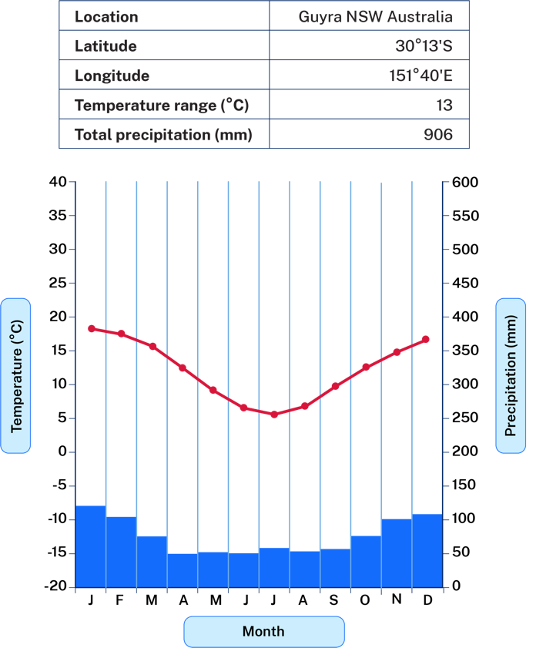
Features of a climate graph
Title
Guyra climate graph
Location information including latitude and longitude
Temperature range = maximum mean temperature – minimum mean temperature
Total precipitation = sum of precipitation data over 12 months
Line graph represents temperature
Left axis has temperature values
Right axis has precipitation values
Column graph represents precipitation

Slide 9
Steps in drawing climate graphs
We do
On graph paper rule the horizontal axis and divide into 12 for each month of the year.
Rule up the temperature scale and the precipitation scale. Write in the temperature and precipitation figures. Label each axis.
Begin plotting the temperature information from the table. Mark temperature values with a dot in the middle of the column for their corresponding month in line with the value on the temperature axis. Join the dots in a straight line.
Use a ruler to draw the column graph for precipitation. The columns in a climatic graph touch each other. Start with drawing the column for January and repeat until each month is complete.
Month | J | F | M | A | M | J | J | A | S | O | N | D
Average temperature (°C)
Precipitation (mm)
[TEACHER PROVIDE LOCAL CLIMATE DATA TABLE HERE]
Notes:
Provide students will climate data and graphing paper or climate table template.
Planning, programming and assessing geography 7–10 (2024) Climate graphs and Climate graphs template (XLSX) will support instruction, strategy and provides templates.

Slide 10
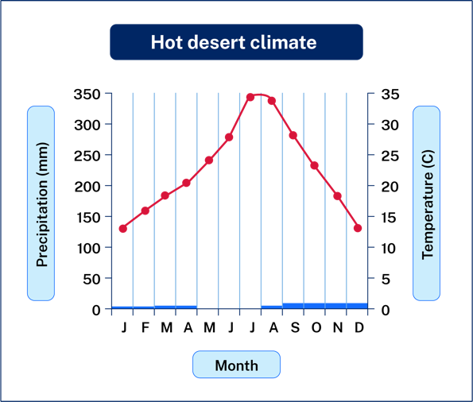
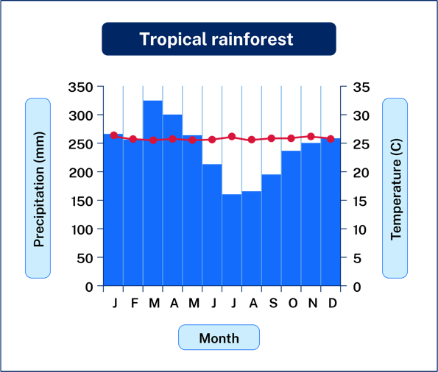
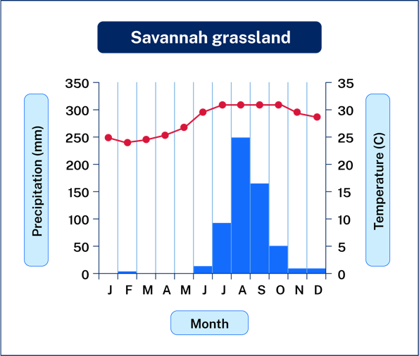
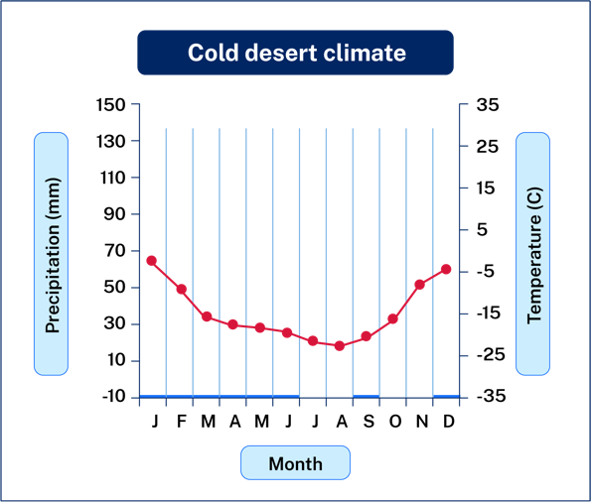
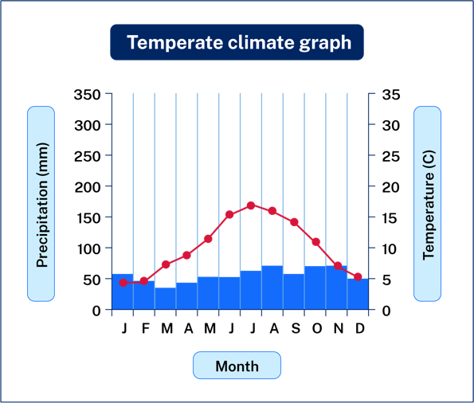
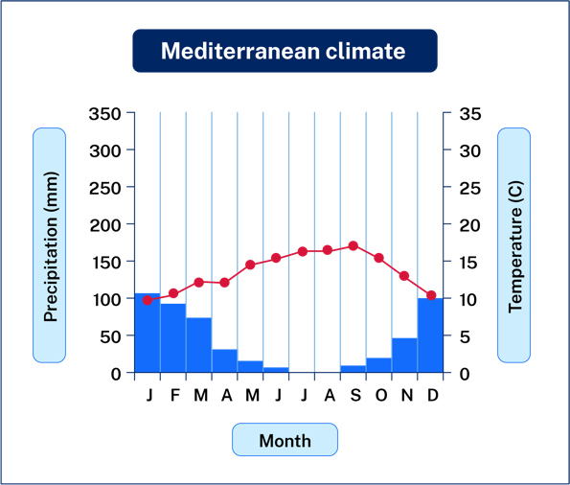
Precipitation and Temperature Charts for Various Climate Zones
Notes:
Interpreting a climate graph:
Hemispheres – if the temperature increases mid-year then it means the warmest month of the year is in the middle of the year and therefore the place is in the northern hemisphere. If it decreases in the middle of the year the place is in the southern hemisphere.
Closeness to the equator – if the temperature is fairly high (mid 20 to high 20) and there is only a small range (less than 5) then the place is likely to be near the equator. Generally the further away from the equator the place is the greater range of temperature will be apparent. Places near to the poles experience huge differences in temperature between summer and winter.
Seasonal distribution of rainfall – when over 60 per cent of rainfall occurs during a period of time you observe a maximum rainfall period. This is termed summer maximum when 60 percent or more occurs in the summer months. Visa versa winter maximum.
Dry conditions – locations receive less than 25 millimetres of rainfall in any month.

Slide 11
3-2-1 things I learned today
List 3 things you learned today:
3
1.
2.
3.
List 2 questions you have about these things:
2
1.
2.
Give 1 reason why it’s important to learn about these things:
1
1.

Slide 12
References
This presentation contains NSW Curriculum and syllabus content. The NSW Curriculum is developed by the NSW Education Standards Authority. This content is prepared by NESA for and on behalf of the Crown in the right of the State of New South Wales. The material is protected by Crown copyright.
Please refer to the NESA Copyright Disclaimer for more information https://educationstandards.nsw.edu.au/wps/portal/nesa/mini-footer/copyright.
NESA holds the only official and up-to-date versions of the NSW Curriculum and syllabus documents. Please visit the NSW Education Standards Authority (NESA) website https://educationstandards.nsw.edu.au/wps/portal/nesa/home and the NSW Curriculum website https://curriculum.nsw.edu.au.
Geography 7-10 © Syllabus NSW Education Standards Authority (NESA) for and on behalf of the Crown in right of the State of New South Wales, 2024.

Slide 13
Copyright
© State of New South Wales (Department of Education), 2025
The copyright material published in this resource is subject to the Copyright Act 1968 (Cth) and is owned by the NSW Department of Education or, where indicated, by a party other than the NSW Department of Education (third-party material).
Copyright material available in this resource and owned by the NSW Department of Education is licensed under a Creative Commons Attribution 4.0 International (CC BY 4.0) license.
This license allows you to share and adapt the material for any purpose, even commercially.
Attribution should be given to © State of New South Wales (Department of Education), 2025.
Material in this resource not available under a Creative Commons license:
the NSW Department of Education logo, other logos and trademark-protected material
Material owned by a third party that has been reproduced with permission. You will need to obtain permission from the third party to reuse its material.
Links to third-party material and websites
Please note that the provided (reading/viewing material/list/links/texts) are a suggestion only and implies no endorsement, by the New South Wales Department of Education, of any author, publisher, or book title. School principals and teachers are best placed to assess the suitability of resources that would complement the curriculum and reflect the needs and interests of their students.
If you use the links provided in this document to access a third-party’s website, you acknowledge that the terms of use, including licence terms set out on the third-party’s website apply to the use which may be made of the materials on that third-party website or where permitted by the Copyright Act 1968 (Cth). The department accepts no responsibility for content on third-party websites.

