Slide 1

Lesson 1 – scatter graphs
Stage 5 geography
Sustainable biomes and agriculture
[TEACHER NAME]

Slide 2
Learning intentions and success criteria
We are learning to
identify features of a scatter graph
identify correlation patterns illustrated by scatter graphs.
We can
use data to construct a scatter graph
interpret scatter graphs.
Notes:
Notes for teachers:
Learning intentions and success criteria are best co-constructed with students. Adapt the learning intention as required and add matching success criteria.
For more information See ⁠AITSL or the NSW Department of Education explicit teaching strategies, ⁠Sharing learning intentions and ⁠Sharing success criteria
LISC is not necessarily presented at the beginning of the lesson. Teacher needs to consider most effectual time to introduce
LISC should be revisited during the lesson to support students' evaluation of their learning

Slide 3
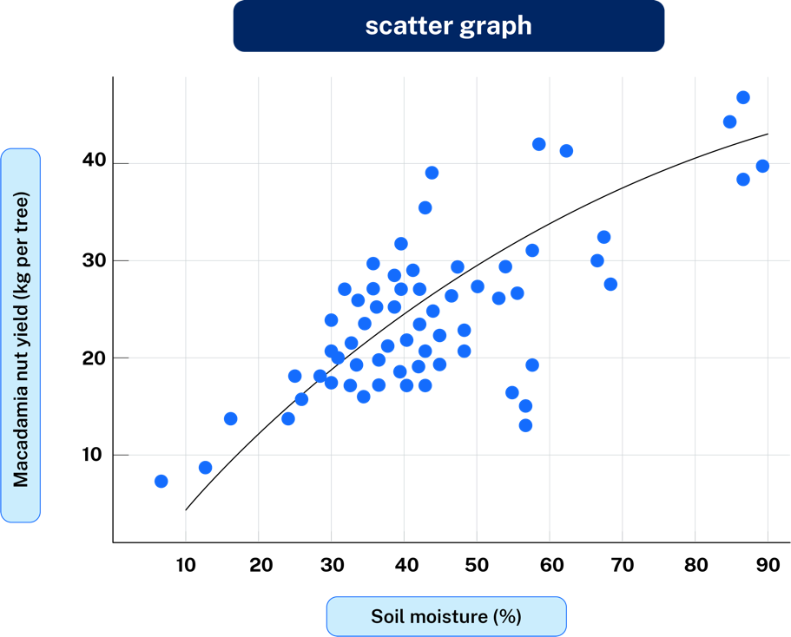
Key features of a scatter graph
Identify key features
shows relationships between two sets of named data
the sets of data are called variables
it is drawn to see if different variables have anything in common
if the scatter of points form a line in a particular direction, there is a relationship between them
the line is called best-fit line.
Notes:
Note – teachers may like to provide students with the ‘Scatter graph glossary of key terms’ from Biomes and sustainable agriculture student resource booklet. Planning, programming and assessing geography 7–10 (2024)

Slide 4
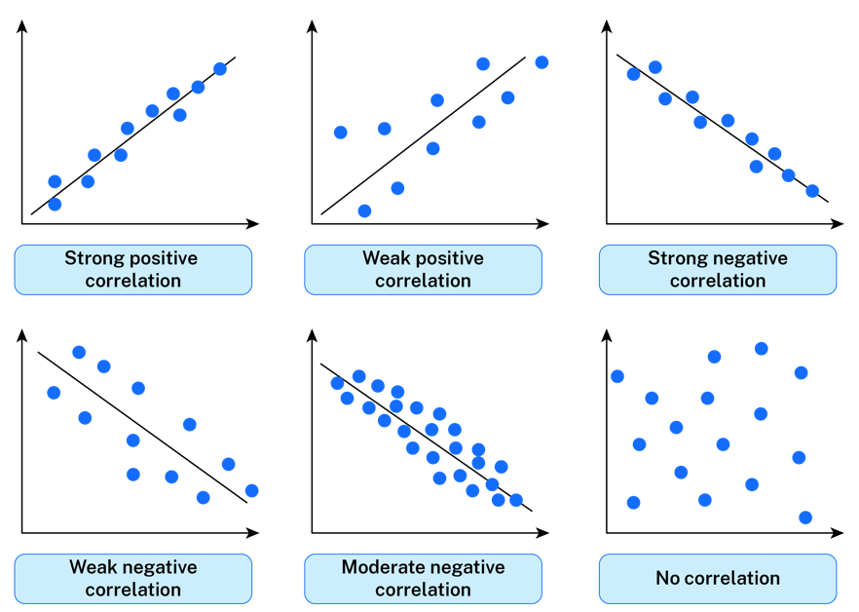
Different Types of Correlation
Notes:
Scatter graphs show relationships. There are many different types of relationships that can occur between two variables.

Slide 5
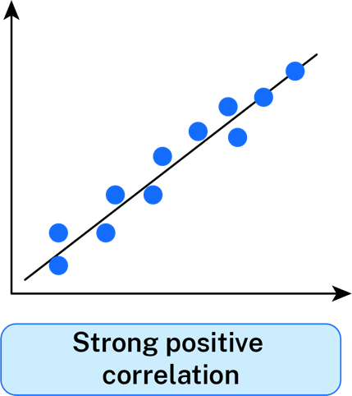
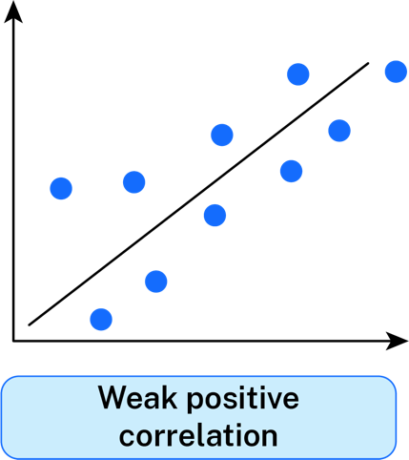
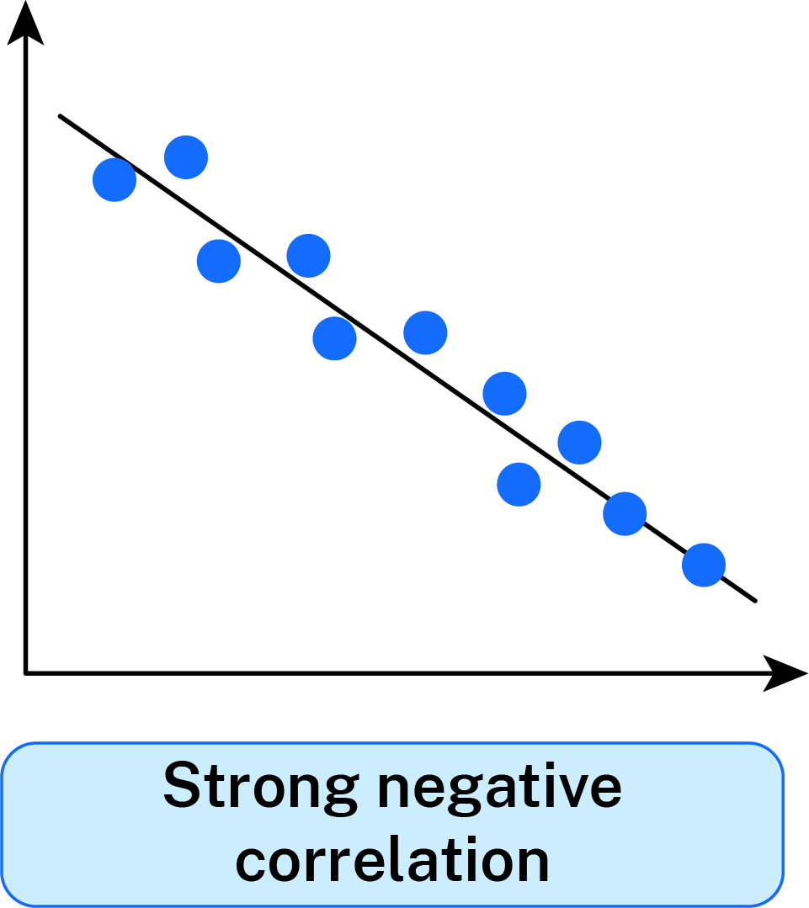
Examples of Positive Correlation in Data Relationships
Line slopes up to the right.
Line slopes up to the right.
Line slopes down from the left.
Notes:
Strong positive correlation - As one of the variables increase in value so does the other.
Weak positive correlation - When one variable increases, the other tends to increase as well, but in a weak and non reliable manner.
Strong negative correlation - As one of the variables decrease in value so does the other.

Slide 6
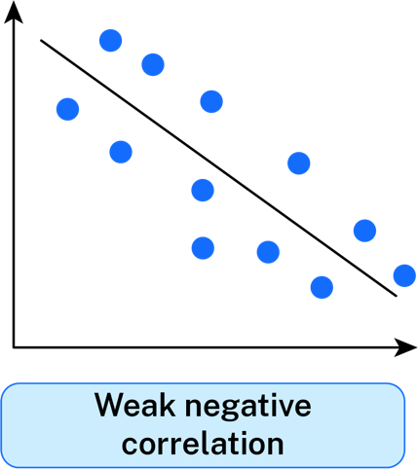
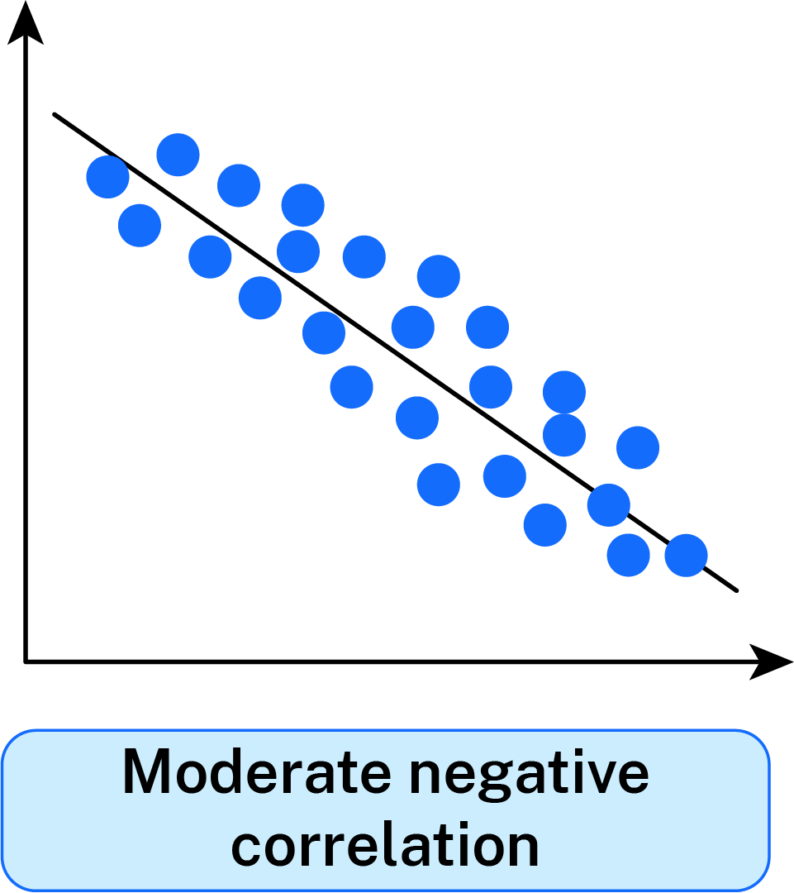
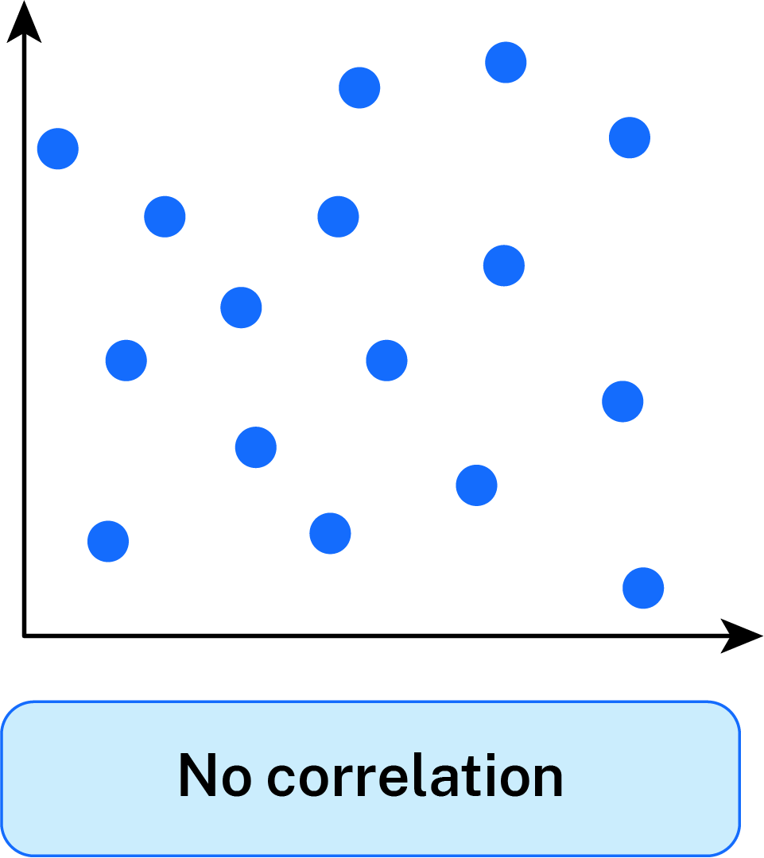
Examples of Negative and No Correlation in Data Relationships
Slopes down from the left.
Slopes down from the left
There is no correlation or relationship between the variables.
Notes:
Weak negative correlation - As one of the variables increases the other variable decreases.
Moderate negative correlation - When one variable increases, the other tends to increase as well, but in a weak and non reliable manner.

Slide 7
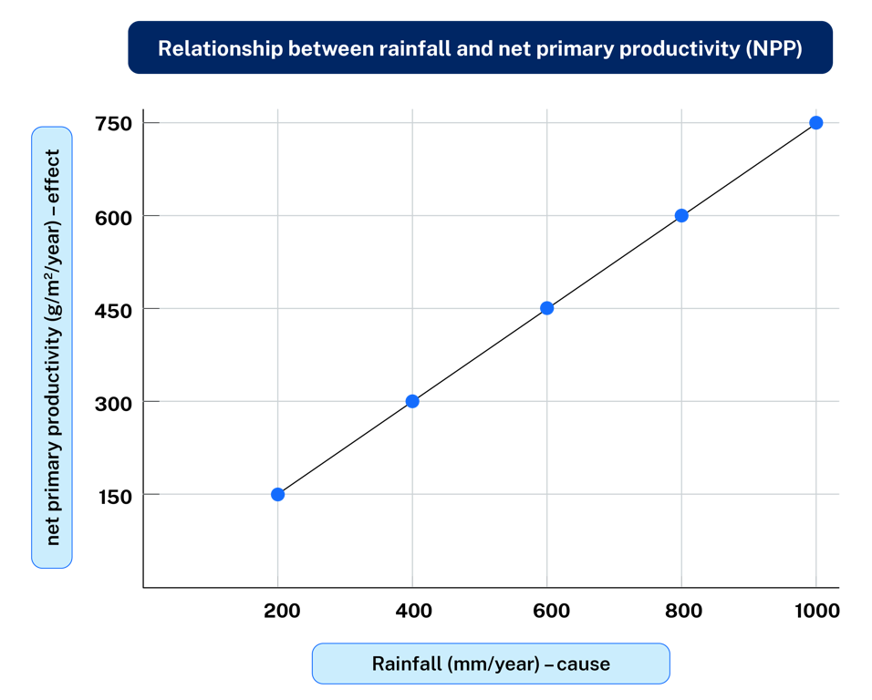
Getting familiar with scatter graphs (1)
I do
rainfall (mm/year) | 200 | 400 | 600 | 800 | 1000
NPP (g/m²/year) | 150 | 300 | 450 | 600 | 750
Horizontal axis will show rainfall variation (cause).
Notes:
On a half piece of A4 paper draw a horizontal axis and vertical axis.
Label the axis by deciding which variable is causing the change in the other by identifying the cause and effect. The horizontal axis should illustrate the cause and the vertical axis should illustrate the effect.
Develop a scale for each of the two axes.
Plot the data by placing a single point at the meeting point (coordinate) of the two values. Do not join up these points.
Give the graph an appropriate title.
Draw a best fit line.
💬 Presenter Note (not visible in slideshow):
The graph showing the answer is visible in normal view (editing mode), but it's set to appear only when clicked during the slideshow. To avoid revealing the answer to students too early, please present this slide in full-screen slideshow mode.

Slide 8
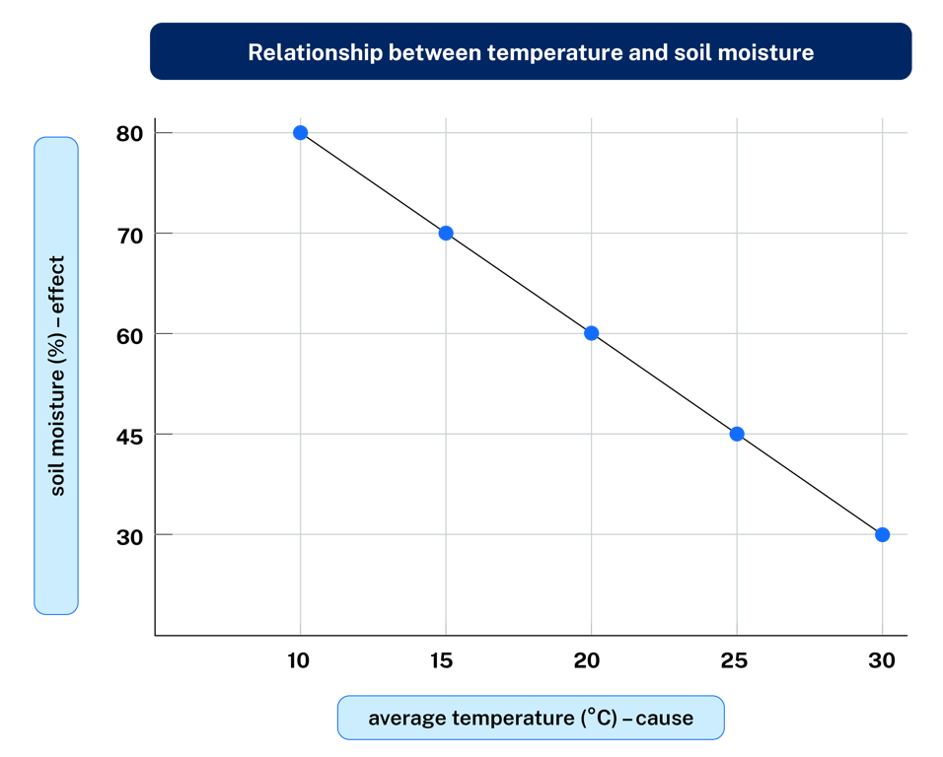
Getting familiar with scatter graphs (2)
I we do
average temperature (°C) | 10 | 15 | 20 | 25 | 30
soil moisture (%) | 80 | 70 | 60 | 45 | 30
Horizontal axis will show temperature variation (cause).
Notes:
On a half piece of A4 paper draw a horizontal axis and vertical axis.
Label the axis by deciding which variable is causing the change in the other by identifying the cause and effect. The horizontal axis should illustrate the cause and the vertical axis should illustrate the effect.
Develop a scale for each of the two axes.
Plot the data by placing a single point at the meeting point (coordinate) of the two values. Do not join up these points.
Give the graph an appropriate title.
Draw a best fit line.
💬 Presenter Note (not visible in slideshow):
The graph showing the answer is visible in normal view (editing mode), but it's set to appear only when clicked during the slideshow. To avoid revealing the answer to students too early, please present this slide in full-screen slideshow mode.

Slide 9
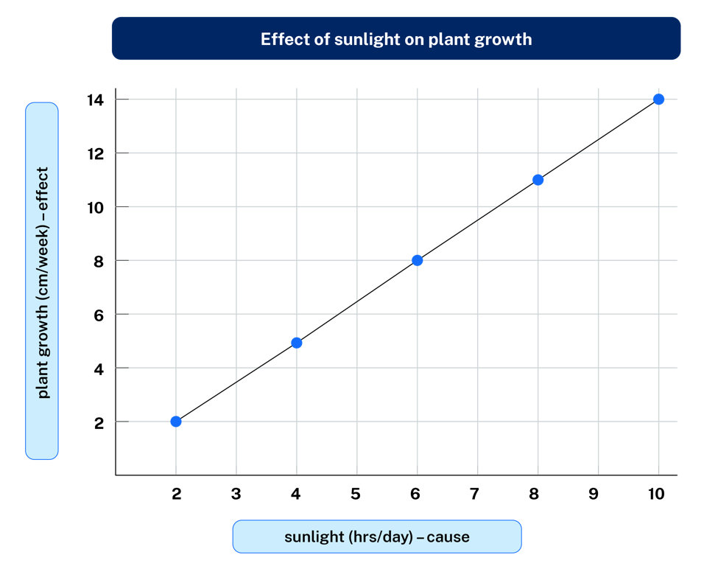
Getting familiar with scatter graphs (3)
You do
sunlight (hrs/day) | 2 | 4 | 6 | 8 | 10
plant Growth (cm/week) | 2 | 5 | 8 | 11 | 14
Horizontal axis will show variation (cause).
Notes:
On a half piece of A4 paper draw a horizontal axis and vertical axis.
Label the axis by deciding which variable is causing the change in the other by identifying the cause and effect. The horizontal axis should illustrate the cause and the vertical axis should illustrate the effect.
Develop a scale for each of the two axes.
Plot the data by placing a single point at the meeting point (coordinate) of the two values. Do not join up these points.
Give the graph an appropriate title.
Draw a best fit line.
💬 Presenter Note (not visible in slideshow):
The graph showing the answer is visible in normal view (editing mode), but it's set to appear only when clicked during the slideshow. To avoid revealing the answer to students too early, please present this slide in full-screen slideshow mode.

Slide 10

Recognising correlation
What correlation did we see?
Use all three scatter graphs developed in the lesson to answer the following for each:
Was there a relationship between ? And ?
What type of correlation exists?

Slide 11
References
This presentation contains NSW Curriculum and syllabus content. The NSW Curriculum is developed by the NSW Education Standards Authority. This content is prepared by NESA for and on behalf of the Crown in the right of the State of New South Wales. The material is protected by Crown copyright.
Please refer to the NESA Copyright Disclaimer for more information https://educationstandards.nsw.edu.au/wps/portal/nesa/mini-footer/copyright.
NESA holds the only official and up-to-date versions of the NSW Curriculum and syllabus documents. Please visit the NSW Education Standards Authority (NESA) website https://educationstandards.nsw.edu.au/wps/portal/nesa/home and the NSW Curriculum website https://curriculum.nsw.edu.au.
Geography 7-10 © Syllabus NSW Education Standards Authority (NESA) for and on behalf of the Crown in right of the State of New South Wales, 2024.

Slide 12
Copyright
© State of New South Wales (Department of Education), 2025
The copyright material published in this resource is subject to the Copyright Act 1968 (Cth) and is owned by the NSW Department of Education or, where indicated, by a party other than the NSW Department of Education (third-party material).
Copyright material available in this resource and owned by the NSW Department of Education is licensed under a Creative Commons Attribution 4.0 International (CC BY 4.0) license.
This license allows you to share and adapt the material for any purpose, even commercially.
Attribution should be given to © State of New South Wales (Department of Education), 2025.
Material in this resource not available under a Creative Commons license:
the NSW Department of Education logo, other logos and trademark-protected material
Material owned by a third party that has been reproduced with permission. You will need to obtain permission from the third party to reuse its material.
Links to third-party material and websites
Please note that the provided (reading/viewing material/list/links/texts) are a suggestion only and implies no endorsement, by the New South Wales Department of Education, of any author, publisher, or book title. School principals and teachers are best placed to assess the suitability of resources that would complement the curriculum and reflect the needs and interests of their students.
If you use the links provided in this document to access a third-party’s website, you acknowledge that the terms of use, including licence terms set out on the third-party’s website apply to the use which may be made of the materials on that third-party website or where permitted by the Copyright Act 1968 (Cth). The department accepts no responsibility for content on third-party websites.

